Slide 1
Complications of anasthesia
Dr Mohammad Emair
Anesthesia, ICU and Pain management Specialist
Mu’tah University

Slide 2
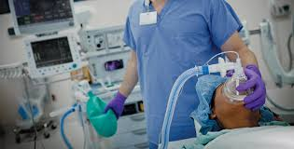
Definition
Anasthesia
Anasthesia is from the Greek and means 'loss of sensation'.
Anasthesia allows invasive and painful procedures to be performed with little distress to the patient

Slide 3
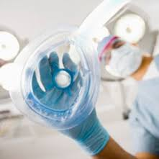
Complications of anasthesia
Complications of anesthesia are inevitable even with most experienced Doctors.
These complications range from minor to most serious problems
When anesthetic complications occur, appropriate evaluation, management, and documentation to minimizing the negative outcomes.

Slide 4
Complications of anasthesia
Incidence
Perioperative mortality rate due to anesthetic cause account is less than 1:20,000.

Slide 7
Some of the factors that can increase risk of complications include:
Smoking
Obstructive sleep apnea
Obesity
High blood pressure
Diabetes
Other medical conditions involving heart, lungs or kidneys
Medications, such as aspirin, that can increase bleeding
History of heavy alcohol use
Drug allergies
History of adverse reactions to anesthesia

Slide 8
Complications of anasthesia
Divided to:
Pre-operative complication
Intra-operative complication
Post-operative complication

Slide 9
Complications of anasthesia
Divided to:
Pre-operative complication
Intra-operative complication
Post-operative complication

Slide 10
Pre-operative complications
Heavy premedication that cause Respiratory depression.
Induction:
The effect of anesthetic drugs
Aspiration of gastric content
Difficult intubation that cause airway injury
Trauma to the lips , teeth extraction and nasal bleeding

Slide 11
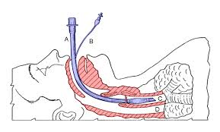
Pre-operative complications
Airway injury
Occur due to difficult intubation or mal- practice intubation.
The most common airway injury is dental trauma.
The incidence of dental trauma is 1 in 4500.
Occur due to tracheal intubation that involve laryngoscopy and endotracheal intubation.
The upper incisors most common site of injury.

Slide 12
Pre-operative complications
Risk factors for dental trauma:
tracheal intubation
preexisting poor dentition
Difficult intubation due to:
limited neck motion
previous head and neck surgery
craniofacial abnormalities
history of difficult intubation

Slide 13
Pre-operative complications
Other airway injuries:
temporomandibular joint (TMJ) injuries
Laryngeal injuries
tracheal injuries
Esophageal perforations
pharyngoesophageal perforation

Slide 14
Complications of anasthesia
Divided to:
Pre-operation complication
Intra-operative complication
Post-operative complication

Slide 15
Intra-operative complication
Due to surgical causes or anesthetic causes.
The anesthetic complications involve:
Respiratory complications
Cardiovascular complications
Bad positioning of patient on the table and nerve injuries
Hypothermia ,malignant hyperpyrexia
Hypoxia, hypercapnea, acidosis
Air embolism
Fires and explosion
Laryngospasm

Slide 16
Intra-operative complication
Respiratory abnormalities
It involve:
Tachypnea
RR may reach 40
Due to light anesthesia and volatile agent.
Slow breathing
Due to over dose of opiates.
Shallow breathing
Due to deep anesthesia and we have to assess his/her breathing.
Irregular breathing
due to light anesthesia.
Coughing
Due to the use of volatile agents with heavy smoker and in respiratory infection.

Slide 17
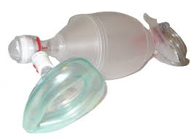
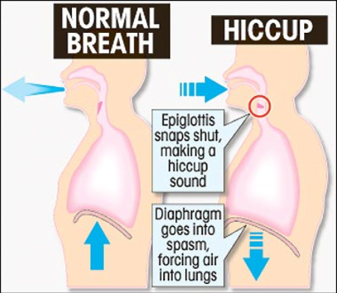
Intra-operative complication
Respiratory abnormalities
Respiratory arrest
due to obstruction of airway or central or peripheral respiratory depression.
Patient need ambu baging
Hiccup
intermittent spasm of the diaphragm with sudden closure of the glottis.
Occur in Deepen anesthesia.
Give muscle relaxant, ventilate and Block phrenic nerve.

Slide 18
Intra-operative complication
Cardiovascular complications
It involve:
Cardiac arrhythmias
Hypotension
Cardiac arrest

Slide 19
Intra-operative complication
Cardiovascular complications
Cardiac arrhythmias
Due to:
Pre-existing cardiac pathology
Hypercapnea , Hypoxia and acidosis
Electrolyte imbalance
Myocardial ischemia
Sinus tachycardia, Supra-ventricular tachycardia, ventricular tachycardia.
We give the patient digitalis and antiarrhythmic drugs.

Slide 20
Intra-operative complication
Cardiovascular complications
Hypotension
Due to:
Excessive premedications that cause:
Depression of vasomotor center
Skeletal muscle tone
Release of histamine
premedications:
anti-hypertensive drugs
Steroids
Tranquilizers

Slide 21
Intra-operative complication
cardiac arrest
first manifestation of anomalous origin of the left coronary artery
The most common cause of cardiac arrest due to anasthesia was hypoxia because of ventilatory problems
Post succinylcholine asystole
post-induction hypotension

Slide 22
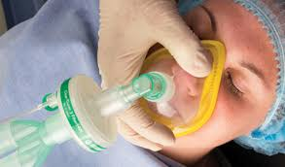
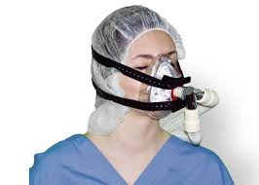
Intra-operative complication
Nerve injuries
Either by compression or stretching.
Supra orbital nerve :from the face mask.
Facial nerve .

Slide 23
Intra-operative complication
Nerve injuries
Brachial plexus : from pressure of the head of humerus , avoid extension , hyper abduction and external rotation
Radial Nerve : arm falls down an unpadded table
Radial Nerve at wrist : hands under buttock
Ulnar Nerve : resting arm on unpadded armrest

Slide 25
Intra-operative complication
Nerve injuries
Sciatic Nerve : when fail to flex both legs at same time
Lingual Nerve : biting tip of tongue following laryngospasm

Slide 26
Intra-operative complication
Hypothermia
due to:
cold environment
cold fluid and blood
cold anesthetic gases and vapors
site and duration of operation
anesthetic technique spinal ,or epidural or halothane which causes vasodilatation

Slide 27
Intra-operative complication
Air embolism
Due to:
Surgical causes:
operation in the neck
operation on the post. Cranial fossa.
operation on the heart.
Surgical emphysema.
Accidental during I.V infusion.

Slide 28
Intra-operative complication
Air embolism
Important factors:
volume of the air.
speed of injection.
pressure in veins.
general condition of patient.

Slide 29
Intra-operative complication
Laryngospasm
Is a reflex , prolonged closure of vocal cords in response to a trigger during light anasthesia
It is most common during induction and emergence , often precipitated by :
Premature insertion of an oral airway , the presence of pharyngeal secretions or blood , or airway irritation by a volatile anesthetic agent.

Slide 30
Intra-operative complication
It can be produced by surgical and visceral stimuli such as : incision , peritoneal traction, anal stretch and cervical dilatation.
Children are particularly prone to laryngospasm.
The use of intravenous barbiturates disinhibit laryngeal reflex and increases the risk of laryngospasm in comparison with propofol.
Poor management of laryngospasm can lead to in adequate ventilation with hypoxemia, hypercapnia an reduced depth of anesthesia.

Slide 31
Intra-operative complication
Crowing inspiratory noises with signs of respiratory with signs of respiratory obstruction suggest partial laryngospasm.
Complete laryngospasm is silent.

Slide 32
Complications of anasthesia
Divided to:
Pre-operation complication
Per-operative complication
Post-operative complication

Slide 33
Post-operative complication
Divided to:
Minor complications:
Headache.
Muscle pain, nausea and vomiting.
Major complications:
Post operative respiratory complications.
Scoline apnea

Slide 34
Post operative complication
Post-operative respiratory complications
Causes:
Decrease or inhibit ciliary action.
Lower the resistance to infection.
Hypoventilation (with spinal AN, Deep AN, post-op narcotics).
Intrabronchial aspiration of foreign sub.
Prolonged shock.

Slide 35
Post operative complication
Post-operative respiratory complications:
Bronchitis
Pneumonia
Collapse of the lung within 48 hour
Lung abscess within 3 week
Pulmonary edema
Pulmonary embolism
Pulmonary TB

Slide 36
Post operative complication
Scoline apnea
prolonged period taken by a patient to regain the ability to breath after being given a standard dose of the muscle relaxant, scoline, during surgery .
Autosomal recessive
Affects 1:7000 of population
Due to pseudocholinesterase deficiency or atypical form.

Slide 37
Post operative complication
Scoline apnea
Treatment:
Conservative
Ventilation
Maintenance of anesthesia

Slide 38
Post operative complication
Other complications:
Delayed recovery from anesthesia
Ocular injuries
Hearing loss
Allergic reactions

Slide 39
Delayed recovery from anesthesia
Post operative complication
Due to:
Anesthetic drugs overdose
Disturbance of physiology due to anesthesia
due to surgery

Slide 40
Ocular injuries
Post operative complication
It involve:
Corneal abrasions
Corneal ulceration
Retinal detachment
Use adhesive tap and close the eyes.

Slide 41
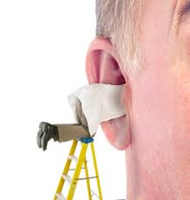
Hearing loss
Post operative complication
Perioperative hearing loss is transient and subclinical.
The incidence of low frequency hearing loss following dural puncture may be as high 50%.

Slide 42
THANK YOU

