Slide 1
Juvenile Idiopathic Arthritis
Aseel Maayah
Arwa Ajaleen
Mohammad Alqudah
Mahdi abu aloush

Slide 2
Juvenile idiopathic arthritis (JIA)
formerly called juvenile rheumatoid arthritis(JIA)
is a broad term used to describe several different forms of chronic arthritis in children
the most common chronic rheumatological disease of childhood
Without appropriate and early aggressive treatment, JIA may result in significant morbidity, such as leg-length discrepancy, joint contractures, permanent joint destruction, or blindness from chronic uveitis.

Slide 3
Definition
Arthritis is defined as joint effusion with the presence of : limitation of range of motion, tenderness, and hotness
JIA is defined as arthritis of one or more joints occurring for at least 6 weeks in a child younger than 16 years of age
JIA is a diagnosis of exclusion. A number of conditions, such as infections, malignancy, trauma, reactive arthritis, and connective tissue diseases such (SLE), must be excluded before a diagnosis of JIA can be made

Slide 4
etiology
The etiology is not completely understood
multifactorial, (genetic and environmental factors)
siblings of those affected by JIA have a prevalence that is 15-30 fold higher than the general population.
Other factors : psychological stress, trauma, hormonal abnormalities, and infectious triggers

Slide 5
Epidemiology
JIA is one of the more frequent chronic diseases of childhood
prevalence of 1 : 1,000 children.
has two peaks, one at 1-3 years and one at 8-12 years, but it can occur at any age
Girls are affected more commonly than boys

Slide 6
Pathology
Cell-mediated and humoral immunity play a role in the pathogenesis of JIA
The common underlying manifestation is the presence of chronic synovitis.
The synovium becomes thickened and hyper vascular with infiltration by lymphocytes, along with inflammatory cytokines such as: (TNF-a), (IL-6), IL-1 and IL-17.
The role of humoral immunity in is supported by the increased level of autoantibodies, such as antinuclear antibodies (ANAs), and by the presence of circulating immune complexes

Slide 7
Clinical Features
All subtypes of JIA, share common symptoms:
Joint swelling
morning stiffness .
pain, and limited movement of a joint.
Limping or problems using a limb.
Spiking fevers
Rash
Eye involvement : uveitits , iritis . (Red eyes )
Unspecific symptoms like : lethargy, reduced physical activity, and poor appetite .

Slide 8
There are five types of juvenile arthritis:
1- Oligoarthritis
2- Polyarthritis
3- Systemic-onset JIA
4- Psoriatic arthritis
5- Enthesitis related arthritis
Notes:
JIA can be divided into several subtypes, depending on the number of joints involved (less than five versus five or more), the presence of sacroiliac involvement, and the presence of systemic features, each with particular disease characteristics

Slide 9
Oligoarthritis
-The most common type
-presents in young children, with a peak at 2 to 4 years .
-It's often mild
male (3:1) <-female

Slide 10
Oligoarthritis
-Arthritis affecting 1-4 joints during 1st 6 mo of disease.
-The arthritis is found in medium-sized to large joints
-Asymmetrical pattern
-Large, weight-bearing joints (knee and ankle) are usually affected.

Slide 11
Oligoarthritis
-Extra-articular manifestations :
*Most likely type to cause chronic anterior uveitis (with an incidence of 80%)
*The incidence of anterior uveitis increases when antinuclear antibodies (ANA) are present
-Prognosis :
- Mostly good
- 10% of cases may progress to symmetric polyarthritis, which has an unfavorable prognosis

Slide 12
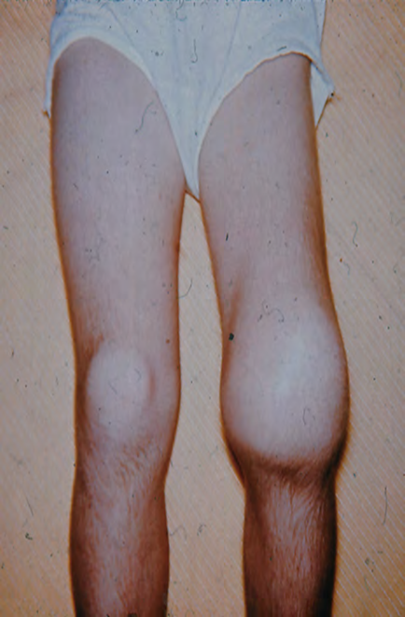
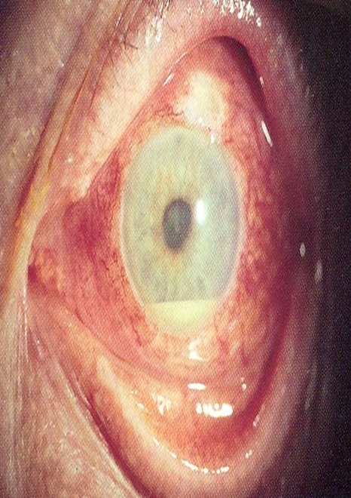

Slide 13
Polyarthritis
-Also called polyarticular juvenile idiopathic arthritis (pJIA)
-The second most common type of JIA.
-In this type (40%), children present with arthritis in five or more joints within the first 6 months of diagnosis.
Children who develop polyarticular disease after oligoarthritis called extended oligoarthritis

Slide 14
Polyarthritis classification depends on RF
1. Seronegative polyarticular JIA :
-most common
-RF negative
-Symmetrical or asymmetrical
-Peak incidence : 1–4 years and 6–12 years (bimodal incidence)
-Female > male
-moderate risk of chronic uveitis

Slide 15
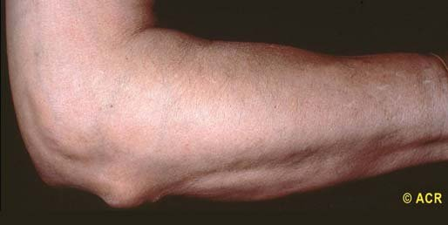
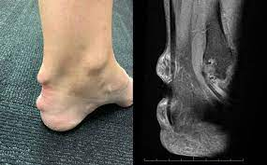
Polyarthritis
2. Seropositive polyarticular JIA :
-< 10% of cases
-RF positive
-Symmetrical
-Peak incidence : 9-12 years
-Female > male (10:1)
-Extra-articular manifestations : Rheumatoid nodules on the extensor surface of elbows and the Achilles tendon (∼ 30% of cases)

Slide 16
Evidence of systemic inflammation is more common in ployarthritis than oligoarthritis .( including malaise , low grade fever , anemia of chronic disease and elevated inflammatory markers ESR , CRP )
Patient can present with chronic uveitis and its complication

Slide 17
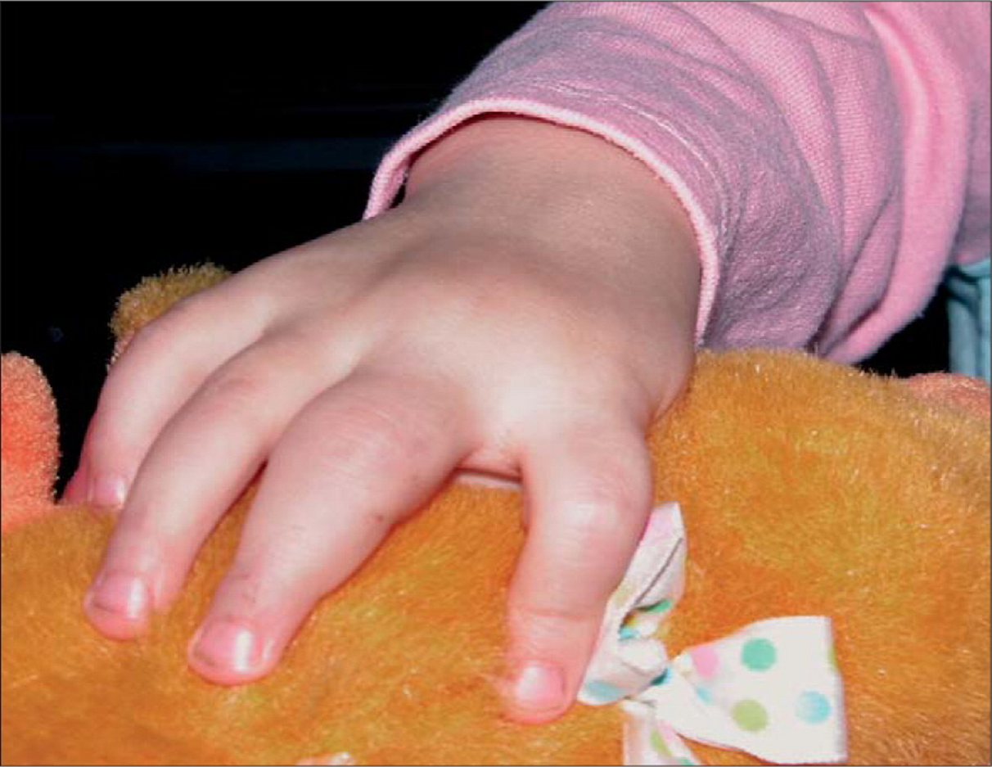
Sausage finger ( Dactylitis)
DDX:
psoriasis
Sickle cell disease
Various form of arthritis

Slide 18
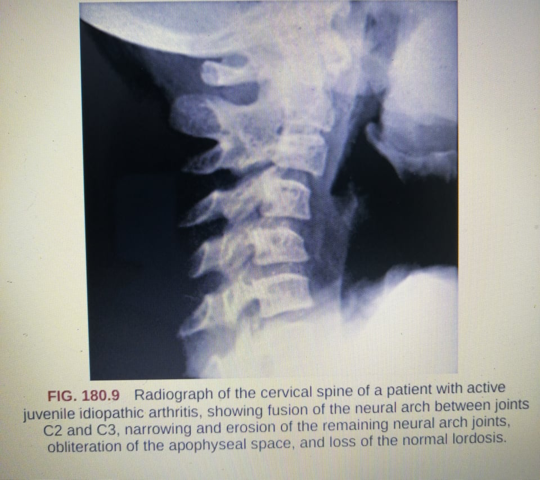
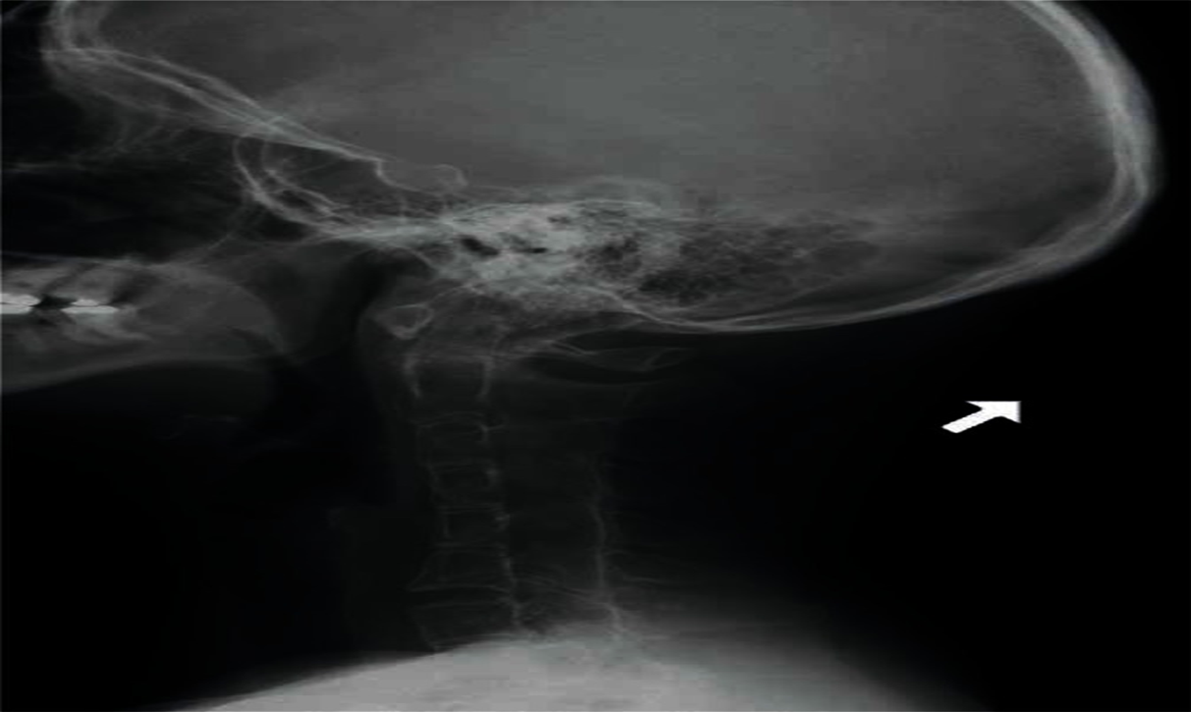
Long term complication :cervical spine involvement through subluxation and fusion with loss of lordosis and limited extension

Slide 19
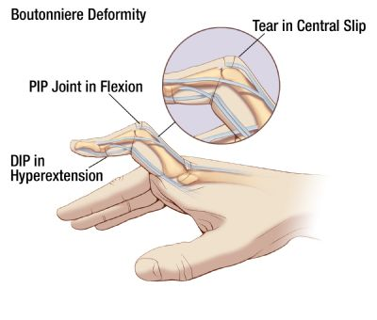
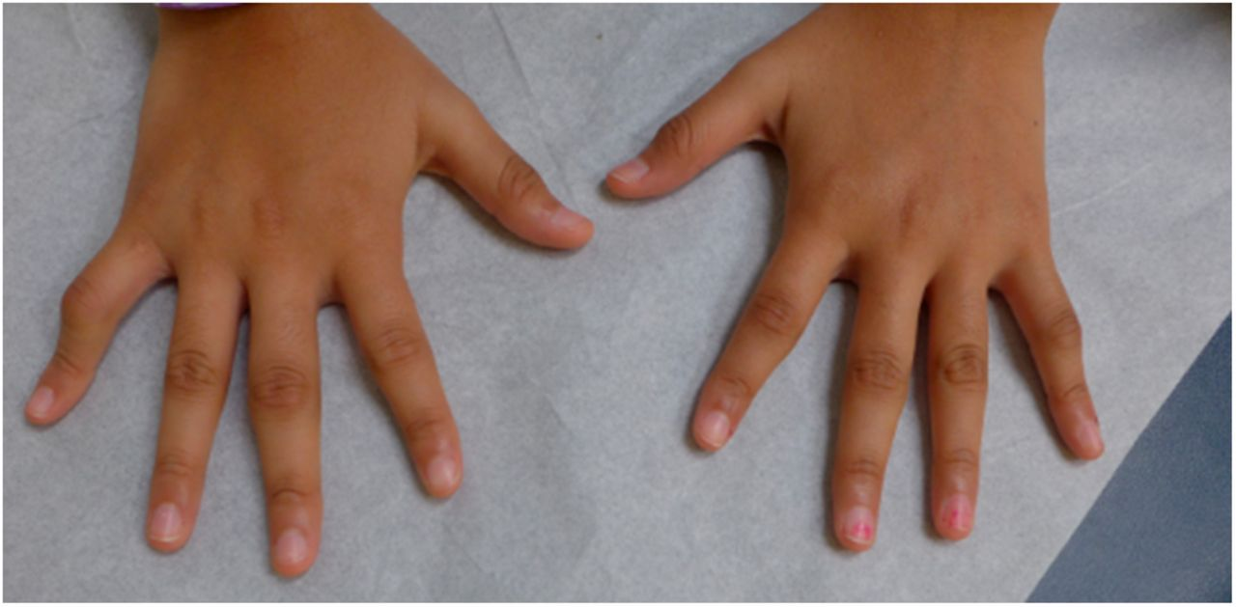
long term complication : Boutonnière finger
( flexion at PIP , extension DIP )

Slide 20
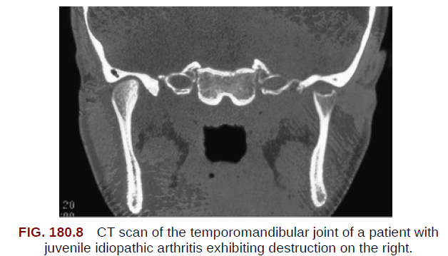
TM joint involvement may lead to micrograthia ( undersized jaw )
TM involvement + loss of lordosis
May lead to intubation and anaesthetic difficulty

Slide 21
Systemic onset JIA
Or also called juvenile form of Still's disease
In this type ( 10% ) patients do not present with onset of arthritis but rather with preceding systemic inflammation.
The arthritis of JIA follows the systemic inflammation by 6 weeks to 6 months. The arthritis is typically polyarticular in nature and can be extensive and resistant to treatment
Peak incidence : 2–4 years
Females = males

Slide 22
Systemic onset JIA
Typical, intermittent spiking fever ( up to 39 ), once or twice per day, of at least 2 weeks’ duration.
Extra- articular manifestations :
salmon-pink macules of different sizes accompanies febrile periods seen on trunk and proximal extremities or over pressure areas. Rarely to pruritic.
Hepatosplenomegaly occurs in 70% of children.
Generalized lymphadenopathy .
Serositis, such as pleuritis and pericarditis , occurs in 50% of children

Slide 23
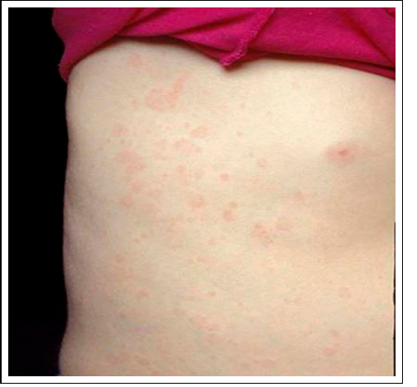
salmon-pink macules

Slide 24
Diagnosis & prognosis
Diagnosed by exclusion
lab findings:
systemic inflammatory features include : anemia of chronic disease, leukocytosis, thrombocytosis, elevated acute phase reactants(ESR, CRP, ferritin )
The prognosis of systemic JIA depends on the severity of the arthritis
Most systemic symptoms resolve over months to years,
and mortality, which is < 0.3% in North America, is associated mainly with Macrophage Activation Syndrome (MAS) and infections secondary to immune suppression.

Slide 25
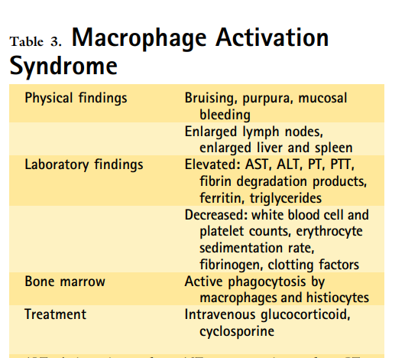
Macrophage Activation Syndrome
Occurring in more than 10% of sJIA patients,
MAS can be seen in the context of overwhelming inflammation
which leads to activation of proliferation of T lymphocytes and macrophages
resulting in overwhelming release of proinflammatory cytokines.
The patient develops high fevers, liver insufficiency hepatosplenomegaly, neurological abnormalities, and bleeding diathesis.
. There is evidence of disseminated intravascular coagulation,
.

Slide 26
MAS
Bone marrow sampling may identify mature macrophages displaying hemophagocytic activity
Laboratory abnormalities include pancytopenia, prolongation of the PT and PPT and elevated levels of D-dimer, and ferritin
Because MAS carries a significant mortality early recognition and treatment of MAS with corticosteroids or cyclosporine is important to prevent multisystem organ failure

Slide 27
Psoriatic arthritis
Defined by arthritis together with either a psoriatic rash or two of the following:
-dactylitis (sausage-like fingers)
-nail pitting
-onycholysis (painless detachment of the nail from the nail bed)
-psoriasis in a first-degree relative
Notes:
Dactylitis is swelling of ≥1 digit(s), usually in an asymmetric distribution, that extends beyond the
joint margin.
A minimum of 2 pits on any 1 or more nails at any time.

Slide 28
Dactylitis

Slide 29
-Juvenile psoriatic arthritis most often appears between the ages of 11 and 12 .
-Girls are more likely to develop it when they are younger and boys when they are older
-Typically, psoriatic plaques are seen on the extensor sides of joints, haired skin, the umbilicus and the perineum

Slide 30
psoriatic plaques

Slide 31
Enthesitis Related Arthritis
-Enthesitis is defined as tenderness at the insertion of a tendon, ligament, joint capsule, or fascia to bone.
-This form occurs most often in boys older than 6 years and is linked to ankylosing spondylitis and inflammatory bowel disease.

Slide 32
-
The main characteristics of the patients include:
1. RF and ANA negativity
2. HLA B27 positivity is reported in 65-80 % of patients
3. Asymmetric arthritis of the lower extremities
4. The Achilles tendon is the most commonly affected site
Notes:
1. Presence of or history of sacroiliac joint
tenderness or inflammatory lumbosacral pain,
or both ¶
2. Presence of HLA-B27 antigen
3. Onset of arthritis in a male >6 yr old
4. Acute (symptomatic) anterior uveitis
5. History of ankylosing spondylitis, enthesitisrelated
arthritis, sacroiliitis with IBD, Reiter
syndrome, or acute anterior uveitis in firstdegree
relative

Slide 33
:Other characteristics
1. Presence of or history of sacroiliac joint tenderness or inflammatory lumbosacral pain, or both
2. Acute (symptomatic) anterior uveitis
3. History of ankylosing spondylitis, enthesitis related arthritis, sacroiliitis with IBD or acute anterior uveitis in first degree relative

Slide 34
Undifferentiated arthritis
Arthritis that fulfills criteria in no category or in ≥2 of the above categories.

Slide 35
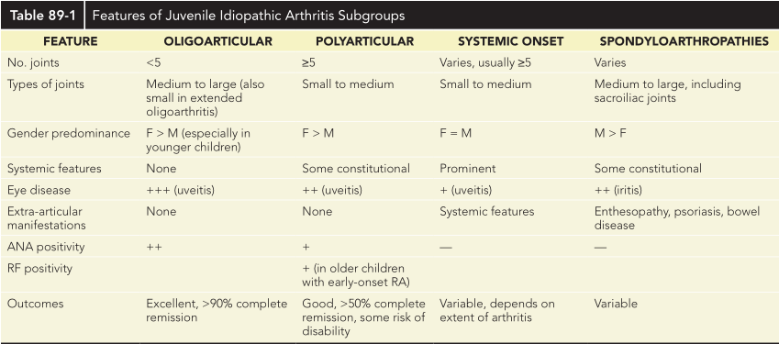

Slide 36
COMPLICATIONS of JIA :
Complications with JIA result primarily from :
the loss of function of an involved joint secondary to contractures, bony fusion, or loss of joint space.
More serious complications stem from associated uveitis; if left untreated, it can lead to serious visual loss or blindness.

Slide 37
Long-term Complications:
1.Anemia of chronic diseases
2.Permanent joint damage
3.Decreased Growth
4.Disproportionate limbs
5.Pericarditis, pleuritis

Slide 38
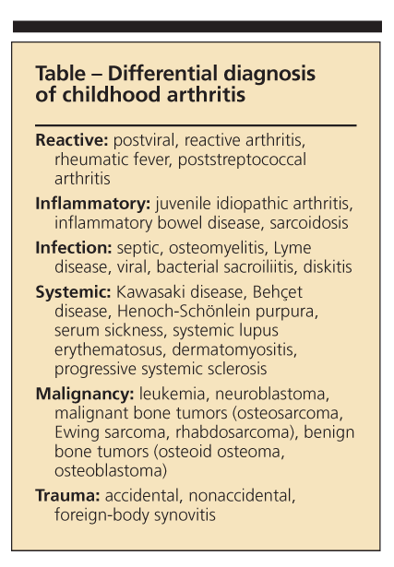
Differential diagnosis
The diagnosis of JIA is established by the presence of arthritis, the duration of the disease for at least 6 weeks, and exclusion of other possible diagnoses.

Slide 39
Important notes
-The diagnosis of (JIA) is based on the history and physical
examination findings.
-No laboratory studies are diagnostic for JIA, and indeed, all laboratory study findings may be normal in children with this disorder.
-Testing can be used to monitor the condition, its potential complications, response to treatment, and to monitor for potential side effects associated with some treatments

Slide 40
LABORATORY AND IMAGING STUDIES

Slide 41
Usual Lab Test workup
CBC
ESR & CRP
ANA
RF
HLA-B27
Synovial fluid analysis

Slide 42
CBC
-Children with polyarticular and systemic disease commonly show anemia of chronic disease, Leukocytosis and thrombocytosis
-Most children with oligoarticular JIA have no laboratory abnormalities.

Slide 43
ESR & CRP
-(ESR) or (CRP) level is usually elevated in children with systemic-onset JIA .
-May be elevated in those with polyarticular disease.
-It is often within the reference range in those with oligoarticular disease.
-When elevated, inflammatory markers can be used to monitor disease activity

Slide 44
ANA & RF
-70% of children with oligoarticular JIA have positive ANA.
-Positive ANA should also raise suspicion of (SLE).
-A positive ANA is a marker for increased risk of anterior uveitis.

Slide 45
-Patients with seropositive polyarticular disease should have a rheumatoid factor(RF)
-Anti-cyclic citrullinated peptide (anti-CCP) antibody performed to identify children with early onset adult rheumatoid arthritis(indicate a poor prognosis).

Slide 46
Synovial fluid analysis
Diagnostic arthrocentesis may be necessary to exclude suppurative arthritis in children who present with acute onset of monarticular symptoms.
The synovial fluid white blood cell count is typically less than 50,000 to 100,000/mm3 and should be predominantly lymphocytes, rather than neutrophils seen with suppurative arthritis. Gram stain, PCR, and culture should be negative.

Slide 47
Radiology
Early radiographic changes include:
-Soft tissue swelling
-Periarticular osteopenia
-periosteal new-bone formation around affected joints
-Erosions of bony articular surfaces may be a late finding.

Slide 48
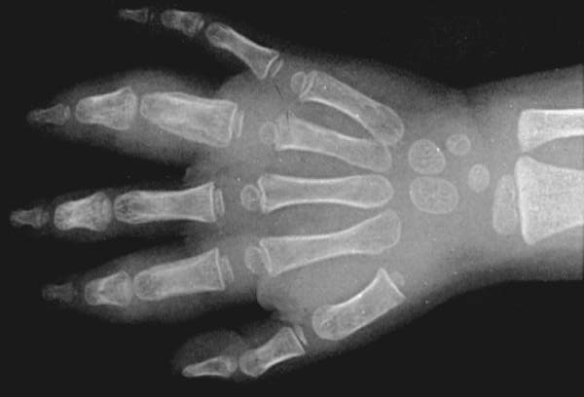
Early(6mo duration) radiographic changes of JIA. Soft-tissue swelling and periosteal new bone formation appear adjacent to the 2nd and 4th proximal interphalangeal joints.

Slide 49
Continued active disease may lead to :
-subchondral erosions
-loss of cartilage
-with varying degrees of bony destruction, and fusion.

Slide 50
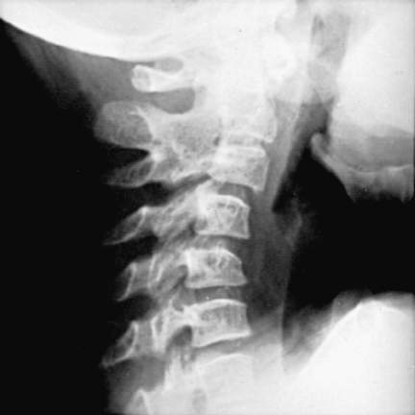
Radiograph of the cervical spine of a patient with active JIA, showing:
1- fusion of the neural arch between joints C2 and C3,
2- narrowing and erosion of the remaining neural arch joints,
3- obliteration of the apophyseal space, and loss of the normal lordosis

Slide 51
TREATMENT
The treatment of JIA focuses on suppressing inflammation, preserving and maximizing function, preventing deformity, and preventing blindness.
Nonsteroidal anti-inflammatory drugs :(NSAIDs) are the first choice in the treatment of JIA. Naproxen, ibuprofen, indomethacin, and others have been used successfully.

Slide 52
Second-line medications : disease-modifying antirheumatic drug(DMARD) such as :
Hydroxychloroquine and sulfasalazine have been used in patients whose arthritis is not completely controlled with NSAIDs alone.
Methotrexate, has become the drug of choice for polyarticular and systemic-onset JIA, which may not respond to baseline agents alone.
Methotrexate can cause bone marrow suppression and hepatotoxicity; regular monitoring can minimize these risks.

Slide 53
Biologic agents that inhibit TNF-α and block the inflammatory cascade, including : etanercept, infliximab, and adalimumab, are effective in the treatment of JIA.
The risks of these agents are greater, include serious infection and, possibly, increased risk of malignancy.
Anakinra, an interleukin-1receptor antagonist, is very beneficial in the treatment of the systemic features of systemic-onset JIA.

Slide 54
Systemic corticosteroid medications, such as prednisone and prednisolone, should be avoided in all but the most extreme circumstances, such as for severe systemic-onset JIA with internal organ involvement or for significant active arthritis leading to the inability to ambulate.
In this circumstance, the corticosteroids are used as bridging therapy until other medications take effect. For patients with a few isolated inflamed joints, intra-articular corticosteroids may be helpful.

Slide 55
Non-pharmacological interventions :
Rehabilitation of the involved joints : non-pharmacological interventions such as dynamic exercises , occupational therapy and hydrotherapy can be applied as treatment adjunct to pharmaceutical interventions in patients with early arthritis.

Slide 56
American College of Rheumatology (ACR) criteria for complete remission are as follows :
No inflammatory joint pain
No morning stiffness
No fatigue
No synovitis
No progression of damage, as determined in sequential radiographic examinations
No elevation of the erythrocyte sedimentation rate (ESR) and C-reactive protein (CRP) levels

Slide 57
Thank you

