Slide 1
Introduction to the Medical Terminology

Slide 2
Basic Elements of a Medical Term
Most medical terms are derived from Greek and Latin language. (Thus, two different roots may have the same meaning. For example, the Greek word dermatos and the Latin word cutane both refer to the skin).
Most medical terms are combination of two or more parts. To understand a medical term, it is essential to know the
Medical roots
Combining Form
Prefix
Suffix
These four parts of a medical term are known as ELEMENTS.

Slide 3
Term Root
It is the main part or foundation of the medical term and contains its primary meaning.
Greek roots are used to build words that describe a disease, condition, treatment, or diagnosis.
Latin roots are used to build words that describe anatomical structures.
It can appear at the beginning of a word, after a prefix, before a suffix, or between a prefix and a suffix.
All terms have at least one word root.
A word root may be used alone or combined with other
elements to form a complete word.
i.e. SPEAK (word root) + ER (suffix) = SPEAKER (complete word)

Slide 4
Medical Root Examples
“stomat” means mouth (Greek)
“or” means mouth (Latin)
“dermat” means skin (Greek)
“cutane” means skin (Latin)
“nephr” means kidney (Greek)
“ren” means kidney (Latin)
“angi” means blood vessel (Greek)
“vascul, vas” means blood vessel (Latin)
“encephal” means brain (Greek)
“cerebr” means brain (Latin)
“cardi” means heart (Greek)
“cordi” means heart (Latin)

Slide 5
Combining Forms
A combining form is created when a word root is combined with a vowel. The vowel, known as a combining vowel, is usually an o, but sometimes it is an i.
The combining vowel is necessary to make the pronunciation of word roots easier.
The combining vowel has no meaning of its own, but enables two word elements to be connected.
A combining form is presented as word root/vowel (such as gastr/o).
i.e. gastr / o pronounced GASTRO.
Word root
Combining vowel

Slide 6
When a word has more than one root, a combining vowel is used to link the root to each other.
i.e. osteoarthritis oste/ o / arthr/ itis
Slashes separate elements
Word root
suffix
Combining vowel
Word root

Slide 7
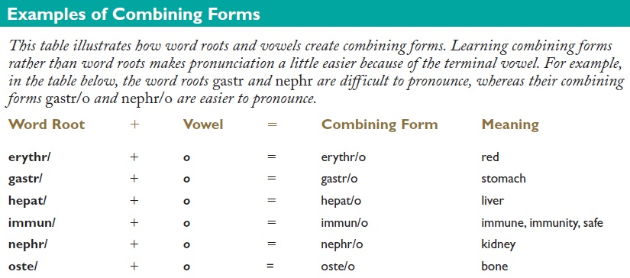

Slide 8
Suffix
A suffix is composed of one or more letters added to the END of a word root or combining form to modify its meaning.
By adding a suffix to the end of a word root, we create a noun or adjective with a different meaning.
In medical terminology, a suffix usually describes a pathology (disease or abnormality), symptom, surgical or diagnostic procedure, or part of speech.
Many suffixes are derived from Greek or Latin words.

Slide 9
Changing the suffix changes the meaning of the medical term.
When a suffix begins with a consonant, a combining vowel, such as “o”, is used before the suffix.
This is to make pronunciation easier.
Word root: scler / (hardening)
Suffix: / derma (skin)
Term: Scler / o / derma (hardening of the skin)
Combining vowel

Slide 10
Meanings of certain suffixes
-al pertaining to dent/al
(pertaining to teeth)
-er one who speak/er
(one who speaks)
-able capable of being play/able
(capable of being played)

Slide 11
-ly an act or process splenomega/ly
(an abnormal
enlargement of the spleen)
-y denote a procedure endoscop/y
(looking inside the body)
-oma (tumor) hemat/oma
(blood tumor)
NOTE: The element that comes before a suffix can either be a word root or combining form.

Slide 12
The suffixes
-scope (instrument to view)
-rrhexis (rupture)
-rrhea (excessive flow or discharge)
all begin with a consonant, therefore a combining vowel must be used between the word root and the suffix.

Slide 13
The suffixes
-algia (pain)
-edema (swelling)
-uria (urine, urination)
These suffixes begin with a vowel, therefore a combining vowel is NOT used between the word root and the suffix.

Slide 14
Prefix
A prefix is a syllable or syllables attached to the beginning of a word or word root to alter its meaning or create a new word.
Not all medical terms have a prefix.
The prefix usually indicates a number, time, position, direction, or negation (absence). Many of the same prefixes used in medical terminology are also used in the English language.
Some prefixes:
Anti- (against)
Hyper- (excessive)
Pre- (before)
Post- (after)
Homo- (same)
Hypo- (under)

Slide 15
Hypoinsulinemia
Hypo / insulin / emia
Notice that there is no combining vowel in this word because the prefix ends with a vowel and the suffix begins with a vowel.
Prefix
suffix
Word root
LOW
INSULIN
BLOOD

Slide 16
Interpretation of a medical term
The understanding of a medical term is achieved by breaking the medical term down; then building it up. i.e.;
Define the suffix, or last part of the word.
Define the first part of the word (which may be a word root, combining form, or prefix).
Define the middle parts of the word.
Examples:
Leukocytopenia
Leuk (word root = white)
cyt (word root = cell)
/ o / = combining vowel
- penia (suffix = decrease)
Hence, Leukocytopenia = a decrease in the number of white blood cells

Slide 17
Interpretation of a medical term (cont.)
Examples:
Acrocyanosis
Acr (word root = extremities)
cyan (word root = blue)
/ o / = combining vowel
- osis (suffix = condition)
Hence, Acrocyanosis = a condition characterized by blue extremities
Osteopathology
Oste (word root = bone)
patho (word root = disease)
/ o / = combining vowel
- logy (suffix = the study of)
Hence, Osteopathology = the study of bone diseases

Slide 18
Plural words
Are formed by adding or substituting another vowel or syllable at the end of a word (i.e. suffix).
Examples
macula – the plural is maculae
adenoma – the plural is adenomata
glomerulus – the plural is glomeruli
pelvis – the plural is pelves
ovum – the plural is ova
spermatozoon – the plural is spermatozoa

Slide 19
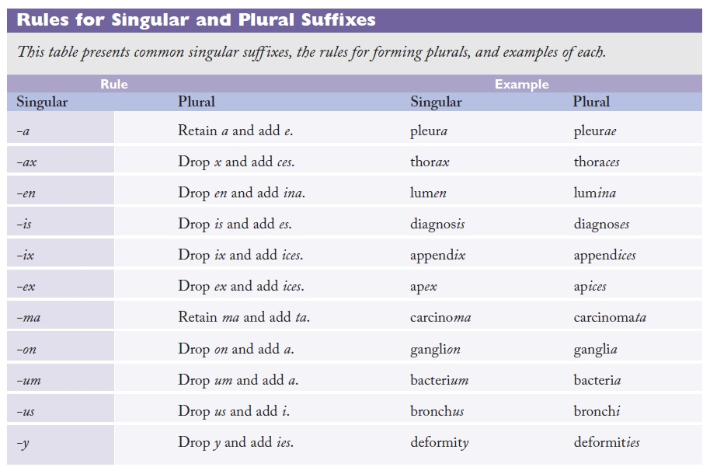

Slide 20
Eponyms
Eponyms are medical terms derived from the name of a person. Many procedures and tests are also named after the person who invented or perfected them.
Examples of diseases;
Addison’s disease
Alzheimer’s disease
Cushing’s disease
Parkinson’s disease
Stokes-Adam’s syndrome

Slide 21
Eponyms (cont.)
Examples of body parts;
Bowman capsules
Cowper’s glands
Wernicke’s center or area
Examples of procedures;
Allen’s test (a test for patency of radial or ulnar arteries and the blood supply to the hand)
Belsey Mark IV operation (a procedure to correct gastroesophageal reflux)
Heimlich maneuver (a technique for removing foreign objects from the airway of a choking victim
Examples of tools;
Foleys catheter
Swan-Ganz catheter
Hegar dilators
Shirokar ligature

Slide 22
Acronyms
Acronyms are medical abbreviations. They are used very frequently in medicine. They boost efficiency as long as they are used intelligently.
Examples;
ACE (angiotensin converting enzyme)
ACTH (adrenocorticotropic hormone)
AIDS (acquired immune deficiency syndrome)
ALP (Alkaline phosphatase)
HDL (high density lipoprotein)
Hys (hysterical)
Hx (history)
MI (myocardial infarction)
RBC (red blood cells)
RBBB (right bundle branch block)
RTA (road traffic accident)
Rx (prescription, pharmacy)
TB (tuberculosis)

