Slide 1
Hirsutism
Supervied by: Dr. Seham Abufraijeh
Abdallah Dalal
Mai Khataleen
Notes:
Sources of first part:
https://www.uptodate.com/contents/pathophysiology-and-causes-of-hirsutism?source=history_widget
https://www.uptodate.com/contents/evaluation-of-premenopausal-women-with-hirsutism?source=history_widget

Slide 2
Intro…
Hirsutism, defined as excessive male-pattern hair growth.
It affects between 5 and 10 percent of women of reproductive age.
Hirsutism may be the initial and possibly only sign of androgen excess

Slide 3
PATHOPHYSIOLOGY
Hair can be categorized as either vellus (fine, soft, and not pigmented) or terminal (long, coarse, and pigmented).
The number of hair follicles does not change over an individual's lifetime, but the follicle size and type of hair can change in response to numerous factors, particularly androgens.
Hirsutism involves the conversion of vellus hair to terminal hair within the hair follicle.

Slide 4
Role of androgens
Androgens increase hair follicle size, hair fiber diameter, and the proportion of time terminal hairs spend in the anagen phase (growth phase).
Androgen excess in women leads to increased hair growth in most androgen-sensitive sites (eg, upper lip, chin, midsternum, upper abdomen, back, and buttocks) but to loss of hair in the scalp region.

Slide 5
Causes
Hirsutism is a result of the interaction between circulating serum androgens and the sensitivity of the hair follicle to androgens. Several different androgens may be secreted in excess:
Testosterone, which is usually of ovarian origin.
Dehydroepiandrosterone sulfate (DHEAS), which is of adrenal origin.
Androstenedione, which can be of either adrenal or ovarian origin

Slide 6
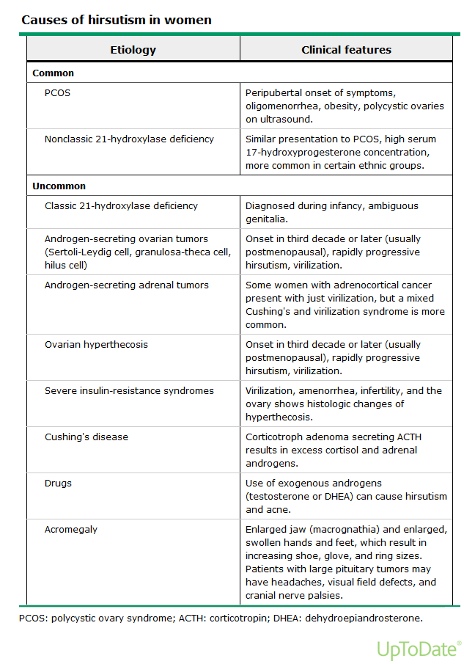

Slide 7
Polycystic ovary syndrome
PCOS is the most common cause of hirsutism in women.
The syndrome is characterized by menstrual irregularity and hyperandrogenism, both clinical (hirsutism, acne, or male-pattern balding) and biochemical (elevated serum androgen concentrations).
The androgen excess in women with PCOS usually becomes evident about the time of puberty or soon thereafter because androgen production is increased by both puberty (increased ovarian steroid production) and adrenarche (increased adrenal androgen production).

Slide 8
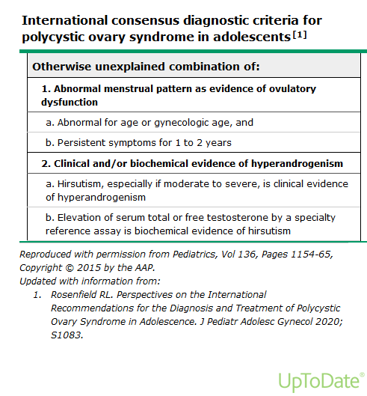

Slide 10
congenital adrenal hyperplasia
Excess androgen production is a key feature of most forms of congenital adrenal hyperplasia.
These disorders are usually recognized at birth or in early infancy, but nonclassic (also called late-onset) forms have been identified.
Affected women present peripubertally with hirsutism and sometimes menstrual irregularity or primary amenorrhea.
Laboratory tests: Serum 17-OH progesterone level is markedly elevated.

Slide 11
Ovarian tumors
Hirsutism caused by an androgen-secreting tumor usually occurs later in life and progresses rapidly when compared with PCOS.
Examination: Physical examination will show evidence of virilization. (baldness, acne, deepening of the voice, increased muscularity and clitorus enlargement)
An adnexal mass will be palpated on pelvic examination.
Laboratory tests: Testosterone level is markedly elevated. (more than 150ng/dL)
Imaging: Pelvic ultrasound will show an adnexal mass.
Notes:
Virilization : baldness, acne, deepening of the voice, increased muscularity and clitorus enlargement.

Slide 12
Adrenal tumors
History: Typically the onset has been rapid without positive family history + Cushing syndrome manifestations.
Examination: Physical examination will show evidence of virilization.
Laboratory tests: DHEAS level is markedly elevated.
Imaging: CT or MRI scan will show an abdominal-flank mass.

Slide 13
idiopathic hirsutism
The diagnosis of idiopathic hirsutism is given to women with hirsutism but normal serum androgen concentrations, no menstrual irregularity, and no identifiable cause of the hirsutism. (Diagnosis of exclusion).
It is due to idiopathic increase in sensitivity of hair follicles to DHT.

Slide 14
Ovarian hyperthecosis
Ovarian hyperthecosis is a nonmalignant ovarian disorder characterized by increased production of testosterone by luteinized thecal cells in the stroma, leading to markedly increased serum testosterone concentrations.
It is still unclear if hyperthecosis is a distinct disorder or is part of the spectrum of PCOS. The woman's history is usually one of gradual onset of hirsutism and frank virilization.
Hyperthecosis is seen primarily in postmenopausal women

Slide 15
Approach to patient: History
Age of onset: Women with PCOS, the most common cause of hirsutism, typically have a peripubertal onset of hirsutism.
Androgen secreting tumors usually occur late in life.
Stable versus progressive hair growth: very rapid in androgen secreting tumors.
Virilization
Menstrual history: oligomenorrhea or amenorrhea?
Drug history: androgenic steroids, Valproate.
Family history

Slide 16
Ferriman-Gallwey score
It is the most widely used method to quantify hair growth.
Using this method, nine androgen-sensitive sites are graded from 0 to 4
A Ferriman-Gallwey score >8 is considered abnormal for black or white women.
For Mediterranean, Hispanic, and Middle Eastern women, a Ferriman-Gallwey score ≥9 to 10 is considered abnormal
for Asian women, a score ≥2.

Slide 17
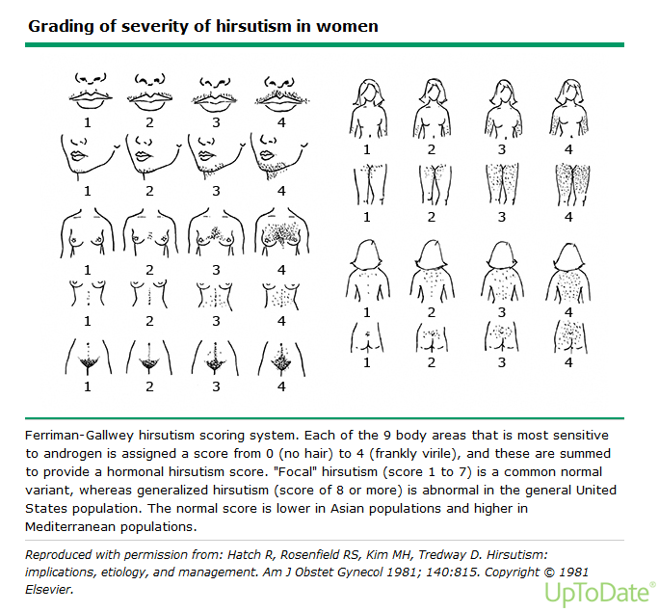

Slide 18
Physical examination
Evidence of virilization: deepening of the voice, temporal and/or crown balding, increased muscle mass, and clitoromegaly.
Skin findings: Acne, acanthosis nigricans, striae and thin skin.
Body mass index (BMI): a calculation of BMI should be obtained. Many women with PCOS are obese.
Abdominal and pelvic exam: Abdominal and pelvic examination should be performed to look for mass lesions that could indicate an androgen-secreting tumor.

Slide 19
Investigations
Mainly based on your judgment regarding history and examination.
Hirsutism and normal menstrual cycles: suggest measuring only a serum total testosterone.
Hirsutism with oligomenorrhea/amenorrhea: Women with hirsutism and irregular menstrual cycles have an underlying endocrine disorder. We suggest measuring serum total testosterone as well as a routine evaluation for oligo/amenorrhea: beta-hCG, FSH, LH, TSH and 17-OH progesterone.

Slide 20
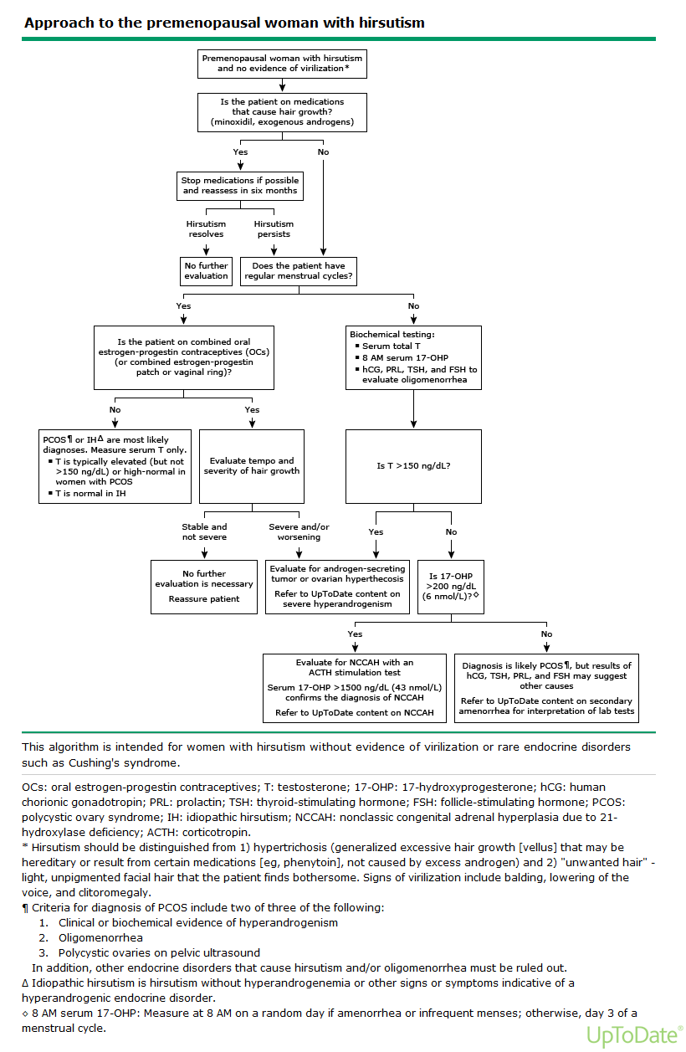

Slide 21
Cant judge by clinical picture?

Slide 22
Elevated DHEAS : suggest adrenal cause
Next step: Abdominal CT/MRI.
Elevated 17-OH progesterone: suggest Congenital adrenal hyperplasia
Elevated testosterone (more than 150ng/dL): suggest ovarian tumor
Next step: pelvic Ultrasound.
Elevated testosterone (less than 150ng/dL): suggest PCOS.
Next step: Ultrasound + LH/FSH ratio.
All 3 tests are normal: suggest idiopathic hirsutism.

Slide 23
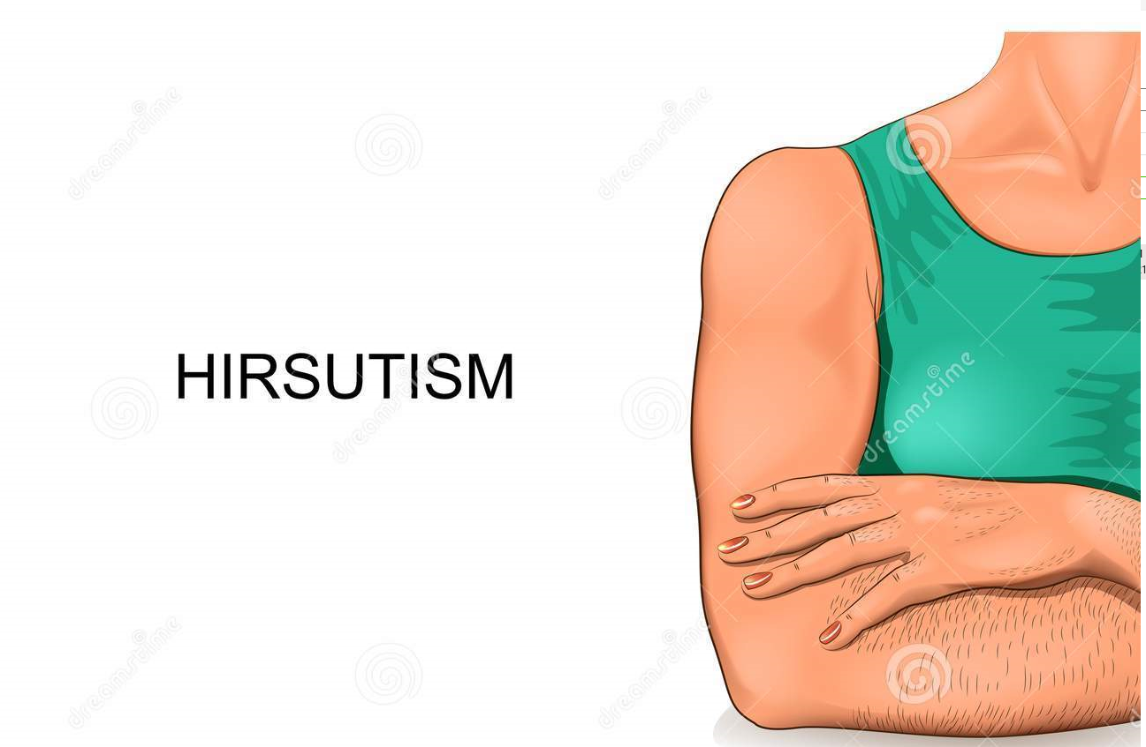
Management of
For further explanation and links please check the notes beneath the slides

Slide 24
Six-month assessment — We suggest a trial of at least six months before making any changes in dose, adding a medication, or switching to a new medication. This is because the growth phase of a hair follicle is approximately six months; a significant reduction in hair growth may not occur before then.
Reasonable expectations should be discussed; women should be counseled that drug therapy is unlikely to completely eliminate already existing hair growth, but that hair may become less coarse, grow more slowly, and/or require less frequent use of cosmetic methods (shaving, plucking, waxing).
Notes:
https://www.uptodate.com/contents/management-of-hirsutism-in-premenopausal-women/abstract/10

Slide 25
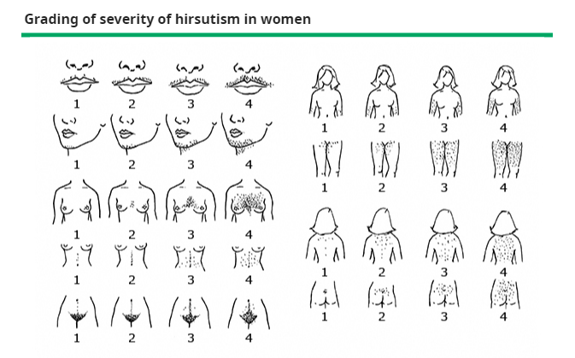
we do try to obtain an F-G score at baseline and at each follow-up visit
We do not suggest routine monitoring of serum androgens to assess the response to drug therapy. However, if there is progression of hirsutism during therapy, repeat biochemical evaluation is warranted.

Slide 26
Combined estrogen-progestin oral contraceptives
For most women, COCs are our first-line drug; an antiandrogen can then be added if the clinical response is suboptimal after six months of therapy.
Notes:
Women should be aware that COCs and antiandrogens do not have US Food and Drug Administration (FDA) approval for the indication of hirsutism. Therefore, these therapies represent "off-label" use. These preparations also provide additional non-hirsutism benefits such as contraception and cycle management. It is assumed that transdermal and vaginal estrogen-progestin contraceptive preparations are also effective for hirsutism, but data are limited.
Our approach is similar to that outlined in the 2018 Endocrine Society clinical guidelines [10]. We suggest that most women with hirsutism start with pharmacologic therapy, and we consider combined estrogen-progestin oral contraceptives (COCs) to be the first-line drug. Exceptions would include women with contraindications to COC use or those who choose not to take COCs.

Slide 27
Choice of pill
Although data suggest that COCs have similar efficacy for hirsutism
we typically choose one that contains a progestin with low or neutral androgenicity, such as:
norethindrone
norgestimate
Some clinicians prefer to start with a COC containing an antiandrogenic progestin
drospirenone,
cyproterone acetate (CPA).
Note : We typically avoid COC preparations containing the most androgenic progestin, levonorgestrel. Although limited clinical trial data suggest that levonorgestrel-containing COCs have similar benefits for hirsutism as other less androgenic COCs
Notes:
Mechanisms of action in hyperandrogenism/hirsutism
Inhibition of gonadotropin secretion
Increased SHBG
Reduction in serum total and free testosterone concentrations
Secondary mechanisms

Slide 28
Duration of drug therapy
— Pharmacologic therapy is usually continued during the reproductive years as the underlying condition typically persists during this window, and hirsutism recurs when treatment is discontinued
When pregnancy is desired, all pharmacologic treatments for hirsutism must be discontinued. Antiandrogens, in particular, are contraindicated in women trying to conceive because of potential adverse effects on male sexual development.

Slide 29
Antiandrogens
We do not typically start with combination therapy (both a COC and an antiandrogen) as initial treatment.
However, in occasional patients with :
severe hirsutism causing significant distress
in women who have not had a good response to COC monotherapy in the past, it is reasonable to initiate combination therapy with a COC and antiandrogen

Slide 30
Antiandrogens as Monotherapy
Although antiandrogens appear to be as effective as COCs for hirsutism], we suggest not using them as monotherapy, because of the potential adverse effects on a developing male fetus in utero. However, in women who cannot conceive or who are using a reliable contraceptive method, either a COC or an antiandrogen can be used as initial therapy as they appear to have similar efficacy
For women with contraindications to COC use, antiandrogens may be given as initial therapy, as long as the individual is using some form of reliable contraception.

Slide 31
Antiandrogens
An antiandrogen (spironolactone) is then added if the clinical response is suboptimal after six months of therapy
We suggest spironolactone, as clinical trials have shown consistent benefit, and it is considered to be safe ,We start with 50 mg twice daily and increase to 100 mg twice daily as needed

Slide 32
The side effects of spironolactone
include hyperkalemia (a rare problem in women with normal renal function and aldosterone secretion). However, we measure a serum potassium level in all patients after one month of spironolactone administration. Women with renal insufficiency should not be prescribed spironolactone, because of the high risk of hyperkalemia.

Slide 33
Antiandrogens choice
Available antiandrogens: Efficacy — In a network meta-analysis of pharmacologic therapies for hirsutism ,analyses of seven trials of individual antiandrogens versus placebo
two spironolactone trials 100 mg/day
three finasteride 2.5 to 5 mg/day
two flutamide 500 mg/day
each antiandrogen showed a significant reduction in hirsutism scores. The effects of the three drugs were similar. Of note, we suggest not using flutamide because of its potential hepatotoxicity. When results of the seven trials of the three antiandrogens were pooled, antiandrogens were significantly more effective than placebo at reducing F-G scores

Slide 34
Direct methods of hair removal
such as photoepilation (laser and intense pulsed light), are also referred to as "permanent" hair reduction techniques. Women may choose to start these options at any point; some choose this as their initial therapy.
However, hyperandrogenic women are likely to experience hair regrowth because of the continued stimulation of hair follicles by endogenous androgens. Women who decide to pursue laser/intense pulsed light should also be on pharmacologic therapy to suppress androgens and prevent new hair growth.

Slide 35
TREATMENTS NOT ROUTINELY RECOMMENDED
Metformin
GnRH agonist or antagonist therapy
Notes:
Metformin
do not appear to be effective for hirsutism. Metformin is used primarily for blood glucose control in patients with type 2 diabetes but has also been used for some indications in women with polycystic ovary syndrome (PCOS). However, it is no longer suggested for treating hirsutism [10].
We agree with the 2018 Endocrine Society guidelines and suggest against its routine use for hirsutism as metformin has minimal or no benefit [9-11,65].
GnRH agonist or antagonist therapy
We suggest against the routine use of gonadotropin-releasing hormone (GnRH) analog therapy (agonist or antagonist) for hirsutism. However, GnRH agonists are sometimes considered for women with severe hyperandrogenemia, menstrual disturbances, and signs of virilization in addition to hirsutism (for example, ovarian hyperthecosis). It should only rarely be used in women with PCOS

Slide 36
SPECIAL POPULATIONS
Women with NCCAH
Obesity
Postmenopausal women
Notes:
NCCAH :women with nonclassic congenital adrenal hyperplasia due to 21-hydroxylase deficiency (NCCAH) who do not respond to or cannot tolerate COC and antiandrogen therapies [10]. Glucocorticoids are also indicated for ovulation induction in women with NCCAH
glucocorticoids were more effective than COCs or antiandrogens for suppressing serum adrenal androgen concentrations (dehydroepiandrosterone [DHEA] and dehydroepiandrosterone sulfate [DHEAS]) but less effective for decreasing hirsutism scores
Obesity :Weight loss results in improved insulin sensitivity, a decrease in serum androgens, and, in some cases, a return of ovulatory cycles The impact on hirsutism is less clear.
postmenopausal women with new hirsutism that is severe or rapidly progressive, the possibility of an androgen-secreting tumor or ovarian hyperthecosis must be excluded before initiating treatment.

Slide 37
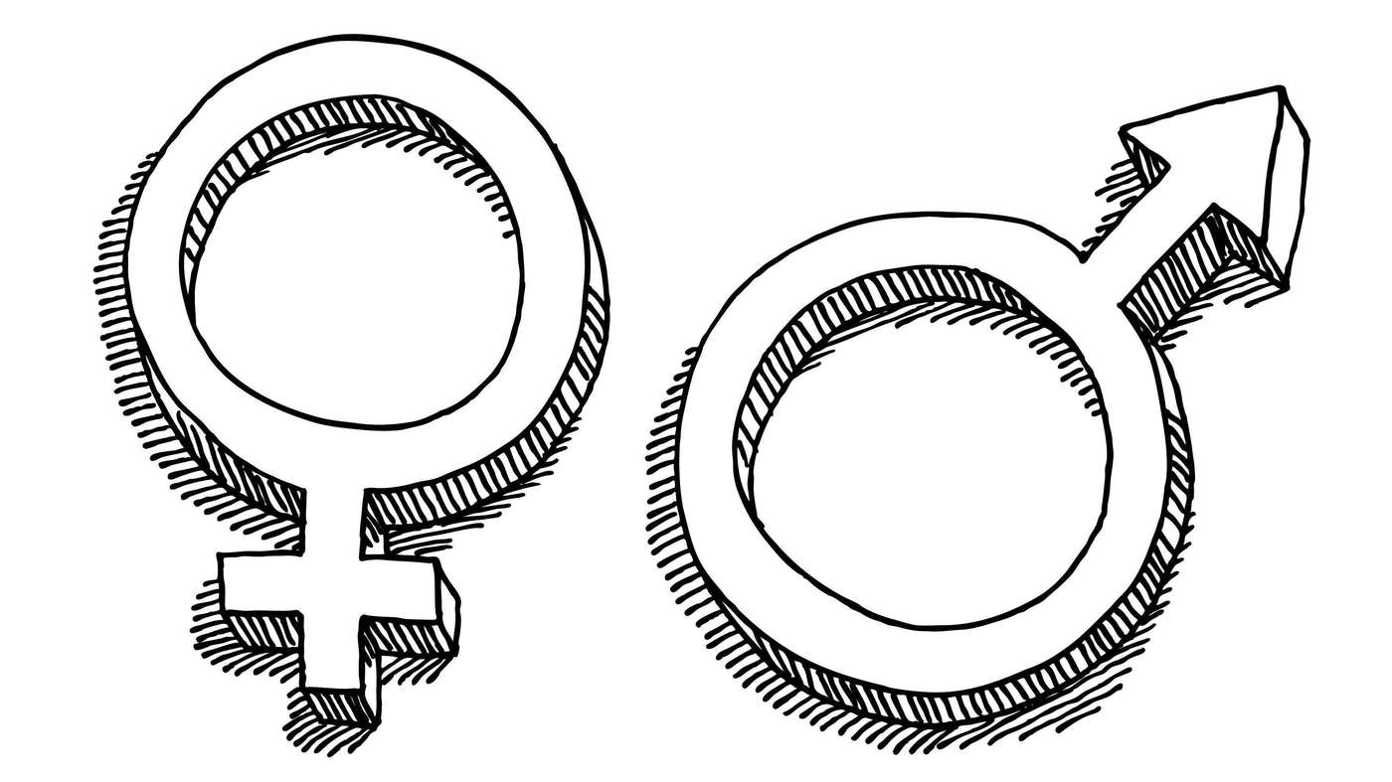
Disorder of sex development (DSD)
Supervised by dr. seham abu-fraijeh
Presented By : mai khataleen
Ansam alnaimat
Notes:
Defined in a 2006 consensus statement as "congenital conditions in which development of chromosomal, gonadal, or anatomical sex is atypical." The word "difference" is sometimes substituted for "disorder." The adjective "sexual" is sometimes used instead of "sex" but can be confusing because it can refer to either biologic sex or the act of sex. The term "differentiation" is sometimes used instead of "development." Though commonly used by clinical providers, the term "DSD" is not universally accepted by patients and support groups (refer to UpToDate content on evaluation of atypical genitalia).
IntersexHaving an atypical genital appearance. Some reserve "intersex" as a term for social identity, but others do not make this distinction. The term is disfavored by some.
© 2021 UpToDate, Inc. and/or its affiliates. All Rights Reserved.

Slide 38
Topics that we are going to discuss in this lecture
Adrenal disorders Congenital Adrenal Hyperplasia
Androgen insensitivity syndrome
Turner syndrome
Gonadal dysgenesis:Swyer syndrome
Androgen secreting tumor
This slide is not for presentation
just to ask if we should include turner syndrome or not ?
It was included in the previous seminars

Slide 39
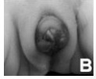
Presentations
DSD
Infants with a congenital discrepancy between external genitalia, gonadal, and chromosomal sex are classified as having a disorder of sex development
Ambiguous genitalia • Common presentations of DSD
XX female exposed to excessive androgens
XY male with insufficient androgens
Female external genitalia
XY male with lack of androgen activity
Often discovered at puberty
Notes:
Diabetic fetopathy associated with bilateral adrenal hyperplasia and ambiguous genitalia: a case report. Journal of Medical Case Reports. 2008; 2 : 251. doi:10.1186/1752-1947-2-251

Slide 40
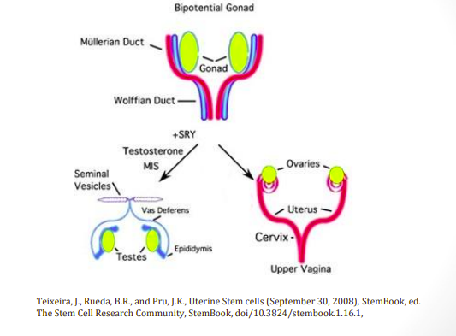
Sexual Development
The gonads develop from the intermediate mesoderm during 5th week ,they appear as bulge that protrude into the ventral body cavity
Default genital development is female
Male development requires special factors:
Testosterone
Dihydrotestosterone
Mullerian inhibiting factor

Slide 41
Notes:
The gonads develop from the intermediate mesoderm during 5th week ,they appear as bulge that protrude into the ventral body cavity .
Adjacent to the gonads are the mesonephric (wolffian)ducts…which eventually develop into structure of the reproductive system in male .
2nd pair of duct ,paramesonephric (mullerian)ducts… develop lateral to mesonephric duct & form structures of reproductive system in female .
The male pattern of development is innatiated by Y chromosome “master switch” gene name SRY Sex determining Region of the Y chromosome)
, which stands for sex-determining region of Y chromosome
When the SRY gene is expressed during development , its protein product causes the primitive sertoli cells to begin to differentiate in the gonadal tissue during 7th week .
The developing sertoli cell secrete hormone called Mullerian-inhibiting substance (MIS) that causes apoptosis of cell with in the paramesonephric (mullerian ) duct .
At 8th week the primitive leyding cells in the gonadal tissue begin to secrete testesterone .
Then testesterone begin stimulates develop wolffian duct on each side into:- epididymis,vas deferens,ejaculatory duct ,&seminal vesicle .
Female embryo have 2X chromosome & no Y chromosome .
Because SRY absent ,the gonads develop into ovaries ,& because MIS is not
The distal end of mullerian duct fuse to form the uterus & vagina whereas the unfused proximal portion become the uterine (fallopian tube . The walffian duct degenerate because testesterone is absent.
The external genitalia on both male & female embryos also remain undifferentiated untill about 8th week.
In male embryo ,some testosterone converted to 2nd androgen called dihydrotestosterone (DHT) that stimulate development of the urethra ,prostate , & external genitalia.
In the absence of DHT the genital tubercle gives rise to the clitoris in female embryos.
Female embryo have 2X chromosome & no Y chromosome .
Because SRY absent ,the gonads develop into ovaries ,& because MIS is not
The distal end of mullerian duct fuse to form the uterus & vagina whereas the unfused proximal portion become the uterine (fallopian tube . The walffian duct degenerate because testesterone is absent.
The external genitalia on both male & female embryos also remain undifferentiated untill about 8th week.
In male embryo ,some testosterone converted to 2nd androgen called dihydrotestosterone (DHT) that stimulate development of the urethra ,prostate , & external genitalia.
In the absence of DHT the genital tubercle gives rise to the clitoris in female embryos.

Slide 43
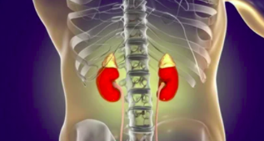
Adrenal disorders (Congenital Adrenal Hyperplasia )
describe a group of disorders that arise from inborn glandular enzyme defects that cause overproduction of the immediate steroid precursor of the specific enzyme deficiency.
The most common cause of congenital adrenal hyperplasia (CAH) worldwide, accounting for >95 percent of cases, is 21-hydroxylase deficiency (21OHD
Less common cause of adrenal hyperplasia is :11β-
hydroxylase deficiency and 3-beta-hydroxysteroid dehydrogenase

Slide 44
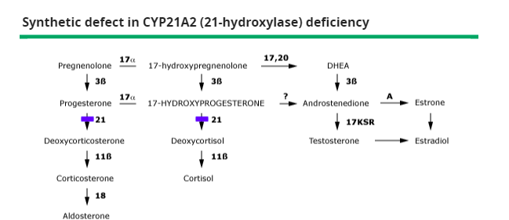

Slide 45
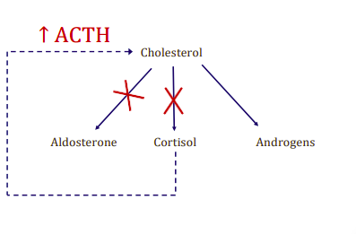
21 hydroxylase deficiency
autosomal recessive disorder
2 forms :
classic early virilization type with or without salt-losing crisis present at birth or shortly thereafter
non-classic type with late-onset virilization presents later in life, generally at the time of puberty or later
Clinical manifestations of 21-hydroxylase deficiency depend upon the degree of enzyme deficiency determined in part by the type of 21-hydroxylase genetic mutation that occurs on chromosome 6

Slide 46
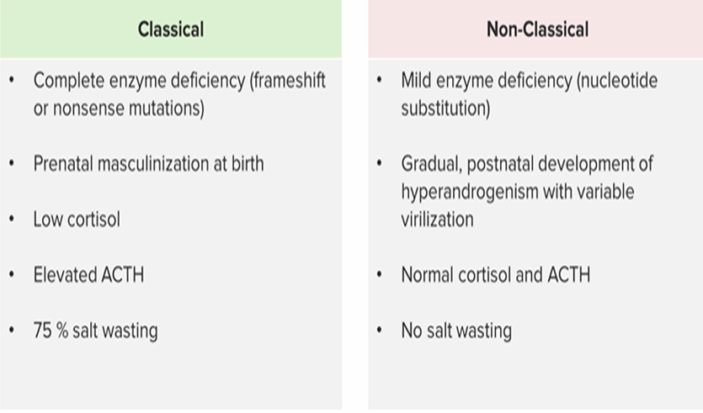
21 hydroxylase deficiency classical vs NC
Notes:
autosomal recessive disorder
2 forms, classic early virilization type with or without salt-losing crisis present at birth or shortly thereafter
non-classic type with late-onset virilization presents later in life, generally at the time of puberty or later
Clinical manifestations of 21-hydroxylase deficiency depend upon the degree of enzyme deficiency determined in part by the type of 21-hydroxylase genetic mutation that occurs on chromosome 6
for example, patients with salt-wasting disease usually carry mutations on both alleles that completely destroy enzymatic activity.

Slide 47
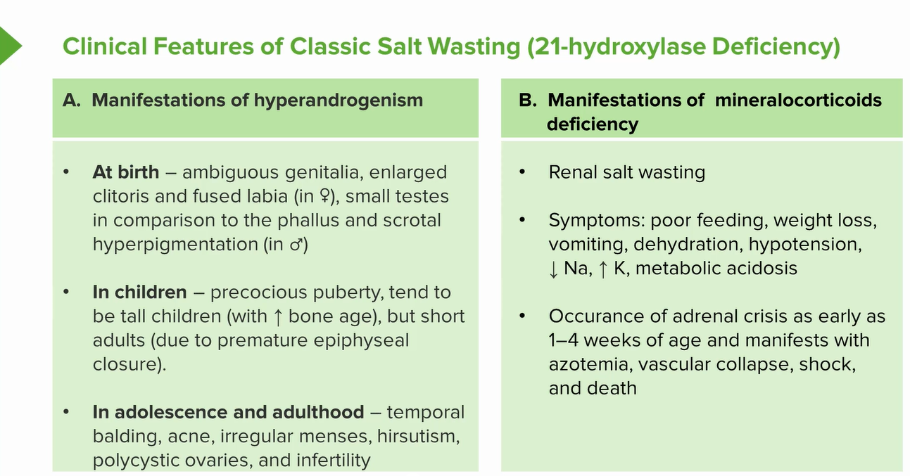
Notes:
Manifestations of 21-Hydrolase Deficiency
• Severe:
• Newborn female infant
• Virilized (ambiguous genitalia), or virilized and has life-threatening salt wasting
• Mild:
• Frequently associated with terminal body hair,
acne, alterations in menstrual cycles and infertility
• Manifested at puberty
• Adrenarche may precede thelarche.
• History of pubic hair growth occurring before the onset of breast development

Slide 48
The diagnosis of 21-hydroxylase deficiency
Newborn screening — The diagnosis of classic 21-hydroxylase deficiency (21OHD) is based upon a very high serum concentration of 17-hydroxyprogesterone (17OHP),
this diagnosis is almost always made soon after birth as routine newborn screening The screening test for 17OHP is measured using a filter paper blood sample obtained by a heel puncture, preferably between two and four days after birth.
Interpretation of results — The characteristic biochemical abnormality for diagnosis at any age in patients with 21OHD is a very high serum concentration of 17OHP in a randomly timed blood sample. Most affected neonates have random concentrations greater than 3500 to 5000 ng/dL (105 to 150 nmol/L)
. All have concentrations greater than 1000 ng/dL (30 nmol/L).
Serum electrolytes, to assess for salt-wasting and risk of adrenal crisis, and repeated every 24 to 48 hours until 21OHD is excluded.
The biochemical findings are less severe in patients with the nonclassic form of the disorder. :In children, a 17-hydroxyprogesterone level of >200 ng/dL (6 nmol/L) taken at 8:00 AM has 92 to 98 percent sensitivity and specificity for the diagnosis of nonclassic 21-hydroxylase deficiency The early morning timing is critical because the 17-hydroxyprogesterone level falls rapidly during the course of the day.
Notes:
measuring increased 17-OH progesterone in plasma during the follicular phase (preferably measured while fasting
Patients with classic form will have significantly elevated
plasma 17-OH progesterone levels, usually over 2000
ng/dL
less severe form:
mildly elevated basal levels, 200 ng/d
increase to 1000 ng/dL in response to ACTH stimulation

Slide 49
Treatment
To treat congenital adrenal hyperplasia, it's best to get a referral to a specialist in childhood hormonal issues (pediatric endocrinologist).
Initial dosing for newborns — In the absence of adrenal crisis, a typical starting regimen for an infant includes:
Hydrocortisone .
Fludrocortisone
Sodium chloride
Notes:
HYDROCORTISON : at 20 to 30 mg/m²/day, divided three times daily (ie, 2.5 mg three times a day), with rapid dose reduction when target hormone levels are reached. Only the tablet formulation of hydrocortisone should be used, administered by crushing the tablets and mixing with a small amount of water; liquid hydrocortisone should not be used
FLUDROCORTISON : 100 mcg once or twice daily.
Sodium chloride, 1 to 2 g or 17 to 34 mEq/day (2 to 4 mEq/kg/day), divided in several feedings.
The aim is to replace deficient corticosteroids and to suppress ACTH-driven adrenal androgen production.
To treat congenital adrenal hyperplasia, it's best to get a referral to a specialist in childhood hormonal issues (pediatric endocrinologist).

Slide 50
Prenatal diagnosis
can be considered when a fetus is known to be at risk because of an affected sibling or when both partners are known to be heterozygous for one of the severe mutations,.
Molecular analysis of CYP21A2 genes is now the method of choice for prenatal diagnosis. This test is available commercially, but it is expensive and not necessarily covered by insurers. Molecular analysis of fetal CYP21A2 genes in amniocytes or chorionic villus samples is used as a screening method.
Preimplantation genetic testing of embryos and selection of only genetically unaffected embryos for transfer is available, but it is not widely used .
Noninvasive fetal cell-free DNA testing of the mother's plasma has correctly identified fetal 21OHD status as early as five weeks gestation ,This prenatal cell-free DNA screening could be used in conjunction with prenatal therapy to reduce risk of dexamethasone exposure to unaffected fetuses.
However, because long-term risks are unknown, prenatal dexamethasone therapy is considered an experimental approach and is recommended to be done only in a research setting
If 21-hydroxylase deficiency (21OHD) is identified by prenatal diagnosis, confirmatory steroid testing should be performed two to three days after birth. After obtaining a blood sample to confirm the diagnosis, treatment should be initiated.
Notes:
thus predicting a one-in-eight chance of female genital atypia

Slide 51
11B-Hydroxylase deficiency
Deficiency of CYP11B1 (11OHD), affects 1 in 100,000 live births and accounts for up to 5 percent of adrenal steroidogenic
Pathogenesis — Deficiency of 11-beta-hydroxylase activity in the zona fasciculata blocks the conversions of 11-deoxycorticosterone (DOC) and 11-deoxycortisol to corticosterone and cortisol, respectively. The resulting increase in corticotropin (ACTH) secretion causes the accumulation of 11-deoxysteroid precursors and adrenocortical hyperplasia. Since CYP17A1 activities are intact and also stimulated by high ACTH concentrations, some of the upstream steroids are metabolized to adrenal-derived androgens.
Genetic findings — The autosomal recessive disorder 11OHD is caused by mutations of the CYP11B1 gene, located on chromosome 8q21-q22

Slide 54
Clinical manifestations — The clinical manifestations of the disorder result from high adrenal production of the mineralocorticoid DOC and the androgen precursor dehydroepiandrosterone sulfate (DHEAS), which are metabolized to androstenedione and active androgens in the adrenal and/or peripheral organs . Consequently, the two characteristic clinical features are hypertension with hypokalemia, as found in any other form of mineralocorticoid excess, and androgen excess.
Classically, female newborns are identified with ambiguous genitalia, including clitoral enlargement and labioscrotal fusion as in 21OHD
In children who are not diagnosed at birth, 11OHD presents as premature adrenarche, with body odor and axillary and pubic hair development. Somatic growth and bone age generally advance faster than in idiopathic premature adrenarche, suggesting the diagnosis of 11OHD.
Notes:
. Since 11-deoxycortisol has little biological activity and cannot substitute for cortisol as a glucocorticoid, however, these patients are paradoxically vulnerable to adrenal crises, although they are relatively protected by mineralocorticoid (DOC) excess.

Slide 56
*Hypertension occurs in approximately two-thirds of patients, often early in life . Although it is ascribed to DOC excess, the correlations between blood pressure and serum DOC concentrations or severity of the deficiency based on genotype are poor. A few patients with 11OHD have salt-wasting or hypotensive crises , but the reasons for this phenotypic heterogeneity are not known. As with 17OHD, hypertension is often accompanied byhypokalemia with suppression of plasma renin activity and aldosterone due to volume expansion
*The hypertension and hypokalemia distinguish 11OHD from 21OHD and HSD3B2 deficiency, and the androgen excess distinguishes 11OHD from 17OHD. As in 21OHD, untreated males may experience hyperplasia of adrenal rest tissue, which often presents as retroperitoneal or testicular masses that regress with treatment
*Nonclassic 11OHD should be considered in children with androgen excess and in hirsute or oligomenorrheic adolescent and adult women when symptoms began in childhood and 21OHD has been excluded. In nonclassic 11OHD, 17OHP is elevated but not as high as in 21OHD. Consequently, the evaluation of hirsute women should begin with 17OHP and only consider cosyntropin-stimulated 11-deoxycortisol to diagnose nonclassic 11OHD in selected cases.

Slide 57
Biochemical features — Patients with classic CYP11B1 deficiency have a characteristic set of hormonal findings, often with hypokalemia:
●High serum concentrations of 11-deoxycortisol, DOC, DHEA and DHEAS, androstenedione, and testosterone, with low cortisol and corticosterone (figure 6 and table 1).
●Increased urinary excretion of 11-deoxysteroid metabolites, most prominently tetrahydro metabolites of 11-deoxycortisol and DOC, which are normally present in trace quantities . Urinary excretion of 17-ketosteroids and of all 19-carbon steroids, which reflects integrated androgen synthesis, is also increased.

Slide 58
Treatment approach — The goals of therapy in children with 11OHD are to reduce mineralocorticoid and adrenal androgen precursor synthesis sufficiently to ameliorate the hypertension, hypokalemia, and androgen excess.
Children are generally treated with glucocorticoids only, typically hydrocortisone (10 to 25 mg/m2), to lower ACTH LEVEL
spironolactone is sometimes added to antagonize both androgens and mineralocorticoids, allowing reduced glucocorticoid dosing, particularly in adult
In adult women with 11OHD, growth and bone age advancement are no longer concerns, but androgen excess and hypertension remain indications for treatment.
●Spironolactone, 25 to 200 mg/day, treats both the mineralocorticoid-mediated hypertension with hypokalemia and the androgen excess by blocking both the mineralocorticoid and androgen receptors.

Slide 59
ANDROGEN INSENSIVITY SYNDROME
occurs in individuals where virilization of the external genitalia does not occur, due to a partial or complete inability of the androgen receptor to respond to androgen stimulation
In the fetus with CAIS, testes form normally due to the action of the SRY gene. At the appropriate time, these testes secrete AMH, leading to the regression of the Müllerian ducts.(WOMAN DON’T HAVE UTERUS )
Testosterone is also produced at the appropriate time; however, due to the inability of the androgen receptor to respond, the external genitalia do not virilize and instead undergo female development.
The baby is born with normal female external genitalia, an absent uterus and testes that are found somewhere in their line of descentthrough the abdomen from the pelvis to the inguinal canal.

Slide 60
Presentation is usually at puberty with primary amenorrhoea, although if the testes are in the inguinal canal they can cause a hernia in a younger girl.
Once the diagnosis is made, initial management is psychological with full disclosure of the XY karyotype and the information that the patient will be infertile.
X-linked recessive disorder

Slide 61
Gonadectomy is recommended because of the small long-term risk of testicular malignancy, although this can be deferred until after puberty.
HRT

Slide 62
Turner Syndrome
*The total complement of chromosomes is 45 in Turner syndrome, which results from a complete or partial absence of one X chromosome (45XO)
*Turner syndrome is the most common chromosomal anomaly in
females, occurring in 1 in 2,500 live female births
*Turner syndrome was first reported as a clinical syndrome (prior to the availability of karyotyping) in seven women with short stature, sexual immaturity, neck webbing, and cubitus valgus in a paper published in 1938 by Henri Turner, an Oklahoma physician
*

Slide 63
PATHOGENESIS Turner syndrome is a sex chromosome disorder caused by loss of part or all of an X chromosome. Genotypes associated with Turner syndrome are :
●45,X – 45% of patient with turner . The X chromosome is derived from the mother in two-thirds of patients and from the father in the remaining one-third .
45,X with mosaicism – 50% Turner syndrome have a mosaic chromosomal complement (eg, 45,X/46,XX or 45,X/47,XXX,) the clinical phenotype of girls with mosaicism for a normal cell line is often milder compared with that seen in 45,X patients.
X chromosome anomalies

Slide 64
Clincal feature :
the most typical clinical features include short stature, webbing of the neck and a wide carrying angle.
Associated medical conditions include coarctation of the aorta, inflammatory bowel disease, sensorineural and conduction deafness, renal anomalies and endocrine dysfunction, such as autoimmune thyroid disease
In this condition, the ovary does not complete its normal development and only the stroma is present at birth. The gonads are called ‘streak gonads’ and do not function to produce oestrogen or oocytes.

Slide 65
Diagnosis
Diagnosis is usually made at birth or in early childhood from the clinical appearance of the baby or due to short stature during childhood. However, in about 10% of women, the diagnosis is not made until adolescence with delayed puberty.
The ovaries do not produce oestrogen, so the normal physical changes of puberty cannt happen
It confirmmed by karyotyping
• High FSH and LH levels.
• Bilateral streaked gonads.
• Karyotype - 80 % 45, X0
Treatment: HRT

Slide 66
Tretment
In childhood, treatment is focused on growth, but in adolescence it focuses on induction of puberty. Pregnancy is only possible with ovum donation. Psychological input and support is important. In girls with mosaicism the clinical picture can vary and normal puberty and menstruation can occur, with early cessation of periods.

Slide 67
Gonadal dysgeneses :46 XY swyer syndrome
In this situation, the gonads do not develop into a testis, despite the presence of an XY karyotype. In about 15% of cases, this is due to a mutation in the SRY gene on the Y chromosome, but in most cases the cause is unknown.
In complete gonadal dysgenesis (Swyer syndrome), the gonad remains as a streak gonad and does not produce any hormones.
In the absence of anti-Müllerian hormone (AMH), the Müllerian
structures do not regress and the uterus, vagina and Fallopian tubes develop normally. The absence of testosterone means the fetus does not virilize . Baby is female despite XY chromosome
The gonads do not function and presentation is usually at adolescence with delayed puberty.

Slide 68
The dysgenetic gonad has a high malignancy risk and should be removed when the diagnosis is made
diagnosis usually performed laparoscopically.
Puberty must be induced with oestrogen and pregnancies have been reported with a donor oocyte.

Slide 69
Mixed gonadal dysgenesis is a more complex condition. The karyotype may be 46XX, but XX/XY mosaicism is present in up to 20%. In this situation, both functioning ovarian and testicular tissue can be present and if so, this condition is known as ovotesticular DSD.
The anatomical findings vary depending on the function of the gonads. For example, if the testis is functional, then the baby will virilize and have ambiguous or normal male genitalia. The Müllerian structures are usually absent on the side of the functioning testis, but a unicornuate uterus may be present if there is an ovary or streak gonades

Slide 70
Ovarian tumors
sertorli-leydig cell tumor
Uncommon Virilizing Ovarian Tumors
A-Gynandroblastoma
B-Lipid (lipoid) cell tumors
C-Hilar cell tumors

Slide 71
sertorli-leydig cell tumor
are ovarian neoplasms that secrete testosterone
constitute <0.4% of ovarian tumors
Usually occur in women between the ages of 20 and 40.
The tumor is most often unilateral (95% of cases)
may reach a size of 7 to 10 cm in diameter.

Slide 72
Gross: Yellow and lobulated, with a smooth external surface. Well-differentiated neoplasms with retiform components are often soft and spongy, while poorly differentiated subtypes may have areas of hemorrhage and necrosis.
U/S: Often large (average 16 cm in maximal diameter but may be >20 cm). Most are unilateral and solid but may contain areas of closely packed small cysts.

Slide 73
At least one-third of patients have virilization. Less than one-third of patients have signs/symptoms of excess estrogen.
Women with a Sertoli–Leydig cell tumor
have a rapid onset of acne, hirsutism (75% of patients), amenorrhea (30% of patients), and virilization.
Clinical course : 2 overlapping stages
the stage of defeminization : amenorrhea, breast atrophy, and loss of the subcutaneous fatty deposits
the stage of masculinization : clitoral hypertrophy, hirsutism, and deepening of the voice.
These changes may occur over 6 months or less.
On exam : An ovarian mass may be palpable on pelvic examination.

Slide 74
Lab tests
Suppression of FSH and LH,
low plasma androstenedione,
and marked elevation of testosterone.
Imagining : Pelvic CT scan and US reveal a mass
Treatment :
surgical removal of the involved ovary.
The contralateral ovary should be inspected, and if it is found to be enlarged, it should be disected for gross inspection.

Slide 75
Following surgical removal :
ovulatory cycles return spontaneously, and further progression of hirsutism is arrested.
If the clitoris has become enlarged, it does not revert to its pretreatment size.
temporal hair is restored, and the body habitus becomes feminine once again.
Terminal hair in a sexual distribution will not revert to vellus hair, but the growth and pigmentation will slow.
Most patients will require mechanical removal of excess hair following removal of the ovarian tumor.
The 10-year survival rates for this low-grade malignant ovarian tumor approximate 90% to 95%.

Slide 76
Uncommon Virilizing Ovarian Tumors
Gynandroblastoma is a rare ovarian tumor, having both granulosa cell and arrhenoblastoma components. The predominant clinical feature is masculinization estrogen production may simultaneously produce endometrial hyperplasia and irregular uterine bleeding.
Lipid (lipoid) cell tumors
sheets of round, clear, pale-staining cells
The clinical presentation is masculinization or defeminization
elevated 17-ketosteroids in many cases.

Slide 77
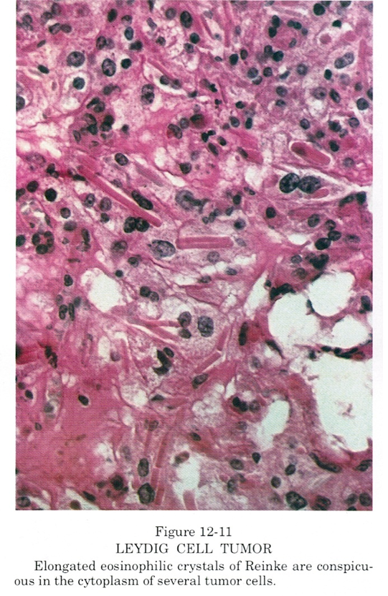
Hilar cell tumors arise from an overgrowth of mature hilar cells or from ovarian mesenchyme and are typically found in postmenopausal women.
They are characterized clinically by masculinization(homologs of the interstitial or Leydig cells of the testis).
Histologically, the tumors contain pathognomonic Reinke albuminoid crystals in most cases and
grossly, they are always small, unilateral, and benign.
Treatment is surgical removal for these three rare tumors

