Slide 1
Lower Limb Fractures Pt.2
Suhaib Moseley
Mutah University
2020
Edited by;
Lana Sabateen
Malak Al-Majali
Sara Khreisat

Slide 2
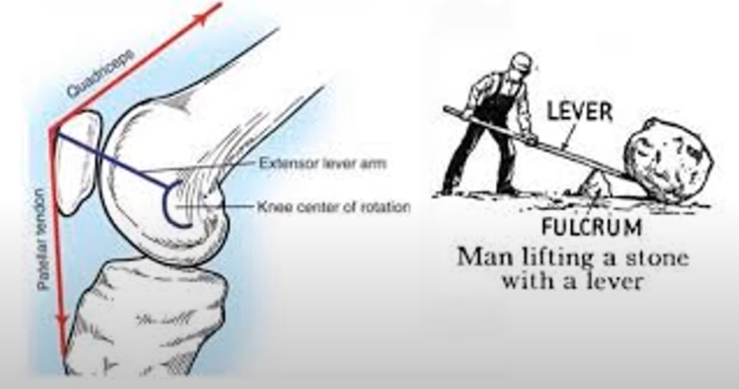
Patella (kneecap)
A flat circular triangular bone which articulate with the femur, covers and protects the anterior articular surface of the knee joint.
The largest sesamoid bone in the body.
Primary Function of the patella is knee extension to improve quadriceps efficiency; it increases the leverage that the quadriceps tendon can exert on the femur by increasing the angle at which it acts.
The patella is attached to the tendon of the quadriceps femoris muscle which contracts to extend the knee.
It is stabilized by the insertion of the horizontal fibers of the vastus medialis and by the prominence of the lateral femoral condyle which prevents lateral dislocation during flexion. The retinaculum fibers of the patella also stabilize it during exercise.

Slide 3
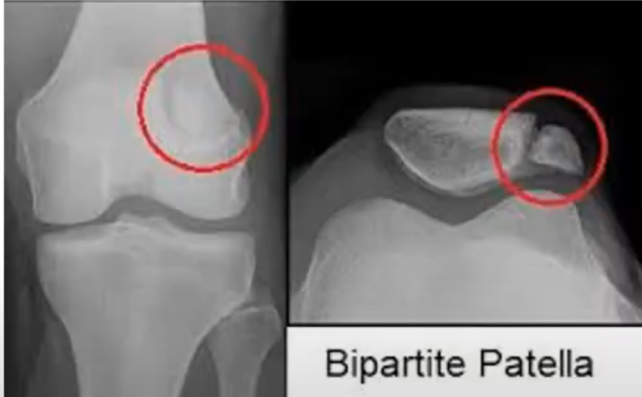
Bipartite Patella
A condition where the patella is composed of two separate bones instead of fusing together as what normally occurs in early childhood.
Occurs in about 1 – 2% of population.
Often asymptomatic and most commonly diagnosed as an incidental finding on x-ray.

Slide 4
Patella Fracture
Mechanism Of injury:
Direct impact injury occur from fall or dashboard injury causes failure in compression.
Indirect eccentric contraction occurs from rapid knee flexion against contracted quadriceps muscle which causes failure in tension.
Pattern Of fracture: As seen in the picture.

Slide 5
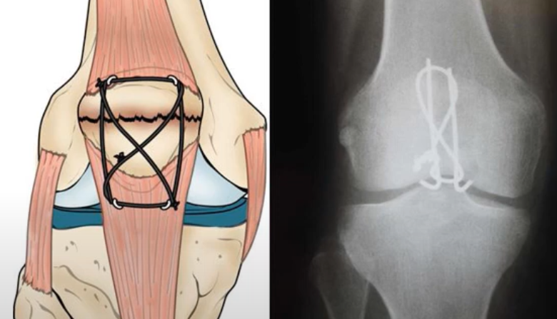
Patella Fracture
Management:
Depends on the integrity of the extensor mechanism.
If intact (patient able to perform straight leg raise) in non-displaced or minimally displaced fracture, the management will most likely be non-operative by a cylindrical cast from above the ankle to above the knee.
Not intact: surgery; open reduction and internal fixation.

Slide 6
Patella Fracture
Complications:
Loss of range of motion (most common)
Loss of reduction
Infection (post-op)
Secondary post traumatic patellofemoral osteoarthritis
The need for hardware removal.

Slide 7
Proximal Tibial Fractures
The proximal tibia is composed of the medial tibial plateau and the lateral tibial plateau which is separated by the tibial spine.
Proximal tibial fractures are common and are associated with a high rate of soft tissue complications.
Mechanism of injury:
Low energy trauma: causes torsional injury and spinal/oblique fracture (indirect trauma).
High energy trauma: resulting from a direct trauma, usually associated with compartment syndrome and soft tissue injury that may complicate the outcome.

Slide 8
Proximal Tibial Fractures
Schatzker Classification:
Type I: Split of lateral tibial Plateau
Type II: split of lateral tibial plateau with articular depression
Type III: central depression of tibial plateau without split.
Type IV: Split of medial tibial plateau with central depression.
Type V: Bicondylar fracture
Type VI: dissociation of the metaphyseal and diaphyseal junction.

Slide 9
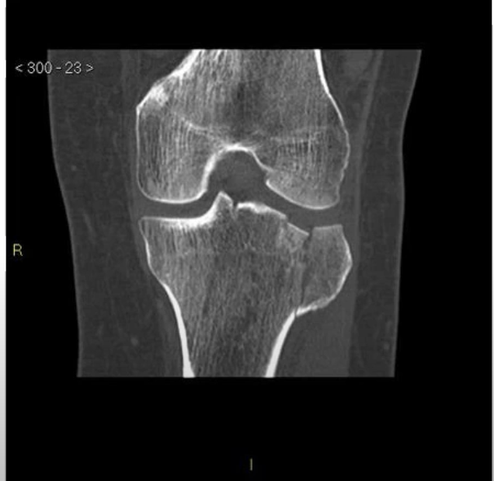
Proximal Tibial Fractures
CT Scan:
Very helpful in defining the extent of the bone injury (better view of joint depression that helps in classification) & facilitates the orthopedic planning and intervention.
Management:
Depends on mechanism of injury (Low/High energy trauma), associated soft tissue complication and compartment syndrome.
Low energy fractures with acceptable alignment: non-operative by cast immobilization (we can use a cast then move to a hinged knee brace)
High energy trauma and articular involvement: operative; open reduction to reduce the knee joint and then fix the proximal tibia. Sometimes we use bone graft to elevate the joint and promote healing.

Slide 10
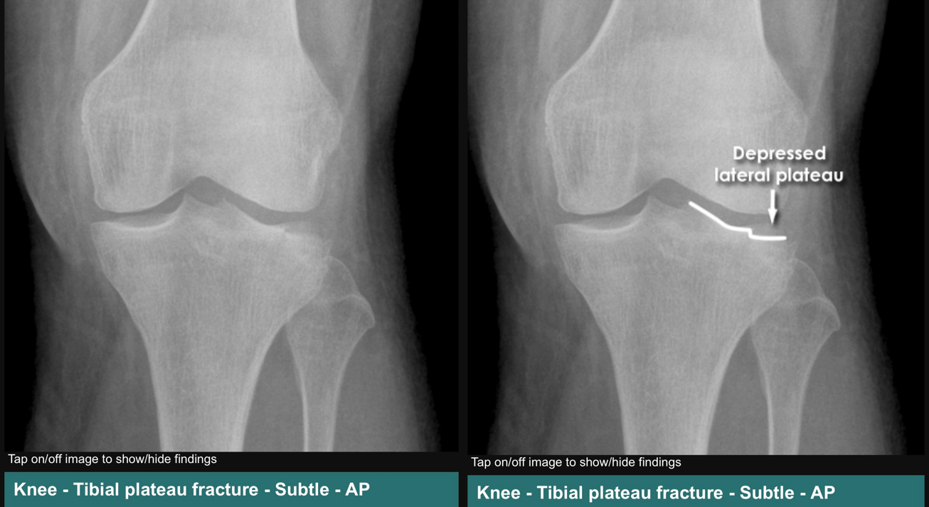
Proximal Tibial Fracture - X-ray.

Slide 11
Proximal Tibial Fractures
Complications:
Soft tissue complications
Compartment syndrome
Infection
Post traumatic secondary osteoarthritis (mainly after surgical intervention)
Decrease in ROM of knee
Associated meniscus and ligament injury
Neurovascular bundle injury

Slide 12
Tibial Shaft fracture
Since approximately 1/3 of the tibia lies directly beneath the skin, open fractures are common compared to other long bones
These open fractures are most commonly caused by a high velocity trauma (e.g. motor vehicle collisions), while closed fractures are often due to sport injuries or falls.
Fractures are classified according to pattern:
Simple: A1/A2/A3
Butterfly: B1/B2/B3
Comminuted: C1/C2/C3

Slide 13
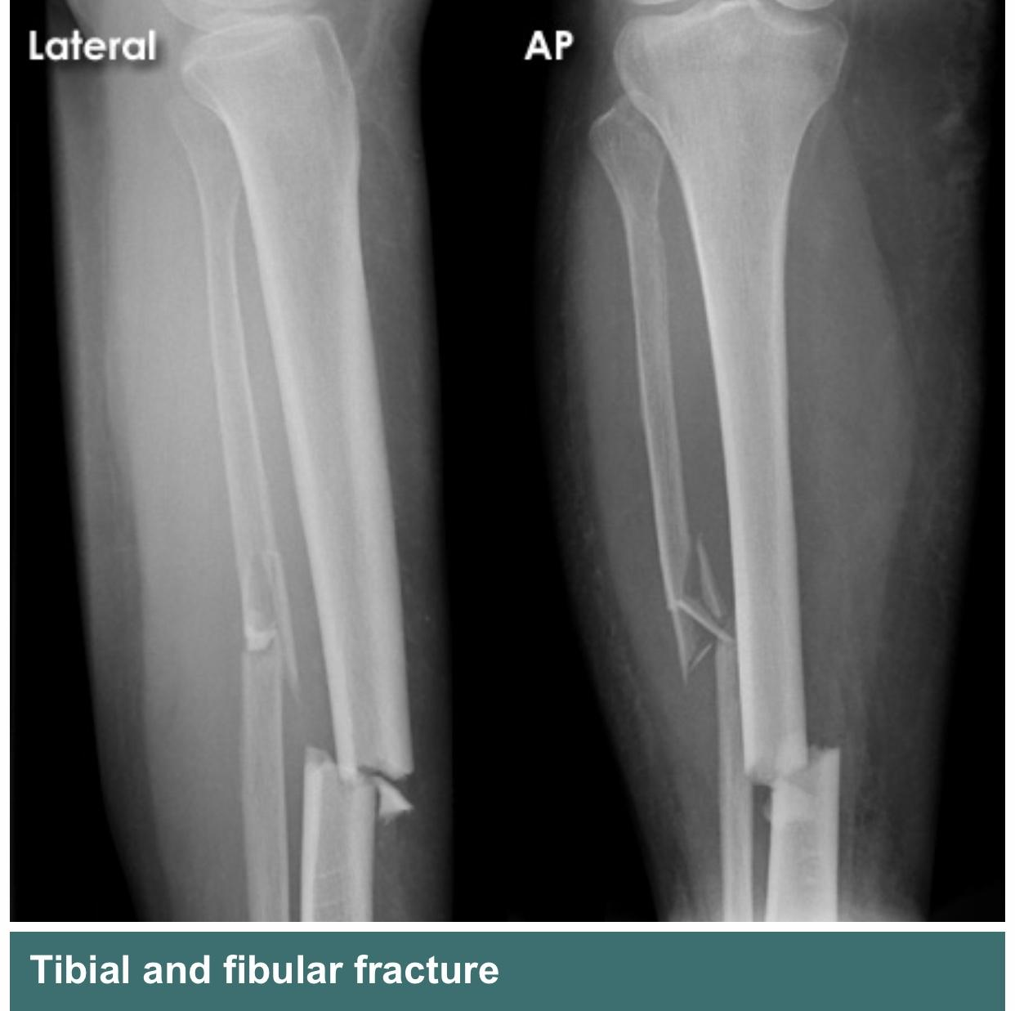
Tibial Shaft fracture – X - ray

Slide 14
Tibial Shaft Fracture
Management:
Depends on whether it’s an open or closed fracture.
Closed fractures with acceptable alignments can be treated non-operatively.
Open fractures and/or unacceptable alignment: Surgery – Intramedullary nearing (with plate and screws).
Open fractures need to be classified according to Gustilo classification as well. Immediately start the patient on antibiotics, ATS, analgesia and adequate irrigation.
Notes:
** Note: what is written in the slide is from Dr. Sohaib’s Lecture. Everything in this section has been mentioned during the clinical rounds and checked from the book**
Indication for external fixation (using x-fix):
Soft tissue is in a very bad status: this will provide protection to the tissue by fixating the bone and preventing muscle contraction around it until the tissue heals to an acceptable level.
Multiple traumas that require multiple surgeries (staging management / damage control)

Slide 15
Tibial Shaft Fracture
Complications:
Infections (open fracture & surgical intervention)
Delayed union & non-union (since the shin of the tibia is subcutaneous & has no soft tissue coverage)
Malunion and deformity (resulting in ankle osteoarthritis)
Local discomfort related to metal implants
Neurovascular bundle injury
Notes:
** Note: what is written in the slide is from Dr. Sohaib’s Lecture. Everything in this section has been mentioned during the clinical rounds and checked from the book**
Indication for external fixation (using x-fix):
Soft tissue is in a very bad status: this will provide protection to the tissue by fixating the bone and preventing muscle contraction around it until the tissue heals to an acceptable level.
Multiple traumas that require multiple surgeries (staging management / damage control)

Slide 16
Ankle Joint – Anatomy
Formed from the articulation of distal tibia, distal fibula and upper dome of talus.
Upper dome of talus is wider anteriorly than posteriorly that’s why the ankle joint is more stable in dorsal flexion than planter flexion.
Ankle joint has 3 malleoli:
Lateral malleolus formed from distal fibula.
Medial malleolus formed from distal tibia.
Posterior malleolus formed from distal tibia.
Notes:
** Note: what is written in the slide is from Dr. Sohaib’s Lecture. Everything in this section has been mentioned during the clinical rounds and checked from the book**
Approach to an ankle fracture with syndesmosis injury
X-ray parameters: in addition to what is mentioned above, check the tibiofibular overlap as well (normal value should be between 0.6 – 1)
All parameters must be measured at maximal external rotation.
Management of any ankle injury is almost always surgical because:
Intraarticular injury (poor healing)
Weight bearing area that needs early mobility.
Allows for examination for a syndesmosis injury.
Post-OP management:
Back Slab / Brace to protect the soft tissue
Patient is not allowed o bear weight but allowed limited ROM to avoid stiffness.

Slide 17
Anatomy of The Ankle - X-ray
Notes:
** Note: what is written in the slide is from Dr. Sohaib’s Lecture. Everything in this section has been mentioned during the clinical rounds and checked from the book**
Approach to an ankle fracture with syndesmosis injury
X-ray parameters: in addition to what is mentioned above, check the tibiofibular overlap as well (normal value should be between 0.6 – 1)
All parameters must be measured at maximal external rotation.
Management of any ankle injury is almost always surgical because:
Intraarticular injury (poor healing)
Weight bearing area that needs early mobility.
Allows for examination for a syndesmosis injury.
Post-OP management:
Back Slab / Brace to protect the soft tissue
Patient is not allowed o bear weight but allowed limited ROM to avoid stiffness.

Slide 18
Ankle Ligaments
Syndesmosis (Distal tibiofibular syndesmosis): fibrous joint held together by ligaments. Located near the ankle joint, between the two bones distally.
Made up of several ligaments:
Anterior inferior tibiofibular ligament.
Posterior inferior tibiofibular ligament.
The interosseous ligament.
The transverse tibiofibular ligament.
Its ligaments act as a shock observer, providing stability and support for the ankle.
Its main job is to align the tibia and the fibula, keeping them from spreading too far apart from each other.

Slide 19
Ankle Ligaments - Xray

Slide 20
Ankle Fractures
X-ray Parameters for assessment of the ankle joint stability:
Medial Clear Space: between medial malleolus and the talus should be less than 4mm.
Tibiofibular Clear Space: between the groove of the distal tibial prominence and the medial margin of the distal fibula should be less than 6mm.
Any increase in these spaces indicate a syndesmosis injury and instability of the ankle joint with deltoid ligament disruption.

Slide 21
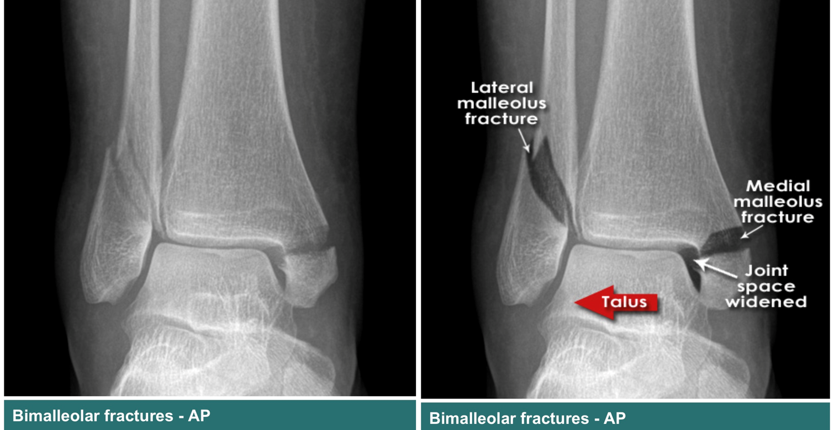
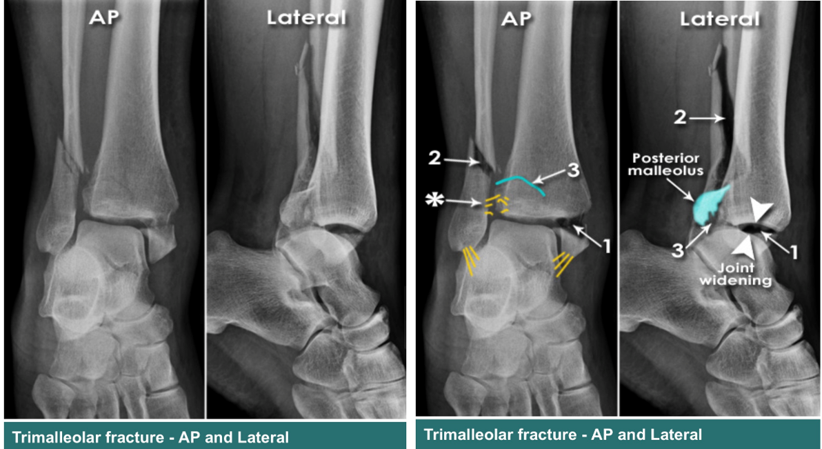
Ankle Fractures
Injury Patterns:
Isolated medial malleolus fracture.
Isolated lateral malleolus fracture.
Posterior malleolus fracture.
Bimalleolar and bimalleolar-equivalent fractures
Trimalleolar fracture.

Slide 22
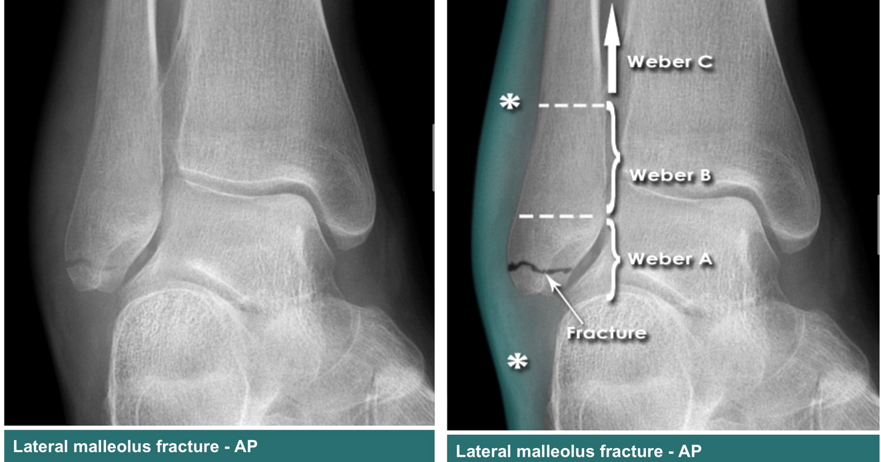
Ankle Fractures
Weber Classification: depends on the level of fibular fracture relative to the syndesmosis.
Weber A: Fibular fracture is below the syndesmosis.
Weber B: Fibular fracture is at the level of the syndesmosis.
Weber C: Fibular fracture is above the syndesmosis.

Slide 23
Ankle Fractures
Management:
Non-operative by a short leg cast, indicated in:
Isolated non-displaced medial malleolus fracture or tip avulsions.
Isolated lateral malleolus fracture with < 3mm displacement and no talar shift.
Bimalleolar fracture if elderly or unable to undergo surgical intervention.
Posterior malleolus fracture with <25% joint involvement or < 2mm step off.

Slide 24
Ankle Fractures
Management:
Operative: Open reduction and internal fixation, indicated in:
Any talar displacement.
Displaced Isolated medial or lateral malleolus fracture.
Posterior malleolus fracture with >25% joint involvement or >2mm step off.
Open fractures
Malleolar non-unions
Bimalleolar and bimalleolar-equivalent fractures

Slide 25
Ankle Fractures
Complications:
Infections
Non- union
Malunion
Secondary post traumatic arthritis of ankle joint
Soft tissue complications/compartment syndrome.

Slide 26
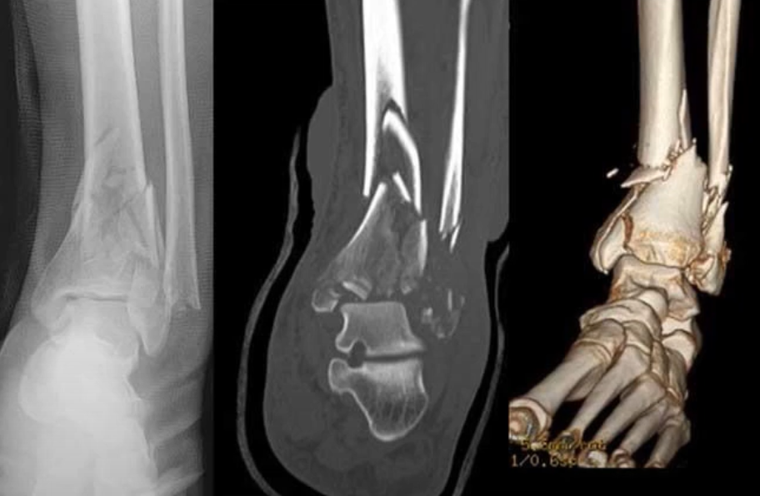
Pilon Fracture
Also known as (distal) tibial plafond fracture.
Plafond: “the ceiling,” the horizontal distal aspect of the tibia articulating with the talus.
Pilon: an analogy of the mechanism of injury; talus is driven into the ankle joint causing the break in the horizontal distal articulation of the tibia.

Slide 27
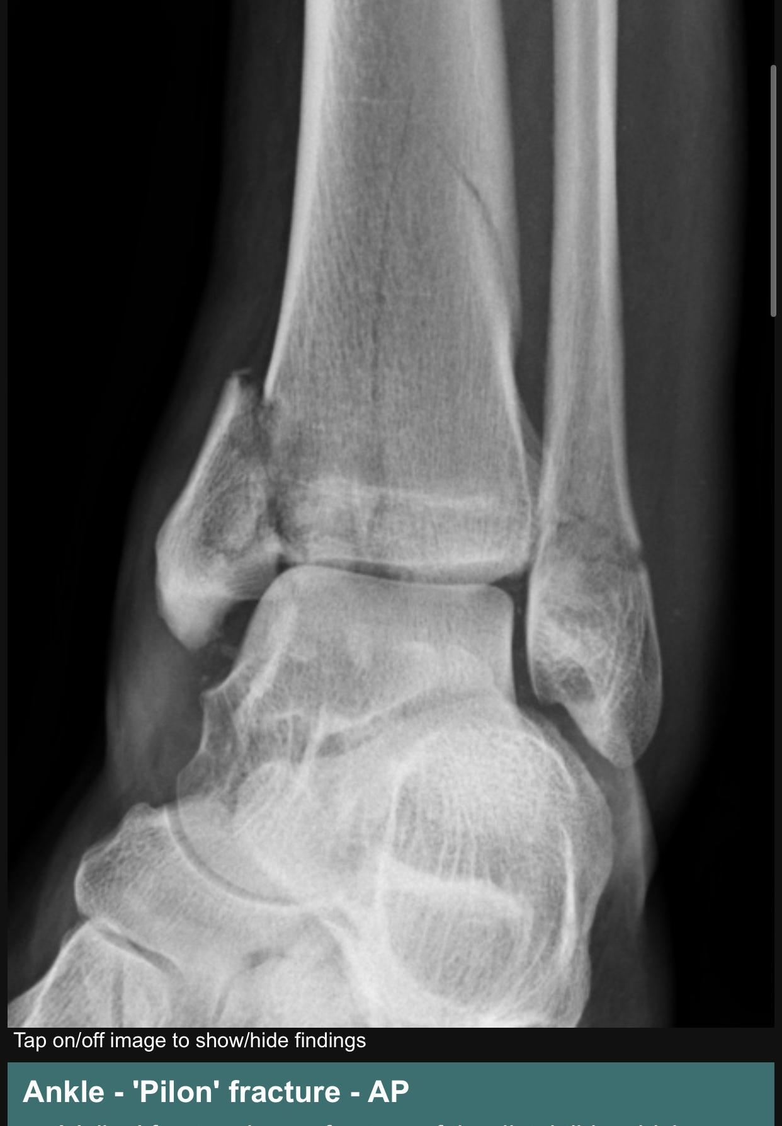
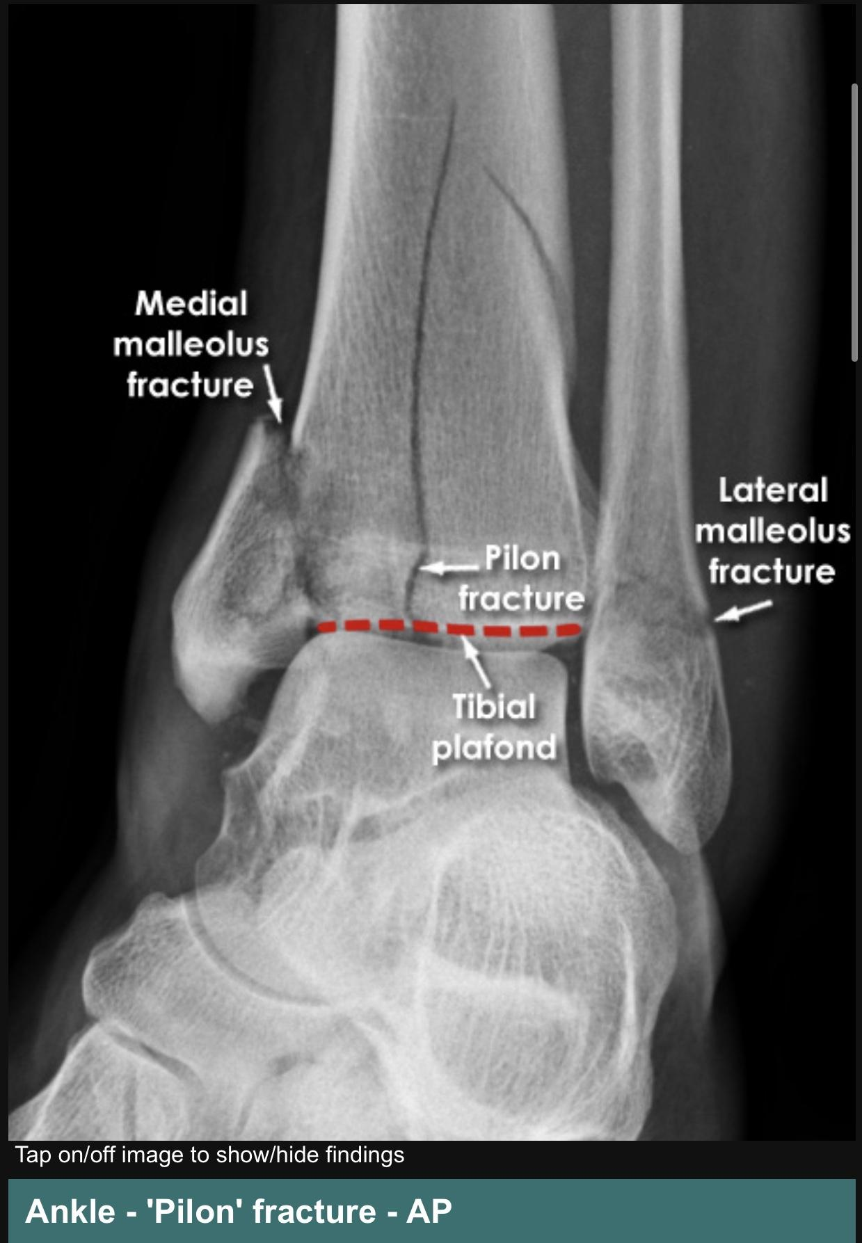
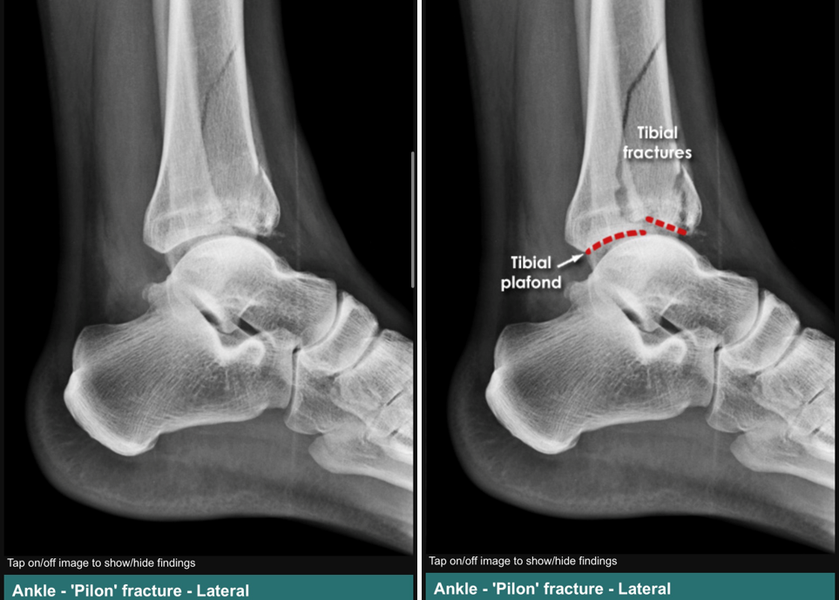
Pilon Fracture – X-ray

Slide 28
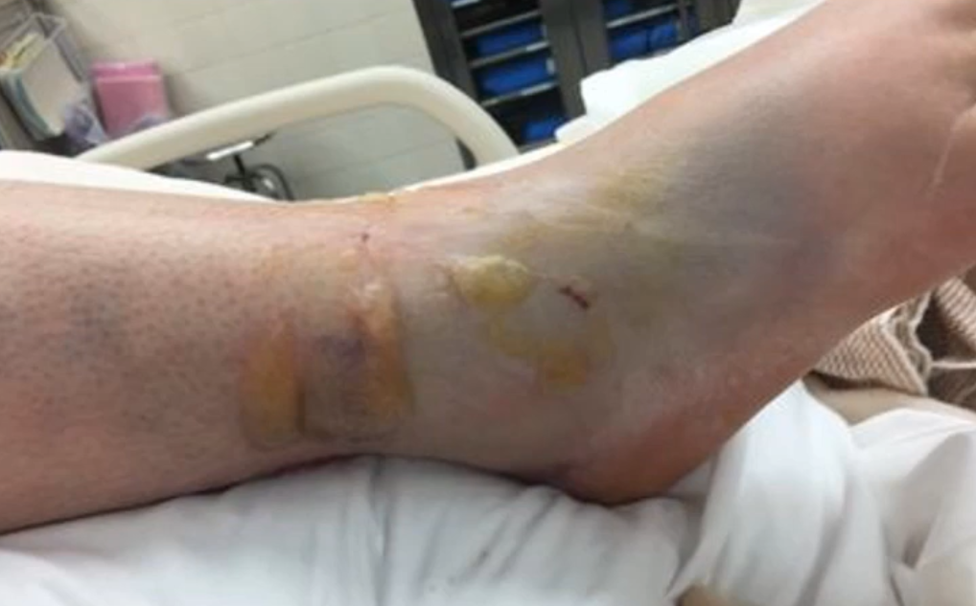
Pilon Fracture
Mechanism:
Can be due to a low or a high energy trauma.
In high energy traumas, the soft tissue involvement will increase the difficulty of the management and increase the risk of complications.
We can think of Pilon fractures as a soft tissue injury associated with a fractured bone.
CT Scan:
A must in tibial plafond fractures in order to assess the articular involvement and help in surgical planning.

Slide 29
Pilon Fracture
Ruedi and Allgower Classification:
Type 1: Cleavage fracture with no major articular disruption
Type 2: Fracture dislocation with major articular surface disruption without comminution.
Type 3: Major articular disruption with impacted and comminuted fracture dislocation.

Slide 30
Pilon Fracture
Management:
Non-operative: Immobilization, in:
Stable fracture patterns without articular surface displacement
Critically ill patients
When there’s significant risk of skin problems (DM, vascular disease, neuropathy)
Operative:
Temporising spanning external fixation across the ankle joint; acute management that provides stabilization to allow for soft tissue healing in fractures with significant joint depression or displacement. Leave until swelling resolves (generally 10 – 14 days)
ORIF: Definitive fixation for majority of pilon fractures.
Limited or definitive ORIF can be done acutely with low complication in certain situations.

Slide 31
Pilon Fracture
Complications:
Wound slough (10%)
Dehiscence (9 – 30%), wait until edema subside before ORIF (1 – 2 weeks)
Infection (5-15%)
Varus malunion
Non-union
Posttraumatic arthritis
Chondrolysis
stiffness

Slide 32
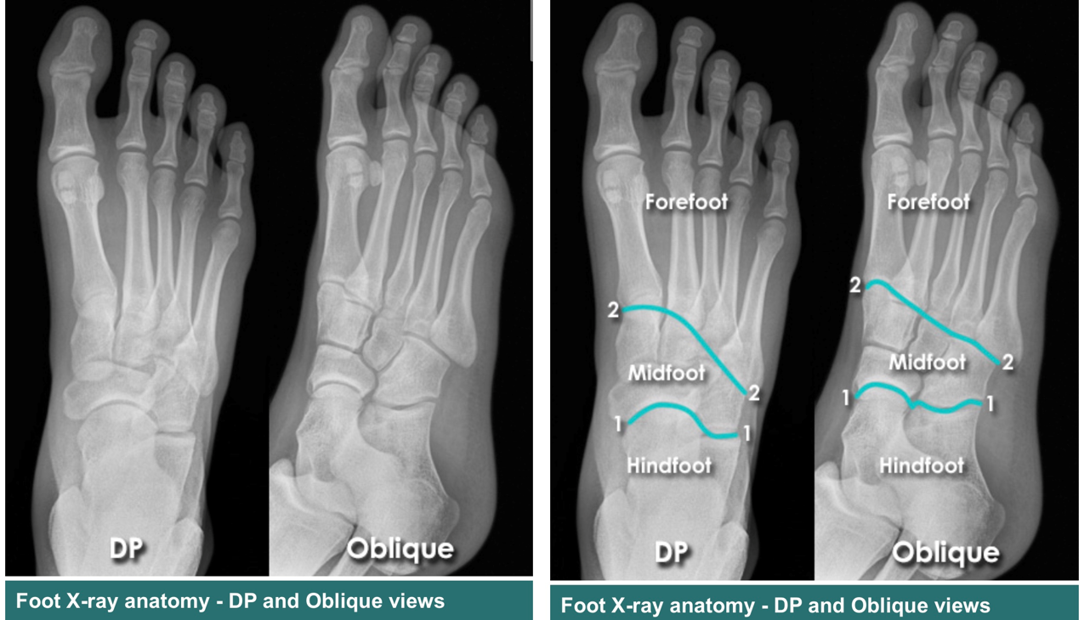
The Foot
Composed of three regions:
Hindfoot
Midfoot
Forefoot

Slide 33
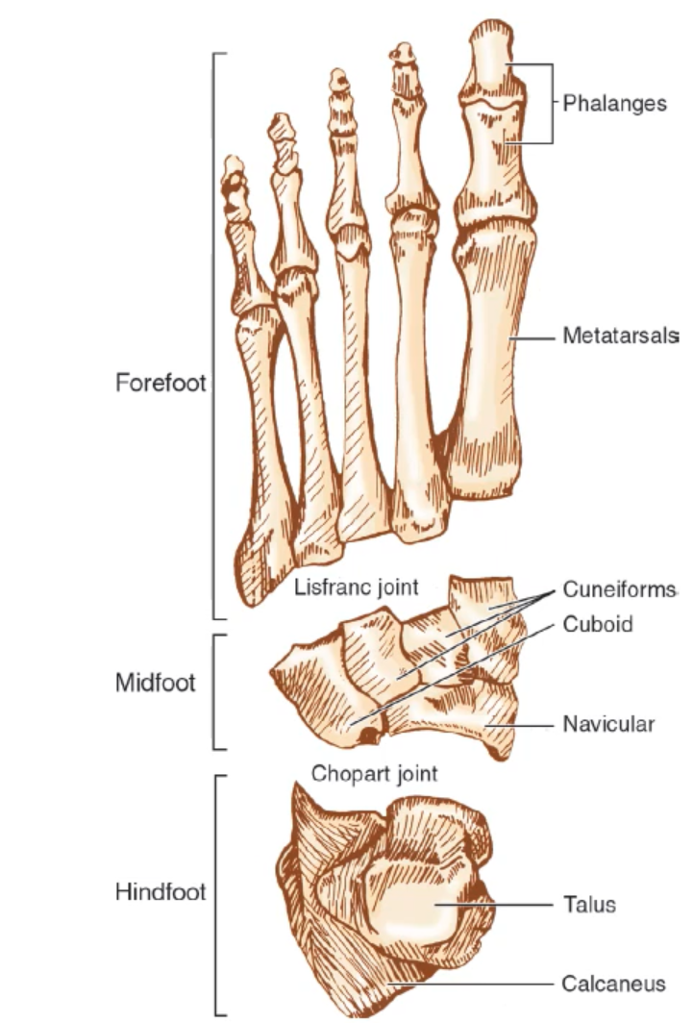
Hindfoot
Composed of the talus and calcaneus articulating with each in the subtalar joint.
Anteriorly, it articulates with the midfoot via the navicular bone articulation with the talus and the cuboid bone articulating with the calcaneus.
The joint between these 4 bones (Talus/calcaneus and navicular/cuboid) is the Chopart joint.

Slide 34
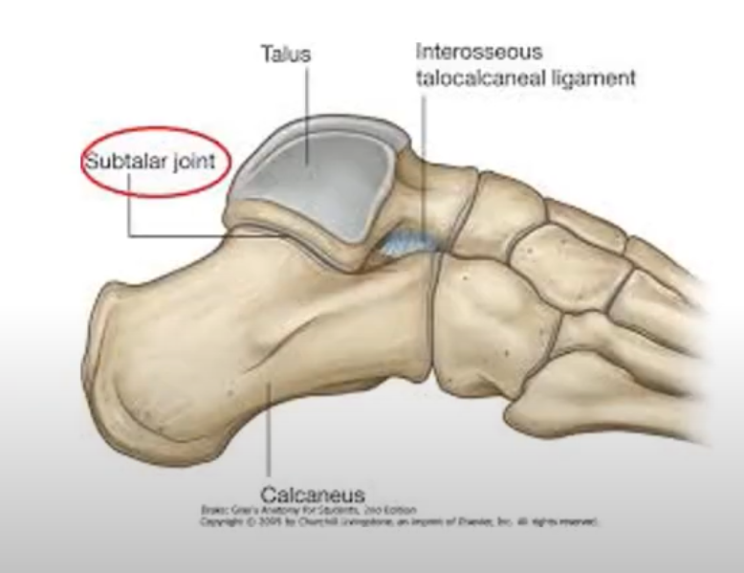
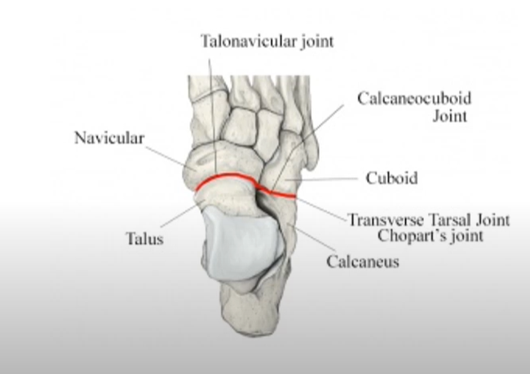
Hindfoot
Subtalar Joint:
The subtalar joint is responsible for the pronation and supination movement and is stabilized by the interosseous talocalcaneal ligament.
Chopart Joint:
The joint between the hindfoot and the midfoot. Also known as the transverse tarsal joint

Slide 35
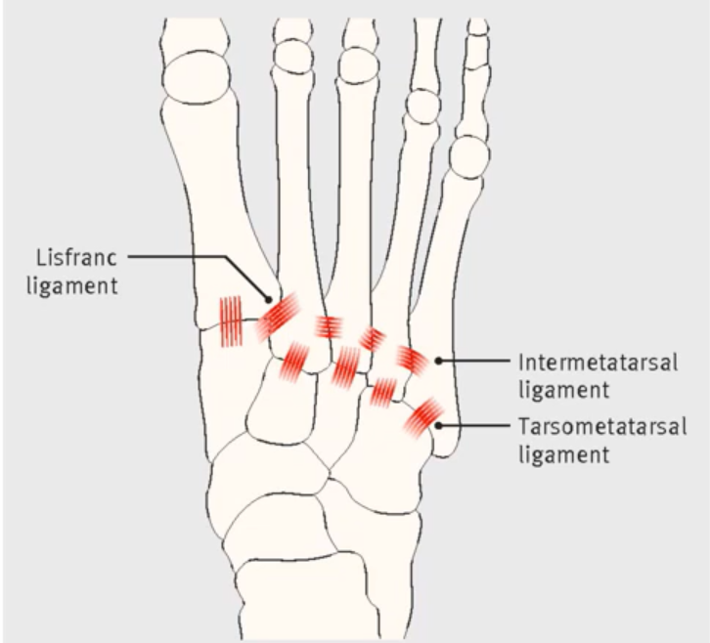
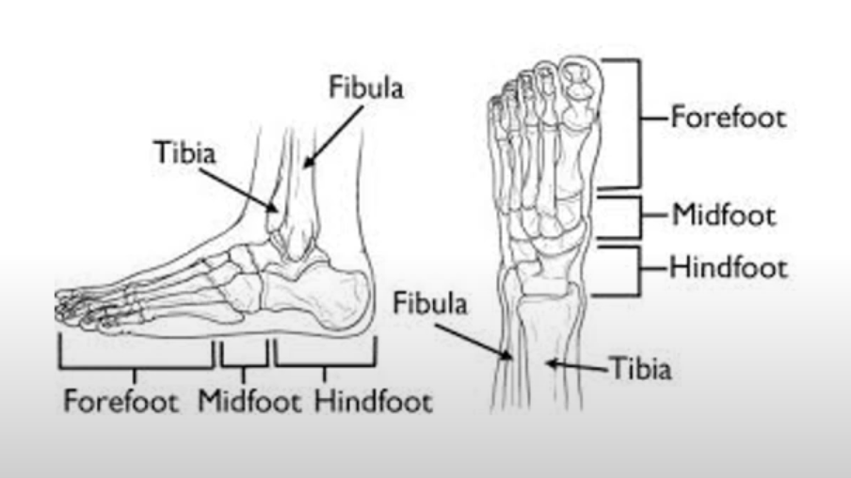
The Foot
Midfoot:
Composed of the navicular bone, the cuboid bone and the 3 cuneiform bones.
Articulates with the forefoot through the Lisfranc joint.
The Lisfranc ligament is one of the most important stabilizers of the foot. Found between the medial cuneiform and the base of the 2nd metatarsal bone.
Forefoot:
Composed of the five metatarsal bones and the phalanges of the toes.

Slide 36
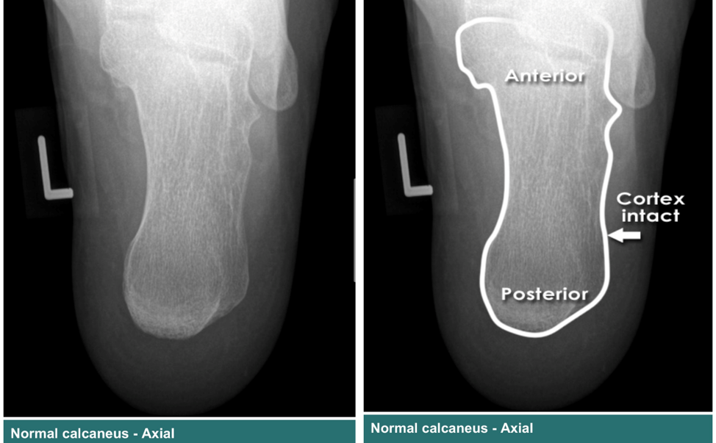
Calcaneus Fracture
Most commonly fractures tarsal bone.
Has a high morbidity & disability that is associated with displace intraarticular fractures.
The calcaneus is one of the hindfoot bones, articulating anteriorly with cuboid bone and superiorly with the talus bone.
Fractures can be extraarticular (25%) or intraarticular (75%)

Slide 37
Calcaneus Fracture
Sanders Classification of intraarticular calcaneus fractures:
Based on the number of articular fragments seen on the coronal CT image at the widest point of the posterior facet.

Slide 38
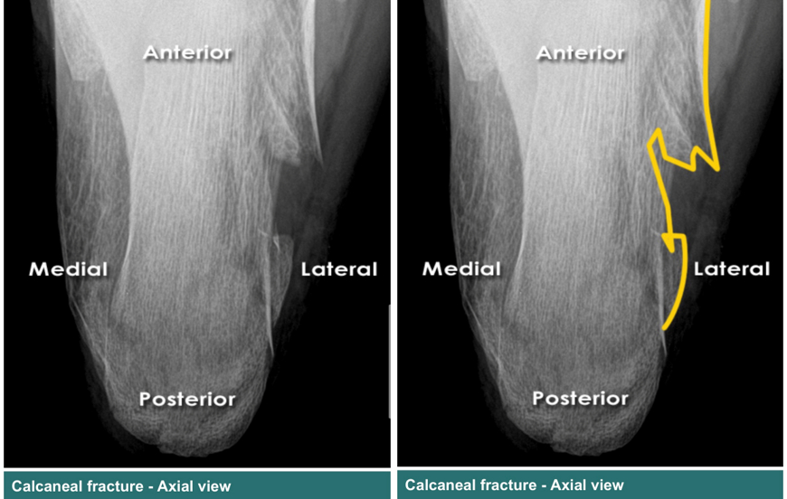
Calcaneus Fracture – X-ray

Slide 39
Calcaneus Fracture
Management:
Non-operative: for extraarticular fractures with acceptable alignment and intraarticular fractures with acceptable alignment.
Operative: in nonacceptable articular alignment of the subtalar joint, either ORIF or by percutaneous screw fixation.

Slide 40
Calcaneus Fracture
Complications:
Compartment syndrome
Wound Dehiscence & Infection after ORIF (DM & smoking increase the risk)
Malunion & deformity
Arthritis
Chronic persistent pain

Slide 41
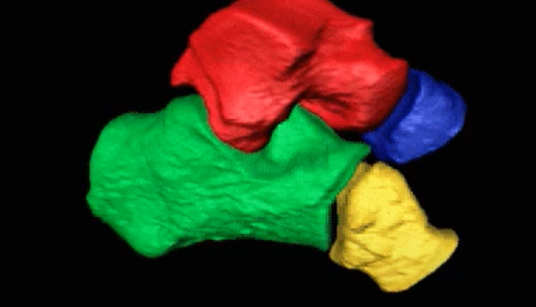
Talus Fractures
2nd largest tarsal bone.
One of the bones with the highest percentage of its surface area covered by articular cartilage.
Has a retrograde blood supply (like the scaphoid in the wrist; blood enters distally)
Articulates superiorly with the tibia at the ankle joint, anteriorly with the navicular bone & inferiorly with the calcaneus.
Composed of:
Body (account for 13 – 23% of talus fractures)
Lateral Process (account for 10% of talus fractures)
Talar Head (Least common talus fracture)
Talar Neck
Management:
Non-operative: short leg cast for 6 weeks for non-displaced fractures < 2mm
Operative: Displaced >2mm

Slide 42
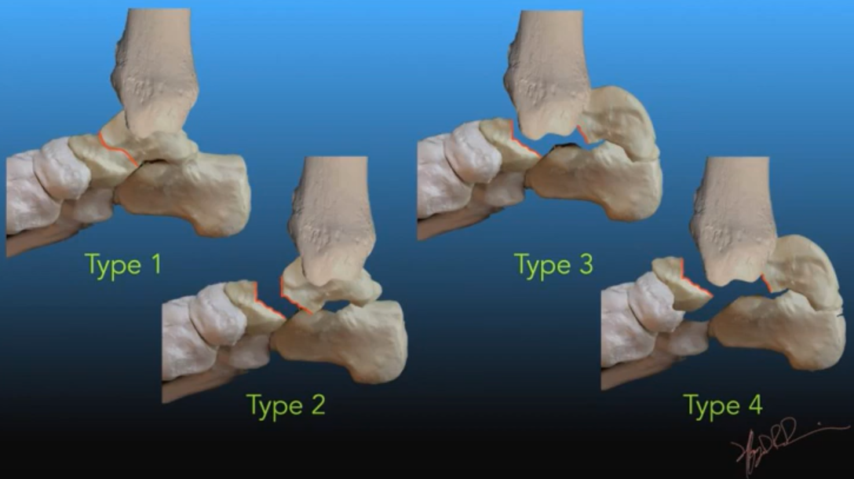
Talar Neck Fracture
Most common fracture of talus (50%)
Mechanism of injury: High energy trauma with forced dorsiflexion and axial load.
Hawkins classification, predicts the outcome of fracture & AVN rate:
Type 1: Non-displaced Fracture
Type 2: Subtalar dislocation fracture of talus neck
Type 3: subtalar and tibiotalar dislocation
Type 4: subtalar, tibiotalar and talonavicular dislocation

Slide 43
Talar Neck Fracture
Management:
Non-operative: in Hawkins type 1, a short leg cast for 8 - 12 weeks & non weight bearing for the 1st 6 weeks.
Operative: in Hawkins type 2,3,4 to decrease risk of avascular necrosis.

Slide 44
Talar Neck Fracture
Complications:
Avascular necrosis
Talonavicular arthritis
Malunion & non-union
Subtalar arthritis
Chronic pain from symptomatic non-union

Slide 45
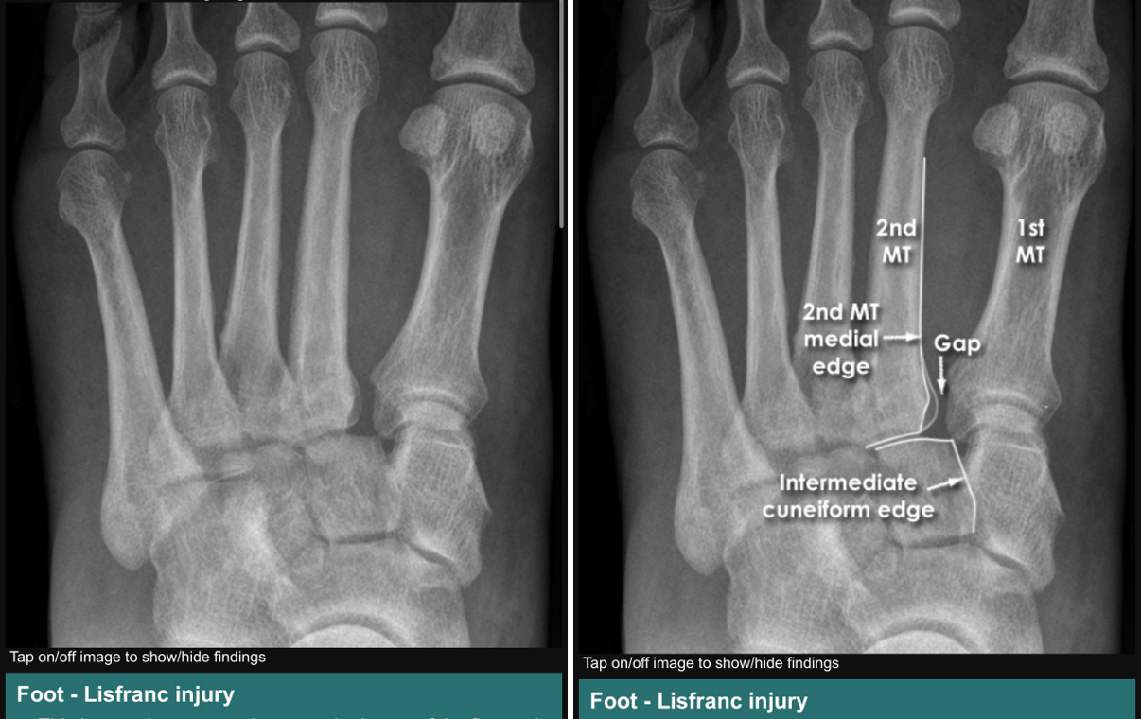
Lisfranc Fracture
A tarsometatarsal fracture dislocation characterized by traumatic disruption between the articulation of the medial cuneiform and the base of the 2nd metatarsal bone.
Mechanism of injury: usually caused by an indirect rotational force and axial load through a hyper plantarflexed forefoot.

Slide 46
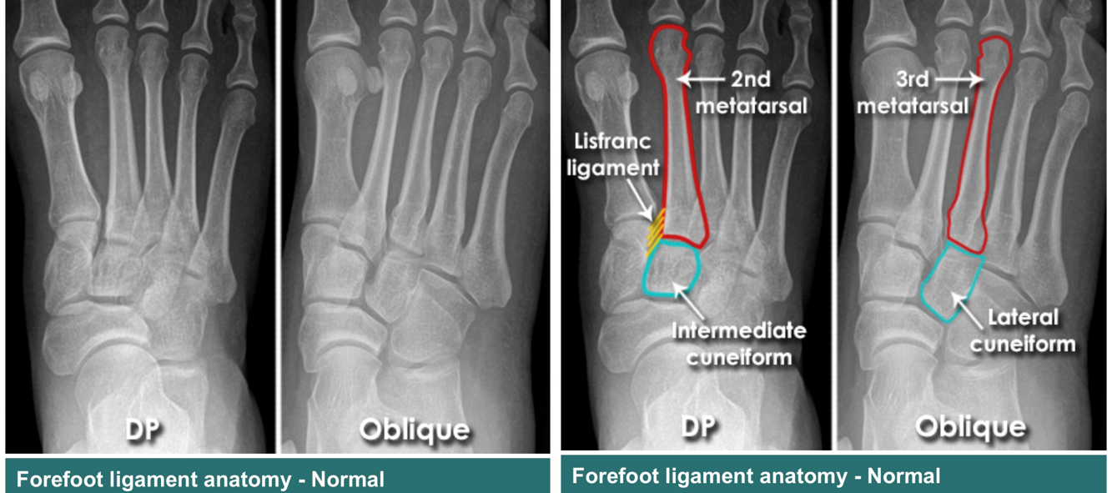
Lisfranc Fracture
Normal x-ray: 1st metatarsal is aligned with the medial cuneiform and the 2nd metatarsal is aligned with the intermediate cuneiform.
Lisfranc Fracture X-ray: the space between 1st metatarsal & 2nd metatarsal is increased and abnormal. The 2nd metatarsal is not well aligned with the intermediate cuneiform.

Slide 47
Lisfranc Fracture
Management:
Non-operative: cast immobilization for 8 weeks, indicated in:
No displacement on weight bearing & stress radiographs with no evidence of bony injury on CT (Usually it’s a dorsal sprain)
Non ambulatory patients
Presence of serious vascular disease.
Severe peripheral neuropathy.
Operative: open reduction, restoration of the joint (important for stability of foot arches) and internal fixation.

Slide 48
Lisfranc Fracture
Complications:
Secondary post traumatic arthritis: most common, may cause altered gait and long-term disability.
Soft tissue complications & compartment syndrome.
Non-union (uncommon)
Chronic residual pain (even after perfect anatomical reduction and fixation)

Slide 49
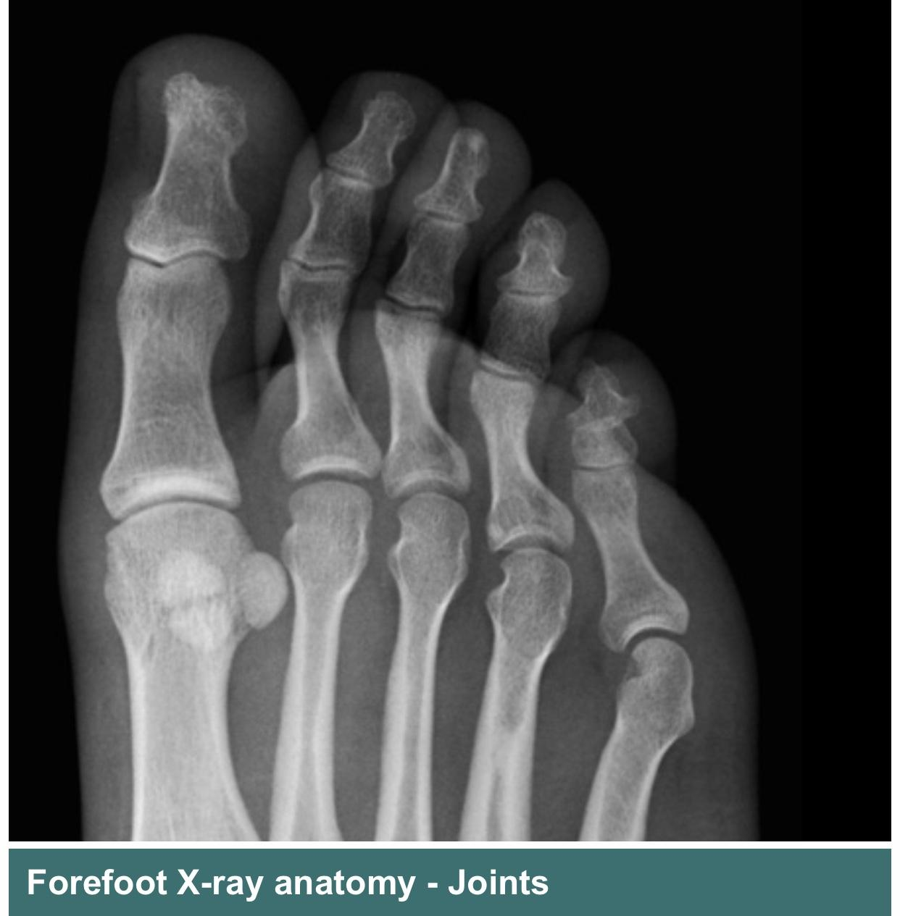
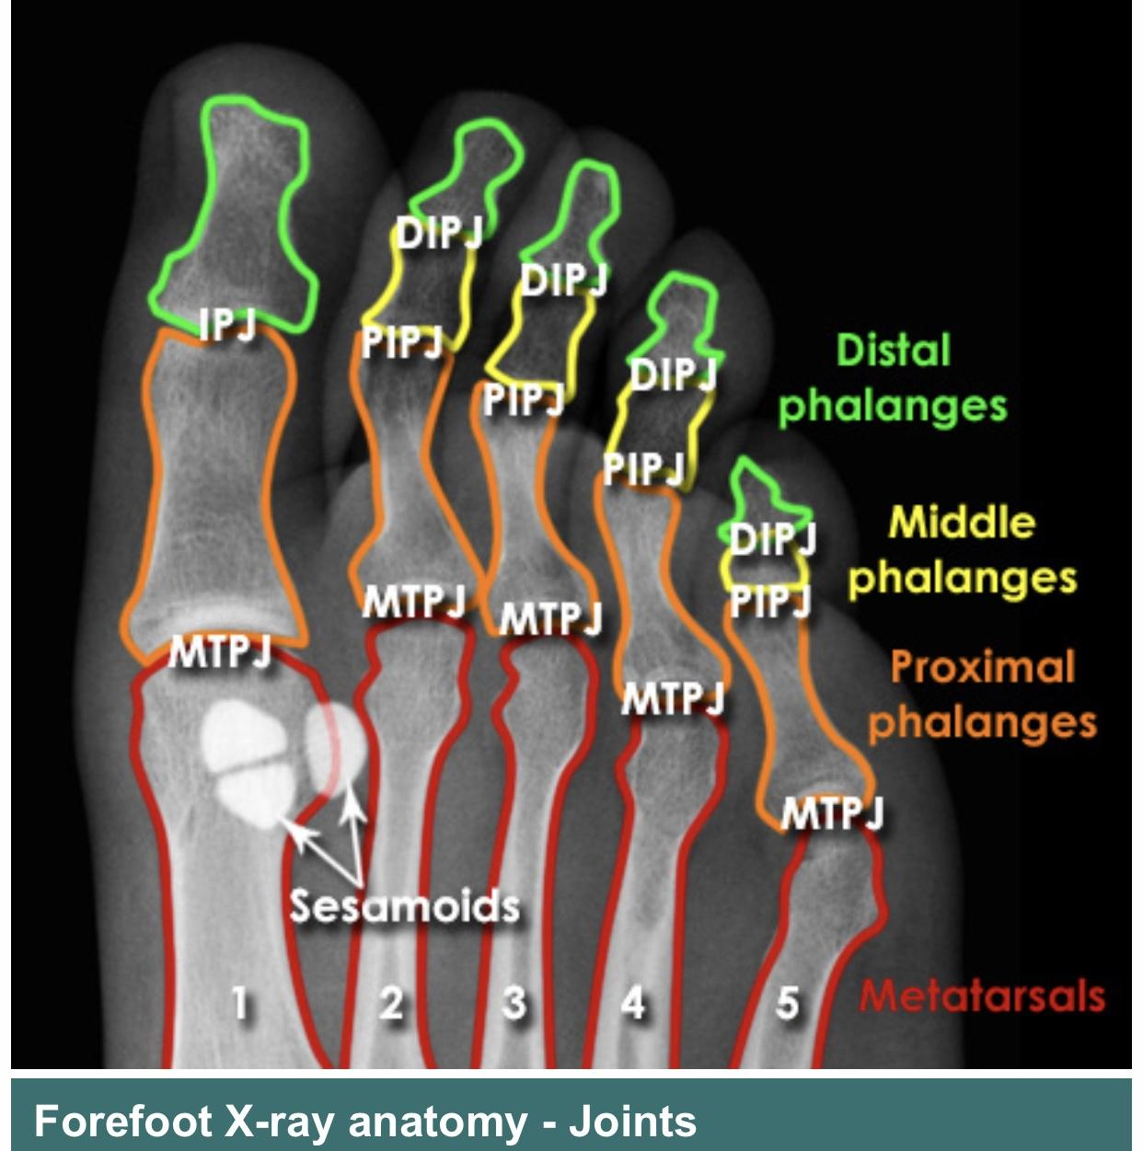
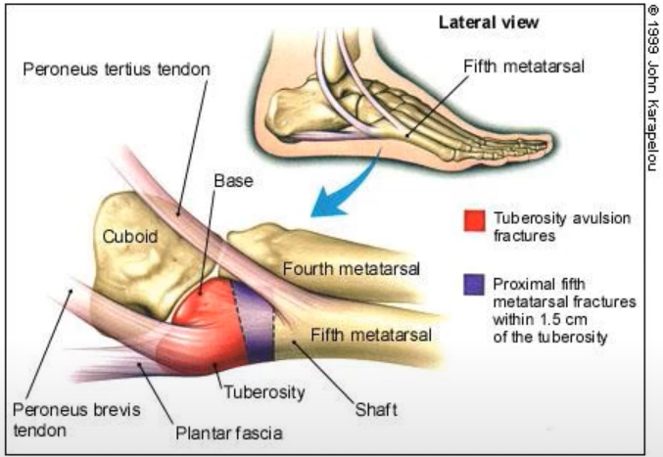
Metatarsal Fracture
Each of the metatarsal bones is composed of a head, body and a base.
The 5th metatarsal, which is the mot commonly fractured, has the insertion of peroneus teres tendon and peroneus brevis tendon at its base.
At risk of tuberosity avulsion fracture and proximal 5th metatarsal fractures within 1.5 cm of the tuberosity.

Slide 50
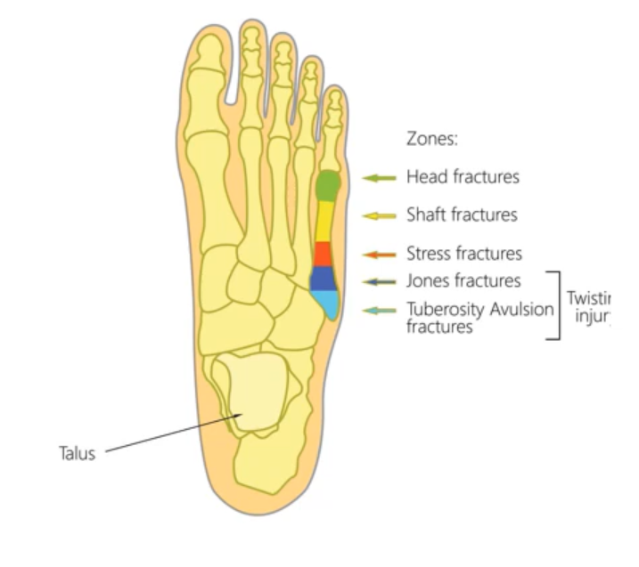
5th Metatarsal Bone Fracture
Has 5 types:
Tuberosity (zone 1) avulsion fracture.
Jones Fracture (zone 2)
Stress fracture (zone 3)
Shaft fracture (zone 4)
Head fracture (zone 5)
At the junction of the metaphysis and diaphysis, there’s an avascular watershed area that increases the rate of non-union (up to 15 – 30%).
Base of 5th metatarsal fracture’s accounts for 25% of all metatarsal fractures of which 90% are zone 1 fractures.

Slide 51
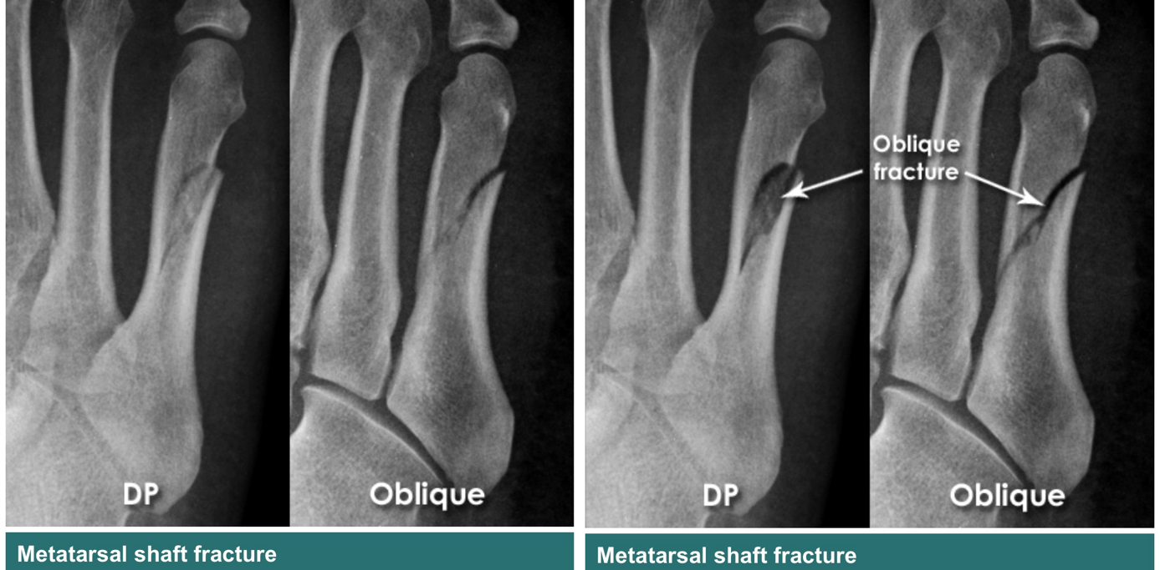
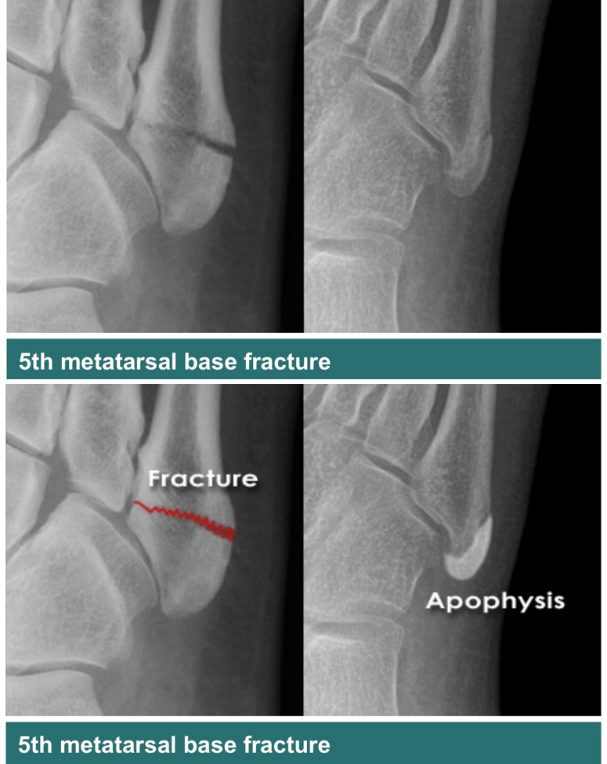
Metatarsal Bone Fracture - Imaging

Slide 52
Metatarsal Bone Fracture
Mechanism of Injury:
Direct injury, might be associated with significant soft tissue injury.
Indirect injury (most common) occurs when forefoot is flexed and hindfoot or leg are rotating.
Complications:
Soft tissue complications & compartment syndrome.
Delayed Union, Non-union and refracture.
Metatarsalgia from malunion (pain in the area of metatarsopharyngeal joints)

Slide 53
Metatarsal Bone Fracture - Management
Metatarsal fractures are among the most common injuries of the foot.
Goals of treatment include:
Maintenance of transverse and longitudinal arches of forefoot.
Restore alignment to allow for normal force transmission across metatarsal heads.
Non-Operative
Operative: indicated in
Open fracture
1st metatarsal with any displacement as there’s no intermetatarsal ligament support and 30 – 50% of weight bearing with gait is transmitted through it.
Multiple fractures
Central metatarsal: sagittal plane deformity > 10 ̊ or > 4mm translation.

Slide 54
Phalangeal Fractures
The big toe is composed of proximal and distal phalanges while 2nd – 5th are composed of proximal, middle and distal phalanges.
Toes fractures are relatively common accounting for 10% of cases (of these over 60 – 75% involve the smaller toes) treated by primary and emergency physicians.

Slide 55
Phalangeal Fractures
Management:
Displaced fractures of lesser toes should be treated with reduction and body taping.
Patients with displaced fracture of 1st toe often require rigid stabilization of the reduction.
Complications:
Persistent pain and decreased tolerance for activity (common)
Malunion
Degenerative joint disease in intraarticular phalangeal fractures
Osteomyelitis: potential complication of open fractures

