Slide 1
Bladder Cancer
Presented by:
Lujain Alessa
Sham AlShobaki
Ruaa Allawanseh

Slide 2
bladder is a hollow muscular organ in the lower abdomen can’t be palpated or percussed until there is a urine volum of at least 150 ml The wall of the bladder has four main layers: 1- The inner layer is called the lining. This lining is made up of cells called urothelial or transitional cells. This layer is called the urothelium or transitional epithelium. 2- Under the urothelium is a thin layer of connective tissue, blood vessels , and nerves, which is called the lamina propria. 3-Next is a thick layer of muscle called the muscularis propria (detrusor muscle). 4- Outside of this muscle, a layer of fatty connective tissue
Normal bladder

Slide 3
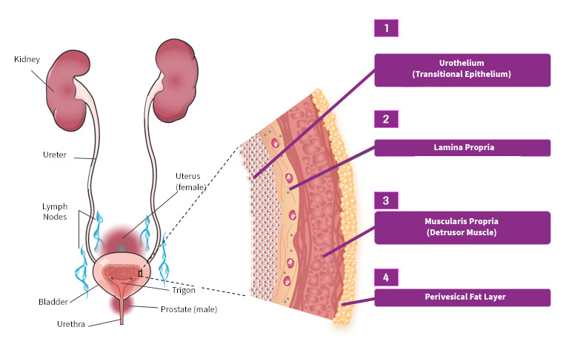
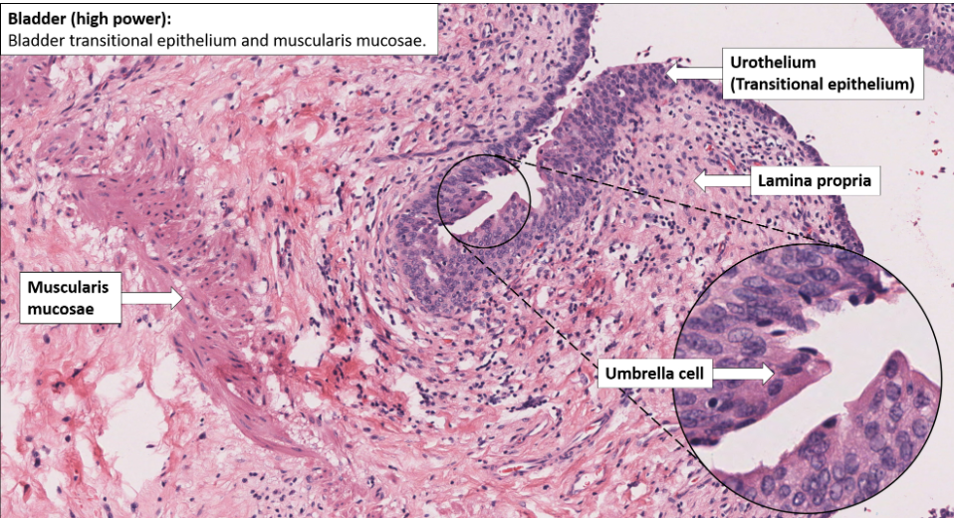

Slide 4
Bladder Cancer Prevalence
Bladder cancer is the second most common urological malignancy.

Slide 5
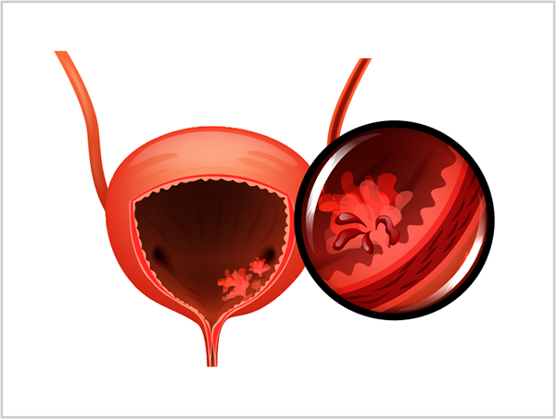
*Men are 2.5 times more likely to develop the disease than women.
*Age increases risk , most commonly diagnosed in the 8th decade and rare <50 years.
*Racially, Black people have a lower incidence than White people, but inexplicably they appear to carry a poorer prognosis.
Risk factors

Slide 6
6
*Environmental carcinogens found in urine, are the major cause of bladder cancer.
*Chronic inflammation of bladder mucosa: bladder stones, long-term catheters
*Smoking is the major cause of bladder cancer in the developed world
*Occupational exposure to carcinogens, in particular aromatic hydrocarbons like aniline
*Drugs: phenacetin and cyclophosphamide.
*Pelvic radiotherapy.

Slide 7
pathology and staging
Benign tumors of the bladder, including inverted papilloma and nephrogenic adenoma, are uncommon.
The vast majority of primary bladder cancers are malignant and epithelial in origin.

Slide 8
Types of Bladder Cancer :
1-Transitional cell (urothelial) carcinoma>90%
2-Flat carcinomas (CIS)
3-Squamous cell carcinoma 7%
4-Adenocarcinoma 2%
5-Rarities include phaeochromocytoma, melanoma, lymphoma, and sarcoma arising within the bladder muscle
Secondary bladder cancers are mostly metastatic adenocarcinoma from gut, prostate, kidney, or ovary

Slide 9
1-Transitional cell (urothelial) carcinoma
.* This is the most common form of bladder cancer. It represents roughly 95% of bladder cancers
*Bladder cancer can be described as superficial or non-muscle invasive
*may be single or multifocal

Slide 10
2-Flat carcinomas
Do not grow toward the hollow part of the bladder. It is a flat tumor. You may also hear it :called
carcinoma in situ (CIS) ). This is poorly differentiated carcinoma, but confined to the epithelium and associated with an intact basement membrane
The cells are poorly cohesive ( lack of intercellular connections ), up to 100% of patients with CIS exhibiting positive urine cytology
untreated CIS lesions will progress to muscle invasive UC, making CIS the most aggressive form of superﬁcial UC.

Slide 11
3-Squamous cell carcinoma
-Roughly 1% to 2% of bladder cancers are squamous cell carcinomas. Nearly all squamous cells are solid or ulcerative and muscle-invasive
-SCC in the bladder is associated with chronic inflammation, stones and In Egypt, 80% of SCC is induced by the ova of Schistosoma haematobium
-long-term catheters develop SCC.
-Smoking is also a risk factor for SCC.

Slide 12
4- Adenocarcinoma
*Adenocarcinoma is rare, usually solid/ulcerative and carries a poor prognosis. One third originate in the urachus(remnant of a channel between the bladder and the umbilicus )
*located deep to the bladder mucosa in the dome of the bladder.
*Adenocarcinoma is a long-term (10 years) complication of bladder exstrophy( continental abnormality of bladder and bony pelvis bladder is exposed to outside environment)

Slide 13
Tumor spread :
Direct tumor growth to involve the detrusor muscle, the ureteric orifices, prostate, urethra, uterus, vagina, perivesical fat, bowel, or pelvic side walls.
Implantation into wounds/percutaneous catheter tracts.
It’s contraindicated to do suprapubic catheterization for any pt suspected to have bladder cancer
Lymphatic infiltration of the iliac and para-aortic nodes.
Haematogenousmost commonly to liver (38%), lung (36%), adrenal gland (21%), and bone (27%). Any other organ may be involved.

Slide 14
Bladder cancer grading
The grades for bladder cancer are:
low-grade – the cancer cells are slow-growing and are less likely to spread
high-grade – the cancer cells grow more quickly and are more likely to spread. Carcinoma in situ (CIS) is always classed as high-grade.

Slide 15
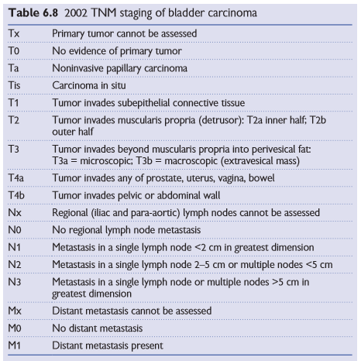
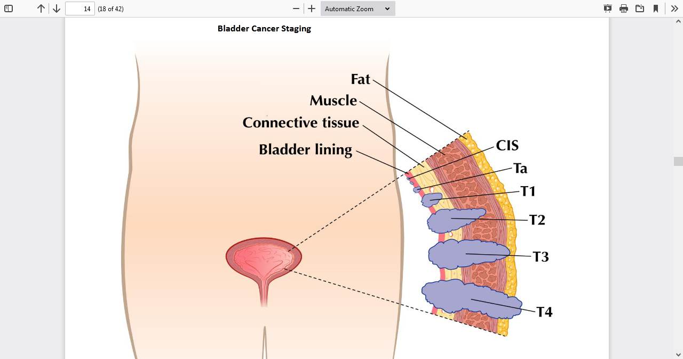
Bladder cancer staging

Slide 17
Non muscle invasive
means the cancer cells are only in the inner lining of the bladder
Muscle invasive
The cancer is in the muscle layer of the bladder or has spread into the fat layer. But it has not spread outside the bladder.
Locally advanced
This is when the cancer has spread outside the bladder into nearby tissues, such as the prostate, vagina, ovaries, womb or back passage (rectum). It may also be in a lymph node in the pelvis, near to the bladder.
Advanced
This is when the cancer has spread to other parts of the body, such as the liver, lungs or bones, or to the lymph nodes further from the bladder.

Slide 18
Bladder cancer: presentation
Symptoms
The most common presenting symptom (85% of cases) is painless haematuria. This may be initial or terminal if the lesion is at the bladder neck or in the prostatic urethra. 35% of patients >50 years and 10% <50 years with macroscopic haematuria have bladder cancer. History of smoking or occupational exposure is relevant.
Asymptomatic microscopic haematuria, found on routine urine stick-testing. Up to 16% of females and 4% of males have stick-test haematuria: less than 5% of those <50 years, while 7-13% of those >50 years will have a malignancy.
Pain is unusual, even if the patient has obstructed upper tracts, since the obstruction and renal deterioration arise gradually, Pain may be caused by locally advanced (T4 disease).

Slide 19
Filling-type lower urinary tract symptoms, such as urgency or suprapubic pain. There is almost always microscopic or macroscopic haematuria. This so-called malignant cystitis is typical in patients with CIS.
Recurrent urinary tract infections and pneumaturia due to malignant colovesical fistula, though less common than benign causes (diverticular and Crohn's disease).
More advanced cases may present with lower-limb swelling due to lymphatic/venous obstruction, bone pain, weight loss, anorexia, confusion, and anuria (renal failure due to bilateral ureteric obstruction).
Urachal adenocarcinomas may present with a blood or mucus umbilical discharge or a deep subumbilical mass (rare).
*the urachus, a fibrous remnant of the allantois that extends from the bladder to the umbilicus

Slide 20
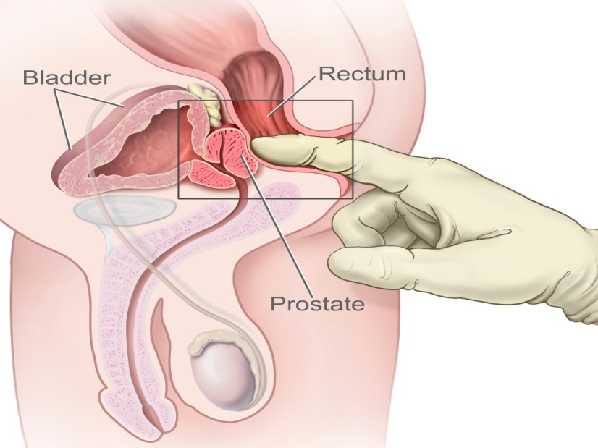
Signs
_ General examination may reveal pallor, indicating anemia due to chronic renal impairment or blood loss.
_ Abdominal examination may reveal a suprapubic mass in the case of locally advanced disease.
_Digital rectal examination may reveal a mass above or involving the prostate.

Slide 21
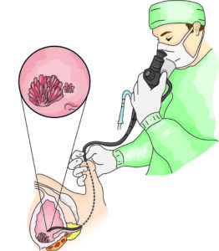
Bladder cancer: diagnosis and staging
After a urinary tract infection has been excluded or treated, all patients with microscopic or macroscopic haematuria require investigation of their upper tracts, bladder, and urethra. Usually, renal ultrasound and flexible cystoscopy, performed under local anesthesia, are first-line investigation

Slide 22
CT scan before and after IV contrast is becoming the first-line radiological investigation of haematuria.

Slide 23
*False -ve cytology is frequent (40-70%) in patients with papillary TCC, but more sensitive (90-100%) in patients with high-grade TCC and CIS.
* False +ve cytology can arise due to infection, inflammation, instrumentation, and chemotherapy.

Slide 24
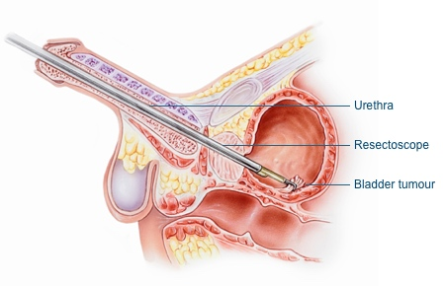
Transurethral Resection of Bladder Tumor (TURBT)

Slide 25
Staging investigations
are usually reserved for patients with biopsy-proven muscle-invasive bladder cancer unless clinically indicated, since superficial TCC and CIS disease are rarely associated with metastases.
1-Pelvic CT or MRI may demonstrate extra-vesical tumor extension or iliac lymphadenopathy, reported if >8mm in maximal diameter.
2-Chest X-ray
3-Isotope bone scan is obtained in cases being considered for radical treatment.
4-Staging lymphadenectomy (open or laparoscopic) may be indicated in the presence of CT-detected pelvic lymphadenopathy if radical treatment is under consideration.

Slide 26
TCC MANEGMENT

Slide 27
Bladder cancer (non-muscle invasive TCC): surgery and recurrence
TURBT
As a primary treatment, a visually complete tumor resection is adequate for
70% of newly presenting patients with Ta/T1 superficial disease. The remaining
30% of patients experience early recurrence, 15% with upstaging.
Because of this, it is standard care that all new patients receive adjuvant
treatment with a single dose of post-operative intravesical chemotherapy
(usually mitomycin). Complications of TURBT are uncommon,
including bleeding, sepsis, bladder perforation, incomplete resection,
and urethral stricture.

Slide 28
Alternatives to TURBT
Transurethral cyst diathermy or laser are accepted, quicker and less morbid
procedure for ablating small superficial recurrences when obtaining tissue for histology is not considered necessary

Slide 29
Follow-up after TURBT
Second resection: an early repeat TUR (within 2–6 weeks) should be undertaken:
(a) if the first resection was incomplete
(b) when the pathologist reports that the resected specimen contains no muscularis propria
(c) if a high-grade, but apparently non-invasive, T1 tumor has been reported since perhaps 10% (3–25%) of high grade T1 tumors are under staged T2 tumors. This strategy improves recurrence-free survival and prognosis while complications include bladder perforation.

Slide 30
In the absence of these indications for a second resection, review cystoscopy is performed at 3 months. If this demonstrates recurrence, 70% will recur further. If not, only 20% will recur further. If the bladder is clear
at follow-up, subsequent cystoscopies are performed under local anesthetic at 9 months and thereafter annually for 5y (patients with low-risk
TCC) or until the patient is no longer fit to undergo treatment (patients
with high-risk disease).

Slide 31
Predicting recurrence and progression in Ta/T1 TCC
A validated scoring system based on the following factors has been developed (by the EORTC):2
- Number of lesions
- Tumour diameter
- Prior recurrence
- T stage
- Tumour grade
- Presence of concomitant CIS.

Slide 32
ADJUVANT THERAPY
Intravesical chemotherapy (e.g. mitomycin C (MMC) [ decreases rate of recurrence]
For many patients at low risk of recurrence, the risk reduction seen with single-dose postoperative chemotherapy is equivalent to that seen using weekly instillations for 6 weeks, commencing up to 2 weeks post-TURBT. Such longer courses are still recommended for patients at higher risk of recurrence or who have multifocal recurrences, excluding those with high-grade Ta/T1 TCC or CIS

Slide 33
ADJUVANT THERAPY
Intravesical BCG [decreases rate of progression ]
BCG produces complete responses in 60–70% of patients. It is as effective as chemotherapy for adjuvant treatment of low- and intermediate risk TCC, therefore, is not often used (except as second-line) because of the additional toxicity.

Slide 34
Contraindications to intravesical BCG include:
- Immunosuppressed patients.
- Pregnant or lactating women.
- Patients with haematological malignancy.
- Following traumatic catheterization

Slide 35
muscle invasive TCC
Radical cystectomy with:
• Ileal conduit urinary diversion.
• Ureterosigmoidostomy urinary diversion.
• Continent urinary diversion.

Slide 36
Radical cystectomy :
• complete removal of the urinary bladder, pelvic lymph nodes ; external/ internal iliac LNs and obturator LNs , and adjacent organs ; ( prostate, seminal vesicle and proximal part of urethra in males / ovaries , fallopian tubes , uterus , cervix and anterior vaginal wall in females)

Slide 37
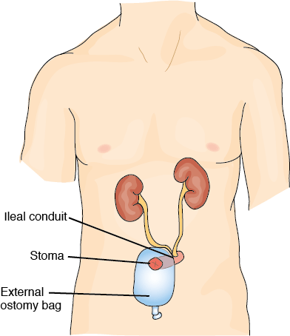
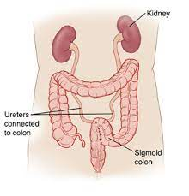
Ileal conduit urinary diversion
Ureterosigmoidostomy urinary diversion

Slide 38
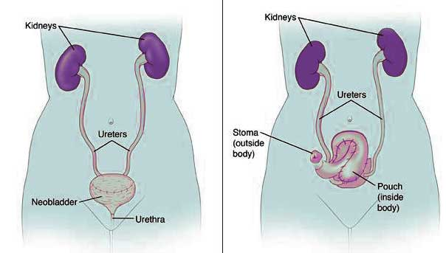
Continent urinary diversion

Slide 39
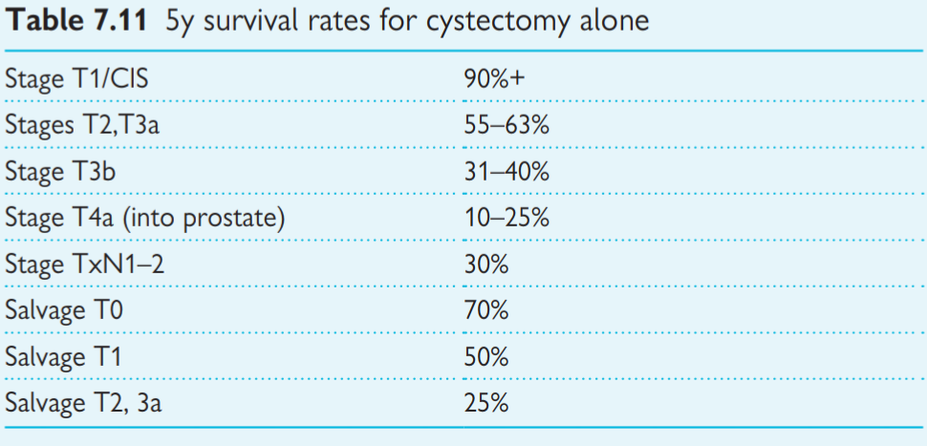

Slide 40
Palliative treatment
RT is effective for metastatic bone pain or to palliate symptomatic (bleeding) local tumor.
Intractable haematuria may be controlled by intravesical formalin or a Alum, hyperbaric oxygen, bilateral internal iliac artery embolization or ligation, or palliative cystectomy/diversion.
Ureteric obstruction may be relieved by percutaneous nephrostomy .
Involvement of the palliative care team can be very helpful to the patient and family.

Slide 41
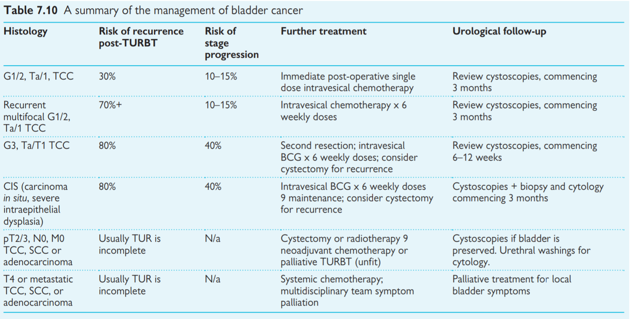

Slide 42
Thank you

