Slide 1
Venous thromboembolism
Done by : Somaya Hazaimeh
Shatha Rawashdeh
Supervised by : Dr . Saddam AbuQudairi

Slide 2
Venous thromboembolism (VTE), which includes deep
venous thrombosis (DVT) and pulmonary thromboembolism
(PE).
More than 80% of clinically significant
pulmonary emboli occur from DVTs in the lower extremities;
the remaining emboli originate from pelvic and upper
extremity veins.
Unfortunately, the diagnoses of DVT and PE missed, and effective prophylactic treatment is underused.

Slide 3
The most common manifestation of VTE is DVT +/- PE
Rarer manifestation:
Jugular vein thrombosis
Upper limb DVT
Cerebral sinus thrombosis
Intra-abdominal venous thrombosis (e.g. Budd–Chiari syndrome.
Notes:
Associated with polycythemoia versa and paraxosymal nocturnal hemoglobinuria

Slide 4
DVT : is the formation of blood clot in one of the deep veins of the body ,usually the legs .

Slide 5
Basic Information
Virchow triad:
■ Venous stasis
■ Immobility
■ Elevated venous pressure
■ Elevated blood viscosity
■ Vessel wall damage
■ Increased blood coagulability
■ Activation of clotting
■ Inhibition of fibrinolytic system
■ Deficiencies of coagulation factors
Most important clinical risk is venous stasis from immobility

Slide 6
Clinical risk factors :
Lower extremity DVT
■ Recent surgery
■ Major trauma (more than 50% develop DVT if prophylaxis not implemented )
■ Previous DVT (25% recurrence over 5 years after first DVT)
■ Increasing age (exponential increase after age 50 years)
■ Pregnancy/puerperium (PE is second leading cause of death; 75% occur postpartum) due to increase estrogen
■ Oral contraception
■ Medical conditions with immobility/ hypercoagulability
Common: cancer, heart failure, myocardial infarction, obesity, myeloproliferative disorder , nephrotic syndrome.
Uncommon: systemic lupus erythematosus, antiphospholipid antibody, sickle cell anemia, homocystinuria, Behçet syndrome

Slide 7
Upper extremity DVT
■ Central venous catheter
■ Cancer
■ Anatomic abnormality of costoclavicular junction

Slide 8
Familial Thrombophilic Disorders
Common :
Activated protein C resistance ( Factor V Leiden):
DVT recurrence risk significant in homozygotes; insignificant in heterozygotes
Prothrombin 20210 gene mutation :
problematic when coexisting with other defects
Notes:
Mutation beyond the coding region of the prothrombin gene . Results in a 25% increase in prothrombin levels
Common: 1%–2% of white U.S. population
Less common in African Americans and Asians
Increase in Relative Risk of Thrombosis: 2-3X
Laboratory Findings : DNA-based test for confirmation .

Slide 9
Rare :
Deficiencies of antithrombin III, protein C, protein S
■ Autosomal dominant
■ Protein C or S deficiency associated with
warfarin-induced skin necrosis

Slide 10
Clinical Presentation :
Symptoms and signs neither sensitive nor specific
■ Only 20% of symptomatic patients have leg DVT
■ Leg pain or swelling may be present
■ Homans sign (pain and tenderness with dorsiflexion of ankle) present in less than 40%
■ Starts in calf (except leg trauma, orthopedic surgery); most are self-limited
■ Twenty-five percent of calf DVT extend to thigh
■ Thigh DVT strongly associated with PE
■ Untreated symptomatic proximal DVT: 20% mortality from acute PE
■ 40% to 50% of patients with symptomatic thigh DVT have silent PE

Slide 11
DVT can be a recurrent disease (after anticoagulation stopped)
■ Overall recurs in 25% by 5 years; 50% of recurrences are in contralateral leg
■ Recurrence risk after unprovoked (no major risk factors) DVT nearly double

Slide 12
The Incidence
DVT has an annual incidence of approximately
1 : 1000 in Western populations and the case mortality is 1–3%. It is increasingly common with ageing, and many of the deaths are related to coexisting medical conditions , such as active cancer.

Slide 13
DVT is typically unilateral but may be bilateral, and clot may extend proximally into the inferior vena cava. Bilateral DVT is more commonly seen with underlying malignancy or anomalies of the inferior vena cava.

Slide 14
Evaluation and Diagnosis
Noninvasive :
1-B-mode compression US
Visualizes noncompressable clot in proximal veins
■ 99% sensitive and specific for symptomatic proximal leg DVT
■ 30%to 60% sensitive, 99% specific for asymptomatic proximal leg DVT
■ Initial test of choice for upper extremity DVT evaluation, but sensitivity and specificity 80%

Slide 15
2-Computed tomography (CT) venography
■ Performed with CT angiography; able to visualize clot in thigh, pelvic veins, inferior vena cava (IVC)
■ Sensitivity and specificity comparable to
compression US, so not routinely recommended; useful if injured or casted leg because US cannot be performed in this scenario

Slide 16
3-Magnetic resonance imaging (MRI)
■ Able to visualize clot in calf, thigh, pelvic veins,
IVC, upper extremities
■ Performed with injured or casted leg because US
cannot be performed in this scenario
■ Requires administration of high-dose gadolinium
■ Can cause nephrogenic systemic fibrosis,
especially in the context of renal insufficiency
■ Sensitivity and specificity greater than 90%

Slide 17
D-Dimer
■ Degradation product of cross-linked fibrin
■ Elevated in DVT/PE (95% sensitivity), but specificity low (40%) because of nonspecific elevations in patients with:
Surgery, trauma, malignancy, disseminated intravascular coagulopathy, pregnancy, and infection and in normal elderly person
■ Positive D-dimer not helpful; negative (i.e., normal) D-dimer more clinically useful as follows:
■ Normal d-dimer with low or intermediate pretest probability for DVT or PE excludes thromboembolism

Slide 18
Clinical criteria can be used to rank patients according to their likelihood of DVT or PE: for example, by using scoring systems such as the Wells score.

Slide 20
Investigation
Notes:
DVT diagnosis in the symptomatic lower extremity
■ Determine pretest clinical risk using the Wells
prediction rule
Low or moderate clinical suspicion and normal
D-dimer
Further testing unnecessary, low incidence of
DVT/PE if no therapy given
■ Low or moderate clinical suspicion and negative US
(if D-dimer not available)
■ Further testing unnecessary, low incidence of
DVT/PE if no therapy given
■ High clinical suspicion: US necessary (regardless of
D-dimer result)
■ Negative bilateral whole leg US excludes DVT
■ Negative initial thigh US (without calf testing):
15% of these patients have calf DVT, 20% to 30% of
which will extend to thigh
■ US should be repeated at 1 week
■ Negative serial US: Acceptable 1% to 2% risk of
thromboembolism if untreated
■ Positive compression US prompts treatment
regardless of pretest risk or symptoms

Slide 23
Management
The management of leg DVT includes elevation and analgesia.
■ Acceptable forms of therapy
■ Low-molecular-weight heparin (LMWH), most commonly enoxaparin 1 mg/kg every 12 hours or 1.5 mg/kg once per day (minimum 5 days, no monitoring, contraindicated in renal failure)
or
■ Unfractionated heparin (UH) 80 U/kg IV bolus, 18 U/kg/hour (minimum 5 days)
or
■ Fondaparinux (50 to 100 kg: 7.5 mg subcutaneously once a day) for minimum 5 days (no monitoring, contraindicated if renal failure)
Notes:
Heparin and warfarin are started at the same time then when INR is between 2-3 we stop heparin and continue with warfarin.
, activated partial thromboplastin time 1.5 to 2.5 continuous

Slide 24
then
■ Warfarin 5 or 10 mg/day started day 1, target
international normalized ratio (INR) 2 to 3
■ Protein C and S decline when warfarin is started
during an active thrombotic state. This decline
causes an increase in thrombogenic potential.
Heparin can counteract this temporary
procoagulant effect
■ Rivaroxaban 15 mg orally twice daily for 3 weeks,
then 20 mg orally once a day
■ LMWH treatment of choice for VTE during pregnancy
Notes:
An alternative is the oral Xa inhibitor, rivaroxaban, which has a rapid onset of action and can be used immediately from diagnosis without the need for LMWH

Slide 25
PE/DVT: Duration of therapy
■ Three months after reversible major risk factors:
provoked VTE
■ Three months to indefinite: first unprovoked VTE
■ Indefinite if low bleeding risk and patient agrees
■ Three months if significant bleeding risk or patient
refuses indefinite treatment
■ Indefinite for
■ First DVT/PE with active cancer
or
■ Second unprovoked DVT/PE

Slide 26
Thrombolytic Therapy :
Indicated in :
Extensive iliofemoral DVT
■ Prevents ischemic injury
■ Decreases postphlebitic syndrome

Slide 27
Risk of TT
■ Serious bleeding 6% to 45% (threefold greater than heparin)
■ Fatal bleeding 2% (tenfold greater than heparin)
Approved drugs
■ Recombinant tissue-type plasminogen activator (rt-PA) infusion over 2 hours
■ Streptokinase infusion over 24 hours
■ Urokinase infusion over 12 to 24 hours

Slide 28
■ Contraindications of TT
■ Absolute:
■ Intracranial or intraspinal disorders, surgery, trauma in preceding 2 months
■ Active bleeding
■ Relative:
■ Surgery, organ biopsy, large vessel puncture, cardiopulmonary resuscitation, within 10 days postpartum

Slide 29
Surgical or catheter embolectomy
■ Alternative to TT when TT contraindications present
■ Effective in small case series; morbidity and mortality poorly defined
Indications
■ Contraindication to anticoagulation
■ Recurrence of DVT/PE on therapeutic anticoagulation
Effects
■ Decrease early recurrent PE after anticoagulation without mortality effect
■ Increase incidence of later DVT
■ Remove after resolution of indication

Slide 33
Recurrence
Recurrence of DVT is about 2–3% per annum in
patients who have a medical temporary risk factor at
presentation and about 8% per annum in those with
apparently unprovoked DVT.
Recurrence plateaus at around 30–40% at 5 years.
Post-thrombotic syndrome is
due to damage of venous valves by the thrombus. It
results in persistent leg swelling, heaviness and discoloration.
The most severe complication of this syndrome
is ulceration around the medial malleolus

Slide 34
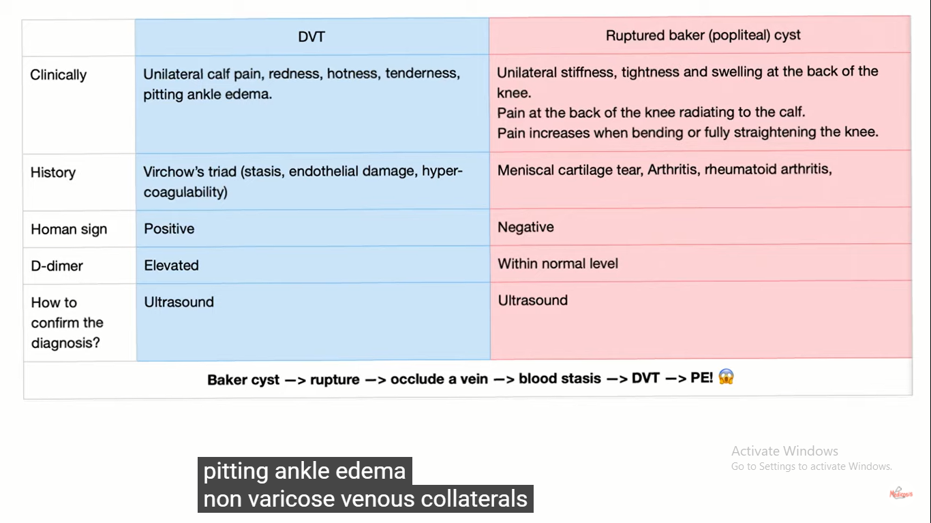

Slide 35
References
Davidson’s principles and practice of medicine (22nd Ed).
John Hopkins Internal medicine broad view , fifth edition

Slide 36
Pulmonary embolism
PE is acommon and potentially lethal condition.
The majority (80%) of pulmonary emboli arise from the propagation of lower limb DVT .
Venous thrombo-embolism occurs in approximately 1% of all patients admitted to hospital and accounts for around 5 % of in-hospital deaths .
It is a common mood of death in patients with cancer, stroke and pregnancy .

Slide 37
Notes:
Thrombotic Disorders :
Antithrombin Deficiency , protein C and S deficiency , Factor V leiden deficiency , Prothrombin gene mutation , Anti-phospholipid syndrome

Slide 38
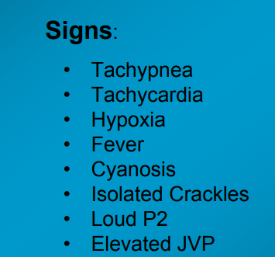
Symptoms and Signs of PE :

Slide 39
Investigations :
1) Chest X-ray :
A variety of non-specific radiographic appearances have been described .
But the chest X-ray is most useful in excluding key differential diagnoses, e.g. pneumonia or pneumothorax.
Normal appearances in an acutely breathless and hypoxaemic patient should raise the suspicion of PE

Slide 41
2) ECG :
The ECG is often normal but is useful in excluding other important differential diagnoses, such as acute myocardial infarction and pericarditis.
The most common findings in PE include sinus tachycardia and anterior T-wave inversion but these are non-specific;
larger emboli may cause right heart strain revealed by an S1Q3T3 pattern, ST-segment and T-wave changes, or the appearance of right bundle branch block.

Slide 43
3) ABGs :
Arterial blood gases typically show a reduced PaO2 and a normal or low PaCO2, and an increased alveolar– arterial oxygen gradient, but may be normal in a significant minority.
A metabolic acidosis may be seen in acute massive PE with cardiovascular collapse.

Slide 44
4) D-dimer :
An elevated D-dimer is of limited value, as it may be raised in a variety of conditions including PE, myocardial infarction, pneumonia and sepsis.
However, low levels (< 500 ng/mL), particularly where clinical risk is low, have a high negative predictive value and further investigation is usually unnecessary .
The D-dimer result should be disregarded in high-risk patients, as further investigation is mandatory even if it is normal.

Slide 45
5) CT Pulmonary angiography (CTPA) :
Is the first-line diagnostic test. It has the advantages of visualising the distribution and extent of the emboli, or highlighting an alternative diagnosis, such as consolidation, pneumothorax or aortic dissection .
As the contrast media may be nephrotoxic, care should be taken in patients with renal impairment, and CTPA avoided in those with a history of allergy to iodinated contrast media.

Slide 47
6) Ventilation–perfusion scanning : is seldom used nowadays .
7) Colour Doppler ultrasound of the leg veins remains the investigation of choice in patients with suspected DVT, but may also be used in patients with suspected PE, particularly if there are clinical signs in a limb, as many will have identifiable proximal thrombus in the leg veins.

Slide 48
8) Bedside echocardiography is extremely helpful in the differential diagnosis and assessment of acute circulatory collapse. Acute dilatation of the right heart is usually present in massive PE, and thrombus may be visible.
Alternative diagnoses, including left ventricular failure, aortic dissection and pericardial tamponade, can also be identified.

Slide 49
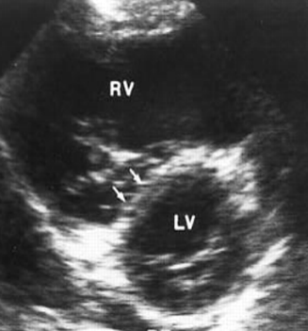
Systole
Diastole
Right Ventricular Dilatation
Right Ventricular size does not change from diastole to systole = Hypokinesis
D-shaped Left Ventricle
40% of patient with PE have Right ventricular abnormalities seen by Echocardiography

Slide 50
Management :
- General Measures
- Anticoagulation
- Thrombolytic and surgical therapy
- Caval Filters

Slide 51
General measures :
Prompt recognition and treatment are potentially life saving.
Sufficient oxygen should be given to hypoxaemic patients to maintain arterial oxygen saturation above 90%.
IV fluids should be given firstly to increase RV filling pressure and maintain COP.
Heparinisation will prevent further emboli occurring
If hypotension is severe and do not respond to plasma expanders, Use inotropic support
Thrombolysis should be considered if the patient is not improving after 15-30 minutes with the above measures
Diuretics and vasodilators should be avoided, as they will reduce cardiac output.

Slide 52
Anticoagulation :
Heparin Low molecular weight heparin (LMWH) should be given initially after a PE is diagnosed subcutaneous . The dose is based on the patient’s weight and there is usually no requirement to monitor tests of coagulation.
Treatment with LMWH should continue for at least 5 days or until the international normalised ratio (INR) is 2.0 or above for at least 24 hours .

Slide 53
Warfarin – a vitamin K antagonist – remains the most commonly used oral anticoagulant.
should be given within 24 hours of the diagnosis
Therapy is initiated with a high loading dose, followed by a maintenance dose based on the international normalised ratio (INR).
**LMWH is given at the same time with warfarin until the INR is in the therapeutic range

Slide 54
Decisions regarding the duration of anticoagulation represent a balance between the risk and consequences of recurrence, and the risks of prolonged anticoagulation.
In patients with an identifiable and reversible risk factor, anticoagulation may be safely discontinued following 3 months of therapy.
Those with persistent prothrombotic risks or a history of previous emboli should be anticoagulated for life.

Slide 55
Thrombolytic and surgical therapy :
Thrombolysis is indicated in any patient presenting with acute massive PE accompanied by cardiogenic shock. In the absence of shock, the benefits are less clear but thrombolysis may be considered in those presenting with right ventricular dilatation and hypokinesis or severe hypoxaemia.
Patients must be screened carefully for haemorrhagic risk, as there is a high risk of intracranial haemorrhage.

Slide 56
Surgical pulmonary embolectomy may be considered in selected patients but carries a high mortality.
Caval filters :
A patient in whom:
anticoagulation is contraindicated,
who has suffered massive haemorrhage on anticoagulation,
or recurrent VTE despite anticoagulation,
should be considered for an inferior vena caval filter.

Slide 57
Prognosis :
Immediate morality is greatest in those with echocardiographic evidence of right ventricular dysfunction or cardiogenic shock.
Once anticoagulation is commenced, however, the risk of mortality rapidly falls. The risk of recurrence is highest in the first 6–12 months after the initial event, and at 10 years around one-third of individuals will have suffered a further event.

Slide 58
References
Davidson’s principles and practice of medicine (22nd Ed).

