Slide 1
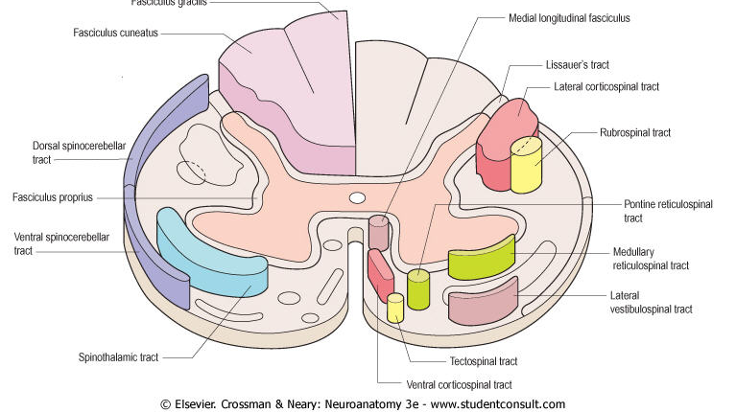
TRACTS OF THE SPINAL CORD DESCENDING TRACTS

Slide 2
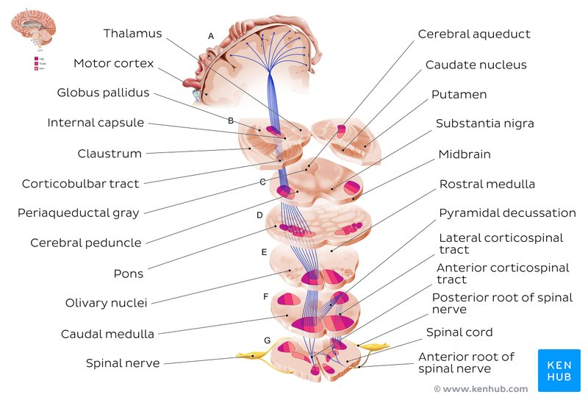
DESCEDING SPINAL TRACTS
Are concerned with somatic and visceral motor activities.
Have their cells of origin in the cerebral cortex or in the brainstem.

Slide 3
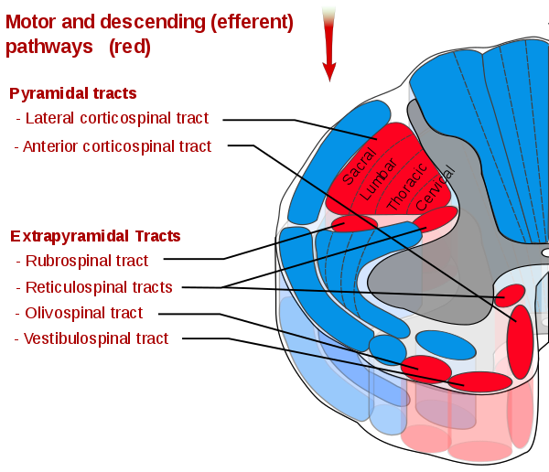
Descending (Motor) TRACTS
PyramidalTRACTS.
Corticospinal
1- Lateral corticospinal T.
2- Ventral corticospinal T.
Corticobulbar T
The motor systems outside of the pyramidal tract are often referred to collectively as the “extrapyramidal system”.
Extra-Pyramidal Ts.
3- Rubrospinal T.
4- Lateral tecto, reticulo, vestibulo spinal Ts.
5- Ventral tecto,reticulo, vestibulo spinal Ts.

Slide 4
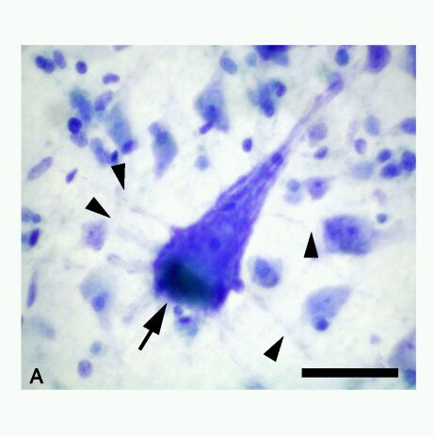
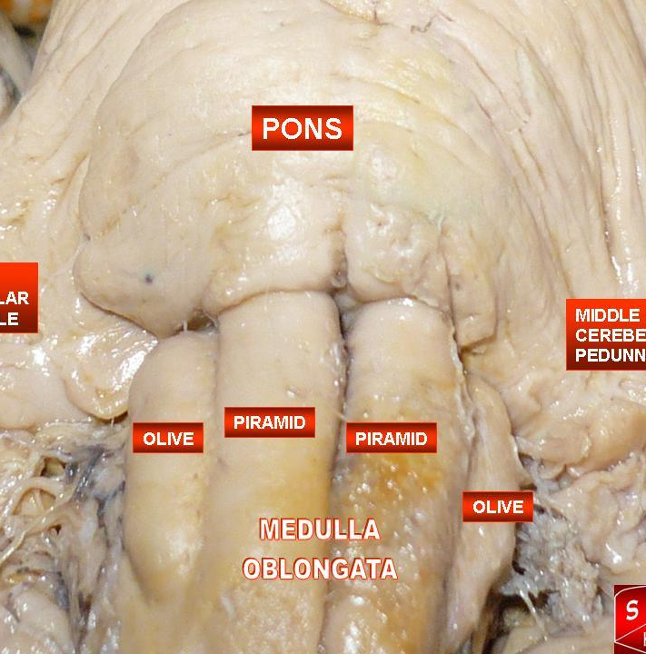
Pyramidal TRACTS

Slide 6
IMPORTANT TERMS
UPPER MOTOR NEURONS
(UMNs)
The upper motor neurons originate in the cerebral cortex and travel down to the brain stem or spinal cord, while the
LOWER MOTOR NEURONS (LMNs)
lower motor neurons begin in the spinal cord and go on to innervate muscles and glands throughout the body

Slide 7
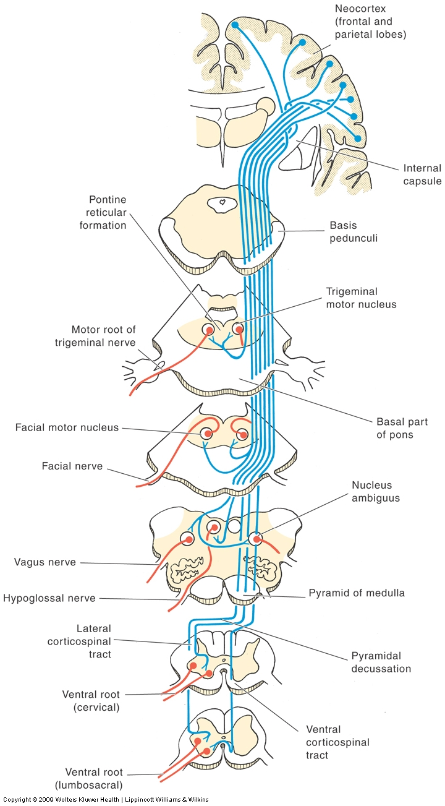
Corticospinal Tract
Control of precision and speed of skilled movements, particularly of distal limb muscles (e.g. digits).
Tract forms visible ridges referred to as the ‘pyramids’ on the anterior surface of the medulla, so also called the pyramidal tract. About 85% of fibres cross in the caudal medulla at the decussation of the pyramids.
Crossed fibres form the Lateral CST.
Uncrossed fibres form the Ventral CST, which cross segmentally.

Slide 8
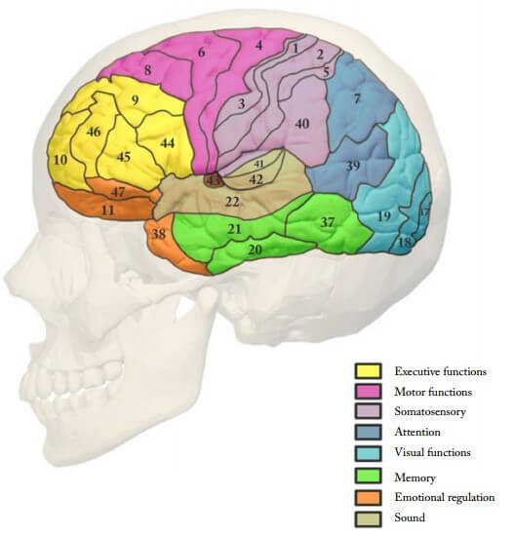
Lateral Corticospinal (pyramidal) Tract
2. Origin and termination:
Origin:
• Arises from lamina V of the cerebral cortex from three cortical areas, in equal proportions:
The premotor cortex (area 6);
The precentral motor cortex (area 4);
And the postcentral sensory cortex (areas 3, 1, and 2).
Terminaton
• Terminates via interneurons on ventral horn motor neurons and sensory neurons of the dorsal horn.

Slide 9
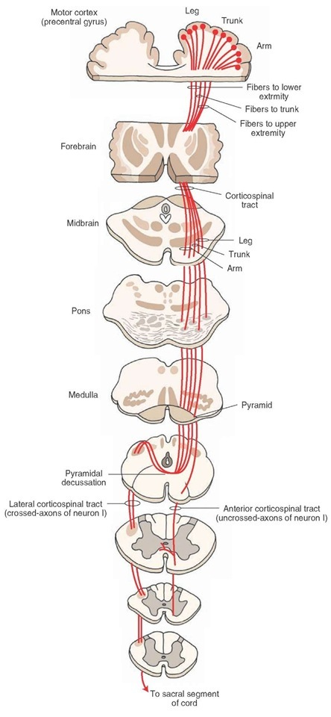
VENTRAL Corticospinal (pyramidal) Tract
is a small uncrossed tract that decussates at spinal cord levels in the ventral white commissure.
is concerned with the control of axial muscles.

Slide 10
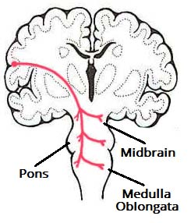
Corticobulbar (Corticonuclear) Fibers
• Arise from precentral and postcentral gyri.
•Corticobulbar tract supplies upper motor neuron innervation to the cranial nerves supplying head and face
Corticobulbar tract supplies input bilaterally to trigeminal, facial, and hypoglossal nerve nuclei

Slide 11
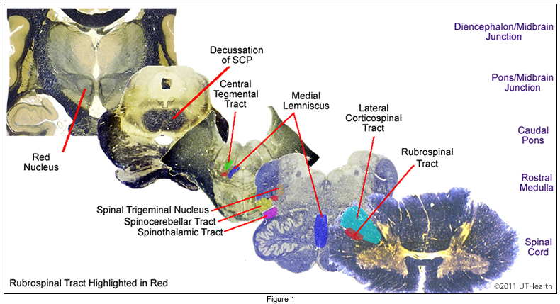
Rubrospinal tract
Arises in the contralateral red nucleus of the midbrain.
Plays a role in the control of flexor tone.
Is ventral to the lateral corticospinal tract.

Slide 12
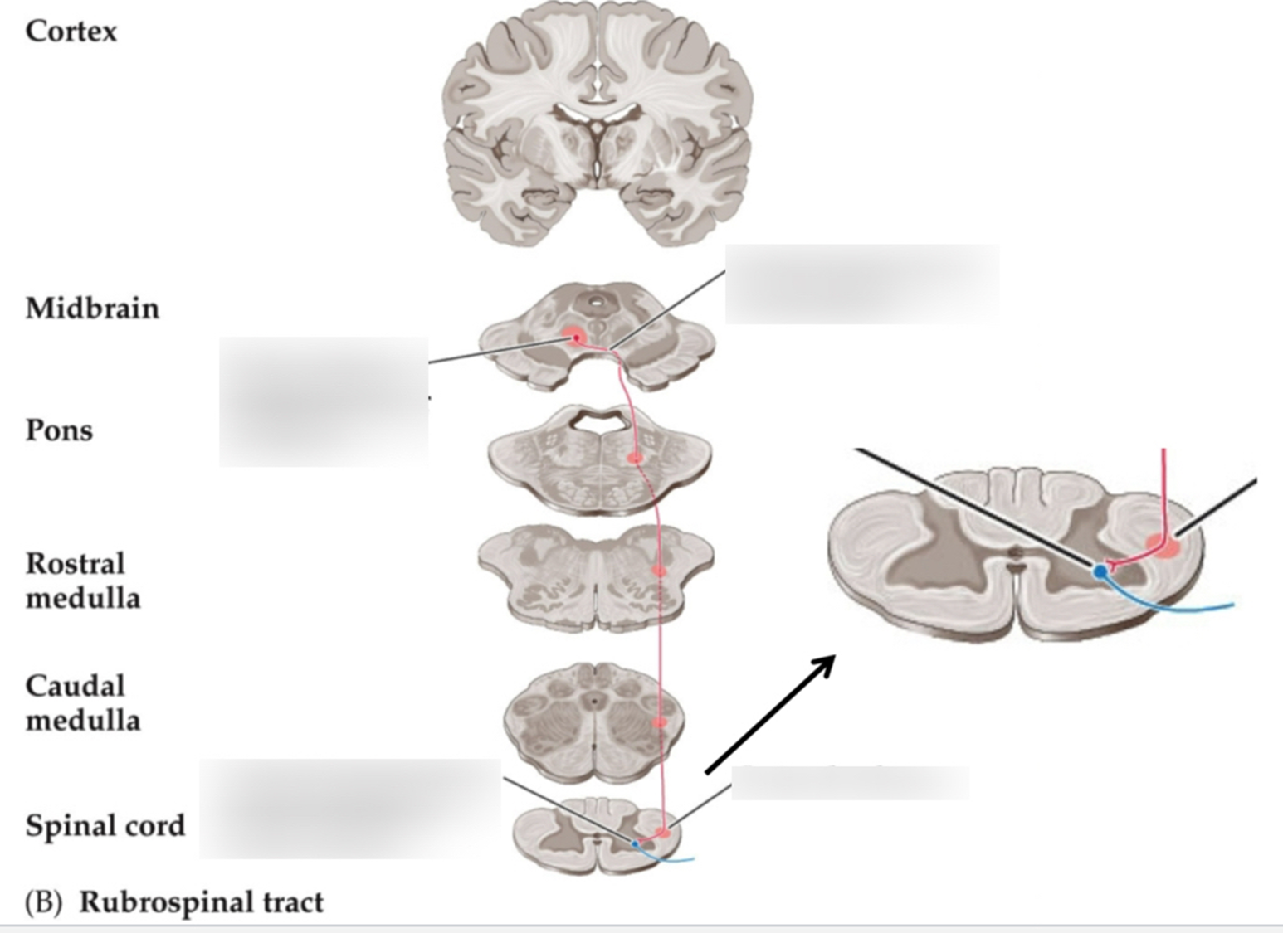

Slide 13
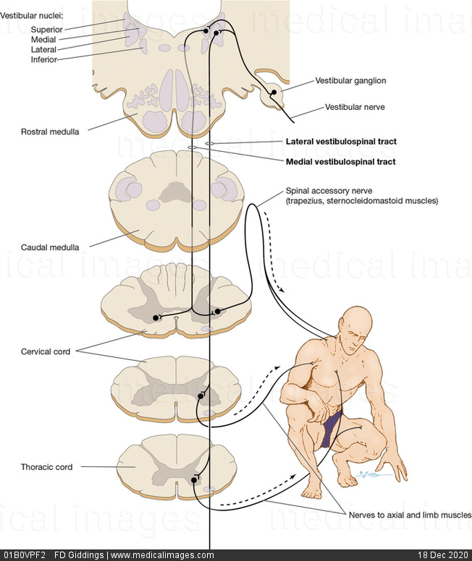
Vestibulospinal Tract
•Arises from the giant cells of deiters in the ipsilateral lateral vestibular nucleus.
• Plays a role in the control of extensor tone
• Is located in the ventral funiculus.

Slide 14
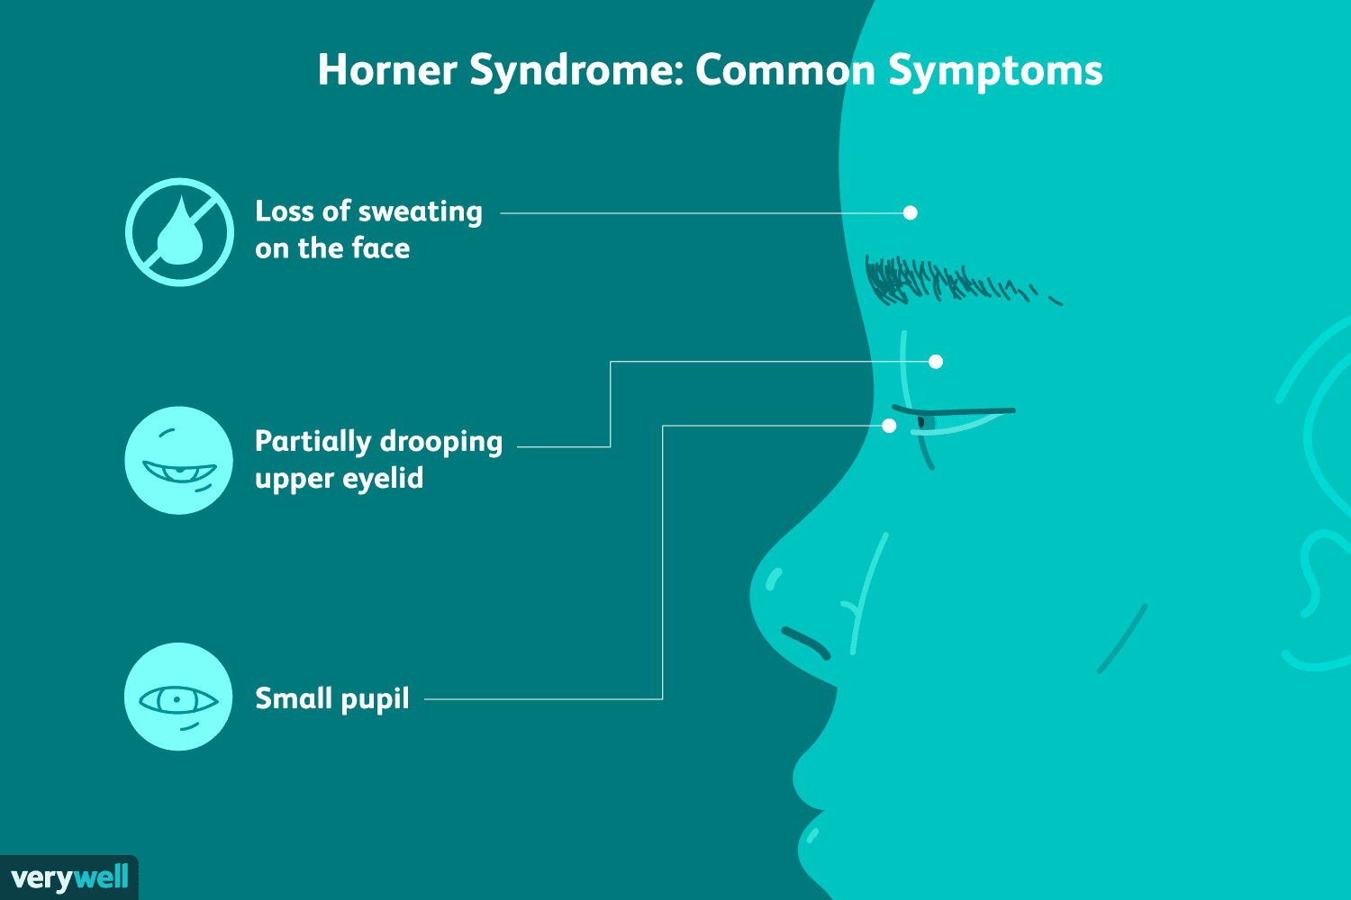
Descending autonomic tracts
• project to sympathetic (T1–L3) and parasympathetic (S2–S4) centres in the spinal cord.
• innervate :
The ciliospinal center (T1–T2),
a pupillary center;
interruption of this
tract results in Horner syndrome.

Slide 15
TRACT | Function | ORIGIN | CROSSED? | End | NOTE
Lateral CorticoSpinal Tract | carries motor signals from the primary motor cortex in the brain, down the spinal cord, to the muscles of the trunk and limbs. | premotor cortex (area 6) precentral motor cortex (area 4) postcentral sensory cortex (areas 3, 1, and 2) | YES | Contralateral dorsal quadrant of the lateral funiculus of the spinal cord | 1. not fully myelinated until the end of the second year 2.Transection results in spastic hemiparesis with the Babinski sign
Ventral CorticoSpinal tract | control of axial muscles. | Same as above {SAME SIDE OF CORTEX} | NO | Ipsilateral ventral white matter in spinal cord | Smaller than Lateral corticospinal tract
CORTICOBULBAR tract | carries efferent, motor, information from the primary motor cortex to the muscles of the face, head and neck | Primary motor cortex Premotor cortex Supplementary motor area | Only 50% of the corticobulbar fibers decussate | BRAIN STEM

Slide 16
TRACT | Function | ORIGIN | CROSSED? | End | NOTE
Rubrospinal tract | plays a role in the control of flexor tone. | arises in the contralateral red nucleus of the midbrain | YES | Spinal cord white matter | is ventral to the lateral corticospinal tract
Vestibulospinal tract | plays a role in the control of extensor tone. | ipsilateral lateral vestibular nucleus | NO | located in the ventral funiculus.
Descending autonomic tracts | 1.innervate the ciliospinal center (T1–T2), a pupillary center | project to sympathetic (T1–L3) and parasympathetic (S2–S4) centers in the spinal cord. |  |  | interruption results in Horner syndrome.

Slide 17
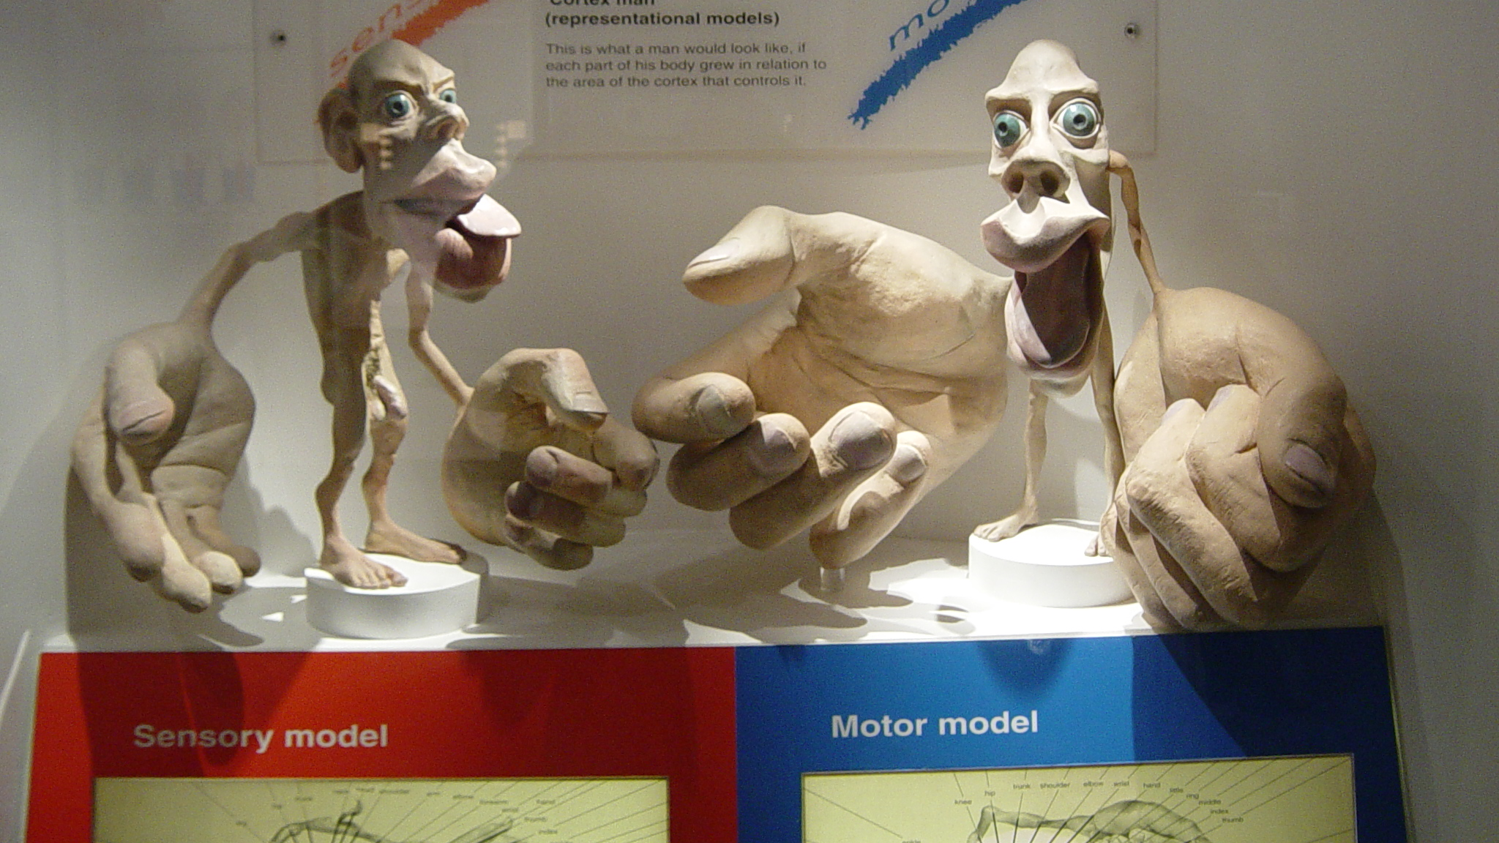
From: Natural History Museum

