Slide 1
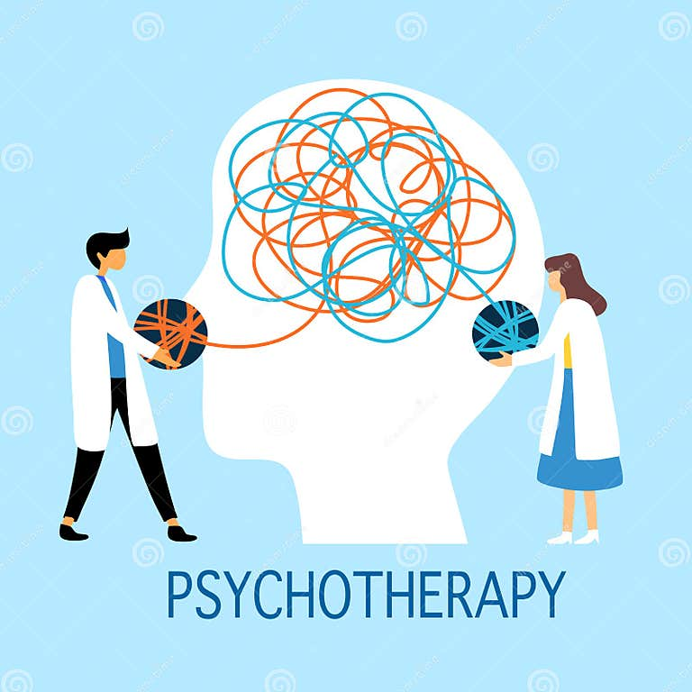
Psychotherapy
Done by :
Sura Dmour
Sewar Dmour

Slide 2
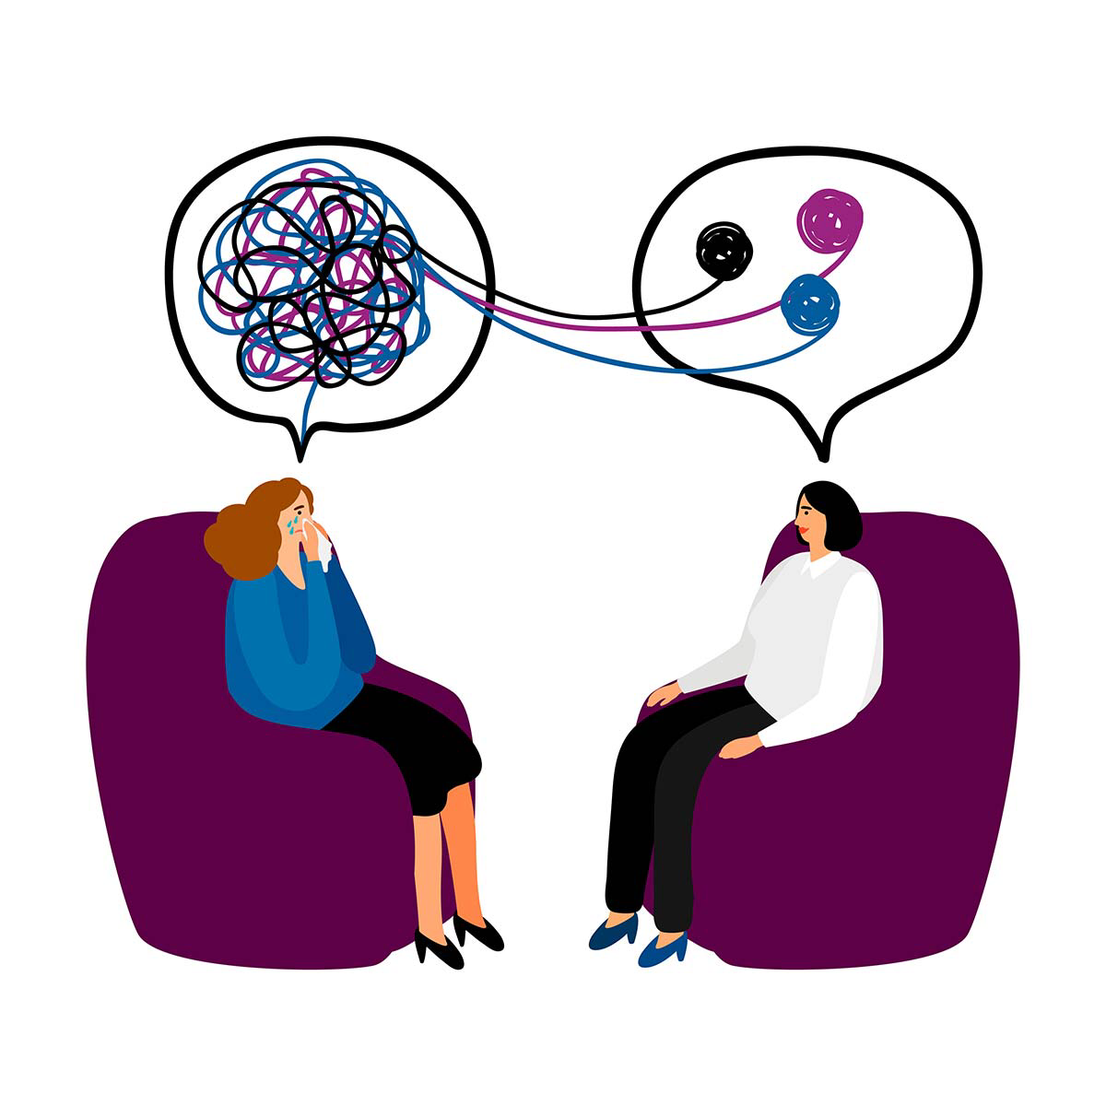
Definition
"Psychotherapy“ also called “ Talking Therapy”
is an umbrella term that describes the use of psychological methods, when based on regular personal interaction, to help a person change and overcome problems in desired ways
It is defined by the interaction or treatment between a trained professional and a client, patient, family, couple, or group. The Problems addressed are psychological in nature and can vary in terms of causes, influences, triggers, and resolutions.
it increase sense of well-being, reduce discomfort. It could be short term or with many session over years. Can be combined with medication.

Slide 3
Who seeks psychotherapy?

Slide 4
STRUCTURAL THEORY
Id: Unconscious; involves instinctual sexual/aggressive urges and primary process thinking.
Superego: Moral conscience and ego ideal (inner image of oneself that one wants to become).
Ego: Serves as a mediator between the id, superego, and external environment, and seeks to develop satisfying interpersonal relationships; uses defense mechanisms (see below) to control instinctual urges and distinguishes fantasy from reality using reality testing. Problems with reality testing occur in psychotic individuals

Slide 5
TOPOGRAPHIC THEORY
Unconscious: Includes repressed thoughts that are out of one’s awareness; involves primary process thinking (primitive, pleasure-seeking urges with no regard to logic or time, prominent in children and psychosis). Thoughts and ideas may be repressed into the unconscious because they are embarrassing, shameful, or otherwise too painful.
Preconscious: Contains memories that are easy to bring into awareness, but not unless consciously retrieved.
Conscious: Involves current thoughts and secondary process thinking (logical, organized, mature, and can delay gratification)

Slide 6
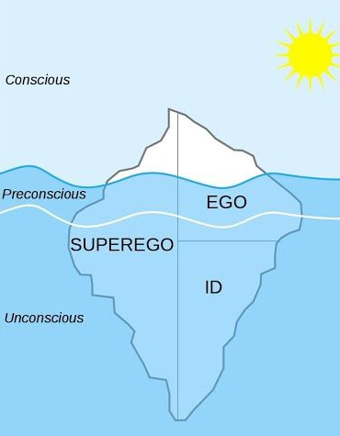
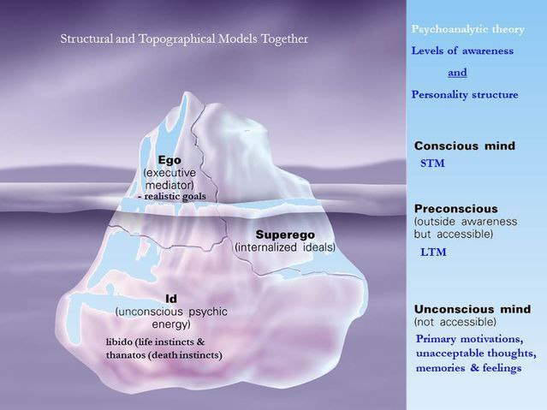

Slide 7
Defense Mechanisms
Defense mechanisms are used by the ego to protect oneself and relieve anxiety by keeping conflicts out of awareness. They are (mostly) unconscious processes that are normal and healthy if they are mature in nature and used in moderation (i.e., adaptive). They may be unhealthy if immature (i.e., maladaptive). Immature defense mechanisms can be used excessively as seen in some psychiatric disorders.
Defense mechanisms are often classified
-Mature defense mechanisms are healthy and adaptive, and they are seen in normal adults
-Neurotic defenses are encountered in obsessive-compulsive patients, patients with other anxiety disorders, and adults under stress.
-Immature defenses are seen in children, adolescents, psychotic patients, and some nonpsychotic patients, such as patients with severe personality disorders. They are the most primitive defense mechanisms.

Slide 8
MATURE DEFENSES
Mature ego defenses are commonly found in healthy, high-functioning adults. These defenses often help people integrate conflicting emotions and thoughts.
Altruism: Performing acts that benefit others in order to vicariously experience pleasure.
Humor: Expressing (usually) unpleasant or uncomfortable feelings with out causing discomfort to self or others.
Sublimation: Satisfying socially objectionable impulses in an acceptable manner (thus channeling them rather than preventing them).
Suppression: Purposely ignoring an unacceptable impulse or emotion in order to diminish discomfort and accomplish a task.

Slide 9
NEUROTIC DEFENSES
Controlling: Regulating situations and events of external environment to relieve anxiety.
Displacement: Shifting emotions from an undesirable situation to one that is personally tolerable
Intellectualization: Avoiding negative feelings by excessive use of intellectual functions and by focusing on irrelevant details.
Isolation of affect: Unconsciously limiting the experience of feelings or emotions associated with a stressful life event in order to avoid anxiety.
Rationalization: Explanations of an event to justify outcomes or behaviors and to make them acceptable.
Reaction formation: Doing the opposite of an unacceptable impulse.
Repression: Preventing a thought or feeling from entering consciousness. (Repression is unconscious, whereas suppression is a conscious act.)

Slide 10
IMMATURE DEFENSES
Acting out: Giving in to an impulse, even if socially inappropriate, in order to avoid the anxiety of suppressing that impulse.
Denial: Not accepting reality that is too painful.
Regression: Performing behaviors from an earlier stage of development in order to avoid tension associated with current phase of development.
Projection: Attributing objectionable thoughts or emotions to others.

Slide 11
Types of Psychotherapy
Psychoanalysis
Behavioral therapy
Cognitive therapy
Cognitive behavioral therapy
Group therapy
Family therapy

Slide 12
PSYCHOANALYSIS
Freud proposed that behaviors, or symptoms, result from unconscious mental processes including defense mechanisms and conflicts between one’s ego, id, superego, and external reality.
goal of psychoanalysis is to resolve unconscious conflicts by bringing repressed experiences and feelings into awareness and integrating them into the patient’s conscious experience.
Psychoanalysis is therefore considered insight oriented
Treatment is usually 3–5 days per week for many years.
During therapy sessions, the Portfolio patient Designed usually lies on a couch with the therapist seated out of view.

Slide 13
psychoanalysis can be useful in the treatment of:
Clusters B and C personality disorders
Anxiety disorders
Problems coping with life events
Sexual disorders

Slide 14
Important concepts & techniques used in psychoanalysis
Free association: The patient is asked to say whatever comes into his or her mind during therapy sessions. The purpose is to bring forth thoughts and feelings from the unconscious so that the therapist may interpret them.
Dream interpretation: Dreams are seen to represent conflict between urges and fears. Interpretation of dreams by the psychoanalyst is used to help achieve therapeutic goals.
Therapeutic alliance: This is the bond between the therapist and the patient, who work together toward a therapeutic goal.
Transference: Projection of unconscious feelings regarding important figures in the patient’s life onto the therapist. Interpretation of transference is used to help the patient gain insight and resolve unconscious conflict.
Countertransference: Projection of unconscious feelings about important figures in the therapist’s life onto the patient. The therapist must remain aware of countertransference issues, as they may interfere with his or her objectivity

Slide 15
PSYCHOANALYSIS-RELATED THERAPIES
1.Psychoanalytically oriented psychotherapy and brief dynamic psychotherapy:
These employ similar techniques and theories as psychoanalysis, but they are less frequent, less intense, usually briefer (weekly sessions for 6 months to several years), and involve face-to-face sessions between the therapist and patient (no couch).
2.Interpersonal therapy:
Focuses on development of social skills to help treat certain psychiatric disorders. Treatment is short (once-weekly sessions for several months). The idea is to improve interpersonal relations. Sessions focus on reassurance, clarification of emotions, improving interpersonal communication, and testing perceptions.
3. Supportive psychotherapy:
Purpose is to help patient feel safe during a difficult time and help to build up the patient’s healthy defenses.Treatment is not insight oriented but instead focuses on empathy, understanding, and education. Supportive therapy is commonly used as adjunctive treatment in even the most severe mental disorders.

Slide 16
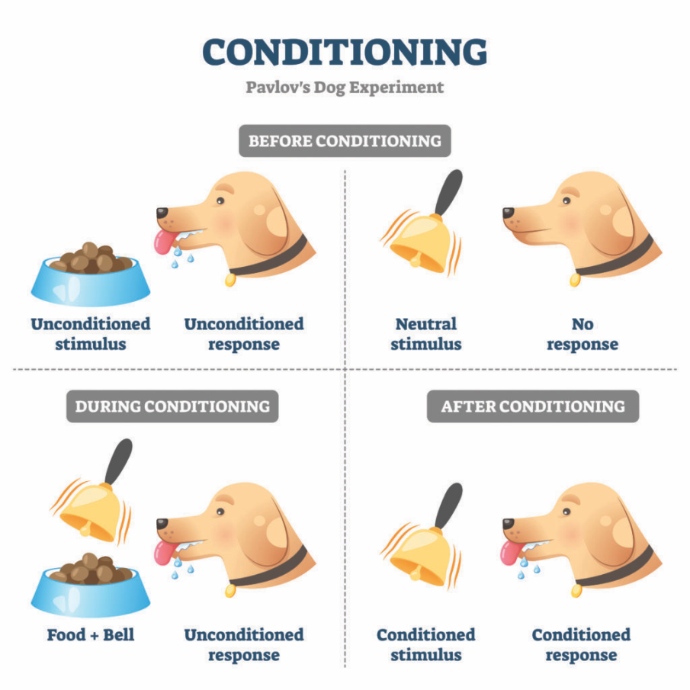
Behavioral therapy
Behavioral therapy is based on learning theory, which states that behaviors are learned by conditioning and can similarly be unlearned by deconditioning.
treat psychiatric disorders by helping patients change behaviors that contribute to their symptoms. It can be used to extinguish maladaptive behaviors (such as phobic avoidance, compulsions, etc.) by replacing them with healthy alternatives. The time course is usually brief, and it is usually combined with cognitive therapy as CBT

Slide 17
Some techniques used in behavioral therapy:
Systematic desensitization:
The patient performs relaxation techniques while being exposed to increasing doses of an anxiety-provoking stimulus. Gradually, he or she learns to associate the stimulus with a state of relaxation. Commonly used to treat phobic disorders.
Example: A patient who has a fear of spiders is first shown a photograph of a spider, followed by exposure to a stuffed toy spider, then a videotape of a spider, and finally a live spider. At each step, the patient learns to relax while exposed to an increasing dose of the phobia

Slide 18
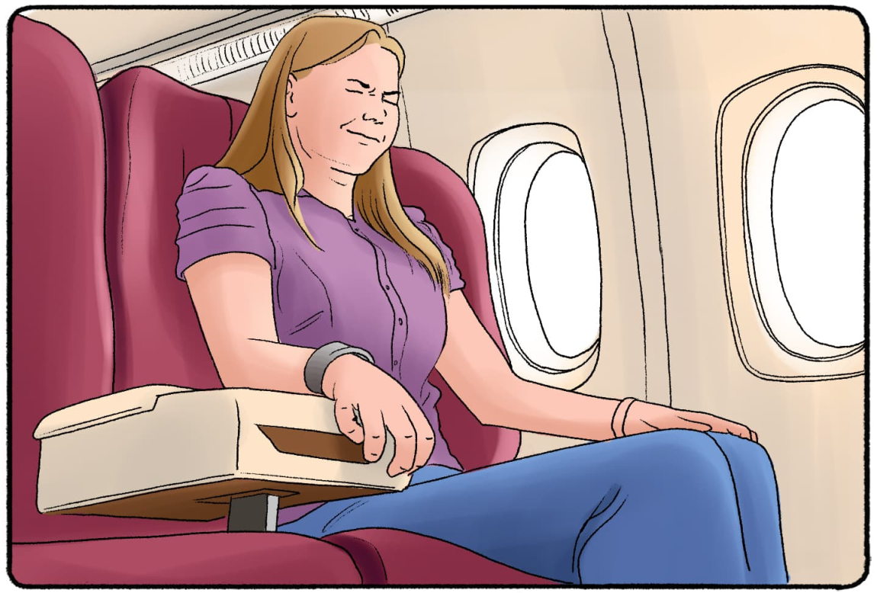
Flooding and implosion:
Through habituation, the patient is confronted with a real (flooding) or imagined (implosion) anxiety-provoking stimulus and not allowed to withdraw from it until he or she feels calm and in control. Relaxation exercises are used to help the patient tolerate the stimulus. Less commonly (than systematic desensitization) used to treat phobic disorders.
Example: A patient who has a fear of flying is made to fly in an airplane [flooding] or imagine flying [implosion].

Slide 19
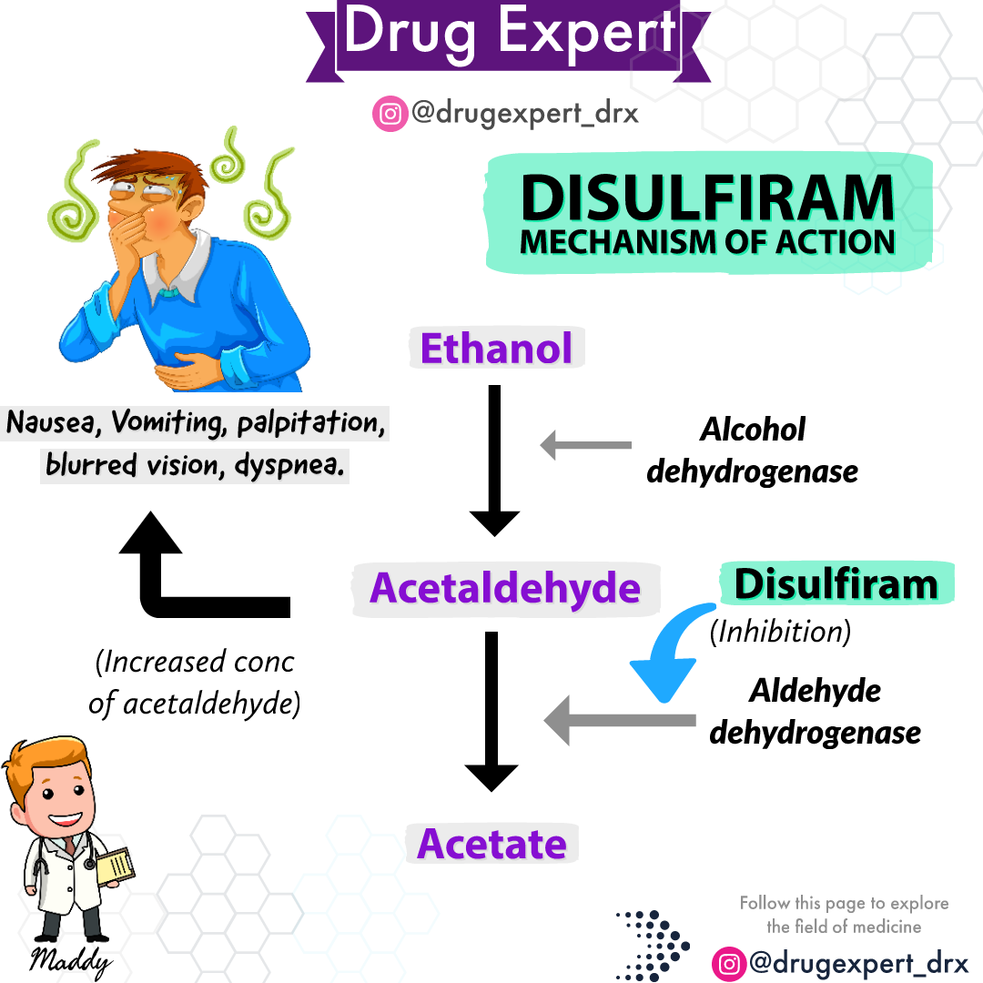
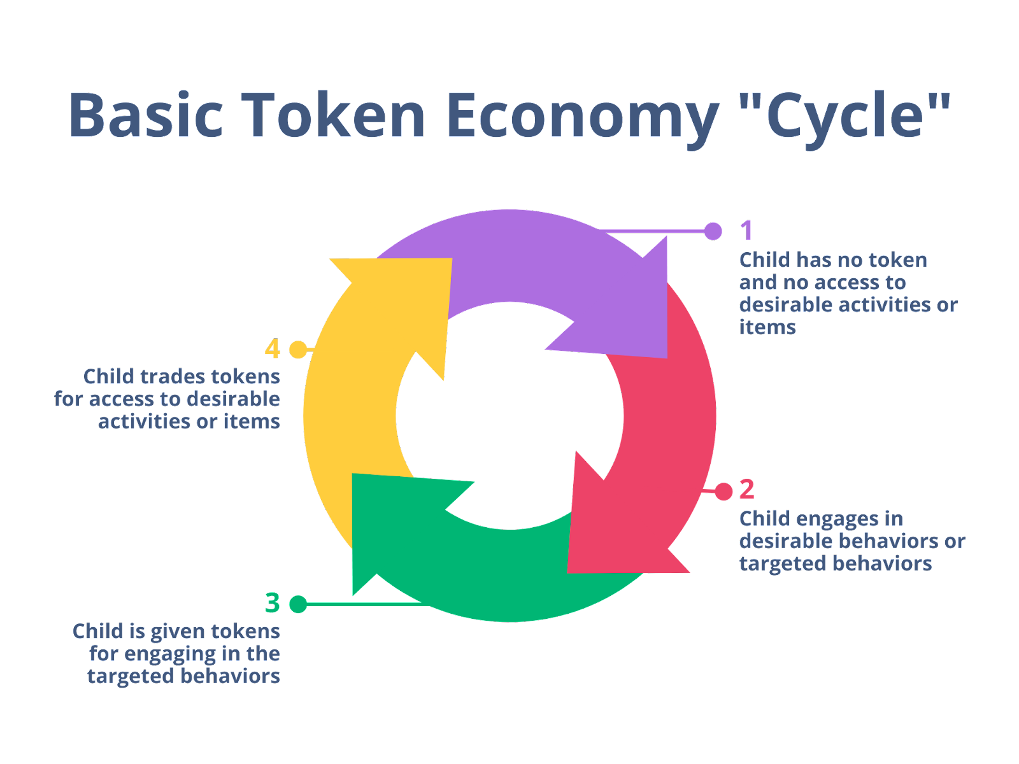
Token economy:
Aversion therapy:
Rewards are given after specific behaviors to positively reinforce them. Commonly used to encourage showering, shaving, and other positive behaviors in disorganized patients or individuals on addiction rehabilitation units
A negative stimulus (such as an electric shock) is repeatedly paired with a specific behavior to create an unpleasant response. Used to treat addictions or paraphilias.
Example: An
alcoholic patient is
prescribed Antabuse,
which makes him ill
Every time he drinks
alcohol.

Slide 20
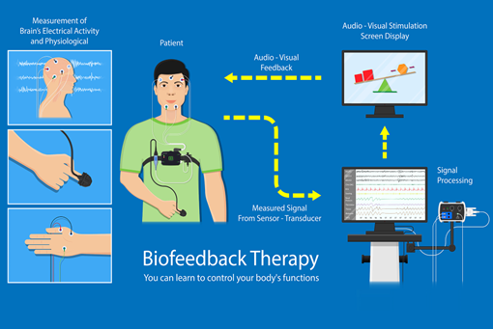
Biofeedback:
Physiological data (such as heart rate and blood pressure measurements) are given to patients as they try to mentally control physiological states.
Can be used to treat anxiety disorders, migraines, hypertension, chronic pain, asthma, and incontinence.
Example: A patient is given her heart rate and blood pressure measurements during a migraine while being instructed to mentally control visceral changes that affect her pain.

Slide 21
Cognitive therapy
•seeks to correct faulty assumptions and negative feelings that exacerbate psychiatric symptoms.
• The patient is taught to identify maladaptive thoughts and replace them with positive ones.
Most commonly used to treat :
depressive and anxiety disorders
paranoid personality disorder
obsessive-compulsive disorder
somatic symptom disorders eating disorders.
It is usually combined with behavioral therapy as CBT.

Slide 23
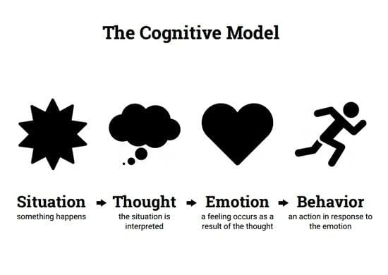
Cognitive behavioral therapy (CBT)
is a type of psychotherapeutic treatment that helps people learn how to identify and change the destructive or disturbing thought patterns that have a negative influence on their behavior and emotions

Slide 24
•Characteristics of Cognitive-Behavioral Therapies:
1.Thoughts cause Feelings and Behaviors.
2.Brief and Time-Limited. Average number of sessions = 16 Sessions psychoanalysis = several years
3.Emphasis placed on current behavior
4.CBT is a collaborative effort between the therapist and the client.
5. Teaches the benefit of remaining calm or at least neutral when faced with difficult situations. (If you are upset by your problems, you now have 2 problems:
1) the problem, and 2) your upsetness
6. Based on "rational thought." - Fact not assumptions.
7. CBT is structured and directive. Based on notion that maladaptive behaviors are the result of skill deficits.
8. Based on assumption that most emotional and behavioral reactions are learned. Therefore, the goal of therapy is to help clients unlearn their unwanted reactions and to learn a new way of reacting.
9. Homework is a central feature of CBT

Slide 25
Steps in CBT
Identify troubling situations or conditions in your life
Become aware of your thoughts, emotions and beliefs about these problems.
Reshape negative or inaccurate thinking.
Identify negative or inaccurate thinking.

Slide 26
Types of CBT
Brief CBT : Brief cognitive behavioral therapy (BCBT) is a form of CBT which has been developed for situations in which there are time constraints on the therapy sessions. BCBT takes place over a couple of sessions that can last up to 12 accumulated hours by design. This technique was first implemented and developed on soldiers overseas in active duty

Slide 27
Rational Emotive Behavioral Therapy: A form of cognitive-behavioral therapy in which somebody is encouraged to examine and change irrational thought patterns(irrational thinking) and beliefs in order to reduce dysfunctional behavior .Probably the most important REBT strategy is homework. This can include such activities as:Reading Self-help exercises Experiential activities Journaling Thought Stopping Intentional Reframing Therapy sessions are really ‘training sessions’, between which the client tries out and uses what they have learned
Clinical applications of REBT: Depression, Anxiety disorders , Eating disorders, addictions, impulse control disorders, Anger management, antisocial behaviour, personality disorders, Sexual abuse recovery, Adjustment to chronic health problem, physical disability, or mental disorder, Pain management, General stress management, Child or adolescent behaviour disorders, Relationship and family problem, Personal growth, Workplace effectiveness

Slide 28
Structured cognitive behavioral training (SCBT):
is a regimented cognitive-behavioral process that uses a systematic, highly structured workshop-style approach to break down and replace dysfunctional emotionally dependent behaviors.
Structured cognitive behavioral training is currently used primarily in the behavioral health industry and in criminal psychology

Slide 29
Dialectical behaviour therapy (DBT) :
Dialectical behavior therapy (DBT) is a modified type of cognitive behavioral therapy (CBT).
Its main goals are to teach people how to live in the moment, develop healthy ways to cope with stress, regulate their emotions, and improve their relationships with others.
DBT was originally intended to treat borderline personality disorder (BPD), but it has been adapted to treat other mental health conditions beyond BPD. It can help people who have difficulty with emotional regulation or are exhibiting self-destructive behaviors (such as eating disorders and substance use disorders).2 This type of therapy is also sometimes used to treat post-traumatic stress disorder (PTSD).

Slide 30
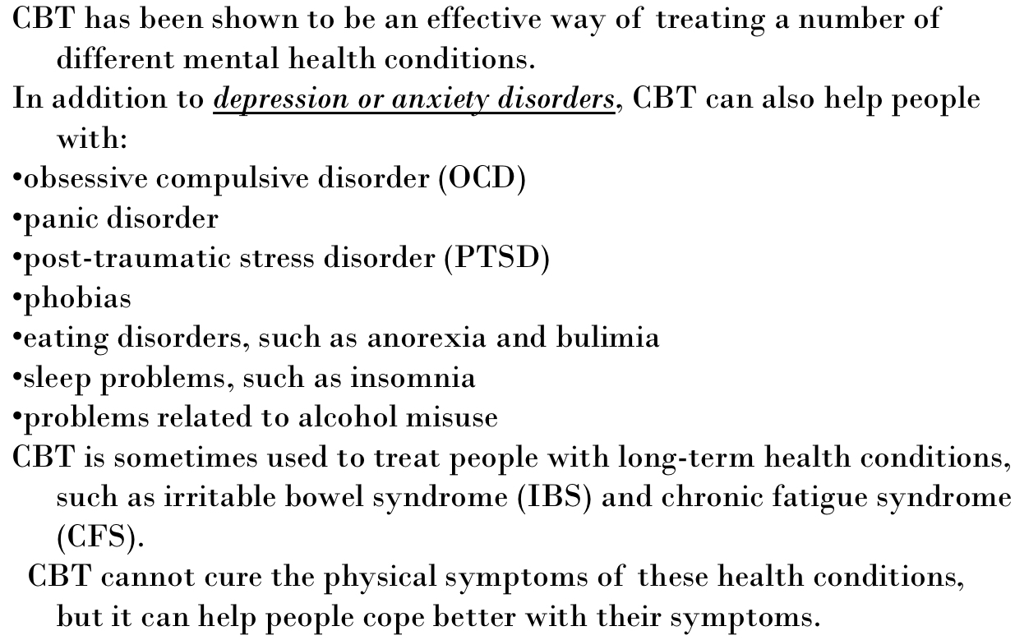
When is CBT used?

Slide 31
Group therapy
Three or more patients with a similar problem or pathology meet together with a therapist for group sessions. Many of the psychotherapeutic techniques already reviewed are used, including behavioral, cognitive, and supportive.
is a modality that employs a professionally trained leader who selects, composes, organizes, and leads a collection of members to work together toward the maximal attainment of the goals for each individual in the group and for the group itself

Slide 32
Aims to form a support network for individuals with similar diseases or difficulties
Allows direct interaction between therapists and patients, and direct interaction between patients
Certain groups can be peer-lead and do not need to have a therapist present (e.g., Alcoholics Anonymous)These groups meet to discuss problems, share feelings, and provide support to each other.

Slide 33
Advantages of group therapy over individual therapy include:
1. Patients get immediate feedback and support from their peers
2.Patients gain insight into their own condition by listening to others with similar problems.
3. If a therapist is present, there is an opportunity to observe interactions between others.

Slide 34
Indications :
Personality disorders
Substance use disorders
Family and group disorders
Chronic or life-threatening conditions (e.g., diabetes, cancer)

Slide 35
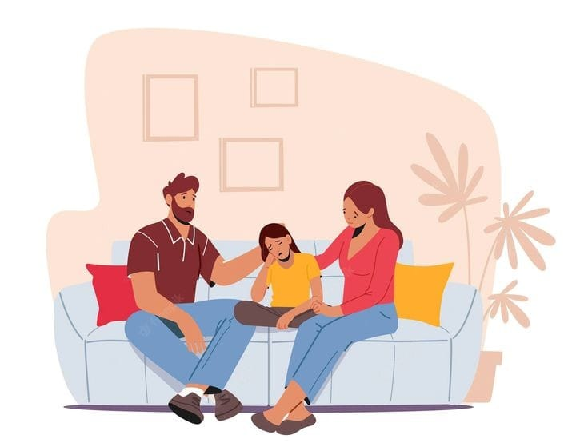
Family therapy
is a type of treatment designed to help with issues that specifically affect families' mental health and functioning.
It can help individual family members build stronger relationships, improve communication, and manage conflicts within the family system.
By improving how family members interact and relate to one another, family therapy can foster change in close relationships.
Interrupt rigid patters that cause distress
Family systems theory: family units act as though their homeostasis must be maintained

Slide 36
Focuses on identifying and resolving familial dysfunctions and problems of individual members that affect the family as a whole.
Aims to improve communication skills between family members.
Indications :
Behavioral problems in family members (e.g., antisocial behavior in adolescents, substance use)
Conflict between parents, siblings, or parents and children
Changes and other challenges within the family (e.g., illness, death, etc....)

