Slide 1
Fructose & Galactose Metabolism
Dr. Nesrin Mwafi
Biochemistry & Molecular Biology Department
Faculty of Medicine, Mutah University

Slide 2
Other substrates enter Glycolysis
Glucose
Mannose
hexokinase
Galactose
Gal-1P
G1P
G6P
Mannose-6p
isomerase
Hexokinase
(extrahepatic tissues)
Fructose
F6P
in liver
FBP
Glyceraldehyde
F1P
DHAP
G3P
Glycerol
glycerol
kinase
Glycerol-3-P

Slide 3
Fructose Sources
Dietary Sources of Fructose:
1. Sucrose (table sugar) consists of
glucose and fructose
2. Free fructose: fruits (fruit sugar),
honey, vegetables
3. Sweetener: High Fructose Corn
Syrup (HFCS)

Slide 4
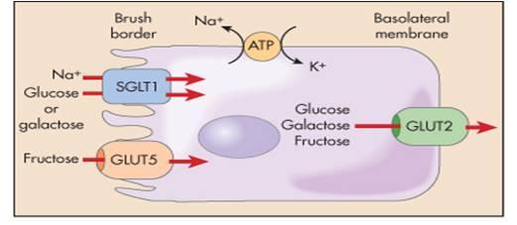
Fructose Absorption
Free fructose is absorbed from intestinal lumen through GLUT5 found at the apical membrane of the intestinal absorptive cells (enterocytes)
Fructose then crosses to blood capillaries through GLUT2 at the basolateral membrane
Fructose absorption and entrance into cells is insulin independent
Glucose and Galactose are absorbed via SGLT1 at the apical end and then through GLUT2 at the basolateral membrane.

Slide 5
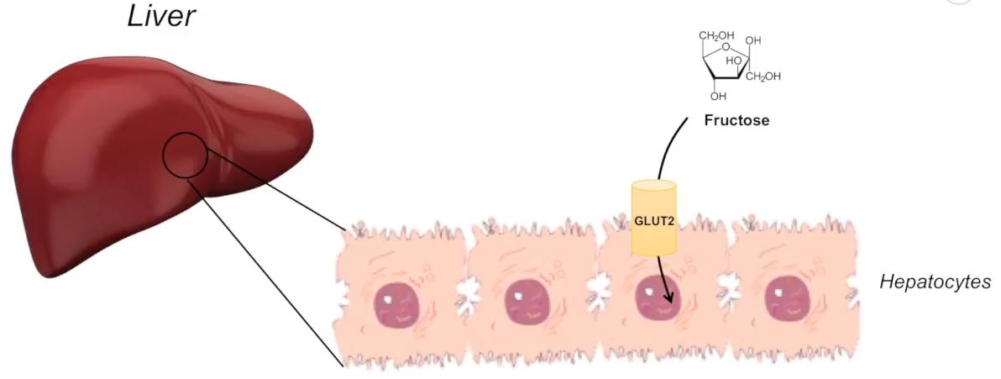
Fructose Metabolic Pathways
Fructose can be metabolized by one of two metabolic pathways:
Major Pathway (called Fructose-1-phosphate) in Liver
Minor Pathway in other tissues (Extrahepatic cells like kidney and testis)
the fructose is phosphorylated by hexokinase and the generated
fructose-6-phosphate directly joins the glycolysis

Slide 6
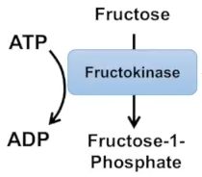
Fructose Metabolism in Liver
Fructose-1-phosphate (F-1-P) pathway (Fructolysis) consists of 3 steps:
Phosphorylation of fructose by the hepatic enzyme fructokinase to generate fructose-1-phosphate. This step is important to trap fructose inside hepatocytes and to destabilize fructose (an activation step)
The cleavage of F-1-P by aldolase b (also known as F-1-P Aldolase) to produce dihydroxyacetone phosphate (DHAP) and glyceraldehyde
(DHAP)

Slide 7
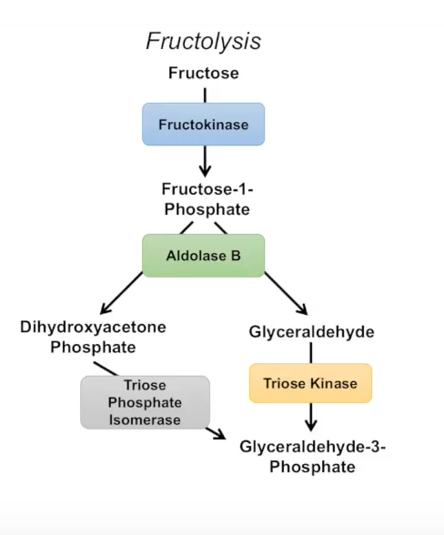
Fructose Metabolism in Liver
Glycerol dehydrogenase
Glycerol
ATP
ADP
Glycerol kinase
ATP
Triose phosphate isomerase
ADP
Dehydrogenase
Glycerol-3-phosphate
Triglycerides

Slide 8
Fructose Metabolism in Liver
Phosphorylation of glyceraldehyde to form glyceraldehyde-3-phosphate (GAP) by triose kinase. Alternatively, glyceraldehyde is reduced to glycerol by glycerol dehydrogenase then phosphorylated by glycerol kinase to produce glycerol-3-phosphate (reversibly converted to DHAP)
DHAP is reversibly converted by isomerase to GAP so can join the glycolysis at this point.
Conclusion: DHAP and glyceraldehyde are very important intermediates which connect carbohydrates with lipid metabolism

Slide 9
Fates of Fructolysis intermediates
Fates of fructose metabolism intermediates in liver:
ATP generation
Directed towards glycogen
replenishment
Once liver glycogen is
replenished, the intermediates
are primarily directed toward
triglyceride synthesis (T.G) and the
prolonged unregulated T.G.
formation can lead to
non-alcoholic to fatty liver
disease and obesity
Glucose
glycogenolysis
Glycogen
Glucose 1-p
phosphoglucomutase
G6P
glycogenesis
Hexokinase
(extrahepatic
tissues)
Fructose
F6P
in liver
FBP
Glyceraldehyde
F1P
DHAP
G3P
Glycerol
glycerol
kinase
Glycerol-3-P
ATP generation

Slide 10
Abnormalities in Fructose Metabolism
Inborn errors in fructose metabolism:
Essential fructosuria: deficiency of the hepatic fructokinase enzyme which results in the incomplete metabolism of fructose in the liver and consequently its excretion in the urine unchanged. It does not require a treatment as it is asymptomatic (benign condition)
Hereditary fructose intolerance (HFI): deficiency of the aldolase B enzyme which results in the accumulation of fructose-1-phosphate (severe condition). Symptoms: vomiting, abdominal pain, hypoglycemia, Jaundice, hemorrhage, hepatomegaly and renal failure. It can be treated by limiting fructose intake (fructose, sucrose and sorbitol).
Reduced phosphorylation potential:
Intravenous (I.V.) infusion of fructose can lower the phosphorylation potential of liver cells by trapping P_{i} due to phosphorylation of fructose by fructokinase. Additionally, fructose in high amounts is lipogenic so fructose is contraindicated for total parenteral nutrition (TPN) solutions

Slide 11
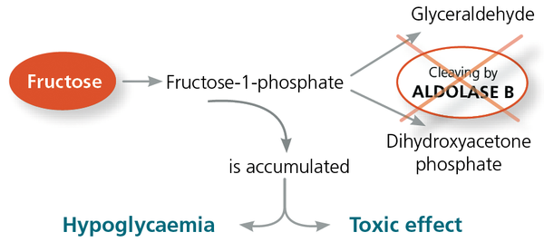
Hereditary Fructose Intolerance (HFI)
Inhibition of gluconeogenesis and glycogenolysis due to depletion of inorganic phosphate (P_{i}) stores in liver
Cirrhosis, liver damage and kidney failure

Slide 12
Dietary Fructose Intolerance (DFI)
Dietary Fructose Intolerance (DFI): is also known as fructose malabsorption due to impaired absorption of fructose from small intestine as result of deficiency in fructose carriers (GLUT5)
Symptoms: abdominal pain & cramps, diarrhea, bloating and flatulence, nausea

Slide 13
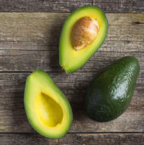
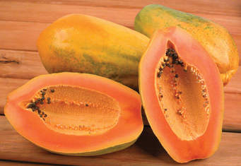
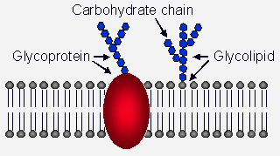
Galactose Sources
Dietary Sources of Galactose:
1. Lactose (milk sugar) consists of
glucose and galactose
2. Free galactose: fruits & vegetables
such as avocadoes, papaya,
bananas, apples
3. Obtained also from lysosomal
degradation of complex CHO
(e.g. glycoproteins and
glycolipids which are important
membrane components)

Slide 14
Galactose Absorption
Free galactose is absorbed from intestinal lumen through SGLT1 (sodium dependent) found at the apical membrane of the intestinal absorptive cells (enterocytes)
Galactose then crosses to blood capillaries through GLUT2 at the basolateral membrane
Galactose absorption and entrance into cells is insulin independent

Slide 15
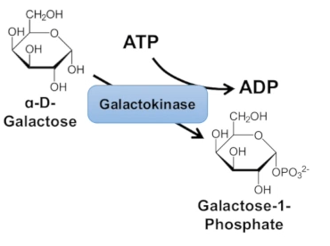
Galactose Metabolism
Unlike glucose, galactose as well as fructose do not have their own catabolic pathways and should be metabolized into molecules which are part of the glycolysis
Galactose is metabolized to glucose-6-phosphate in 3 steps:
Phosphorylation of galactose to galactose-1-phosphate (Gal-1-p) by galactokinase (trapping,
continuous influx of galactose
and destabilization or
activation)

Slide 16
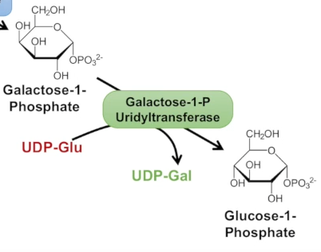
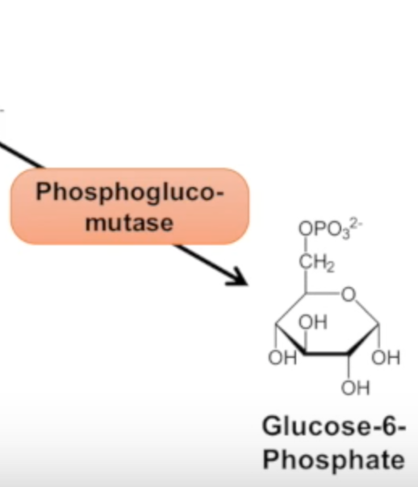
Galactose Metabolism
Gal-1-p Uridyltransferase enzyme transfers uridine monophosphate (UMP) group to Gal-1-p forming UDP galactose and glucose-1-phospate
Glu1-p is converted to glu6-p by the enzyme phosphoglucomutase (reversible)
Regeneration of UDP-Glu
from UDP-Gal using
epimerase enzyme (flip OH group at
C4 from up to down)
Glycolysis

Slide 17
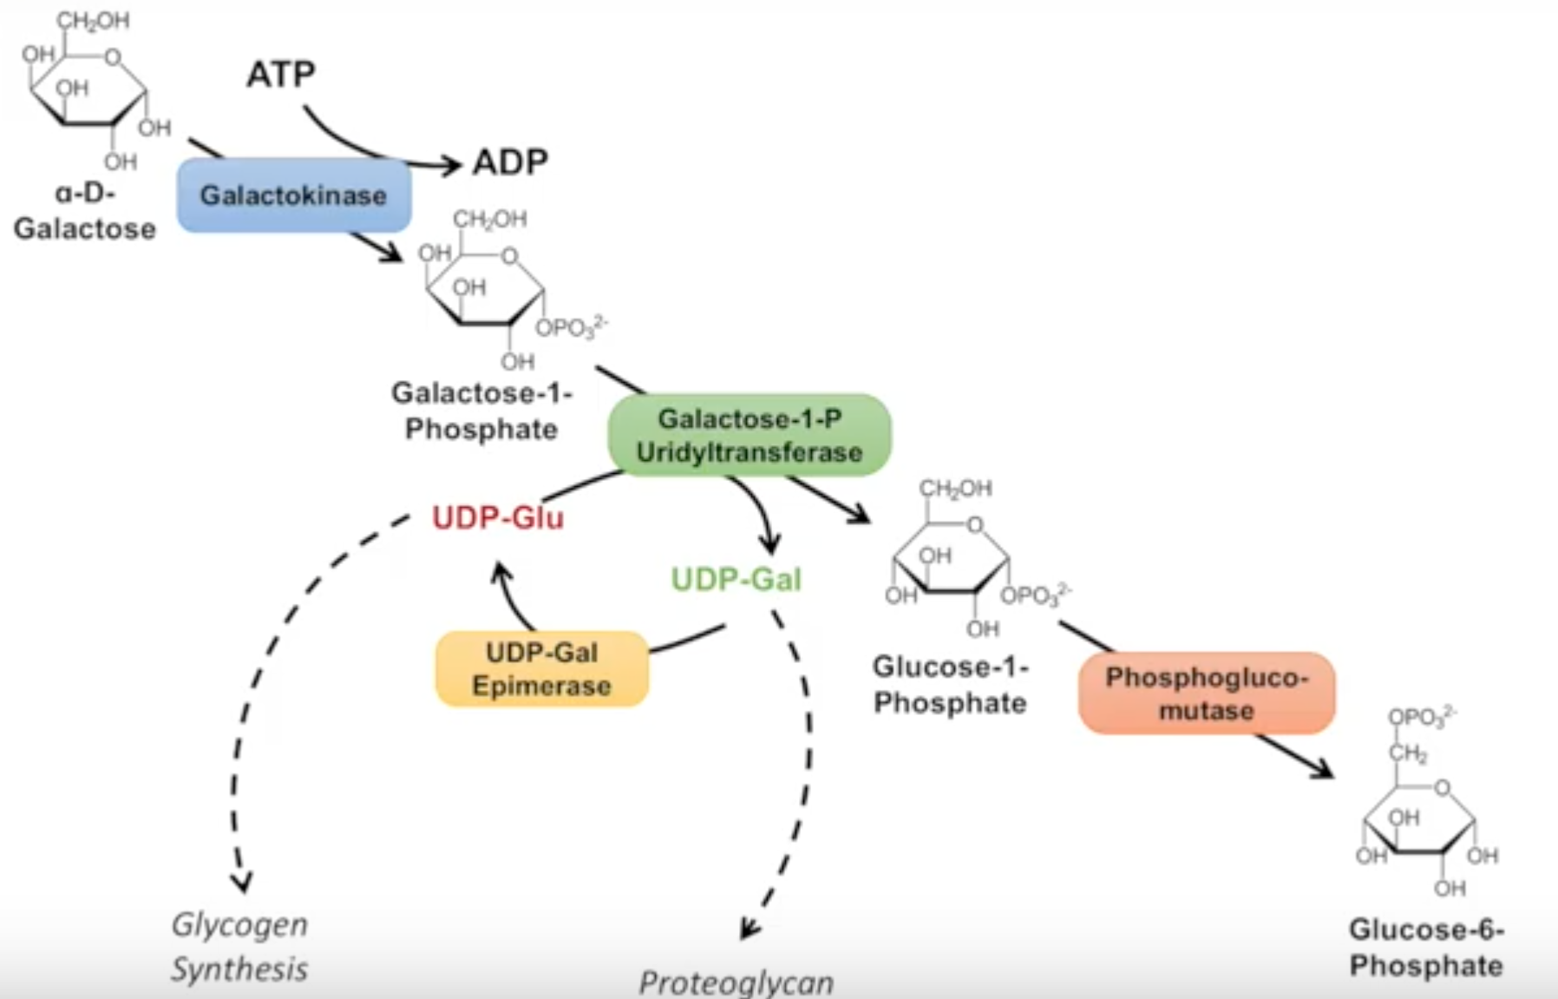
Galactosemia
Galactosemia: is a rare genetic disorder characterized by the inability to metabolize galactose due to deficiency in one of the three enzymes involved in galactose metabolism:
Classic Galactosemia

