Slide 1
Glucose metabolism disorders during pregnancy
Dr- ASHWAQ TRAWNEH

Slide 2
Diabetes mellitus
Diabetes mellitus (DM) is a collection of metabolic disorders with hyperglycaemia as the common feature and is predominantly classified outside pregnancy into two major subtypes, type 1 and type 2.

Slide 3
PREVALENCE
up to 5% of pregnancies being complicated by either pre-existing or gestational diabetes.
in pregnant women, with diabetes5%having type 2 diabetes, 7.5% having type 1 Diabetes, and the majority, 87.5% having Gestational diabetes.

Slide 4
MANAGEMENT
Pre-conception
Optimising pre-conception care in women with diabetes has been shown to improve outcome.
only 35% of pregnant women with diabetes received adequate pre-conceptional counselling and careStudies have shown lower rates of congenital abnormalities and pregnancy complications in women who received multidisciplinary preconception care.

Slide 5
Pre-conceptual counselling
Multidisciplinary management
Optimise glycaemic control – aim HbA1c 43 mmol/mol or less.
Discuss hypoglycaemia.
Review diet and weight loss .
Discuss complications of pregnancy .
Prescribe folic acid 5 mg .
Review renal function and blood pressure .
Retinal assessment .
Review other medications, e.g. ACE inhibitors, statins
Smoking cessation .

Slide 6
Type 1
The risk of major congenital malformations, in particular cardiac and neural tube defects, increases with poor control of blood glucose during the first 8 weeks of pregnancy.
Levels of glycated haemoglobin, HbA1c, are used to reflect long-term glycaemic control, and in general, all congenital malformations are associated with poor control in the first trimester.

Slide 7
If significantly raised, to greater than 69–80 mmol/mol (8.5–9.5%), malformation rates of around 20% Therefore, women should be advised that optimising diabetic control pre-pregnancy will improve outcome of pregnancy.
Good glycaemic control will also reduce the risks of miscarriage, stillbirth and neonatal death.

Slide 8
Smoking and diet should also be discussed and women with a body mass index of greater than 27kg/m² be supported to lose weight.
Risks of pregnancy should also be outlined, and the need for frequent and regular attendance at clinics during the antenatal period.
.

Slide 9
Targets for self monitoring of blood glucose
These targets should be the same ranges as recommended for all people with type 1 diabetes.
Monthly testing of HBA1c should be offered to women planning pregnancy and women advised to aim for an HbA1c of less than 48 mmol/mol (6.5%).
Women with an HbA1c greater than 86 mmol/mol (10%) should be strongly advised to avoid pregnancy until better control is achieved.

Slide 10
Women planning pregnancy should also be offered ketone testing strips and be advised to self-monitor for ketonaemia if they become unwell or hyperglycaemic.
Women should be prescribed 5 mg of folic acid to be taken pre-conception and for the first 12 weeks of pregnancy .
The risks of other complications of pregnancy, including pre-eclampsia, birth trauma, fetal macrosomia and the increased risk of caesarean section, should also be discussed.

Slide 11
Other aspects of the women’s diabetes should also be reviewed, such as :
blood pressure, renal function and retinal assessment.
Retinal assessment should be offered preconception unless this has been performed within the last 6 months.
The use of any medications that are contraindicated in pregnancy should be assessed, and changed if a suitable alternative exists.

Slide 12
Typical drugs falling into this category are statins, angiotensin II-converting enzyme (ACE) inhibitors and angiotensin receptor blockers (ARBs).
ACE inhbitors, ARBs and statins should be discontinued prior to pregnancy, or as soon as pregnancy is confirmed and antihypertensive agents suitable for use in pregnancy be used.

Slide 13
Renal function should be checked and women with creatinine levels greater than 120 μmol/L, a urinary albumin:creatinine ratio >30mg/ mmol or a glomerular filtration rate of less than 45ml/min/ 1.73m2 should be referred to a renal physician prior to stopping contraception use.

Slide 14
Women who have significant retinopathy or nephropathy should be advised that pregnancy may accelerate these pathological processes.
Some women, with severe end-organ damage, such as diabetic nephropathy with glomerular filtration rate of <30%, severe cardiac damage or neuropathy, face significant maternal risk in pregnancy and may be better advised to avoid pregnancy.
Due to the close association with other autoimmune disorders, some advocate screening for thyroid dysfunction.

Slide 15
Pre-conceptual counselling
Multidisciplinary management
Optimise glycaemic control – aim HbA1c 43 mmol/mol or less
Discuss hypoglycaemia
Review diet and weight loss
Discuss complications of pregnancy
Prescribe folic acid 5 mg
Review renal function and blood pressure
Retinal assessment
Review other medications, e.g. ACE inhibitors, statins
Smoking cessation

Slide 16
Type 2
recent data suggest that women with type 2 diabetes have a similar increase in risk of congenital abnormality to those with type 1, at around double that of women without diabetes
Therefore, the pre-conception advice is the same as that for type 1 diabetes.
This group of women is more likely to be overweight and should be helped to reduce their weight if their body mass index is greater than 27 kg/m2.

Slide 17
Women taking oral hypoglycaemic agents should have their medication reviewed.
Metformin is safe to take in pregnancy so can be continued, but current advice is that other oral hypoglycaemics should be changed.
Some women may achieve better control by converting to insulin, and this should be discussed with the woman.

Slide 18
Antenatal care
The risks and complications of pregnancy in a woman with diabetes are summarised in Box 9.2.
The aim of antenatal care is to target and reduce these risks.
Women should be booked for care early in pregnancy, preferably before 10 weeks.

Slide 19
Complications of pregnancy associated with diabetes
Fetal risks
Maternal risks
Miscarriage
Congenital anomaly
Stillbirth
Prematurity
Macrosomia
Shoulder dystocia and birth injury
Respiratory distress
Neonatal hypoglycaemia and poor feeding
Risk of diabetes
Hypoglycaemia
Diabetic ketoacidosis
Operative delivery
Worsening of retinal disease
Worsening of pre-existing renal impairment
Pre-eclampsia

Slide 20
An early ultrasound scan (7-9 weeks) will enable viability and dating to be confirmed.
At this early appointment, a full clinical history and medication review should be conducted.
If retinal or renal assessment has not occurred during the preceding 3 months, these should be arranged.

Slide 21
NICE guidelines 2015 recommend digital imaging retinal assessment using tropicamide mydriasis both following booking and again at 28 weeks.
If there is any retinopathy present at booking, repeat assessment is recommended at 16-20 weeks.
If the woman has a raised creatinine > 120mmol/l or proteinuria greater than 2g/day or a urinary albumin:creatinine ratio of >30mg/mmol then referral to a renal physician should be considered.

Slide 22
Due to the risk of pre-eclampsia, all women with diabetes should be offered 75 mg aspirin from the first trimester.

Slide 23
Management of diabetic complications
The longer the duration of the diabetes, the higher the chance of a patient having pre-existing vasculopathy, renal dysfunction, neuropathy and diabetic retinopathy.
The presence of these complications increases the risks of pre-eclampsia and fetal growth restriction.

Slide 24
Retinopathy
Pregnancy is associated with progression of pre-existing retinopathy, and this is more likely with increased severity of the pre-existing disease, duration of diabetes, poor glycaemic control and rapid improvements in control .

Slide 25
The presence of hypertension also worsens progression of retinopathy, thus it has been suggested that, in women with these complications, blood pressure should be kept at 120–130/70–80 mmHg.
Beta blockers should be avoided as antihypertensives due to their possible adverse effects of glucose metabolism.
There is evidence that some diabetic retinopathy may regress after delivery, but women with retinopathy should undergo further retinal assessment by 6 months postpartum.

Slide 26
Diabetic nephropathy is considered as a continuous spectrum from microalbuminuria, proteinuria and impaired renal function to end-stage renal disease in which there is increasing serum urea and creatinine.
Overall, with the exception of women with pre-existing renal failure, nephropathy does not deteriorate with pregnancy.
However, there is an increased risk of growth restriction, pre-eclampsia and preterm birth.
Thus increased surveillance is required in these women.

Slide 27
Congenital anomalies
the prevalence of confirmed major anomalies to be 41.8/1000 total births in pregnant women with diabetes.
The commonest are cardiac abnormalities in which there is a 3 to 5-fold relative increased risk.
Although caudal regression (sacral agenesis) is the most well-known associated abnormality (200-fold increased risk), the prevalence is low.

Slide 28
Diabetes conveys a 2 to 10-fold increased risk of neural tube defects.
Thus, all women with diabetes should have a detailed fetal anatomy scan at 20 weeks, which should include the four-chamber cardiac view, 3 vessel view and the outflow tracts.
NICE and SIGN currently do not recommend specialist fetal echocardiography for women with diabetes.

Slide 29
MEDICATIONS
Good glycaemic control is the key to improving the outcome of pregnancy in women with diabetes.
This can be achieved using a combination of diet, insulin and oral hypoglycaemic agents.

Slide 30
Oral hypoglycaemic agents
With the exception of metformin and glibenclamide, there are few available data regarding the safety of most of these drugs in pregnancy, or whether they cross the placenta.

Slide 31
Metformin is increasingly used in women with polycystic ovarian syndrome as it reduces the risk of first-trimester miscarriage and reduces the risk of developing gestational diabetes.
Metformin is known to cross the placenta; use in early pregnancy does not increase the risk of congenital malformations.

Slide 32
Glibenclamide may cross the placenta in small amounts and some small observational studies suggest that it may reduce morbidity and mortality in developing countries in which insulin use is impractical and expensive.
Of the other sulfonylureas, chlorpropamide and tolbutamide, although probably not associated with congenital malformations, may be associated with prolonged neonatal hypoglycaemia and seizures.

Slide 33
Current recommended practice is for women who conceive on oral hypoglycaemic agents to be switched to insulin therapy as soon as they are pregnant.
However, there is growing interest in the use of metformin and glibenclamide in the management of type 2 diabetes or gestational diabetes.

Slide 34
Current NICE recommendations are that metformin may be considered as an alternative to insulin therapy in pregnant women with type 2 diabetes.
However, this remains the exception rather than the rule in current practice, with most women with pre-existing diabetes managed on insulin therapy.

Slide 35
Insulin
There are four main types of insulin available for use, categorised by duration of action (summarised in Table 9.1).
The newer long-acting insulin analogues may be associated with fewer hypoglycaemic episodes as they provide steady background levels without peaks.
Some insulin preparations are described as biphasic as they contain a combination of two types of insulin, for example Mixtard 30, which contains a short-acting insulin, together with intermediate insulin, given twice a day.

Slide 36
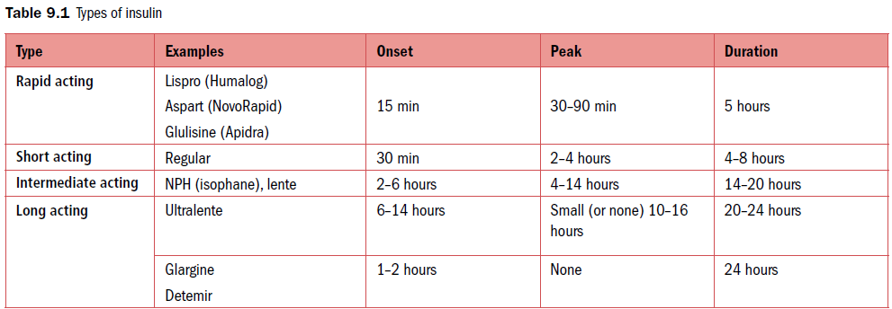

Slide 37
Insulin regimens:
multiple daily injection (MDI) regimen.
will typically consist of a long-acting basal insulin, given once or twice a day, with additional boluses given via a pen to cover meal times.
The short acting insulins, aspart and lispro, have been associated with less hypoglycaamia, and better glycameic control overall, therefore use of these preparations should be considered in pregnancy.

Slide 38
Continuous subcutaneous insulin infusion (CSII) pumps
Regular and short-acting insulin can be delivered via a pump and the benefits include less risks of hyper- and hypoglycaemia and better compliance.
Therefore, they are particularly useful in patients with unstable diabetes and troublesome hypoglycaemia.

Slide 39
The pumps consist of a cannula that is inserted into the subcutaneous abdominal tissue (site changed every 3 days) through which a continuous basal level of fast-acting insulin is administered.
Additional boluses are also given through the pump for meal times.

Slide 40
NICE (2015) rcommends that CSII pumps be offered to pregnant women if their MDI regimen does not achieve adequate control without problematic hypoglycaemia.

Slide 41
GLYCAEMIC CONTROL
Although good glycaemic control during pregnancy is likely to reduce the risks of macrosomia, stillbirth, neonatal hypoglycaemia and respiratory distress syndrome, the evidence for the timing and frequency of testing, or target blood glucose ranges, is of poor quality and at times conflicting.

Slide 42
a satisfactory HbA1c level, does not reduce the risk of macrosomia, postprandial blood glucose measurements in the third trimester correlated with macrosomia.
The HAPO study found that there was no threshold level of blood glucose which complications were increased and that there was a continuous linear association between blood glucose levels and complications such as macrosomia.

Slide 43
Suggested targets for capillary plasma glucose are:
Fasting less than 5.3mmol/l (95 mg)
1 hour post meal less than 7.8mmol/l (140 mg)
2 hours post meal less than 6.4mmol/l (115).
HbA1C less than 6%.
Women taking insulin or glibenclamide should be advised to keep blood glucose greater than 4mmol/l. (72)

Slide 44
SIGN guidelines
fasting levels of 4–6 mmol/L
1 hour postprandially, <8 mmol/L `
2 hours postprandially <7 mmol/L
before bed,>6 mmol/L
The physiological adaptations of pregnancy result in increasing insulin requirements with gestation, and obtaining good control necessitates frequent review by a diabetic team at 1- to 2-weekly intervals.

Slide 45
HbA1C
HbA1c represents blood glucose levels in the preceding 4–12 weeks, and does not reflect subtle changes in blood glucose, in particular postprandial levels.
Furthermore, it falls in response to the physiological changes in pregnancy, and the timescale may not be appropriate in pregnant women.
It is recommended at booking in order to determine the overall risk to the pregnancy from poor pre-existing control and can be considered for women with pre-existing diabetes to aid assessment of ongoing risk .

Slide 46
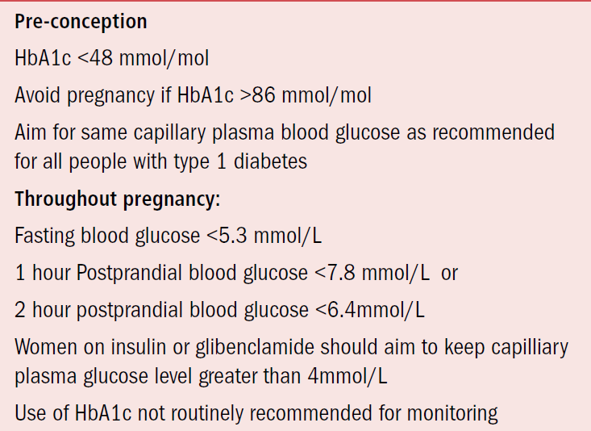
Glycaemiccontrol recommended leveles

Slide 47
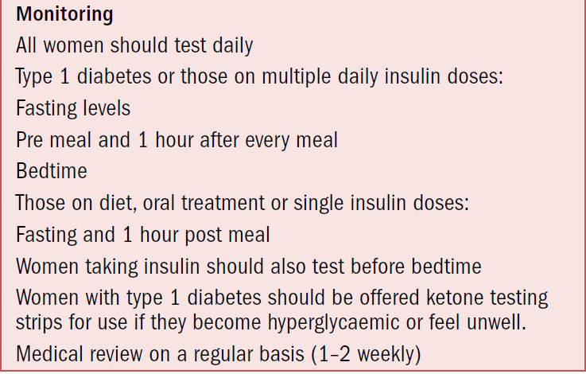

Slide 48
Hypoglycaemia
Tighter glycaemic control in pregnancy is associated with an increase in the risk of hypoglycaemia.
This is compounded by the fact that pregnant women also have an altered hormonal response to hypoglycaemia and reduced awareness, often worsened by pregnancy-related nausea and vomiting.
Studies have shown that the highest risk time for hypoglycaemic episodes is between 8 and 16 weeks.

Slide 49
NICE defines hypoglycaemia as : a blood glucose of <3.5mmol/L, and this level of blood glucose should be treated even if the patient is asymptomatic. Manegment of hypoglycaemia:
If the patient is conscious, this should be by consuming 10–15 g of glucose (approximates to 4 teaspoons of sugar or half a can of juice or 3 glucose tablets).
Alternatives include a glucose gel (2 tubes of HypoStop/Glucogel) which can be rubbed on the inside of the cheek.
This should be followed by a slower-releasing carbohydrate such as bread or a sandwich.

Slide 50
If unconscious, a family member can administer glucagon (0.5–1 mg) intramuscularly. This has a rapid onset and lasts approximately 90 minutes. For these reasons, it is recommended that patients carry information identifying them as having diabetes.
Patients in hospital can be given 150 mL of 10% dextrose intravenously.
Once a patient is conscious, they should be given oral therapy as above.
If after 10 minutes the blood glucose remains less than 5 mmol/L, the treatment should be repeated.
Insulin doses with the next meal should not be withheld but may require modification.

Slide 51
Diabetic ketoacidosis
Diabetic ketoacidosis (DKA) is defined as: a plasma glucose over 12 mmol/L, an arterial pH of less than 7.3, with ketonuria or ketonaemia, associated with poor maternal and fetal outcome.
CTG abnormalities are typical in the third trimester and resolve with treatment of the hyperglycaemia.

Slide 52
Management should involve the diabetic teams and treatment of the precipitating cause, and will usually require intravenous insulin via a sliding scale.
Volume replacement with careful monitoring and replacement of potassium are also needed.
It is recommended that this therapy is administered within a level 2 critical care unit, where both medical and obstetric care is available.
A continuous CTG may be necessary.

Slide 53
abnormalities are to be expected in a woman with DKA, and it would be unsafe to perform an emergency caesarean until the woman is stable from metabolic and haemodynamic perspectives.

Slide 54
NICE guidelines 2015 recommend that all pregnant women with type 1 diabetes should be given testing strips and a meter for blood ketones and instructed in their use.
A pregnant woman present with hyperglycaemia or feeling unwell should be tested for ketonaemia.

Slide 55
Administration of corticosteroids
Corticosteroids, given to reduce neonatal morbidity and mortality associated with prematurity, almost always have an adverse effect on glucose tolerance, resulting in an increased insulin requirement in diabetic women.
This can be managed by increasing subcutaneous doses, or by the use of intravenous insulin via a sliding scale.

Slide 56
The peaks in blood glucose usually occur between 9 and 15 hours after the first dose and 8–15 hours after the second dose.
Diabetes should not be considered a contraindication to the use of antenatal steroids, but close monitoring and additional insulin will probably be needed, often requiring a sliding scale.

Slide 57
FETAL MONITORING
The aim of fetal monitoring is to detect the two extremes of fetal weight and to reduce the risk of stillbirth.
Women, usually those with long-standing type 1 disease involving end organ damage, are at risk of pre-eclampsia and fetal growth restriction.

Slide 58
According to ACOG , fetal surveillance should begin between 32-34 weeks in stable diabetes and at 28 weeks for growth restricted fetuses.
Fetal surveillance methods are :
Kick count.
Weekly BPP.
Biweekly NST.
Overt DM and GDM on insulin are admitted at 34 weeks.

Slide 59
Although uterine artery Doppler at 20–22 weeks’ gestation can be used to aid prediction of growth restriction, the negative likelihood ratio is not good enough to negate the risk or alter the management of regular growth scans starting from 26–28 weeks gestation.
Therefore, the RCOG do not recommend uterine artery Doppler for these women.

Slide 60
Fetal macrosomia, defined by either a birthweight greater than 4 kg or a birthweight centile greater than 90th, is associated with increased rates of caesarean section, and birth injury such as shoulder dystocia, fractures and brachial plexus injury.

Slide 61
Monitoring strategies aimed at reducing these risks consist of :
regular ultrasound scans and NSTs, but there is no good evidence for the use of any of these in the care of women with diabetes.
NST interpretation can be challenging as diabetes may reduce the variability and increase the baseline fetal heart rate. There may also be fewer movements and thus fewer accelerations. Therefore, patterns of change may be a better indicator of deterioration in fetal wellbeing.

Slide 62
NICE guidelines recommend regular ultrasound scans for growth, liquor volume and umbilical artery Doppler in women with diabetes at 4-weekly intervals, guided by findings and control of blood glucose betweeen 28 and 36 weeks.
Ultrasound estimation of fetal weight to detect macrosomia is subject to inaccuracy, with sensitivities and positive predictive values 36–76% and 51–85% respectively, and there is evidence that this increases caesarean section rate without clinical benefit.

Slide 63
The negative predictive value is better at 80–96%, hence there is probably a role for ultrasound in the exclusion of macrosomia.
Routine monitoring before 38 weeks of biophysical profile or CTG is not recommended unless there is a particular risk of growth restriction.

Slide 64
MODE AND TIMING OF DELIVERY
There is evidence to suggest that induction of labour at 38 weeks may reduce the risk of shoulder dystocia in macrosomic infants of women with diabetes.
An RCT compared induction with expectant management in women requiring insulin (most had gestational diabetes) and found that expectant management did not reduce caesarean section rates and increased the rates of large babies and shoulder dystocia.

Slide 65
The rate of shoulder dystocia was lower in the induction group.
Interestingly, there are also retrospective data suggesting that induction is associated with a reduction in caesarean section rates in women with diabetes .
Current NICE (2015) guidelines advise that timing and mode of delivery should be discussed with women with diabetes, and that women with any pre-existing diabetes without compliations be offered an elective birth between 37+0 and 38+6 weeks gestation.

Slide 66
SIGN (2010) guidance is that women with diabetes and a normally grown baby should be offered delivery (induction or caesarean section if indicated)after 38 completed weeks, and certainly by 40 weeks.
Women with pre-existing diabetes and any complications may need to be offered delivery before 37 weeks.
Women with an ultrasound diagnosis of macrosomia should be informed of the risks and benefits of induction of labour, vaginal birth and caesarean section.

Slide 67
One retrospective case–control study suggested that caesarean section was safer with estimated fetal weights greater than 4.25 kg; thus some advocate this fetal weight as a cut-off , but this is poor quality data.
Diabetes is not a contraindication for attempting a vaginal birth after Caesarean section.

Slide 68
INTRAPARTUM CARE
Good control of maternal blood glucose during labour is important as maternal hyperglycaemia is associated with :
1-neonatal hypoglycaemia. A maternal blood glucose of greater than 7.1 mmol/L is associated with neonatal hypoglycaemia .
2-perinatal asphyxia’
3-fetal distress’ .
Thus, current guidance is that maternal blood glucose should be kept between 4 and 7 mmol/L during labour and delivery.(72—126)
However, there are no studies investigating the best method of achieving this.

Slide 69
Blood glucose should be tested hourly and women not maintaining their blood glucose within this range should be commenced on an intravenous insulin and dextrose infusion via a sliding scale.
Sliding scales should be developed together with local diabetologists, but an example is given in Table 9.2.
This may be considered at the onset of labour for women with type 1 diabetes, particularly if their oral intake is reduced.

Slide 70
It will also be required for women delivered by elective caesarean section.
. Care should be taken with the use of sliding scales, and the intravenous infusions regularly checked (preferably hourly), as severe clinical incidents and death have occurred when infusions have become blocked or run too fast.

Slide 71
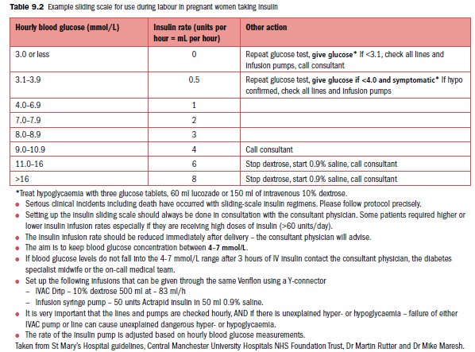

Slide 72
Induction of labour in women with diabetes is conducted in the same way as women without diabetes (Syntocinon infusions should be administered in saline), and NICE guidelines state that diabetes alone is not a contraindication to allowing a vaginal birth after a caesarean section..
NICE guidelines state that analgesia for women with diabetes should be managed in the usual way.
Diabetes may be associated with delayed gastric emptying, thus increasing risks for women requiring a general anaesthetic .

Slide 73
General anaesthesia also increases risks of hypoglycaemia and reduces awareness, thus these women should have blood glucose monitoring every 30 minutes until fully conscious.
Since women with other co-morbidities such as autonomic neuropathy or obesity face additional risks, these women should be offered anaesthetic review during the third trimester.

Slide 74
POSTPARTUM CARE
Some suggest changing insulin regimens to the pre-pregnancy dosing, others suggest halving of insulin doses, and this should be carefully planned by the diabetic team.
Careful capillary blood glucose monitoring is recommended to aid insulin dose adjustment for the first 2–3 days following delivery, aiming for values of 5–9 mmol/L.
Women who have undergone caesarean section will require continuation of the sliding scale until normal eating has been resumed.
Women with type 2 diabetes can change from insulin back to their oral hypoglycaemic agents.

Slide 75
Breastfeeding
Glycaemic control is better in women who exclusively breastfeed than in those who bottlefeed .
so overall breastfeeding should be supported.
Small cohort studies have demonstrated that breastfeeding increases the frequency of hypoglycaemia in type 1 diabetics .
Thus women should be advised to have a snack before or during breastfeeding and be advised of this risk.
NICE currently recommends that women with pre-existing type 2 diabetes can safely take metformin and glibenclamide while breastfeeding.

Slide 76
KEY POINTS
Women with diabetes have poorer pregnancy outcomes than women without diabetes.
Good glycaemic control pre-conception and in the first 8 weeks reduces the risk of congenital abnormalities.
Pregnant women with diabetes should be managed in a joint obstetric/diabetic clinic involving the input of obstetricians, diabetologists, dieticians, specialist nurses and midwives.
Insulin requirements usually increase during pregnancy.

Slide 77
Fasting blood glucose should be less than 5.3 mmol/L.
Postprandial levels at one hour should be less than 7.8 mmol/L. .
Tight glycaemic control results in a higher incidence of hypoglycaemia, hence education of the woman and her family about these risks is paramount.
Diabetic ketoacidosis is associated with poor maternal and fetal outcome.
Women with diabetes should be offered 4 weekly ultrasound monitoring of fetal growth and wellbeing, although there is no good evidence that these monitoring strategies reduce the risks of stillbirth and macrosomia.

Slide 78
Women with pre-existing diabetes and no complications should be offered delivery after between 37+0 and 38+6 weeks.
Women with macrosomia should have the risks and benefits of different modes of delivery discussed with them.
Maternal blood glucose should be kept between 4 and 7 mmol/L during labour and delivery to reduce the risks of neonatal hypoglycaemia. This may require an insulin/ dextrose infusion.
Insulin requirements fall rapidly postnatally.
Breastfeeding is associated with better glycaemic control and a risk of hypoglycaemia.
All women should receive postnatal advice regarding contraception and planning of their next pregnancy.

Slide 79
Gestational diabetes
Gestational diabetes mellitus (GDM) is defined as impaired carbohydrate tolerance resulting in hyperglycaemia, which first develops or becomes diagnosed during pregnancy.

Slide 80
Risk factors for gestational diabetes
Body mass index >30 kg/m2
Previous H\O:
macrosomic infant ≥4.5 kg
Still birth \IUFD.
Polyhydraminos.
Previous gestational diabetes
First-degree relative with diabetes type 2.
Ethnic origin: (South Asia .Black Caribbean middle Eastern) .

Slide 81
The risks of developing GDM in subsequent pregnancies are high, with recurrence rates between 30 and 84 per cent.
systematic review found that the risk was highest in the ethnic groups at particular risk of an initial presentation of GDM.
Furthermore, women who have required insulin treatment for GDM in a previous pregnancy have a recurrence risk of 75%.

Slide 82
SCREENING AND DIAGNOSIS
There is now good evidence that the treatment of GDM improves pregnancy outcome and these women are at risk of type 2 DM in later life.
Women with any of the risk factors should be offered screening for GDM using the oral glucose tolerance test (OGTT) at 24-28 weeks.
This involves a fasting venous plasma glucose then ingesting a 75g glucose load and testing the venous plasma blood glucose at 2 hours (Table 25.1).

Slide 83
In addition, women with more than 2+ glycosuria on a single urine dipstick, or + on 2 or more occasions should also be offered testing.
Fasting or random blood glucose, HbA1c or urinalysis should not be used for screening.
According to the NICE Diabetes in Pregnancy guidelines 2015, a diagnosis of GDM is made if the fasting plasma glucose is 5.6mmol/litre or more, or the two hour level is 7.8mmol/ litre or more .

Slide 84
In 2010, the International Association of Diabetes and Pregnancy Study Groups (IADPSG) published a consensus document in an attempt to achieve universal agreement on diagnostic criteria for GDM.
Using the HAPO data, It suggested universal screening of all pregnant women at 24–26 weeks, using a 2-hour OGTT, with a diagnosis of GDM if any glucose levels given in Table 25.1 are exceeded.

Slide 85
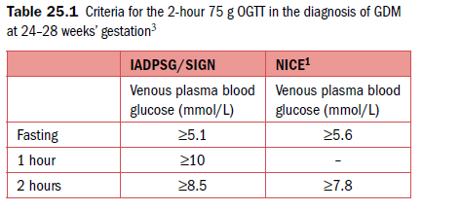

Slide 86
The SIGN (2010) guidelines :based on risk factors (Table 25.2).
Due to the high risk of recurrence, women who have had GDM in a previous pregnancy should be offered either early self monitoring of blood glucose or a 2 hour 75g OGTT as soon as possible after booking.
If this test is normal, a repeat test at 24-28 weeks is recommended.

Slide 87
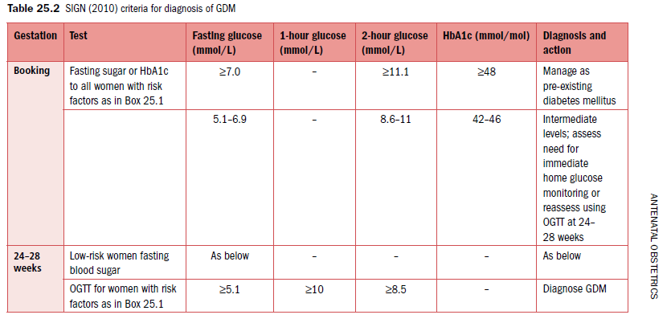

Slide 88
MANAGEMENT
Congenital malformations
As expected from the pathogenesis, there is no excess risk of major congenital malformations in women developing GDM, as blood glucose would be expected to be normal during organogenesis.
Some UK centres have described 12–20 per cent of women with GDM as having persistently impaired glucose tolerance on postnatal testing, and are thus likely to have type 2 diabetes.

Slide 89
Antenatal care
After diagnosis, women should be offered a review in a Joint diabetic antenatal clinic within one week.
This will enable early discussion of the implications of GDM, and also the recommended management, which will include a discussion of diet and exercise.
In addition, women should be taught how to self-monitor blood glucose and all women should be referred to a dietician.

Slide 90
Antenatal care should be focused on reducing the risks of GDM, namely fetal macrosomia and the possible increased risk of pre-eclampsia.

Slide 91
Glycaemic control
Several studies have now demonstrated the benefits of treating GDM:
There was a lower rate of serious perinatal complications (defined as death, shoulder dystocia, fractures and nerve injury) and more babies were admitted to special care,
but there was no increase in caesarean section rate
and significantly fewer babies had macrosomia.
A reduction in risk of shoulder dystocia from 4 per cent to 1.5 per cent, and a reduction in risk of hypertensive disorders.

Slide 92
The primary goal of treatment is to achieve near-normal glycaemic control using:
blood glucose monitoring,
diet and exercise,
oral hypoglycaemic agents and
insulin therapy,
As studies have shown that women achieving lower glucose levels had the lowest complication rates.

Slide 93
Diet and exercise
Lifestyle modifications, including dietary changes and exercise should be offered to all women diagnosed with GDM.
Studies have shown that diets high in carbohydrates of low glycaemic index (GI) can improve overall glycaemic control and postprandial hyperglycaemia [
Increased exercise may also have beneficial effects, with several small studies showing improved glucose control and reduced need for insulin.

Slide 94
Therefore, NICE guidelines suggest that women with GDM should choose diets containing low-GI carbohydrates and low-fat proteins.
They should also be advised to undertake moderate exercise (30 minutes a day).

Slide 95
Diagnosis and recommended management as outlined in NICE guidelines 2015 are summarised in table 25.2
As an initial treament, women with a fasting plasma glucose at diagnosis of less than 7mmol/litre should be offered diet and exercise as a method of controlling blood sugar1 as long as there are no other complications present such as polyhydramnios or macrosomia.
They should be advised to test a fasting and a blood glucose one hour after a meal every day and that they should aim for the recommended target blood glucose levels stated in box 25.3.

Slide 96
RECOMMENDED MANAGEMENT OF GDM AT DIAGNOSIS(NICE)

Slide 97
25.2 Targets for daily capiliary plasma glucose¹
Fasting less than 5.3mmol/l and
1 hour after meals less than 7.8 mmol/l or
2 hours after meals of less than 6.4mmol/l
IF After 1-2 weeks of diet and exercise , blood glucose is not within these recommended levels, additional therapy should be offered.

Slide 98
Pharmacological treatments
Overall, 82–93 per cent of women with GDM will achieve glycaemic control with diet alone.
Poor control of blood glucose is associated with similar complications as for women with pre-existing DM (macrosomia, birth trauma, neonatal hypoglycaemia, perinatal death, induction of labour and caesarean section).
Therefore, NICE guidance suggests that hypoglycaemic therapy should be considered if diet and exercise fail to achieve blood glucose targets over a period of 1–2 weeks.

Slide 99
Options for treatment include
oral hypoglycaemic agents (metformin or glibenclamide)
, regular insulin or insulin analogues.
The choice is dependent on the particular patient and will depend on glucose control and acceptability.

Slide 100
The current Scottish guidelines (SIGN 2010) recommend initial metformin or glibenclamide for women in whom lifestyle measures have two or more values above the following targets in a 2-week period.:
≥5.5 mmol/L pre-meal or ≥7.0 mmol/L 2 hours post-meal at ≤35 weeks
≥5.5 mmol/L pre-meal or ≥8.0 mmol/L 2 hours post-meal at >35 weeks
Any post-meal levels >9.0 mmol/L.

Slide 101
NICE guidelines (2015) recommend metformin if blood glucose is not within the targets stated in box 25.2 within 1-2 weeks of diet and exercise intervention.
In addition, women with polyhydramnios or macrosomia and a fasting plasma glucose of between 6-6.9mmol/l should be offered immediate treatment with insulin, with or without metformin.

Slide 102
Similarly, if fasting blood glucose is 7.0mmol/l or more at diagnosis, insulin, with or without metformin should be offered as a treatment in addition to diet and exercise.
This, and the recommended daily monitoring regimen is summarized in table 25.2.

Slide 103
RECOMMENDED MANAGEMENT OF GDM AT DIAGNOSIS(NICE)

Slide 104
If metformin is contraindicated or the woman finds the treatment unacceptable, then insulin therapy should be offered.
Glibenclamide can be offered as an alternative to women who decline insulin, or in whom metformin cannot be tolerated.
HbA1c levels should not be used for monitoring blood glucose control routinely in the second or third trimesters of pregnancy in women with GDM.
However, it is recommended that HBA1c is tested at the time of diagnosis of GDM in order to exclude pre-existing type 2 diabetes.

Slide 105
Fetal monitoring
Women with GDM are at risk of developing fetal macrosomia.
It has been suggested that this can be detected and predicted by the measurement of fetal abdominal circumference on ultrasound.
A cohort study of 201 women with GDM reported the sensitivity of abdominal circumference at 30–33 weeks’ gestation to predict macrosomia as 88 per cent, with a specificity of 83 per cent.
The positive predictive value was 56 per cent and the negative predictive value 96 per cent.

Slide 106
One RCT of 141 women with GDM compared ultrasound at 28 and 32 weeks with 32 weeks alone.
Insulin therapy was commenced if the abdominal circumference was greater that the 75th percentile.
This study found that there were more macrosomic babies in the group scanned only at 32 weeks.
NICE suggests that insulin therapy should be considered if macrosomia is present.
There are no studies clearly demonstrating benefits of particular monitoring regimens in terms of frequency of ultrasound scans.
However, fetal monitoring should be conducted as for women with pre-existing DM .

Slide 107
Timing and mode of delivery
The majority of studies investigating timing and mode of delivery include women with pre-existing and gestational diabetes.
The timing and mode of delivery should be discussed with women, especially during the third trimester.
NICE recommends that pregnant women with uncomplicated GDM be offered elective birth no later than 40+6 weeks’ gestation.
This represents a change from previous guidelines and the current Scottish guidelines (SIGN 2010) that suggest delivery between 38 and 40 weeks if parameters are normal.

Slide 108
Patient management should be individualised and timing and mode of delivery considered in the context of glycaemic control and fetal ultrasound findings.
Women with complications should be electively delivered before this gestation but a woman with diet-controlled GDM, with good control and no evidence of macrosomia, does not need delivery before 40+6 weeks.

Slide 109
Intrapartum care
Intrapartum maternal hyperglycaemia poses the same risks to the fetus of neonatal hypoglycaemia in GDM as in type 1 and type 2 diabetes.
Thus, blood glucose should be tested every hour and maintained between 4 and 7 mmol/L.
A sliding scale of intravenous insulin and dextrose should be instituted if blood glucose falls outside this range.
Women who have not required treatment with insulin in the antenatal period are less likely to require IV insulin and dextrose.

Slide 110
Similarly, women undergoing elective caesarean section are unlikely to require intraoperative insulin and dextrose infusions if they have not required antenatal insulin treatment.
Women who require steroid treatment for lung maturity should be treated in the same way as women with pre-existing diabetes .

Slide 111
Postnatal care
Women with true GDM are unlikely to require insulin following delivery, so women with GDM should stop all hypoglycemic agents (oral or insulin) immediately after birth.
In order to detect women with previously undiagnosed pre-existing diabetes, it is recommended that blood glucose monitoring be conducted in the early postnatal period.

Slide 112
NICE do not recommend a particular regimen for postnatal testing, but pre-meal and bedtime testing until blood glucose levels return to normal (4–6 mmol/L), then once daily while an inpatient, would be appropriate.
Contraception should also be discussed prior to discharge.

Slide 113
Future risks of developing DM
Women who have developed GDM are at increased risk of subsequent type 2 diabetes, with rates of progression within 5 years between 15 and 50 per cent .
A systematic review and meta-analysis concluded that lifestyle interventions reduced the progression of impaired glucose tolerance to type 2 iabetes with a hazard ratio of 0.5 .
NICE guidelines (2015) therefore recommend that women undergo testing for diabetes between 6 and 13 weeks after birth .

Slide 114
Prior to the 2008 NICE guidelines, the recommended test was the 75 g OGTT at 6 weeks postpartum and annually thereafter.
Subsequently a study suggested that a postnatal fasting plasma glucose of 6.0 mmol/L or more could be used to select women who should undergo a full glucose tolerance test.

Slide 115
Thus, NICE suggested that changing from a glucose tolerance test to fasting plasma glucose could represent a cost saving to the NHS.
Current NICE guidelines recommend a fasting plasma glucose at 6-13 weeks, which may most conveniently be performed when the woman attends for her postnatal check.
If this is not possible or has not been performed, a fasting glucose or HbA1c should be offered after 13 weeks.
The recommended actions based on this test is outlined in table 25.4.

Slide 116
Women whose postnatal screening test is negative should be offered annual testing for diabetes.
The 2010 SIGN guidelines recommend assessment at 6 weeks postnatally with a fasting blood glucose and then an OGTT if clinically indicated, followed by annual fasting blood glucose or HbA1c.

Slide 117
Table 25.4 Recommended postnatal testing and actions in women

Slide 118
KEY POINTS
GDM is impaired carbohydrate tolerance that first develops during pregnancy.
GDM is associated with increased risks of macrosomia and its associated complications, neonatal hypoglycaemia and late pregnancy loss.
There are many well-defined risk factors, the main ones being ethnic origin, obesity and GDM in a previous pregnancy.
There is current debate regarding screening and diagnostic testing for GDM. NICE guidelines recommend that women at risk should be tested using the 2-hour 75 g OGTT at 24–28 weeks’ gestation.

Slide 119
Women who have had GDM in a previous pregnancy should be offered early self-monitoring of blood glucose or an OGTT as soon as possible after booking and repeat at 24-28 weeks if normal.
Diagnose GDM using a 75g 2 hour OGTT. Diagnosis should be made if the fasting plasma glucose is 5.6mmmol/l or more, or the 2 hour level is 7.8mmol/l or more.
Treating GDM reduces the incidence of complications.

Slide 120
Diet and lifestyle modifications should be offered to all women. Additional treatment with oral hypoglycaemic agents and/or insulin may also be needed.
Pregnant women with GDM should be managed in a joint obstetric/diabetic clinic involving the input of obstetricians, diabetologists, dieticians, specialist nurses and midwives. Review should be offered within 1 week of diagnosis.
Women should be taught how to self monitor plasma glucose
The target for fasting plasma glucose is less than 5.3mmol/l.
Postprandial levels should be less than 7.8 mmol/L.

Slide 121
Women on insulin or glibenclamide should be advised to maintain plasma glucose above 4mmol/l.
Women with GDM should be offered monitoring of fetal growth and wellbeing.
Women with uncomplicated GDM should be offered elective delivery by 40+6 weeks gestation.. Care should be individualised, and will depend on glycaemic control and development of macrosomia.
Women with macrosomia should have the risks and benefits of different modes of delivery discussed with them.

Slide 122
Maternal blood glucose should be monitored hourly during labour and be kept between 4 and 7 mmol/L during labour and delivery. Women who are diet controlled are unlikely to need any specific treatment during labour.
Women GDM are unlikely to require insulin postnatally so should stop all hypoglycaemic agents immediately after birth.

Slide 123
Women should undergo early postnatal glucose monitoring to ensure that their blood glucose is in the normal range.
Women who have had GDM are at high risk of developing type 2 diabetes in the future. This risk can probably be reduced by lifestyle modifications.
Women should be screened for diabetes at the 6-week postnatal check with a fasting plasma glucose and annually thereafter.
All women should receive postnatal advice regarding contraception and planning their next pregnancy

Slide 124
THANK YOU

