Slide 1
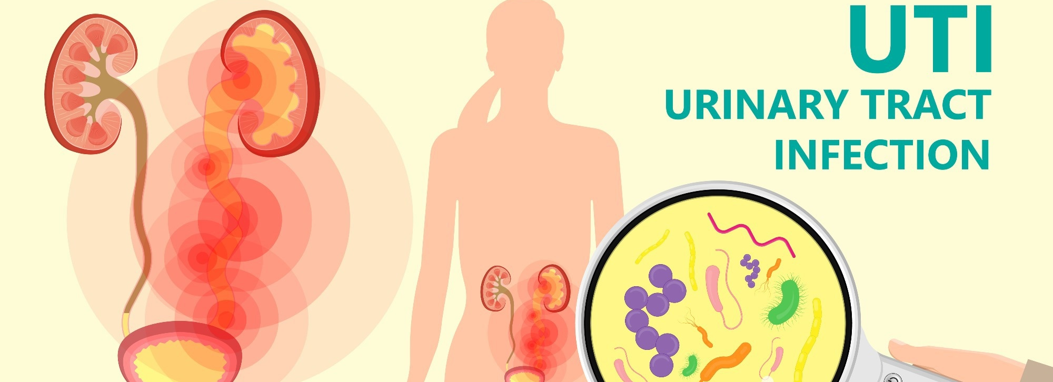
Urinary Tract Infection ( UTI )
Tala Sarayreh
Sondos Qatawneh
Wafaa Mohammed

Slide 2
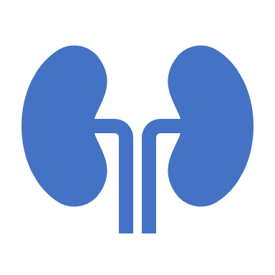
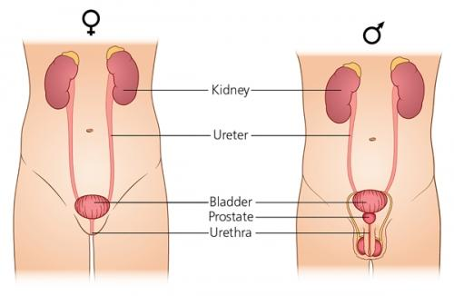
UTI : An infectious disease defined as any infection of the urinary tract The most common nosocomial infection ( hospital acquired ) One of the most common types of outpatient infections (community acquired )

Slide 3
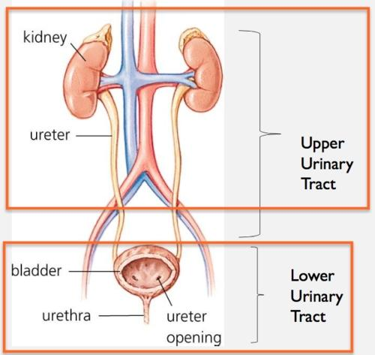
2 Types of UTI :
1. Lower UTI , involves the :
• Urethra → Urethritis
• Bladder → Cystitis
2. Upper UTI , involves the :
• Kidney → Pyelonephritis
( affects renal pelvis , glomeruli , tubules , interstitium )
• Ureter → Ureteritis

Slide 4
Pathogenesis : In healthy human-beings, all urinary tract is sterile except the lower end of urethra Normally the urine is sterile and has low pH that kill the pathogens
1. Ascending infection
(more common)
Bacteria moves from rectum , perineum and vagina
through the urethra → bladder → kidney
2. Descending infection (rare)
Bacteria moves through the blood or lymph to
→ kidney → bladder → urethra
2 Types paths of infection :

Slide 5
Sequence of ascending infection :
3. Inflammatory response ( pyuria : WBC in the urine ) and neutrophile infiltration in bcterial infection ) 4. Evasion of immune system via virulent factor
5. Pathogen ascends more and more till reaches the kidney and colonizes it 6. If untreated it spreads into the circulation via renal veins and causes bacteremia ( septic shock )
2. Colonization and multiplication
1. Bacterial infection or contamination

Slide 6
Causes of UTI :
1. Most common cause is the Bacterial infection either : • Gram (-ve) bacteria : E. coli (First most common 80%) , Klebsiella , Proteus , Enterobacter • Gram (+ve) bacteria :
Enterococcus , Staphylococcus saprophyticus
2. Fungal infection
( Candida )
4. Foreign bodies
( kidney stones )
3. Chemical irritants
( soap , bubble path , skin lotions )
5. Traumatic injury

Slide 7
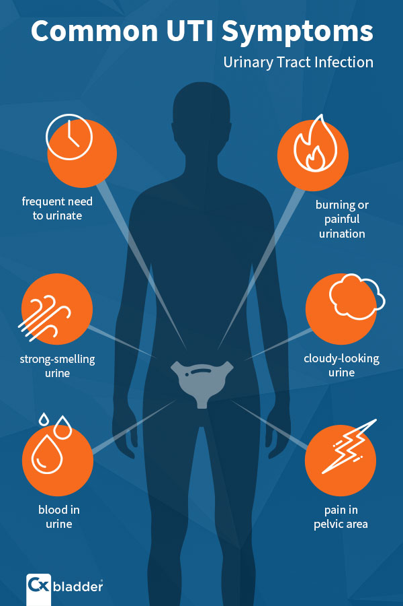
Signs and Symptoms : - It may be asymptomatic - Symptoms depend on the site of infection
Lower UTI
- Dysuria
- Frequency
Upper UTI ( more severe symptoms)
- Flank pain
Other
- Fatigue
- Urgency
- Vomiting
- Chills
- Malaise
- Nausea
- Lower UTI symptom
- Incontinence
- Altered mental status
- Hematuria
- Changes of urine (amount, color, content, smell, ..)
- Loin pain radiated to the back
- Pain at costovertebral angle “ renal angle tenderness in examination “ in advanced stages
- Fever
- Oliguria
- Suprapubic discomfort
- Feeling of incomplete emptying the bladder

Slide 8
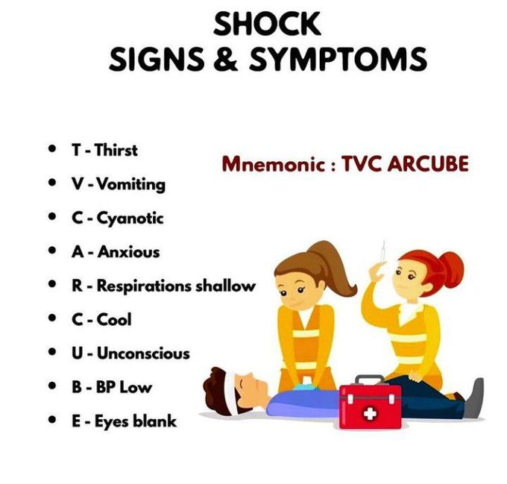
Repeated episodes of acute infections lead to chronic inflammation and advanced complications may reach to urosepsis or septic shock ( patient with signs of shock ) DDx of UTI Symptoms : 1. STDs 2. Prostatitis

Slide 9
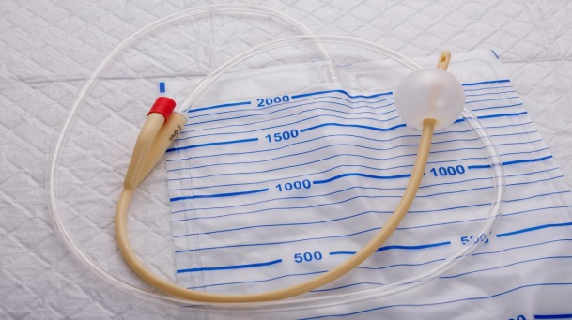
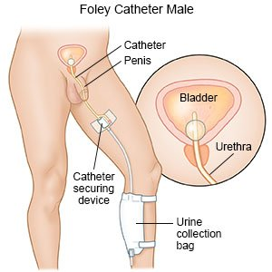
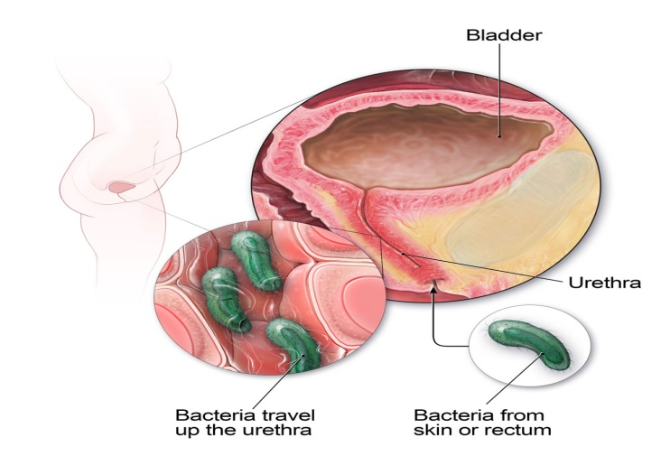
Risk factors :
1. Urinary tract abnormalities 2. Urinary catheter
( CAUTI : Catheter Associated UTI ) increases the risk up to five folds 3. DM 4. Immunocompromised status 5. Impaired bladder emptying 6. Obstructions and Urinary stasis ( increase adhesion and colonization of bacteria in the bladder )

Slide 10
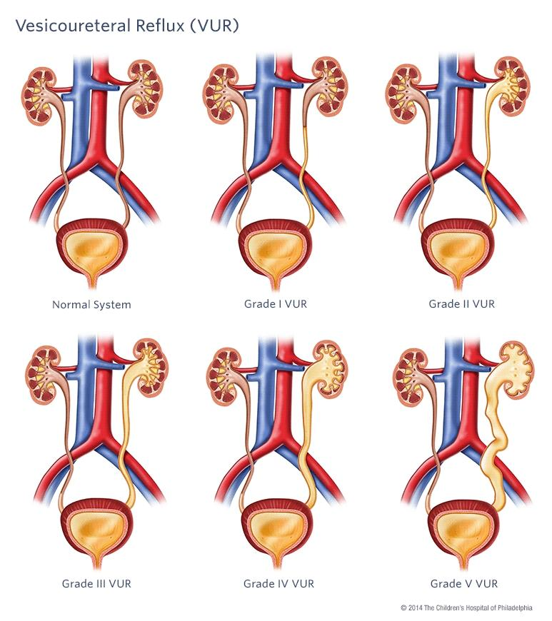
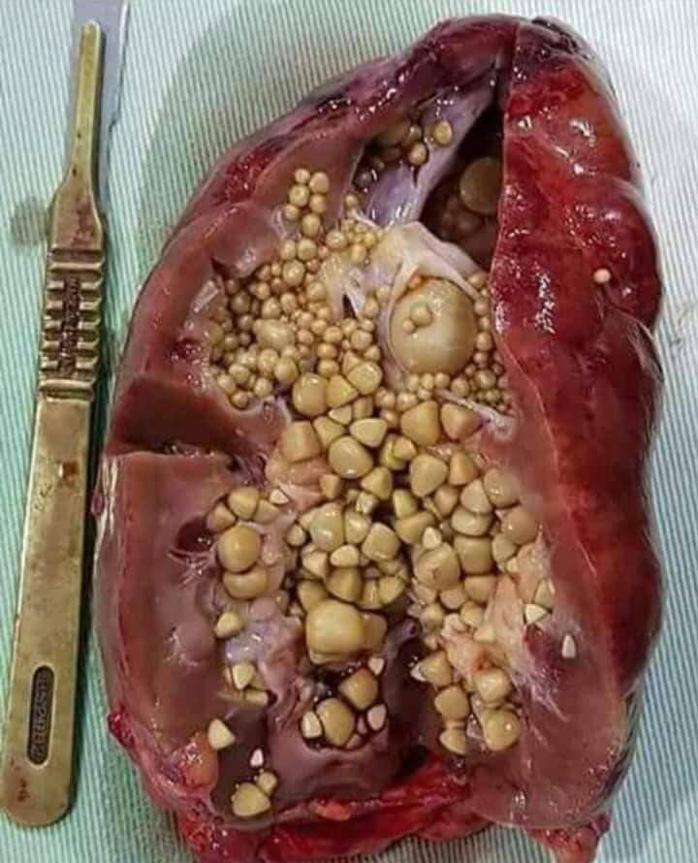
Continue ..
7. VUR (vesico-ureteral reflux) a condition in which urine flows backward from the bladder to one or both ureters and sometimes to the kidneys 8. Renal stones 9. Enlarged prostate (BPH : Benign Prostatic Hyperplasia) 10. Sexual intercourse 11. STDs ( associated with itching, discharge, bad smell ) 12. Poor hygiene 13. uncircumcised ( male child )

Slide 11
[ UTI has age and gender predilection ]
Age → Children and elderly
Gender → more in female due to : 1. shorter urethra 2. Postmenopause ( decreased estrogen levels so decreased vaginal flora ) 3. Pregnancy 4. Prostatic secretions in males contain bactericidal components

Slide 12
Classification of urinary tract infections
Urinary tract infections are classified and treated based on :
clinical presentation | location | severity | source of infection | frequency
1.Asymptomatic bacteriuria (ASB)
2.Urinary tract infection (UTI)
1.Lower UTI
2.Upper UTI
1.Complicated UTI (cUTI)
2.Uncomplicated UTI
3.Urosepsis
1.Community-acquired)
2.Healthcare-associated
Recurrent UTI

Slide 13
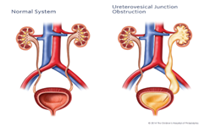
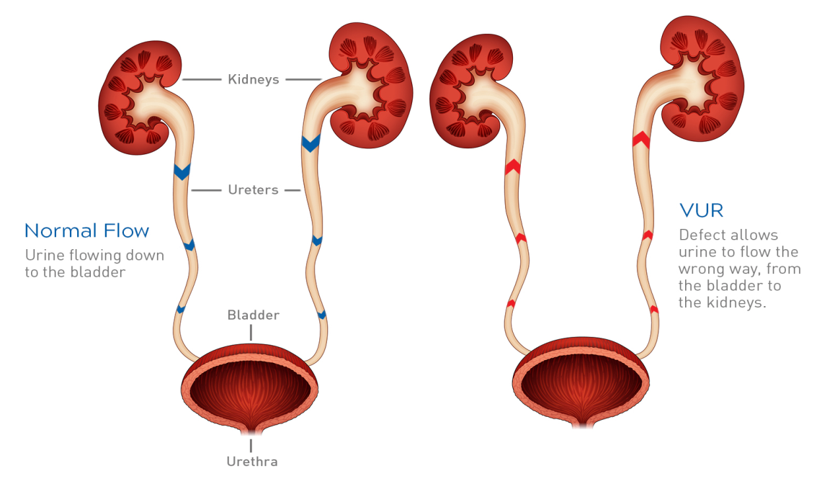
By severity
Uncomplicated UTI : Infection in the urinary tract where there is no functional or anatomical anomalies, functional impairment, or concomitant disease that would promote the UTI.
Complicated UTI: Infection associated with structural or functional abnormalities of the genitourinary tract or presence of underlying disease that increases risk of acquiring an infection

Slide 14
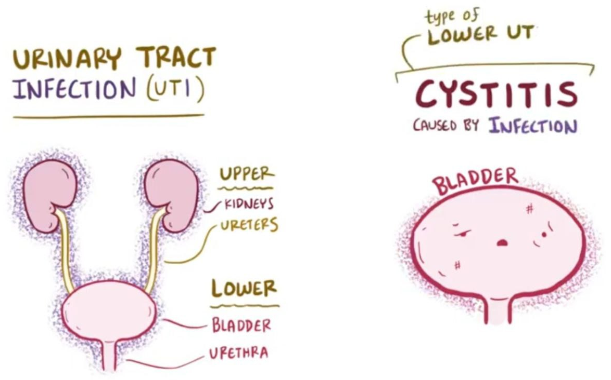
By location
Lower UTI :
cystitis ( most common form )
Clinical features
Typical features of cystitis and urethritis include:
abrupt onset of frequency of micturition and urgency.
burning pain in the urethra during micturition (dysuria).
suprapubic pain during and after voiding.
urine that may appear cloudy and have an unpleasant odour
non-visible or visible haematuria.
intense desire to pass more urine after micturition, due to spasm of the inflamed bladder wall (strangury).
Systemic symptoms are usually slight or absent.

Slide 15
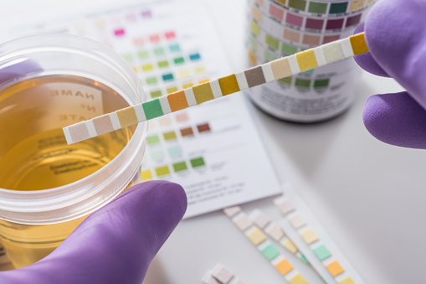
Diagnosis By
Dipstick urinalysis
Microscopic Urinalysis (clean-catch midstream specimen)
urine culture

Slide 16
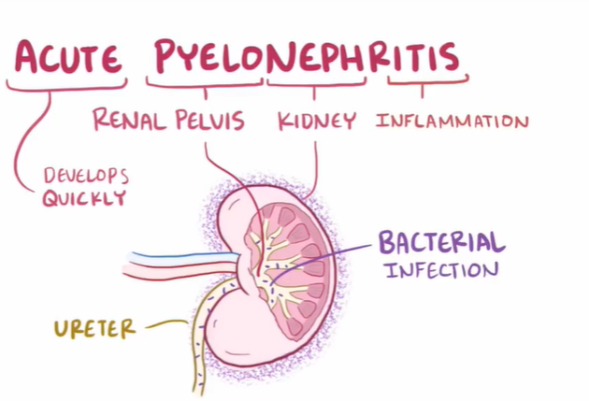
Upper UTI
Acute pyelonephritis
Pyelonephritis is an infection of the upper urinary tract .
The kidneys are infected in a minority of patients with UTI.
Acute renal infection (pyelonephritis) presents as a classic triad of loin pain, fever and tenderness over the kidneys.
The renal pelvis is inflamed and small abscesses are often evident in the renal parenchyma infection.
Renal infection is almost always caused by organisms ascending from the bladder, and the bacterial profile is the same as for lower urinary tract infection.
Rarely, bacteraemia may give rise to renal or perinephric abscesses, most commonly due to staphylococci.
Predisposing factors, such as cysts or renal scarring, facilitate infection.

Slide 17
Clinical features :
Symptoms
Fever , chills
Signs
Fever with tachycardia
Diagnosis
Urineanalysis
Flank pain
Nausea , vomiting and sometimes diarrhea
Patients are generally appear more I’ll than patients with cystitis
Costovertebral angle tenderness (unilateral or bilateral )
Abdominal tenderness maybe present on examination
Urine culture
Blood culture
CBC
Renal function
Imaging studies

Slide 18
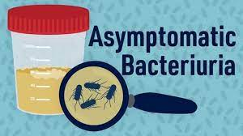
By clinical presentation
Asymptomatic bacteriuria
Significant bacteriuria without clinical features of UTI
This is defined as more than 10*5 organisms/mL in the urine of apparently healthy asymptomatic patients.
Approximately 1% of children under the age of 1 year, 1% of schoolgirls, 0.03% of schoolboys and men, 3% of non-pregnant adult women and 5% of pregnant women have asymptomatic bacteriuria. It is increasingly common in those aged over 65.
There is no evidence that this condition causes renal scarring in adults who are not pregnant and have a normal urinary tract, and, in general, treatment is not indicated. Up to 30% will develop symptomatic infection within 1 year, however.
Treatment is required in infants, pregnant women and those with urinary tract abnormalities.

Slide 19
By frequency
Persistent or recurrent UTI
≥ 3 episodes of symptomatic, culture-proven UTI in one year or ≥ 2 episodes in 6 months
If the causative organism persists on repeat culture despite treatment, or if there is reinfection with any organism after an interval, then an underlying cause is more likely to be present and more detailed investigation is justified.
In women, recurrent infections are common and investigation is justified only if infections are frequent (three or more per year) or unusually severe.
Recurrent UTI, particularly in the presence of an underlying cause, may result in permanent renal damage, whereas uncomplicated infections rarely (if ever) do so.
If an underlying cause cannot be treated, suppressive antibiotic therapy can be used to
prevent recurrence
reduce the risk of sepsis and renal damage.
Urine should be cultured at regular intervals; a regimen of two or three antibiotics in sequence, rotating every 6 months, is often used in an attempt to reduce the emergence of resistant organisms. Other simple measures may help to prevent recurrence .

Slide 20
Diagnosis: clinical feature +laboratory finding
1)urine analysis
2)urine culture
3)imaging
4)blood culture (consider in febrile pts)
5)renal function (serum creatinine >1.2mg/dl)

Slide 21
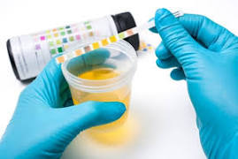
Urine unalysis
best initial test (routine test)
midstream sample
straight catheterization (children,bedridden pts)
Report finding:
1)pyuria> 10 wbc/HPF
2)positive leucocyte esterase(enzyme produce by wbc)
3)nitrites (nitrates (bacteria ) nitrites (nitrites and esterase can be detected by a urine depstic
Combined positive nitrites and leukocyte esterase on urine depistic unalysis is 80-90% sensitive and 60-98% specific of uti
4)ph>8 (urease producing bacteria (proteus))
5)RBC (normal 3_5)
RBC>5 (injury ,stone , tumor in kidney or urinary bladder)
*Need more investigation *
E.coli

Slide 22
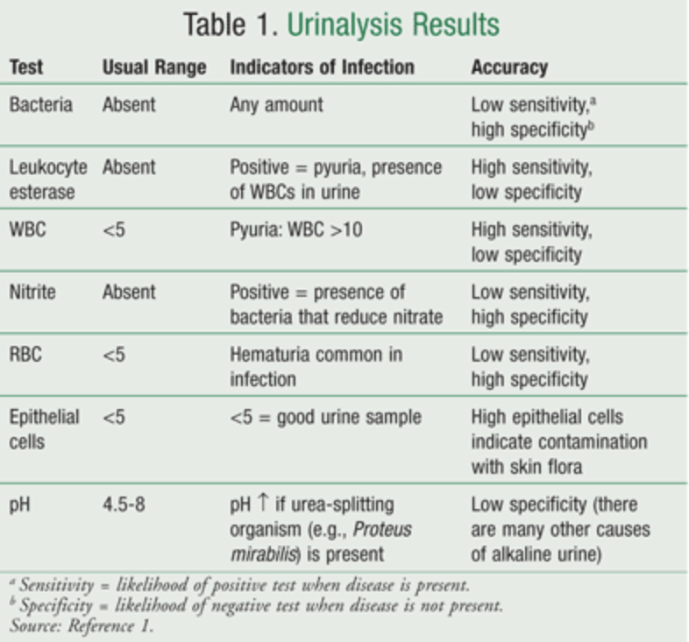

Slide 23
Urine culture
The gold standard for identification of UTI is the quantitative culture of urine for specific bacteria.
Defining the CFU/ml. that represents clinically significant infection can be difficult. It is dependent on the method of collection, the sex of the patient, and the type of bacteria isolated.
Traditionally, cultures demonstrating 100,000 CPU/ml. are considered diagnostic of a UTI, but now AAP guidelines suggest pyuria and 50,000 CFU/ml. of a single organism are diagnostic of UTI

Slide 24
2)urine culture
*complicated UTI
*pyelonephritis (perform culture before giving abx)
*Hx of recurrent UTI
*anatomic or functional abnormalities
in cystitis and urethritis no need of culture

Slide 25
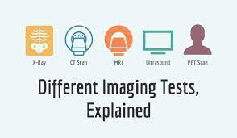
3)imaging :
not routinely done
obstruction (stone)
recurrent complicated UTI
early recurrence of UTI despite apprpriate tx (2 week)

Slide 26
Antibiotics
The goal in treatment is to eradicate the infection by selecting the appropriate antibiotics that would target specific bacterial susceptibility.
The general principles for selecting the appropriate antibiotics include:
Consideration of the infecting pathogen (antibiotic susceptibility, single-organism vs polyorganism infection, pathogen vs normal flora, community vs hospital-acquired infection);
The patient (allergies, underlying diseases, age, previous antibiotic therapy, other medications currently taken, outpatient vs inpatient status, pregnancy);
The site of infection (kidney vs bladder vs prostate)

Slide 27
Treatment (cystitis) :
Antibiotics are recommended in all cases of proven UTI Trimethoprim or nitrofurantoin is the usual first choice of drug for initial treatment.
Quinolone antibiotics such as ciprofloxacin and norfloxacin, and cefalexin are also generally effective.
Penicillins and cephalosporins are safe to use in pregnancy but trimethoprim, sulphonamides, quinolones and tetracyclines should be avoided.

Slide 28
For uncomplicated pyelonephritis.
Use outpatient treatment if the patient can take oral antibiotics. Treat based on Gram stain:
• TMP/SMX or a fluoroquinolone for 10 to 14 days is effective for most gram negative rods.
• Amoxicillin is appropriate for gram-positive cocci (enterococci, S. saprophyticus).
• A single dose of ceftriaxone or gentamicin is often given initially before starting oral treatment.
b. Repeat urine culture 2 to 4 days after cessation of therapy.
c. If symptoms fail to resolve within 48 hours, adjust treatment based on urine culture.
d. Failure to respond to appropriate antimicrobial therapy suggests a functional or structural abnormality

Slide 29
2. lF the patient is very ill, elderly, pregnant, unable to tolerate oral medication, or has significant comorbidities, or if urosepsis is suspected
Hospitalize the patient and give IV fluids.
Treat with antibiotics.
Start with parenteral antibiotics (broad-spectrum)-ampicillin PLUS gentamicin OR CIPROFLOXACIN as an initial choices
If blood cultures are negative, treat with IV antibiotics until the patient is febrile for 24 hours, then give oral antibiotics to complete a 14- to 21-day course.
If blood cultures are positive (urosepsis), treat with IV antibiotics for 2 to3 weeks

Slide 30
For recurrent pyelonephritis.
a. If relapse is due to the same organism despite appropriate treatment, treat for6 weeks.

Slide 31
Recurrent UTI
>2 UTI within 6 month or
>3 UTI within 1 year
***chemprophylaxis should be considered in all women with recurrent UTI Trimethoprim or nitrofurantion is recommended for prophylaxis.

Slide 32
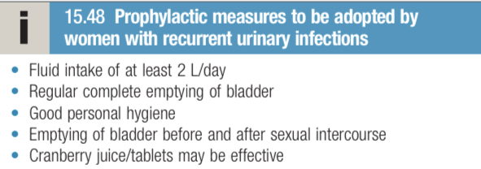
PREVENTION: behavioral modification : increase fluid intake post coital voiding genital hygiene timely bladder voiding

