Slide 1
DIABETES IN PREGNANCY
Supervised by :
Dr. Ashwaq Tarawneh
Presented by :
Junaid Jaradat
Mohammad Khirfan
Noor Athamneh
Bayan Abu-qudairi

Slide 2
DIABETES IN PREGNANCY: AN EMERGING CHALLENGE
Rising prevalence: increasing ra tes of diabetes and obesity due to dietary changes and reduced physical activity contribute to a growing global health burden.
Clinical recognition of GDM is important because therapy can reduce pregnancy complications and potentially reduce long-term sequelae in the offspring
.
Maternal & fetal risks: diabetes in pregnancy poses significant risks, including:
Maternal risks: spontaneous abortion, preeclampsia, and complications
during delivery.
Fetal risks: congenital anomalies, macrosomia, intrauterine fetal demise.
Neonatal risks: hypoglycemia, hyperbilirubinemia, and respiratory
distress syndrome.

Slide 3
TYPES OF DIABETES IN PREGNANCY
Pre-Gestational Diabetes (PGDM)
Pre-existing type 1 or type 2 diabetes diagnosed before pregnancy.
Requires preconception optimization to reduce risks.
Gestational Diabetes Mellitus (GDM)
Diabetes first diagnosed during pregnancy (typically in the second or third trimester).
Results from pregnancy-induced insulin resistance and usually resolves postpartum but increases future diabetes risk.

Slide 4
SPECIAL CONSIDERATIONS FOR TYPE 1 DIABETES IN PREGNANCY
Type-1 Diabetes Mellitus (T1DM), which results from
pancreatic β-cell destruction usually leading to absolute
insulin deficiency.
Glycemic Changes:
Increased Hypoglycemia Risk in the first trimester due to improved insulin sensitivity.
By ~16 weeks, insulin resistance rises significantly, reaching 2–3 times pre-pregnancy insulin requirements in the second and early third trimesters.

Slide 5
SPECIAL CONSIDERATIONS FOR TYPE 1 DIABETES IN PREGNANCY
Diabetic Ketoacidosis (DKA) Risk:
Pregnancy is a ketogenic state, increasing the risk of DKA at lower blood glucose levels than in nonpregnant individuals.
Women should have ketone strips and receive DKA prevention & detection education.

Slide 6
SPECIAL CONSIDERATIONS FOR TYPE 2 DIABETES IN PREGNANCY
Type-2 Diabetes Mellitus (T2DM), which results from a
progressive insulin secretory defect on the background
of insulin resistance.
Obesity & Insulin Resistance
Strong association with obesity, which increases pregnancy complications.
Higher insulin doses may be required, though glycemic control is generally easier than in type 1 diabetes.
- Increased Risk of Preeclampsia
Diabetes in pregnancy significantly raises the risk of preeclampsia,
necessitating close monitoring and early intervention.

Slide 7
GESTATIONAL DIABETES MELLITUS (GDM)
Diabetes first diagnosed during pregnancy due to pregnancy-induced insulin resistance.
Hyperglycemia is first detected during pregnancy and typically resolves postpartum.

Slide 8
PAT HOGENESIS
Pregnancy is characterized by insulin resistance and hyperinsulinemia, which ensures an adequate supply of glucose for the fetus.
The resistance due to placental secretion of diabetogenic hormones including growth hormone, corticotropin releasing hormone, placental lactogen, and progesterone, as well as increased maternal adipose deposition.
These and other endocrinologic and metabolic changes ensure that
the fetus has a good supply of fuel and nutrients at all times.
Gestational diabetes occurs in women whose pancreatic function is not sufficient to secrete adequate amounts of additional insulin to overcome the insulin resistance created by changes in diabetogenic hormones during pregnancy.

Slide 9
METABOLIC CHANGES
There is a significant 30% increase in basal hepatic glucose production by the third trimester of pregnancy.
50% to 60% decrease in insulin sensitivity in late gestation.
Normal pregnancy is characterized by:
Mild fasting hypoglycemia
Postprandial hyperglycemia
Hyperinsulinemia

Slide 10
Metabolic changes in Gestational Diabetes
Women with GDM had Elevated Fasting plasma glucose, and elevated post-prandial glucose levels.
There is an increase in basal endogenous glucose production, similar to that observed in subjects with normal glucose tolerance.
The ability of insulin to suppress endogenous glucose production is decreased in women with GDM compared with a matched controlgroup (approximately 80% versus 95%).
Impairment of insulin secretion by the beta cells of the pancreas
Increased insulin resistance

Slide 11
S CRE E NI NG F OR GE S TAT I ONAL
DIAB E T ES
ACOG recommendation for diagnosis of GDM:
Universal screening for low risk pregnant at 24 to 28 weeks, via a two- step regimen, which consisting of:
A 50-g, 1-hour glucose challenge test (GCT)
For GCT results exceeding the selected threshold, a 100-g, 3-hour OGTT is performed.
Early pregnancy screening of women at high risk for pre
gestational diabetes and GDM, or in areas in which the prevalence of insulin resistance is 5% or higher.
Note: a 1-step approach can be used by proceeding directly to the 100-g, 3-hour OGTT

Slide 12
S CRE E NI NG F OR GDM
Patients at high risk of developing GDM:
A family history of diabetes, especially in first degree relatives
BMI >30 kg/m 2
Age >25 years
Previous delivery of a macrosomic baby (4 kg)
Personal history of impaired glucose tolerance
Previous unexplained perinatal loss or birth of a malformed infant
Glycosuria at the first prenatal visit
Polycystic ovary syndrome
Current use of glucocorticoids
Essential hypertension or pregnancy-related hypertension

Slide 13
GLUCOSE CHALLENGE TEST (GCT)
A 50-g, 1-hour GCT,which may be administered in the fasting or non fasting state.
Sensitivity is improved if the test is performed in the fasting state
A threshold value of ≥135 - 140 mg/dL can be used.
For GCT results exceeding the selected threshold, a 100-g, 3-hour
OGTT is performed.
If initial screening is negative, repeat testing is performed at 24 to 28 weeks.

Slide 14
3 HOURS ORAL GLUCOSE TOLERANCE TEST(OGTT)
Assessment for GDM | Plasma Glucose Level after a 100-g Glucose Load mg/dL (mmol/L)
Fasting | 95 (5.3)
1 hr | 180 (10.0)
2 hr | 155 (8.6)
3 hr | 140 (7.8)
Test prerequisites:
1-hr, 50-g glucose challenge result ≥135 or 140 mg/dL Overnight fast of 8-12 hr
Carbohydrate loading for 3 days, including ≥150 g of carbohydrate Seated, not smoking during the test
Two or more values must be met or exceeded for a diagnosis of GDM

Slide 15
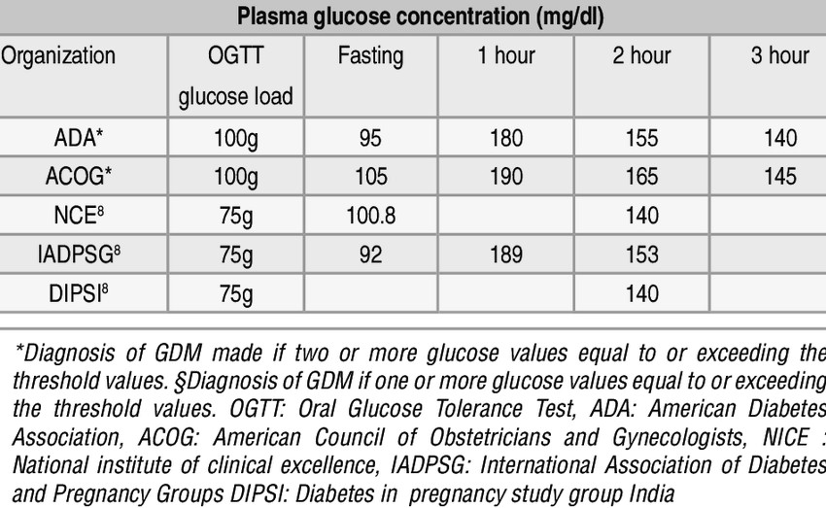

Slide 16
Understanding Risks and Management Strategies

Slide 17
Management of pregnancies complicated by DM
Periconceptional counseling
Achieve normoglycemia
Prevent ketosis
Provide adequate weight gain
Contribute to fetal well-being
Prevention of obstetric complications.
Timing the delivery.
Select the mode of delivery.
Intensive neonatal care.

Slide 18
Glycemic Management During Pregnancy
Glycemic Targets during pregnancy:
Target glucose values
Fasting PG ≤95 mg/dL (5.3 mmol/L)
1h postprandial PG ≤140 mg/dL (7.8 mmol/L)
2h postprandial PG ≤120 mg/dL (6.7 mmol/L)

Slide 19
Glycemic Management During Pregnancy
Measurements of glycohemoglobin have proved to be a useful
index of glycemic control over 4 to 6 weeks.
providing a numeric index of the patient’s overall compliance
and an indication of her average plasma glucose level over the past 30 to 60 days.
Hb A1C, should be less than 6.0%.

Slide 20
Principles of Medical Nutritional Therapy
avoid single, large meals containing foods with a high percentage of simple carbohydrates.
Three major meals and three snacks are preferred.
A bedtime snack may be needed to prevent accelerated (starvation) ketosis
overnight.
Carbohydrates should account for no more than 50% of the diet, with protein and fats equally accounting for the remainder.

Slide 21
Principles of Medical Nutritional Therapy
Recommended total weight gain and caloric intake for singleton Pregnancies according to pre-pregnancy BMI
Pre-Pregnancy BMI | Recommended range of total weight gain (Kg) | Recommended caloric requirement
BMI <18.5 | 12.5 – 18.0 | up to 40 kcal/kg/day
BMI 18.5 - 24.9 | 11.5 – 16.0 | 30 kcal/kg/day
BMI 25.0 - 29.9 | 7.0 – 11.5 | 22 - 25 kcal/kg/day
BMI ≥30 | 5.0 – 9.0 | 12 – 14 kcal/kg/day

Slide 22
Insulin therapy
recommended when medical nutrition therapy fails to maintain self-monitored glucose at the acceptable levels.
Any insulin regimen for pregnant women requires combinations and timing of insulin injections different from those that would be effective in the non pregnant state.
The regimens must be modified continually as the patient progresses from the first to the third trimester and as insulin resistance rises.
The regimen should always be matched to the patient’s unique physiology, work, rest, and food intake schedule.

Slide 23
Insulin therapy
In the 1st trimester from 6-10 weeks, progressively reduce the insulin dose by a total of 10% to 25% to avoid hypoglycemia.
Insulin requirements normally peak at 36 weeks gestation and drop significantly
thereafter.
A combination of short- and intermediate-acting insulins can be employed to maintain glucose levels in an acceptable range.
nowadays mainly use long-acting at night and short-acting insulin half hour
before meals (not mixtard) , MDI
Approximately two thirds of the daily insulin dose is given in the morning and one third in the afternoon and at bedtime.
A typical total insulin dose is 0.6 U/kg in the 1st trimester, but this must be increased weekly or every other week with pregnancy duration from the 2nd trimester onward.

Slide 24
Insulin therapy
The total first dose of insulin is calculated according to the patient’s weight as follow:
In the 1st trimester .......... weight x 0.6
In the 2nd trimester........ weight x 0.7
In the 3rd trimester........... weight x 0.8
How to check if GDM is controlled?
Clinically by
Polyhydramnios
Macrosomia (organomegaly occurs at all organs except brain so AC > BPD )

Slide 25
Use of Oral Hypoglycemic Agents
Glyburide :
maternal use of glyburide was not associated with an excess risk of
neonatal hypoglycemia or congenital anomalies.
minimal transport across the human placenta.
glyburide should be taken at least 30 minutes before a meal.
Metformin :
equivalent to insulin in effectiveness.
Recommended dosing begins with 500 mg twice daily.
crosses the placenta.

Slide 26
Use of Oral Hypoglycemic Agents
α-Glucosidase Inhibitors:
-inhibit pancreatic amylase and α-glucosidase enzymes in the small intestine.
-delaying cleavage of complex sugars to monosaccharides and reducing the increase of blood glucose levels after a meal.
-Acarbose is given before meals, initially in an oral dose of 25 mg three times daily up to a maximum of 100 mg three times daily.

Slide 27
CORTICOSTEROIDS IN GDM

Slide 28
GDM COMPLICATIONS
- Maternal Risks:
- Fetal & Neonatal Risks:
Infections: Increased risk of UTI & vaginal candidiasis
Ketoacidosis (especially in Type 1 diabetes)
Worsening retinopathy
Miscarriage
Polyhydramnios
Preeclampsia
Thromboembolic & cardiovascular diseases
Preterm delivery
Cesarean delivery
Large for gestational age (LGA) infants
NICU admission
Neonatal hypoglycemia & hyperbilirubinemia

Slide 29
DIA BETIC KETOACIDOSIS ( DKA) IN
PREGNA NCY – DIAGNOSIS & EVALUATION
Definition & Epidemiology
Occurs in 5-10% of pregnant women with pregestational T1DM.
Defined by hyperglycemia, serum ketones, and acidosis.
Euglycemic DKA is more common in pregnancy.
Risk factors:
Type 1 DM or new-onset DM
Infections (UTI, respiratory)
Poor compliance, insulin pump failure, steroid treatment
Symptoms: Abdominal pain, nausea, vomiting, altered sensorium

Slide 30
DIA BETIC KETOACIDOSIS ( DKA) IN
PREGNA NCY – DIAGNOSIS & EVALUATION
Key Laboratory Findings: pH < 7.3 , Bicarbonate < 15 mEq/L,
Anion gap > 10 & Serum ketones elevated
Initial Evaluation:Vitals & EKG
Laboratory tests: VBG/ABG (if altered sensorium or unstable vitals) & CMP, anion gap, and serum ketones
Assess for underlying etiology (e.g., infection)
Fetal assessment (avoid intervention during DKA)
ICU admission if: pH < 7.1, altered sensorium, abnormal EKG/Kussmaul breathing

Slide 31
DIA BETIC KETOACIDOSIS ( DKA) IN
PREGNA NCY – DIAGNOSIS & EVALUATION
Continued Evaluation:
BG every hour, vitals every 1-2 hours
Monitor:
Serum electrolytes (anion gap,VBG, ketones)
Continuous maternal ECG and pulse oximetry
Fetal monitoring (CEFM if > 24 weeks)
Additional measures:
Foley catheter for I&O
NICU/Anesthesia consult

Slide 32
DKA IN PREGNANCY –
MANAGEMENT
Fluid Resuscitation
1 L NS in first hour
0.5–1 L/hour for 2-4 hours
250 mL/hr 0.45% NS until 80% corrected
Once BG < 300 mg/dL → switch to D5½NS & follow intrapartum IV insulin protocol
Insulin Therapy
Loading dose: 0.1–0.4 units/kg
Maintenance: 2–10 units/hour (adjust per labor protocol)
Double insulin rate if BG doesn’t drop by 20% in 2 hours
Continue until bicarbonate & anion gap normalize

Slide 33
DKA IN PREGNANCY –
MANAGEMENT
Electrolyte Management
Potassium (K)
If low/normal → infuse K (15-20 mEq/h)
If elevated → wait until normal, then 20-30 mEq/L
Phosphate
Replace if <1.0 mg/dL
Consider in cardiac dysfunction or obtunded patients

Slide 34
FE TAL COMPLIC ATION WITH DIABETES
Miscarriage
Increased congenital malformation (cardiac and NTD)
Preterm delivery.
Intra uterine death.
Macrosomia.
Shoulder dystocia

Slide 35
FETAL COMPLICATION WITH DIABETES
Women with GDM are at risk of developing fetal macrosomia.
It has been suggested that this can be detected and predicted by the measurement of fetal and abdominal circumference on US .
A cohort study of 201 women with GDM reported the sensitivity of abdominal circumference at 30-33 week’s gestation to predict macrosomia as 88% , with a specificity of 83% .
NICE suggests that insulin therapy should be considered if macrosomia is present , especially if the abdominal circumference was greater that the 75th percentile.

Slide 36
FETAL SURVEILLANCE
The goals are to accomplish the following:
Verify fetal viability in the first trimester
Validate fetal structural integrity in the second trimester
Monitor fetal growth during most of the third trimester
Ensure fetal well-being in the late third trimester

Slide 37
Weeks of Gestation | Test
Preconception | Maternal glycemic control
8-10 | Sonographic crown-rump measurement , fetal viability
18-20 | High-resolution sonography to detect congenital anomalies
20-22 | Fetal cardiac echography
28 | Baseline sonographic growth assessment of the fetus; daily fetal movement counting
32 | Repeat sonography for fetal growth
34 | weekly biophysical profile
36 | Estimation of fetal weight, head and abdominal circumference percentiles by sonography
37-38 | delivery for patients with poor glucose monitoring compliance, persistently poor glycemic control, or suspicious findings on fetal biophysical testing
39-40 | Delivery for patients in good glycemic control

Slide 38
TIMING AND ROUTE OF DELIVE RY
Because of the apparent delay in fetal lung maturity in diabetic pregnancies, delivery before 39 weeks should be performed only for compelling maternal or fetal reasons.
NICE recommends that pregnant women with uncomplicated GDM be offered
elective birth no later than 40+6 week’s gestation.
For women who remain euglycemic with diet, discuss induction of labor at 40
weeks, and recommend elective induction when she reaches 41 weeks of gestation.
When glucose levels are medically managed with insulin or oral agents, undergo induction of labor at 39 weeks.
If a concomitant medical condition (eg, hypertension) is present or glycemic control is suboptimal, induction of labor at 37-38 weeks of gestation after confirmation of fetal lung maturity.

Slide 39
INTRAPARTUM GLYCEMIC MANAGEMENT
Withhold AM insulin injection.
Begin and continue glucose infusion (5% dextrose in water) at 100 mL/hr
throughout labor.
Begin infusion of regular insulin at 0.5 U/hr.
Begin oxytocin as needed.
Monitor maternal glucose levels hourly , and maintain it between 4 and 7
mmol/L
Adjust insulin infusion according to blood glucose readings
* A sliding scale of IV insulin and dextrose should be instituted if blood glucose falls outside this range ( 4-7 mmol/L ) .

Slide 40
INTRAPARTUM GLYCEMIC
MANAGEMENT
When cesarean delivery is planned:
The procedure should be performed early in the day to avoid prolonged periods of fasting.
No morning insulin or oral hypoglycemic agents should be taken.
Begin and continue glucose, with short-acting insulin given on a sliding scale as needed every 1 to 4 hours to maintain the maternal plasma glucose level in the range of 80 to 160 mg/dL.

Slide 41
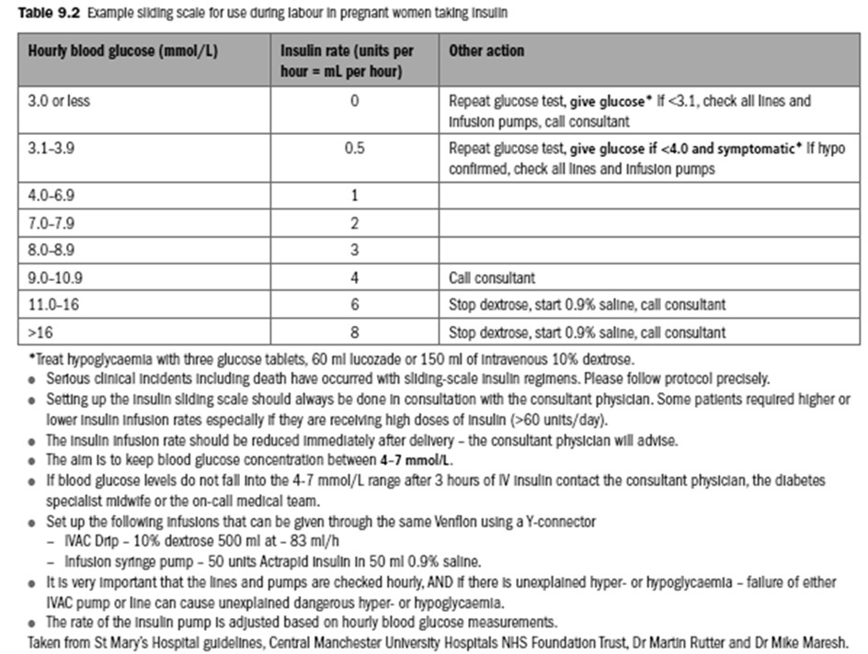
<54
55-70
72-124
126-142
144-160
162-196
198-288
>288

Slide 42
POSTPARTUM MANAGEMENT
Women with pregestational diabetes should be carefully monitored postpartum as they have a high risk of hypoglycemia and should be returned to their pre pregnancy doses of insulin.
Women with true GDM are unlikely to require insulin following delivery , so women with GDM should stop all hypoglycemic agents ( oral or insulin) immediately after birth .
All women should be encouraged to breast-feed, since this may reduce offspring obesity, especially in the setting of maternal obesity.
Current NICE guidelines recommend a fasting plasma glucose at 6-13 weeks when the woman attends for her postnatal check .
If this is not possible or has not been performed , a fasting glucose or HbA1c should be offered after 13 weeks .

Slide 43
RECOMMENDED POSTNATA L TESTING AND ACTIONS IN WOMEN WITH GDM

Slide 44
POSTPARTUM CARE
FOR PREGESTATIONAL DM
Some suggest changing insulin regimens to the pre-pregnancy dosing, others suggest halving of insulin doses, and this should be carefully planned by the diabetic team.
Careful capillary blood glucose monitoring is recommended to aid insulin dose adjustment for the first 2–3 days following delivery, aiming for values of 5–9 mmol/L.
Women who have undergone caesarean section will require continuation of the sliding scale until normal eating has been resumed.
Women with type 2 diabetes can change from insulin back to their oral hypoglycaemic agents.

Slide 45
BREASTFEEDING
Glycemic control is better in women who exclusively breastfeed than in those who bottle feed .
so overall breastfeeding should be supported.
Small cohort studies have demonstrated that breastfeeding increases the frequency of hypoglycemia in type 1 diabetics .
Thus, women should be advised to have a snack before or during breastfeeding
and be advised of this risk.
NICE currently recommends that women with pre-existing type 2 diabetes can safely take metformin and glibenclamide while breastfeeding.

Slide 46
KEY PRECONCEPTION INTERVENTIONS
- Optimize Glycemic Control:
Aim for A1C ≤ 6.5% (48 mmol/mol) before conception to minimize complications.
Maintain blood glucose as close to normal as safely possible.
- Family Planning & Contraception:
Discuss reproductive goals early.
Recommend effective contraception, prioritizing long-acting reversible options until A1C and treatment are optimized for pregnancy.

Slide 47
KEY PRECONCEPTION INTERVENTIONS
- Medication adjustments:
Switch to insulin if using oral hypoglycemic agents.
Discontinue teratogenic medications such as ace inhibitors and arbs to prevent fetal harm.
- Folic acid supplementation:
5 mg/day starting 3 months preconception until 12 weeks post-conception to reduce neural tube defects.

Slide 48
OPTIMIZING HEALTH BEFORE PREGNANCY
Achieve a Healthy Weight
Obesity increases the risk of adverse pregnancy outcomes—weight optimization is key.
Screen for & Manage Complications
Retinopathy: Requires ophthalmological evaluation before conception.
Nephropathy:
Assess serum creatinine & urine microalbumin/creatinine ratio (ACR).
Microalbuminuria or overt nephropathy increases the risk of hypertension & preeclampsia.

Slide 49
THANK YOU

