Slide 1
بسم الله الرحمن الرحيم
Polycystic Ovary Syndrome
A-Z
Dr Moamar Al-Jefout, MD, JBO&G, MMed (HR&HG), Ph.D Associate Professor in Human Reproduction.
Endoscopic Surgeon UAEU. CM&HS/UAE
. Mutah University/Jordan 2020 drmoamar@yahoo.co.uk

Slide 2
I received no financial compensation for this talk
I have no conflict of interest

Slide 3
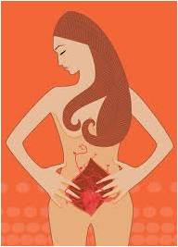
is a disorder that affects approximately 5% to 10% of reproductive-aged women and is characterized by irregular cycle, infertility, and excessive androgens
.
PCOS
Notes:
Custom animation effects: page turns in open book
(Difficult)
Tip: You will need to use drawing guides and the ruler to position the objects on this slide. For instructions on animating an opening book cover, refer to the previous slide (Custom animation effects: open book) for instructions.
To display the drawing guides and the ruler, do the following:
On the Home tab, in the Slides group, click Layout, and then click Blank.
Right-click the slide background area, and then click Grid and Guides. In the Grid and Guides dialog box, under Guide settings, select Display drawing guides on screen. (Note: One horizontal and one vertical guide will display on the slide at 0.00, the default position. The spine of the book will be aligned to the vertical drawing guide.)
On the View tab, in the Show/Hide group, select Ruler.
To reproduce the first shape in the Inside-left page 1 group on this slide, do the following:
On the Home tab, in the Drawing group, click Shapes, and then under Rectangles, click Rounded Rectangle (second option from the left). On the slide, drag to draw a rounded rectangle.
Select the rounded rectangle. Under Drawing Tools, on the Format tab, in the Size group, do the following:
In the Shape Height box, enter 4.5”.
In the Shape Width box, enter 3.33”.
On the rounded rectangle, drag the yellow diamond adjustment handle to the left to reduce the amount of rounding on the corners.
On the Home tab, in the bottom right corner of the Drawing group, click the Format Shape dialog box launcher. In the Format Shape dialog box, click Fill in the left pane, select Gradient fill in the Fill pane, and then do the following:
In the Type list, select Linear.
Click the button next to Direction, and then click Linear Left (first row, fifth option from the left).
In the Angle box, enter 180°.
Under Gradient stops, click Add or Remove until two stops appear in the drop-down list.
Also under Gradient stops, customize the gradient stops that you added as follows:
Select Stop 1 from the list, and then do the following:
In the Stop position box, enter 0%.
Click the button next to Color, and then under Theme Colors click Red, Accent 2, Darker 50% (sixth row, sixth option from the left).
Select Stop 2 from the list, and then do the following:
In the Stop position box, enter 100%.
Click the button next to Color, and then under Theme Colors click Red Accent 2, Darker 25% (fifth row, sixth option from the left).
Also in the Format Shape dialog box, click Line Color in the left pane. In the Line Color pane, select No line.
On the slide, drag the rectangle until the right edge is against the vertical drawing guide.
On the Home, tab, in the Drawing group, click the arrow under Arrange, point to Align, and then do the following:
Click Align to Slide.
Click Align Middle.
To reproduce the second shape in the Inside-left page 1 group on this slide, do the following:
On the Home tab, in the Drawing group, click Shapes, and then under Rectangles click Rectangle (first option from the left). On the slide, drag to draw a rectangle.
Select the rectangle. Under Drawing Tools, on the Format tab, in the Size group, do the following:
In the Shape Height box, enter 4.33”.
In the Shape Width box, enter 3.15”.
On the Home tab, in the bottom right corner of the Drawing group, click the Format Shape dialog box launcher. In the Format Shape dialog box, click Fill in the left pane, select Gradient fill in the Fill pane, and then do the following:
In the Type list, select Linear.
Click the button next to Direction, and then click Linear Left (first row, fifth option from the left).
In the Angle box, enter 180°.
Under Gradient stops, click Add or Remove until five stops appear in the drop-down list.
Also under Gradient stops, customize the gradient stops that you added as follows:
Select Stop 1 from the list, and then do the following:
In the Stop position box, enter 0%.
Click the button next to Color, and then under Theme Colors click White, Background 1, Darker 35% (fifth row, the first option from the left).
Select Stop 2 from the list, and then do the following:
In the Stop position box, enter 5%.
Click the button next to Color, and then under Theme Colors click White, Background 1 (first row, first option from the left).
Select Stop 3 from the list, and then do the following:
In the Stop position box, enter 18%.
Click the button next to Color, and then under Theme Colors click White, Background 1, Darker 5% (second row, first option from the left).
Select Stop 4 from the list, and then do the following:
In the Stop position box, enter 38%.
Click the button next to Color, and then under Theme Colors click White, Background 1 (first row, first option from the left).
Select Stop 5 from the list, and then do the following:
In the Stop position box, enter 93%.
Click the button next to Color, and then under Theme Colors click White, Background 1 (first row, first option from the left).
Also in the Format Shape dialog box, click Line Color in the left pane. In the Line Color pane, select No line.
Also in the Format Shape dialog box, click Shadow in the left pane. In the Shadow pane, click the button next to Presets, under Outer click Offset Right (second row, first option from the left), and then do the following:
In the Transparency box, enter 60%.
In the Size box, enter 100%.
In the Blur box, enter 4 pt.
In the Angle box, enter 0°.
In the Distance box, enter 3 pt.
On the slide, drag the rectangle until the right edge is against the vertical drawing guide.
On the Home tab, in the Drawing group, click Arrange, point to Align, and then do the following:
Click Align to Slide.
Click Align Middle.
On the Home tab, in the Editing group, click Select and then click Select All. On the Home tab, in the Drawing group, click Arrange, and then click Group.
On the Home tab, in the Editing group, click Select, and then click Selection Pane.
In the Selection and Visibility pane, double-click the group to edit the name, and then enter Inside-left page 1.
To reproduce the first shape in the Inside-right page 3 group on this slide, do the following:
On the Selection and Visibility pane, select the Inside-left page 1 group.
On the Home tab, in the Clipboard group, click the arrow under Paste, and then click Duplicate.
On the Home tab, in the Drawing group, click Arrange, point to Rotate, and then click More Rotation Options. In the Size and Position dialog box, on the Size tab, under Size and rotation, in the Rotation box, enter 180°.
On the Selection and Visibility pane, double-click the duplicate group to edit the name, and then enter Inside-right.
On the slide, drag the Inside-right group until the left edge is against the vertical drawing guide.
On the Home tab, in the Drawing group, click Arrange, point to Align, and then do the following:
Click Align to Slide.
Click Align Middle.
To reproduce the text box in the Inside-right page 3 group on this slide, do the following:
On the Insert tab, in the Text group, click Text Box. On the slide, drag to draw the text box.
Enter text in the text box, and then select the text. On the Home tab, in the Font group, do the following:
In the Font list, select Bodoni MT Condensed.
In the Font Size list, select 16.
Drag the text box onto the right-side page to the right of the vertical drawing guide.
If the text is wider than the page, drag the adjustment handles on the text box to decrease the width, and then repeat the previous step to reposition.
To reproduce the page edges in the Inside-right page 3 group on this slide, do the following:
On the Home tab, in the Drawing group, click Shapes, and then under Lines click Line (first option from the left).
On the slide, press and hold SHIFT, and then drag to draw a straight, vertical line.
Select the vertical line. Under Drawing Tools, on the Format tab, in the Size group, in the Shape Width box, enter 4.32”.
Under Drawing Tools, on the Format tab, in the Shape Styles group, click the arrow to the right of Shape Outline, and then under Theme Colors click White, Background 1, Darker 15% (third row, first option from the left).
On the Home tab, in the Clipboard group, click the arrow under Paste, and then click Duplicate. Repeat this process until there is a total of six lines.
On the slide, drag the lines until they are bunched together in a dense group, no wider than 0.5”.
In the Selection and Visibility pane, press and hold CTRL, and then select the six straight connectors (lines).
On the Home tab, in the Drawing group, click Arrange, and then do the following:
Point to Align, and then click Align Selected Objects.
Point to Align, and then click Distribute Horizontally.
Point to Align, and then click Align Middle.
Click Group.
On the slide, drag the group of lines until the right edge is touching the right edge of the white rectangle to the right of the vertical drawing guide.
On the Home tab, in the Drawing group, click Arrange, point to Align, and then do the following:
Click Align to Slide.
Click Align Middle.
In the Selection and Visibility pane, press and hold CTRL, and then select the group of lines, the text box, and the Inside-right group.
On the Home tab, in the Drawing group, click Arrange, and then click Group.
In the Selection and Visibility pane, double-click the new group to edit the name, and then enter Inside-right page 3.
To reproduce the first shape in the Inside-left page 2 group on this slide, do the following:
On the Home tab, in the Drawing group, click Shapes, and then under Rectangles click Rectangle (first option from the left). On the slide, drag to draw a rectangle.
Under Drawing Tools, on the Format tab, in the Size group, do the following:
In the Shape Height box, enter 4.33”.
In the Shape Width box, enter 3.15”.
On the Home tab, in the bottom right corner of the Drawing group, click the Format Shape dialog box launcher. In the Format Shape dialog box, click Fill in the left pane, select Gradient fill in the Fill pane, and then do the following:
In the Type list, select Linear.
Click the button next to Direction, and then click Linear Left (first row, fifth option from the left).
In the Angle box, enter 180°.
Under Gradient stops, click Add or Remove until five stops appear in the drop-down list.
Also under Gradient stops, customize the gradient stops that you added as follows:
Select Stop 1 from the list, and then do the following:
In the Stop position box, enter 0%.
Click the button next to Color, and then under Theme Colors click White, Background 1, Darker 35% (fifth row, first option from the left).
Select Stop 2 from the list, and then do the following:
In the Stop position box, enter 5%.
Click the button next to Color, and then under Theme Colors click White, Background 1 (first row, first option from the left).
Select Stop 3 from the list, and then do the following:
In the Stop position box, enter 18%.
Click the button next to Color, and then under Theme Colors click White, Background 1, Darker 5% (second row, first option from the left).
Select Stop 4 from the list, and then do the following:
In the Stop position box, enter 38%.
Click the button next to Color, and then under Theme Colors click White, Background 1 (first row, first option from the left).
Select Stop 5 from the list, and then do the following:
In the Stop position box, enter 93%.
Click the button next to Color, and then under Theme Colors click White, Background 1 (first row, first option from the left).
Also in the Format Shape dialog box, click Line Color in the left pane. In the Line Color pane, select No line.
Also in the Format Shape dialog box, click Shadow in the left pane. In the Shadow pane, click the button next to Presets, under Outer click Offset Right (second row, first option from the left), and then do the following:
In the Transparency box, enter 60%.
In the Size box, enter 100%.
In the Blur box, enter 4 pt.
In the Angle box, enter 0°.
In the Distance box, enter 3 pt.
On the slide, drag the rectangle until the right edge is against the vertical drawing guide.
On the Home tab, in the Drawing group, click the arrow under Arrange, point to Align, and then do the following:
Click Align to Slide.
Click Align Middle.
To reproduce the page edge in the Inside-left page 2 group on this slide, do the following:
On the Home tab, in the Drawing group, click Shapes, and then under Lines click Line (first option from the left).
On the slide, press and hold SHIFT, and then drag to draw a straight, vertical line.
Select the vertical line. Under Drawing Tools, on the Format tab, in the Size group, in the Shape Width box, enter 4.32”.
Under Drawing Tools, on the Format tab, in the Shape Styles group, click the arrow next to Shape Outline, and then under Theme Colors click White, Background 1, Darker 15% (third row, first option from the left).
On the slide, drag the line near the edge of the left-side page (white rectangle to the left of the vertical drawing guide).
On the Home tab, in the Drawing group, click Arrange, point to Align, and then do the following:
Click Align to Slide.
Click Align Middle.
In the Selection and Visibility pane, press and hold CTRL, and then select the rectangle and the straight connector (line).
On the Home tab, in the Drawing group, click the arrow under Arrange, and then click Group.
In the Selection and Visibility pane, double-click the new group to edit the name, and then enter Inside-left page 2.
To reproduce the first shape in the Inside-right page 2 group on this slide, do the following:
In the Selection and Visibility pane, select the Inside-left page 2 group.
On the Home tab, in the Clipboard group, click the arrow under Paste, and then click Duplicate.
With the duplicate group still selected, on the Home tab, in the Drawing group, click Arrange, point to Rotate, and then click More Rotation Options. In the Size and Position dialog box, on the Size tab, under Size and rotation, in the Rotation box, enter 180°.
In the Selection and Visibility pane, double-click the duplicate group to edit the name, and then enter Inside-right.
In the Selection and Visibility pane, select the new Inside-right group. On the slide, drag the selected group until the left edge is against the vertical drawing guide.
On the Home, tab, in the Drawing group, click Arrange, point to Align, and then do the following:
Click Align to Slide.
Click Align Middle.
On the Insert tab, in the Illustrations group, click Picture. In the Insert Picture dialog box, select a picture, and then click Insert.
On the slide, select the picture. Under Picture Tools, on the Format tab, in the bottom right corner of the Size group, click the Size and Position dialog box launcher. Select the picture. Under Picture Tools, on the Format tab, in the bottom right corner of the Size group, click the Size and Position dialog box launcher. In the Size and Position dialog box, on the Size tab, resize or crop the picture as needed so that under Size and rotate, the Height box is set to 1.4” and the Width box is set to 2.1”. Resize the picture under Size and rotate by entering values into the Height and Width boxes. Crop the picture under Crop from by entering values into the Left, Right, Top, and Bottom boxes.
On the slide, drag the picture until the left edge is 0.5” to the right of the vertical drawing guide and the bottom edge is 0.5” above the horizontal drawing guide.
To reproduce the text box in the Inside-right page 2 group on this slide, do the following:
On the Insert tab, in the Text group, click Text Box. On the slide, drag to draw the text box.
Enter text in the text box, and then select the text. On the Home tab, in the Font group, do the following:
In the Font list, select Bodoni MT Condensed.
In the Font Size list, select 16.
On the slide, drag the text box until the left edge of the text is 0.5” to the right of the vertical drawing guide and the top edge of the text is against the horizontal drawing guide.
If the text is too wide for the page, drag the adjustment handles on the text box to adjust the width, and then repeat the previous step to reposition.
To reproduce the page edges in the Inside-right page 2 group on this slide, do the following:
In the Selection and Visibility pane, select the Inside-right group you just created. On the Home tab, in the Drawing group, click Arrange, and then click Ungroup.
In the Selection and Visibility pane, select the straight connector (line) that you just ungrouped from the page. On the Home tab, in the Clipboard group, click the arrow under Paste, and then click Duplicate. Repeat this process for a total of six lines.
On the slide, drag the six lines until they are bunched together in a dense group, no wider than 0.5”.
In the Selection and Visibility pane, press and hold CTRL, and then select the six straight connectors (lines). On the Home tab, in the Drawing group, click Arrange, point to Align, and then do the following:
Click Align Selected Objects.
Click Distribute Horizontally.
Click Align Middle.
With the group of lines still selected, on the Home tab, in the Drawing group, click Arrange, and then click Group.
On the slide, drag the group until the right edge of the group of lines is touching the right edge of the page.
On the Home tab, in the Drawing group, click Arrange, point to Align, and then do the following:
Click Align to Slide.
Click Align Middle.
In the Selection and Visibility pane, press and hold CTRL, and then select the new group of lines and the rectangle. On the Home tab, in the Drawing group, click the arrow under Arrange, and then click Group.
Also in the Selection and Visibility pane, double-click the new group to edit the name, and then enter Inside-right.
Also in the Selection and Visibility pane, press and hold CTRL, and then select the Inside-right group, the text box, and the picture. On the Home tab, in the Drawing group, click Arrange, and then click Group.
In the Selection and Visibility pane, double-click the new group to edit the name, and then enter Inside-right page 2.
To reproduce the first shape in the Inside-left page 3 group, do the following:
In the Selection and Visibility pane, select the Inside-left page 2 group.
On the Home tab, in the Clipboard group, click the arrow under Paste, and then click Duplicate.
In the Selection and Visibility pane, double-click the duplicate group to edit the name, and then enter Inside-left.
On the slide, drag the rectangle until the right edge is against the vertical drawing guide.
On the Home, tab, in the Drawing group, click Arrange, point to Align, and then do the following:
Click Align to Slide.
Click Align Middle.
To reproduce the picture in the Inside-left page 3 group, do the following:
On the Insert tab, in the Illustrations group, click Picture. In the Insert Picture dialog box, select a picture, and then click Insert.
On the slide, select the picture. Under Picture Tools, on the Format tab, in the bottom right corner of the Size group, click the Size and Position dialog box launcher. In the Size and Position dialog box, on the Size tab, resize or crop the picture as needed so that under Size and rotate, the Height box is set to 1.4” and the Width box is set to 2.1”. Resize the picture under Size and rotate by entering values into the Height and Width boxes. Crop the picture under Crop from by entering values into the Left, Right, Top, and Bottom boxes.
On the slide, drag the picture until the left edge is 0.5” to the right of the vertical drawing guide and the top edge is 0.25” below the horizontal drawing guide.
To reproduce the text box in the Inside-left page 3 group, do the following:
On the Insert tab, in the Text group, click Text Box, and then on the slide, drag to draw the text box.
Enter text in the text box, and then select the text. On the Home tab, in the Font group, do the following:
In the Font list, select Bodoni MT Condensed.
In the Font Size list, select 16.
On the slide, drag the text box until the right edge of the text is 0.5” to the left of the vertical drawing guide and the bottom edge of the text is 0.25” above the horizontal drawing guide.
If the text is too wide for the page, drag the adjustment handles on the text box to decrease the width, and then repeat the previous step to reposition.
To reproduce the page edges in the Inside-left page 3 group, do the following:
In the Selection and Visibility pane, select the Inside-left group you just created. On the Home tab, in the Drawing group, click Arrange, and then click Ungroup.
In the Selection and Visibility pane, select the straight connector (line) that you just ungrouped from the page. On the Home tab, in the Clipboard group, click the arrow under Paste, and then click Duplicate.
On the slide, drag the duplicate line until it is very close to the original line.
In the Selection and Visibility pane, press and hold CTRL, and then select the two straight connectors (lines). On the Home tab, in the Drawing group, click Arrange, point to Align, and then do the following:
Click Align Selected Objects.
Click Align Middle.
With the group of lines still selected, on the Home tab, in the Drawing group, click Arrange, and then click Group.
On the slide, drag the group until the left edge of the group of lines is touching the left edge of the rectangle.
On the Home tab, in the Drawing group, click Arrange, point to Align, and then do the following:
Click Align to Slide.
Click Align Middle.
In the Selection and Visibility pane, press and hold CTRL, and then select the new group of lines, the rectangle, the text box, and the picture. On the Home tab, in the Drawing group, click the arrow under Arrange, and then click Group.
Also in the Selection and Visibility pane, double-click the new group to edit the name, and then enter Inside-left page 3.
To reproduce the first shape in the Inside-right page 1 group on this slide, do the following:
In the Selection and Visibility pane, select the Inside-left page 2 group.
On the Home tab, in the Clipboard group, click the arrow under Paste, and then click Duplicate.
In the Selection and Visibility pane, double-click the new group to edit the name, and then enter Inside-right.
In the Selection and Visibility pane, select the Inside-right group. On the Home tab, in the Drawing group, click Arrange, point to Rotate, and then click More Rotation Options. In the Size and Position dialog box, on the Size tab, under Size and rotation, in the Rotation box, enter 180°.
On the slide, drag the group until the left edge is against the vertical drawing guide.
On the Home tab, in the Drawing group, click Arrange, point to Align, and then do the following:
Click Align to Slide.
Click Align Middle.
To reproduce the text box in the Inside-right page 1 group on this slide, do the following:
On the Insert tab, in the Text group, click Text Box. Drag to draw a text box on the slide.
Enter text in the text box (to match the example above, enter Introduction), and then select the text. On the Home tab, in the Font group, do the following:
In the Font list, select Vivaldi.
In the Font Size list, select 18.
On the Home tab, in the Paragraph group, click Center to center the text in the text box.
On the slide, drag the text box until the left edge of the text is 0.75” to the right of the vertical drawing guide and the bottom edge of the text is 0.5” above the horizontal drawing guide.
If the text is too wide for the page, drag the adjustment handles on the text box to decrease the width, and then repeat the previous step to reposition.
To reproduce the page edges in the Inside-right page 1 group on this slide, do the following:
In the Selection and Visibility pane, select the Inside-right group you just created. On the Home tab, in the Drawing group, click Arrange, and then click Ungroup.
In the Selection and Visibility pane, select the straight connector (line) that you just ungrouped from the page. On the Home tab, in the Clipboard group, click the arrow under Paste, and then click Duplicate. Repeat this process for a total of six lines.
On the slide, drag the six lines until they are bunched together in a dense group, no wider than 0.5”.
In the Selection and Visibility pane, press and hold CTRL, and then select the six straight connectors (lines). On the Home tab, in the Drawing group, click Arrange, point to Align, and then do the following:
Click Align Selected Objects.
Click Distribute Horizontally.
Click Align Middle.
With the group of lines still selected, on the Home tab, in the Drawing group, click Arrange, and then click Group.
On the slide, drag the group until the right edge of the group of lines is touching the right edge of the page.
On the Home tab, in the Drawing group, click Arrange, point to Align, and then do the following:
Click Align to Slide.
Click Align Middle.
In the Selection and Visibility pane, press and hold CTRL, and then select the new group of lines, the rectangle, and the text box. On the Home tab, in the Drawing group, click the arrow under Arrange, and then click Group.
Also in the Selection and Visibility pane, press and hold CTRL, double-click the new group to edit the name, and then enter Inside-right page 1.
Right-click the slide background area, and then click Grid and Guides. In the Grid and Guides dialog box, under Guide settings, clear Display drawing guides on screen.
On the View tab, in the Show/Hide group, clear Ruler.
In the Selection and Visibility pane, the final arrangement of the six groups of objects should be the following (from top to bottom):
Inside-right page 1
Inside-left page 3
Inside-right page 2
Inside-left page 2
Inside-right page 3
Inside-left page 1
To move a group of objects up in the Selection and Visibility pane, do the following:
In the Selection and Visibility pane, select the group of objects.
On the Home tab, in the Drawing group, click Arrange, and then click Bring Forward.
To move a group of objects down in the Selection and Visibility pane, do the following:
In the Selection and Visibility pane, select the group of objects.
On the Home tab, in the Drawing group, click Arrange, and then click Send Backward.
To reproduce the animation effects on this slide, do the following:
On the Animations tab, in the Animations group, click Custom Animation.
In the Selection and Visibility pane, select the Inside-right page 1 group. In the Custom Animation task pane, do the following:
Click Add Effect, point to Exit, and then click More Effects. In the Add Exit Effect dialog box, under Moderate, click Collapse.
Select the first animation effect (collapse effect for the Inside-right page 1 group). Under Modify: Collapse, do the following:
In the Start list, select With Previous.
In the Direction list, select To Left.
In the Speed list, select Fast.
In the Selection and Visibility pane, select the Inside-left page 2 group. In the Custom Animation task pane, do the following:
Click Add Effect, point to Entrance, and then click More Effects. In the Add Entrance Effect dialog box, under Moderate, click Stretch.
Select the second animation effect (stretch effect for the Inside-left page 2 group). Under Modify: Stretch, do the following:
In the Start list, select After Previous.
In the Direction list, select From Right.
In the Speed list, select Fast.
In the Selection and Visibility pane, select the Inside-right page 2 group. In the Custom Animation task pane, do the following:
Click Add Effect, point to Exit, and then click More Effects. In the Add Exit Effect dialog box, under Moderate, click Collapse.
Select the third animation effect (collapse effect for the Inside-right page 2 group). Under Modify: Collapse, do the following:
In the Start list, select On Click.
In the Direction list, select To Left.
In the Speed list, select Fast.
In the Selection and Visibility pane, select the Inside-left page 3 group. In the Custom Animation task pane, do the following:
Click Add Effect, point to Entrance, and then click More Effects. In the Add Entrance Effect dialog box, under Moderate, click Stretch.
Select the fourth animation effect (stretch effect for the Inside-left page 3 group). Under Modify: Stretch, do the following:
In the Start list, select After Previous.
In the Direction list, select From Right.
In the Speed list, select Fast.
To reproduce the background effects on this slide, do the following:
Right-click the slide background area, and then click Format Background. In the Format Background dialog box, click Fill in the left pane, select Gradient fill in the Fill pane, and then do the following:
In the Type list, select Linear.
Click the button next to Direction, and then click Linear Down (first row, second option from the left).
Under Gradient stops, click Add or Remove until two stops appear in the drop-down list.
Also under Gradient stops, customize the gradient stops that you added as follows:
Select Stop 1 from the list, and then do the following:
In the Stop position box, enter 63%.
Click the button next to Color, and then under Theme Colors click Black, Text 1 (first row, second option from the left).
Select Stop 2 from the list, and then do the following:
In the Stop position box, enter 100%.
Click the button next to Color, and then under Theme Colors click Black, Text 1, Lighter 50% (second row, fifth option from the left).

Slide 4
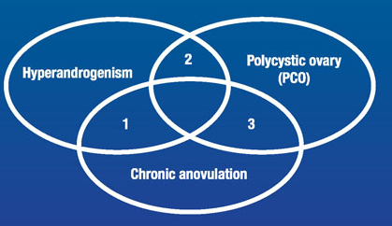

Slide 5
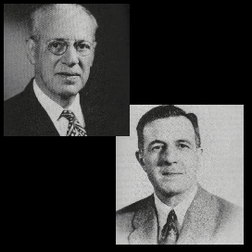
History
The description of polycystic ovaries dates back as far as 1720.
Stein and Leventhal, USA 1935.

Slide 6
Disease evolution!!!! Thrifty phenotype hypothesis????

Slide 7
PCOS is just another form of diabetes (type III diabetes)

Slide 8
Natural history (E. Diamanti-Kandarakis, 2010)

Slide 9
Prevalence
The UK and US------6–7%.
The prevalence tends to vary depending on ethnicity and the criteria used to define PCOS.
PCOS is higher in those with:
gestational diabetes.
premature adrenarche
in those with first-degree relatives who have PCOS.
DENND1A over-expression

Slide 10
Genetics
Clusters in families and both female and male relatives can show stigmata of the syndrome
Complex, polygenic disorder with multiple alleles associated with a small degree of risk
Genome-wide association studies implicate many genes, including:
LHCGR (luteinizing hormone/choriogonadotropin receptor)
FSHR (follicle stimulating hormone receptor)
INSR (insulin receptor)
DENND1A (DENN domain containing 1A)
THADA (THADA armadillo repeat containing)

Slide 11
Ethnicity/race
Ethnic variations affect phenotypic expression
Patients of European ancestry display greater midline hirsutism than those of East Asian ancestry
Patients of African ancestry have higher rates of hypertension and cardiovascular risk factors
Patients of Mediterranean ancestry have greater quantities of body hair compared with most patients of Asian ancestry, who have relatively little body hair
Other risk factors/associations
Associated with several cardiometabolic diseases or conditions that should be assessed and monitored
Obesity (about 75% of patients)
Type 2 diabetes mellitus (about 10% of patients)
Dyslipidemia (about 70% of patients)
Obstructive sleep apnea
Nonalcoholic steatohepatitis
Subclinical vascular disease

Slide 12
Long term effects
Obesity: the best waist circumference >78 cm
Poor Quality of life
Depression (Rasgon NL, 2003)
DM------20%-
HT-------40 % (Enrico Carmina, 1998)
Higher rate of TAH
Cardiovascular diseases. (L. W. Cho, 2011)
Ca endometrium & ovary------2-3 fold (E Carmina, 1997)
PCOS and pregnancy.
Hirsutism.
Infertility.
Sleep apnea
IBS

Slide 13
WHO classes of anovulation
Class 1: Hypogonadotrophic hypogonadal anovulation
Class 2: Normogonadotrophic normooestrogenic anovulation
This group accounts for 85% of ovulatory disorders. Women may secrete normal gonadotrophins and oestrogens but FSH secretion during the follicular phase is subnormal. This subgroup includes women with PCOS.
Class 3: Hypergonadotrophic hypogonadism
Hyperprolactinaemic anovulation

Slide 14
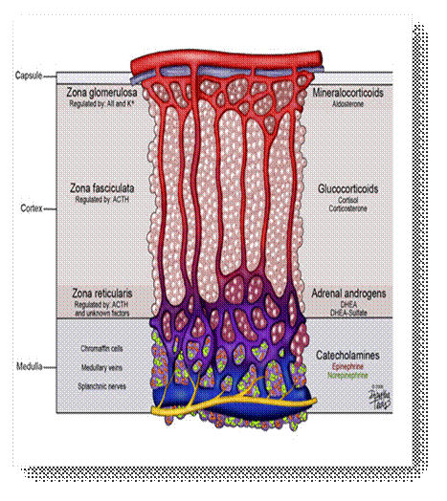
Schematic presentation of the adrenal zones and the main product

Slide 15
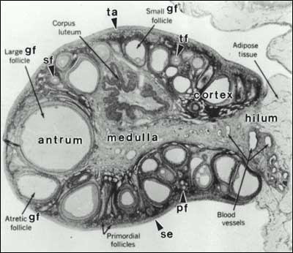
The adult ovary can be subdivided into three regions: the cortex, medulla, and hilum regions

Slide 16
Ovarian steroidogenesis

Slide 17
Ovarian Vs Adrenal steroidogenesis
The ovary lacks the 21-hydroxylase and B-hydroxylase reactions.
Hence, no glucocorticoids and mineralocorticoids in the ovary

Slide 18
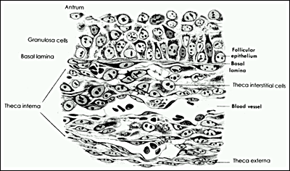

Slide 19
Two gonadotropin-two cell theory

Slide 20
Folliculo-genesis in PCOS
PCOS: is the commonest cause of anovulatory infertility.
Anovulation in PCOS is characterized by arrested growth of antral follicles.
Although arrested antral follicle growth probably reflects the abnormal endocrine environment in PCOS (and, particularly the effect of hyperinsulinemia),
There is increasing evidence of abnormalities of follicle development from the very earliest, gonadotropin-independent stages.
The underlying molecular basis of this fundamental ovarian abnormality remains to be determined.

Slide 21
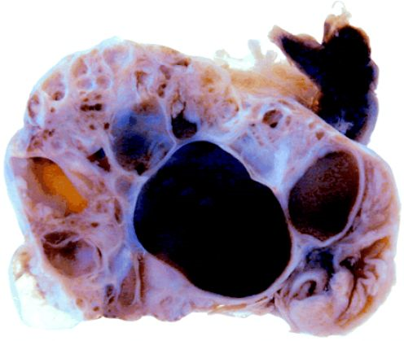
Ovarian follicular defect
Notes:
#

Slide 22
Anti-Mullerian Hormone (AMH)
AMH is a polypeptide of the transforming growth factor beta (TGFβ) family, solely secreted by granulosa cells of the pre-antral and small antral ovarian follicles
Serum AMH levels are elevated in normoandrogenic women with PCO and are further increased in hyperandrogenic women with PCO, independent of antral follicle number.
Serum AMH levels in PCOS patients are elevated two to threefold, are positively correlated with antral follicle number and serum androgen levels, and are reduced in parallel with antral follicle number by metformin therapy
In women, AMH inhibits the recruitment of primordial follicles out of the resting oocyte pool and may suppress follicle-stimulating hormone (FSH) action contributing to ovulatory disturbances

Slide 23
Pathophysiology: Abnormalities in the hypothalamic pituitary axis (HPA)
GnRH
hypothalamus
LH
pituitary
Androgens block inhibitory effect of progesterone
X
ovary
androgens

Slide 24
Insulin resistance
Insulin resistance is defined as a reduced glucose response to a given amount of insulin and usually results from faults within the insulin receptor and post-receptor signalling.
In the ovary, high levels of circulating insulin are thought to contribute both to excess androgen production and to anovulation.

Slide 25
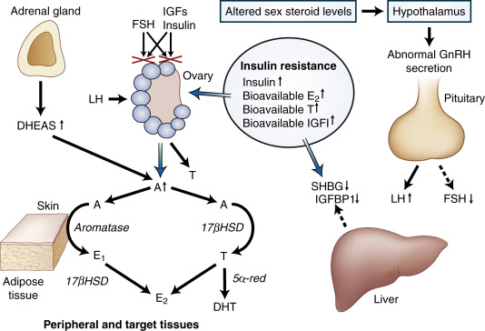

Slide 26
Insulin resistance (post receptoral defect)
Notes:
Very imp

Slide 27
Insulin resistance:
dyslipidemia & elevated level of plasminogen activator inhibitor-1
Notes:
SHBG: steroid hormone binding globulin very imp

Slide 28
The endometrium in women with PCOS
The endometrium in women with PCOS is affected by hormonal and metabolic abnormalities:[1] .
has high levels of insulin-like growth factor-1 (IGF-1) activity [2] ,
decreased concentrations of sex hormone- binding globulin (SHBG) [3] ,
up-regulation of endometrial aromatase, hyperandrogenemia and hyperinsulinemia.
Consequently, those molecular changes increase the potential for neoplastic changes within the endometrium [4]
1- Giudice, L.C. (2006) 2- Wu, M.-H., et al. (2004), 3- Jayagopal, V., et al. (2003) 4-Chittenden, B., et al. (2009)

Slide 29
Unopposed E2
Anovulation- the progesterone levels are within suboptimal or absent effects over the endometrium----over-response to the proliferative effects of estrogen (E2) [1] .
Insulin resistance and hyperinsulinemia especially in obese patients may trigger the development of PCOS in genetically predisposed individuals [2] .
Therefore, in PCOS, the prolonged unopposed oestrogen, hyperinsulinemia, elevated free IGF-1 and androgens may further augment mitogenic activity within endometrial cells by activating mitogen-activated protein kinase (MAPK), leading to high prevalence of hyperplasia and possible transformation to endometrial cancer [3] [4] .
1- Chittenden, B., et al. (2009) 2- Al-Jefout et al (2017) 3- Venturoli, S., et al. (1988) 4-Park, J.C., et al. (2011)

Slide 30
Endometrial hyperplasia
Up to one-third of endometrial carcinomas are assumed to be preceded by hyperplasia [1] .
The prevalence of endometrial hyperplasia in women with PCOS varies from 1% to 48.8% [2]
Anovulation - risk factor for EH, with or without atypia [3, 4].
The prevalence of endometrial cancer among PCOS cases is not higher than those of the general population [5,6] .
In women with PCOS is estimated to be around 20% - 37% [7] , which increases even more in obese women with PCOS [8]
Conversely, a recent review stated that this risk is overestimated [9] .
1- Kurman, R.J., (1985) 2- Holm, N.S.L., et al. (2012) 3- Chamlian, D.L. and Taylor, H.B. (1970) 4- Ho, S.P., et al. (1997).5- Cheung, A.P. (2001) 6- Hardiman, P., Pillay, O.S. and Atiomo, W. (2003) 7-Lin, S.L., et al. (2013) 8- Fanta, M. (2013) 9-Eryilmaz, O.G., et al. (2012)

Slide 31
Endometrial thickness & EH in PCOS (Al-Jefout et al, 2018)
There is some evidence showing that there is an increase in endometrial thickness throughout the menstrual cycle in infertile patients with PCOS, when compared to infertile patients without PCOS [1] .
Several studies have attempted to find a predictive cut-off value to measure endometrial thickness in cases of patients with EH [2,3] .
Though, it is still unclear at this stage to determine which PCOS patients need endometrial biopsy for the purpose of intervention to avoid any long term complications.
1- Eryilmaz, O.G., et al. (2012) 2- McCormick, B.A., et al. (2011) 3-Tingthanatikul, Y., et al. (2006)

Slide 32
Endometrial thickness & EH in PCOS (Al-Jefout et al, 2018)
Our results showed that the prevalence of endometrial hyperplasia among infertile patients with PCOS is 18.3%.
This prevalence of EH is in concordance with the figures worldwide; 1% to 48.8%
The high prevalence of EH in our population may be explained that these are infertility cases with long standing PCOS.
Recently, McCormick et al. suggested an ET of 9.35 mm as the threshold to detect endometrial hyperplasia only in obese patients with PCOS, with100% sensitivity, 56% specificity, 100% negative predictive value, and 50% positive predictive value.
Cheung, A.P. (2001) suggested 7 mm as a threshold with 100% sensitivity but with low specificity (27.8%) for endometrial hyperplasia POCS patients.

Slide 33
Endometrial thickness & EH in PCOS (Al-Jefout et al, 2018)
We propose a new threshold value of 9.5 mm of endometrial thickness measured in the follicular phase by vaginal U/S, which had a high sensitivity of 92.9%, and moderate specificity of 51.85% with positive predictive value of 47.8%, and negative predictive value of 100%.
The cutoff value of 9.5 mm is more practical and it achieves a good predictive value in obese and none-obese women with PCOS.

Slide 34
IR & oligo/amenorrhea in PCOS patients
IR values in PCOS patients correlate with high BMI and WC values
There was a significant difference among four phenotype groups in terms of prevalence of IR (Χ = 39; P < 0.01). (Al-Jefout et al, 2017)
In our study, partial correlation analysis; ET was positively correlated with insulin resistance (r = 0.439, P = 0.007), which points to the importance of insulin resistance in the pathophysiology of PCOS and associated long term possible risk for developing EH.
In women with normal periods the HOMA-IR values were 2.96 (2.47-3.37) and were less than in women with oligo/amenorrhea 3.18 (2.77-3.79) with P value - 0.041. (Al-Jefout et al, 2017)
In our study, women with oligo/amenorrhea or irregular cycles were 5.5 and 13.7 times more at risk of developing EH than women with regular cycles respectively.
Cheung, A.P. (2001) has shown that the risk of endometrial hyperplasia raises by 43.2% (OR 1.4) in PCOS patients with amenorrhea for more than 3 - 6 months.

Slide 35
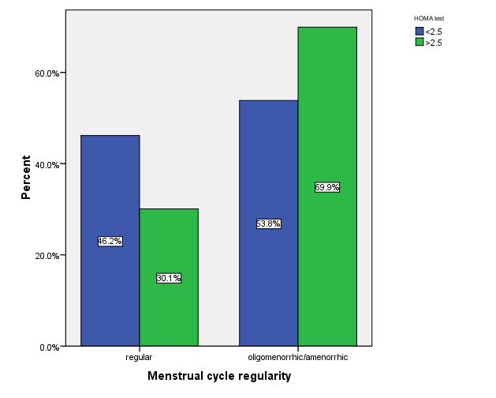
IR & Menstrual irregularities (Al-Jefout et al 2017)

Slide 36
Triangle of EVEL in PCOS (Al-Jefout, 2020)
Infertility & PCOS
Insulin resistance
Endometrial hyperplasia
Oligo/
amenorrhea

Slide 37
Criteria for Defining PCOS
NIH 1990
To include all of the following:
Clinical hyperandrogenism and/orhyperandrogenemia.
Chronic anovulation
Exclusion of related disorders
ESHRE/ASRM (Rotterdam) 2003
To include two of the following in addition to exclusion of related disorders:
Oligoanovulation
Hyperandrogenism and/or hyperandrogenemia
PCO on U/S

Slide 38
Criteria for Defining PCOS
AES 2006 To include all of the following:
Hyperandrogenism (hirsutism and/or hyperandrogenemia)
Ovarian dysfunction (oligoanovulation and/or polycystic ovaries)
Exclusion of related disorders .
AES, Androgen Excess Society.

Slide 39
PCOS phenotypes
(Phenotype A)
Androgen excess + ovulatory dysfunction + polycystic ovarian morphology
(Phenotype B)
Androgen excess + ovulatory dysfunction
(Phenotype C)
Androgen excess + polycystic ovarian morphology
(Phenotype D)
Ovulatory dysfunction + polycystic ovarian morphology
(Al-Jefout et al 2017, Livadas and Diamanti-Kandarakis, 2012, National Institutes of Health (NIH),2012)

Slide 40
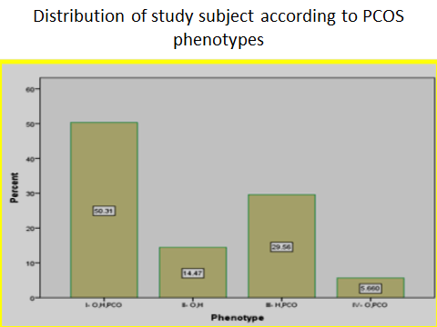
Prevalence of different PCOS phenotypes (Al-Jefout et al, 2017)
The most common phenotype in our study was
type I - 50.3% (n = 80/159),
Type III (women with hyperandrogenism, polycystic ovaries and normal ovulatory cycles; H/PCO-ovulatory PCOS) 29.6% (n = 47/159).
Type II women had chronic anovulation and hyperandrogenism but normal ovarian morphology, (H/O), 14.5% (n = 23/159)
Type IV - 5.7% (n = 9/159) (O/PCO, no hyperandrogenism but chronic anovulation and polycystic ovaries).

Slide 41
Diagnosis in adolescent requires special considerations
Diagnosis in adolescents is controversial as it is complicated by several factors
Many features of polycystic ovary syndrome, including acne, menstrual irregularities, and hyperinsulinemia, are common in normal puberty
Menstrual irregularities with anovulatory cycles and varied cycle length are common in adolescents for approximately 2 years after menarche owing to immaturity of hypothalamic-pituitary-ovarian axis
Multicystic ovaries are a common normal finding in adolescents owing to natural history of ovarian development at menarche

Slide 42
Proposed criteria for diagnosis in adolescents include the otherwise unexplained combination of:
Abnormal uterine bleeding pattern, meeting both of the following requirements:
Abnormal for gynecologic age (eg, ovulatory dysfunction that persists more than 2 years after menarche)
Cycles shorter than 19 days or longer than 90 days are abnormal at any stage
75% of menstrual cycles range from 21 to 45 days during first postmenarcheal (gynecologic) year
95% of adolescents achieve 21- to 40-day adult menstrual cyclicity by fifth gynecologic year
Persistent symptoms for 1 to 2 years
In adolescent females, large, multicystic ovaries are a common finding; therefore, ultrasonography is not a recommended investigation in patients younger than 17 years

Slide 43
Clinical Presentation History
Reproductive history
Menstrual dysfunction occurs in 75% to 85% of patients 9
Oligomenorrhea or amenorrhea (infrequent or absent menstrual bleeding) is the most common pattern, with most intervals greater than 35 days 3
Polymenorrhea (less than 21-day intervals) is relatively rare 3
Onset usually develops in adolescence; may start at menarche, or shortly thereafter 9
In some adolescents, condition is noted by absence of established regular menses 3
Note that ovulatory dysfunction can be present subclinically, with no obvious disruption in regularity of vaginal bleeding 9

Slide 44
History of clinical hyperandrgenism
Hair and skin concerns
Excessive terminal body hair growth is a common concern
Hirsutism develops gradually and worsens with weight gain
Acne can occur with hirsutism; overall, acne is less common as a presenting complaint (15%-30% of patients)
During adolescence, acne is not considered a firm sign of hyperandrogenism; however, if it persists into the mid-20s or 30s, it is often a sign of hyperandrogenism
Hair loss, when it occurs, is most pronounced over vertex or crown and spares frontal hairline

Slide 45
Physical examination
Signs of hyperandrogenism
Hirsutism (about 75% of patients; more severe in abdominally obese patients)
Excessive terminal hair that appears in a male pattern (eg, chest, midline lower abdomen, above lip)
Terminal hairs grow more than 5 mm in length, are pigmented, and have a central core of compacted cells, which gives a denser color and coarser feel and shape
Substantial numbers of terminal hairs over chin, neck, lower face, and sideburns indicate androgen excess
Ferriman-Gallwey score of 8 or higher is generally considered to represent hirsutism
Acne (60% of patients, at some point)
Acanthosis nigricans (37% of patients)
Androgenic alopecia (about 5% of patients)
Typically affects vertex or crown in diffuse pattern
Acrochordons: (fibroepithelial polyps, skin tags, papillomas) are common benign neoplasms of the skin, often associated with obesity.

Slide 46
Physical examination
Overweight or obesity (about 75% of patients)
Central distribution of adiposity can also be present in those with BMI in reference range
Overweight: BMI of 25 kg/m² or higher
Obese: BMI of 28 kg/m² or higher
Waist circumference greater than 88 cm is considered abdominal obesity in women
Waist to hip ratio greater than 0.8 is considered unhealthy

Slide 47
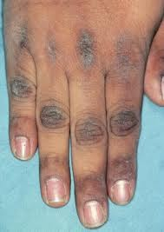
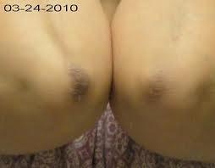
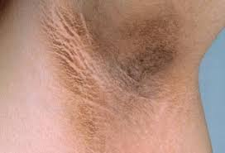
Acanthosis Negricans

Slide 48
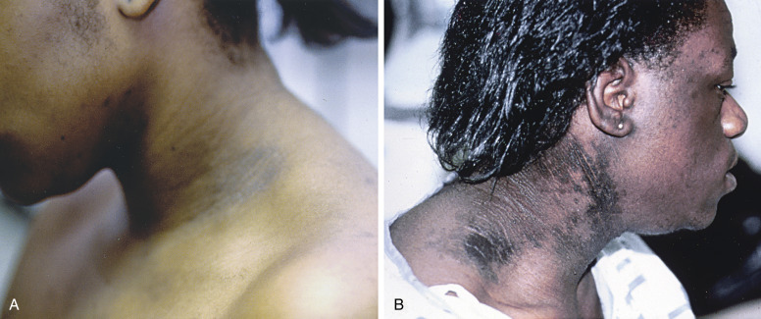

Slide 49
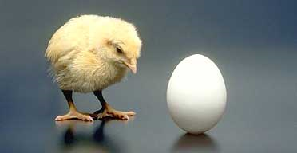
What comes first, the hyperinsulinemia or the hyperandrogenism ?
Insulin increases circulating androgen levels
Glucose increases the circulating levels of both insulin and androgen
Weight loss decreases the levels of both insulin and andrgens
In vitro, insulin stimulates thecal cell androgren productions
The experimental reduction of insulin levels in PCOS women reduces androgen levels
After normalisation of androgen with GnRH-a, the hyperinsulin response to GTT remains abnormal in obese women with PCOS.
Notes:
#

Slide 50
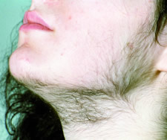
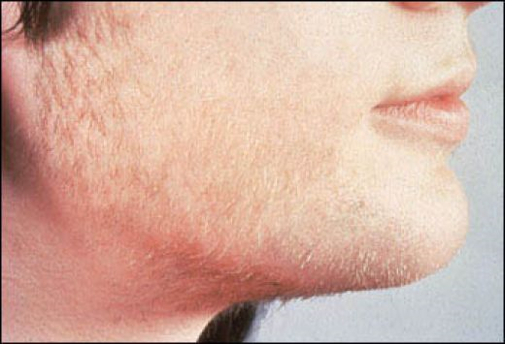
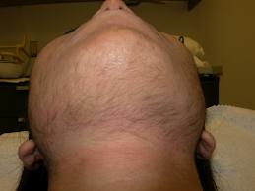
Hirsutism

Slide 51
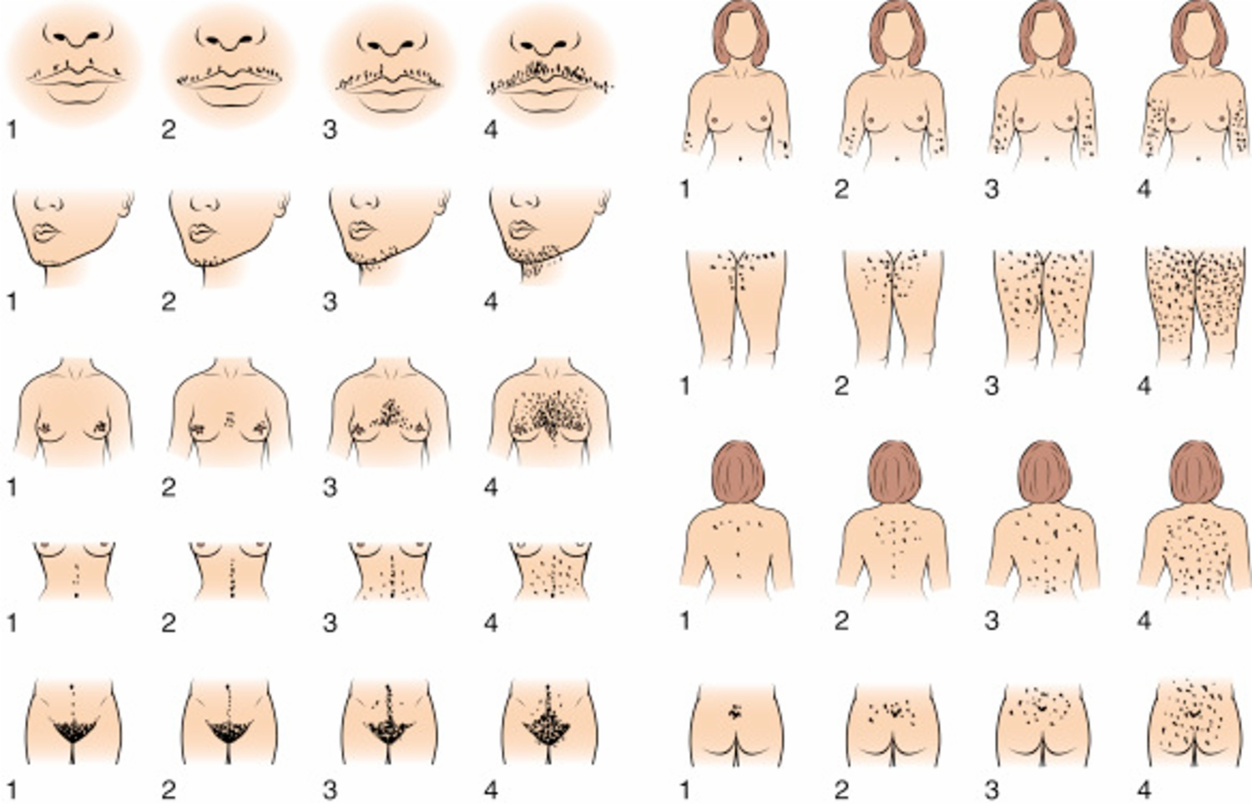
Ferriman–Gallwey scoring system
The Ferriman-Gallwey scoring system is used to quantify the amount of hair growth.
Each area of the body is scored for the amount of hair.
A score 6–8 corresponds to mild hirsutism,
A score 8–15 corresponds to serious and more than 15 corresponds to overt hirsutism.

Slide 52
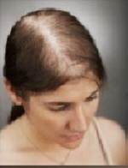
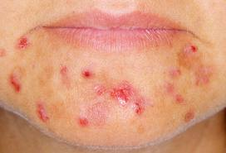
Alopecia and acne

Slide 53
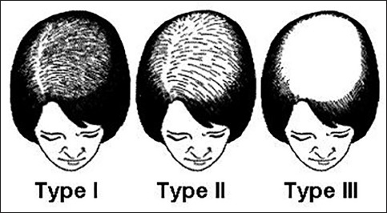
Ludwig's classification of hair loss among females
Grade I: Perceptible thinning of the hair on the crown, limited in the front by a line situated 1-3 cm behind the frontal hairline
Grade II: Pronounced rarefaction of the hair on the crown within the area seen in Grade I.
Grade III: Full baldness (total denudation) within the area seen in Grades I and II.

Slide 54
Clinical features of polycystic ovarian disease. Goldzieher JW, Axelrod LR,1963, Fertil Steril 14:631-653

Slide 55
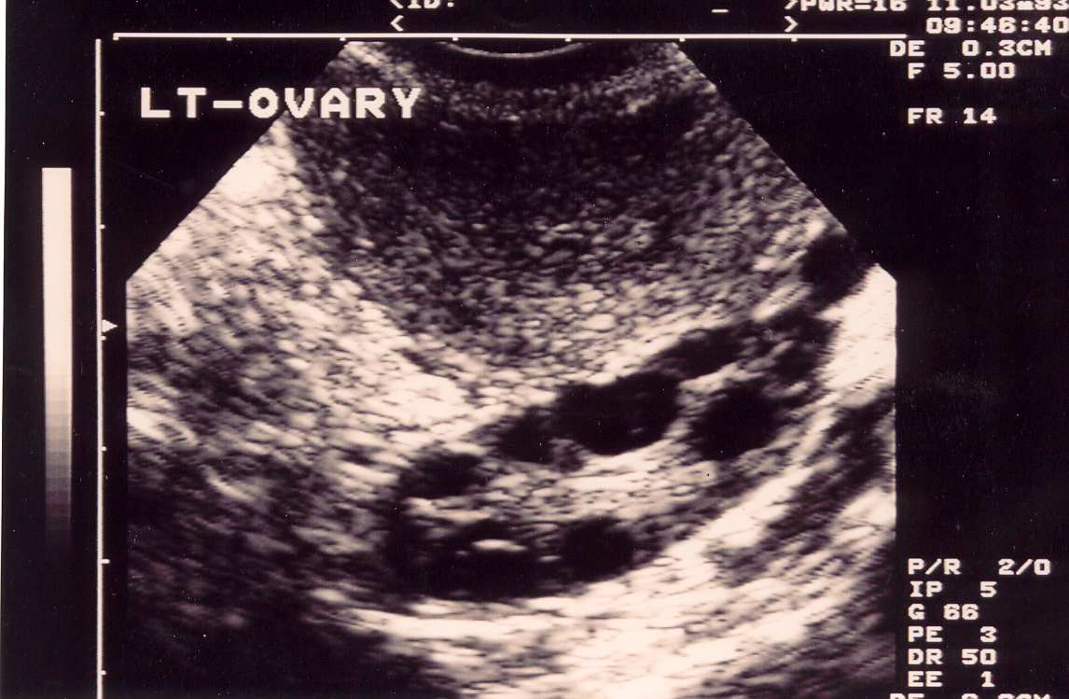
PCO
Ultrasonic Criteria of PCO At least one of the following: 12 or more follicles measuring 2–9 mm in diameter, increased ovarian volume (>10 cm3).
The absence of PCO on U/S does not exclude PCOS
Necklace apperance

Slide 56
PCO Vs PCOS
Polycystic ovaries are detected in 19-33%of the “normal population”, of whom approximately 80% have symptoms of PCOS, albeit usually mild.
∴ 20%of women with polycystic ovaries are symptom free.
The presence of polycystic ovaries may be a marker for increased reproductive and metabolic risk.
Polycystic ovaries are associated with increased ovarian reserve and a reduced rate of ovarian aging

Slide 57
Differential Diagnosis for Polycystic Ovary Syndrome
Nonclassic adult type adrenal hyperplasia
Cushing syndrome
Androgen-producing tumor: adrenal, ovary
Thyroid disease
Hyperprolactinemia
Ovarian failure
Drug exposure

Slide 58
Signs of androgen excess
Testosterone, DHEAS, FSH and LH
TEST. >150 ng/dL
DHEAS >700 mug/dL
DHEAS 500-700 mug/dL
U/S ? MRI or CT
↑Serum 17-OH
Progesterone level
Ovarian
Or adrenal
tumor
Adrenal
hyperfunction
Late CAH
Lower elevations  PCOS

Slide 59
Assessment of biochemical hyperandrogenism
About 70% of patients with PCOS diagnosed by NIH criteria will have elevated serum free testosterone levels.
Free androgen index (Testosterone/SHBG x 100).
Exclusion of NCAH:
morning serum 17-hydroxyprogesterone concentration greater than 150 ng/dL in the early follicular phase strongly suggests the diagnosis

Slide 60
Work up
TSH and prolactin.
FBS, Fasting Insulin and calculating (not in guidelines)
An oral glucose tolerance test (OGTT), fasting plasma glucose or HbA1c should be performed to assess glycaemic status. In high-risk women with PCOS (including a BMI > 25kg/m2 or in Asians > 23kg/m2, history of impaired fasting glucose, impaired glucose tolerance or gestational diabetes, family history of diabetes mellitus type 2,hypertension or high-risk ethnicity), an OGTT is recommended.
HOMA test- the best for Insulin resistance (Al-Jefout et al 2017)- not in the common practice!
Lipid profile.
DHAES
SHBG
17 alpha- Hydroxyprogesterone
FAI (free androgen index)- SHBG and Free/Total Testosterone
FSH, LH and oestradiol to exclude the possibility of premature ovarian failure in those women with oligomenorrhoea or amenorrhoea
Notes:
Very very imp

Slide 61
LH/FSH Ratio
The ratio of greater than 2 is only present in approximately 40% of PCOS (Al-Jefout et al 2017).
The cutoff value for the LH/FSH ratio is quite dependent on the assay used to measure these gonadotropins, making difficult its broad application in clinical practice.
In addition, the high proportion of obesity in PCOS may confound the measurement, explaining the normal LH/FSH ratio found in many patients, particularly if the assessment is based on a single LH and FSH determination.

Slide 62
Adolescents at risk of PCOS
It is important to screen and diagnose adolescent PCOS in order to prevent the development of future infertility, type II DM, cardiovascular disease, and even endometrial cancer.
Lifestyle modification is of the greatest benefit for adolescents in terms of management.
(Yii MF. Gynecological Endocr. 25(10):634-9, 2009).
Treatment with OCP, progestins, antiandrogens, or insulin-lowering drugs is critical in reducing the development of adulthood infertility, diabetes, metabolic syndrome, and endometrial carcinoma in patients with PCOS.

Slide 63
PCOS Rx
Treatment depends on the needs of the patient and preventing long term health problems
Weight reduction results in improvement in all symptoms of PCOS.
Lifestyle changes in women with PCOS improves hyperandrogenism and insulin resistance
(Cochrane review, Moran LJ, 2011)
A loss of only 7% to 10% of body weight can result in improved insulin resistance, a significant reduction in testosterone, decreased abdominal fat, and resumption of menses.
lifestyle (diet and exercise) intervention improves FSH, SHBG, total testosterone, androstenedione, FAI and FG score in women with PCOS. (Liza Haqq, 2014) Metanalysis

Slide 64
Metformin

Slide 65
Metformin
biguanide class
Metformin is the only antidiabetic drug that has been conclusively shown to prevent the cardiovascular complications of diabetes.
It helps reduce LDL lesterol and triglyceride levels, and is not associated with weight gain
The most serious potential adverse effect of biguanide use is lactic acidosis, the incidence for which is 9 per 100,000 person-years

Slide 66
Metformin
The use of metformin as first line solo infertility therapy has not been supported by randomized trials.
Clomiphene is roughly three times more effective at achieving live birth compared to metformin
(Legro RS, N Engl J Med 356:551-566, 2007).
Meta-analysis has suggested there may be some benefit to pregnancy by adding clomiphene to metformin, particularly in obese women with PCOS compared to clomiphene alone (OR 2.67)
(Creanga AA, Obstet Gynecol 111:959-968, 2008).
Currently the use of metformin alone as a first line therapy for infertility in PCOS does not appear supported by the literature. RCOG

Slide 67
Metformin
Metformin seems to be safe when continued into pregnancy as no increase in congenital abnormalities, teratogenicity or adverse effects on infant development have been recorded.
One RCT showed reduction in:
GDM – 9 fold reduction
(Begum, M. R., 2009)
PL, MC and IUGR.
Whether metformin should be continued into the pregnancy is still disputed.

Slide 68
Other benefits of metformin
Short-term metformin therapy improves arterial stiffness and endothelial function in young women with PCOS. (Cantrell, L, 2009).
The combination of metformin and simvastatin could lead to a better reduction of T and LH levels and thus reversing the LH:FSH ratio, lipid profile, and insulin resistance. (Kazerooni, T, 2009).
Metformin may also prevent Endometrial cancer in PCOS. (Mohammad Shafiee, 2014)

Slide 69
Metformin treatment before and during IVF or ICSI in women with polycystic ovary syndrome
No evidence that metformin treatment before or during ART cycles improves live birth or pregnancy rates.
The risk of OHSS in women with PCOS and undergoing IVF or ICSI cycles was reduced with metformin.
Cochrane review (L O Tso et al, 2009)

Slide 70
Cochrane review (Thomas Tang et al, 2010)
Thirty one trials (2537 women) were included for analysis, 27 of them using metformin and involving 2150 women. Authors' conclusions
In agreement with the previous review, metformin is still of benefit in improving clinical pregnancy and ovulation rates.
However, there is no evidence that metformin improves live birth rates whether it is used alone or in combination with clomiphene, or when compared with clomiphene.
Therefore, the use of metformin in improving reproductive outcomes in women with PCOS appears to be limited

Slide 71
Letrozole
Off-label letrozole is a first line therapy used to achieve pregnancy with live birth for subfertile women with polycystic ovary syndrome
Letrozole Oral tablet; Adult premenopausal females: Limited studies indicate 2.5 mg, 5 mg, or 7.5 mg PO once daily on days 3 through 7 of the menstrual cycle may be effective; alternatively, a 20-mg single dose on day 3 of the menstrual cycle has also been studied.
Ovulation and pregnancy rates are similar to those achieved with clomiphene.
Ensure patient is NOT pregnant prior to starting letrozole, as letrozole may cause birth defects.
Note: Anastrozole, which is a potent and highly selective aromatase inhibitor, is ineffective for ovulation induction

Slide 72
Clomiphene citrate (CC)
CC acts by blocking oestrogen receptors.
This induces release of FSH.
CC will restore ovulation in approximately 75% and induce pregnancy in 35–40% of anovulatory women with PCOS.
The reasons for the differential in ovulation and pregnancy rates are thought to be mainly due to the anti-oestrogen effects of CC on endometrial development and cervical mucus.

Slide 73
CC
In some women, CC blocks the endometrial oestrogen receptors and suppresses pinopode formation, both essential for implantation, to such an extent that implantation may be impeded.
This adverse response to CC cannot be overcome by adding oestrogen preparations, but substitution of CC with tamoxifen (20 mg for every 50 mg of clomiphene) can avoid the problem.

Slide 74
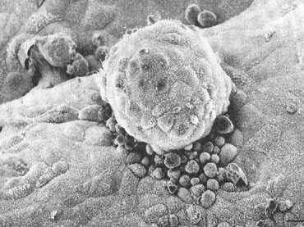
Pinopodes

Slide 75
CC-resistant
CC resistance is more common in very obese women and those with very high serum androgen, insulin or LH concentrations.
In CC-resistant PCOS patients, CC and metformin combination and laparoscopic ovarian drilling, in selected cases, should be considered before gonadotropin administration.
Strategies for clomiphene-resistant patients include the addition of a:
corticosteroid such as dexamethasone,
extended duration of clomiphene,
Other novel therapies.
IVF as last resort.

Slide 76
Low-dose gonadotrophin therapy

Slide 77
Step-down protocol
Prevention of OHSS.
Reduction in Multiple pregnancies.

Slide 78
Laparoscopic ovarian drilling
An ovulation rate of 60-84% and a pregnancy rate of 50% were experienced within 1 year of LOD in many reports.
(Gjonnaess, 1984; Abdel Gadir et al., 1990; Kovacs et al., 1991; Armar and Lachelin, 1993; Naether et al., 1994; Li et al., 1998; Felemban et al., 2000; Amer et al., 2002a)
LOD is more successful in lean women (BMI< 25) with PCOS
(Duleba et al. 2003)
If no ovulation results within 2–3 months of LOD, administration of CC will induce ovulation in some women who were previously resistant to CC.
If this is not successful, a low-dose FSH protocol can be applied.

Slide 79
LOD Vs Metformin
Although metformin results in a better attenuation of insulin resistance and hormonal profile. However, laparoscopic ovarian drilling is associated with higher rates of ovulation and pregnancy.
(Hamed HO. International Journal of Gynaecology & Obstetrics. 108(2):143-7, 2010 Feb)

Slide 80
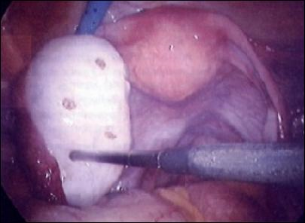
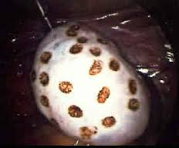
LOD complications
Pereovarian adhesions.
Premature ovarian failure-very rare.
Hartman’s Solution for prevention!
(Rajashekar L, 2008)

Slide 81
Unilateral Vs Bilateral LOD
Unilateral drilling cauterization of ovary is equally efficacious as bilateral drilling in inducing ovulation and achieving pregnancy.
Unilateral ovarian drilling may be a suitable option in clomiphene citrate resistant infertility patient of PCOS which can replace bilateral ovarian drilling with the potential advantage of decreasing the chances of adhesion formation.
(K. K. Roy, 2009)

Slide 82
PCOS and pregnancy (CM.Boomsma, Human Reproduction Update, 2006), Meta-analysis
Fifteen of 525 identified studies were included, involving 720 women presenting with PCOS and 4505 controls.
A significantly higher risk of gestational diabetes
PIH
PET
preterm birth.
Their babies had a significantly higher risk of admission to a NICU.

Slide 83
PCOS and pregnancy cont…
A higher perinatal mortality (OR 3.07; 95% CI:1.03–9.21), unrelated to multiple births.
In conclusion, women with PCOS are at increased risk of pregnancy and neonatal complications.
Pre-pregnancy, antenatal and intra-partum care should be aimed at reducing these risks.

Slide 84
Oral contraceptive choices
Inert Oral tablet, Norgestimate, Ethinyl Estradiol Oral tablet; Adult and Adolescent females: Follow dose as for routine contraception.
Ethinyl Estradiol, Desogestrel Oral tablet, Inert Oral tablet; Adult and Adolescent females: Follow dose as for routine contraception.
Drospirenone, Ethinyl Estradiol Oral tablet, Inert Oral tablet; Adult and Adolescent females: Follow dose as for routine contraception for specific product as specified in product label: 1 tablet PO daily of selected product. Treatment for 6 to 12 months may be required; OCs have limited utility when the underlying cause of the condition is not related to a hypoestrogenic or hyperandrogenic state.

Slide 85
Antiandrogens
Primarily used to treat hirsutism (clinical hyperandrogenism), often in combination with an oral contraceptive
Spironolactone (first line antiandrogen for hirsutism and acne)
Effective in decreasing degree of hirsutism and, to a lesser extent, acne Spironolactone Oral tablet; Adult females: 50 to 200 mg/day PO in 1 or 2 divided doses.
Finasteride (second line antiandrogen for hirsutism; 87 off-label use)
Finasteride Oral tablet [Alopecia]; Adult, non-pregnant women: 5 mg PO once daily either alone or in combination with oral contraceptives shown to reduce hirsutism in women with mild hirsutism; minimal adverse reactions compared to other antiandrogens.

Slide 86
PCOS treatment in women not seeking fertility
Life style modification
Anti-androgens- aldactone
COCP containing drospirinon- YAZ
Insulin sensitizing agents- metformin

Slide 87
Metabolic dysfunction
Insulin resistance, glucose intolerance, and type 2 diabetes are common comorbidities
More than 50% of patients are insulin resistant, even those whose weight falls within reference range
Impaired glucose tolerance occurs in 35% of adult patients
Approximately 25% of adolescent patients have metabolic syndrome
Type 2 diabetes occurs in 10% of patients (also influenced by age, adiposity, and family history)
Screen for impaired glucose tolerance and type 2 diabetes with a 2-hour oral glucose tolerance test, repeated every 3 to 5 years depending on various factors such as degree of overweight or obesity, presence of central adiposity, and interval weight gain
Oral glucose tolerance test is preferred to other methods because it is more sensitive in this population and capable of detecting glucose abnormalities earlier than hemoglobin A1C test

Slide 88
Depression
Increased incidence and prevalence over lifetime
Screen for depression and anxiety at diagnosis, then periodically

Slide 89
Hypertension
At menopause, women with polycystic ovary syndrome have risk of developing hypertension that is 2.5-fold higher than that of age-matched controls; hypertension may accelerate atherosclerotic cardiovascular disease
Screen with blood pressure measurement at each visit

Slide 90
Obstructive sleep apnea
Prevalence of sleep apnea is 5- to 30-fold higher for patients with polycystic ovary syndrome, even after adjustment for age and BMI
Screen with symptom assessment, and if apparent apnea/hypopnea is identified, obtain polysomnography
Successful treatment of obstructive sleep apnea with CPAP improves insulin sensitivity and reduces diastolic blood pressure

Slide 91
Dyslipidemia
Approximately 70% of patients with newly diagnosed disease have abnormal lipid levels, including increased total cholesterol level, high triglyceride levels, high LDL-C level, and decreased HDL-C level
Screen with semiannual measurement of blood lipid levels, or more frequently if there has been interval weight gain
Treatment or primary prevention of atherosclerotic cardiovascular disease depends on several factors, including LDL-C level, age, presence of diabetes, and estimated risk of cardiac event within 10 years following guidance established for the general population

Slide 92
Key Points
Polycystic ovary syndrome is a heterogeneous endocrine disorder that occurs in about 5% to 10% 1 of reproductive-aged women
Common clinical manifestations include oligomenorrhea, acne, and hirsutism
Diagnosis is made when at least 2 of the following occur: hyperandrogenism (clinical and/or biochemical); ovulatory dysfunction; or polycystic ovarian morphologic features
Important comorbidities include obesity, type 2 diabetes, obstructive sleep apnea, depression, and nonalcoholic fatty liver disease
Treatment addresses several issues, including overweight/obesity, metabolic abnormalities, anovulation, acne, hirsutism, endometrial protection, infertility, and cardiovascular risk factors
For most components of disease, primary treatment is weight loss through lifestyle modification 2

Slide 93
Key Points
First line pharmacologic therapy is oral contraceptives, which are effective for reducing signs of hyperandrogenism and regulating menstrual cycle 3
Additional pharmacologic options include metformin for metabolic dysfunction and clomiphene or letrozole for ovulation induction 4 5
Complications include those related to pregnancy (eg, increased risk of adverse maternal, fetal, and neonatal outcomes) and increased risks of endometrial cancer, nonfatal stroke, and possibly cardiovascular events 6
Polycystic ovary syndrome is a lifelong disorder, and institution of pharmacologic therapy and lifestyle measures to improve metabolic and endocrine status are intended to reduce future likelihood of cardiovascular disease

Slide 94
Case # I
A 17-year-old nulliparous adolescent female, who may have only one kidney, presents with primary amenorrhea. She denies weight loss or excessive exercise. On examination, she is 165 cm in tall and weighs 55 kg. Her blood pressure is 140/88 mm Hg. mFG>12, Ludwig I, Acanthosis Nigricans +. Her thyroid gland is normal. She has appropriate Tanner stage IV breast development, axillary and pubic hair, and female external genitalia for the exception of mild enlargement of the clitoris.
Most likely diagnosis and your DD?
Next step in diagnosis:
If your primary diagnosis is right what is your plan of management?

Slide 95
Case # II
A 27-year-old nulliparous female, c/o primary infertility for 3 years. Her periods every 35-40 days 5 days heavy and prolonged. On examination, she is 165 cm in tall and weighs 55 kg, waist circumference >85 cm. Her blood pressure is 120/88 mm Hg. mFG>12, Ludwig I, Acanthosis Nigricans ++. Her thyroid gland is normal. She has appropriate Tanner stage IV breast development, axillary and pubic hair, and female external genitalia are normal. U/S scan showed: thick endometrium, PCOM volume >13 cm3
What are the key issues in her case
What is your most likely diagnosis and your DD?
Next step in diagnosis:
If your primary diagnosis is right what is your plan of management?

Slide 96
Hyperprolactinemia
Hyperprolactinemia is a condition of elevated serum prolactin.
Prolactin is a 198-amino acid protein (23-kD) produced in the lactotroph cells of the anterior pituitary gland.
Its primary function is to enhance breast development during pregnancy and to induce lactation.
Secretion is pulsatile; it increases with sleep, stress, pregnancy, and chest wall stimulation or trauma, and therefore must be drawn after fasting.
Normal fasting values are generally less than 25-30 ng/mL,

Slide 97
pituitary adenomas
hyperprolactinemia is a state wherein pituitary lactotroph adenomas produce prolactin.
These lactotroph adenomas, called "prolactinomas," ­account for approximately 40% of all pituitary tumors. However, hyperprolactinemia can also result from a pharmacologic cause or some other pathologic problem of the hypothalamic-pituitary dopaminergic pathways. Idiopathic hyperprolactinemia may be identified though a diagnosis of exclusion

Slide 98
Prolactin-secreting adenomas
Prolactin-secreting adenomas are divided into 2 groups:
(1) microadenomas (more common in premenopausal women), which are smaller than 10 mm
(2) macroadenomas (more common in men and postmenopausal women), which are 10 mm or larger.
Although modern high-speed helical CT scanners produce very detailed images, MRI is the imaging study of choice. MRI can detect adenomas that are as small as 3-5 mm.

Slide 99
Pathophysiology
The primary action of prolactin is to stimulate breast epithelial cell proliferation thereby inducing and maintaining milk production.
Estrogen stimulates the proliferation of pituitary lactotroph cells, resulting in an increased quantity of these cells in premenopausal women, especially during pregnancy.
However, lactation is inhibited by the high levels of estrogen and progesterone during pregnancy. The rapid decline of estrogen and progesterone in the postpartum period allows lactation to commence.

Slide 100
Dopamine has the dominant influence over prolactin secretion.
Secretion of prolactin is under tonic inhibitory control by dopamine, which acts via D2-type receptors located on lactotrophs.
Prolactin production can be stimulated by the hypothalamic peptides, thyrotropin-releasing hormone (TRH) and vasoactive intestinal peptide (VIP), along with epidermal growth factor and dopamine receptor agonists. Thus, primary hypothyroidism (a high TRH state) can cause hyperprolactinemia.
VIP increases prolactin in response to suckling, probably because of its action on receptors that increase adenosine 3',5'-cyclic phosphate (cAMP).

Slide 101
Frequency
This condition occurs in less than 1% of the general population and in 10-40% of patients presenting with secondary amenorrhea.
Approximately 75% of patients presenting with galactorrhea and amenorrhea have hyperprolactinemia. Of these patients, approximately 30% have prolactin-secreting tumors

Slide 102
Clinical presentation
Women typically present with a history of oligomenorrhea, amenorrhea, or infertility, which generally results from prolactin suppression of gonadotropin-releasing hormone (GnRH). Galactorrhea is due to the direct physiologic effect of prolactin on breast epithelial cells.

Slide 103
Drugs causing hyperprolactenemia
Detailed drug history should be obtained because many common medications cause hyperprolactinemia, usually with prolactin levels of less than 100 ng/mL.
Dopamine-receptor antagonists (eg, phenothiazines, butyrophenones, thioxanthenes, risperidone, metoclopramide, sulpiride, pimozide)
Dopamine-depleting agents (eg, methyldopa, reserpine)
Others (eg, isoniazid, danazol, tricyclic antidepressants, monoamine antihypertensives, verapamil, estrogens, antiandrogens, cyproheptadine, opiates, H2-blockers [cimetidine], cocaine)

Slide 104
Rx
Bromocriptine
Cabergoline: (Dostinex 0.5 mg daily ), an ergot derivative, is a potentdopamine receptor agonist on D2 receptors.
It is frequently used as a first-line agent in the management of prolactinomas due to higher affinity for D2 receptor sites, less severe side effects, and more convenient dosing schedule than the older bromocriptine.

Slide 105
Thank you

