Slide 1
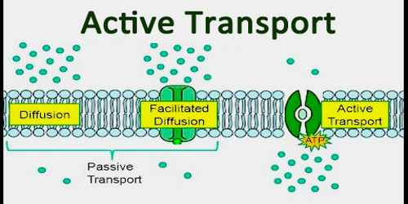

Slide 2
What is diffusion? • Why is osmosis a form of diffusion?

Slide 3
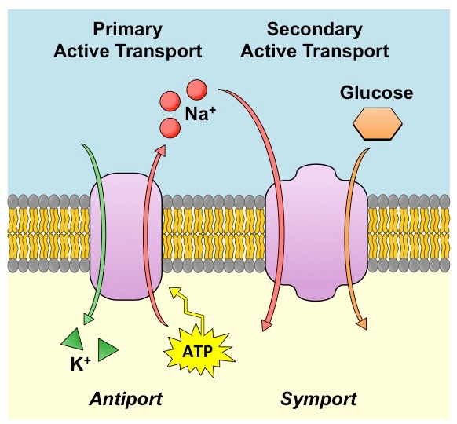

Slide 4
