Slide 1
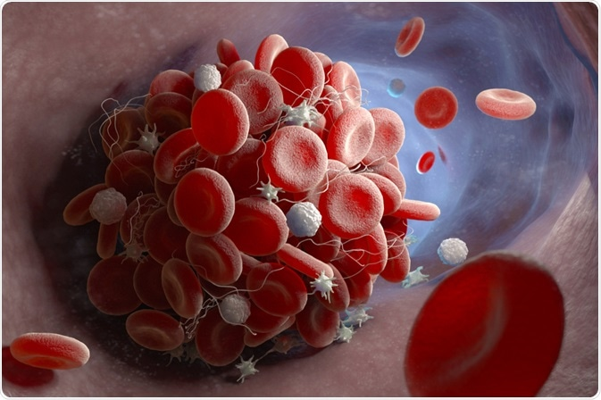
Hemodynamic Disorders, Thromboembolism, and Shock
Eman Krieshan ,M.D.
14-12-2022.

Slide 2
Composition of blood
clotting factors
1. plasma protein (Fluid and electrolyte).
2. RBC.
3. clotting pathway.
4. WBC.
So any disturbances in these processes lead to pathological conditions: e.g
Defect in Fluid and electrolyte balance(EDEMA)
damage to blood vessels or defective clot formation (HEMORRHAGE)
Disturbance in clotting pathway led to either :
Hemorrhage.
thromboembolism

Slide 3
So clinically we have:
1. fluid and electrolytes disturbance :
increased volume : HYPEREMIA AND CONGESTION
abnormal distribution : EDEMA
Decreased volume:
INFARCTION.
Shock
2. Inadequate hemostasis :
HEMORRHAGE
THROMBOSIS and EMBOLISM
3. disturbance in RBC:
extravasation from vessels: HEMORRHAGE.
fluid
Clotting pathway
RBC
Notes:
occlusion of the vascular supply to the affected tissue: INFARCTION.
diminished cardiac output or reduced effective circulating blood volume: Shock

Slide 4
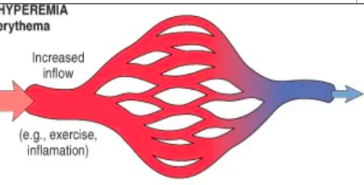
1. HYPEREMIA AND CONGESTION
Hyperemia and congestion both refer to an increase in blood volume within a tissue.
Hyperemia is an active process resulting from arteriolar dilation and increased blood inflow, as occurs at sites of inflammation or in exercising skeletal muscle.

Slide 5
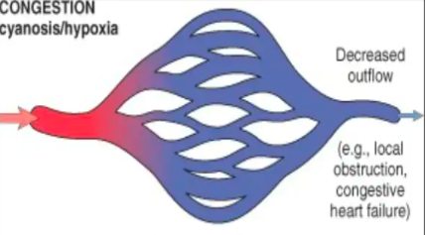
Congestion is a passive process resulting from impaired outflow of venous blood from a tissue.
It can occur systemically, as in cardiac failure, or locally as a consequence of an isolated venous obstruction.

Slide 6
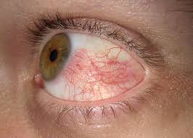
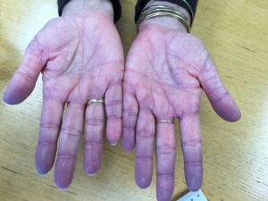
Clinically
Hyperemic tissues are redder than normal because of engorgement with oxygenated blood
Congested tissues have an abnormal blue-red color (cyanosis) that stems from the accumulation of deoxygenated hemoglobin in the affected area.

Slide 7
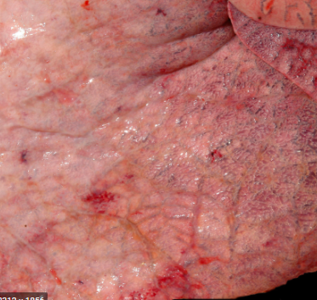
I.LUNG CONGESTION.
Cut surfaces of hyperemic or congested tissues feel wet and typically ooze blood

Slide 8
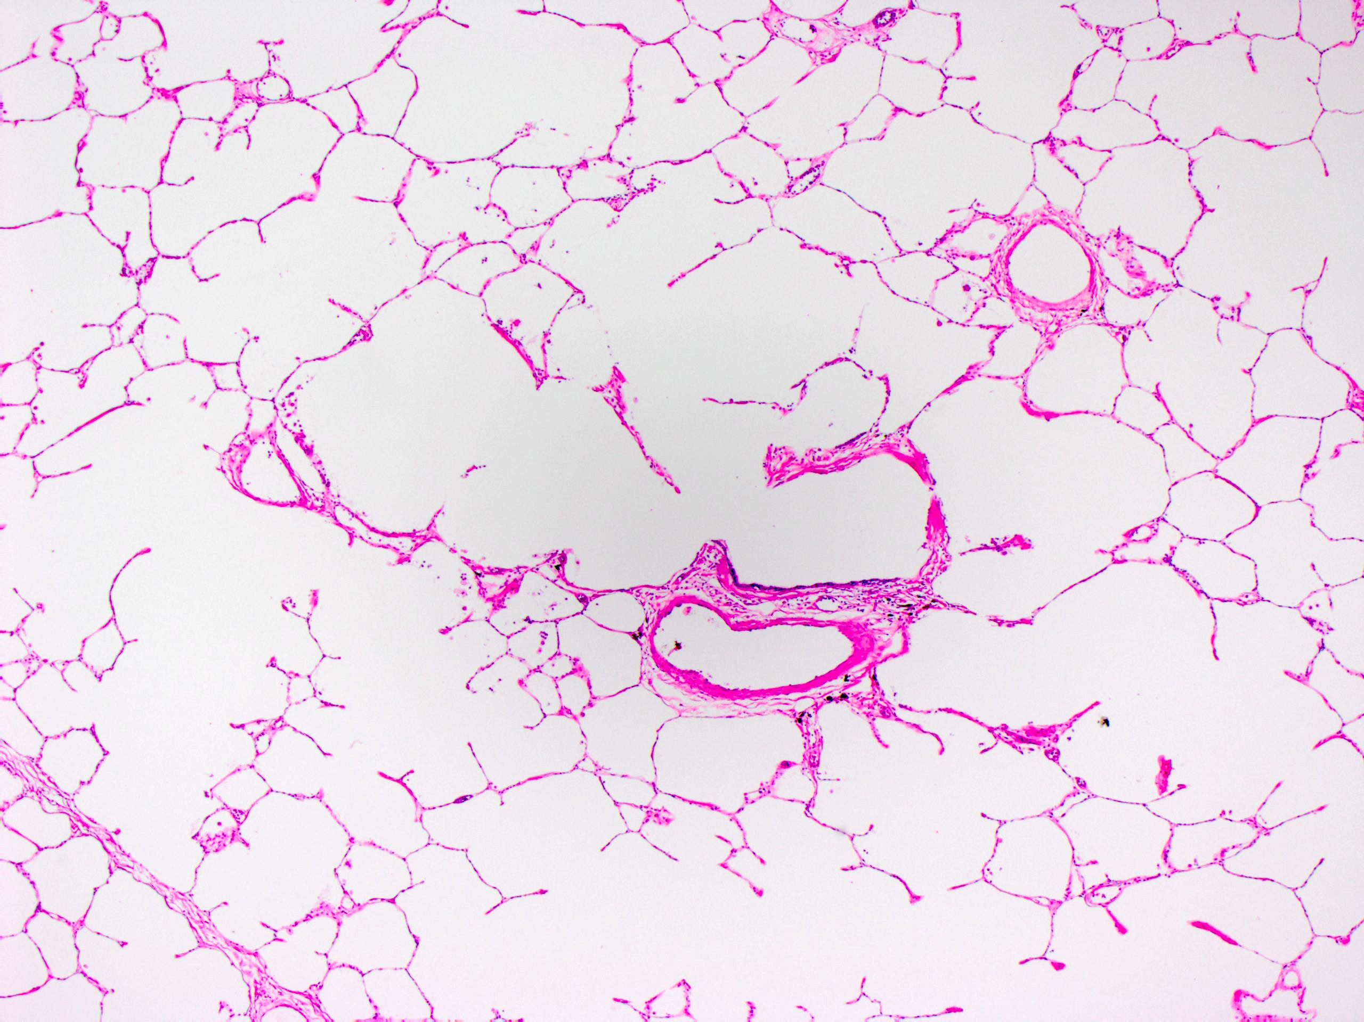
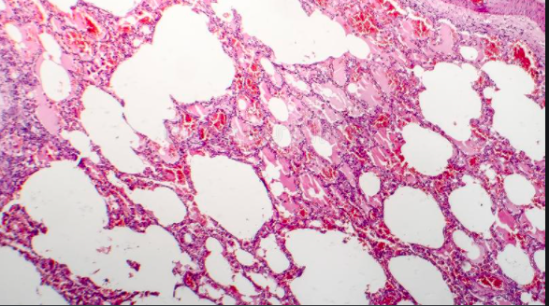
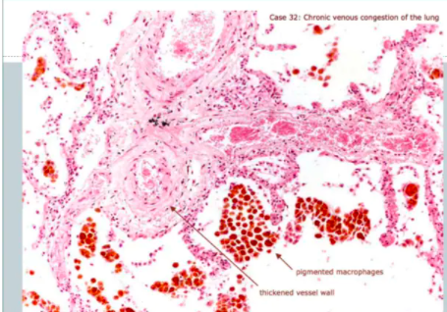
Microscopic examination:
acute pulmonary congestion is marked by blood-engorged alveolar capillaries and variable degrees of alveolar septal edema and intraalveolar hemorrhage.
chronic pulmonary congestion, the septa become thickened and fibrotic, and the alveolar spaces contain numerous macrophages laden with hemosiderin (“heart failure cells”) derived from phagocytosed red cells.

Slide 9
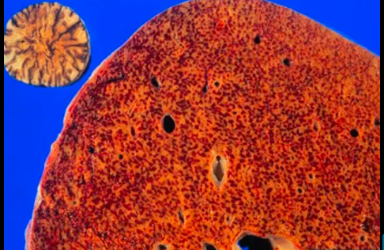
II.HEPATIC CONGESTION.
central areas are red and slightly depressed compared with the surrounding tan viable parenchyma, creating “nutmeg liver”

Slide 10
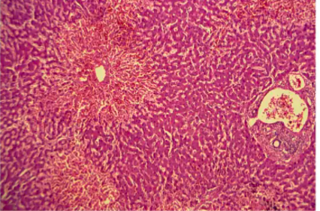
centrally located hepatocytes are prone to necrosis more than t he periportal hepatocytes which is better oxygenated because of their proximity to hepatic arterioles

Slide 11
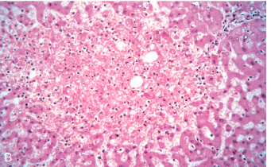
Microscopic findings include :
centrilobular hepatocyte necrosis.
Hemorrhage.
hemosiderin-laden macrophages

Slide 12
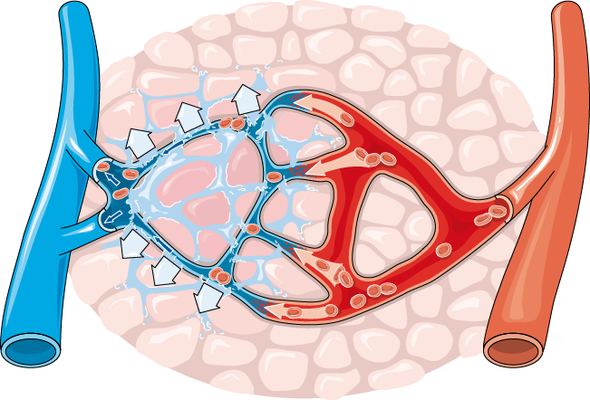
EDEMA

Slide 13
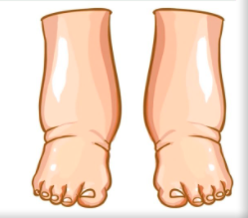
2. EDEMA
is an accumulation of interstitial fluid within tissues and subcutaneously.
Extravascular fluid can also collect in body cavities and such accumulations are often referred to collectively as effusions.
Examples include:
effusions in the pleural cavity (hydrothorax).
the pericardial cavity (hydropericardium).
the peritoneal cavity (hydroperitoneum, or ascites).
Anasarca is severe, generalized edema marked by profound swelling of subcutaneous tissues and accumulation of fluid in body cavities.

Slide 14
Anasarca is a medical condition that leads to general swelling of the whole body

Slide 15
Causes of Edema

Slide 17
Mechanisms of edema
1. Increased Hydrostatic Pressure:
Increases in hydrostatic pressure are mainly caused by disorders that impair venous return, either :
Localized: e.g deep venous thrombosis.
Generalized increases in venous pressure: e.g congestive heart failure.

Slide 19
Increased Hydrostatic Pressure
reduced cardiac output leads to
systemic venous congestion
lead to increase in capillary hydrostatic pressure.
reduction in cardiac output results in
hypoperfusion of the kidneys,
triggering the renin-angiotensin-aldosterone axis
and inducing sodium and water retention (secondary hyperaldosteronism

Slide 20
2. Reduced Plasma Osmotic Pressure
Reduction of plasma albumin concentrations leads to decreased colloid osmotic pressure of the blood and loss of fluid from the circulation.
albumin accounts for almost half of the total plasma protein.
common causes of reduced plasma osmotic pressure:
lost from the circulation: e.g Nephrotic syndrome
synthesis of inadequate amounts: e.g severe liver disease (e.g., cirrhosis) and protein malnutrition.

Slide 21
3. Lymphatic Obstruction
Edema may result from lymphatic obstruction that compromises resorption of fluid from interstitial space.
results from a localized obstruction caused by an inflammatory or neoplastic condition.

Slide 22
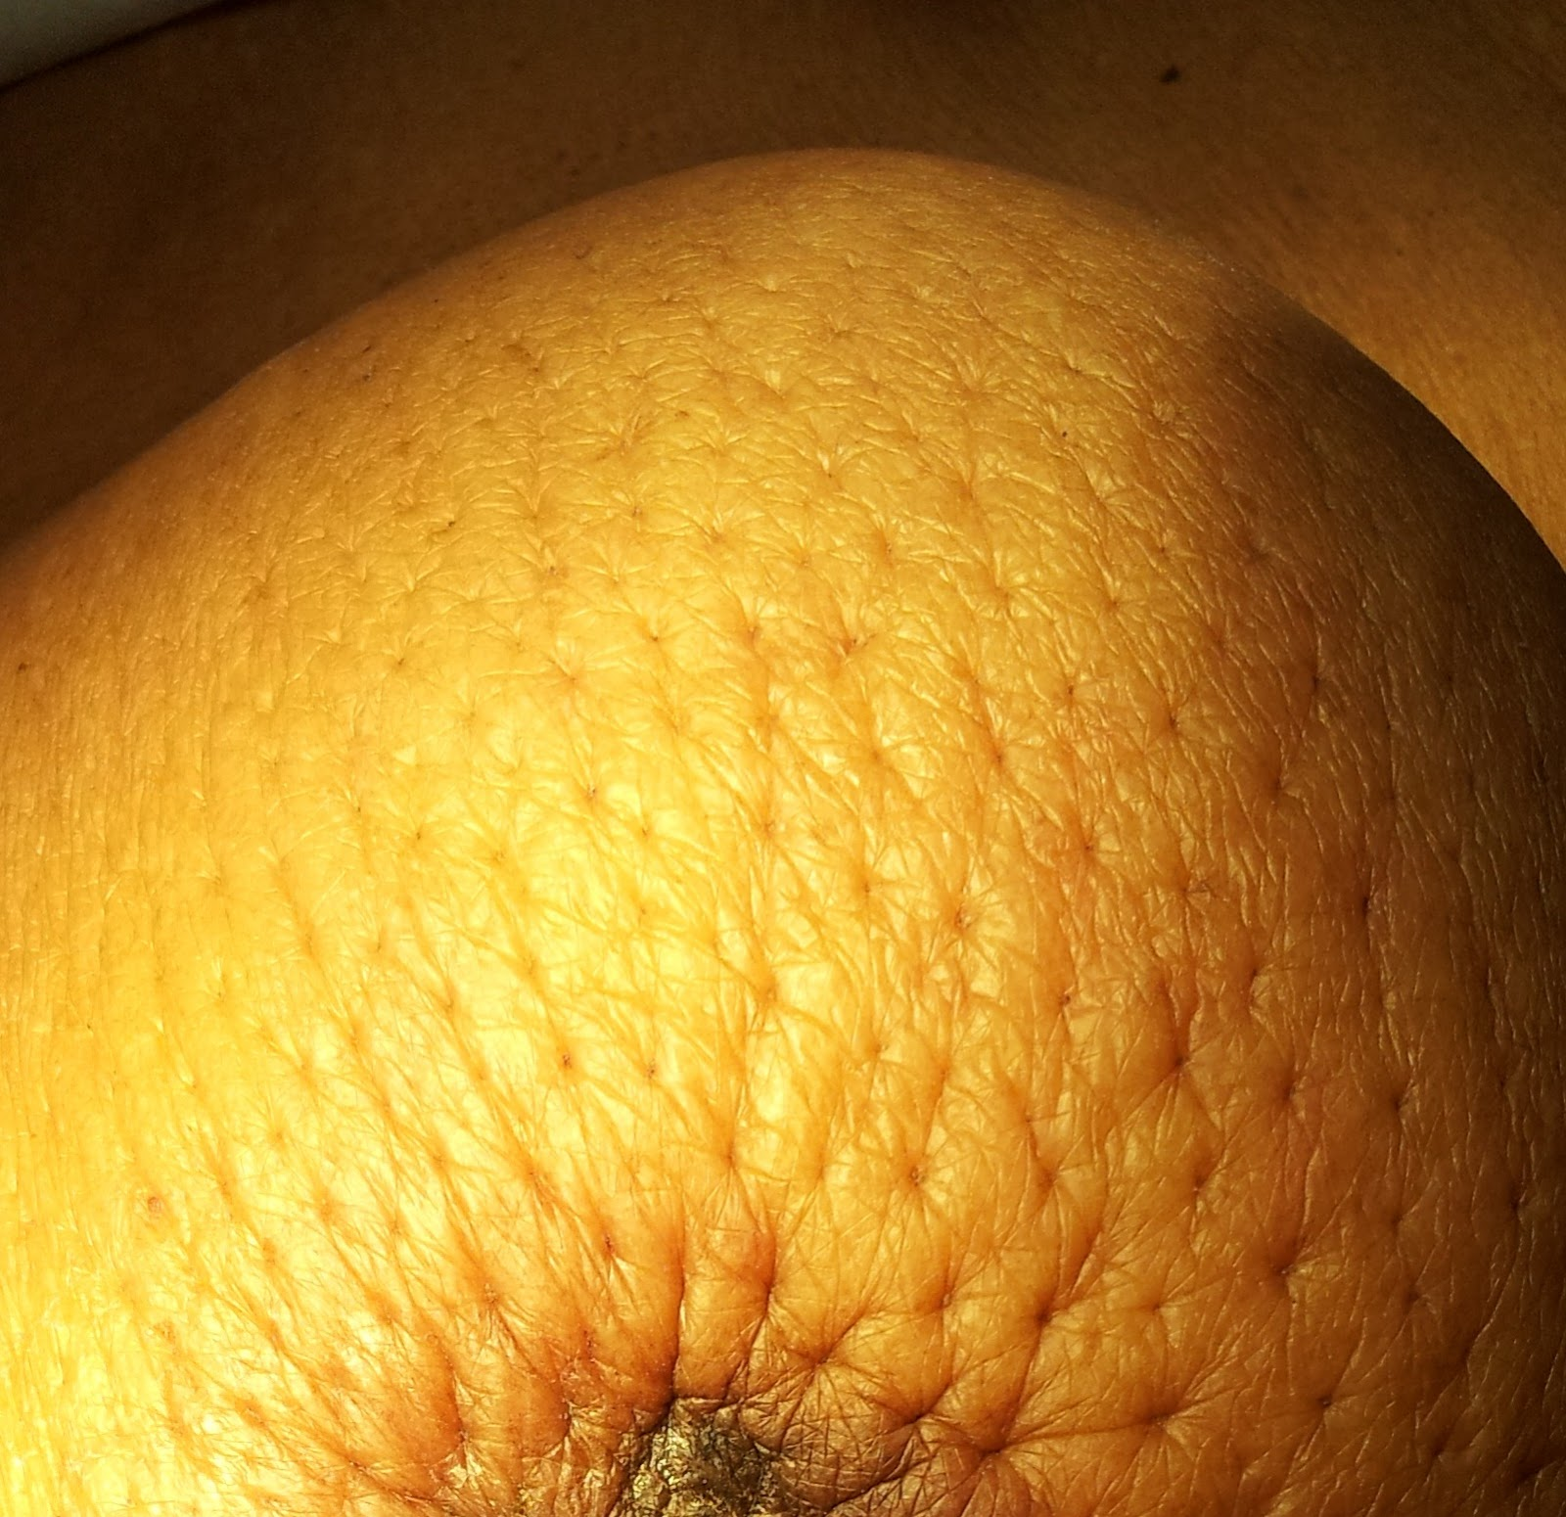
Infiltration and obstruction of superficial lymphatics by breast cancer may cause edema of the overlying skin; the characteristic finely pitted appearance of the skin of the affected breast is called peau d’orange (orange peel).

Slide 23
the parasitic infection filariasis can cause massive edema of the lower extremity and external genitalia (so-called “elephantiasis.

Slide 24
4. Sodium and Water Retention
Excessive retention of salt lead to edema by increasing hydrostatic pressure (because of expansion of the intravascular volume) and reducing plasma osmotic pressure.
Excessive salt and water retention are seen in a wide variety of diseases that compromise renal function, including poststreptococcal glomerulonephritis and acute renal failure.

Slide 25
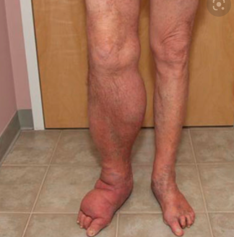
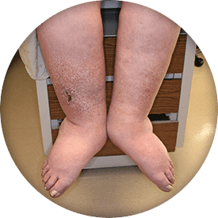
Edema is easily recognized on gross inspection;

Slide 26
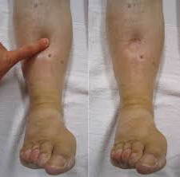
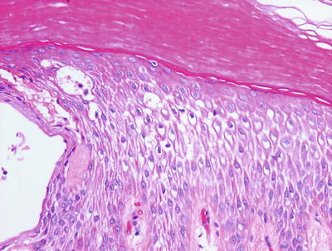
microscopic examination:
1.skin : clearing and separation of the extracellular matrix
Subcutaneous edema can be diffuse but usually accumulates preferentially in the legs with standing and the sacrum with recumbency, a relationship termed dependent edema.
Finger pressure over edematous subcutaneous tissue displaces the interstitial fluid, leaving a finger-shaped depression; this appearance is called pitting edema

Slide 27
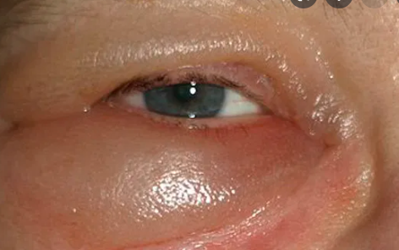
Edema resulting from renal dysfunction or nephrotic syndrome often manifests first in loose connective tissues (e.g., the eyelids, causing periorbital edema).

Slide 28
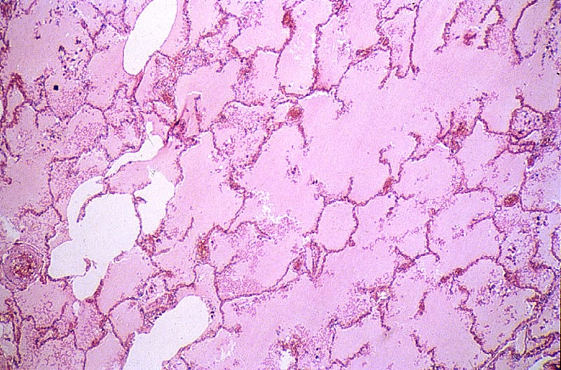
Clinical Features
Subcutaneous edema :
is important to recognize primarily because it signals potential underlying cardiac or renal disease.
when significant, it also can impair wound healing and the clearance of infections.
Pulmonary edema:
It can cause death by interfering with normal ventilatory function; besides impeding oxygen diffusion, alveolar edema fluid also creates a favorable environment for infections..

Slide 29
Brain edema:
Is life threatening; if the swelling is severe, the brain can herniate (extrude) through the foramen magnum pressure, the brain stem vascular supply can be compressed, leading to death due to injury to the medullary centers controlling respiration and other vital functions .

Slide 30
II. HEMORRHAGE
extravasation of blood from vessels, is most often the result of damage to blood vessels or defective clot formation.
Trauma, atherosclerosis, or inflammatory or neoplastic erosion of a vessel wall also may lead to hemorrhage.
Hemorrhagic diatheses:

Slide 31
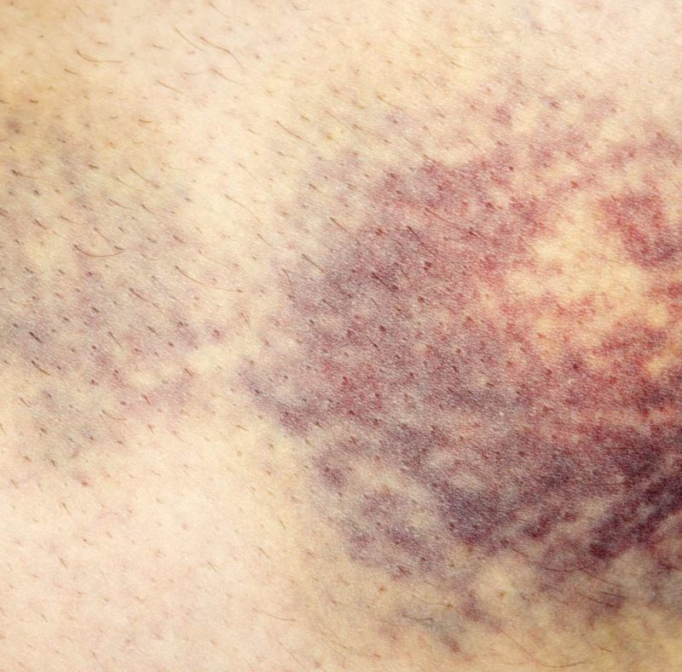
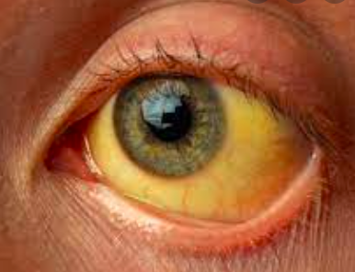
Hemorrhage may be manifested by different appearances and clinical consequences.
Hemorrhage may be external or accumulate within a tissue as a hematoma,
May ranges in significance from trivial (e.g., a bruise) to fatal (e.g., a massive retroperitoneal hematoma resulting from rupture of a dissecting aortic aneurysm.
Extensive hemorrhages can occasionally result in jaundice from the massive breakdown of red cells and hemoglobin.

Slide 32
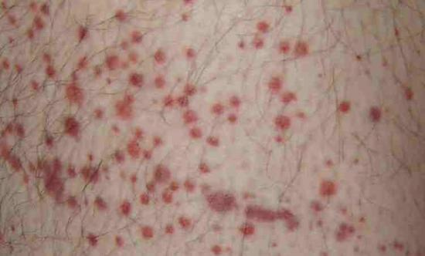
Subcutaneous bleeding my present as
1. Petechiae :
are minute (1 to 2 mm in diameter) hemorrhages into skin, mucous membranes, or serosal surfaces
Causes
low platelet counts (thrombocytopenia).
defective platelet function.
loss of vascular wall support, as in vitamin C deficiency.

Slide 33
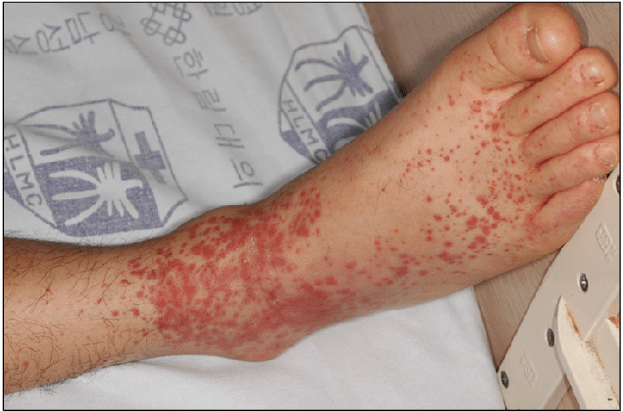
2. Purpura
are slightly larger (3 to 5 mm) hemorrhages.
Purpura can result from the same disorders that cause petechiae, as well as:
trauma.
vascular inflammation (vasculitis).
increased vascular fragility.

Slide 34
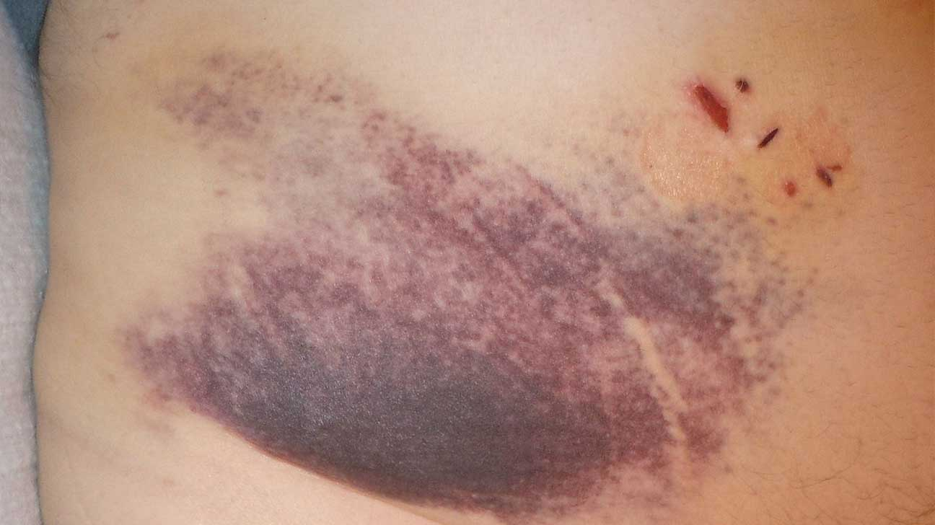
3.Ecchymoses:
are larger (1 to 2 cm) subcutaneous hematomas (also called bruises).
Extravasated red cells are phagocytosed and degraded by macrophages; the characteristic color changes of a bruise result from the enzymatic conversion of hemoglobin (red-blue color) to bilirubin (blue-green color) and eventually hemosiderin (golden-brown)

Slide 35
The clinical significance of any particular hemorrhage depends on:
the volume of blood that is lost.
the rate of bleeding.

