Slide 1
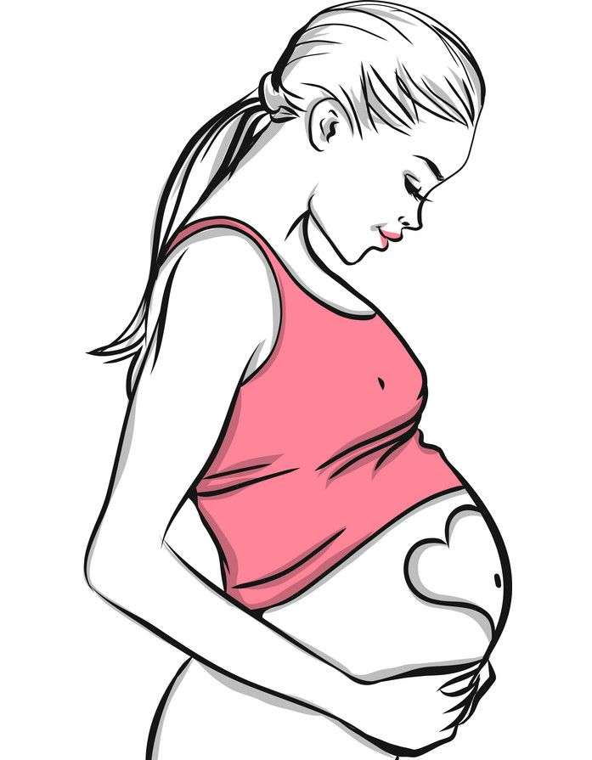
Pulmonary Disorders in pregnancy
Supervised by:
Dr.Malik Alqasem
Presented by:
Loulou Mahmoud
Nadine Othman

Slide 2
Introduction
The major respiratory changes in pregnancy involve three factors: the mechanical effects of the enlarging uterus, the increased total body oxygen consumption, and the respiratory stimulant effects of progesterone.
Hormonal changes in pregnancy affect the upper respiratory tract and airway mucosa, producing mucosal edema, hypersecretion, increased mucosal friability.
Estrogen is responsible for producing tissue edema, capillary congestion, and hyperplasia of mucus glands.
The enlarging uterus produce anatomical changes to the thoracic cage, the diaphragm is displaced upward by as much as 4 cm.
The anteroposterior and transverse diameter of the thorax increases, which enlarges chest wall circumference.
Notes:
Diaphragm function remains normal, and diaphragmatic excursion is not reduced.

Slide 3
Asthma
Asthma is a chronic inflammatory disorder characterized by bronchial hyperreactivity, and it is the most common pulmonary disease in pregnancy, affecting between 3% and 9% of pregnant women.
Can pregnancy make asthma worse or better?
Research suggests that asthma severity during pregnancy is related to asthma severity before pregnancy. Symptoms are more likely to worsen in people with severe asthma.
If asthma gets better, the improvement is generally gradual as the pregnancy progresses.
If asthma worsens, the increase in symptoms is most noticeable during the first and third trimesters of pregnancy.
Some women might experience worse asthma signs and symptoms early in pregnancy because they stop taking their medications after becoming pregnant. Any changes you make to your medication routine might also influence the severity of your asthma.

Slide 4
Any investigation to follow up during pregnancy?
Hypoxia may contribute to low birth weight, pre-eclampsia, congenital malformations, spontaneous abortions and placenta previa in asthmatic females . Reduced partial pressure of oxygen (PO2) is a feature of acute severe asthma or status asthmaticus and a small decrease in maternal PO2 can have serious effects on the fetus
Ultrasounds starting at week 32 of your pregnancy to monitor baby growth and activity.

Slide 5
Features of severe lifethreatening asthma
Peak expiratory flow rate <35% of predicted
pO2 <8 KPa (60mmHg)
pCO2 >4.6 Kpa
Silent chest.
Cyanosis.
Bradycardia.
Arrhythmia.
Hypotension.
Exhaustion.
Confusion.

Slide 6
Is it safe to take asthma medication during pregnancy?
Most asthma medications can be safely used during pregnancy.
Also, it's safer to take asthma medications during pregnancy than it is to experience asthma symptoms or an asthma attack. If you're having trouble breathing, your baby might not get enough oxygen.

Slide 7
What about delivery and breast feeding?
Most women don't experience major asthma symptoms during labor and delivery.
If the patient takes asthma medication, continue doing so during labor and delivery.
Breast-feeding is encouraged for women who have asthma — even if they take medication.

Slide 8
Treatment guidelines
For those with mild intermittent asthma, a short-acting inhaled β2- agonist (albuterol) can be used as needed.
Patients with mild persistent asthma should be treated with a daily low-dose inhaled glucocorticoid (budesonide).
The preferred treatment for moderate persistent asthma is either a daily medium-dose inhaled glucocorticoid or a combination of a daily low-dose inhaled glucocorticoid and a long-acting β2-agonist (salmeterol).
Those with severe persistent asthma should be treated with a daily high-dose inhaled glucocorticoid combined with a long-acting β2-agonist. They may require the addition of a systemic glucocorticoid.

Slide 9
Acute severe exacerbations must be treated aggressively with oxygen therapy, intravenous fluids, systemic glucocorticoids, administration of short-acting β2-agonists and ipratropium by nebulized aerosol, and antibiotics if there is evidence of bacterial infection. Intravenous magnesium sulfate or subcutaneous terbutaline can be added if needed.
To prevent fetal hypoxia, pulse oximetry should be used and oxygen saturation should be maintained at 95% or greater
Because of the hyperventilation and compensated respiratory alkalosis present in normal pregnancy, an arterial blood gas with a PaO2 less than 70 mm Hg and/or a PaCO2 greater than 35 mm Hg are indicative of severe respiratory compromise
Serial fetal monitoring and ultrasonic assessment of fetal growth should be implemented

Slide 10
What can I do to prevent complications?
Routine follow up
Take medication as prescribed.
Don't smoke.
Avoid and control triggers. Avoid exposure to secondhand smoke and other potential irritants, such as dust and animal dander.
Control gastroesophageal reflux disease (GERD). GERD — a chronic digestive disease that causes acid reflux and heartburn — can worsen asthma
Recognize warning signs. such as coughing, chest tightness, shortness of breath or wheezing.

Slide 11
The timing of delivery is dependent on the status of both the mother and the fetus.
When pregnancy is progressing well, there is no need for early delivery, and it is advisable to await the spontaneous onset of labor
Early delivery can be considered for fetal growth restriction or maternal deterioration.
Notes:
Labor and delivery are usually not triggers of acute asthma attacks.
Glucocorticoid therapy, including inhaled or high-potency topical use for more than 3 weeks, may suppress the hypothalamic-pituitary-adrenal axis, and administration of stress doses of medication during labor or delivery should be considered.
An epidural block during labor reduces pain, anxiety, hyperventilation, and respiratory effort, all of which are known to aggravate the disease.
Vaginal delivery should be anticipated. Cesarean delivery is performed only for obstetric reasons.
Oxytocin is the preferred drug for the initial management of postpartum hemorrhage.
Prostaglandins should not be used, because they are likely to trigger acute bronchoconstriction.

Slide 12
Venous Thromboembolism during Pregnancy
Venous thromboembolism is the leading cause of morbidity during pregnancy and is the leading cause of non obstetric maternal mortality.
VTE is approximately 5 times more common in pregnant women compared to non pregnant women of similar age.
The most constant predisposing factor is increased venous stasis.
Other factors that contribute to VTE are, advanced maternal age, prolonged bed rest, hemorrhage, sepsis, multiparity, and obesity.

Slide 13
Diagnosis
Three fourths of cases of venous thrombosis occur antepartum, with approximately 50% occurring by week 15 of gestation.
The most obvious symptoms is swelling and heavy pain or extreme tenderness in one of your legs.
Up to 80% of DVT cases in pregnancy occur in the left leg( left thigh and calf more common than pelvic ) .
More common on left side due to compression of the left iliac vein by right iliac artery and compression by the gravid uterus.

Slide 14
Diagnosis
Laboratory studies:
D-dimer???
Imaging for DVT is the best method of diagnosis :
The current initial test of choice in the evaluation of VTE is compression ultrasonography of the lower extremity veins.
Compression ultrasonography has been shown to be more than 95% sensitive and specific for proximal lower extremity DVT. CUS is less accurate for the diagnosis of pelvic DVT.
Notes:
In pregnancy, CUS should be performed with the patient in the left lateral decubitus position and with Doppler analysis of flow variation during respiration to maximize the study’s ability to diagnose pelvic DVT. ^{[6]}
Indirect thrombin inhibitors: Include unfractionated heparin and low ̶-molecular-weight heparin (LMWH), as well as synthetic heparin pentasaccharides and orally administered Factor Xa inhibitors (rivaroxaban, apixaban, edoxaban)
Direct thrombin inhibitors: Include argatroban, lepirudin, bivalirudin, dabigatran
Vitamin K antagonist: Warfarin is included in this class
Heparin (unfractionated and low molecular weight) is the preferred drug for managing VTE in pregnancy.

Slide 15
Pulmonary embolism
PE during pregnancy are more problematic because dyspnea and tachypnea are common in pregnancy and the modality of imaging that we are going to use for diagnosis.
DIAGNOSIS :
Chest x ray???
D-dimer????
Lower extremity Compression ultra sonography.
Ventilation Perfusion Scintigraphy
Pulmonary Computed Tomographic Angiography.

Slide 16
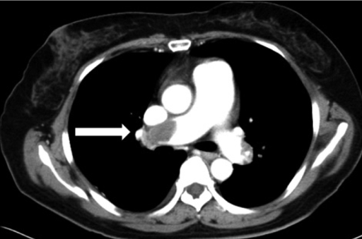

Slide 17
Pulmonary embolism
Treatment :
Low molecular weight heparin.
Unfractionated heparin (renal failure patient, high risk of bleeding, risk of emergent
surgery ).
3. Thrombolytic ( streptokinase 100 mg over 2 hrs )in hemodynamic unstable patient).

Slide 18
Amniotic fluid embolism
Associated with uterine manipulation, uterine trauma, and the early postpartum period
Amniotic fluid containing particulate cellular elements enters the vascular circulation through endocervical veins or uterine tears, obstructs the pulmonary vessels, and causes vascular spasms, resulting in pulmonary hypertension.
Acute left ventricular failure might occur

Slide 19
Amniotic fluid embolism
Clinical features
Clinical presentation usually involves a sudden onset of severe dyspnea, hypoxemia, and cardiovascular collapse.
Less common presentations are hemorrhage caused by disseminated intravascular coagulation and fetal distress.

Slide 20
Diagnosis
**clinical picture.
** Fetal squamous cells in a wedged pulmonary capillary aspirate.
>>> differential diagnoses include:
septic shock, pulmonary thromboembolism, ruptured placenta, tension pneumothorax, and myocardial ischemia
Rx: supportive measures with prompt attention to adequate oxygenation, ventilation, and inotropic support……coticosteroids??

Slide 21
Cystic Fibrosis
It is an inherited autosomal recessive condition, with a carrier frequency of around 1 in 25 in the general population
It is due to mutations in the cystic fibrosis transmembrane conductance regulator gene, CFTR, which is the gene that regulates epithelial cell chloride channel function and as a result the internal organs become clogged with thick mucus, leading to infections and chronic inflammation, particularly affecting the lungs, gut and pancreas.
It is the most severe form of obstructive lung disease observed during pregnancy, but there is no evidence that pregnancy increases the maternal risk, unless there is severe disease with pulmonary hypertension
Because of improvements in diagnosis and treatment, the majority of females with cystic fibrosis now survive to adulthood

Slide 22
Cystic Fibrosis
Affected patients may have pancreatic insufficiency manifested as
Diabetes
Malabsorption
Or liver cirrhosis
Poor prognostic factors include
Vital capacity of <50% of predicted value
Cor pulmonale
Pulmonary hypertension

Slide 23
Cystic Fibrosis
Evaluation and Management
Genetic counseling and screening should be offered
Pulmonary function tests should be performed monthly throughout pregnancy
Pulmonary infection should be managed aggressively
For labor and delivery
Fluids and electrolytes should be followed closely because the increased sodium content of sweat in affected patients may make them prone to hypovolemia during labor.
Overall 70% to 80% of pregnant mothers with CF have successful deliveries of healthy infants
Breast milk should be evaluated for sodium content before the infant is allowed to breast-feeding
Notes:
Preconception care and counseling should involve optimizing nutrition and pulmonary function, as well as testing the father’s carrier status and counseling about inheritance risks to the fetus .. Women with pulmonary hypertension should be counseled about the greater risk that pregnancy poses for an adverse maternal, fetal, or neonatal outcome

Slide 24
Pneumonia
It is an inflammatory condition of the lung affecting primarily the small air sacs known as alveoli.
The incidence of pneumonia is particularly high among pregnant women with certain predisposing antecedents, such as a history of smoking or respiratory disease.
It is one of the important causes of indirect maternal mortality
Virtually any infectious agent that causes pneumonia in the nonpregnant host has been reported to complicate pregnancy, with the most common organisms being :
Streptococcus pneumonia
Haemophilus Influenza
Mycoplasma pneumonia
Staph. Aureus

Slide 25
Pneumonia
The classic symptoms of pneumonia
Sudden onset of rigors followed by fever
pleuritic chest pain
shortness of breath
Productive or dry cough
Risk of respiratory failure and empyema is increased

Slide 26
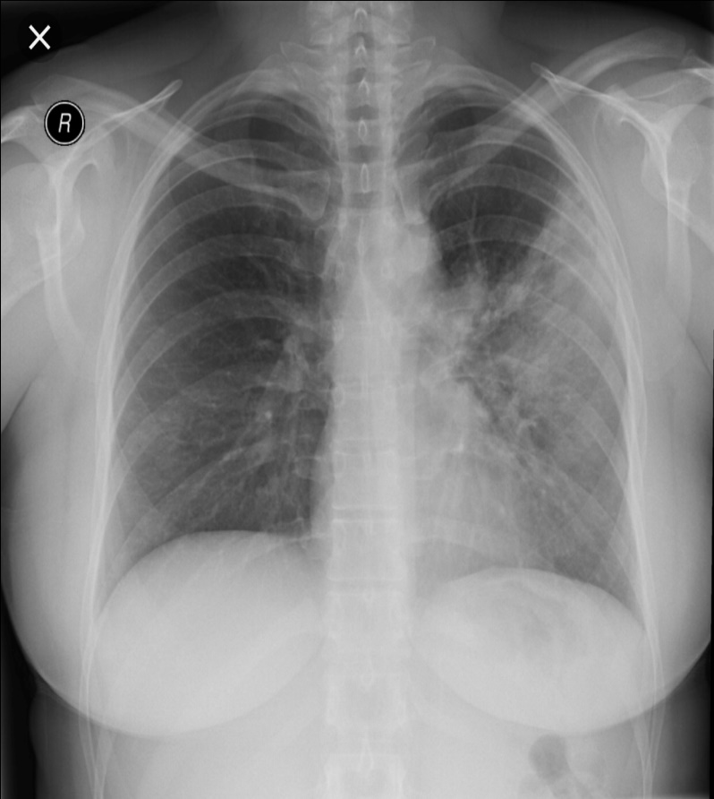
Pneumonia
Patients with suspected pneumonia should get a chest radiograph with abdominal shield
Other investigations are
Sputum microscopy
Sputum culture
Serologic tests

Slide 27
Pneumonia
Fever should be treated with acetaminophen and fluid status should be monitored closely since the pregnant women are prone to pulmonary edema
In bacterial pneumonia, the antibiotics that are safe in a pregnant patient are
( penicillins, cephalosporins, and macrolides).
Quinolones and Tetracyclines should be avoided in pregnancy ( fetal arthropathy and malformations )

Slide 28
Pneumonia
Viral and fungal pneumonia
Influenza has an acute onset after an incubation of 1-4 days and presents as high fever, headache, malaise, and cough.
Viral and fungal pneumonia are often complicated by a secondary bacterial pneumonia.
Varicella pneumonia is a serious respiratory tract infection that can lead to high maternal mortality. This should be treated with acyclovir
Patients with P.carinii pneumonia require treatment with trimethoprim-sulfamethoxazole with folate supplementation.

Slide 29
Pneumonia
Complications
Pregnant women with pneumonia are prone to preterm labor and delivery, as well as pulmonary edema.
The frequency of low birth weight infants born to mothers with pneumonia is higher than among controls without pneumonia.
Maternal mortality with varicella pneumonia may reach 40% in the absence of antiviral therapy.
The risk of congenital malformations after fetal exposure to primary maternal varicella before 20 weeks’ gestation is estimated to be <2% and is <0.4% before 12 weeks.
Infection after 20 weeks’ gestation may lead to postnatal disease, with symptoms ranging from typical varicella with a benign course to fatal disseminated infection or shingles appearing months to years after birth.

Slide 30
Pneumonia
Complications
Congenital varicella syndrome occurs in 1% to 2% of cases of maternal varicella depending on gestational age.
Congenital varicella is characterized by limb hypoplasia, chorioretinitis, cutaneous scars, and cortical atrophy.
Varicella pneumonia has been associated with preterm labor.

Slide 31
Tuberculosis
Low socio
economic status
Positive family history or past history
Risk Factors
Area with high prevalence of TB
IV drug abuse
HIV infection
It is an infectious disease usually caused by Mycobacterium Tuberculosis (MTB) bacteria.
Tuberculosis generally affects the lungs, but can also affect other parts of the body.

Slide 32
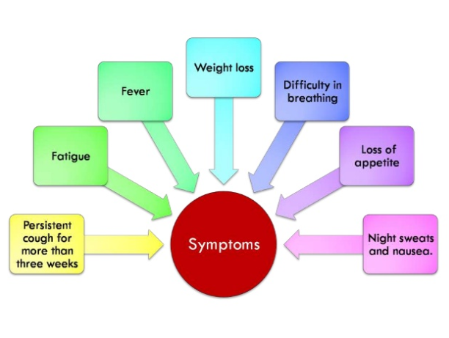
Tuberculosis
Notes:
About 90% of those infected with M. tuberculosis have asymptomatic

Slide 33
Tuberculosis
Diagnosis
Screening is by subcutaneous injection of purified protein derivative (PPD).
- Only 80% of results are positive in the setting of reactivation of disease
- If a patient previously received the Bacillus Calmette–Guérin (BCG) vaccine, the PPD results may remain positive for life
If the PPD test is positive or TB is suspected , Chest radiograph with abdominal shield should be performed
A definitive diagnosis of TB can be made with culture of Mycobacterium tuberculosis or acid-fast stain (ZN stain )
- Sputum samples maybe induced using aerosolized saline; the first morning sputum should be collected for three consecutive days.

Slide 34
Tuberculosis
Effects of TB in pregnancy
If the patient is under medical supervision with adequate treatment, pregnancy has go no deleterious effect on the course of the disease nor the disease has any adverse effects on pregnancy
In active disease, fetus can be affected by transplacental route or by aspiration of amniotic fluid
In untreated patients, the incidence of IUGR, preterm labor and perinatal mortality is high

Slide 35
Tuberculosis
Treatment
Standard treatment in pregnancy consists of isoniazid (INH), ethambutol, pyrazinamide and pyridoxine (B6) supplementation 50mg/day to prevent peripheral neuropathy
Streptomycin should be avoided because of the risk of fetal 8th cranial nerve(the vestibulocochlear) leading to ototoxicity
Rifampin should also be avoided unless INH and ethambutol cannot be used

Slide 36
Tuberculosis
Treatment
INH prophylaxis 300mg/day for 6-9 months is recommended for asymptomatic patients <35 years with positive PPD and negative findings on CXR
If the patient has converted to positive PPD results within the last 2 years, INH therapy should be initiated during pregnancy after the 1st trimester.
If the time since conversion is unknown or longer than 2 years, INH is started during the postpartum period
Notes:
INH is not recommended for patients >35 years due to its hepatotoxicity

Slide 37
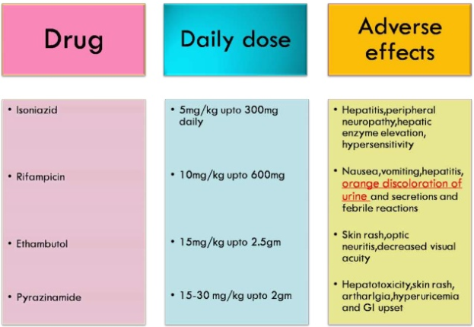
Tuberculosis

Slide 38
Tuberculosis
Obstetric Management
Obstetric management for patient with inactive TB is similar to that of non-pregnant
In patients with active or recently active TB, delivery under regional anesthesia with forceps when necessary to avoid excessive straining during the second stage of labor is advised

Slide 39
Tuberculosis
Breast Feeding
Breast feeding is not contraindicated when a woman is on anti-tb drugs
Breast feeding should be avoided if the infant is also taking the drug to avoid excess drug level
In active lesions breast feeding is avoided and the baby is isolated from the mother following delivery
Baby should be given prophylactic INH 10-20mg/kg/day for 3 months when mother suffering from active disease
BCG should be given to the baby as early as possible

Slide 40
Influenza
It is the most common viral infection in pregnancy
Resulting in increased morbidity and mortality
Risk of hospitalization for an acute cardiopulmonary illness is three to four times more likely in 3rd trimester
Influenza (H1N1) should be suspected in patients not responding to routine antibiotics and in pneumonia or respiratory failure.
Increased risk of preterm delivery or low birth weight infant, severe pneumonia

Slide 41
Influenza
Headache.
Runny nose.
Sore throat.
Fatigue.
Shortness of breath/Cough.
Loss of appetite.
Diarrhea or vomiting.
Sudden chills or fever.

Slide 42
Influenza
Prevention and supportive care
Anti-pyretics for fever ( reduces fetal tachycardia, protective against congenital abnormalities )
Neuraminidase inhibitors ( zanamivir, oseltamivir ) can be used in the treatment

Slide 43
THANK YOU
Supervised by:
Dr.Malik Alqasem
Presented by:
Loulou Mahmoud
Nadine Othman

