Slide 1
Normal and abnormal puberty
Tariq Rabaya, MD
July 2019

Slide 2
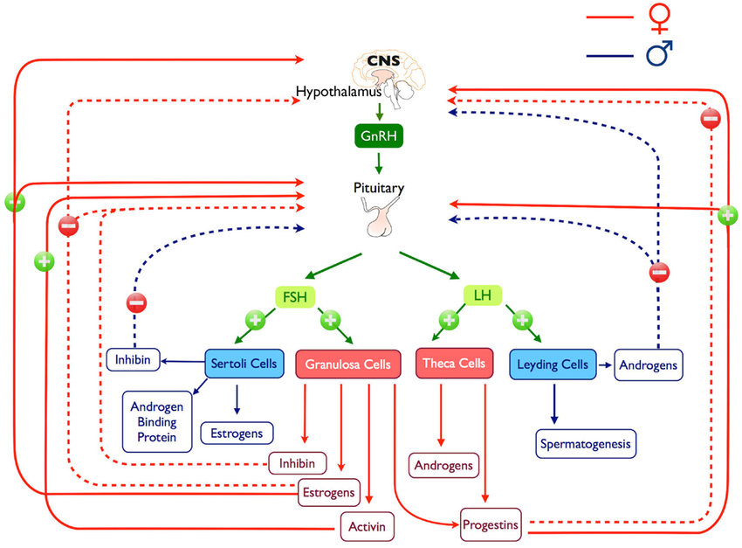

Slide 3
Physiology of puberty
Between early childhood and approximately 8-9 yr. of age (prepubertal stage), the hypothalamic-pituitary-gonadal axis is dormant.
One to 3 yr. before the onset of clinically evident puberty, low serum levels of LH during sleep become demonstrable.
This pulsatile secretion of gonadotropins is responsible for enlargement and maturation of the gonads and the secretion of sex hormones.
By midpuberty, LH pulses become evident even during the daytime and occur at approximately 90-120 min intervals.
Notes:
This sleep-entrained LH secretion occurs in a pulsatile fashion and reflects endogenous episodic discharge of hypothalamic gonadotropin-releasing hormone (GnRH).
Nocturnal pulses of LH continue to increase in amplitude and, to a lesser extent, in frequency as clinical puberty approaches.

Slide 4
A second critical event occurs in middle or late adolescence in girls in whom cyclicity and ovulation occur.
A positive feedback mechanism develops whereby increasing levels of estrogen in midcycle cause a distinct increase of LH.
The increasing secretion of hypothalamic GnRH in a pulsatile fashion thus underlies the onset of pubertal development.
Serum levels of dehydroepiandrosterone (DHEA) and its sulfate (DHEAS) begin to increase at approximately 6-8 yr. of age, before any increase in LH or sex hormones and before the earliest physical changes of puberty are apparent; this process is called adrenarche.
DHEAS is the most abundant adrenal steroid in the blood, and its serum concentration remains fairly stable over 24 hr.

Slide 5
The effects of gonadal steroids (testosterone in boys, estradiol in girls) on bone growth and osseous maturation are critical.
Both aromatase deficiency and estrogen receptor defects result in delayed epiphyseal fusion and tall stature in affected males.
These observations suggest that estrogens, rather than androgens, are responsible for the process of bone maturation that ultimately leads to epiphyseal fusion and cessation of growth.
Estrogens also mediate the increased production of growth hormone, which along with a direct effect of sex steroids on bone growth, is responsible for the pubertal growth spurt.

Slide 6
Normal puberty in females
The breast bud (thelarche) is usually the first sign of puberty (10-11 yr of age)
Followed by the appearance of pubic hair (pubarche) 6-12 mo later.
The interval to the onset of menstrual activity (menarche) is usually 2-2.5 yr., but may be as long as 6 yr.
Peak height velocity occurs early (at breast stages II-III, typically between 11 and 12 yr. of age) in girls and always precedes menarche.
The mean age of menarche is approximately 12.75 yr.
Notes:
The age of onset of puberty varies and is more closely correlated with osseous maturation than with chronological age.

Slide 7
Tanner Staging- females

Slide 8
Normal puberty in males
Growth of the testes (≥4 mL in volume or 2.5 cm in longest diameter) and thinning of the scrotum are the first signs of puberty (11-12 yr).
These are followed by pigmentation of the scrotum and growth of the penis and by pubarche.
Appearance of axillary hair usually occurs in midpuberty.
In males, unlike in females, acceleration of growth begins after puberty is well under way and is maximal at genital stages IV-V (typically between 13 and 14 yr of age).
In males, the growth spurt occurs approximately 2 yr later than in females, and growth may continue beyond 18 yr of age.

Slide 9
Tanner Staging- males

Slide 10
Precocious puberty
Precocious puberty is defined by the onset of secondary sexual characteristics before the age of 8 yr in girls and 9 yr in boys.

Slide 11
Classification
Depending on the primary source of the hormonal production, precocious puberty may be classified as:
Central (also known as gonadotropin dependent, or true)
Peripheral (also known as gonadotropin independent or precocious pseudopuberty)

Slide 12
Central precocious puberty
Is always isosexual
stems from hypothalamic-pituitary-gonadal activation with ensuing sex hormone secretion and progressive sexual maturation.

Slide 13
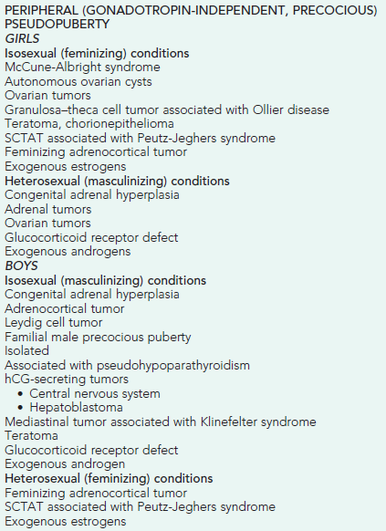
Peripheral precocious puberty
some of the secondary sex characteristics appear
No activation of the normal hypothalamic-pituitary-gonadal interplay.
In this latter group, the sex characteristics may be isosexual or heterosexual (contrasexual)

Slide 14
Combined peripheral and central
Peripheral precocious puberty can induce maturation of the hypothalamic-pituitary-gonadal axis and trigger the onset of central puberty.
This mixed type of precocious puberty occurs commonly in conditions such as:
Congenital adrenal hyperplasia
McCune-Albright syndrome
Familial male-limited precocious puberty

Slide 15
Central Precocious Puberty
Central precocious puberty is defined by:
the onset of breast development before the age of 8 yr in girls
and by the onset of testicular development (volume ≥4 mL) before the age of 9 yr in boys
as a result of the early activation of the hypothalamic-pituitary-gonadal axis.

Slide 16
Epidemiology
It occurs 5-10–fold more frequently in girls than in boys and is usually sporadic.
Although approximately 90% of girls have an idiopathic form, a structural central nervous system (CNS) abnormality can be demonstrated in up to 75% of boys with central precocious puberty.
Beyond its etiology, which thus needs to be specifically addressed, central precocious puberty can impact linear growth and affect the child’s growth potential.

Slide 17
Clinical manifestations
Sexual development may begin at any age and generally follows the sequence observed in normal puberty.
In girls, early menstrual cycles may be more irregular than they are with normal puberty.
The initial cycles are usually anovulatory, but pregnancy has been reported as early as 5.5 yr of age.
In boys, testicular biopsies have shown stimulation of all elements of the testes, and spermatogenesis has been observed as early as 5-6 yr of age.

Slide 18
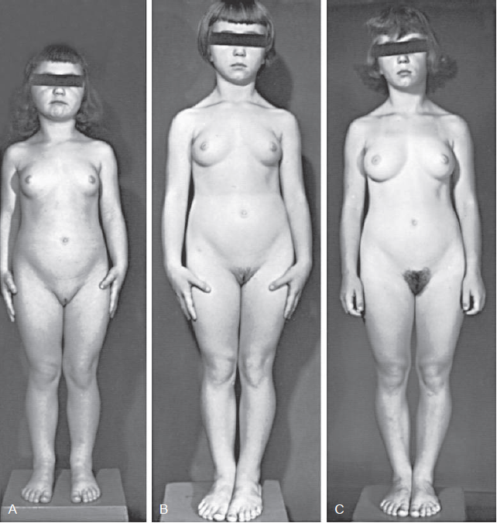

Slide 19
Osseous maturation
In affected girls and boys, height, weight, and osseous maturation are advanced.
The increased rate of bone maturation results in early closure of the epiphyses, and the ultimate stature is less than it would have been otherwise.
Without treatment, approximately 30% of girls and an even larger percentage of boys achieve a height less than the 5th percentile as adults.

Slide 20
Mental development
Mental development is usually compatible with chronological age.
Emotional behavior and mood swings are common, but serious psychological problems are rare.

Slide 21
Patterns of pubertal progression
Rapidly progressive puberty: in most girls (particularly those younger than 6 yr of age at the onset) and a large majority of boys.
Slowly progressive variant: in girls older than 6 yr of age at the onset with an idiopathic form.
Spontaneously regressive or unsustained central precocious puberty is quite rare.
Notes:
This variability in the natural course of sexual precocity underscores the need for longitudinal observation at the onset of sexual development, before treatment is considered.

Slide 22
Laboratory findings
Sex hormone concentrations are usually appropriate for the stage of puberty in both sexes.
Serum estradiol concentrations are low or undetectable in the early phase of sexual precocity in girls, as they are in normal puberty.
In boys, serum testosterone levels are usually detectable or clearly elevated by the time the parents seek medical attention, provided that an early morning blood sample is obtained.
Measurement of LH in serial blood samples obtained during sleep has greater diagnostic power than measurement in a single random sample, and it typically reveals a well-defined pulsatile secretion of LH.

Slide 23
GnRH stimulation test
By intravenous administration of gonadotropin releasing hormone (GnRH stimulation test) or a GnRH agonist (leuprolide stimulation test).
Then to measure LH and FSH at 0, 30, 60 and 120 minutes.

Slide 24
Other investigations
Left wrist x-ray: to asses osseous maturation which is variably advanced, often by more than 2-3 SD.
Pelvic ultrasonography in girls reveals progressive enlargement of the ovaries, followed by enlargement of the fundus and then of the whole uterus to pubertal size.
An MRI scan usually demonstrates physiologic enlargement of the pituitary gland, as seen in normal puberty; it may also reveal CNS pathology

Slide 25
DIFFERENTIAL DIAGNOSIS
Idiopathic
Organic brain lesions
Hypothalamic hamartoma
Brain tumors, hydrocephalus, severe head trauma,
myelomeningocele
Hypothyroidism, prolonged and untreated

Slide 26
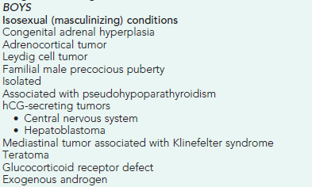
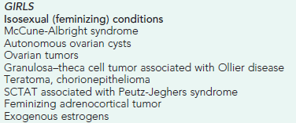
Gonadotropin-independent causes of isosexual precocious puberty must be considered in the differential diagnosis

Slide 27
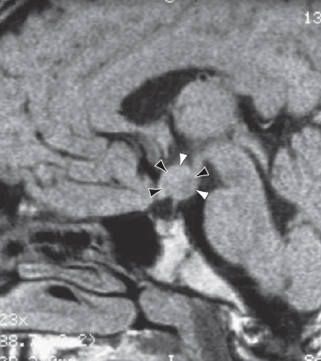
Precocious Puberty Resulting from Organic Brain Lesions
Hypothalamic hamartomas are the most common brain lesion causing central precocious puberty.
Other causes: postencephalitic scars, tuberculous meningitis, tuberous sclerosis, severe head trauma, and hydrocephalus, either isolated or associated with myelomeningocele.
Neoplasms causing precocious puberty include astrocytomas, ependymomas, and optic tract tumors.

Slide 28
How to asses a patient with PP
History
Physical exam
Investigations

Slide 29
History
Onset
Progression
Other associated pubertal changes
Neurological symptoms
History of previous CNS insult
Abdominal pain
Symptoms of hypothyroidism
Growth velocity
Family History
Drug History

Slide 30
Physical exam
Growth Parameters
Tanner Staging
Dermatological exam
Neurological exam
Thyroid exam

Slide 31
Growth charts

Slide 32
Investigations
Bone Age
TFT
LH,FSH
Estradiol/Testosterone
GnRH stimulation test
Pelvic ultrasound
Brain MRI
Others: IGF-1, cortisol, DHEAS, 17-OH progesterone

Slide 33
TREATMENT
Depends on :
- etiology
- Pace of sexual maturation
- Predicted adult height
- Psychosocial ?

Slide 34
GnRH agonist
slows accelerated puberty and improves final height
Leuprolide acetate
Triptorelin
Histrelin
Treatment should be given until it appears that it is safe appropriate for puberty to proceed.

Slide 35
GIPP - treatment
Tumors of the testis, adrenal gland, and ovary are treated by surgery.
hCG-secreting tumors may require combination of surgery, radiation, and chemotherapy depending upon the site and histologic type

Slide 36
McCune-Albright syndrome
Rare disorder
Somatic mutation of the alpha subunit of the G3 protein that activities adenylate cyclase.
Triad: - peripheral precocious puberty
- café-au-lait skin pigmentation
- fibrous dysplasia of bone .
Recurrent formation of follicular cysts and cyclic menses .
Skin manifestations and the bone lesions may increase over time.
May present with vaginal bleeding.

Slide 37
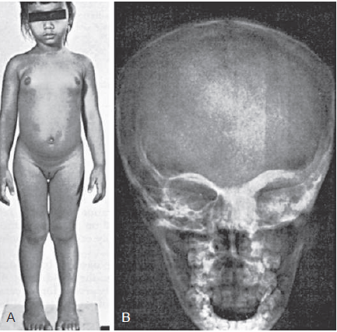
Continued stimulation of endocrine function (eg, precocious puberty, gigantism, Cushing syndrome, adrenal hyperplasia, and thyrotoxicosis).
Mutations in other organs → hepatitis, intestinal polyps, and cardiac arrhythmias.

Slide 38
Antiestrogen –tamoxifen-has been effective in reducing vaginal bleeding.
- Long-term studies of outcomes such as skeletal growth ?
Fibrous dysplasia of bone → bone pain and increased fractures → bisphosphonate pamidronate

Slide 39
Familial male-limited precocious puberty (testotoxicosis)
Rare disorder
Autosomal Dominant
Age of presentation at age 1-4 year
Activating mutation in the LH receptor gene → premature Leydig cell maturation → testosterone secretion.

Slide 40
Familial male-limited precocious puberty - Treatment
Combination of spironolactone and testolactone
Ketoconazole
In few cases a regimen of bicalutamide and anastrozole appeared to be effective in reducing growth velocity and decreasing secondary sexual characteristics without serious adverse effects .

Slide 41
Incomplete (Partial) Precocious Development
Isolated manifestations of precocity without development of other signs of puberty are not unusual
Development of the breasts in girls and growth of sexual hair in both sexes are the 2 most common forms.
PREMATURE THELARCHE
PREMATURE PUBARCHE (ADRENARCHE)
PREMATURE MENARCHE

Slide 42
Medicational Precocity
The most common cause of medicational precocity is currently related to the widespread use of testosterone gels or creams that are applied to the skin for treatment of male hypogonadism.
Less commonly, estrogens in cosmetics, hair creams, and breast augmentation creams have caused breast development in girls and gynecomastia in boys, via percutaneous absorption.

Slide 43
THANK YOU

