Slide 1
Epilepsy in relation to psychiatry
DR.NAJEEB AL-QUSOUS
DONE BY:
YOUSEF ABU HALAWA
MOATH ALHARASIS
Yousef abu halawa
Moath alharasis

Slide 3
Is Epilepsy a Neuropsychiatric or a Neurologic Disorder?
significant proportion of patients with epilepsy also suffer from various types of psychopathology and cognitive deficits.
the rate of suicide are 9 to 25 times higher among patients with epilepsy than in the general population.
psychopathology and psychosocial problems are seen primarily in patients with poorly controlled epilepsy.

Slide 4
Is Epilepsy a Neuropsychiatric or a Neurologic Disorder?
1) The prevalence of depression is 10% among patients with less than one seizure per month.
2) 21% in those whose seizure frequency was more than one per month.
3) 4% in seizure-free patients.
Still, Seizure-free patients off antiepileptic drugs (AED) have a higher risk of psychopathology than general population.

Slide 5
Is Epilepsy a Neuropsychiatric or a Neurologic Disorder?
patients with uncomplicated epilepsy who have remained seizure free off AEDs since childhood had a worse outcome than general population in terms of:
1) Primary education.
2) Marriage.
3) Employment.
4) Socioeconomic status.

Slide 6
Is Epilepsy a Neuropsychiatric or a Neurologic Disorder?
After following a group of epilepsy patients after the age of 18 years, a study reported that:
1) Social isolation was recorded in 16%.
2) Unemployment , Financial dependency in 30%.

Slide 7
Is Epilepsy a Neuropsychiatric or a Neurologic Disorder?
epilepsy patients are vulnerable to psychosocial, even after achieving optimal seizure control in the absence of any cognitive impairment.

Slide 8
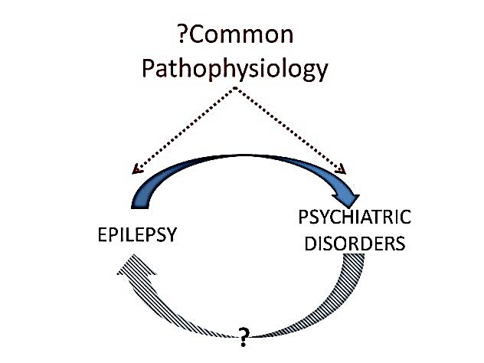
How Close is the Relationship Between Epilepsy and Psychiatric Disorders?

Slide 9
How Close is the Relationship Between Epilepsy and Psychiatric Disorders?
The causes of psychopathology in epilepsy are multifactorial. They include:
1) Genetic risk factors.
2) Biologic risk factors.
3) Iatrogenic causes.
A bi-directional relationship between psychiatric disorders and epilepsy has been suggested by many scholars.

Slide 10
How Close is the Relationship Between Epilepsy and Psychiatric Disorders?
patients with epilepsy having a history of depression prior to the onset of epilepsy are 4 to 17 times more frequently than general population.
This suggests that depression and epilepsy may share common pathogenic mechanism.

Slide 11
How Close is the Relationship Between Epilepsy and Psychiatric Disorders?
Decrements in serotonergic and noradrenergic transmission are linked to the pathophysiology of depression.
Decreased activity of these neurotransmitters is known to exacerbate seizure severity and intensify seizure.
Conversely, antidepressant appear to have an anticonvulsant effect.
Based on this, it is likely that similar neurotransmitter alterations may be common pathogenic mechanism of depression and epilepsy.

Slide 12
Prevalence of Psychiatric Disorders in Patients with Epilepsy

Slide 13
Clinical Expressions of Psychiatric Complications of Epilepsy
Mostly ,The presentation of psychiatric disorders in epileptic patients is often indistinguishable from non-epileptic ones.
This will be our focus ^__^.

Slide 14
A) Psychosis of epilepsy

Slide 15
A) Psychosis of Epilepsy
1) Interictal psychosis of epilepsy.
2) Postictal psychosis.
3) Ictal psychosis.
4) Iatrogenic psychotic disorders.

Slide 16
1) Interictal psychosis of epilepsy
It is divided into 2 categories:
a) episodic psychosis of epilepsy
It has been identified primarily in patients with temporal lobe epilepsy.
These episodes last from a few days to several weeks in duration.
b) chronic or non-episodic psychosis of epilepsy
has a prolonged course and a more guarded prognosis than the episodic psychosis of epilepsy.

Slide 17
2) Postictal psychosis (PIP)
It accounts for approximately 25% of psychosis of epilepsy.
the mean time between the ictal event and the onset of psychotic symptoms is 24 hours.
It can present in the form of isolated symptoms or as a cluster of symptoms.
Physician can avert the recurrence of PIP by introducing low-dose neuroleptic medication at the first sign of PIP, which in most cases is insomnia.

Slide 18
3) Ictal psychosis
Ictal psychosis can be the primary clinical presentation of nonconvulsive status epilepticus.

Slide 19
4) Iatrogenic psychotic disorders
Psychotic disorders, as an expression of a toxic phenomenon, have been reported with most AEDs whether standard or new.
Psychotic disorders can occasionally follow the discontinuation of AEDs
Acute withdrawal from benzodiazepines is well known to result in an acute psychotic episode

Slide 20
B) Depression in epilepsy

Slide 21
B) Depression in Epilepsy
Depression is the most frequent type of psychiatric disorder identified in patients with epilepsy.
1) Interictal forms of depression.
2) Paraictal expressions of depression in epilepsy.
3) Depression as an iatrogenic process.

Slide 22
1) Interictal forms of depression
These are the most common presentation of affective disorders among patients with epilepsy.
Interictal depression in epilepsy commonly presents as a chronic depression that tends to mimic a dysthymic disorder with an intermittent course.

Slide 23
1) Interictal forms of depression
In addition to the depressive symptoms, patients may experience irritability, euphoric mood, fear, and anxiety.
Symptoms are severe enough to disrupt patients’ activities, interpersonal relations, and overall quality of life, and to make them seek treatment.
Symptoms remit completely with sertraline in two thirds of patients.

Slide 24
2) Paraictal expressions of depression in epilepsy
Depressive episodes that are intimately related to the seizure occurrence have unique clinical features.
Paraictal expression can be subclassified into three groups:
a) Ictal depression.
b) Preictal depression.
c) Postictal depression.

Slide 25
a) Ictal depression.
Ictal depression is the clinical expression of a simple partial seizure in which the depressive symptoms are the predominant signs.
The most frequent symptoms include feelings of anhedonia, guilt, and suicidal ideation.
b) Preictal depression.

Slide 26
c) Postictal depression.
Postictal symptoms of depression have been recognized for a very long time.
It is present in about half of patients with consecutive refractory partial seizure disorders.
Depressive symptoms can outlast the ictus for up to 2 weeks, and, at times, have led patients to suicide.

Slide 27
3) Depression as an iatrogenic process
Every AED can cause psychiatric symptoms in patients with epilepsy.
Phenobarbital can cause depression that may be associated with both suicidal ideation and behavior.
Primidone, tiagabine, vigabatrin, felbamate and topiramate are known to cause depressive symptoms.
AEDs with mood stabilizing properties, such as carbamazepine and valproic acid, have a lower possibility to cause depressive symptoms.

