Slide 1
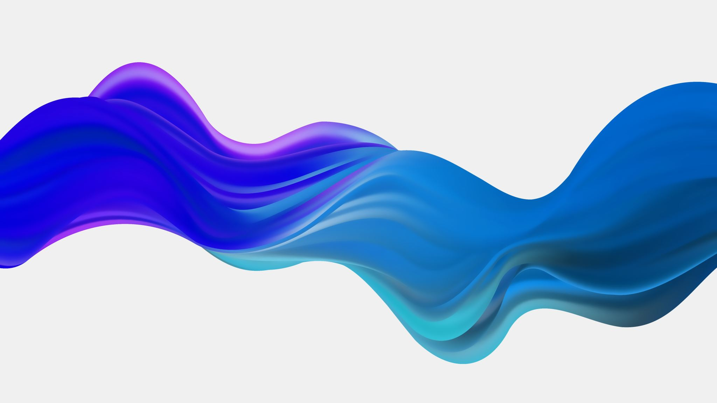
ANTIBIOTICS
Mohammed Tarawneh, MD.
Consultant, Internal Medicine and Infectious Diseases

Slide 2
Nothing to disclose …

Slide 3
Agenda
Beta Lactams:
Penicillin's
Cephalosporins
Carbapenems
Monobactam-Aztreonam
Sulfonamide
Protein Synthesis Inhibitors
Aminoglycosides
Macrolides
Tetracyclines
Clindamycin
Linezolid
Quinolones
Vancomycin
Metronidazole
Nitrofurantoin

Slide 4
Beta Lactam Antibiotics
Penicillin's,
Cephalosporins,
Carbapenems,
Aztreonam

Slide 5
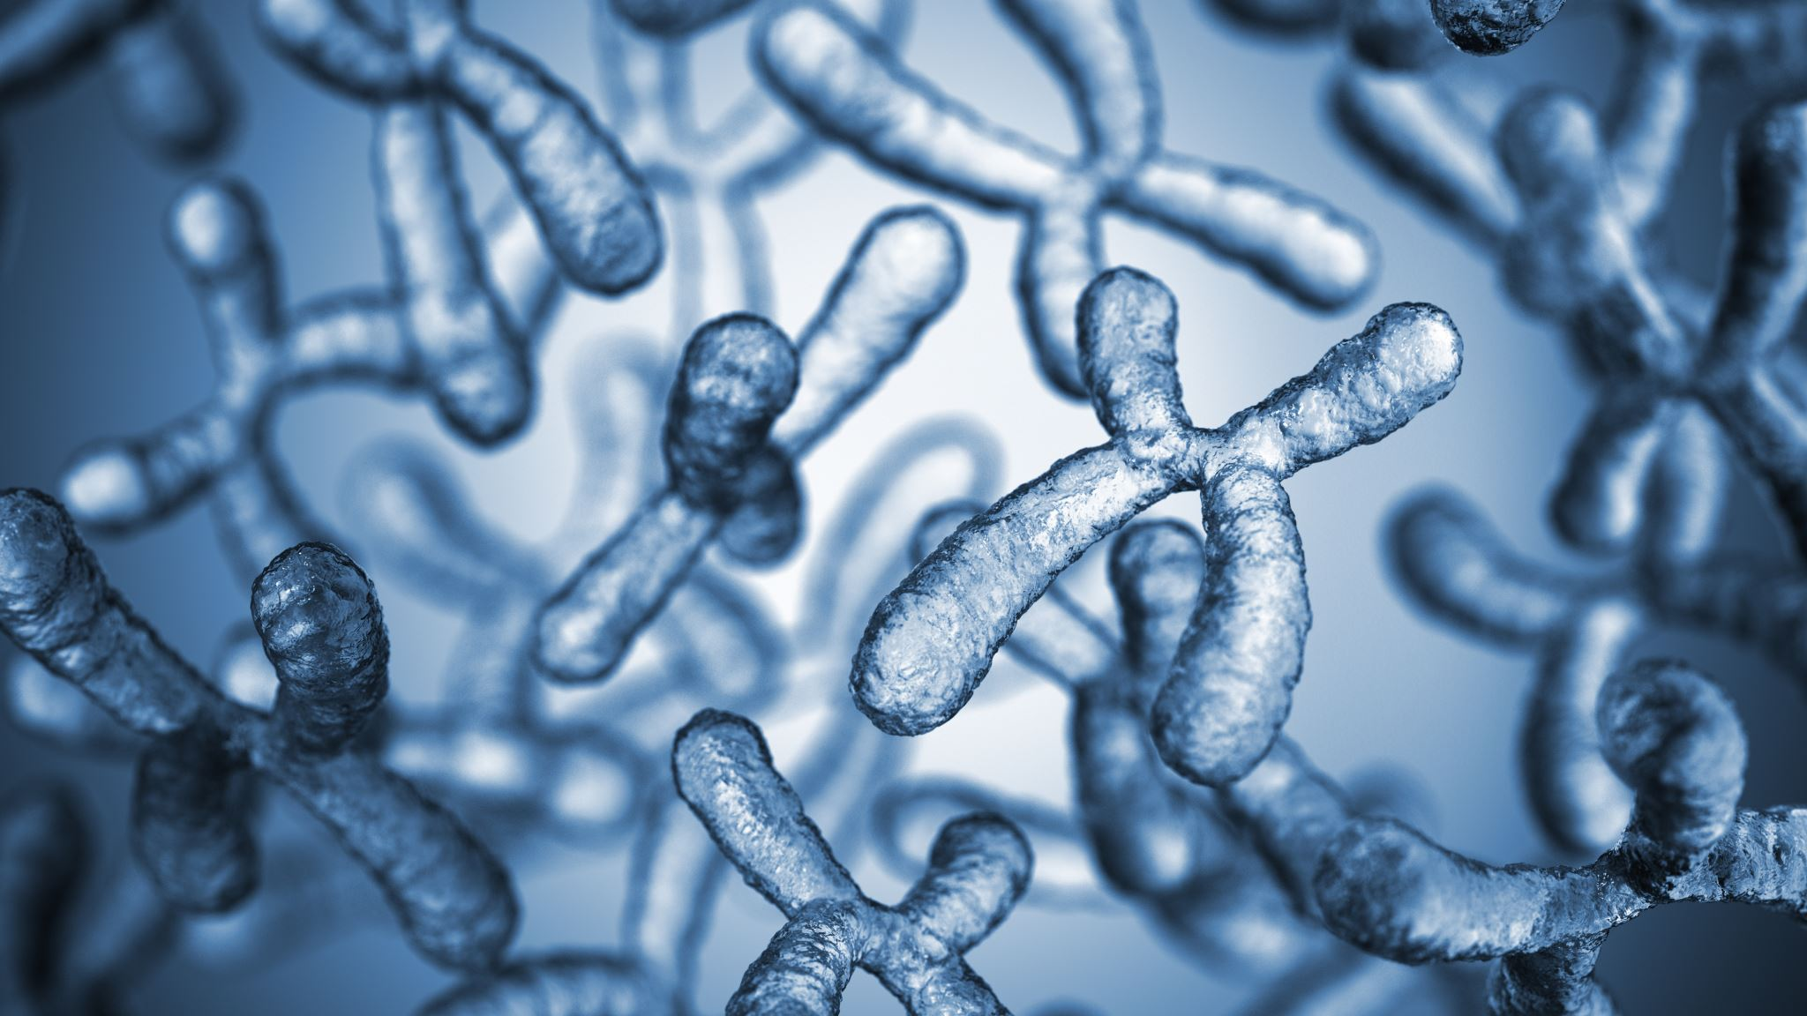
Penicillin's

Slide 6
Thaizolidine Ring:
Penicillin
Side chain
Beta lactam Ring:
Penicillin
Cephalosporins
Carbapenems
Monobactam - Aztreonam

Slide 7
Types of PENICILLINS
Natural
Pen G, Pen VK
Aminopenicillins
Amoxicillin, Ampicillin
Anti Staphylococcus
Oxacillin, Nafcillin, Dicloxacillin
Anti Pseudomonal
Piperacillin, Ticarcillin

Slide 8
Mechanism of action
Penicillin binding proteins >> Inactivates enzymes ( D-ala-D-ala )
Wall breakdown >> Autolysis >> cell death ( Bactericidal )
The same mechanism for all beta lactam antibiotics ☺

Slide 10
Natural Penicillin's
Fungal !!
Penicillin G (IM and IV)
Penicillin VK (oral)
Probenecid (Gout drug) >> Inhibits renal secretion PCN >> Boosts PCN levels → co-administered in special circumstances

Slide 11
Penicillin G and VK
Clinical Uses
Narrow spectrum >> few specific modern uses
Gram positives
Strep pyogenes (strep throat)
Actinomyces
Treponema Pallidum (syphilis)
Rare uses (only in susceptible isolates)
Neisseria meningitides
Strep. pneumonia

Slide 12
Aminopenicillins
Amoxicillin, Ampicillin
Amoxicillin (oral)
Ampicillin (IV) >> Poor bioavailability when given orally
Penetrate porin channel of gram-negative bacteria
Sensitive to beta lactamase enzymes
Covers penicillin bacteria plus some gram negatives

Slide 14
Aminopenicillins
Amoxicillin, Ampicillin
Bacterial
H. Influenza, E. Coli, Proteus, Salmonella, Shigella
Listeria (gram +)
Main Clinical Uses
Otitis Media, Bacterial sinusitis
Meningitis
Newborns, elderly
Listeria coverage

Slide 15
Anti-Staphylococcal Penicillin's
Oxacillin, nafcillin, dicloxacillin
High frequency of adverse effects (interstitial nephritis)
Covers Staph Aureus (non-MRSA) and most strep
Side chain protects B-lactam from staph penicillinase
Prototype: Methicillin >> No longer used

Slide 16
Anti-Staphylococcal Penicillin's
Oxacillin, nafcillin, dicloxacillin
Common uses
Community acquired cellulitis
Impetigo
Staph endocarditis based on culture data
Side effects similar to penicillin

Slide 17
Anti-Pseudomonal Penicillin's
Ticarcillin, Piperacillin
Greater porin channel penetration
Effective against Pseudomonas aeruginosa
Susceptible to B-lactamases!!!
Given with B-lactamase inhibitor
Broad-spectrum antibiotics
Most gram-positive (not MRSA)
More gram-negative (pseudomonas)
Most anaerobic bacteria
Hospitalized patients with sepsis/PNA

Slide 18
Penicillin's
Resistance
Modified penicillin binding proteins
Example: S. pneumonia often produces altered PBPS
Reduced bacterial cell penetration
Gram negative bacteria: poor penetration / Porins
Beta lactamase enzyme
Penicillinase >> Bacterial enzymes >> Degrade beta lactam compounds
Penicillin G and VK
Some other penicillins
Some cephalosporins
Many gram negative bacteria and Staphylococcus aureus
B-Lactamase Inhibitors
Clavulanic Acid, Sulbactam, Tazobactam
Inhibit bacterial B-lactamase
Added to some penicillins to expand coverage
Aminopenicillins
Antistaphylococcal penicillins
Little/no effect used alone

Slide 19
B-Lactamase Inhibitors
Clavulanic Acid, Sulbactam, Tazobactam
Used with aminopenicillins
Amoxicillin / Clavulanicacid (Augmentin)
Ampicillin / Sulbactam
Increases activity against S. Aureus, H. flu
Also increases activity against anaerobes (B. fragilis)
Used with Anti-Pseudomonal penicillin
Ticarcillin-clavulanate
Piperacillin-tazobactam (Zosyn)
Common uses:
Otitis media/sinusitis (Broad-spectrum)
Bite wounds (Polymicrobial with anaerobes)
Hospitalized patients with sepsis / PNA

Slide 20
Penicillin Adverse Effects
Hypersensitivity (allergic) reactions
Commonly leads to hypersensitivity (allergic reaction)
1st exposure: Sensitization
2nd exposure: Hypersensitivity reaction
Symptoms resolve on stopping drug

Slide 21
Penicillin Adverse Effects
Hypersensitivity (allergic) reactions
Acute "immediate”
Type I, IgE-mediated
Usually within 1 hour of taking drug
Histamine release
Itching, urticaria
Bronchospasm
Anaphylaxis

Slide 22
Penicillin Adverse Effects
Maculopapular Rash "Non-immediate" reaction
Type-IV, T-cell-mediated
Days or weeks after starting drug
Most common with aminopenicillins ? Natural as will
Itchy or may be non-pruritic
Absence of fever, wheezing, joint pain
Common with viral infection >> EBV pharyngitis >> Amoxicillin given for pharyngitis >> maculopapular rash. “Mechanism not clear”
Romano A et al. Diagnosis of nonimmediate reactions to B-lactam antibiotics. Allergy 2004

Slide 23
Penicillin Adverse Effects
Immune mediated, CD8 T-cells play important roll
Re-challenge with drug can cause recurrence
Antibiotic associations:
Sulfonamides (TMP-SMX)
Aminopenicillins
Cephalosporins
Skin Reactions
Stevens-Johnson Syndrome
Fever, necrosis
Sloughing of skin
Dermal-epidermal junction
Vesicles, blisters
Toxic epidermal necrolysis
Severe form SJS (>30% skin)
Mortality: SJS 1-5%; TEN 25-35%

Slide 24
Penicillin Adverse Effects
Interstitial Nephritis
Considered a Type IV hypersensitivity reaction. (T cells & Mast cells)
Classic presentation
Fever
Oliguria, Increased BUN/Cr
Eosinophils in urine OR White cells and WBC casts "sterile pyuria"

Slide 25
Penicillin Adverse Effects
Hemolytic Anemia
Type II hypersensitivity
High doses can lead to extrinsic hemolytic anemia
PCN binds to surface RBCS >> Elicits immune response >> Antibodies against PCN bound to RBCS >> Direct Coombs test: positive

Slide 26
Penicillin Adverse Effects
Hypersensitivity (allergic) reactions
Serum Sickness
Type III hypersensitivity reaction
Days/weeks after exposure
Immune complex disorder (IgG)
Complement activation
Urticaria, fever, arthritis, lymphadenopathy
Tatum A et al. Severe serum sickness-like reaction to oral penicillin drugs: three case reports. Ann Allergy Asthma Ummunol 2001

Slide 28
Penicillin Adverse Effects
C. Difficile Infection
Diarrhea following antibiotic therapy >> Antibiotic depletes normal intestinal flora >> C. Difficile growth → pseudomembranous colitis
May occur with any antibiotic, Frequent associations:
Clindamycin
Fluoroquinolones
Cephalosporins
Penicillins

Slide 29
Penicillin Adverse Effects
Jarisch-Herxheimer Reaction
Occurs with PCN therapy for spirochete infections, Classically occurs in syphilis
Febrile syndrome
Fever, chills, flushing, hyperventilation
Usually 2 hrs. after starting therapy
Due to bacterial cell death → immune response

Slide 30
Other Beta Lactam Antibiotics
Cephalosporins, Carbapenems, Aztreonam
Similar mechanism to penicillin
Bind transpeptidases (penicillin-binding proteins/PBPS)
Prevent peptidoglycan crosslinking
Autolysis >> Usually bactericidal
Potentially susceptible to beta lactamase
Hyper sensitivity and adverse reactions are similar to Penicillin

Slide 31
CEPHALOSPORINS

Slide 32
Cephalosporins
Divided into 1st through 5th generation
1st generation: Mostly gram positive coverage >> Successive generations: increased gram (-) coverage

Slide 33
Cephalosporins
1st Generation Cephalosporins
Cefazolin, cephalexin
Developed to treat S. Aureus resistance to penicillin
Covers many gram (+) including S. Aureus (not MRSA)
Stable against S. Aureus beta lactamase
Does not cover enterococcus or listeria
Susceptible to gram negative beta lactamases
Main uses:
Surgical wound (skin) infections
Cefazolin given pre-op for prevention

Slide 34
Cephalosporins
2nd Generation Cephalosporins
Cefuroxime, Cefoxitin, Cefotetan
Developed to treat amoxicillin-resistant infections
Increased affinity for gram (-) PBPS
More resistant to beta lactamase
Increased gram (-)
H. influenza, Enterobacter, Proteus
E. coli, Klebsiella, Serratia, N. gonorrheae
Increased anaerobic coverage (B. fragilis)

Slide 35
Cephalosporins
Cefuroxime (oral):
Otitis media (S. pneumonia, H. flu)
UTI in children (E. coli; no fluoroquinolones)
Cefoxitin/cefotetan (IV):
PID (covers Neisseria; also give doxycycline for Chlamydia)
Pre-op in children with appendicitis
E. coli, Covers gram negatives and some anaerobes
Usually given with metronidazole

Slide 36
Cephalosporins
3rd Generation Cephalosporins
Ceftriaxone, Cefotaxime, Ceftazidime
Broad gram (-) coverage
More resistance to beta lactamase enzymes
More gram (-) PBP affinity
Ceftriaxone, Cefotaxime: Poor coverage pseudomonas
Ceftazidime: Covers pseudomonas
Most achieve good CSF penetration (meningitis)

Slide 37
Cephalosporins
Ceftriaxone
Commonly used for
N. gonorrhea
Commonly used in meningitis
Active against S. pneumonia, N. meningitidis
Good CSF penetration
Ceftazidime
Used in hospitalized patients with
Gram negative infections
Sepsis/pneumonia

Slide 38
Cephalosporins
4th Generation Cephalosporins
Cefepime
Broad spectrum (>3rd generation drugs)
MSSA
Many gram (+)’s
Many gram (-)'s including pseudomonas
Resistant to some ESBL
Hospitalized patients with gram (-) infections

Slide 39
Cephalosporins
5th Generation Cephalosporins
Ceftaroline, Ceftobiprole
Active against MRSA
Low affinity for most other beta-lactams
Covers MRSA and VRSA
Some gram negatives (not pseudomonas)
Studied in skin infections and pneumonia
Ceftobiprole
Covers pseudomonas as will !!

Slide 40
CARBAPENEMS

Slide 41
Carbapenems
Imipenem, meropenem, ertapenem, doripenem
B-lactams, Resistant to cleavage by most B-lactamase

Slide 42
Carbapenems
Drug of choice for ESBL bacteria
Broad spectrum:
Gram (+)
Gram (-) including pseudomonas, Enterobacter and other (SPICE organisms)
Anaerobes including B. fragilis
Used in hospitalized patients
ESBL
Extended Spectrum Beta Lactamase
Plasmid-mediated bacterial enzymes
Confer resistance to most beta-lactam antibiotics
Penicillins, cephalosporins, aztreonam
Found only in gram-negative bacteria:
Pseudomonas, Klebsiella, E. coli
Enterobacter, Salmonella, Serratia, Shigella

Slide 43
Carbapenems
Imipenem
First commercially available carbapenem
Metabolized in kidneys >> Loss of antibacterial effect >> Nephrotoxic metabolites >> Proximal tubule enzyme >> Given with cilastatin (enzyme inhibitor)
Imipenem and meropenem
Older carbapenems
No important differences in efficacy
Ertapenem >> Once daily dosing
Common side effects
Naușea, vomiting, diarrhea
Skin rash
Neurotoxicity
Seizures >> Inhibition of GABA receptors >> Especially at high doses or with renal failure >> Lower risk with meropenem

Slide 44
AZTREONAM - monobactam -

Slide 46
Aztreonam
Binds penicillin-binding protein 3 (PBP-3)
Found in gram negative bacteria ONLY >> not active against G+ or anaerobes
Bactericidal
Limited susceptibility to B-lactamase
Some resistance in ESBL bacteria
Active against pseudomonas
Given IV, and can Synergistic with aminoglycosides
No cross reactivity in penicillin allergic patients >> main indication: penicillin allergy

Slide 48
SULFONAMIDE
-

Slide 50
Sulfonamide
Bacterial Folate Synthesis
Folate required for thymidine/DNA synthesis
Mammalian cells: use exogenous folate (diet)
Bacterial cells: no exogenous folate (must synthesize)

Slide 51
“Para amino benzoic acid”
Sulfonamides
Trimethoprim
Pyrimethamine

Slide 52
Sulfonamides Resistance
Increased PABA
Altered dihydropteroate synthase
Decreased uptake

Slide 53
Sulfonamide
Sulfamethoxazole (SMX), sulfisoxazole, sulfadiazine
Usually given with trimethoprim
TMP-SMX (Bactrim)
Sequential block of THF synthesis
Sulfadiazine
Silver-sulfadiazine (cream for burns)
Sulfadiazine and pyrimethamine
Also sequential block of THF synthesis
Used in toxoplasmosis (HIV)

Slide 54
Sulfonamide Toxicity
Hypersensitivity reactions ~3% of patients
Sulfonamides Hypersensitivity (allergic) reactions >> Similar to penicillin allergic reactions: Anaphylaxis, Maculopapular rash, Serum sickness (fever, rash, arthritis), Interstitial nephritis
Stevens-Johnson Syndrome / Toxic epidermal necrolysis
Photosensitivity >> Drug interaction with UV light, Caused by many drugs, Common drugs: Tetracycline, Sulfonamides, Amiodarone

Slide 55
Sulfonamide Toxicity
Hemolysis in G6PD deficient >> Sulfonamides are oxidants >> trigger for hemolyisis. Other triggers >> Dapsone
Kernicterus in infants
Sulfonamides → increased free bilirubin levels >> Unconjugated bilirubin is neurotoxic >> Basal ganglia, brainstem nuclei >> Permanent neurologic impairment >> Movement disorder (chorea, tremor), Hearing loss, Limited gaze
Raise warfarin levels
Displaces warfarin from albumin >> INR level may rise in patients on warfarin therapy

Slide 56
Dapsone
Not a sulfonamide
Competes with PABA for dihydropteroate synthase
Two main uses:
Mycobacterium leprae (leprosy)
Pneumocystis jiroveci

Slide 57
Trimethoprim / Pyrimethamine
Mechanism of Action
Inhibit dihydrofolate reductase
Similar structure to dihydrofolate

Slide 58
TriMethoPrim - SulfaMethoXazole
Bactrim TMP-SMX
Combination is bactericidal
Covers many gram (+ & -)
Does not cover pseudomonas or B. fragilis (anaerobes)
Covers some fungi and parasites ☺
Common uses:
Urinary tract infections (covers E. Coli well)
Pneumocystis pneumonia in HIV (treatment/prophylaxis)
TMP-SMX Pregnancy
Risk of kernicterus
Disrupts folic acid metabolism

Slide 59
Trimethoprim / Pyrimethamine Toxicity
Bone marrow suppression
Pancytopenia: megaloblastic anemia, leukopenia, thrombocytopenia
Can alleviate with leucovorin (folinic acid)
Converted to THF >> Does not require dihydrofolate reductase >> "Leucovorin rescue"

Slide 60
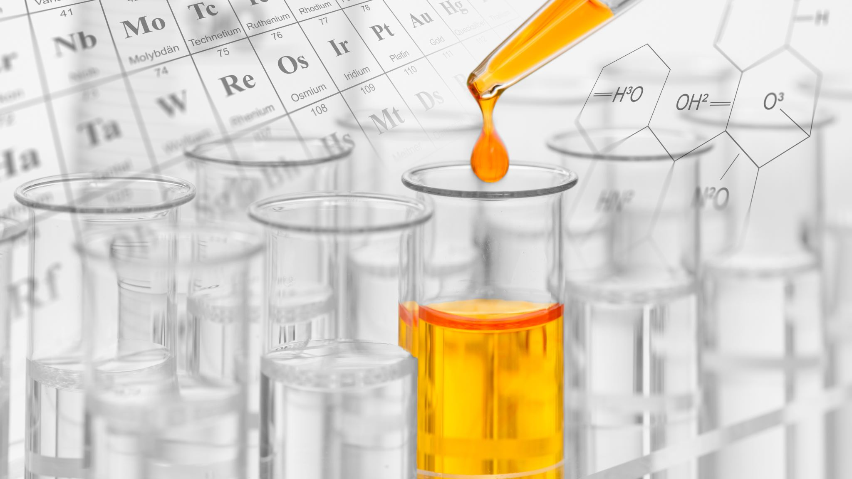
PROTEIN SYNTHESIS INHIBITORS

Slide 61
Protein Synthesis Inhibitors
Aminoglycosides
Macrolides
Tetracyclines
Chloramphenicol
Clindamycin
Linezolid
Streptogramins

Slide 62
Protein Synthesis Inhibitors
Bacterial Protein Synthesis
DNA → Transcription → RNA → Translation → Protein
1- Initiate process
Aminoglycosides / Linezolid
50
Tetracycline
2- Add tRNA
mRNA
tRNA
Protein
30
3- Add peptides translocate
Macrolides / Clindamycin

Slide 63
AMINOGLYCOSIDES

Slide 64
Aminoglycosides
Gentamicin, Neomycin, Amikacin, Tobramycin, Streptomycin
Block initiation of protein synthesis
Primarily bind 30s >> Misreading of genetic code >> Bacteria cannot divide, produce cellular proteins >> Cell death (bactericidal)
Require O2 for transport into cells >> Not effective against anaerobes
Not transferred into eukaryotic cells
Not effective intracellular organisms (Rickettsia/Chlamydia)
Rarely Used alone to treat serious gram (-) infections
What about: TB, ESBL, CRE, Abscess?

Slide 65
Aminoglycosides
Resstance
“Aminoglycoside modifying enzymes”
Bacteria acquire enzymes that modify drug structure
Modified structure binds poorly to ribosomes
Phosphorylation (mediated by aminoglycoside kinases)
Adenylation/acetylation (mediated by transferases)
i
Streptomycin can be used for tuberculosis / Brucellosis
Older agent
Used in combination with other drugs
Neomycin given prior to bowel surgery
Poorly absorbed (stays in gut) >> Decrease colonic bacteria
Often given with Erythromycin
Often added to B-lactams >> Synergistic effects
Vancomycin/gentamycin for endocarditis
Ampicillin/gentamycin for newborn meningitis
Pip/Tazo + tobramycin for CF patients (pseudomonas)

Slide 66
Aminoglycosides
Aminoglycosides Monitoring
Plasma levels need to be monitored
Trough level: Just before next dose
Peak level: Short time after dose
High trough = risk of toxicity
Low peak = less effective therapy
Adverse Effects
Ototoxicity
Toxic to 8th cranial nerve
Hearing loss, balance problems (falls) >> Mechanism not clear
Nephrotoxicity
Acute tubular necrosis
5-10% of drug taken up by proximal tubular cells
Serum Cr will rise
Neuromuscular
Rare side effect >> Can block/limit release of ACh at neuromuscular junctions
Pregnancy class D >> Reports of renal and ototoxicity in fetus

Slide 67
MACROLIDES

Slide 68
Macrolides
Azithromycin, Clarithromycin, Erythromycin
50S ribosomal subunit
Covers many (G+) cocci, esp. strep and Some (G-) coverage
Concentrated inside macrophages, other cells
Effective against intracellular pathogens
Chlamydia (obligate),
Legionella (facultative)

Slide 69
Macrolides
Community acquired pneumonia
Azithromycin covers Strep, H. flu, Atypical inf.
Good for penicillin allergic patients
Chlamydia infection
Azithromycin (safe in pregnancy)
Often co-administered with Ceftriaxone (gonorrhea)
Erythromycin
Binds to motilin receptors in GI tract >> Can be used in GI motility disorders
Clarithromycin >> Part of triple therapy for H. pylori

Slide 70
Macrolides Adverse Effects
Nausea, diarrhea, abdominal pain (motility)
Erythromycin worst offender
Prolonged QT on EKG
Erythromycin also worst offender
Acute cholestatic hepatitis >> AST/ALT/Alk Phos/Bilirubin
Rash >> Maculopapular allergic reaction
P450 Enzyme Inhibitors >> Will raise serum levels of P450 metabolized drugs >> Theophylline, Warfarin

Slide 71
TETRACYCLINES

Slide 72
Tetracyclines
Tetracycline, doxycycline, demeclocycline, minocycline
Transported into bacterial cells
Binds 30S ribosome
Prevents attachment of tRNA
Demeclocycline
Not used as an antibiotic >> ADH antagonist >> Given in SIADH >> Causes nephrogenic DI to reverse SIADH

Slide 73
Tetracyclines
Doxycycline
Most commonly used member tetracycline family
Accumulates intracellularly
Covers many unusual/atypical bacteria
Most zoonoses
Chlamydia
Used to treat acne vulgaris (also minocycline)
Covers propionibacterium acnes within follicles
Tigecycline … !!

Slide 74
Tetracyclines
Tetracycline, doxycycline, demeclocycline, minocycline
Absorption impaired by minerals and antacids
Calcium, magnesium (antacids), Iron, Dairy including milk
These substances are cations that chelate the drug >> Cannot be taken with antacids or milk
Adverse Effects
GI distress (common)
Epigastric pain, nausea, vomiting and anorexia
Photosensitivity >> Red rash or blisters in sun exposed areas

Slide 75
Tetracyclines Adverse Effects
Discoloration of teeth
Brown-yellow discoloration of teeth
Children under the age of eight (does not occur in adults)
Inhibition of bone growth in children
Deposit in bones >> Chelate with calcium
Contraindicated in pregnancy
Cross placenta >> Can accumulate in fetal bone and teeth

Slide 76
CLINDAMYCIN

Slide 77
Clindamycin
50S ribosome
Prevents translocation, Same as macrolides
Covers some gram (+)
Staph, viridans strep, Strep pyogenes, and S. pneumoniae
Covers many anaerobes
Clostridium perfringens
Mouth anaerobes: Fusobacterium, Prevotella, Peptostreptococcus
Main use is to cover anaerobes “above the diaphragm”
Aspiration pneumonia, Lung abscesses, Oral infections (mouth anaerobes)
Lots of resistance to clindamycin in B. fragilis >> Anaerobic infections "below the diaphragm” >> Metronidazole

Slide 78
Clindamycin Adverse Events
Classic cause of C. difficile infection
Up to 10% of patients >> Pseudomembranous colitis >> C. difficile overgrowth >> Massive, watery diarrhea
Antibiotic-associated diarrhea
Milder than C. diff infection >> Changes in GI flora >> Less absorption of solutes → osmotic diarrhea >> Stops when drug discontinued

Slide 79
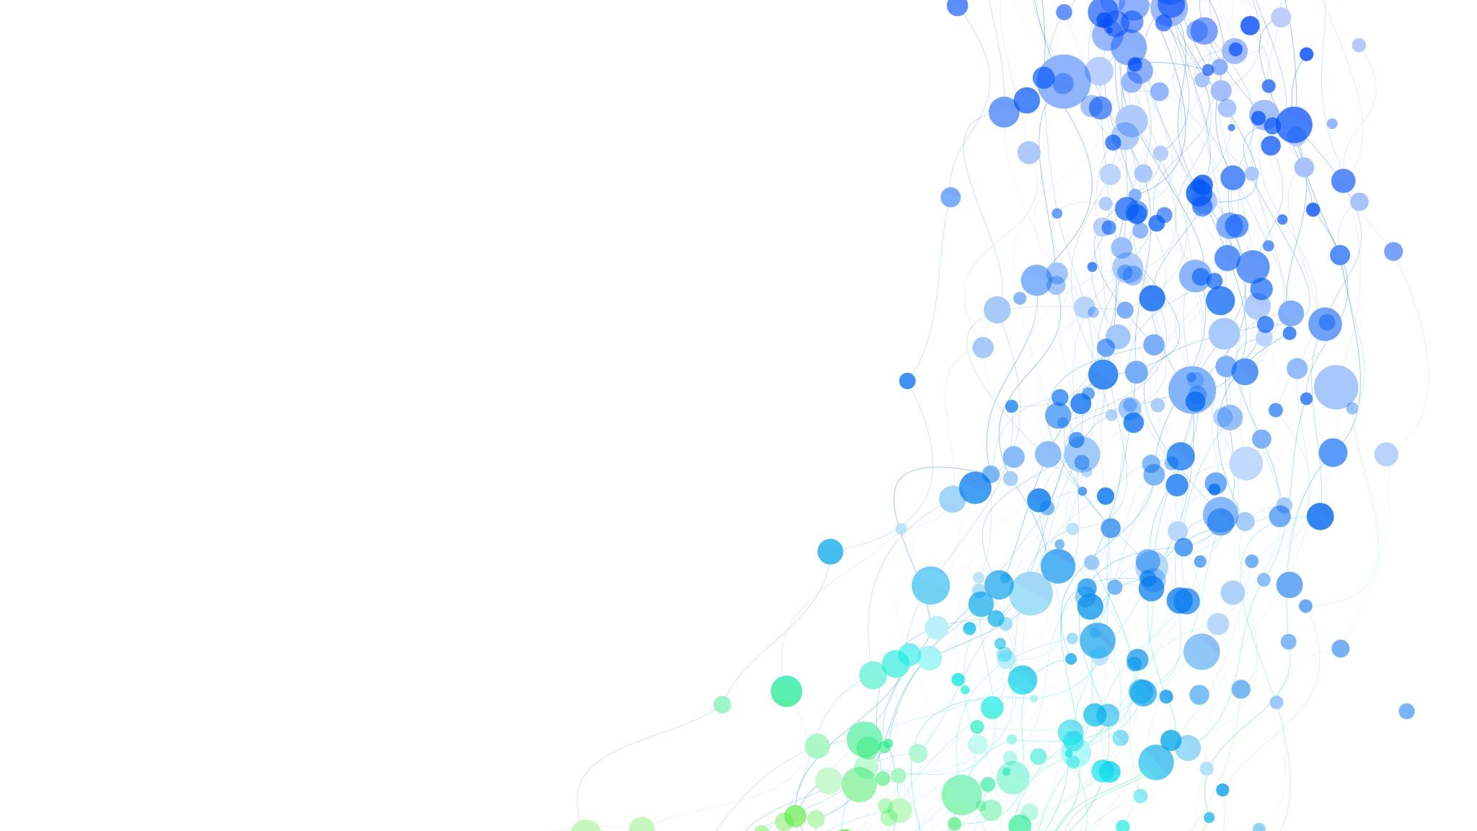
LINEZOLID

Slide 80
Linezolid
Binds to 50S Ribosome
Blocks initiation
Main use:
Vancomycin-resistant enterococcus (VRE) >> Epidemics in hospitals, Usually occurs in patients with prior antibiotic treatment
Weak monoamine oxidase (MAO) inhibitor
Can cause serotonin syndrome >> High risk when given with SSRIS >> Fever, confusion, agitation, hyperreflexia
Can cause Thrombocytopenia!

Slide 82
QUINOLONES

Slide 83
Quinolones
Ciprofloxacin, Levofloxacin, Moxifloxacin, Norfloxacin
Inhibit enzymes for bacterial DNA synthesis
DNA gyrase and Topoisomerase IV >> inhibition >> DNA damage >> Cell death
Resistance Mechanisms
Alterations of DNA gyrase and topoisomerase IV
Alteration in cell permeability
Efflux of drug

Slide 84
Quinolones
Ciprofloxacin, Levofloxacin, Moxifloxacin, Norfloxacin
Many gram (+), gram (-), atypicals
Common clinical uses (adults only)
UTIS (E. Coli, other enteric gram negatives)
Pneumonia (S. pneumo, H. flu, atypicals)
Abdominal infections (enteric gram negatives)

Slide 85
Quinolones
Ciprofloxacin
Some gram positive coverage
Rarely used alone for gram positive coverage (resistance)
Very good gram negative coverage
Most reliable pseudomonas coverage
Used in UTIS, GI infections
Cipro ear drops for otitis externa (swimmer's ear ? P. aeruginosa)

Slide 86
Quinolones
Levofloxacin
More gram positive/atypical coverage than Cipro
Better strep pneumo coverage than Cipro
Covers most methicillin-susceptible Staph aureus
Less effective against pseudomonas than Cipro
Commonly used in pneumonia (strep, atypicals)

Slide 87
Quinolones
Moxifloxacin, Gatifloxacin, Sparfloxacin
Better gram (+)/atypical coverage than Levofloxacin
Less effective for pseudomonas than Levofloxacin
Also used in pneumonia

Slide 88
Quinolones Adverse Reactions
Gastrointestinal upset
Anorexia, nausea, vomiting, and abdominal discomfort
Up to 17% of patients
Neurologic side effects
Headache, dizziness
2 to 6% of patients
QT prolongation on EKG
Caused by blockade of K+ channels
Can lead to torsade de pointes

Slide 89
Quinolones Adverse Reactions
Tendon rupture/tendonitis
Most commonly Achilles
More common older patients (>60), people on steroids
Cannot use in pregnancy/children
Toxic to developing cartilage in animal studies
Antacids
Disrupt absorption of many drugs, Aluminum and magnesium hydroxide, Sucralfate (contains aluminum)
Key drugs that affected by this:
Tetracycline, Fluoroquinolones
Isoniazid, Iron supplements

Slide 90
VANCOMYCIN

Slide 91
Vancomycin
Inhibits peptidoglycan formation (cell wall)
Binds D-alanyl-D-alanine peptides >> Prevents crosslinking >> Cell wall breakdown more than formation → cell death
Same effect as beta lactams via different mechanism
Beta lactams: inhibit transpeptidases
Vancomycin: block transpeptidase binding
Resistance
Terminal amino acids change D-alanyl-D-alanine to >> D-alanyl-D-lactate
VRSA emerges

Slide 92
Vancomycin
Only effective in Gram + (huge!)
Two common uses:
Methicillin resistant Staph Aureus (MRSA)
Oral therapy for C. difficile pseudomembranous colitis
Often given empirically when MRSA is a concern
Endocarditis
Severe pneumonia/sepsis

Slide 93
Vancomycin Adverse Effects
Generally well tolerated
Nephrotoxicity “check Trough level”
Less common with modern preparations
Increased risk if concomitant aminoglycoside therapy
Ototoxicity >> Tinnitus, vertigo, and hearing loss reported (rare)
Red man syndrome
Flushing, erythema, itching >> Usually affects upper body, neck, face more than lower body >> Occurs 10-20 minutes after start of infusion >> Direct activation of mast cells → histamine release "Pseudoallergic drug reaction”
May develop with first administration
Infusion related → slow infusion = no symptoms

Slide 94
METRONIDAZOLE

Slide 95
Metronidazole
Prodrug: Must be reduced to activate
Only anaerobic bacteria capable of reduction
Reduced metronidazole → more drug uptake
Activated form generates free radicals >> Interact with DNA >> DNA breakage/destabilization >> Cell death

Slide 96
Metronidazole Uses
Good coverage of anaerobes “below the diaphragm”
Bacteroides fragilis
Clostridium difficile
Peritonitis, abdominal abscesses, diverticulitis
Often given with quinolone for anaerobic/GI gram(-)
Cipro/Flagyl often used for diverticulitis
H. pylori (Triple therapy) and Gardnerella vaginalis
Treatment of bacterial vaginitis
Anaerobic protozoa (lack mitochondria)
Trichomonas vaginalis, Entamoeba histolytica, Giardia lamblia

Slide 97
Metronidazole Adverse Reactions
Unpleasant metallic taste
GI: Abdominal discomfort, nausea
Neuro: Neuropathy, headache
Disulfiram-like reaction >> Alcohol consumption with metronidazole >> Warmth, flushing, sweating. “Unclear mechanism”
Metronidazole may not inhibit alcohol metabolism >> Patients should avoid alcohol

Slide 98
NITROFURANTOIN

Slide 99
Nitrofurantoin
Rarely used antibiotic
Exact mechanism incompletely understood
Bactericidal drug
Only use is UTIs (concentrates in urine)
Two things to know about this drug:
Used for UTIS in pregnancy (avoid TMP-SMX, quinolones)
Can trigger hemolysis in G6PD patients

