Slide 1
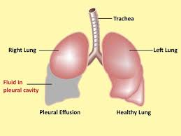
Pleural effusion
Presented by
Hamzeh Shahin
Goergaiette Haddad

Slide 2
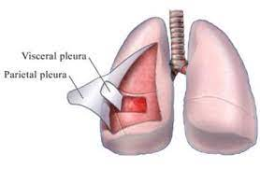
Anatomy
Pleura is a two layered membranous pleural sac with a serous membrane
Parietal Pleura – attached to the chest
Visceral Pleura – attached to the lung
The pleural space – potential space that countains serous fluid (0.13ml/kg)

Slide 3
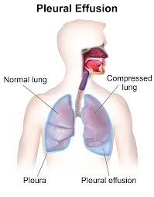
Pleural effusion
Accumulation of fluid in the pleural cavity:
Serous fluid - hydrothorax
Pus - empyema
Blood - hemothorax
Chyle - chylothorax

Slide 4
Pleural effusion
involvement
unilateral
bilateral
mechanism
transudate
exudative

Slide 5
Transudative
Caused by systemic factors:
Increased hydrostatic pressure – Congestive Heart Failure
Decreased oncotic pressure – Nephrotic syndrome, Cirrhosis
Most commonly presents as bilateral effusion

Slide 6
Increased hydrostatic pressure / Decreased oncotic pressure
Unable to maintain fluid intravascularly
Fluid shift to interstitial space
Effusion

Slide 7
Exudative
Causes:
Pneumonia or malignancy of opposite lung → Increased capillary permeability or decreased lymphatic drainage → Inflammation → Increased microvascular pressure
Most commonly presents as unilateral

Slide 8
Microbial invasion
Initiation of inflammatory reaction
Vasodilation increase capillary permeability
fluid shift into interstitial space
leakage of plasma protein
decreased oncotic pressure

Slide 10
Differentiating criteria
 | transudative | Exudative
LDH effusion | <200 IU/ML | >200IU/ML
LDH effusion/serum ratio | <0.6 | >0.6
Protein effusion/serum ratio | <0.5 | >0.5
Specific gravity | < 1.016 | >1.016

Slide 11
Parapneumonic effusion
is caused by bacterial pneumonia , lung abscess , bronchiectasis
Divided into three types:
Uncomplicated
Complicated
Empyema if complicated not treated by antibiotics

Slide 12
Uncomplicated parapneumonic effusions: The fluid may be cloudy or clear, and it doesn’t contain bacteria. PPE will get better when you take antibiotics to treat pneumonia.
Complicated parapneumonic effusions: Bacteria have travelled from the lungs into the pleural space, causing a build-up of fluid and white blood cells. The fluid is cloudy. It will need to be drained.
Empyema: Thick, whitish-yellow pus builds up in the pleural space. This can happen if pneumonia isn’t treated quickly enough.

Slide 13
Clinical presentation
Minimal effusion with minimal lung compression: Asymptomatic
Moderate to large size or caused by inflammation: Symptomatic
May result in respiratory failure
Note that symptoms are related to the underlying cause of effusion

Slide 14
Signs and symptoms:
Dyspnea
Cough – dry
Peripheral edema
Pleuritic chest pain – more likely in exudative

Slide 15
Physical examination
Physical findings accrue at effusion >300 ml
Inspection :
Tachypnea
Absent or diminished movements of affected side
Fullness of chest with bulging of intercostal spaces
Palpation:
Asymmetrical chest expansion, with diminished or delayed expansion on the side of the effusion.
Decreased tactile fremitus
Mediastinal shift away from the effusion (effusion of >1000ml)

Slide 16
Physical examination
Percussion :
Stony dullness to percussion.
Auscultation:
Absent breath sounds over the effusion
Absent vocal resonance
There may be signs of pneumonia ( bronchial breathing , crackles)

Slide 17
investigations
Total and differential leukocyte count
CRP and ESR
Radiological examination
CXR
CT SCAN
Ultrasound for thoracentesis

Slide 18
cxr
In PA VIEW a total of 300ml is needed to diagnose pleural effusion
In lateral decubitus even 50 ml can be detected, it can also determined whether fluid is free flowing or loculated
Findings :
Obliterated costophrenic angles
Tracheal and mediastinal shifts are seen in massive effusion
A curved shadow at lung base that ascend on the chest wall toward the axilla , fluid appear to track up the lateral chest wall (meniscus sign)

Slide 19
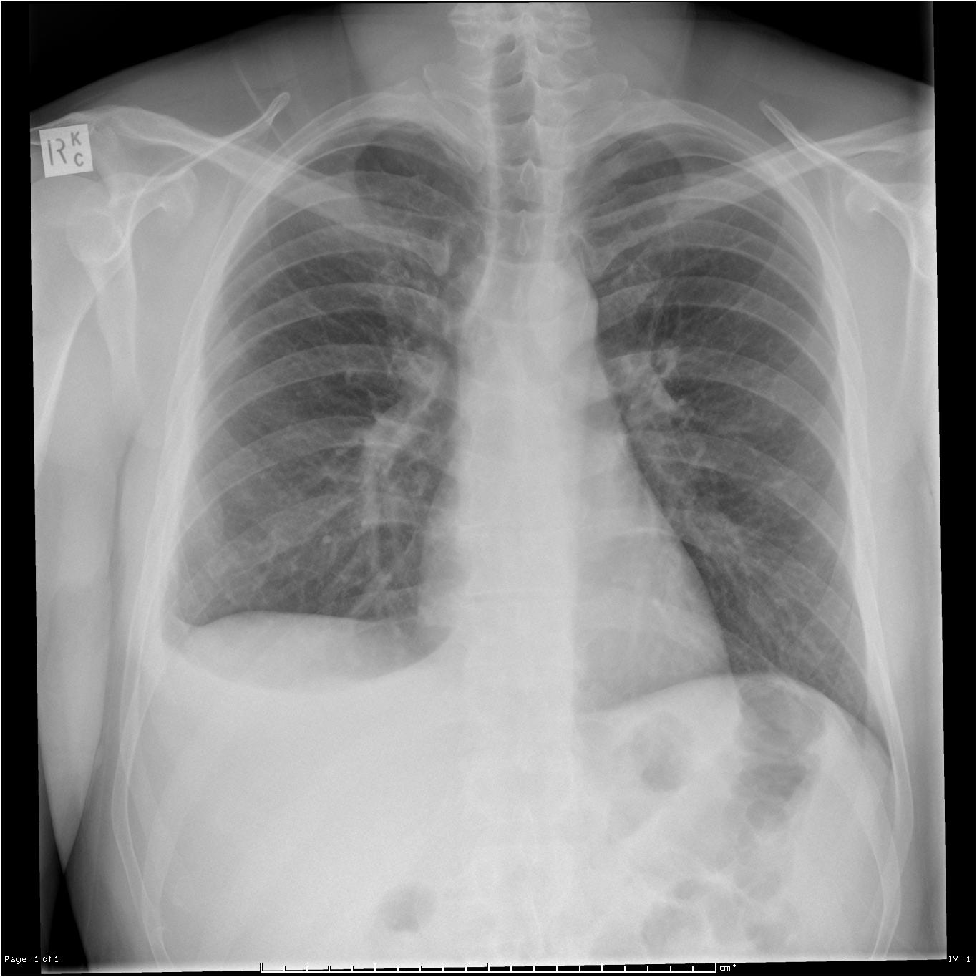

Slide 21
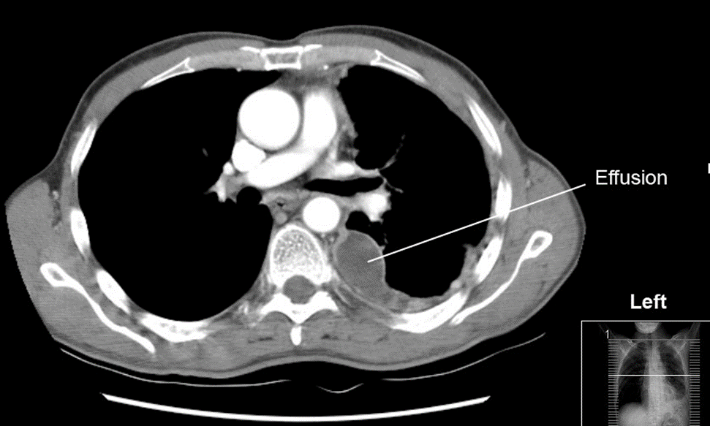
Ct scan
More reliable than CXR for detecting effusion ,it can displays pleural abnormalities, and determine the volume of the pleural fluid

Slide 22
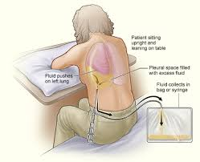
thoracentesis
A procedure that drains fluid or air from the pleural space. It is done using a hollow needle or a plastic tube inserted through the chest wall. Normally only a small amount of fluid is in the pleural space and is done in the most dependent part.

Slide 23
thoracentesis
Diagnostic
Transudates: clear & w/o odour
Empyema: Purulent fluid
Chylothorax: Milky fluid (lymph)
Trauma, Malignancy, post pericardiotomy syndrome, or asbestos-related effusion: bloody fluid
Esophageal rupture , Pancreatitis or Malignancy: Elevated pleural fluid amylase
TB: Exudative effusion – lymphocytic
Parapneumonic effusion or Empyema : PH<7.3

Slide 24
thoracentesis
A thoracocentesis is mandatory also in this setting to rule out a complicated parapneumonic effusion (because of the possibility of progression to an empyema). An empyema (or complicated effusion) needs chest-tube drainage to resolve, while an uncomplicated parapneumonic effusion responds to antibiotics alone
Therapeutic:
Massive collection or rapid collection of pleural fluid
Severe respiratory distress
Suspected empyema
Massive mediastinal shift

Slide 25
management
TREAT THE CAUSE
Pneumonia : antibiotics
CHF: diuretics
malignancy
Pleural fluid: aspiration
Wide bore needle
Intercostal drainage under water seal
Thoracic surgery : needs VATS (Video-assisted thoracoscopic surgery)

