Slide 1
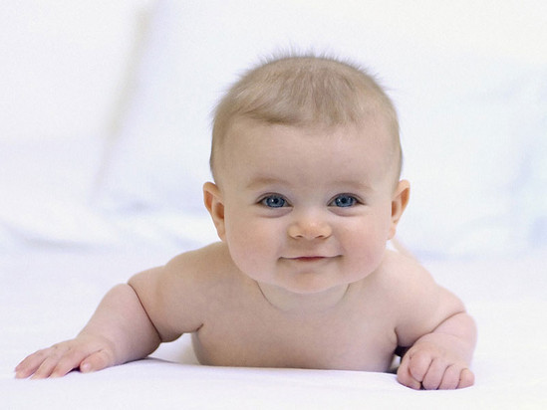

Slide 2
The development of PLACENTA

Slide 3
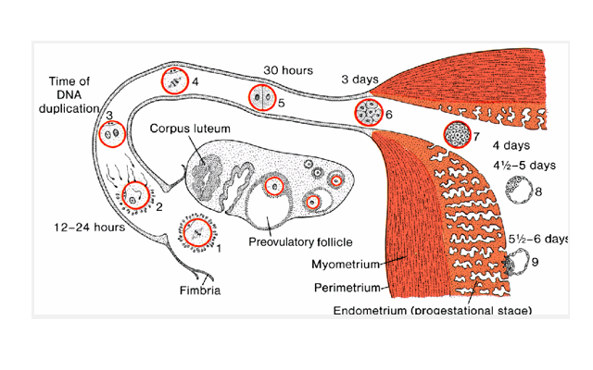

Slide 4
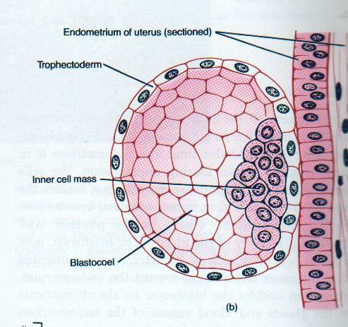
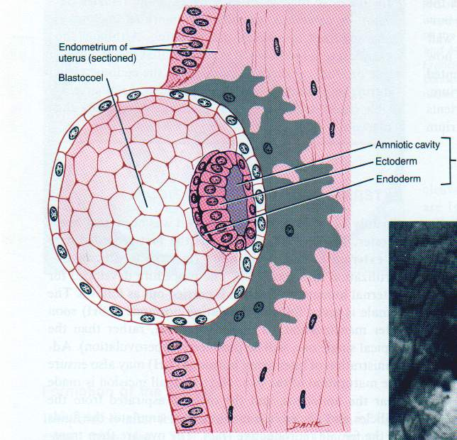

Slide 5
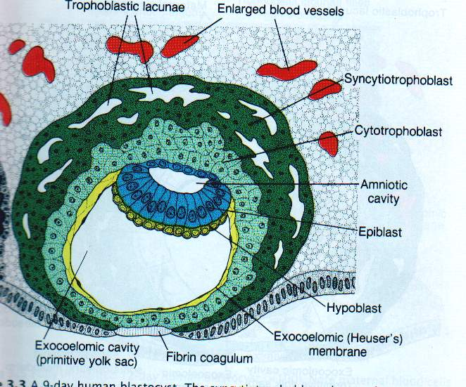

Slide 6
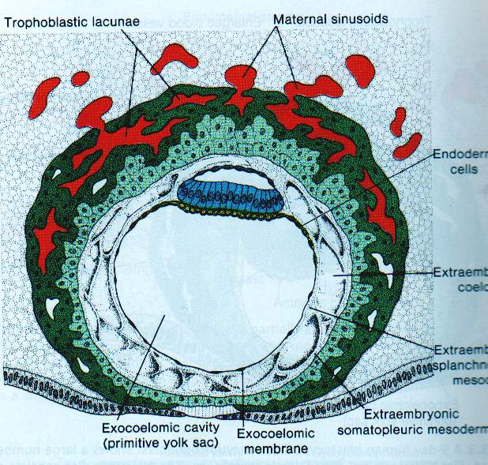

Slide 7
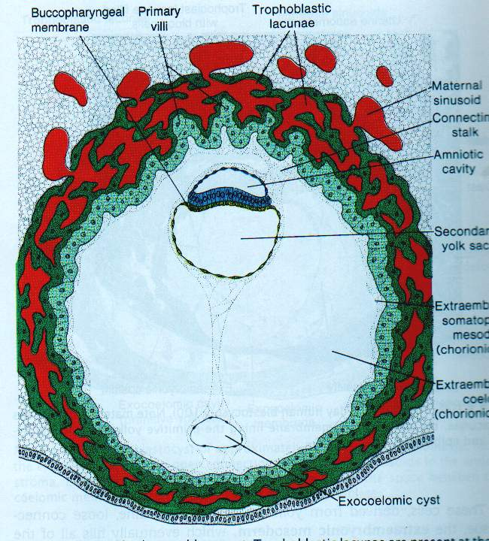

Slide 8
Further Development of Chorionic Villi
Early in the 3rd week, mesenchyme growth into the primary villi forming a core of mesenchymal tissue. Thus the Secondary Chorionic Villi are formed over the entire surface of the chorionic sac.
Some mesenchymal cells in the secondary villi differentiate into capillaries and blood cells forming the Tertiary Chorionic Villi.
The capillaries in the villi fuse to form arteriocapillary networks.

Slide 9
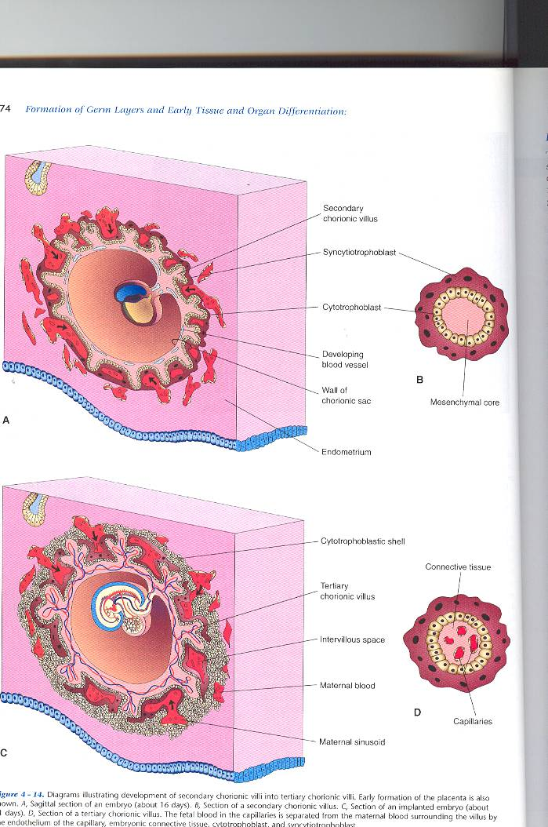

Slide 10
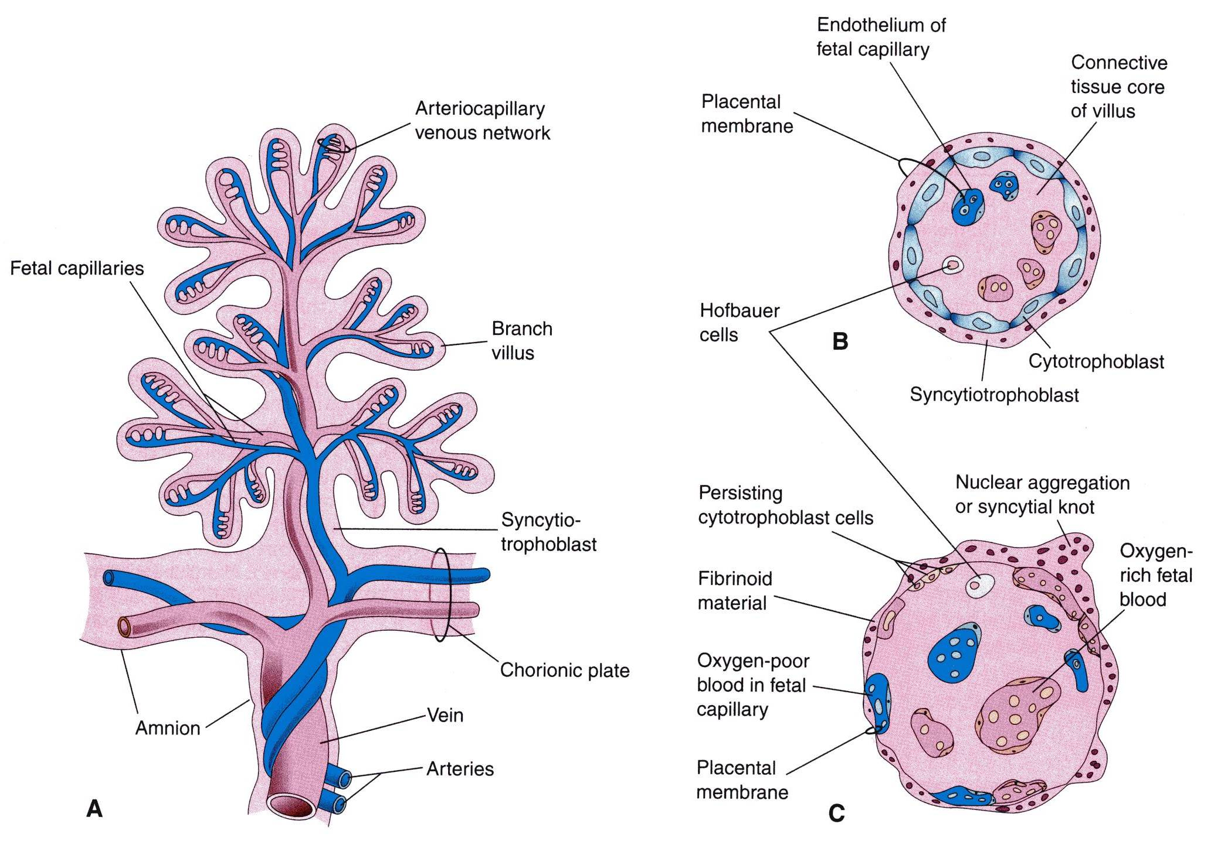
STRUCTURE OF STEM CHORIONIC VILLUS

Slide 11
.free villus: branches
.anchoring villus
---cytotrophoblastic cell column: →cytotrophoblastic shell

Slide 12
Until the beginning of the 8th week, the entire chorionic sac is covered with villi.
After that, as the sac grows, only the part that is associated with Decidua basalis retain its villi.
Villi of Decidua capsularis compressed by the developing sac.
Thus, two types of chorion are formed:
Chorion frondosum (villous chorion)
Chorion laeve – bare (smooth) chorion.

Slide 14
The previous formed arteriocapillary networks become connected with the embryonic heart through vessels which are formed in the mesenchyme of the chorion and connecting stalk.
By the end of the 3rd week, embryonic blood begins to flow through the capillaries in the chorionic villi.
Oxygen & nutrients in the maternal blood in the intervillous space diffuse through the walls of the villi and enter the embryo’s blood.
Carbon dioxide & waste products diffuse from blood in the fetal capillaries through the wall of the chorionic villi into the maternal blood.

Slide 15
PLACENTAL MEMBRANE
This is a composite structure that consists of the extrafetal tissues separating the fetal blood from the maternal blood.
It has four layers:
Syncytiotrophoblast
Cytotrophoblast
Connective tissue of villus
Endothelium of fetal capillaries
After the 20th week, the cytotrophoblastic cells disappear and the placental membrane consists only of three layers.

Slide 16
DECIDUA
This is the endometrium of the gravid (pregnant) uterus.
It has four parts:
Decidua basalis: it forms the maternal part of the placenta
Decidua capsularis: it covers the conceptus
Decidua parietalis: the rest of the endometrium
Decidua reflexa: Junction between capsularis & parietalis.

Slide 17
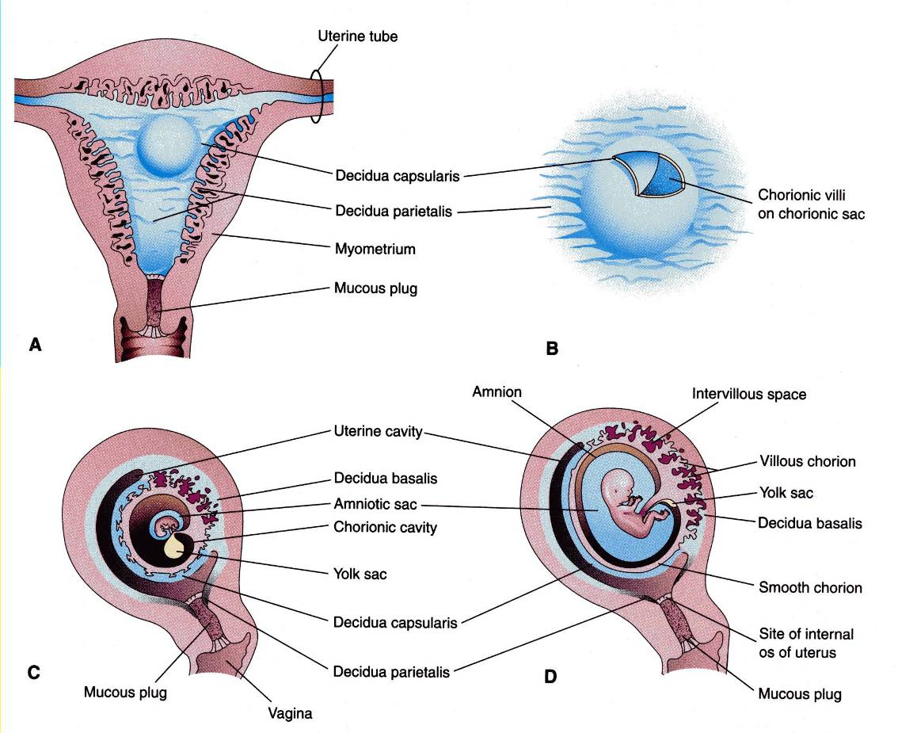

Slide 18
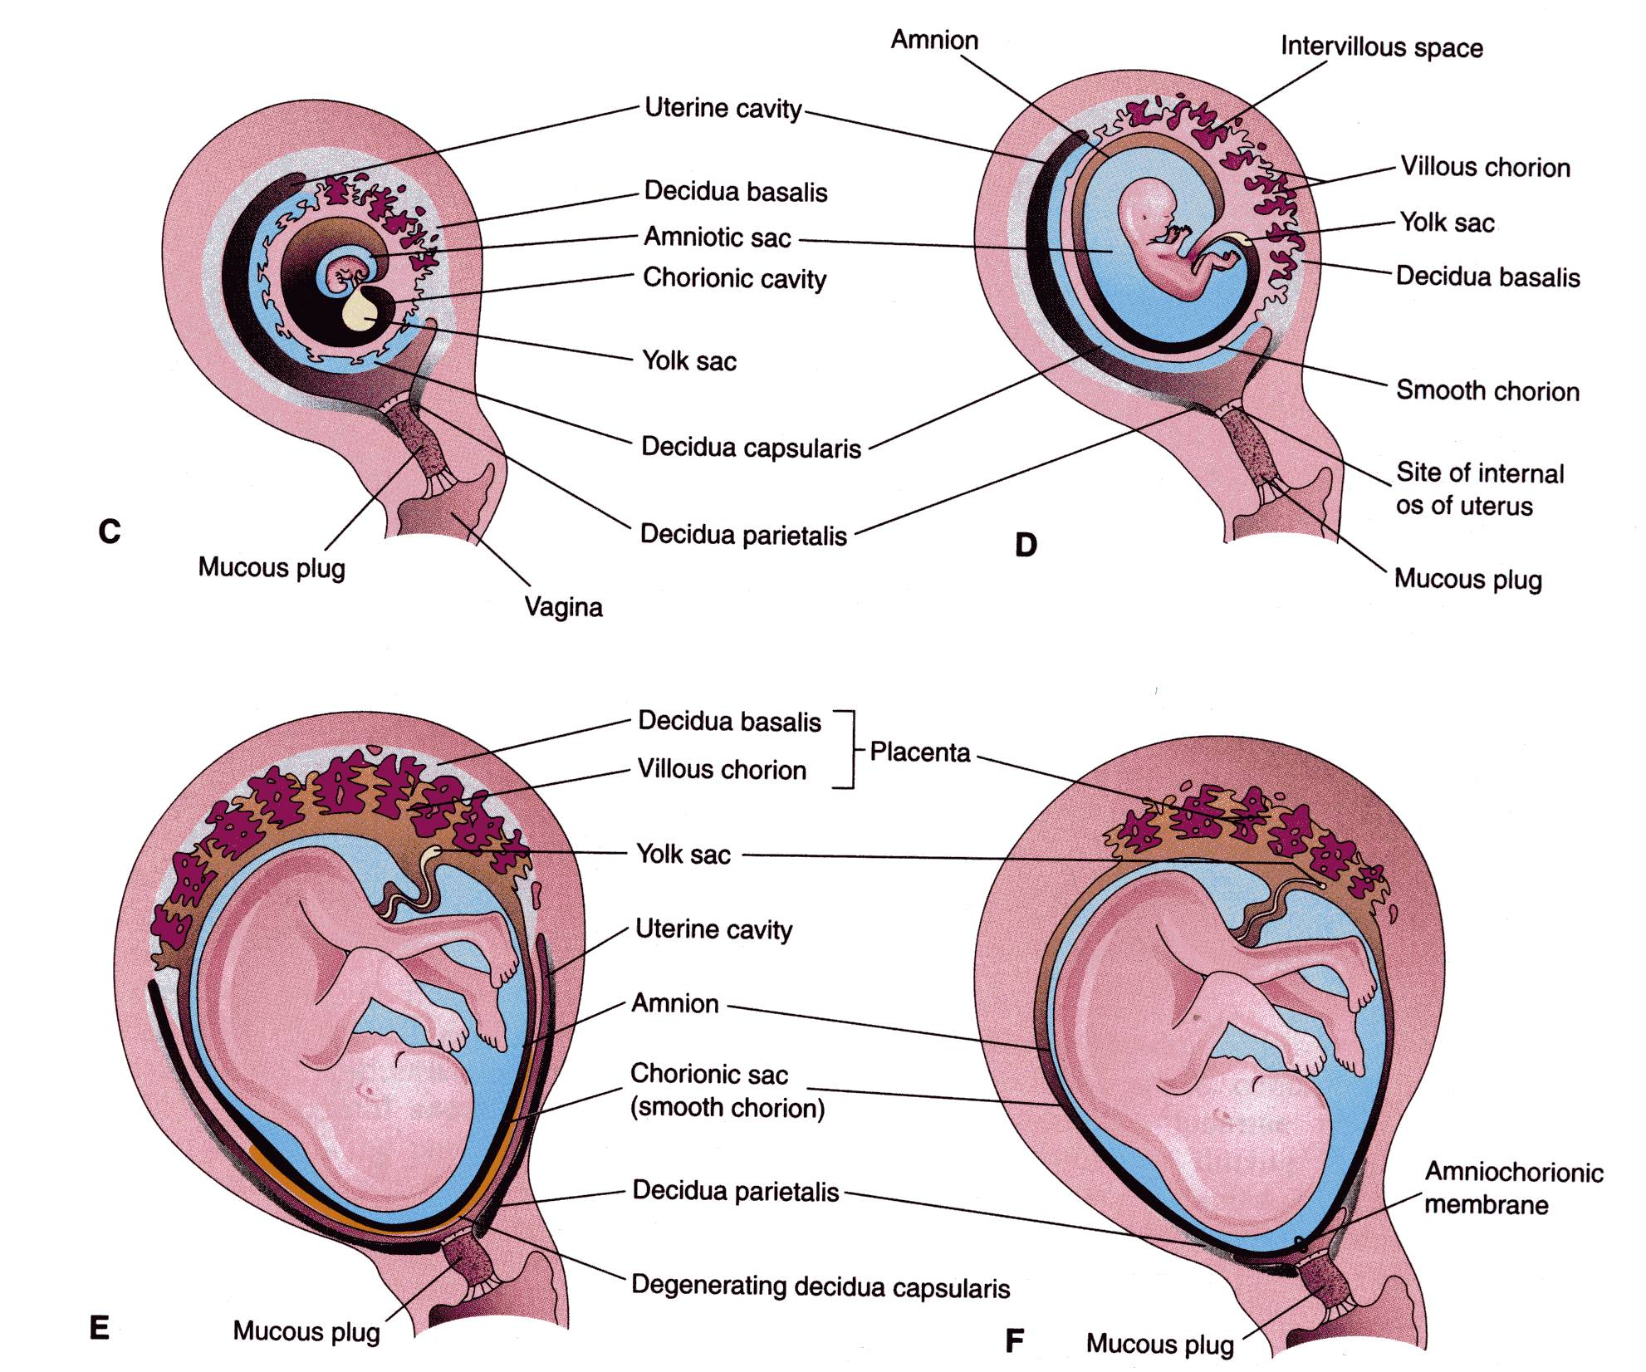

Slide 19
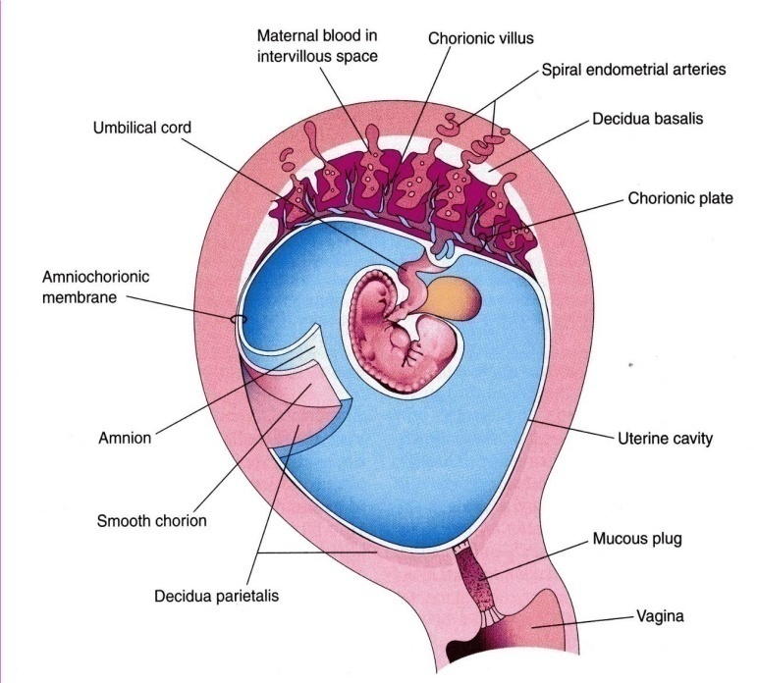
PLACENTA
This is a fetomaternal organ.
It has two components:
Fetal part – develops from the chorionic sac ( chorion frondosum )
Maternal part – derived from the endometrium ( functional layer – decidua basalis )
The placenta and the umbilical cord are a transport system for substances between the mother and the fetus.( vessels in umbilical cord )

Slide 20
DEVELOPMENT OF PLACENTA
The villous chorion ( increase in number, enlarge and branch ) will form the fetal part of the placenta.
The decidua basalis will form the maternal part of the placenta.
The placenta will grow rapidly.
By the end of the 4th month, the decidua basalis is almost entirely replaced by the fetal part of the placenta.

Slide 21
FULL-TERM PLACENTA
Development of the decidual septa:
The decidua basalis forms many septa that protrude into the inter-villous spaces.
These septa divide the placenta into 15-25 lobes called cotyledons.
Cotyledons : slightly bulging villous areas. Their surface is covered by shreds of decidua basalis from the uterine wall.
After birth, the placenta is always inspected for missing cotyledons. Cotyledons remaining attached to the uterine wall after birth may cause severe bleeding.
Grooves – formerly occupied by placental septa
The fetal part of placenta; fetal membranes called developmental adnexa.

Slide 22
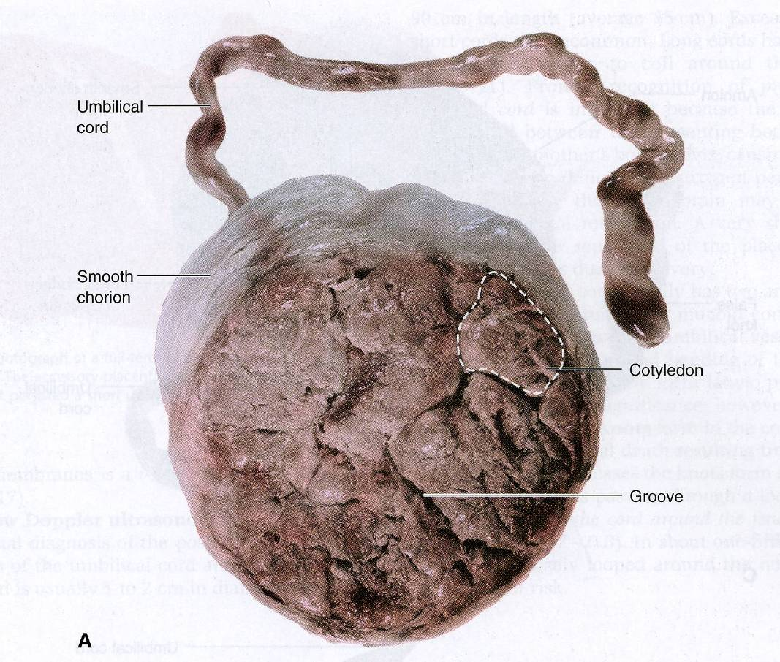
Maternal side

Slide 23
FULL-TERM PLACENTA ( Discoid shape -500- 600 gm- Diameter 15-20 cm – Thickness of 2-3 cm)
Fetal surface:
This side is smooth and shiny. It is covered by amnion.
The umbilical cord is attached close to the center of the placenta.
The umbilical vessels radiate from the umbilical cord.
They branch on the fetal surface to form chorionic vessels.
They enter the chorionic villi to form arteriocapillary-venous system.

Slide 24
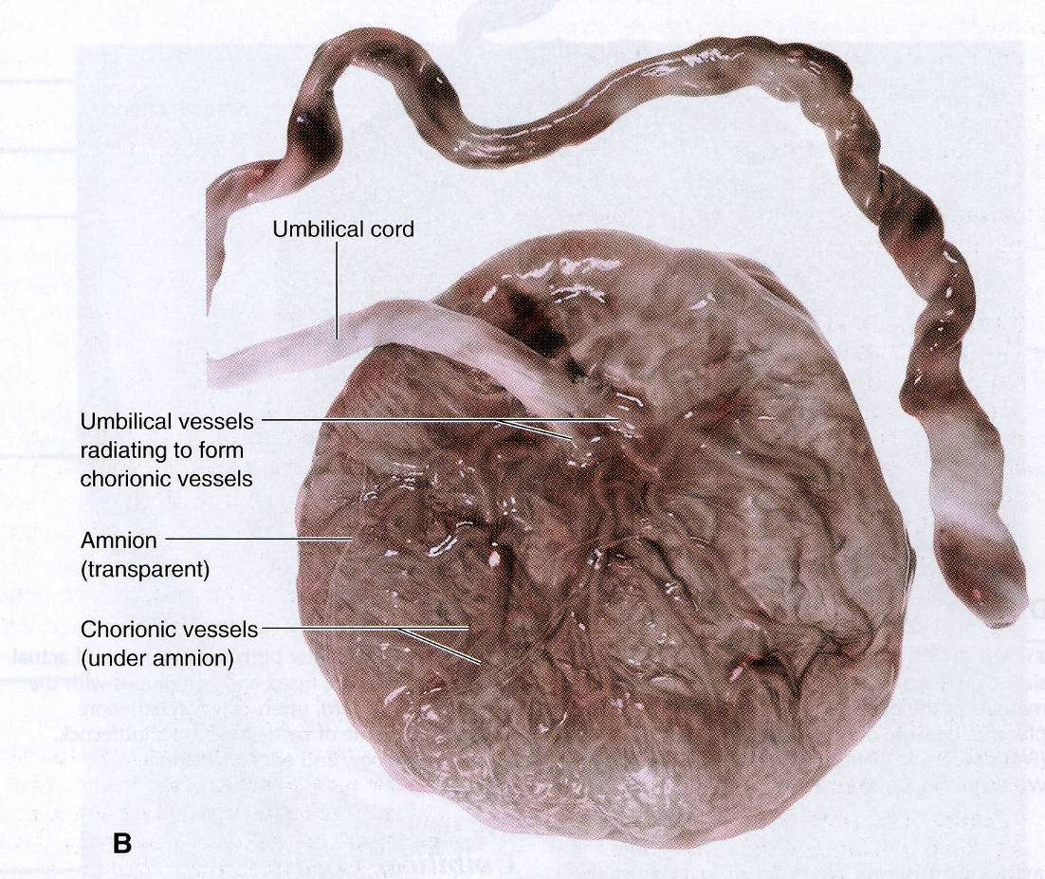
Fetal side

Slide 25
Placental circulation:
The foetal blood reaches to the placenta by 2 umbilical arteries→ where gas exchange occurs with the maternal blood in the intervillus spaces.
Finally the oxygenated blood returns to the fetus by left umbilical vein.
Exchange between the 2 blood streams occurred across the placental barrier.

Slide 26
Functions Of The Placenta:
Protection
Nutrition
Respiration
Excretion
Hormone production

Slide 27
Functions of placental barrier:
It prevents most organisms from passing to the fetus, so it acts as a protective mechanism against damaging factors, many viruses such as Rubella, Coxackie virus, German measles and poliomylitis virus traverse the placenta. These viruses may result in congenital malformations.
Microorganism: treponema pallidum of syphilis which produce destructive change in the eye; brain .
Most of the drugs in addition to cocaine, heroin cross the placenta and cause serious damage.

Slide 28
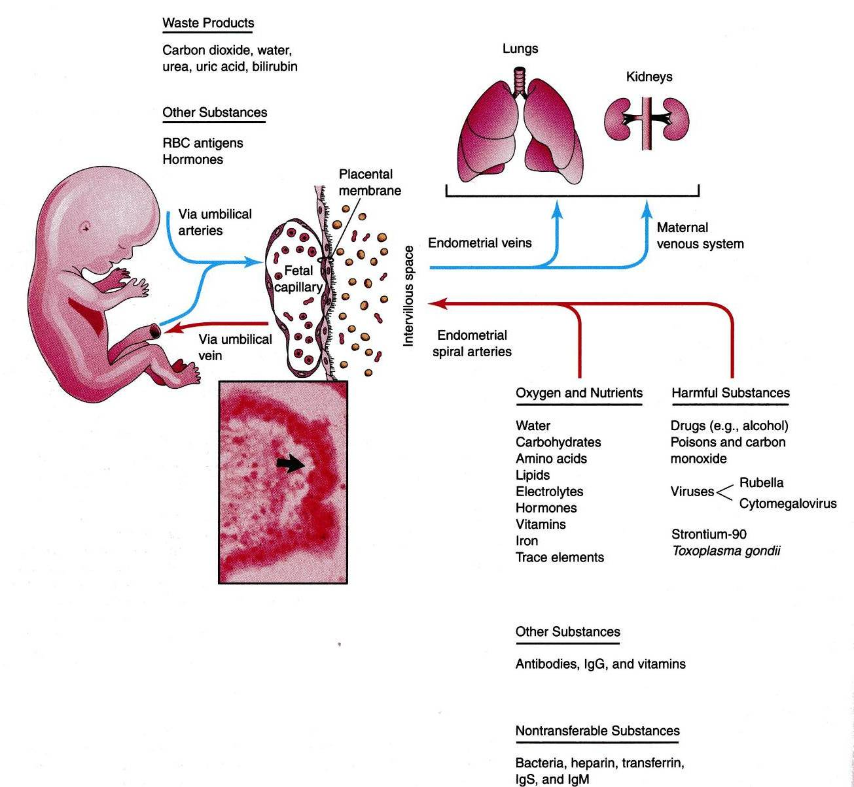

Slide 29
Placental endocrine synthesis
The syncytiotrophoblast synthesizes protein &steroid hormones
The protein homones
1- human chorionic gonadotropin
2- h.c. somatomammotropin
3- h.c. thyrotropin
4- h.c. corticotropin
The steroid hormones
Progesterone & Estrogens

Slide 30
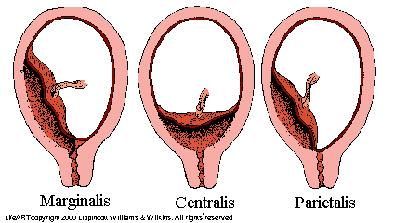
Abnormalities of placenta
1- According to site: Placenta Praevia
the placenta is attached to the lower uterine segment (due to low level of implantation of the blastocyst). It causes severe antepartum haemorrhage. There are three types:

Slide 31
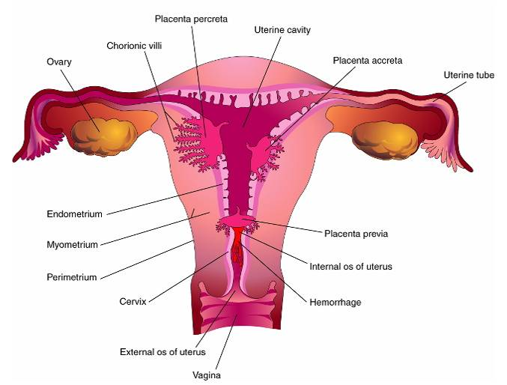
2- Abnormal penetration into the uterus:
1- Placenta accreta: due to abnormal adhesion between the chorionic villi and the uterine wall.
2- Placenta percreta: The chorionic villi penetrate the myometrium all the way to the perimetrium.
- the placenta fails to separate from the uterus after birth and may cause severe postpartum hemorrhage.

Slide 32
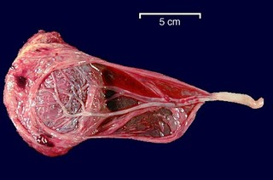
3- Abnormal attachment of umbilical cord: a- Velamentous attachment: The cord does not reach the placenta itself but is attached to amniotic membrane over the fetal surface of placenta. The umbilical vessels pass in the membrane to reach the placenta. It is easly torn. B- Battle- dore placenta (marginal attachment of the cord

Slide 33
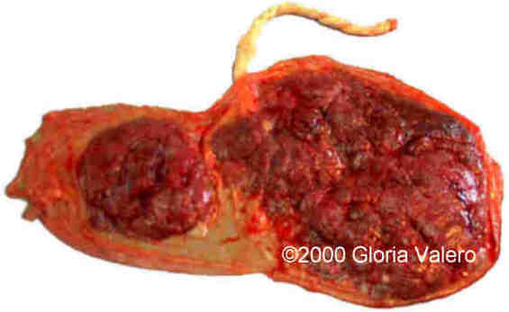
4- Abnormalities according to the number:
1- Double placenta
(bilobed or bidiscoid
placenta).
2- Triple placenta
(trilobed).
3- Accessory placenta (accessory one or more lobes). It may cause severe postpartum hemorrhage if the accessory lobe is retained in the uterus after labor.
5- Shape abnormalities: bi- or trilobed or horsehoe placenta

Slide 34
6-When villi persist on the entire surface of the chorionic sac ,a thin layer of placenta attaches to a large area of the uterus …… it is a membranous placenta.

Slide 35
Congenital tumors of the placenta :
1- Benign tumors:. hydatidiform ( vesicular) mole.
2- Malignant tumors:chorioncarcinoma
(epithelioma).

Slide 36
thank you

