Slide 1
NEURORADIOLGY
DR. ESSMAT AL- OMARI Consultant Radiologist
Mu’tah university

Slide 2
Neuroradiology
Neuroradiology is a subspeciality of radiology focusing on the diagnosis and characterization of abnormalities of the nervous system, spine, head and neck.
The imaging modalities include:
- Plain radiography
- CT scan
- MRI
- Angiography: is being replaced in many instances by MRA
- Ultrasound: is used in limited circumstances.

Slide 3
Neuroradiolgy / investigation
Plain film
The plain skull film may reveal:
Calcification
Pituitary fossa enlargement
Bone lesion or secondary deposit.
Fractures

Slide 4
ULTRASOUND
The neonatal brain can be scanned through the open anterior fontanelle for:
Hydrocephalous
Interventricular or intracerebral hemorrhage
Suspected intracranial pathology.
Doppler studies are used for the diagnosis of carotid artery stenosis.

Slide 5
CT and MRI
CT is especially valuable in acute head injury (recent brain hemorrhage), stroke, and suspected subarachnoid hemorrhage.
* MRI is not used in acute h’ge bcz it appears isodense, instead we use CT scan.
MRI may be used in subarachnoid heamorrhage.
MRI scan demonstrate the brain using a multiplanar facility in axial, coronal, and saggital planes(CT scan is only used in axial sections), with excellent views for the posterior fossa (it is better than CT for chronic and subacute h’ages).

Slide 6
CT and MRI / 2
MRI is superior to CT in:
Lesions of the pituitary fossa.
Spinal cord abnormalities.
White matter disease.
Demyelinating plaques in multiple sclerosis (and other dysmyelinating disease esp in children).
Differentiation of grey(cells) and white(axons) matter.

Slide 7
Arteriography
Cerebral angiogram is useful in evaluation of aneurysm and arterio-venous malformations.
MRA demonstrate cerebral arterial and venous circulation and has replaced conventional angiography in many situations (no contrast is used).

Slide 8
CT
Taken from the base of the skull and upward 5mm for each section for adults
In case of susbected cerebellar tumors the scan are taken 3mm at
the base and 5mm upwards .
White matter(grey),grey matt(white)
Air and CSF (black)

Slide 9
Myelography
Myelography is the radiological visualization of the spinal cord, cauda equina and the surrounding subarachnoid space by injecting contrast medium into the subarachnoid space through a lumbar puncture.
Since the introduction of MRI, this investigation is almost rarely used.

Slide 10
Normal brain CT
This is a lateral view of the skull. We start the cuts from the base and go up to the vertex
Temporal lobe
Cerebellum
Ambian cystrn??
4th ventricle
3rd ventricle
Normal calcification of Pineal body
Quardrigeminal cystern (W-shaped)
Gray matter (white)
White matter (dark)

Slide 11
BRAIN infarction
Ischemic infarction of the brain result from interruption of the blood supply to a portion of the brain.
The main sign of infarction is an area of decreased attenuation (hypodense) within the cerebral substance with effacement of the adjacent sulci.
Hemorrhage may develop within the infarct, (about 5-15%), seen as an area of hyperdensity.

Slide 12
Lacunar infarction
Lacunar infarcts are small, deep cerebral infarcts, occur as a result of occlusion of small distal intracerebral arteries.
Lacunar infarcts are usually less than 1cm in diameter and appear in the region of the internal capsule, basal ganglia, thalumus and brainstem.
Lacunar infarcts are commonly seen in patients older than 60 years with hypertension.
If infarct in cerebrum..the opposite side of the body is affected.
If the infarct is in cerebellum..the same side is affected.

Slide 13
CT and MRI in brain infarction
Why CT is the modality of choice for the initial evaluation of stroke?
CT is superior to MRI in detecting recent brain hemorrhage, and the role of CT is to exclude the presence of intracerebral hemorrhage, because the treatment of an infarct will differ depending on whether hemorrhage is present or not.
MRI is superior and more sensitive than CT in the evaluation of any kind of edema and for the detection of acute infarction.

Slide 14
From dr:
Classification of infarctions in brain:
Hyperacute: 1st 6 hrs
Acute: 6-24 hr
Subacute: 24hr- 6w
Early subacute: 3d-7d
Late subacute: 7d-1M
(late and early can be differentiated by T1 & T2 on MRI)
Chronic: >6wks
Classification of h’ge:
Acute: 6h-3days
Subacute: 3d-1Mon
Chronic: >1M
CT scan is used in cases of hyperacute and acute infarcts and h’ges
MRI is used in subacute and chronic cases.

Slide 15
Normal brain CT
This is a lateral view of the skull. We start the cuts from the base and go up to the vertex
Temporal lobe
Cerebellum
Ambian cystrn??
4th ventricle
3rd ventricle
Normal calcification of Pineal body
Quardrigeminal cystern (W-shaped)
Gray matter (white)
White matter (dark)

Slide 16
Typical acute infarct: Hypodense area, poorly defined (grey color) in the temporal and parietal areas. Sulci are effaced due to edema. Note : an old infarct becomes like the CSF (black) and well-defined.
Sylvian fissure
Signs of brain atrophy: widening of :
Brain sulci
Basal cisterns
Ventricles
Intersphincteric fissure

Slide 17
Brain CT showing a poorly defined hypodense area in the RT parietal lobe. There are two white dots inside the infarcted area that are mostly petechial hemorrhages.

Slide 18
This is a brain CT of an older infarct (than the previous slide) since the area of infarction has become more hypodense (more like the CSF) and well defined.

Slide 19
Brain CT showing an elongated hypodense area in Rt temporal, cerebellar and behind the Rt lateral ventricle. It is an old infarct bcz it is dark and well defined.

Slide 20
Brain hemorrhage
Intracerabral hemorrhage:
Is bleeding in the brain caused by rupture of a blood vessel.
May occur in any part of the brain, but the frequent sites are: basal ganglia, thalamus and cerebellum.
A third of intracerebral bleeds result in intraventricular hemorrhage.
Most common causes are:
- Chronic hypertension
- Rupture aneurysm or arterio-venous malformation

Slide 21
From Dr:
Intracerebral h’ge:
Intraparenchymal (more common)
Intraventricular (<1/3 of intracerebral h’ge)

Slide 22
Intraventricular (in posterior horns) and parenchymal h’ge (basal ganglia). The intracerebral h’ge is surrounded by edema.

Slide 23
This is a CT scan of the same patient in the previous slide but 8 weeks later, the h’ge in the lateral ventricles was hemolysed, hence it appears darker. There is also a chronic subdural h’ge (venous blood) and not epidural bcz it concave medially.
Subdural h’ge

Slide 24
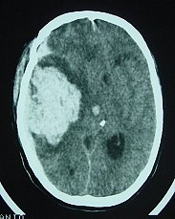
Large intracerebral h’ge surrounded with severe edema and effaced sulci with midline shift (all these are due to mass effect of the h’ge).

Slide 25
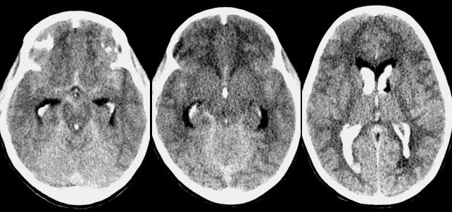
Recent intraventricular h’ge

Slide 26
Intracranial Hematomas Head injury
Intra parenchymal hematoma
Epidural hematoma
Subdural hematoma
Subarachnoid hemorrhage

Slide 27
Epidural Hematoma
Collection of blood between the inner table of the skull and the dura
Most often occurs as a result of an arterial injury, usually meningeal artery or one of its branches, and therefore are usually temporo-parietal in location.
The typical CT appearances of epidural hematoma is biconvex or lenticular, high density lesion.

Slide 28
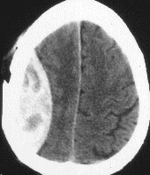
Epidural hematoma (biconvex shape). The white portion is clotted blood and the dark portion is normal blood (not clotted). The cortical sulci are effaced due to edema.
Epidural hematoma is an emergency bcz it in a narrow space and from an artery.

Slide 29
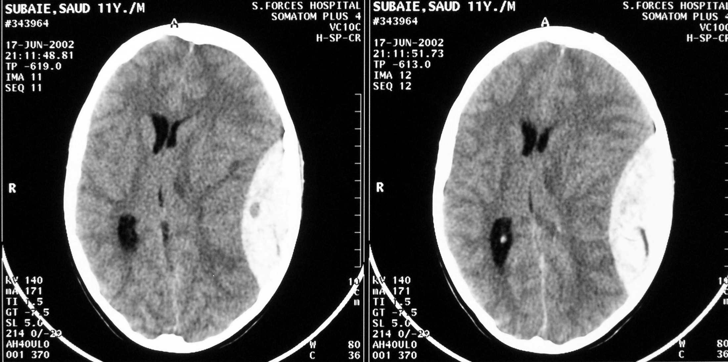
Epidural h’ge + midline shift + effaced sulci.

Slide 30
Subdural Hematoma
Collection of blood between the dura and arachnoid
Result from venous injury, usually tear of the bridging cerebral veins within the subdural space.
The characteristic appearance of acute subdural hemaotma on CT is hyperdense crescent-shaped collection. with concave(medialy-convex configuration

Slide 31
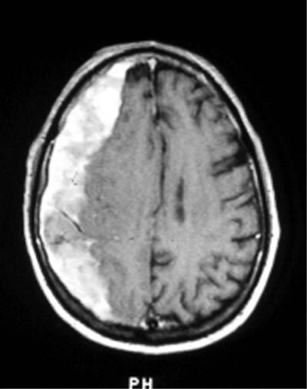
Subdural hematoma: crescent shaped hyperdense area on the Rt with effaced sulci.
The medial border should be either concave or straight medially in subdural hematoma.

Slide 32
Subarachnoid Hemorrhage
Hemorrhage into the CSF spaces, and frequently present in the acutely injured patient.
SAH appear as hyperdensities filling the CSF spaces (basal cisterns, cerebral sulci, sylvian fissures and interhemispheric fissure).
Subarachnoid hemorrhages are most often the consequence of penetrating injury, rupture aneurysm (15% of polycystic kidney disease are ass with berry aneurysm) and systemic hypertension (A-V malformations can cause subarachnoid h’ge).
CT contrast is C/I in brain injury while it should be given in abdominal injury.

Slide 33
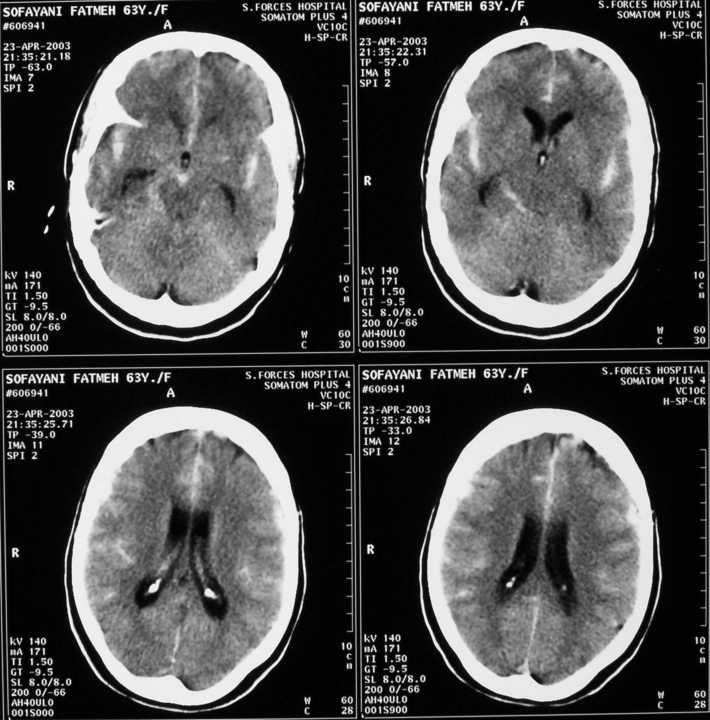
Subarachnoid h’ge: the sulci, interhemispheric fissure, basal cisterns and sylvian fissures appear hyperdense (white) .

Slide 34
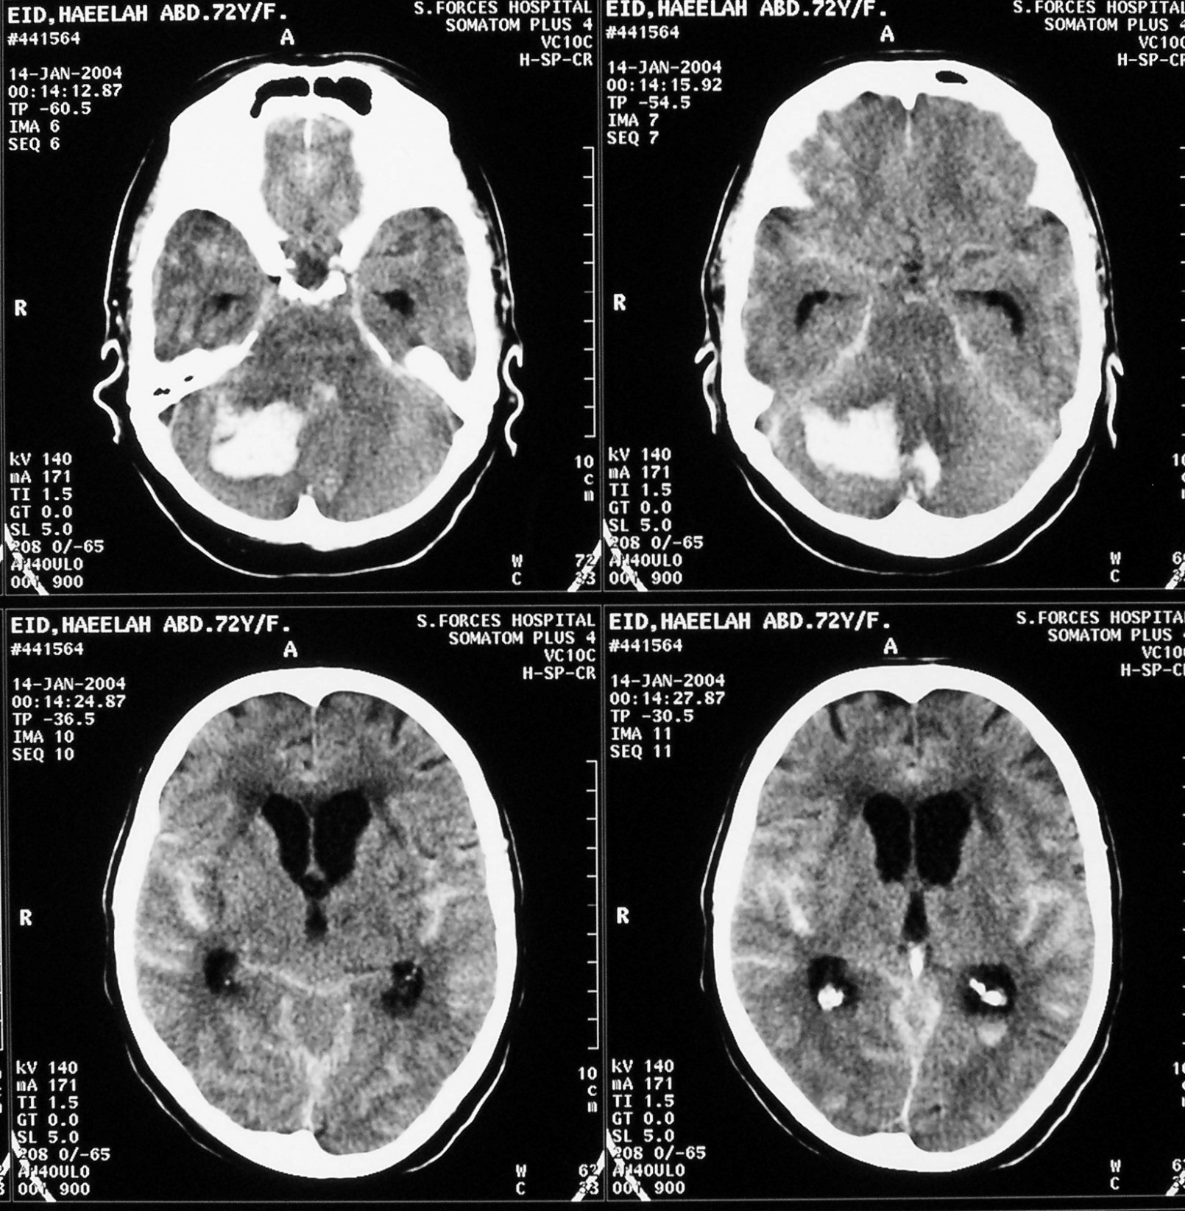
Intracerebellar and subarachnoid h’ge (blood in the cortical sulci, interhemispheric fissure) but no h’ge in the ventricles.
Tentorium cerebelli

Slide 35
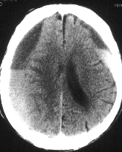
Acute (white), subacute (grey), chronic (black) subdural hematoma + edema. In this case think of child abuse due to repetitive injury. Other names include: non-accidental child injury, shaken-baby syndrome, battered child syndrome.

Slide 36
Cerebral Contusion
Bruising or crushing of brain tissue.
Two types of cerebral contusion:
* nonhemorrhatic (necrotic)
* Hemorrhagic
Hemorrhagic contusions occur due to stretching and shearing injury, often due to impaction of the brain against the skull on the side opposite to the injury.
The hemorrhagic areas may not be evident in the very acute stage or in the first 24 hours.

Slide 37
Brain contusion: severe diffuse brain edema (Lt CT). After 24hrs the h’agic contusion became more defined, in the Lt frontal lobe.

Slide 38
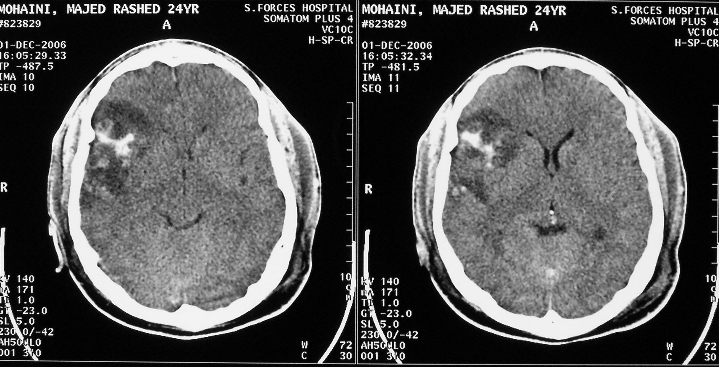
H’agic contusion and subgalial h’ge.

Slide 39
Multiple sclerosis (MS)
MS is a white matter disease, resulting in areas of demyelination in the central nervous system (brain and spinal cord).
Most common in young people and about two thirds of patients are female (age of onset:20-40).
Ms lesions (plaques) are composed of inflammatory lesions and areas of axons (nerve fiber) and myelin (a fat that envelop the nerves.
The demyelinating lesions present with a characteristic relapsing and remitting course.

Slide 40
Multiple sclerosis / 2
MRI is the investigation of choice.
The demyelinating plaques appear as focal discrete areas of abnormal high signal intensity on T2- weighted images.
The common location of plaques are in the periventricular region, corpus callosum, and to a lesser extent in the brain stem, cerebellum, optic nerves and in the spinal cord.
Contrast enhancement of the plaques indicate active disease, if not then they are chronic lesions.

Slide 41
Flare image showing the previous lesions more clearly (high signal intensity lesions). The CSF appears black (as in T1) but white mater appears grey (in T1 it is white) to allow visualization of the sclerotic plaques.
T2 weighted MRI showing multiple periventricular hyperdense plaques of MS.
White mater is grey in flair imaging.

Slide 42
Brain MRI (flare) showing high intensity plaques of MS. The lesions are usually bilateral but not symmetrical.

Slide 43
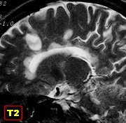
Brain MRI showing high intensity plaques of MS in the corpus callosum and the surrounding gyri.
Body
Splenium of corpus callosum
Genu of corpus callosum with plaques.
Note : if we find plaques in the periventricular area and corpus callosum (>30% of cases) then it is diagnostic of MS.

Slide 44
SPINE DISORDERS
DR. ESSMAT AL- OMARI
Consultant Radiologist
Mu’tah university

Slide 45
Spine disorder
The vertebral column forms the central bony axis of the spine, and is composed of 33 vertebrae.
7 Cervical vertebrae
12 Thoracic vertebrae
5 Lumbar vertebrae
5 Fused sacral segments
4 Fused coccygeal segments

Slide 46
Spine disorder / 2
A typical vertebra consist of two parts:
- Anterior ( the body )
- Posterior ( neural arch )
The two parts of the vertebrae enclose the vertebral canal which contains:
- The spinal cord.
- The meninges.
- The associated vessels.

Slide 47
Normal vertebral column (we should have at least 2 views.
A-P view
Lateral view
Superior articular process
pedicle
Facet joint (epiphesial joint)
Inferior articular process

Slide 48
Spinal cord
The spinal cord is approximately 45cm long (in males, 42cm in females) and descends from the medulla oblongata at the level of the foramen magnum and terminates at the conus medullaris between L1-L2.
The cauda equina is formed by the spinal nerves extending from the lowest portion of the spinal cord to the level of S2.
The spinal nerves lie free in the subarachnoid space.

Slide 49
Nucleus pulposus (white- fluid)
The intervertebral disks between the lumber vertebrae increase in size up to the disk between L5-S1 which is smaller in size than L4-L5. Like the cervical disks; C7-T1 is smaller than C6-C7.
Annulus fibrosus
CSF (white)
The end of the spinal cord is called conus and is wider than the upper parts of the cord.
Dehydrated disk (no nucleus pulposus) + disk bulging or herniation.

Slide 50
DEVELOPMENTAL ANOMALIES OF THE LUMBAR SPINE
Sacralization (fusion of L5 with sacrum) or Lumbarization (splitting of S1 from the sacrum).
Spina bifida.
Synostosis (Block vertebra) : fusion of two vertebrae.
Hemivertebra.
Butterfly vertebra.
Myelomeningocele.
Tethered cord (pulled down, reaching below L1-L2 where it should normally end) . In infants < 2M the spinal cord ends at L3-L4 but >2M it should be at L1-L2.
Diastematomyelia: splitting of the spinal cord to 2 parts, usually limited to a small part of the cord.

Slide 51
Sacralization
Complete sacralisation: when both sides of the lumbar vertebra have fused with sacrum. It is only ttt with analgesics to decrease the back pain.
Partial sacralisation: only one side of the vertebra is fused. This type is worse and leads to scoliosis

Slide 52
Spina bifida in L5 (defect in the neural arch)

Slide 53
Block vertebrae or fusion of C4-C5
(usually block vertebrae have smaller A-P diameters then the vertebrae above)

Slide 54
2 Hemi-vertebrae (have only one pedicle) + scoliosis

Slide 55
Myelomeningocele in spina bifida + tethered cord (T1 weighted MRI)
CSF
Spinal cord bulging into the meningocele

Slide 56
Same as previous slide but this is a T2 weighted MRI

Slide 57
Transverse or axial section of the previous slide

Slide 58
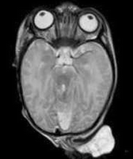
MRI of Occipital Myeloencephalocele (herniation of brain + meninges)

Slide 59
Tethered cord

Slide 60
It turned out to be Diastematomyelia !

Slide 61
SPONDYLOLISIS AND SPONDYLOLISTHESIS
What is spondylolisis ?
Is a defect in the region of the pars interarticularis of a vertebra, most commonly at the fourth and fifth lumbar level.
This defect which was considered to be a congenital abnormality, is now thought to be almost always the result of unhealed stress fracture.

Slide 62
WHAT IS SPONDYLOLISTHESIS ?
Is anterior slipping or subluxation of one vertebral body over the adjacent lower vertebrae.
The main causes of spondylolisthesis are:
Disc degeneration and osteoarthritis of the facet joints.
Defect in the pars interarticularis (spondylolisis).
Fracture of the posterior elements of the vertebra

Slide 63
Spondylolisis (defect in the pars interarticularis; in the neck of the articular process) but without sublaxation. This may lead to spondylolysthesis (with sublaxation)

Slide 64
Spondylolisthesis of L3 over L4 (anterior sublaxationos much more common than posterior)

Slide 65
INTERVERTEBRAL DISC PATHOLOGY
The intervertebral disc which lies between each two vertebral bodies is composed of a central gelatinous core known as the nucleus pulposus and surrounded by fibro cartilage called annulus fibrosus.
Most common articular disorders :
Degenerative disc disease.
Disc bulging and herniation.
Infection.

Slide 66
DEGENERATIVE DISC DISEASE
Refers to a syndrome in which a painful disc causes chronic low back pain.
Disc degeneration is part of the natural process of aging.
The DDD is characterized by:
- Disc space narrowing.
- Osteophytes formation at the vertebral body margins.
- Subchondral bone sclerosis (mainly at the end plates).
- In some cases, collection of gas is seen in the intervertebral disc (vacuum disc phenomenon).

Slide 67
Degenerative disk disease:
Disk space narrowing
Osteophyte formation (ant + post).
Ant osteophytes are usually asymptomatic unless very huge leading to dysphagia (in cervical vertebrae)
Post osteophytes are usually symptomatic as they cause pressure on the spinal cord
3. Subchondral bone sclerosis

Slide 68
DEGENERATIVE DISC DISEASE
Disc degeneration is part of the natural process of aging
The DDD is characterized by:
- Disc space narrowing.
- Osteophytes formation at the vertebral body margins.
- Subchondral bone sclerosis ( mainly at the end plates ).
- In some cases, collection of gas is seen in the intervertebral disc ( vacuum disc phenomenon )

Slide 69
Gas in the disk space; a sign of degenerative disk disease (vacuum disk phenomena)

Slide 70
DISC HERNIATION
The herniated disc is a portion of the nucleus pulposus extends through a tear in the annulus fibrosus, resulting in a focal protrusion at the margin of the disc.
About 90% of disc herniation occurs at L4-L5 and L5-S1, with most of the remainder at L3-L4.
Types of disc herniation:
Prolapse.
Extrusion.
Sequestration.

Slide 73
DISC PROLAPSE (bulging)
The herniated nucleus pulposus extends through a tear in some of the annular fibers(inner part), but still confined by the intact outer most annular fibers

Slide 74
DISC EXTRUSION (protrusion)
The herniated nucleus pulposus penetrates through a complete tear of the annulus fibrosus.
The extruded disc material may extend superiorly or inferiorly, but remain attached to the parent disc.

Slide 75
DISC SEQUESTRATION (Free fragment)
The disc herniates through a complete tear and penetrate the posterior longitudinal ligament and lies within the epidural space.
The herniated disc breaks free of the parent disc and can migrates superiorly or inferiorly within the epidural space or into the neural foramen as a separate fragment.

Slide 76
Disk bulging is common in elderly due to laxity in fibres of annulus fibrosis. It is usually asymptomatic
Extrusion lies in the epidural space. If it goes up or down may cause compression
Prolapse or protrusion (does not extend beyond the vertebral disk)

Slide 77
Disk prolapse (tear in the inner part of annulus fibrosus but the outer part is still intact; leads to localized bulge)
Disk extrusion

Slide 78
Disk extrusion
Disk sequestration
(free fragment)

Slide 79
Types of disk herniation according to the direction of herniation.
Central herniation is usually asymptomatic unless it becomes very large and compresses the vertabral cord. Whereas other types are more symptomatic bcz they can easily compress the roots of the vertebral nerves and cause pain.
Or paracentral
At level of facet joint
Or lateral

Slide 80
Veretebral disks are hydrated (dark). This hydration usually decreases with age.
Central disk herniation

Slide 81
Rt paracentral disk herniation or extrusion + sequestration (fragment)
Free fragment
Paracentral disk extrusion

Slide 82
Disk extrusion with spinal cord compression

Slide 83
Disc herniation / plain film
Can plain film be used to diagnose disc herniation ?
NO
Then why are plain films routinely ordered for patients with low back pain ?
Plain film is essential and may reveal the presence of one of the common causes of back pain such as:
- Degenerative disc disease.
- Facet joint osteoarthritis.
- Spondylolisis and / or spondylolisthesis.
- Neoplastic disease.

Slide 84
Thank You

