Slide 1
Psoriasis
Presented by : Ruba Al Dwairi
Razan Zeyad
Zaina Bashabsheh
Under supervision of Dr. Awad Hasan Al-Tarawneh

Slide 2
Definition
Epidemiology
Pathogenesis
Clinical presentations and variants
Histopathological features
Exacerbating factors
Differential diagnosis
Associated co morbidities
treatment

Slide 3
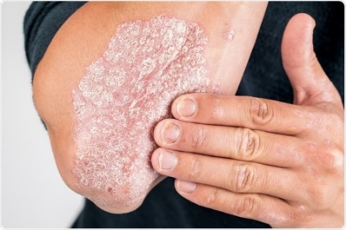
Psoriasis-Definition
Psoriasis is a chronic, inflammatory, immune‐mediated systemic disease affecting mainly the skin with characteristic cutaneous clinical and histopathological features .It can be associated with significant morbidity and impaired patient quality of life .
It’s not curable, and it’s not contagious.
Has two phases:
1. Remission ( no plaques)
2. Relapse

Slide 4
Epidemiology
It is a young person's disease with a median age at onset of 25 years in women and 28 years in men
Its incidence is 2-3% by some studies
Genetic predisposition is important (Between 60% and 90% of patients with psoriasis have a family history of the disease -by one study)
It’s genetic but not hereditary.

Slide 5
Pathogenesis
Precise etiology of psoriasis is not known yet but the pathogenesis is well understood
The development of psoriasis is the end result of interplay between keratinocytes and T lymphocytes with the participation of dendritic cells-the end result of this is hyper proliferation and increased turnover of the epidermal cells and formation of psoriatic plaques.
Keratinocytes need 28 days to complete the cycle from basal layer to the outer most layer, but in psoriasis this cycle take 3-4 days .

Slide 6
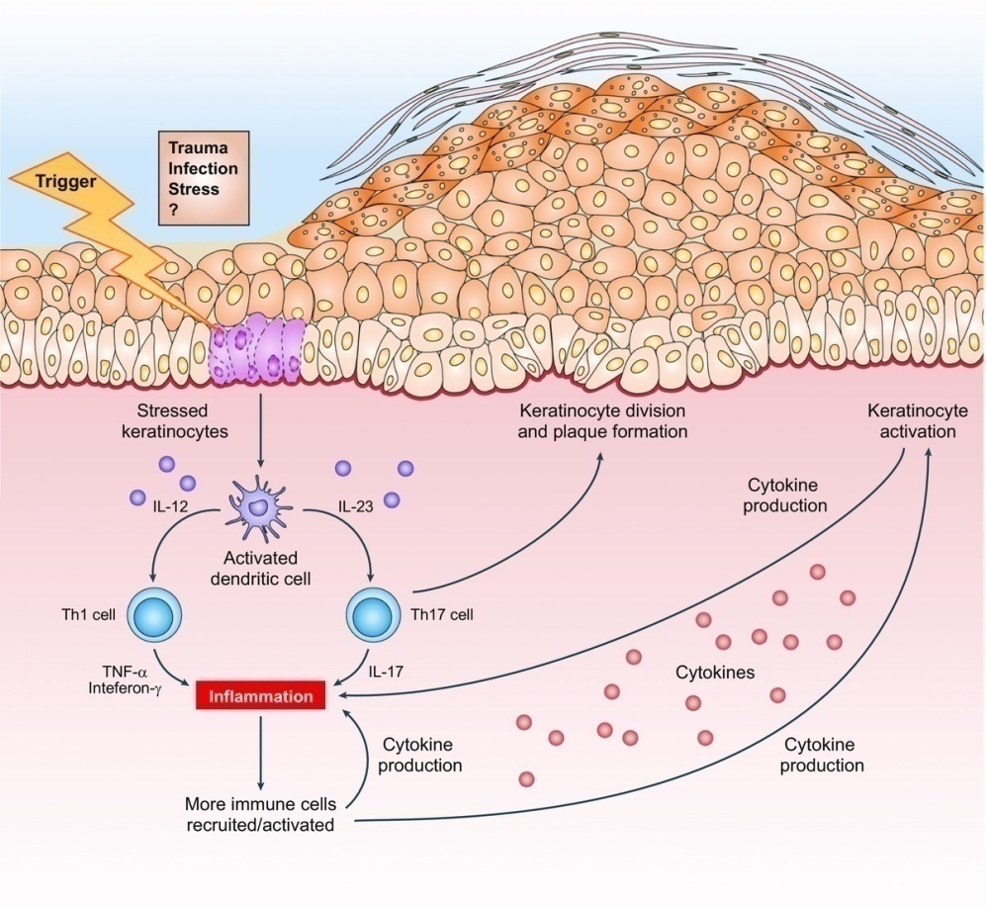
Psoriasis for the primary care practitioner
Journal of the American Association of Nurse Practitioners, Volume: 29, Issue: 3, Pages: 157-178, First published: 23 February 2017, DOI: (10.1002/2327-6924.12443)
Notes:
Pathogenesis of psoriasis. Reprinted by permission from Macmillan Publishers Ltd: [NATURE] (494(7429):552‐554), copyright .
IF THIS IMAGE HAS BEEN PROVIDED BY OR IS OWNED BY A THIRD PARTY, AS INDICATED IN THE CAPTION LINE, THEN FURTHER PERMISSION MAY BE NEEDED BEFORE ANY FURTHER USE. PLEASE CONTACT WILEY'S PERMISSIONS DEPARTMENT ON PERMISSIONS@WILEY.COM OR USE THE RIGHTSLINK SERVICE BY CLICKING ON THE 'REQUEST PERMISSIONS' LINK ACCOMPANYING THIS ARTICLE. WILEY OR AUTHOR OWNED IMAGES MAY BE USED FOR NON-COMMERCIAL PURPOSES, SUBJECT TO PROPER CITATION OF THE ARTICLE, AUTHOR, AND PUBLISHER.

Slide 7
Clinical presentations
Skin: Well demarcated erythematous plaques ( raised lesions their diameter greater than their depth, it is the primary skin lesion in psoriasis ) covered with dry silver scales on extensor surfaces ( in psoriasis vulgaris)
Positive Auspitz sign : after scratching of psoriatic plaque, pinpoint bleeding will appear below the scale.
Nails: pitting, oil spot, onycholysis, discoloration and thickening.
Scalp: Thick scaly plaques covered with silvery dry scales that may extend beyond the hair margin
Mouth –Geographical tongue (rare).

Slide 8
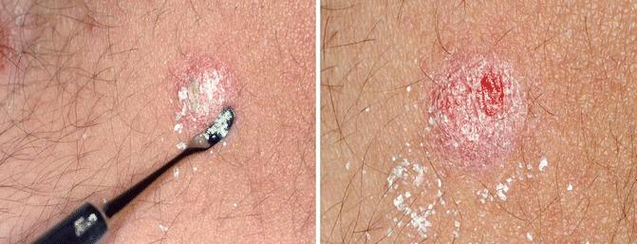
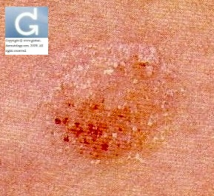
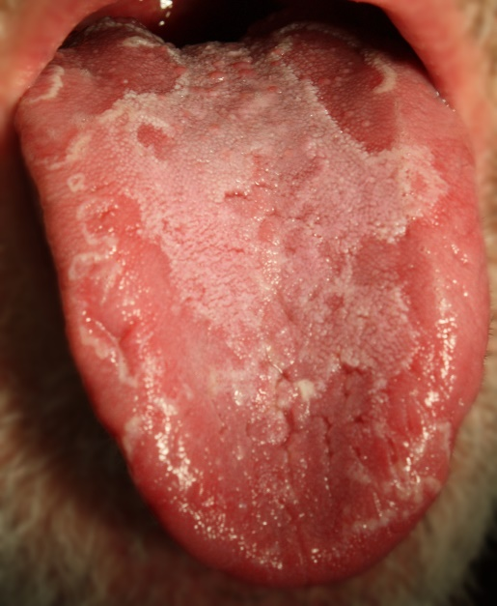
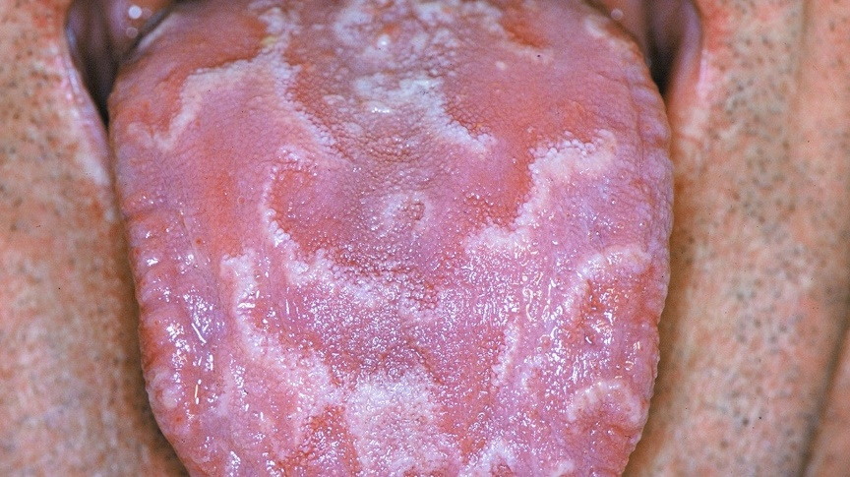
Auspitz sign
Geographical tongue

Slide 9
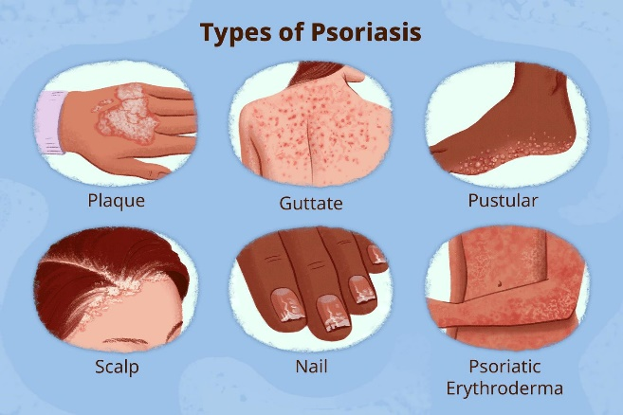
Clinical variants of psoriasis
Plaque psoriasis (psoriasis vulgaris)
Scalp psoriasis
Nail disease
Inverse psoriasis
Pustular psoriasis
Palmoplatar psoriasis
Erythrodermic psoriasis
Guttate psoriasis

Slide 10
Plaque psoriasis( Psoriasis vulgaris)
This presentation is most common and accounts for more than 80% of all cases
It is characterized by well‐defined erythematous plaques that may have adherent dry silvery scales
Symmetrical plaques on elbows, knees, and lower trunk , with scalp involvement and it can be pruritic.
The development of lesions on previously uninvolved skin following cutaneous injury is known as the Koebner phenomenon, seen in psoriasis, vitiligo, lichen planus, eczema and erythema multiform.

Slide 11
Plaque psoriasis(vulgaris)

Slide 12
Plaque psoriasis(vulgaris)

Slide 13
Scalp psoriasis
Between 50% and 80% of patients with psoriasis develop lesions on their scalp
It can occur without skin lesions and called scalp psoriasis
The sales are dry and silvery and the lesions can be felt, there’s no hair loss.
lesions may extend onto facial skin or posterior neck( do not respect the hair margin)

Slide 14
Scalp psoriasis

Slide 15
Scalp psoriasis

Slide 16
3-Nail disease(Nail psoriasis)
Nail involvement is common in all forms of psoriasis, affecting an estimated 80% of patients with the disease especially in pustular, Erythrodermic and palmoplantar forms and with psoriatic arthritis.
Nail pitting, oil drop–like patterns of yellow or salmon discoloration , nail thickening ,Onycholysis and discoloration.
Nail disease can occur without any skin involvement(nail psoriasis )Which is sometimes difficult to diagnose. So we need biopsy .
Erythrodermic is very severe form of the disease.
Certain histologic features seen on biopsy of psoriasis.

Slide 17
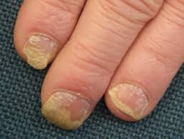
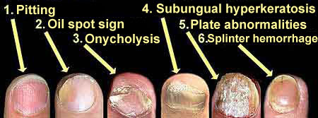
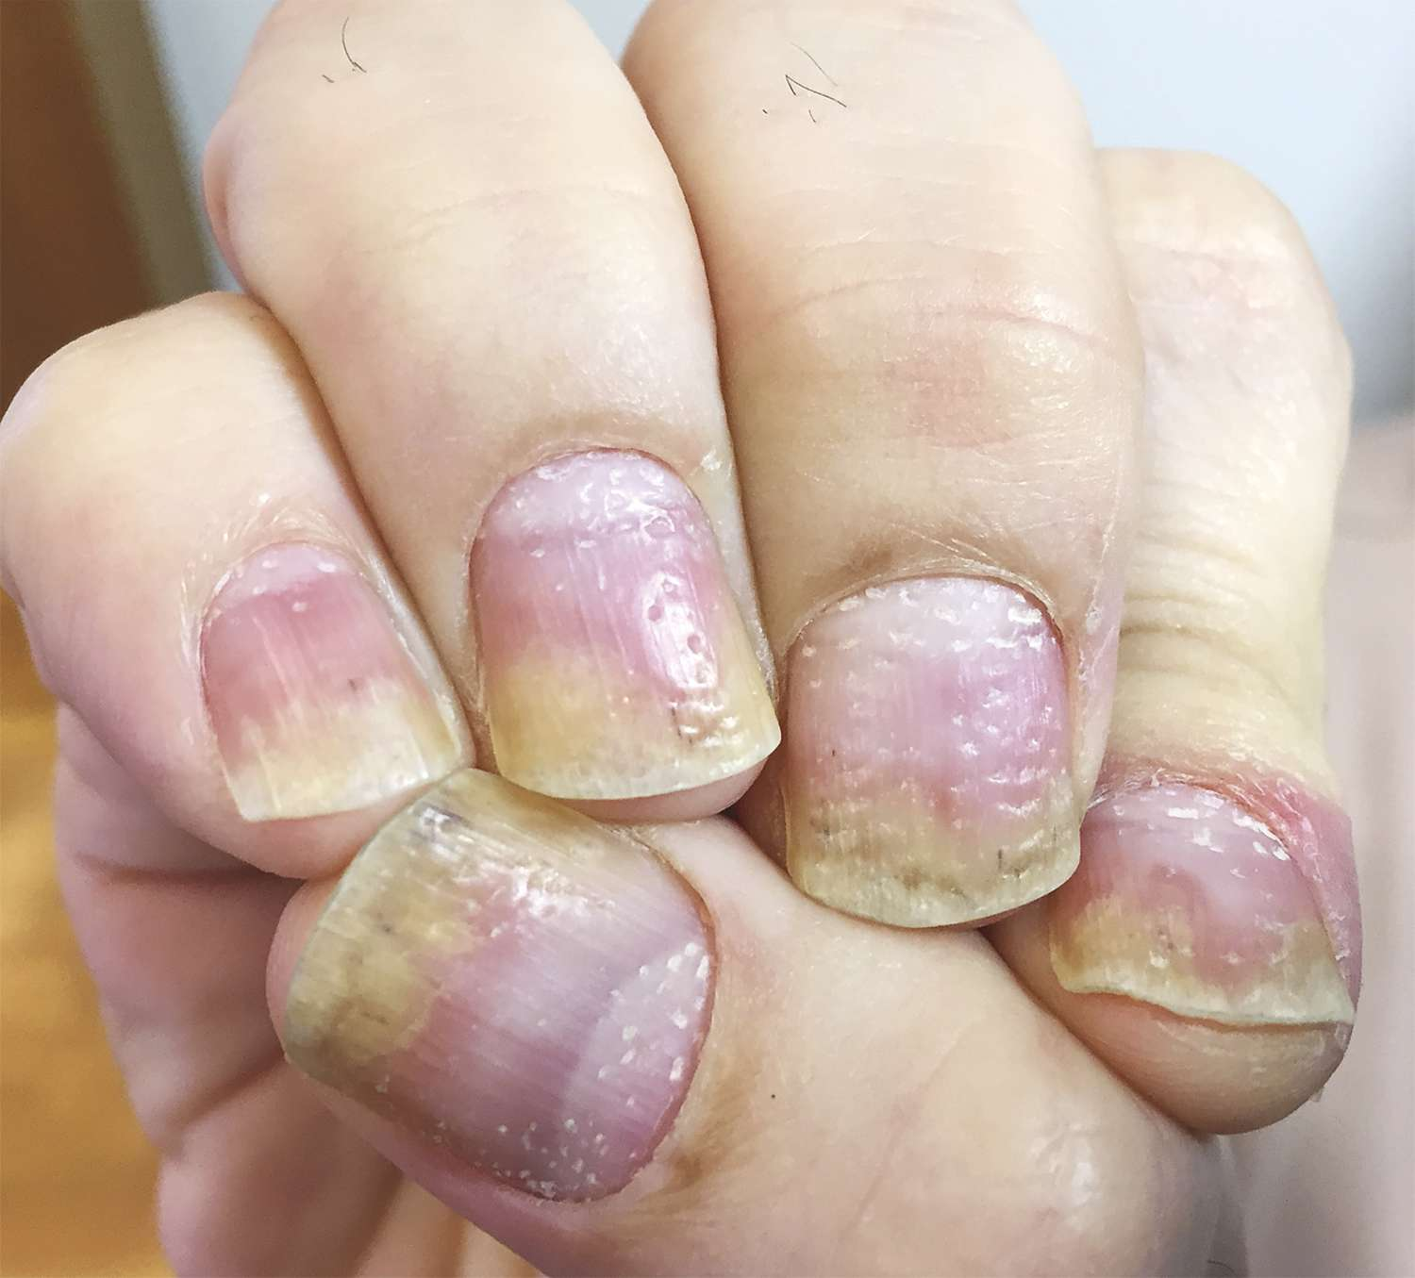
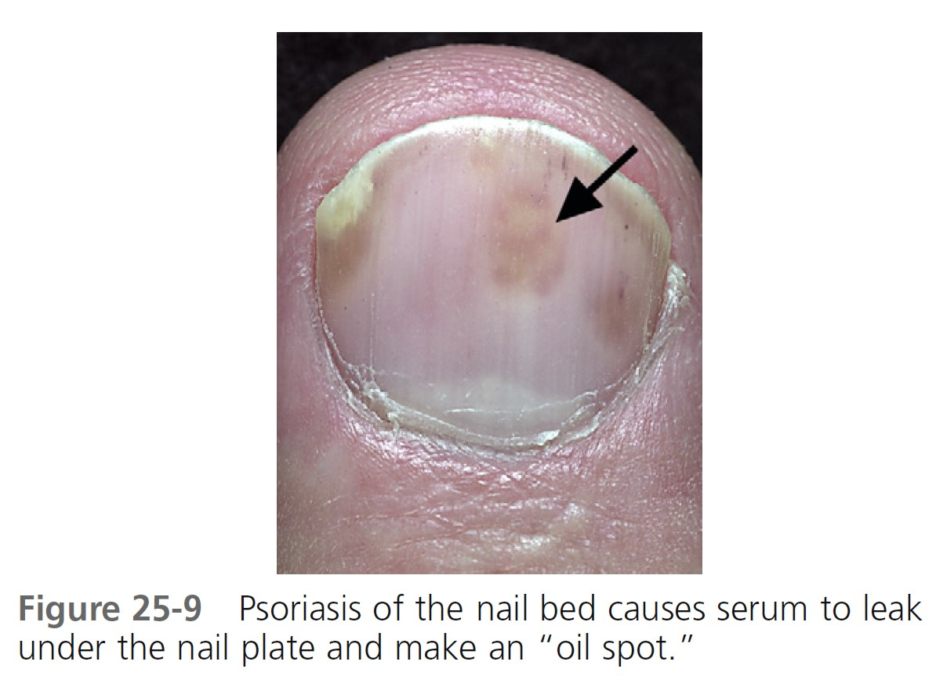
Nail Psoriasis
Onycholysis
( separation of nail plate from nail bed ) , discoloration , oil spots.
Onycholysis , oil spots and pitting.
++Nail thickening and discoloration .

Slide 18
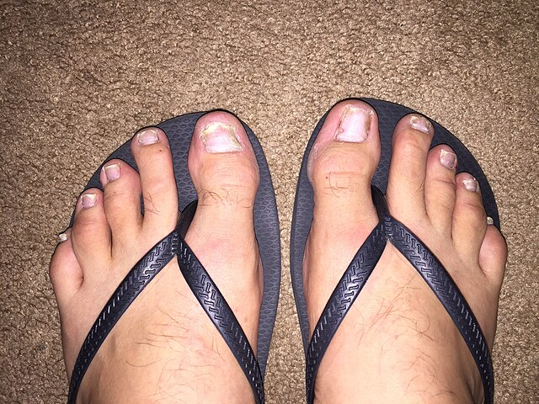
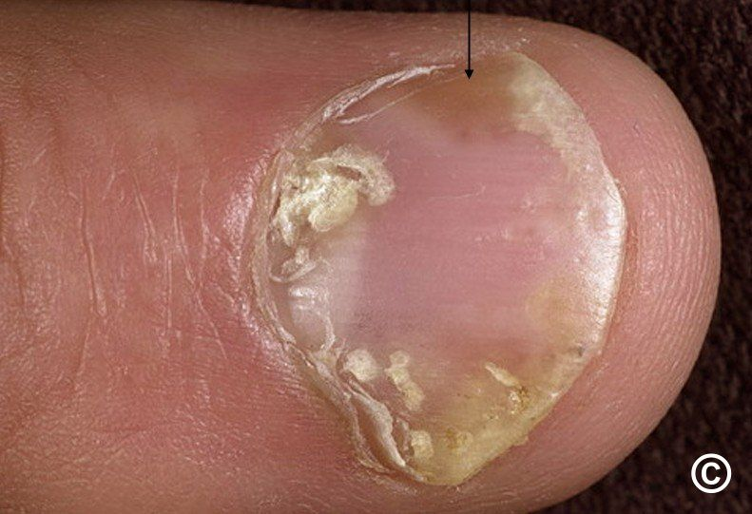
Nail Psoriasis
Onycholysis and oil spots.
Onycholysis , pitting and discoloration.

Slide 19
4-Inverse(flexural) psoriasis
Inverse or flexural psoriasis involves the groin and/or other intertriginous areas, such as the armpits, under the breasts, or in abdominal skin folds.
Characterized by well‐defined, shiny, erythematous plaques with minimal scaling.
Should be differentiated from fungal infection and Seborrheic dermatitis.
Can also be present at genetalia .
Minimal scaling , shiny and no dry why ? Due to skin friction since this type occurs at skin folds .
because this type of psoriasis is missing Characteristic
Scaly dry silver plaques of psoriasis

Slide 20
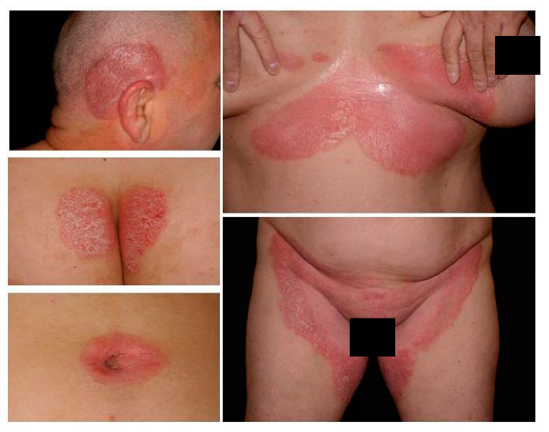
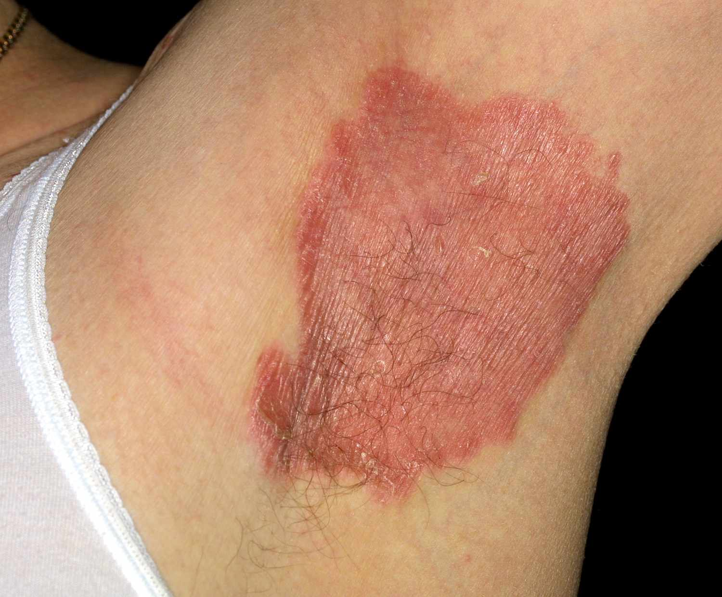
Flexural(inverse)psoriasis
Well demarcated erythema with minimal to no scaling (due to friction of the opposed skin leading to scale removal).

Slide 21
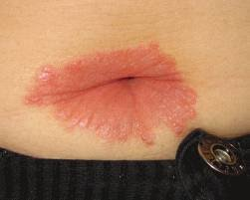
Flexural(inverse)psoriasis
Flexural psoriasis with nail changes
( pitting).
Peri- umbilical flexural psoriasis.

Slide 22
5-Pustular psoriasis
Eruption of sterile pustules that can be generalized and extensive or localized to existing plaques.
Acute generalized pustular psoriasis is known as the von Zumbusch variant, an uncommon, severe form of psoriasis that may be accompanied by edema and fever and may require hospitalization .
Neutrophils infiltration due to inflammation .
It needs systemic treatment.
Bad prognosis and one of the most severe forms .
Why hospitalization although pustules are sterile? Because affected skin will be non-functional , body loses it’s first line of defense , fluid loss and electrolyte imbalances also occur .

Slide 23
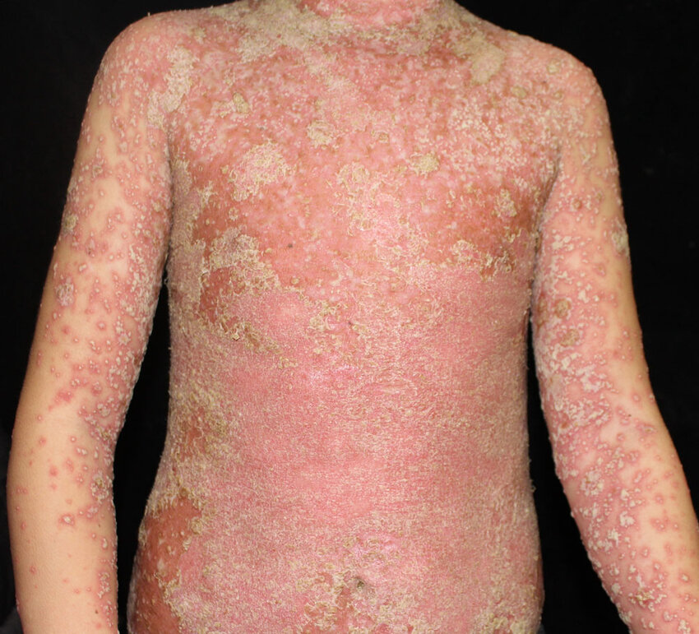
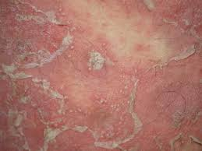
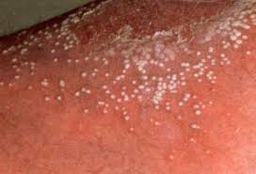
Pustular psoriasis-Generalized
Generalized erythema studied with sterile pustules.

Slide 24
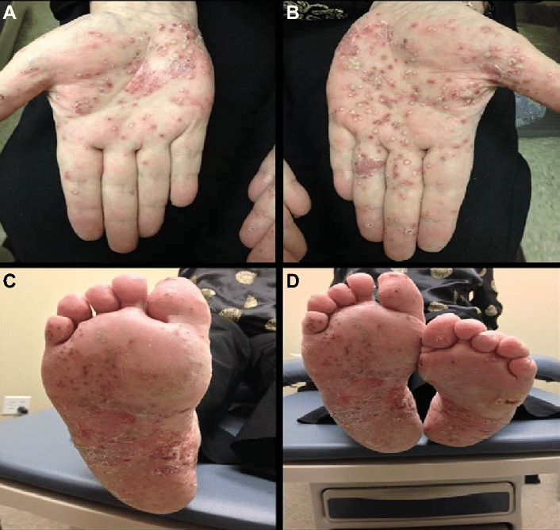
Pustular psoriasis-Localized (palmoplantar)

Slide 25
6-Palmoplantar psoriasis
Palmoplantar pustular psoriasis is characterized by yellow‐brown sterile pustules on the hands and feet.
Nail changes are more frequent in this variant.
Patients may also experience scaling and severe pruritus, making this variant difficult to differentiate from hand eczema.
This form of psoriasis is more common in women.
Smoking is a risk factor for this variant.
Differential diagnosis includes ; eczema ( biopsy is helpful for making the diagnosis of psoriasis) and fungal infection.

Slide 26
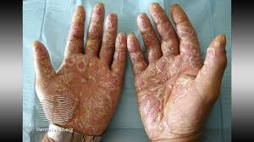
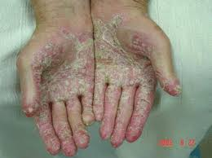
Palmoplantar psoriasis
Symmetrical , dry and well demarcated
Well-defined Itchy erythema with scaling.
Well-defined itchy erythema with scaling , some pustules.
Well-defined itchy erythema with scaling , some pustules and nail changes.

Slide 27
7-Erythrodermic psoriasis
Erythrodermic psoriasis appears as generalized Exfoliative dermatitis that can affect a large percentage of a patient's body surface area.
Erythrodermic : affection of more than 90% of BSA.
Loss skin function , electrolytes imbalance .
Hair loss and nail dystrophy are common with this type.
Patients may experience fever, chills, and/or fatigue.
Erythrodermic psoriasis can be life‐threatening and require hospitalization .

Slide 28
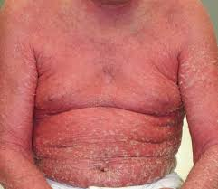
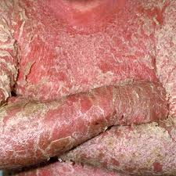
Erythrodermic psoriasis
Generalized erythema with scales , can appear due to maltreated psoriasis vulgaris.

Slide 29
8-Guttate psoriasis
It is characterized by small, scattered, pink, oval (drop‐shaped) papules with silvery scaling that usually appear on the trunk and extremities.
It is typically occurs as new onset psoriasis in patients under 30 years of age.
Guttate psoriasis is often triggered by strep throat infections.
Systemic antibiotic should be given.
Differential diagnosis : pityriasis rosea , lichen planus, pityriasis lichenoides.
Good prognosis .

Slide 30
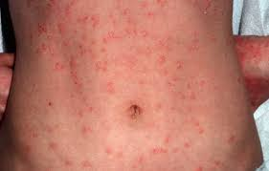
Guttate psoriasis
Small , erythematous papules (drop shaped lesions) covered with scales on the trunk and extremities.

Slide 31
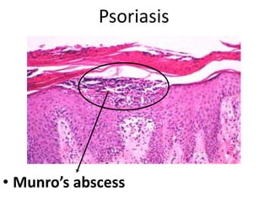
Histopathological features
Hyperkeratosis ( Thickening of the horny cell layer ( stratum corneum )).
Parakeratosis ( Immature keratinization) containing neutrophils (Munro`s microabscess) , immature keratinization , presence of nucleated keratinocytes in horny cell layer .
Acanthosis ( Thickening of the skin).
Hypogranulosis ( Thinning of the granular cell layer).
Lymphocytic inflammatory infiltrate.
So psoriasis has a diagnostic histopathological features.

Slide 32
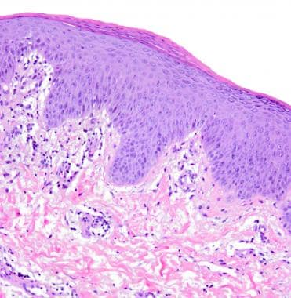
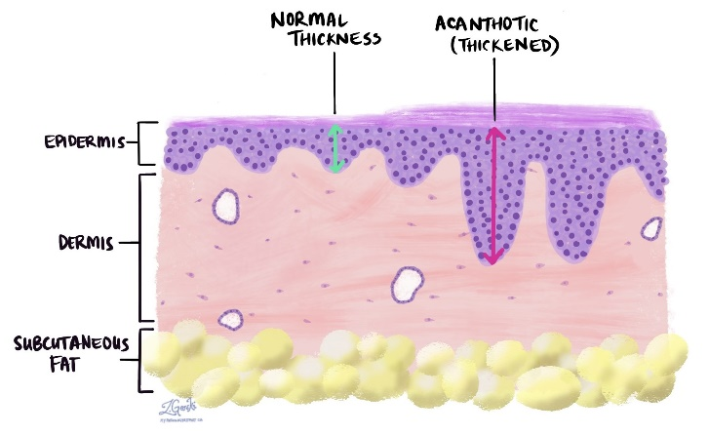
Psoriasis pathology compared with normal skin

Slide 33
Exacerbating factors
Infections, particularly strep throat.
Smoking, alcohol consumption , obesity.
Drugs: lithium, synthetic antimalarial drugs, tetracycline antibiotics, beta blockers, and non- steroidal anti‐inflammatory drugs (NSAIDS). → LMTBN
Skin trauma .
Emotional stress.
In women, psoriasis severity often fluctuates with changes in hormone levels( High levels of disease activity are often observed during puberty, postpartum, and during menopause psoriasis often improve during pregnancy when levels of estrogen are increased ).

Slide 34
Associated co morbidities
Psoriatic arthritis.
Hyperlipidemia.
Obesity.
Hypertension.
Hyper metabolic syndrome.
Increased risk for cardiovascular disease.

Slide 35
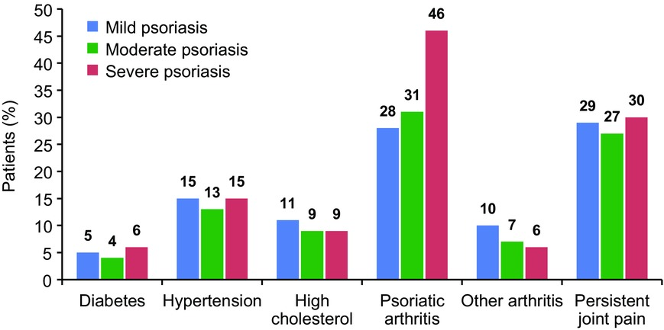
Psoriasis for the primary care practitioner
Journal of the American Association of Nurse Practitioners, Volume: 29, Issue: 3, Pages: 157-178, First published: 23 February 2017, DOI: (10.1002/2327-6924.12443)
Notes:
Prevalence of psoriasis comorbidities by disease severity (Armstrong, Schupp, & Bebo, ).
IF THIS IMAGE HAS BEEN PROVIDED BY OR IS OWNED BY A THIRD PARTY, AS INDICATED IN THE CAPTION LINE, THEN FURTHER PERMISSION MAY BE NEEDED BEFORE ANY FURTHER USE. PLEASE CONTACT WILEY'S PERMISSIONS DEPARTMENT ON PERMISSIONS@WILEY.COM OR USE THE RIGHTSLINK SERVICE BY CLICKING ON THE 'REQUEST PERMISSIONS' LINK ACCOMPANYING THIS ARTICLE. WILEY OR AUTHOR OWNED IMAGES MAY BE USED FOR NON-COMMERCIAL PURPOSES, SUBJECT TO PROPER CITATION OF THE ARTICLE, AUTHOR, AND PUBLISHER.

Slide 36
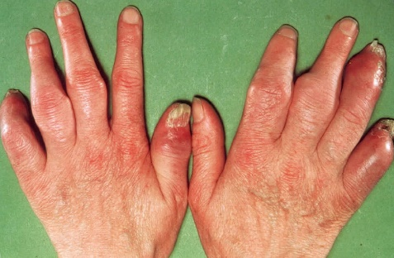
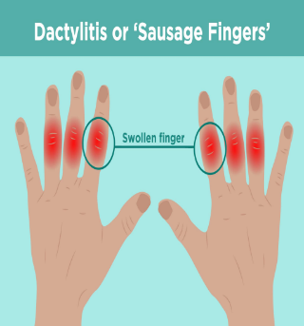
Psoriatic arthritis
One in five patients with psoriasis has psoriatic arthritis (20%).
Psoriasis appears to precede the onset of psoriatic arthritis in 60-80% of patients (by as many as 20 years, but usually by less than 10 years).
In as many as 15-20% of patients, arthritis appears before the psoriasis. They my appear simultaneously.
It is a Seronegative arthritis.
Nail changes is seen more with psoriatic arthritis.
Dactilitis is a clinical feature.
X-ray is helpful in the diagnosis.
Dactilitis

Slide 37
Psoriatic arthritis-Clinical variants
Asymmetrical oligoarticular arthritis( most common).
Symmetrical polyarthritis.
Distal interphalangeal arthropathy.
Arthritis mutilans.
5- Spondylitis with or without sacroilitis.

Slide 38
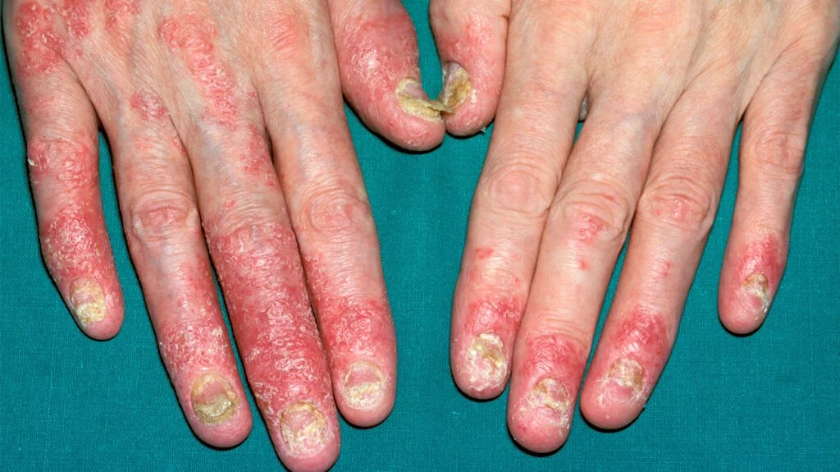
Psoriatic arthritis
Swollen DIP joint.

Slide 39
Differential diagnosis for psoriasis
Eczema.
Lichen planus.
Fungal infection.
Pityriasis rubra pilaris.
Pityriasis lichenoides.
Mycosis fungoides.
Secondary syphilis ( especially in Guttate psoriasis).

Slide 40
Treatment
No curable treatment till now.
Our treatment control the disease to go into a remission.
Topical treatment for less severe not extensive disease(less than 10% body surface area) as first line of treatment.
Systemic treatment for more extensive and severe disease and for disease that is not responding to topical treatment and affecting the quality of life of the patients.

Slide 41
Topical treatment agents
Crude coal tar ( Carcinogenic , irritant and smelly).
Emollients ( Petrolatum / Vaseline).
Dithranol.
Topical steroids.
Topical calcipotriol (Vit.D derivative) help in keratinization .
Topical Calcineurin inhibitors (Tacrolimus).
Topical retinoids (Vit. A derivatives).
Local phototherapy.
Local laser treatment.
Best topical treatment :
Steroid ( anti-inflammation )+ vit D + Vaseline

Slide 42
Systemic treatment Options
Phototherapy (PUVA and NB-UVB).
Methotrexate ( low weekly dose).
Retinoids ( Vit. A derivatives : Acitritin).
Cyclosporine.
Apremilast.
Biological treatment( Adalimumab ( IL23), Etanercept, Secukinumab , Ustekinumab ( IL17) and others).

Slide 43
Phototherapy machine
Phototherapy-Local for nail disease/ Palmoplantar type

