Slide 1
Aberrant liquor volume oligohydramnios and polyhydramnios
Introduction done by : Mohamed khoja polyhdramnios done by : ahmad abo ghonmi oligohydramnios done by : Ahmad Almaasfeh SUPERVISED BY : Dr. Hashem Yaseen

Slide 2
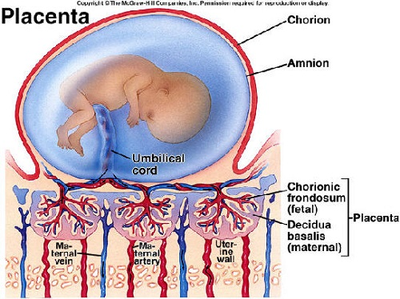
Amniotic fluid
A clear , slightly yellowish liquid that surround the fetus during pregnancy . It is contained in the amniotic sac

Slide 3
AMNIOTIC FLUID FUNCTION :
Essential for fetal growth and development .
Low resistance environment > freedom of movement > musculoskeletal development .
Protection from external forces and infection
Maintain temperature .
Antibacterial activity (antimicrobial peptides )

Slide 4
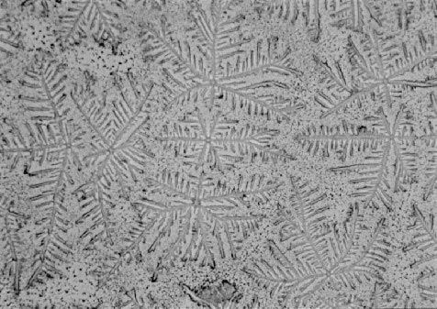
Clinical importance
Screening of fetal malformation (serum alpha fetoprotein)
Assessment of fetal well-being .
Diagnosis of PROM (fern test )
Assessment of fetal lung maturity (L/S ratio ) 32-33 w
arborization
Like fern plant

Slide 5
Amniotic fluid homeostasis
Total AF volume = inflow + outflow into amniotic space
Till approximately 33 w AF production increases in non linear rate
From 36 w > reduction in total AFV observed with rapid decline from 41w
At 22 w median AFV approximately 600 ml , reaching 800 ml at its peak before declining to 700 ml by 40 w .
in late gestation approximately 1000 ml fluids flow into and out of amniotic compartment daily .

Slide 6
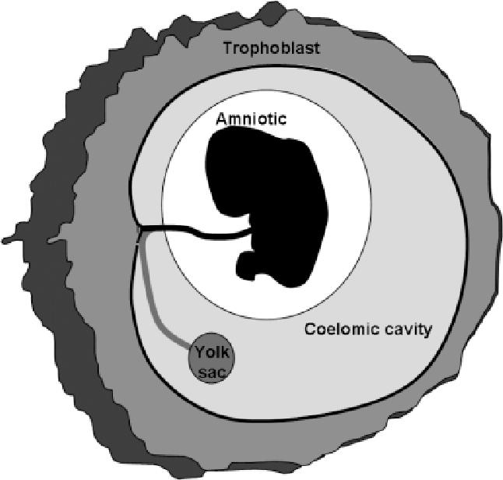
Exact source of production and composition of AF remain clear .
Before 16 w AF same osmolality as maternal plasma and it is most likely to be a transudate that passes from maternal circulation . (5-50ml) in first and early second trimester
Since coelomic fluid is similar to maternal plasma and is located with the extracoelomic space alongside the amniotic sac , this is the probable solute source during early development

Slide 7
8-11 w > fetal urine present , reaching 1000-1200ml/day at term
In renal agenesis >> almost complete lack of AF .
Respiratory tract secretion .
Direct fluid movement from maternal blood > amniotic cavity .
Maintain AFV requires removal of AF > fetal skin (major osmotic pathway ) till keratinized after 22-25 w .
Fetal swallowing (200-1500ml/day)
Intramembranous transport (200-500ml/day ) between AF + fetal blood across fetal placental surface .
Transmembranous flow (10ml/day) Between AF and maternal blood within the uterine wall

Slide 9
Amniotic fluid constituents by 12-14 w
Water and electrolyte
urea
Creatinin
Uric acid
Desquamated fetal cells
Proteins , lipids and phospholipids

Slide 10
AFV ASSESSMENT
Absolute AFV is not routinely measures due to its 3d structure , instead 2d prenatal US is used .
More sophisticated method :
Dye – dilution test , 3D MRI , 3D US BUT Invasive , time consuming and expensive .

Slide 11
Single deepest pocket (SDP) and amniotic fluid index (AFI)
The deepest pocket measured vertically in the AP PLANE AT any location in the amniotic cavity as long as the umbilical cord or fetal parts are excluded
Amniotic fluid index : measured after 20w by dividing the amniotic cavity into 4 quadrants using the maternal linea nigra as the midline , the DVP without fetal part or cord is ascertained for each quadrant and then the 4 measurement are summed .

Slide 12
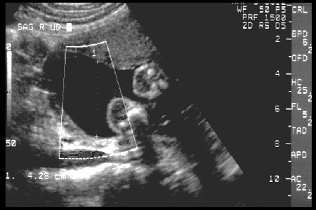

Slide 13
May characterize more women as having oligohydramnios so increase obs intervention
Twins ?

Slide 14
Since effectiveness evidence supports the use of MVP this is recommended until more robust evidence is available .

Slide 15
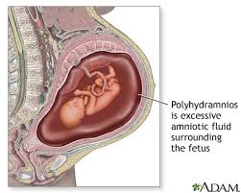
Polyhdramnios
Any increases in the AFV surrounding the fetus is termed hdramnios . Once a pre-defined sonographic value has been exceeded this is classified as polyhdramnios .
Affects approximately 1-2 percent of pregnancies .
In late 2nd and 3rd trimester , an MPD >25 cm is diagnostic

Slide 17
One of the most common causes is poorly controlled diabetes mellitus (osmotic diuresis and fetal polyuria)
Decreased AF absorption results from either :
a failure of fetal swallowing or intestinal reabsorption , e.g. tracheal atresia, intestinal obs (esophageal or duodenal atresia )
Extrinsic intestinal compression (diaphragmatic hernia or masses within the thorax and mediastinum )
Neurological disorders (anencephaly , muscular dystrophy , fetal akinesia syndrome )

Slide 18
Other important causes
Non –immune hydrops and cardiac failure , which may cause secondery to underlying reduced fetal vascular resistance (Sacrococcygeal Teratoma , vein of Galen aneurysm or Fetal anemia .
Parvovirus b19 , CMV , congenital syphilis and viral hepatitis should be included in DD of polyhydramnios when there is clinical suspicion or other suggestive sonographic findings such as non –immune hydrops .

Slide 19
History
Usually asymptomatic ;
However, the gravida may experience :
1. Press symptoms ( Persistent S.O.B, hydronephrosis )
2. Uterine irritability and contractions
3. Abdominal discomfort
4. Lower limb edema

Slide 20
physical examination
Large uterine size for gestational age
(It also may be detected as an incidental finding on a prenatal ultrasound examination)
Difficulty palpating fetal parts and hearing fetal heart

Slide 21
classification
1- mild (MVP 8–12cm, AFI >24 cm and <30 cm)
2- moderate (MVP 12–15cm, AFI >30 cm and <35 cm)
3- severe (MVP >15 cm, AFI >35 cm)

Slide 22
TESTS AND DIAGNOSIS
Sonographic Visualization By US
- Deepest verticle pocket ( DVT )
- Amniotic Fluid Index (AFI)
Dye Dilution

Slide 23
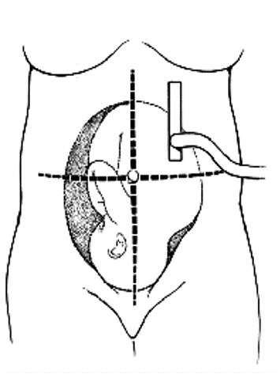
AMNIOTIC FLUID INDEX
AFI between 5-25 cm is considered Normal .
AFI <5-6 cm is considered as Oligohydramnios .
AFI >25 cm is considered as Polyhydramnios

Slide 24
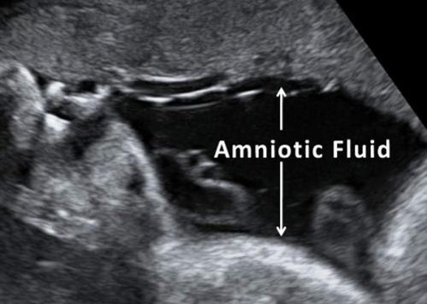
Deepest Vertical Pocket
Single deepest pocket :
≤2 cm ……. Oligo
2.1-8 cm ….. Normal
>8 cm ……… poly

Slide 25
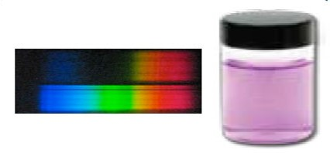
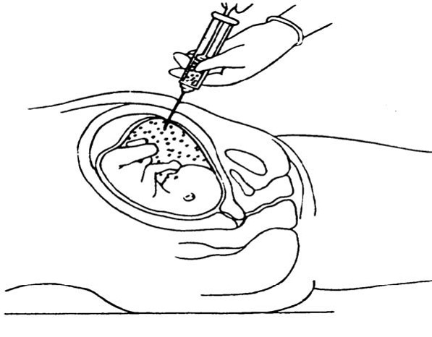
DYE DILUTION
1- A known volume of dye is injected in the amniotic cavity by amniocentesis
2- 20 minutes later a sample of dye is removed
3- the degree of dilution is analysed by spectrophotometry

Slide 26
Investigation
The investigation of cases of polyhydramnios should be individualised based on:
1-gestational age
2-polyhydramnios severity
3-maternal and past obstetric history
Sonographic evaluation of the fetus will in the first instance include fetal number, chorionicity, severity of hydramnios and fetal growth.

Slide 27
investigation
1- Diabetes screening 2- Serological testing to exclude underlying alloimmunisation 3- Serological testing if underlying infectious cause is suspected
4- karyotype : Assessment of structural and chromosomal anomalies if diagnosed less than 30 week’s gestation ( fetal medicine referral)
5- Nonstress test
6- Biophysical profile.
7- Doppler ultrasound

Slide 28
Antepartum fetal monitoring
Why?
The increase in risk of adverse pregnancy outcomes
Two- to five-fold increase in risk of perinatal mortality.
Mild To Moderate Polyhydramnios:
(NST) and (BPP) upon diagnosis
every 1 to 2 weeks until 37 weeks
weekly from 37 weeks to delivery
Severe Polyhydramnios:
NST and BPP every week until delivery

Slide 29
complications
1- General abdominal discomfort and slight dyspnoe ( in mild cases )
2- Marked respiratory distress and severe abdominal symptoms ( moderate to sever)
3- Preterm rupture of membranes and preterm labour
4- Placental abruption and cord prolapse
5- Maternal haemorrhage secondary to uterine atony
6- Fetal malposition & malpresentaion
7- Cesarean delivery & NICU
8- Perinatal mortality

Slide 30
management
1- expectantly if asymptomatic 2- Amnio-reduction 3- Prostaglandin synthetase inhibitor .
A- Indomethacin.
B- Sulindac .

Slide 31
Amnio-reduction
A procedure where amniocentesis is performed for intentional reduction of amniotic fluid volume
The procedure is terminated when the AFI is normalized (generally 15 to 20 cm) or when intraamniotic pressure is less than 20 mmHg .
Amnioreduction only if polyhydramnios is both severe and symptomatic (associated with significant maternal discomfort or preterm labor).

Slide 32
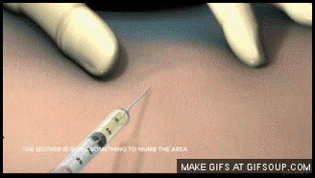
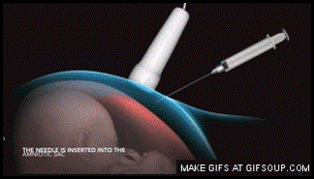
Amnio-reduction

Slide 33
Amnio-reduction
Risk factor : 1- preterm pre-labour rupture of membranes
2-infection
3-placental abruption
4- membranous detachment
Furthermore, re-accumulation may develop rapidly and serial re-treatments may be indicated up to every 2–3 days

Slide 34
indomethacin
a prostaglandin synthetase inhibitor, may also be considered as a treatment for severe polyhydramnios at less than 32 weeks to reduce maternal symptoms and prolong gestation.
more widely recognised for its role as a tocolytic in the prevention of preterm labor, it also reduces fetal urine production and subsequent AFV.

Slide 35
indomethacin
The dose required is determined according to total AFV, ranging from 50 mg/day to 200 mg/day.
Since there is a potential delay in treatment onset (4–20 days), therapy is often commenced after an initial amino-reduction, but subsequently avoids the need for serial invasive procedures.
. Treatment should be used with caution and once AFV has returned to the upper range of normal, treatment is to be stopped immediately

Slide 36
indomethacin
The main fetal risks of treatment include:
1- premature closure of the ductus arteriosus
2- intraventricular haemorrhage
3-renal failure.

Slide 37
MANAGEMENT OF LABOR
Check Fetal Position →
During labor, the fetal position is checked frequently to confirm vertex presentation as the excess amniotic fluid allows greater fetal mobility. Conversion to a breech, compound, or transverse presentation may occur.
Spontaneous rupture of membranes→ can cause sudden severe uterine decompression with risk of cord prolapse or abruption
What to do?
Gradual abdominal or transcervical amnioreduction with a needle may prevent these complications during labor
Fetal Heart Rate → monitored continuously due to increased risk of abnormalities.

Slide 38
Induced labour
No absolute contraindication to use of oxytocin or prostaglandins
These agents should be used with Caution :
marked increase in the incidence of postpartum hemorrhage related to atony in patients with polyhydramnios

Slide 39
TIMING OF DELIVERY
Mild to Moderate polyhydramnios with normal NST and BPP:
induce labor at 39 to 40 weeks ; risk of fetal death appears to increase
significantly at term.
Severe Polyhydramnios :
induce labor at 37 weeks to minimize the risk of umbilical cord
prolapse and/or abruption upon rupture of membranes.
Severe Polyhydramnios with intolerant maternal symptoms before 37 weeks:
amniocentesis as early as 34 weeks and deliver if the fetal lungs are mature.

Slide 40
Key points
● Polyhydramnios prevalence is 1–2 per cent.
● For late second to early third trimester, MPD >8 cm, AFI ³25 cm, or >95th centile for gestational age is diagnostic.
● Idiopathic polyhydramnios remains the most common aetiology.
● Polyhydramnios is positively associated with an increased fetal birthweight.
● Maternal complications relate primarily to excessive uterine distension.
● Polyhydramnios severity is positively associated with an increased risk of an underlying congenital anomaly.

Slide 41
OLIGOHYDRAMNIOS
Done by ahmad almaasfeh
Supervised by dr hashem YASEEN

Slide 42
TOPICS :
DEFINITION
INCIDENCE
AETIOLOGY
SIGN & SYMPTOMES
COMPLICATION
MANEGMENT
SUMMARY

Slide 43
PHYSIOLOGY OF AMNIOTIC FLUID

Slide 45
Amniotic fluid volume
8 weeks : 15 ml,increases 10 ml/wk
17 wks :250 ml ,increases 50 ml/wk
28-38 wks :750-1000ml (decreases after 34 wks)
42 wks<500ml

Slide 46
DEFINITION
Oligohydraminous referes to amniotic fluid volume that is less than expected for gestational age.
AMNIOTIC FLUID INDEX < 5
SINGLE VERTICAL POCKET < 2 cms
Amniotic fluid volume of less than 500 mL at 32-36 weeks' gestation

Slide 47
INCIDENCE
0.5 – 5%

Slide 48
AETIOLOGY
PREGNANCY COMPLICATION
PPROM (common cause )
SROM
POSTTERM PREGNANCY (>42W)
MATERNAL
HTN (PET)
CHRONIC KIDNEY DISEASE
MATERNAL DEHYDRATION

Slide 49
FETAL
IUGR
TTTS
RENAL AGENESIS
URETHRAL OBESTRACTION
DRUGS
Indomethacin
ACE INHIBITORS
IDIOPATHIC

Slide 51
SIGNS AND SYMPTOMS
*NO SPECIFIC SYMPTOMS
*leaking
*Less fetal movements
*Uterus – small for date
*Malpresentations
*IUGR

Slide 52
USG
METHODS
MVP <2 cms
(<1 severe)
AFI <5 cms
(5-8 borderline)

Slide 53
Technique of AFI
Uterus divided into 4 quadrants
Transducer in vertical plane
Sum of 4 quadrants max pocket depth excluding cord & limbs.
Prior to 20 wks 2 halves

Slide 54
COMPLICATIONS
FETAL
Abortion
Prematurity
IUFD
Deformities –clubfoot
Malpresentations
Fetal stress (MSAF – MAS)

Slide 55
MATERNAL
*Increased morbidity
*Prolonged labour: uterine inertia
*Increased operative intervention

Slide 56
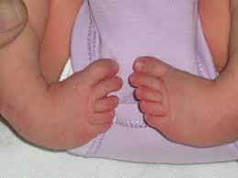

Slide 57
MANAGEMENT
DEPENDS UPON
AETIOLOGY
GESTATIONAL AGE
SEVERITY
FETAL STATUS & WELL BEING

Slide 58
DETERMINE AETIOLOGY
R/O PROM
USG FOR ANOMALIES
R/O IUGR ,IUFD when suspected
Amniocentesis if chromosomal anomalies suspected

Slide 59
Techniques for Monitoring
Single pocket without cord
AFI = sum of deepest pocket in each of 4 quadrants without cord and extrimities
BPP =
NST
breathing 30sec in 30min
move 3 limb/body in 30min
extension of extremity with flexion or open/close hand
single vertical non-cord pocket of 2 cm
Scoring: 0 or 2 for each, 10 is normal, 6 equivocal, 4 abnormal
Modified BPP = NST, +/- acoustic stimulation, AFI
AFI > 5 ok
AFI < 5 or non-reactive NST not ok
modified BPP equally useful as BPP for monitoring .

Slide 60
TREATMENT
ADEQUATE REST – decreases dehydration
HYDRATION – Oral/IV Hypotonic fluids(2 Lit/d)
SERIAL USG – Monitor growth,AFI,BPP
INDUCTION OF LABOUR/ LSCS
Lung maturity attained
Lethal malformation
Fetal jeopardy
Sev IUGR
Severe oligo
*AMNIOINFUSION

Slide 61
TREATMENT ACC. TO CAUSE
Drug induced – STOP IT
PROM – INDUCTION
PPROM – Antibiotics,steroid – Induction
FETAL SURGERY
VESICO AMNIOTIC SHUNT
Laser photocoagulation for TTTS

Slide 64
Key Points *Oligohydramnios is a decrease in the volume of amniotic fluid, with the diagnosis usually being made using ultrasound. *Causes of oligohydramnios include ruptured membranes, placental insufficiency, fetal anomalies, maternal ingestion of medications, chromosomal abnormalities, and idiopathic. *Significant oligohydramnios occurring prior to 22 weeks of gestation is associated with a poor prognosis because of a high likelihood of pulmonary hypoplasia and associated malformations. *Once oligohydramnios is diagnosed, a careful maternal history should be obtained and a physical examination should be performed to evaluate for preterm premature rupture of membranes. *Whenever a diagnosis of oligohydramnios is made > U/S to evaluate for fetal anomalies such as features of urinary tract obstruction or renal malformation. *Management of oligohydramnios depends on the gestational age and on the fetal and maternal status.

Slide 65
THANK YOU
FOR
PAYING ATTENTION

