Slide 1
2. Neoplastic Proliferations of White Cells
~ Myeloid Neoplasms III
Ghadeer Hayel, MD
Histopathologist
April 1st 2021

Slide 2
Essential Thrombocythemia (ET)
Megakaryocyte proliferation with overproduction of platelets.
Elevated platelet counts (>600x10^{x9}/L).
Separated from PCV and primary myelofibrosis based on the absence of polycythemia and marrow fibrosis, respectively.

Slide 3
Essential Thrombocythemia – Pathogenesis
ET is associated with activating point mutations in JAK2 (50%), a receptor tyrosine kinase that is normally activated by thrombopoietin.
Constitutive JAK2 renders the progenitor thrombopoietin-independent and leads to hyperproliferation.
The JAK2 mutation is the same as that found in almost all cases of PCV.
Why some patients with JAK2 mutations present with PCV & others with ET → not understood.

Slide 4
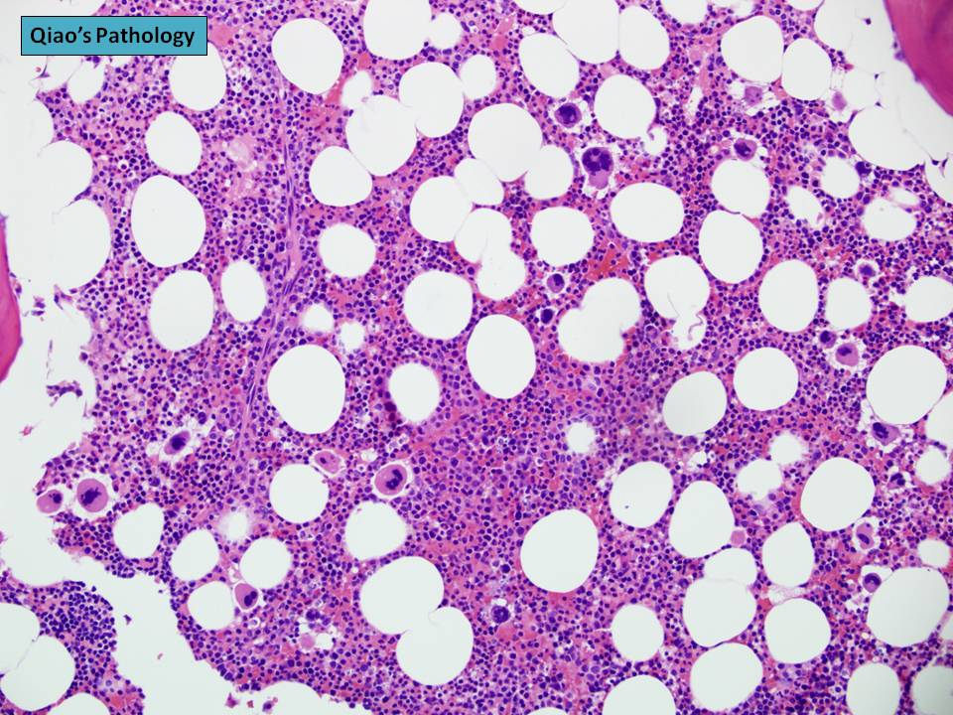
Essential Thrombocythemia – Morphology
Bone marrow cellularity is usually only mildly increased, but megakaryocytes are often markedly increased in number with abnormal large forms.

Slide 5
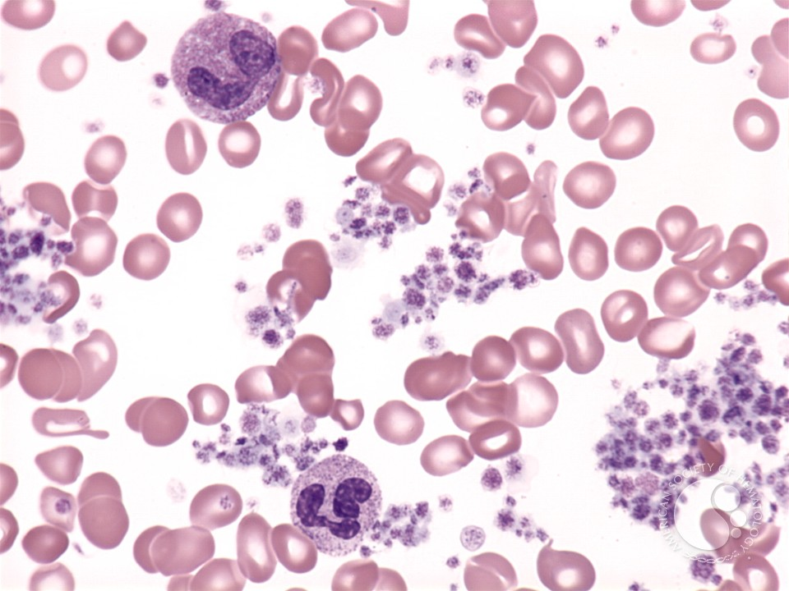
Essential Thrombocythemia – Morphology
Peripheral smears
usually reveal abnormally large platelets often
accompanied by mild leukocytosis.

Slide 6
ET– Clinical features
ET is an indolent disorder with long asymptomatic periods → only occasional thrombotic or hemorrhagic crises.
ET manifests clinically with elevated platelet counts.
Causes of reactive thrombocytosis, (such as inflammatory disorders & iron deficiency) must be excluded before the diagnosis can be established

Slide 7
ET– Clinical features
Platelets are not only increased in numbers but also frequently demonstrate qualitative abnormalities in functional tests.
The types of thrombotic events resemble those observed in PCV.
A characteristic symptom → erythromelalgia, a throbbing and burning of hands and feet caused by occlusion of small arterioles by platelet aggregates → may also be seen in PCV.

Slide 8
ET– Prognosis
Median survival times → 12~15years
Transformation to myelofibrosis (spent phase)is uncommon.
Transformation to acute leukemia is rare.

Slide 9
Primary Myelofibrosis (PM)
The hallmark of primary myelofibrosis is the development of obliterative marrow fibrosis → reduces bone marrow hematopoiesis →
Cytopenias.
Extensive extramedullary hematopoiesis.
Histologically, the appearance is identical to the spent phase that occurs occasionally late in the course of other MPN.

Slide 10
PM - Pathogenesis
JAK2 mutations are present in 50% to 60% of cases
Most of the remaining cases have other mutations →which also give rise to increased JAK signaling.
Why JAK2 mutations are associated PCV in some patients & PM in others is not understood.

Slide 11
PM - Pathogenesis
Pathogenesis is similar between PM and spent phase MPN
The characteristic marrow fibrosis is caused by the inappropriate release of fibrogenic factors from neoplastic megakaryocytes.
Two factors synthesized by megakaryocytes have been implicated (fibrogenic factors ):
Platelet-derived growth factor (PDGF).
TGF-β. (collagen deposition and angiogenesis)

Slide 12
PM - Morphology
PB smear is markedly abnormal →Leukoerythroblastosis
Red cells often exhibit bizarre shapes (poikilocytes, teardrop cells)
Nucleated erythroid precursors.
Immature white cells (myelocytes and metamyelocytes).
Along with abnormal large platelets .

Slide 13
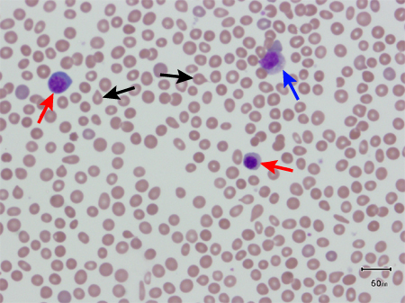
PM - Morphology
PB smear showing 2 nucleated RBCs (red), 2 tear drop RBCs (black) and a myelocyte (blue)

Slide 14
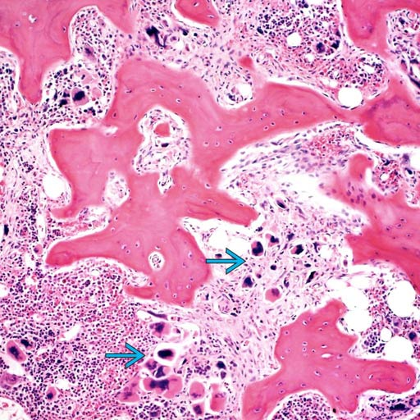
PM - Morphology
+BM in advanced cases is hypocellular & diffusely fibrotic.
+ In early cases it may be hypercellular & only focal fibrosis.
+Abnormally large and clustered megakaryocytes.

Slide 15
PM - Clinical Features
Age more than 60
Anemia and splenomegaly .
Fatigue, weakness and night sweats
Lab results; normochromic and normocytic anemia and Leukoerythroblatosis
Bone marrow is essential for the diagnosis.

Slide 16
PM - Prognosis
Median survival is 4-5 years.
5-20% transform to AML.
More difficult to treat than PCV and CML.
Treat with JAK2 inhibitors and HSCT.

Slide 17
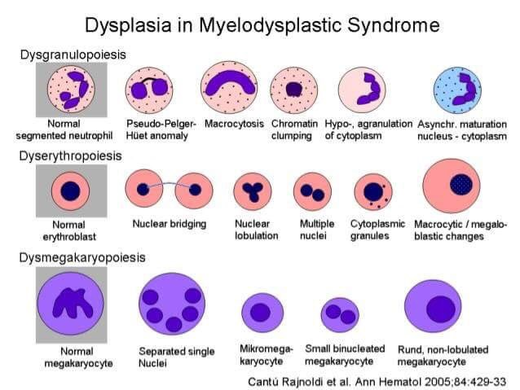
Myelodysplastic Syndromes (MDS)

Slide 18
Myelodysplastic Syndromes (MDS)
A group of clonal stem cell disorders characterized by maturation defects that are associated with ineffective hematopoiesis with cytopenias and a high risk of transformation to AML.

Slide 19
Myelodysplastic Syndromes (MDS)
BM is replaced by the clonal transformed multipotent stem cell that retains the capacity to differentiate into red cells, granulocytes, and platelets, but in an ineffective & disordered fashion. (cells stay in the BM)
So; BM is hypercellular or normocellular, but the PB shows one or more cytopenias.
The abnormal cells in BM are genetically unstable & prone to the acquisition of additional mutations → transformation to AML.

Slide 20
MDS - Pathogenesis
Most cases are idiopathic, but some develop after chemotherapy with alkylating agents or exposure to ionizing radiation therapy.

Slide 21
MDS - Morphology
Hypercellular bone marrow.
Dysplastic changes
Erythroid: Abnormal nuclear contour and iron deposits (ring sideroblasts)
Myeloid: abnormal segmentation and granulation
Megakaryocyte: single nuclear lobes or multiple separate nuclei.

Slide 22
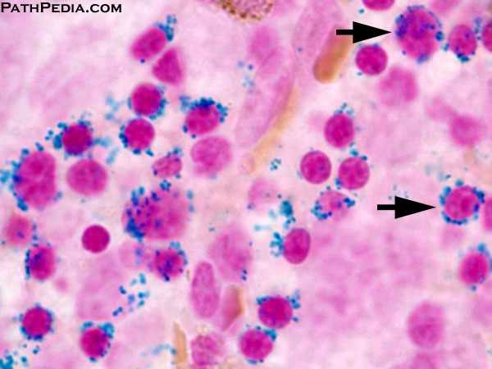
MDS - Morphology
Erythroid: Abnormal nuclear abnormalities & iron deposits (ring sideroblasts)

Slide 23
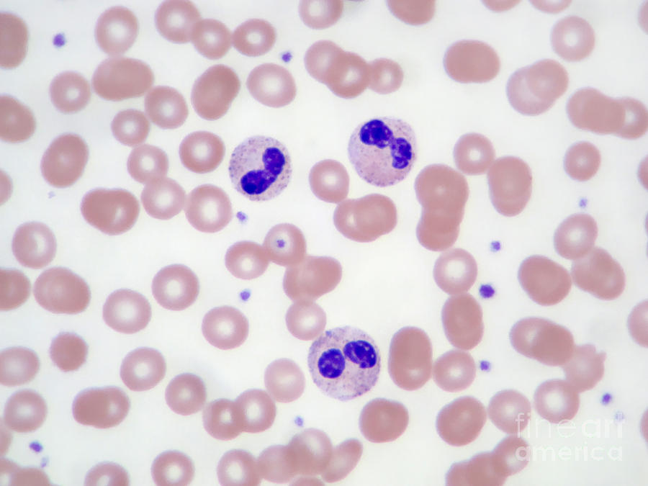
MDS - Morphology
Myeloid: abnormal segmentation; Pseudo-Pelger-Hüet cells, neutrophils with only two nuclear lobes

Slide 24
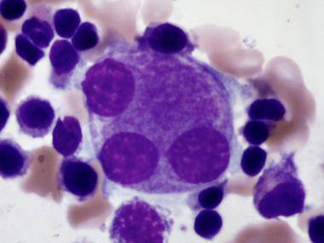
MDS - Morphology
Megakaryocyte: single nuclear lobes or multiple separate nuclei (pawn ball megakaryocytes)

Slide 25
MDS – Clinical features
Predominantly a disease of older adults, 70s
Up to half of cases → discovered incidentally.
If symptomatic, it presents with weakness, infections, and hemorrhages → all due to pancytopenia.
Poor response to conventional chemotherapy.
Transformation to AML → in 10-40% (rapid in t-MDS)
Prognosis is variable.
Median survival time ranges from 9 to 29 months.

Slide 26
THANK YOU!

