Slide 1
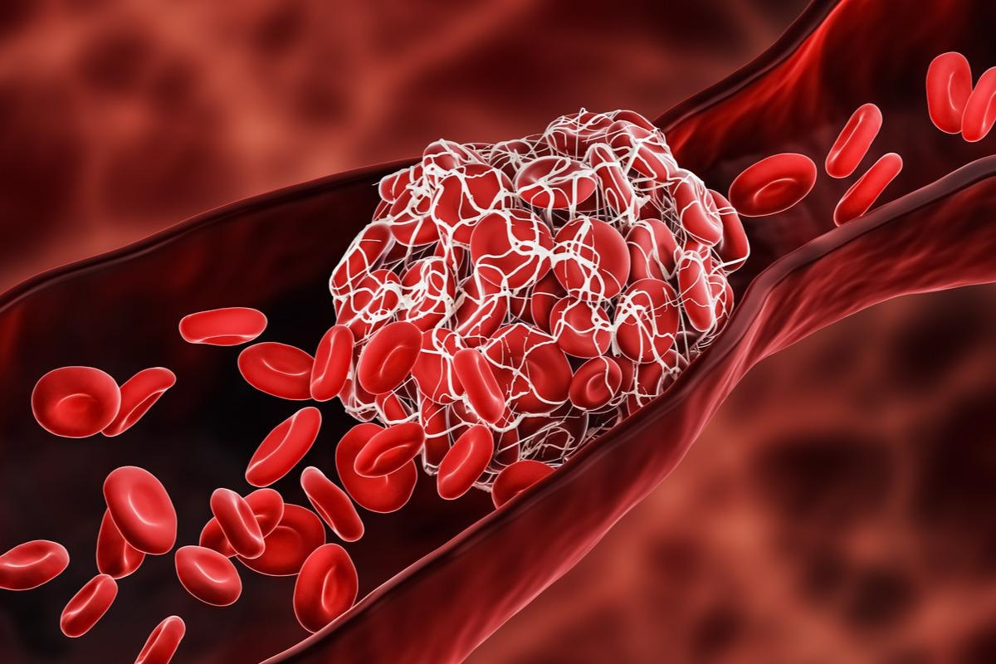
THROMBOEMBOLISM
BY :
SALSABEEL ALROYEI
YOSOR ALAJALEEN

Slide 2
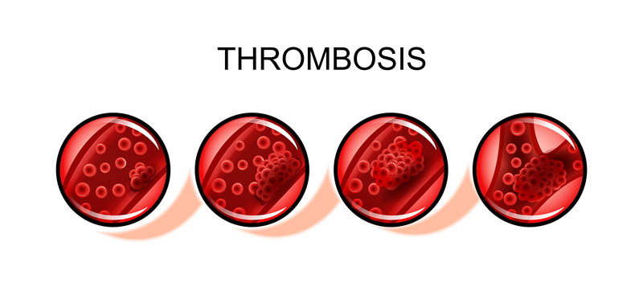
THROMBOEMBOLISM : The formation and/or migration of blood clots in different locations of the venous or arterial vasculature that can occlude or impair the pulmonary or systemic circulation .

Slide 3
Thromboembolism
Venous Thromboembolism
Deep vein thrombosis(DVT)
Arterial Thromboembolism
Pulmonary Embolism

Slide 4
Venous Thromboembolism
Blood clots that form within the venous vascular system, dislodge, and travel to a distant location, e.g., the pulmonary arteries via the right heart
Provoked VTE: VTE occurring in the presence of traditional risk factors for thromboembolic disease, e.g., ≥ 1 strong trigger OR multiple weak triggers
Unprovoked VTE: VTE occurring in the absence of identifiable triggers

Slide 5
Factors predisposing to venous thrombosis
- Increasing age >60
- Trauma
- Obesity
Hereditary hypercoagulable state (protein c and protein s deficiency, anti thrombin 3 deficiency )
Previous DVT, PE and varicose veins
Pregnancy, Oestrogen -containing oral contraceptive pills and hormone replacement therapy
Immobility, e.g. hospitalization and long-distance travel (> 4 hrs)
Major Surgery; Abdominal or pelvic surgery, Lower limb orthopedic surgery
Medical illnesses; malignancy, MI and heart failure

Slide 6
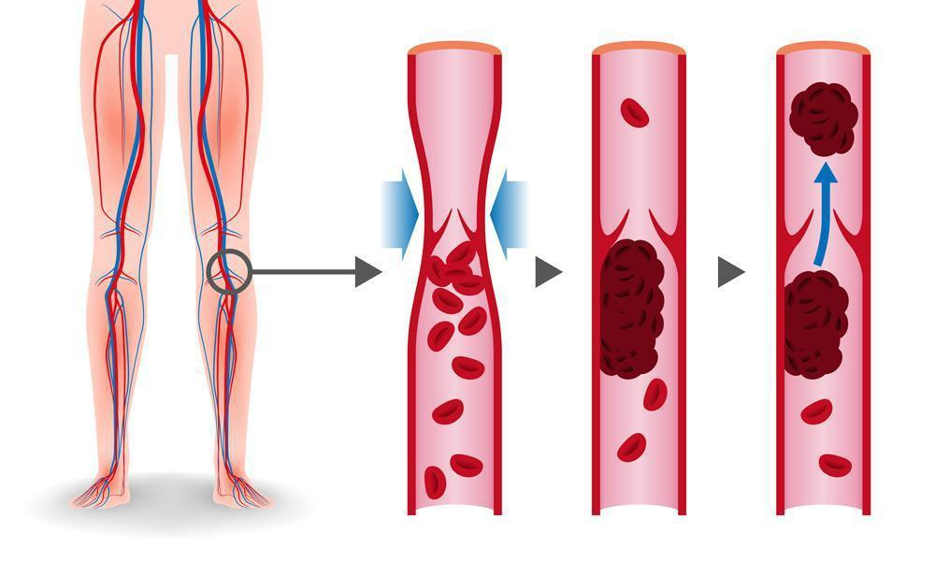
1.Deep vein thrombosis
- (DVT) is a medical condition that occurs when a blood clot forms in a deep vein
- These clots usually develop in the lower leg, thigh, or pelvis, (esp. iliofemoral , femoral and popliteal veins) but they can also occur in the arms and neck

Slide 7
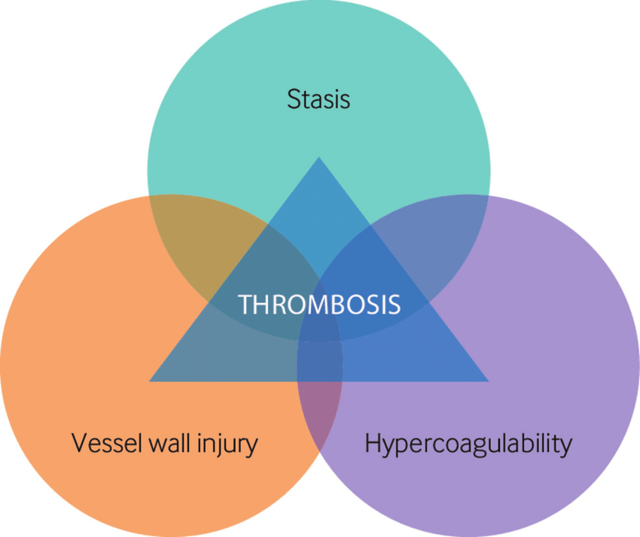
1.Deep vein thrombosis
pathophysiology
>> The Virchow triad
The Virchow triad refers to the three main pathophysiological components of thrombus formation.
Hypercoagulability: increased platelet adhesion, thrombophilia (e.g., factor V Leiden mutation), use of oral contraceptives, pregnancy
Endothelial damage: Inflammatory or traumatic vessel injuries can lead to activation of clotting factors through contact with exposed subendothelial collagen
Venous stasis: varicosis , external pressure on the extremity, immobilization (e.g., hospitalization, bed rest, long flights or bus rides), local application of heat

Slide 8
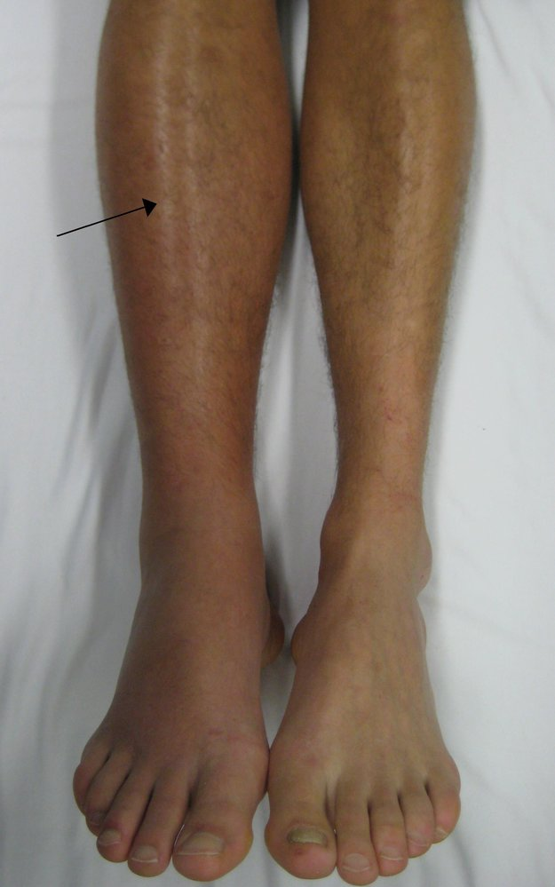
1.Deep vein thrombosis
Clinical features
may be asymptomatic
Localized unilateral symptoms Typically affects deep veins of the legs, thighs, or pelvis
Swelling, feeling of tightness or heaviness
Warmth, erythema, and possibly livid discoloration
Progressive tenderness, dull pain
Distention of superficial veins
Homan’s sign

Slide 9
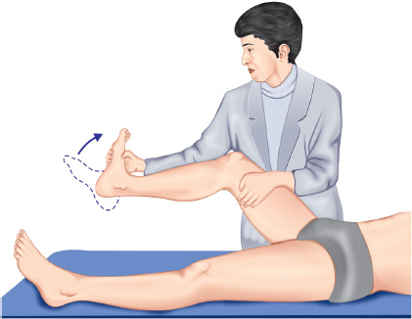
1.Deep vein thrombosis
Homan’s sign
The patient lie in supine position with flexion of knee, then dorsiflexion of foot and squeeze the calf .
Positive result when elicit pain in the calf

Slide 10
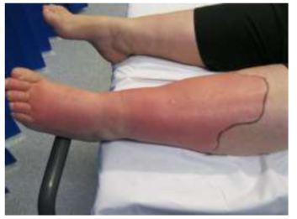
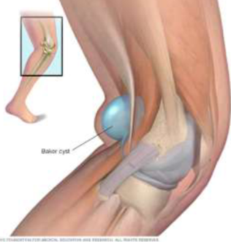
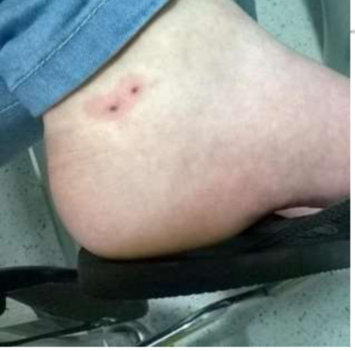
1.Deep vein thrombosis
Differential Diagnosis of unilateral leg swelling
1. Cellulitis: common bacterial skin infection that causes redness, swelling, and pain in the infected area of the skin
2. Ruptured backer cyst
3. Lymphatic obstruction: due to radiation, malignancy or elephantiasis.
4. Hematoma
5. Snake bite: fang marks
6. Compartment syndrome

Slide 11
1.Deep vein thrombosis
History taking for unilateral leg swelling
• The course of unilateral leg swelling (duration, progression of the symptoms, exacerbating factor and relieving factor)
• Constitutional symptoms: fever (suggestive of cellulitis), fatigue, weight loss (suggestive of malignancy as a cause of DVT).
• Looking for complications (Pulmonary embolism): SOB, pleuritic chest pain, hemoptysis, dizziness.
• Looking for the cause of DVT:
Stasis: past medical history of travel for a long period, surgery, heart failure, bed rest.
Hypercoagulability: Hx or family hx of thrombophilia, pregnancy, OCPs, and malignancy (GI symptoms, RS symptoms, weight loss and family hx of early malignancy).
Endothelial injury: surgery, major trauma (especially pelvic),
Bechet disease (recurrent oral and genital ulcer, redness of the eye)

Slide 12
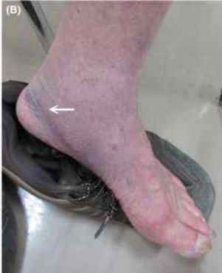
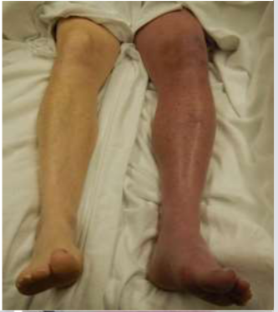
1.Deep vein thrombosis
Physical examination of unilateral leg swelling
• Vitals: fever? (sign of cellulitis), tachypnea or tachycardia (signs of PE)
• Exposure: All the two legs should be exposed
• Inspection (always compare): Redness, obvious swelling and the extent (thigh and calf or calf only) in comparison to the other leg, dilated vein. crescent sign of ruptured Becker cyst
• Palpation:
1. Warmth, pitting edema (lymphedema may cause non-pitting)
2.Measurement of the circumference of both legs: 10 cm below the tibial tuberosity and compare
with the asymptomatic leg. (>3 cm difference)

Slide 13
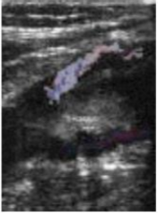
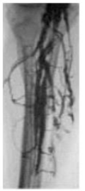
1.Deep vein thrombosis
Diagnosis
1- Duplex ultrasound imaging : initial test for dvt and non-invasive
2- venography : most accurate, invasive and infrequently used
3- D-dimer testing : to rule out DVT when combined with Doppler and clinical suspicion
4- CBC : thrombocytosis (risk for DVT)
5- PTT, PT , INR : baseline before starting treatment
6- wells score : ( scale of -2 to 9 points) number that reflects the risk of developing deep vein thrombosis
-high score : high chance > 2 p
-moderate score : moderate chance 1-2 p
-low score : low chance < 1 p

Slide 14
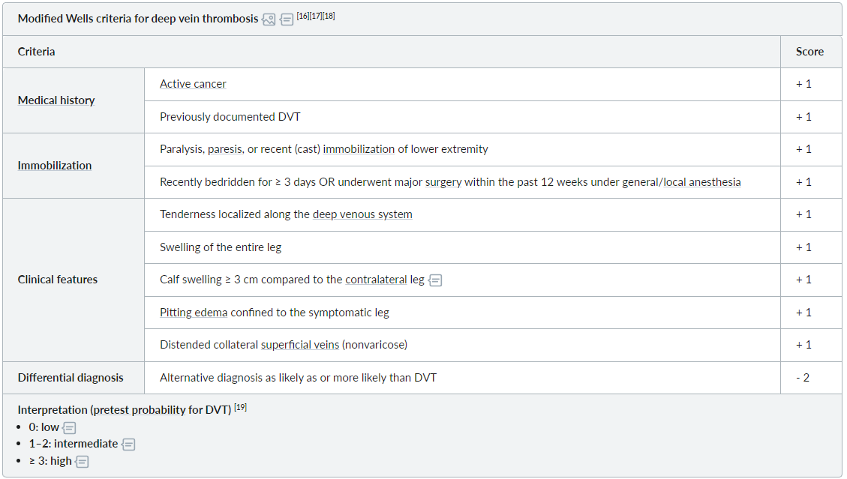

Slide 15
1.Deep vein thrombosis
Diagnosis
A. Intermediate-to-high pretest probability of DVT
1. If Doppler ultrasound is positive, begin anticoagulation
2. If Doppler ultrasound is nondiagnostic, repeat ultrasound every 2 to 3 days for up to 2 weeks
B. Low-to-intermediate probability of DVT
If Doppler ultrasound is negative, there is no need for anticoagulation;
observation is sufficient and repeat ultrasound in 2 days

Slide 16
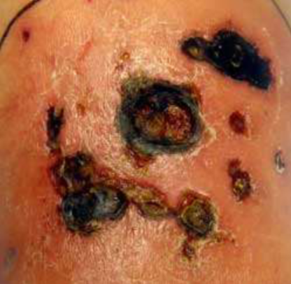
1.Deep vein thrombosis
Treatment
1. MEDICATIONS:
1- Injectable LMWH (e.g., enoxaparin, dalteparin) (best choice for DVT/PE associated with malignancy)
If the patient is contraindicated to give LMWH , so we use unfractionated heparin
2- DOACs (e.g. apixaban, rivaroxaban, edoxaban, dabigatran)
3- warfarin (requires IV heparin bridge as below).
4- Thrombolytic therapy (streptokinase, urokinase, tissue plasminogen activator [tPA])
2. DVT SURGERY:
recommended in the case of very large blood clot.

Slide 17
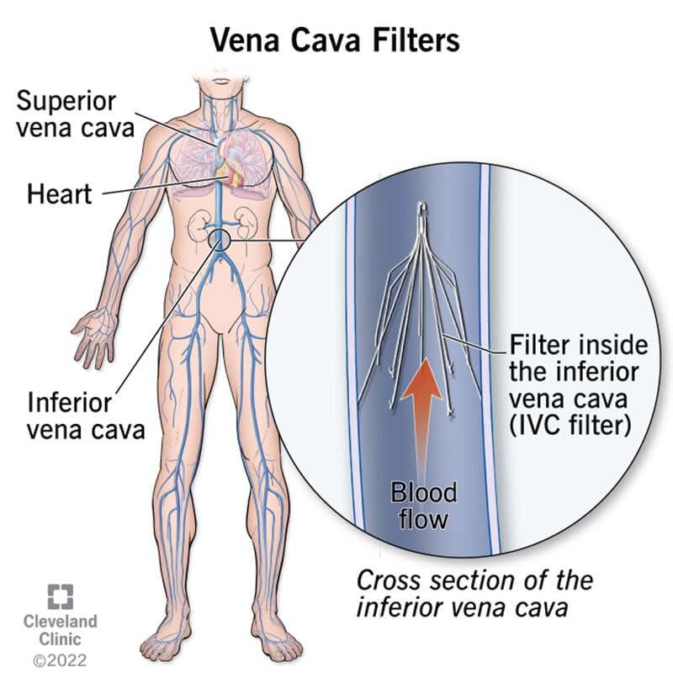
1.Deep vein thrombosis
Treatment
3. Prophylaxis:
• Inferior vena cava filter placement (Greenfield filter) :
-Indications for treatment of VTE
-If absolute contraindication to anticoagulation (bleeding)
-If failure of appropriate anticoagulation
-Effective only in preventing PE, not DVT
• Low dose aspirin.
• Calf exersice.
• Compression stockings (to prevent stasis)

Slide 18
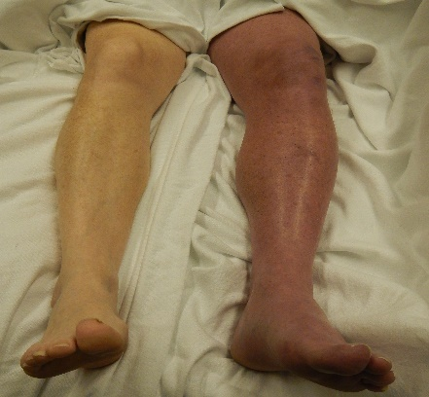
1.Deep vein thrombosis
Complications
Pulmonary embolus (PE)
Post thrombotic syndrome (chronic venous insufficiency): Residual venous obstruction and valvular incompetence (50% of DVT)
Phlegmasia cerulea dolens (painful, blue, swollen leg): Occurs in extreme cases of DVT—indicates that major venous obstruction has occurred. Often associated with malignancy causing hypercoagulable state.
Severe leg edema compromises arterial supply to the limb, resulting in impaired sensory and motor function.
Rx: Venous thrombectomy is indicated.

Slide 19
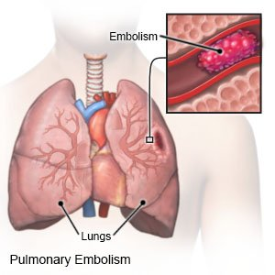
2. Pulmonary embolism
Pulmonary embolism (PE): luminal obstruction of one or more pulmonary arteries, typically due to blood thrombi from deep vein thrombosis (DVT)

Slide 20
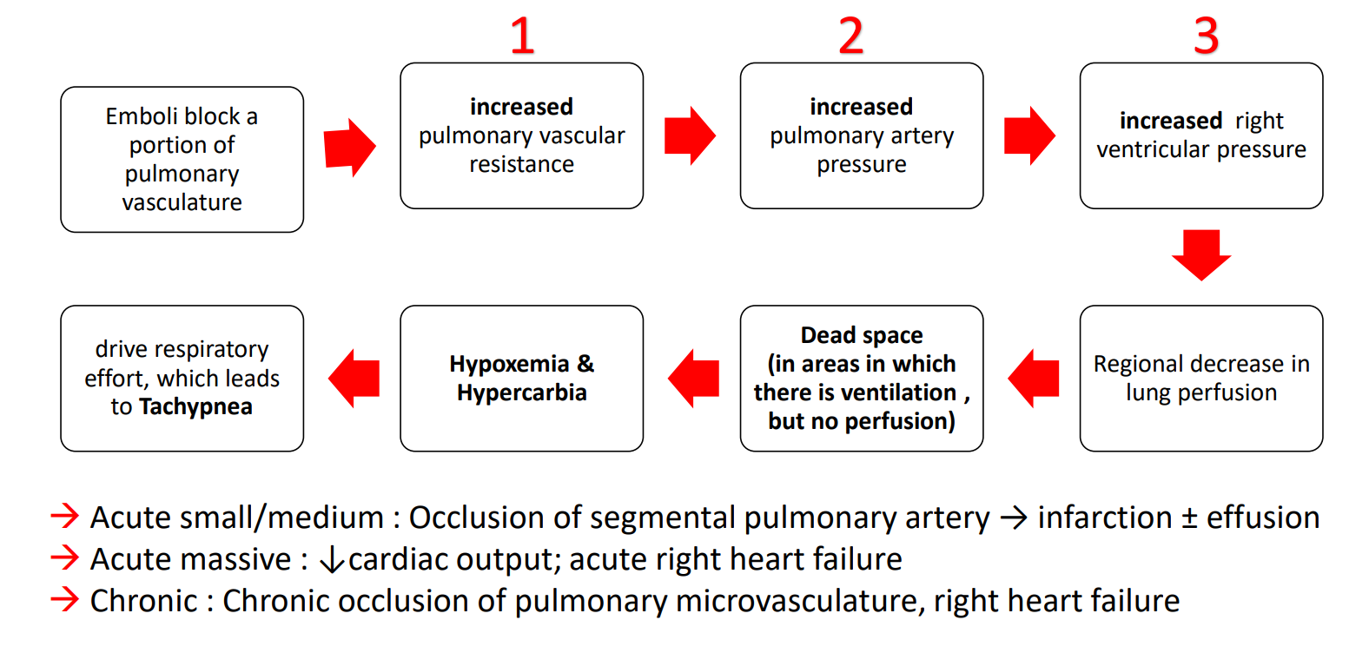
2. Pulmonary embolism
pathophysiology
hypocarbia

Slide 21
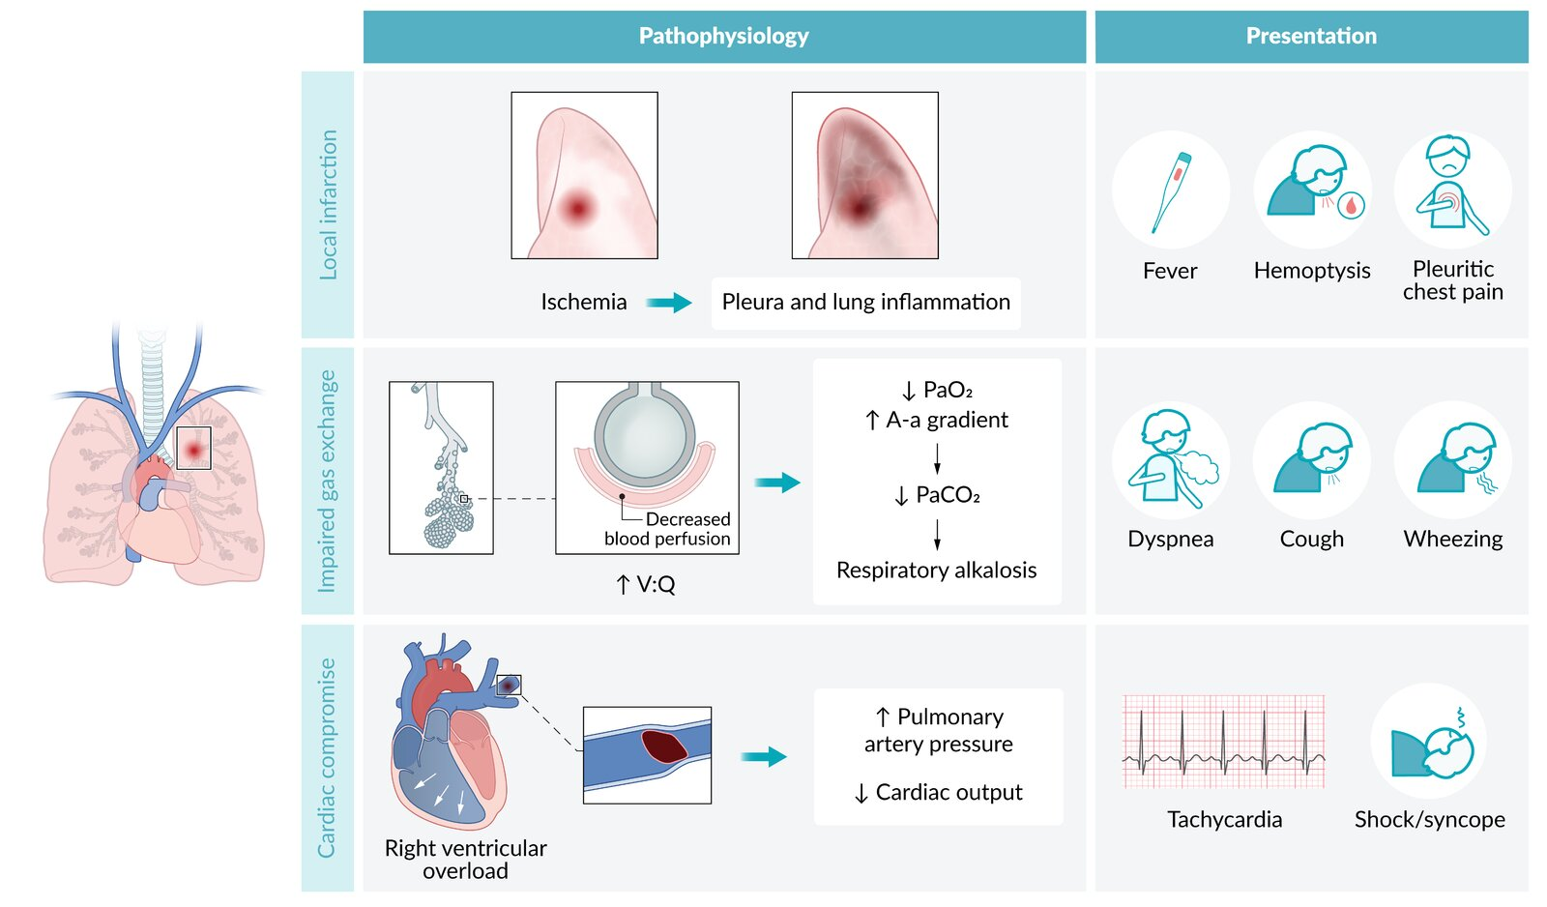

Slide 22
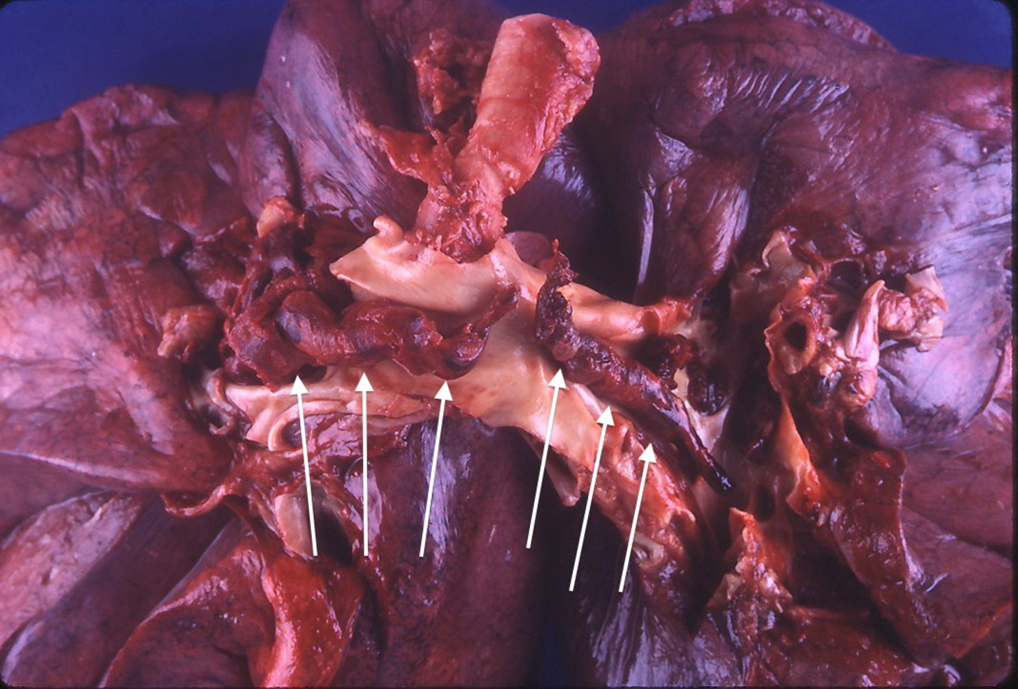

Slide 23
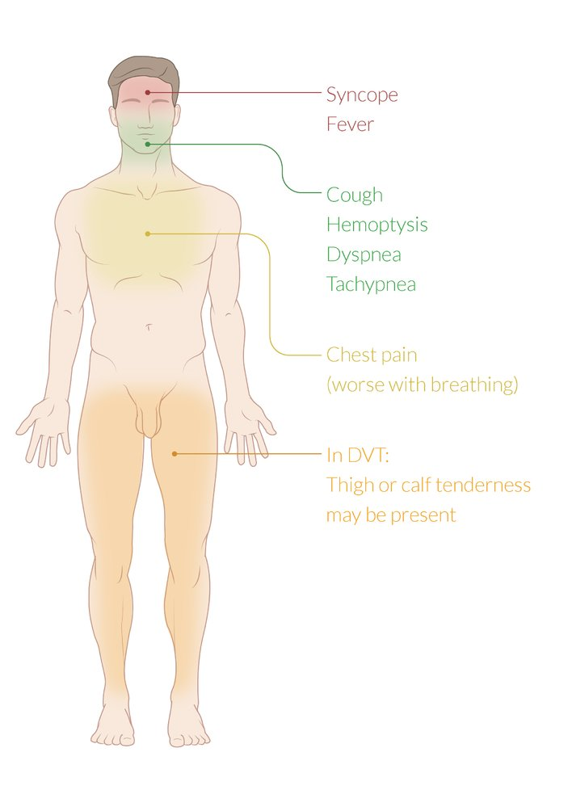
2. Pulmonary embolism
Clinical features
Common features of PE :
Acute onset of symptoms
Dyspnea (> 75% of cases)
Tachycardia and tachypnea (up to 50% of cases)
Sudden pleuritic chest pain (∼ 20% of cases)
Cough and hemoptysis
Associated features of DVT: e.g., unilaterally painful leg swelling

Slide 24
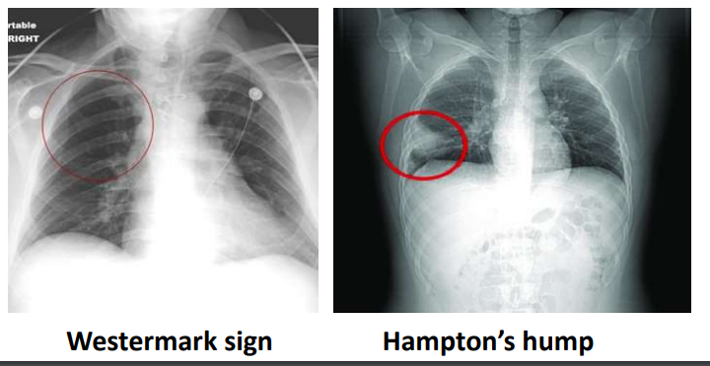
2. Pulmonary embolism
Diagnosis
1- ABG levels “not diagnostic for PE” (paO2 and PaCO2 are low )
2-chest x ray – (usually normal) (but it is the most useful in excluding alternative diagnoses) - Atelectasis or pleural effusion may be present. - Classic radiographic signs, such as Westermark sign or Hampton hump, are rarely present.
3- Venous duplex ultrasound of the lower extremities
4- D- dimer assay (elevated)
6- CTPA “pulmonary angiography” (standred test)
7- V/Q (ventilation–perfusion lung) scan
8- wells criteria

Slide 27
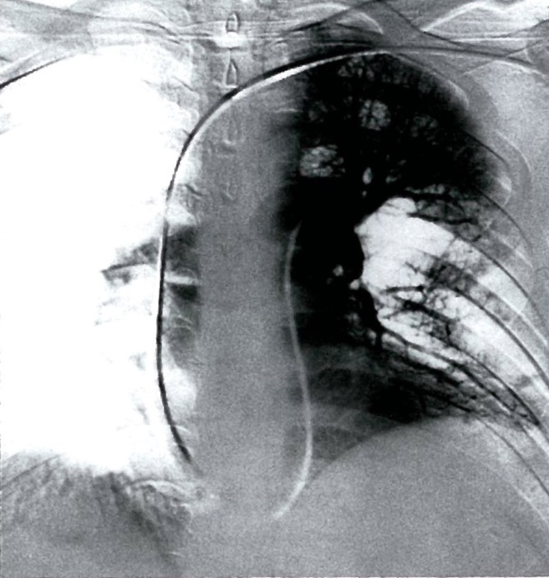
2. Pulmonary embolism
CT pulmonary angiography (CTPA)
CTPA is the preferred test for the diagnosis of acute PE.
Findings
Direct finding of PE: intraluminal filling defects of pulmonary arteries
Pulmonary infarct: opacity with consolidated border; may be accompanied by pleural effusion
Evidence of RV dysfunction

Slide 28
2. Pulmonary embolism
Management
Provide oxygen therapy for hypoxic patients.
Treat PE based on severity and bleeding risk; start empiric anticoagulation for PE if indicated.
Provide analgesia avoid NSAIDs if possible.
Thrombolytic therapy (for example, streptokinase, tPA)
Surgical thrombectomy

Slide 29
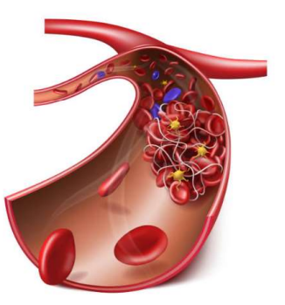
Arterial thromboembolism
Blood clots that form within the arterial vascular system, dislodge, and travel to a distant location, e.g., distal systemic arteries and arterioles
Usually, an acute event that results in ischemic tissue damage (e.g., stroke, acute mesenteric ischemia, acute limb ischemia, acute coronary syndrome. pulmonary infarction)

Slide 30
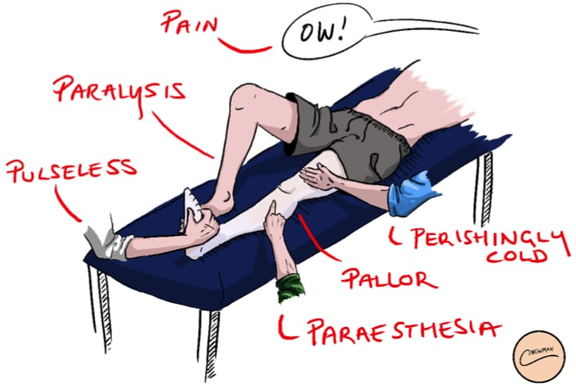
Arterial thromboembolism
6 p’s

Slide 31
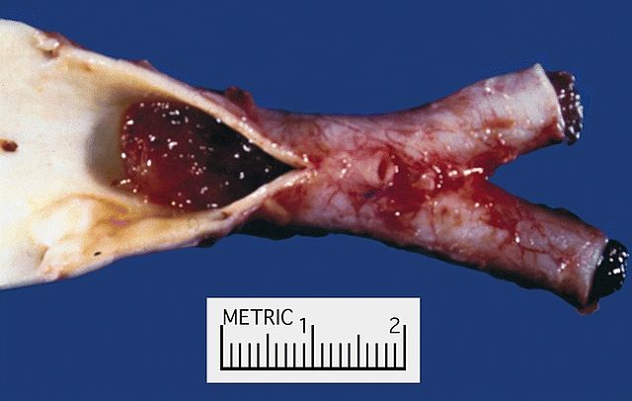
Arterial thromboembolism
Sites
>Arterial emboli often occur in the legs and feet (75%).
>Emboli that occur in the brain cause a stroke (10%).
>Ones that occur in the heart causes heart attack.
>Less common site include the kidneys, intestines and eyes.

Slide 32
Arterial thromboembolism
causes
Abnormal heart rhythms such as atrial fibrillation.
Damage to the arteries by disease or other health conditions.
Endocarditis (infection of the inside of the heart
. High blood pressure because having high blood pressure weakens the arterial walls making it easier for blood to accumulate in the weakened artery and form clots.
Surgery that affects the blood circulation
Hardening of the arteries(atherosclerosis) from high cholesterol.

Slide 33
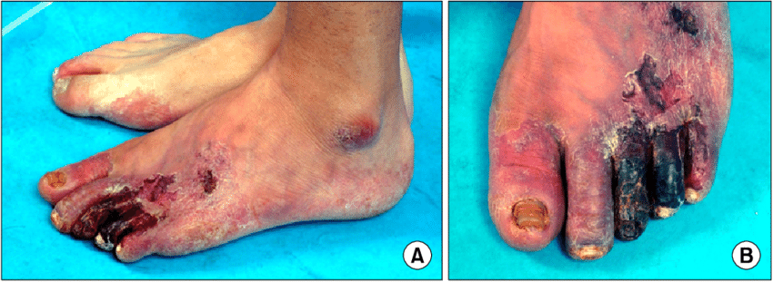
Arterial thromboembolism
Complication
Acute MI
Septic shock.
Stroke
Temporary or permanent decrease or loss of other organ functions
Temporary or permanent kidney failure.
Tissue death (necrosis)and gangrene.

Slide 34
Arterial thromboembolism
Diagnosis
• Angiogram – examines the blood vessels for abnormalities
• Doppler ultrasound – watches blood flow.
• MRI - takes images of the body to locate blood clots.

Slide 35
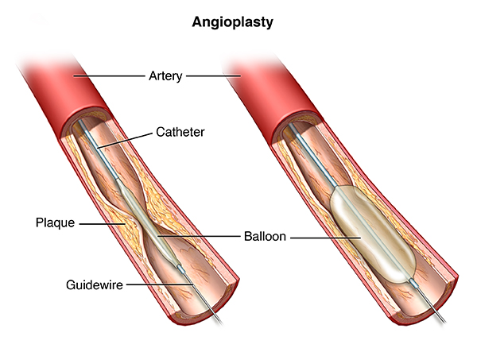
Arterial thromboembolism
Treatment
• Medicines include:
- Thrombolytic such as streptokinase can dissolve the clots
- Anticoagulants (warfarin, heparin or one of the newer blood thinners as apixaban, edoxaban) can prevent new clots from forming.
- Intravenous pain medication
• Surgery:
- Arterial bypass to create a second source of blood supply
- Angioplasty: opening of the artery with a balloon catheter with or without a stent.

Slide 36
THANK YOU

