Slide 1
Biochemical pathways regulating the Function of Sensory Organs
Dr. Nesrin Mwafi
Biochemistry & Molecular Biology Department
Faculty of Medicine, Mutah University

Slide 2
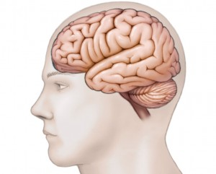
Sensory Organs and Sensory Neurons
Vision >
Olfaction >
Taste >

Slide 3
Biochemistry of Vision

Slide 4
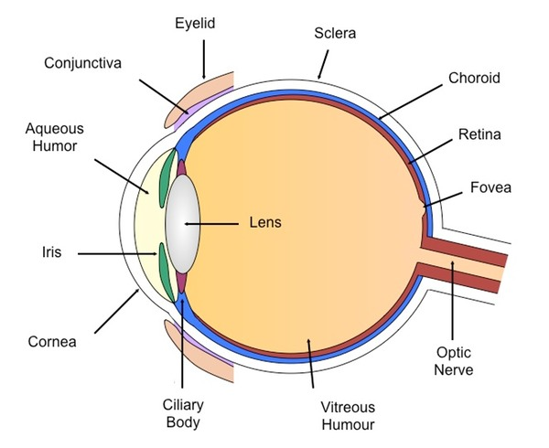
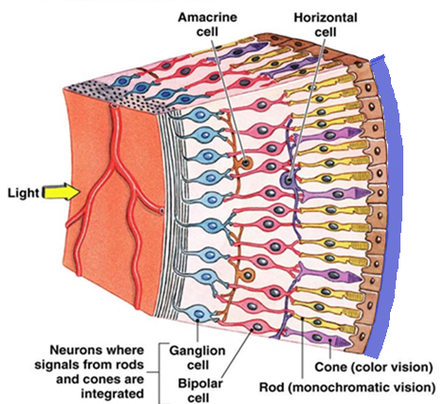
The Structure of Human Eye
Pigment
epithelium
choroid
Blind
spot

Slide 5
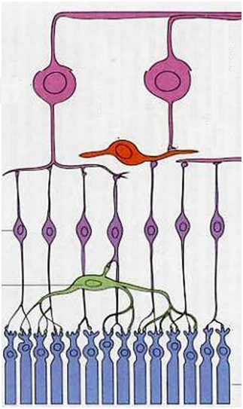
The Structure of Retina
The retina has 3 layers of neurons (the photoreceptor, the bipolar and the ganglion cells) and 2 layers of synapses including the unique ribbon synapses or lateral connection via the horizontal and amacrine cells
Horizontal cells make synapses with rods, cones and bipolar cells whereas the amacrine cells connect bipolar with ganglion cells. Thus horizontal and amacrine cells are involved in the indirect path of visual input transmission.
Ganglion
cells
Amacrine
cell
Bipolar
cells
Horizontal cell
Photoreceptor
cells

Slide 6
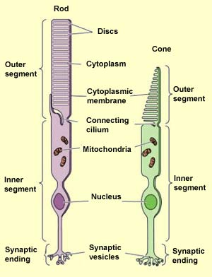
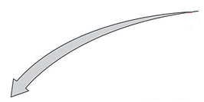
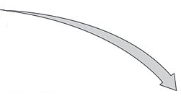
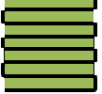
Photoreceptor cells
Retina contains two types of photoreceptors:
Free floating
discs
Outer
segment
interdisc
space
[
I
I
I
I
I
intradisc
space
I
Visual pigment
Visual pigment
I
I
I
I
I
I
Membranous
discs

Slide 7
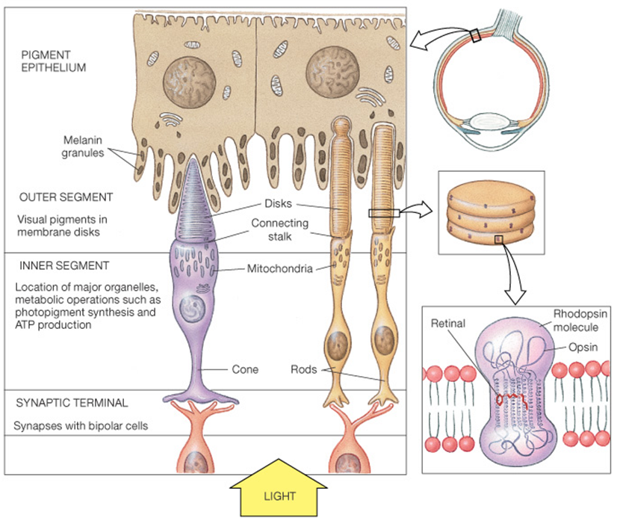
Visual Pigment

Slide 8
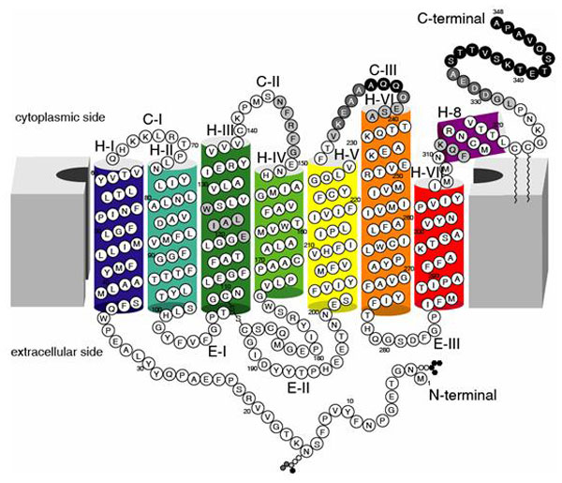
Structure of Rhodopsin
Retinal
attachment site
(lysine 296)
Rhodopsin is the only visual pigment in rods
It consists of the transmembrane protein (GPCR) called opsin and light sensitive moiety called retinal (the aldehyde form of Vitamin A)

Slide 9
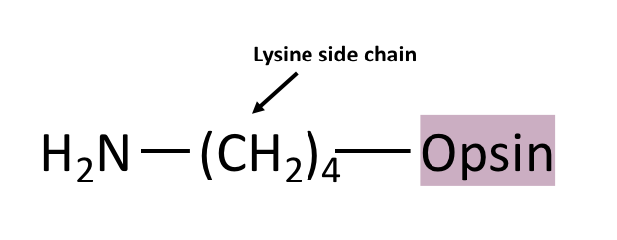
Retinal Binding to Opsin
cis
11
12
+
11-cis Retinal
Opsin
Schiff base linkage
+ H₂O
Lysine side chain

Slide 10
Iodopsin
Iodopsin is the visual pigment in cones consisting of cone opsin protein (photopsin) and the same light sensitive moiety: retinal
3 different types of iodopsins and consequently 3 different types of cone cells (which give us color vision):
L cones (photopsin I + retinal) red light, 560nm
M cones (photopsin II + retinal) green light, 530nm
S cones (photopsin III + retinal) blue light, 420nm

Slide 11
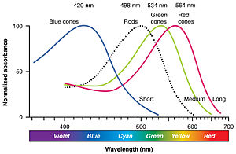
3 Different Cones
530nm
560nm
420nm
498nm

Slide 12
Phototransduction
Phototransduction is the process by which the light detected by photoreceptor cells in the retina is converted into electrical (or cellular) signals.

Slide 13
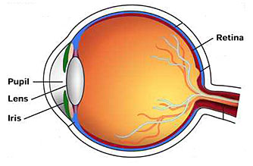
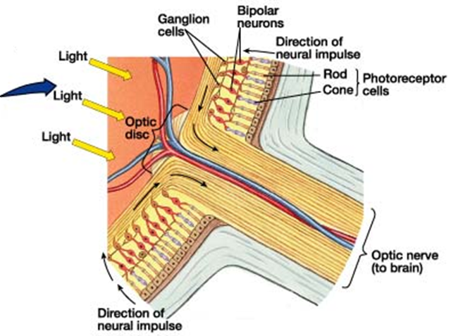
Phototransduction

Slide 14
Phototransduction
Phototransduction is the process by which the light detected by photoreceptor cells in the retina is converted into electrical (or cellular) signals.
These are transmitted as nerve impulses back through layers of retina to optic nerve fibers
The optic nerve carries the information to the brain to be processed there
What is the molecular mechanism involved in visual cycle and how does the absorbed light create a response ?

Slide 15
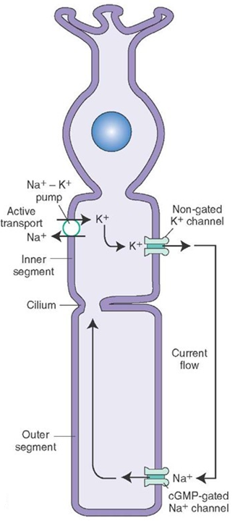
Phototransduction Cascade
In the absence of light, the photoreceptor cell is in the depolarized state with membrane potential of -40 mV. This depends on:
Non-gated K⁺ channel: outflux of K⁺ (ongoing outward K⁺ current)
cGMP-gated Na⁺ channel: influx of Na⁺
(inward Na⁺ current known as dark
current)
Na⁺- K⁺ pump: it is an active transport requires ATP (to transfer 3 Na⁺ out and 2 K⁺ in)

Slide 16
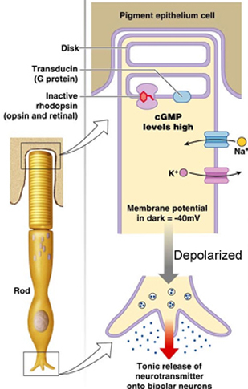
Phototransduction Cascade
In darkness, rhodopsin is inactive and cGMP level is high thus Na⁺ channels are open.
The neurotransmitter molecules are released from synaptic terminal of photoreceptor cell.

Slide 17
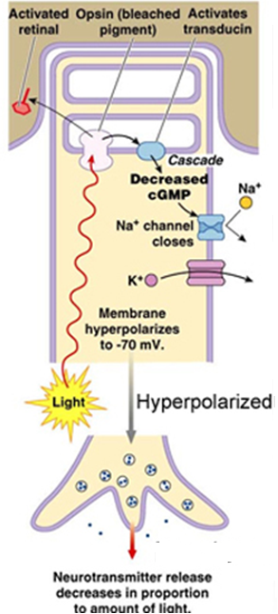
Phototransduction Cascade
In presence of light, a series of changes occur within rhodopsin which activate a downstream signaling cascade resulting in the closure of Na⁺ channels. Indeed, rhodopsin dissociates, the activated opsin decreases cGMP which in turn closes Na⁺ channels and hyperpolarizes the cell. Consequently, less neurotransmitter molecules are released.

Slide 18
Photoisomerization of retinal
Schiff base linkage
Lysine side chain
visual purple
(Photo-bleached)
visual yellow

Slide 19
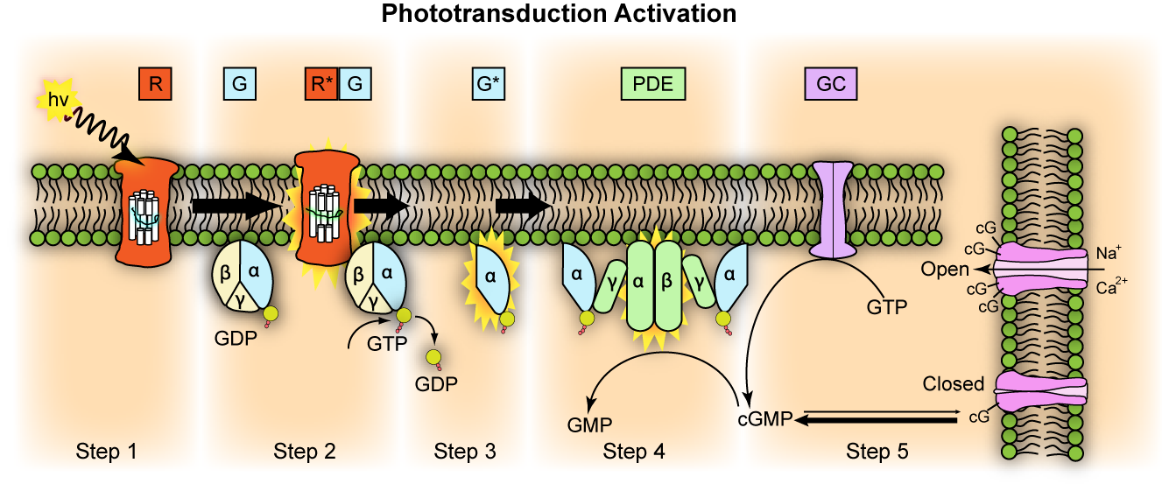
G-protein signaling pathway
Intradisc space
Na⁺
Cytoplasmic side
Na⁺

Slide 20
G-protein signaling pathway
The activated rhodopsin (R*) binds to and activates the heterotrimeric G-protein “transducin” by exchanging its GDP with GTP
The α-subunit of transducin bound to GTP (the activated transducin, G*) dissociates from its β and γ subunits
G* binds to the inhibitory γ subunits of phosphodiesterase enzyme (PDE) activating its two catalytic subunits: α and β. The activated PDE converts cGMP to GMP so reduces the cGMP level and consequently the closure of Na⁺ channels. Thus, the membrane is hyperpolarized and the rate of neurotransmitters release is reduced
Normally, Guanylyl cyclase (GC) enzyme synthesizes cGMP from GTP. So cGMP is the second messenger in phototransduction cascade

Slide 21
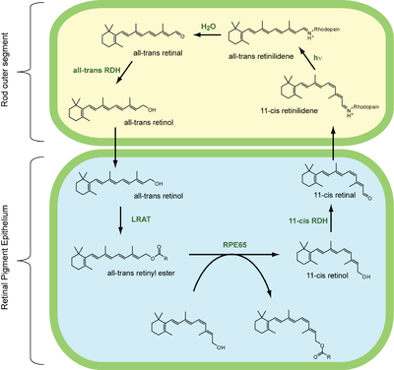
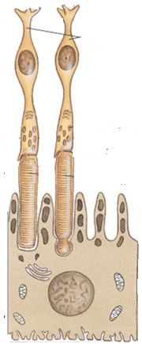
Regeneration of Visual Pigment

Slide 22
Regeneration of Visual Pigment
In darkness, inactive rhodopsin consists of opsin covalently linked to 11-cis retinal via schiff base bond. Light induces photoisomerization of 11-cis retinal to all trans retinal. The rhodopsin becomes activated (called meta-rhodopsin II) and loses its visible purple color (photobleached)
Long after visual cycle is complete, the activated rhodopsin dissociates and the all-trans retinal is released to be recycled back to 11-cis retinal
A series of biochemical reactions occur both in the outer segment of photoreceptor cell and the pigment epithelium layer in retina to regenerate the visual pigment again
First, all-trans retinal is reduced to all-trans retinol via all-trans retinol dehydrogenase (all-trans RDH) which travels back to retinal pigment epithelium (RPE).

Slide 23
Regeneration of Visual Pigment
In RPE, all-trans retinol is first esterified by lecithin retinol acyltransferase (LRAT) to form all-trans retinyl ester (a chemically stable storage form of vitamin A in RPE).
When further chromophore is required, the isomerase enzyme RPE65 (retinal pigment epithelium specific 65-KDa protein) synthesizes 11-cis retinol by using all-trans retinyl ester as substrate.
11-cis retinol is converted via 11-cis retinol dehydrogenase (11-cis RDH) to 11-cis retinal before travelling back to the outer segment of photoreceptor cell where it is again conjugated to an opsin to form new functional visual pigment (e.g. rhodopsin)

Slide 24
Light and Dark Adaptation
Visual adaptation: is the ability of visual system to automatically adjust its sensitivity to accommodate a change in light intensity. Two types:
Dark adaptation: is the slow recovery of visual sensitivity (20-30 min) after exposure to a bright/strong light (i.e. when you move from the light to the dark).
Light adaptation: is the adaptation to increased level of illumination (i.e. when you move from the dark to the light, 5 min).
Mechanisms underlying light /dark adaptation:
Pupil size to adjust amount of light reaching the retina
Switch-over between rods and cones
Bleaching / regeneration of photopigments

Slide 25
Photoreceptor cells
Retina contains two types of photoreceptors:
Rod cells: about 120 million, function in dim light (night vision) and do not perceive color, with high sensitivity and low resolution
Cone cells: about 6 million, function in bright light (daytime vision)and are responsible for color vision, with low sensitivity and high resolution

Slide 26
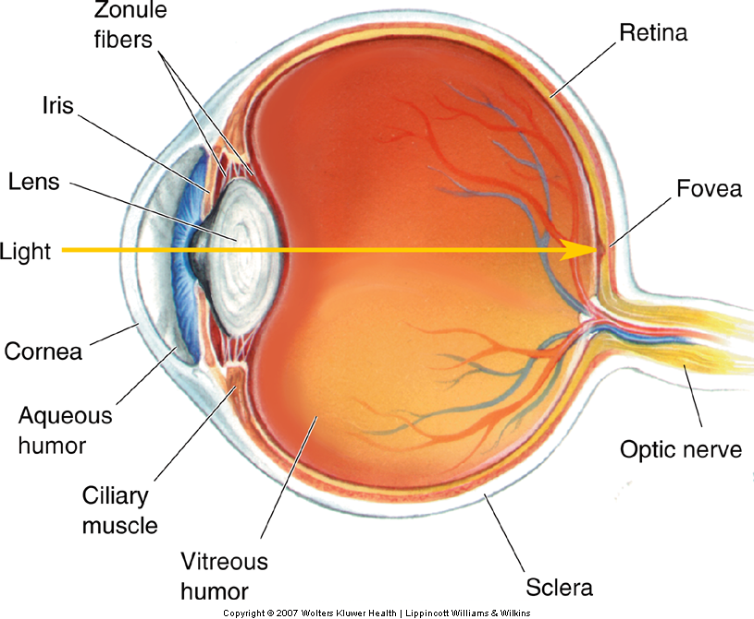
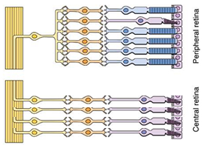
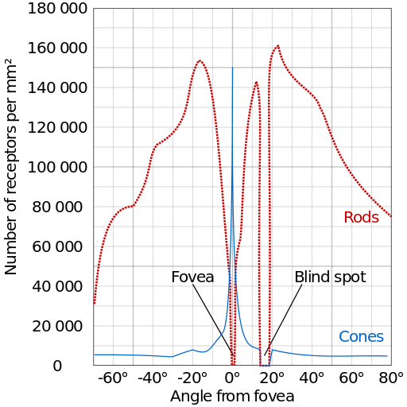
Distribution of Rods & Cones across Retina
Peripheral retina
v
fovea
Central retina
Blind spot
Peripheral retina

Slide 27
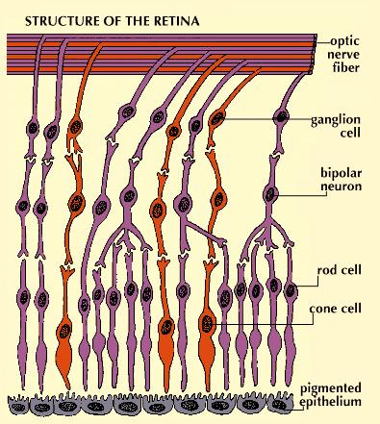
Synaptic pattern of Photoreceptors
High degree of convergence
reduces resolution in rod system, whereas 1:1 relationship of cones to bipolar and ganglion cells increases the resolution or visual acuity.
Rod
Cone bipolar
neuron

Slide 28
Rods vs. Cones
Rods | Cones
Used for scotopic vision (vision under low light conditions) or night vision | Used for photopic vision (vision under high light conditions) or day vision
Very light sensitive | Not very light sensitive
Loss causes night blindness | Loss causes legal blindness
Low visual acuity (poor resolution) as many rods are connected to one bipolar cells showing a high degree of convergence | High visual acuity; better spatial resolution as each cone is connected to one bipolar cell
Not present in fovea | Concentrated in fovea
Outer segment is rod shaped | Outer segment is cone shaped
Confer achromatic or monochromatic vision | Confer color vision (trichromatic vision)
Stacks of membrane-enclosed disks are unattached to cell membrane directly | Disks are attached to outer membrane
About 120 million rods distributed around the retina (peripheral vision) | About 6 million cones distributed in each retina (central vision)
One type of photosensitive pigment (Rhodopsin) | Three types of photosensitive pigments in humans (blue, green and red cones)

Slide 29
Vitamin A and Visual Cycle
Vitamin A is one of the fat-soluble vitamins
Derivatives of vitamin A (preformed): retinol, retinal
(retinaldehyde), retinoic acid (the biologically active metabolite of vitamin A) and retinyl ester
4 main forms of vitamin A
These preformed compounds are found in animal products as retinyl esters (e.g. liver, eggs, cod liver oil, meat, dairy products …. etc)
Retinyl ester, the ester form

Slide 30
Vitamin A and Visual Cycle
Retinoids: are a class of chemical compounds that are related chemically to vitamin A. They are widely used in medicine as they have diverse functions in the body
First generation: retinal, retinol, tretinoin (all trans retinoic acid, Retin-A) , isotretinoin (Roaccutane, UK and Accutane, USA) and alitretinoin
Second generation: etretinate and its metabolite acitretin
Third generation: tazarotene, bexarotene and Adapalene

Slide 31
Vitamin A and Visual Cycle
Provitamin A: like some carotenoids which can be converted/ metabolized in the body to retinoids with vitamin A activity. They are found in plant sources (e.g. carrot)
β-carotene
v
α-carotene
β-cryptoxanthin

Slide 32
Vitamin A and Visual Cycle
Carotenoids: are organic pigments synthesized by plants and cannot be made by animals. Two classes:
Carotenes: are responsible for the orange color of many vegetables & fruits (e.g. carrots and sweet potatoes) also for yellow color of milk-fat and butter (in low concentration). Some are provitamin A: like α-carotene (single retinyl group) and β-carotene (two retinyl groups)
Xanthophylls: are yellow pigments. β-cryptoxanthin (provitamin A) is the only xanthophyll which possess vitamin A activity.

Slide 33
Carotenoids Absorption & Metabolism
Only a limited amount of the provitamin carotenoids (plant sources) can be absorbed intact. These are stored in body tissues such as adipose cells of fat depots throughout the body. To date, the only side effect of excess beta-carotene supplementation appears to be yellowing of the skin.
Carotenoids are largely converted to retinol (vitamin A) during intestinal absorption in the mucosal cell.

Slide 34
Hydrolysis of β-carotene
β-carotene
15,15’-oxygenase
[O]
RRD
RDH
Retinyl esters
RRD: retinaldehyde reductase
RDH: retinol dehydrogenase

Slide 35
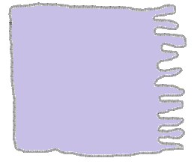
Vitamin A Absorption & Metabolism
Stellate
cells
RE
LRAT
CRBP I
Intestinal mucosal cells
(enterocytes)
retinol
liver
RBP
REHs
RE
Lymphatic
system
retinyl esters (RE)
Intestinal lumen
70%
Bloodstream
V
Bloodstream
chylomicrons
LRAT
animal products rich with vitamin A
RE
Retinol-RBP
RE
RE
retinol
retinyl esters
STRA6
Extrahepatic tissue
RE
CRBP II
30%
RE
RE
REHs
retinol
RE
CRBP II
retinol
retinol
retinol

Slide 36
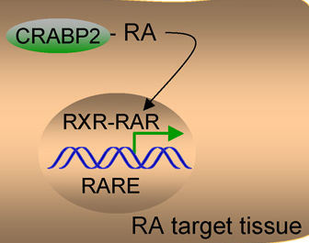
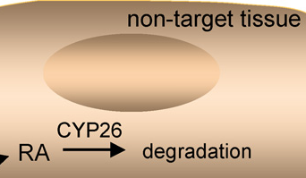
Vitamin A Absorption & Metabolism
Retinol-RBP
STRA6
Retinol dehydrogenases
RDHs
Retinal
Retinol
Retinaldehyde
dehydrogenases
(RALDHs)
CRBP
irreversible
retinyl ester
RA generating tissue
Retinoic acid (RA)

Slide 37
Vitamin A Absorption & Metabolism
REHs: retinyl ester hydrolases like pancreatic triglyceride lipase the main enzyme responsible for the REH activity in intestinal lumen and hepatic lipase enzyme in hepatocytes
LRAT: lecithin retinol acyl transferase
CRBPs: cellular retinol binding proteins like CRBPI ( ubiquitously expressed in tissues), CRBPII (primarily expressed in small intestine) and CRBPIII (predominantly expressed in adipose tissue, heart, muscle & mammary).
RBP: retinol binding protein
STRA6: stimulated by retinoic acid 6

Slide 38
Vitamin A Absorption & Metabolism
Retinol is stored in several tissues particularly liver (as retinyl esters).
Vitamin A is mobilized from liver stores and transported in plasma as retinol bound to a specific transport protein called retinol binding protein “RBP” (retinol is toxic, so, it is not let free and should be esterified or bound to RBP).
Nonspecific and unregulated delivery of retinoids to biological membranes can lead to vitamin A toxicity.

Slide 39
Physiological Roles of Vitamin A
Vision: Vitamin A is a component of photopigments (rhodopsin & Iodopsins) in which retinal (the visual active form of vitamin A) is bound to the protein opsin. These play an essential role in the conversion of light energy into nerve impulses at the retina
Gene transcription and embryonic development: this role is played by retinoic acid form of vitamin A. RA binds its nuclear receptor RAR to regulate the transcription of its target genes

Slide 40
Physiological Roles of Vitamin A
Therefore, RA influences the induction and patterning of some tissues at early stages of embryonic development
Studies showed that RA is essential for development of several organs such as hindbrain, spinal cord, heart, eye…etc.
Vitamin A is unique among the vitamins in that its concentration must be within a very narrow range in order to avoid both deficiency and toxicity
Adding vitamin A or RA to embryo can easily induce teratogenic effects including major alterations in organogenesis (i.e. congenital abnormalities or birth defects)

Slide 41
Physiological Roles of Vitamin A
Antioxidant: carotenoids like β-Carotene protect the body from free-radical damage to DNA and cells to prevent diseases like cancer.
Maintain skin health: vitamin A, and more specifically, retinoic acid, appears to maintain normal skin health by switching on genes and differentiating keratinocytes (immature skin cells) into mature epidermal cells. The retinoic drug isotretinoin (Ro-accutane®) is the most commonly prescribed agent for treatment of acne.
Reproduction: retinoic acid (RA) supports both male and female reproduction. RA plays a vital role during the spermatogenesis (the process of production of sperm cells). In females, vitamin A is important to maintain normal fertilization, implantation and to overcome fetal resorption or malformation

Slide 42
Physiological Roles of Vitamin A
Bone growth: vitamin A is important for healthy bones. However, excessive amounts of vitamin A have been linked to bone loss and an increase in the risk of hip fracture. Indeed, too much retinoic acid affects the process of bone remodeling because it:
activates bone resorption by increasing the number and activity of osteoclasts (the cells that break down bone).
decreases the growth of osteoblasts ( the cells that support bone growth)

Slide 43
Vitamin A Deficiency
Vitamin A is stored in the body so it would take a year or more to develop
a deficiency in the presence of inadequate intake.
Vitamin A deficiency (Hypovitaminosis A):
Infectious diseases due to impaired immunity
Night Blindness (Nyctalopia ): patient cannot see in dim/low light or
near darkness conditions. Nyctalopia is first detectable sign of
vitamin A deficiency.
Complete blindness in severe deficiency.
Xerophthalmia: dryness of the conjunctiva and cornea. If untreated, it can
lead to corneal ulceration and keratomalacia ( softening and necrosis of
the cornea due to severe VAD)
Keratinization of the skin: changes in epithelial cells results in
keratinization, rough dry and scaly skin.

Slide 44
Vitamin A Toxicity
Vitamin A toxicity (Hypervitaminosis A): can occur with
concentrated amounts of vitamin A from animal foods,
fortified foods, or supplements or consuming excessive
amounts of β-carotene from supplements.
Bone defects: increased activity of osteoclasts causes
weakened bones and contributes to osteoporosis and fractures
Birth defects: abnormal fetal development and malformation.

