Slide 1
Case Discussion
Associate Professor of Chest Diseases
Dr.Samah Shehata

Slide 2
Case I
A 63-year-old man presented with a 2-month history of increasing breathlessness and could only walk at a slow pace on the level.
On examination he showed:
Reduced chest movement on the Left
Reduced tactile vocal fremitus
Stony dullness to percussion
Reduced breath sounds
Apex beat in anterior axillary line

Slide 3
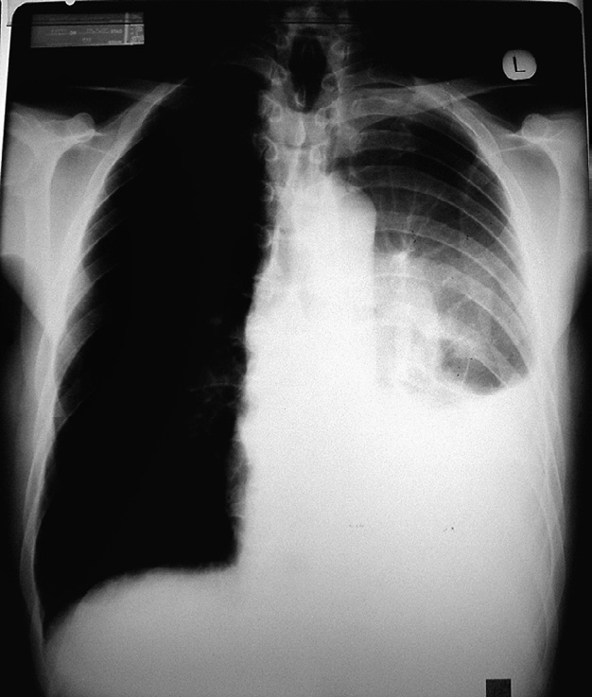

Slide 4
Chest X-ray
showing a left pleural effusion and a hilar mass.

Slide 5
What will you do next?

Slide 6
A diagnostic aspiration was performed after procedure was explained to the patient and consent obtained.
The pleural fluid was sent to the laboratory for:
● Protein/LDH
● Cell count
● Culture including TB
● Cytology for malignant cells.

Slide 7
What are the criteria of pleural analysis suggestive of…….??? Malignancy Tuberculosis

Slide 9
If the diagnosis had not been obtained on the aspirate, what is Next???

Slide 10
Chest CT with contrast.
Biopsy:
Pleural CT-guided,Thoracoscopy
Endobronchial lesion Bronchoscopy

Slide 11
Case II
A 73-year-old man was brought to ER by his wife.He had had winter bronchitis for the last 5 years and was a current smoker of 20 cigarettes/day.
One week ago he had the ‘flu’ and this morning became increasingly breathless, sweaty, pale and confused. He had had a diagnosis of angina made 2 years ago.
RR > 30/min, BP 110/40

Slide 12
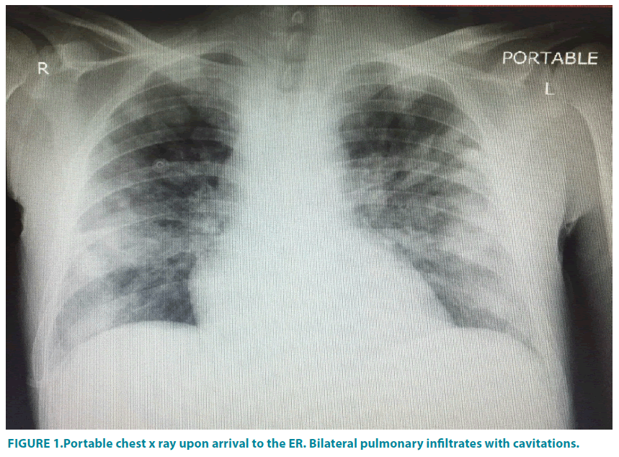

Slide 13
How to assess the severity of pneumonia??
Where to treat the patient??

Slide 14
What is the next investigation??

Slide 15
Urea 9 mmol/L
WBC 28 000 with neutrophilia
ABG (on room air)
pH 7.51
PCO2 29.3 mmHg
PO2 67.0 mmHg
Bicarb 25.0 mmol/L
SO2 91.7%
Sputum culture

Slide 16
What is the treatment??

Slide 20
6 hours after ICU admission,
Arterial blood gas On 10 L O2
pH 7.21
PCO2 46 mmHg
PO2 66 mmHg
Bicarb 17.2 mmol/L
SO2 90.3%
Lactate 4.9 mmol/L (0.4–1.5)

Slide 21
What is your decision according to previous ABG?

Slide 23
Case III

Slide 24
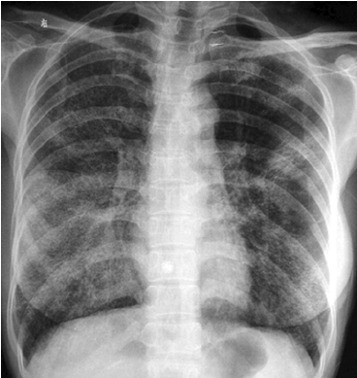

Slide 27
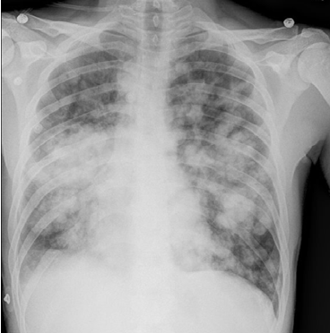
Bilateral airspaces opacities

Slide 28
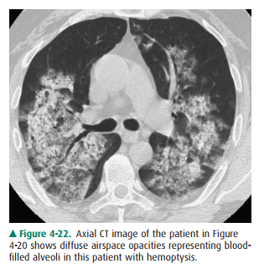

Slide 31
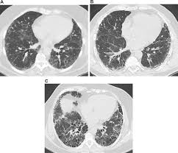

Slide 32
