Slide 1
وسهلا
أهلا
الأستاذ الدكتور/ يوسف حسين
أستاذ التشريح وعلم الأجنة
سلايدات اللاب ^^

Slide 2
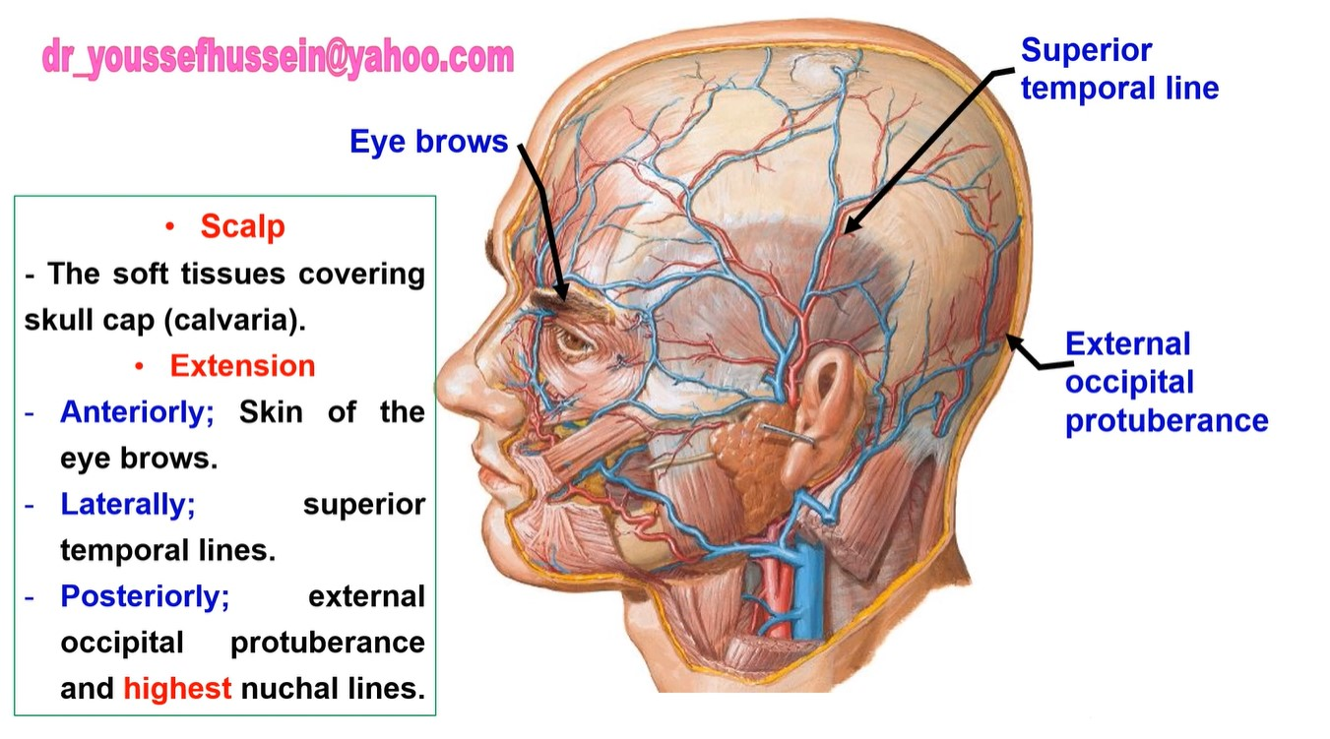

Slide 3
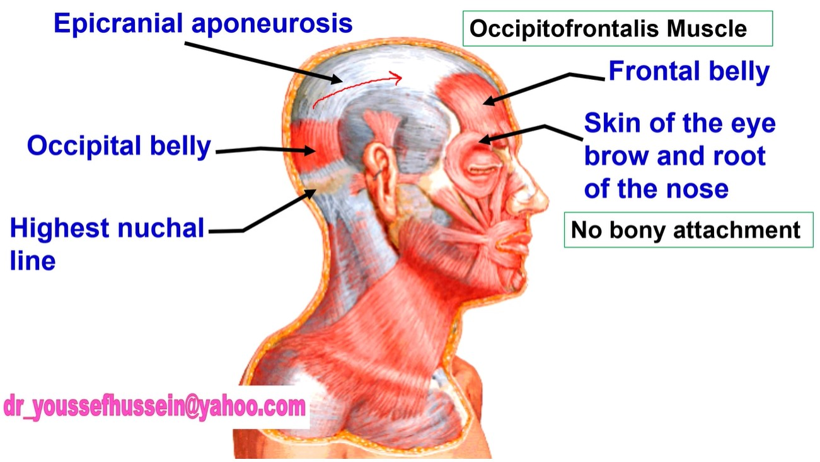

Slide 4
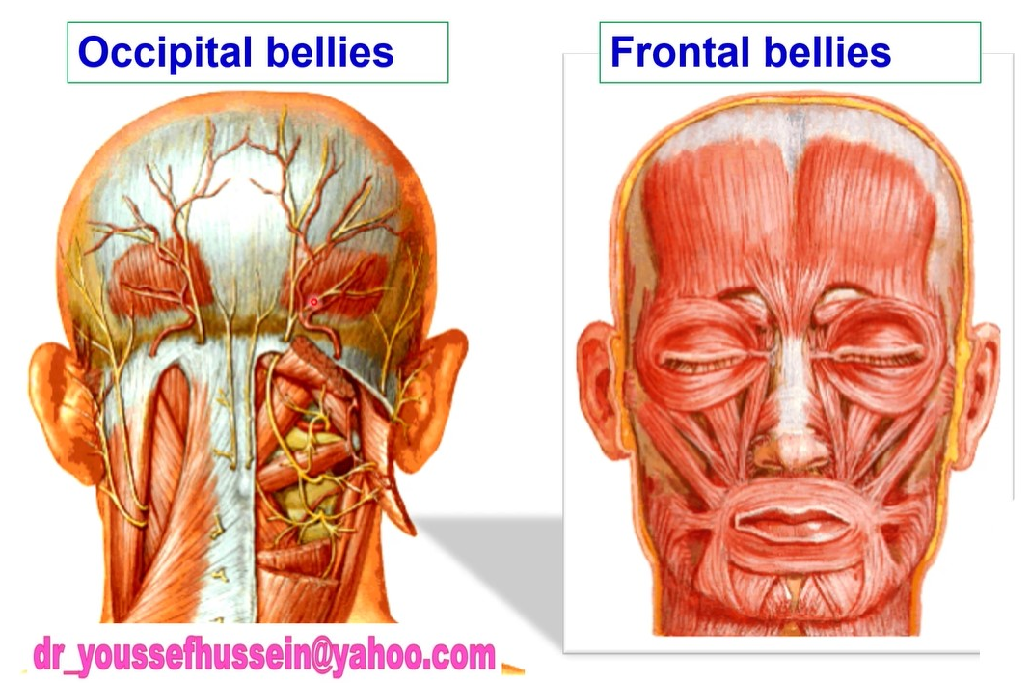

Slide 6
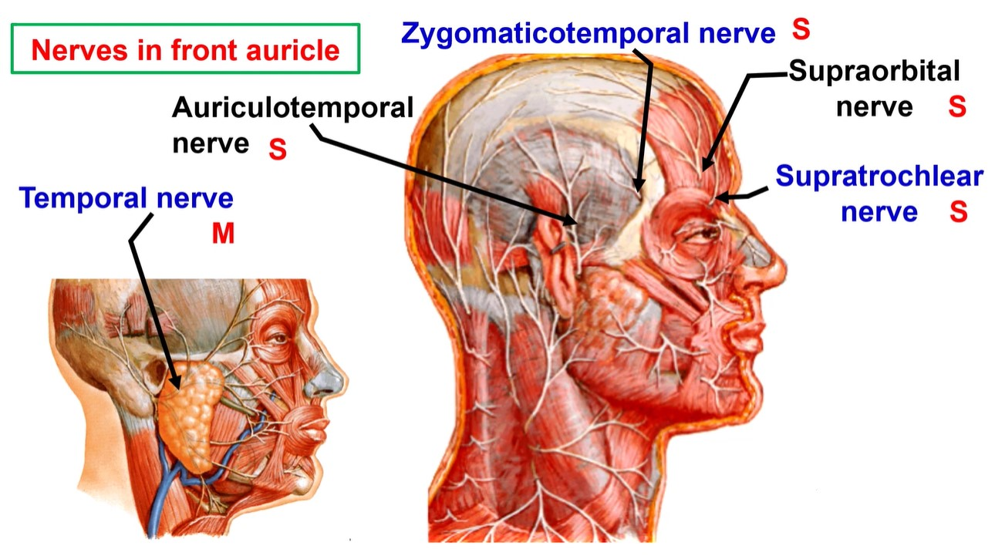

Slide 7
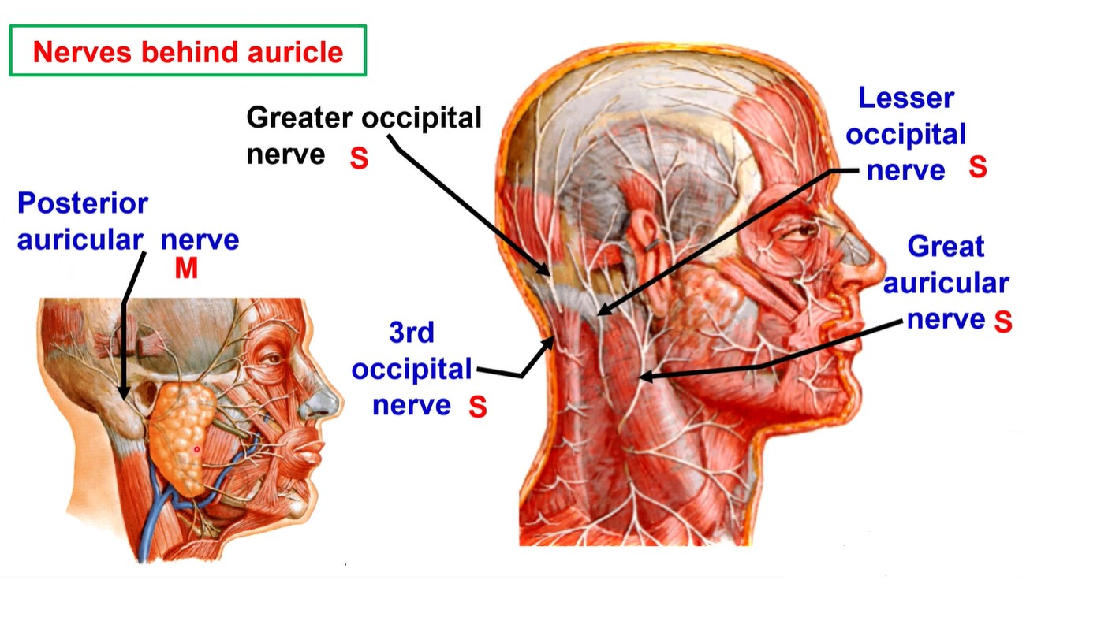

Slide 8
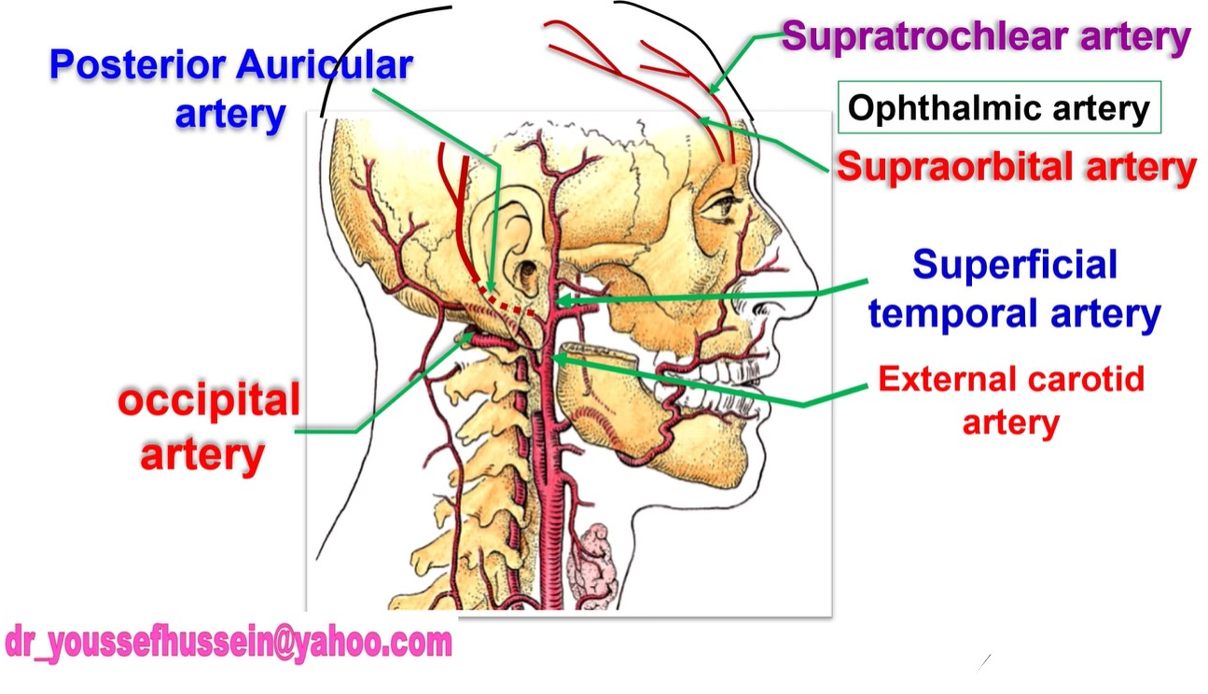

Slide 10
Posterior auricular artery

Slide 11
occipital

Slide 12
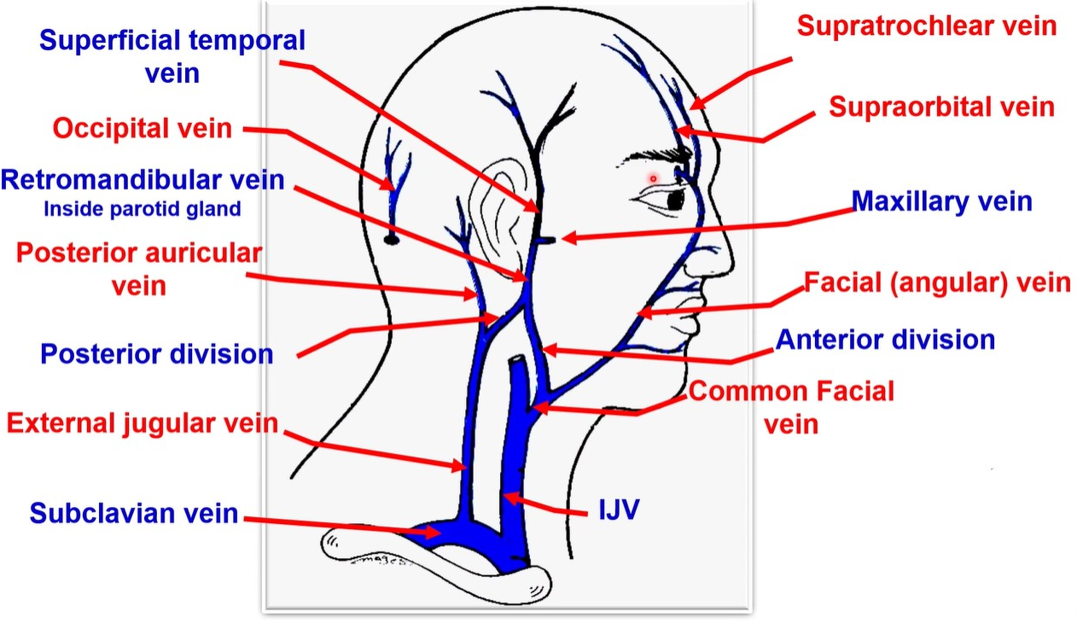

Slide 14
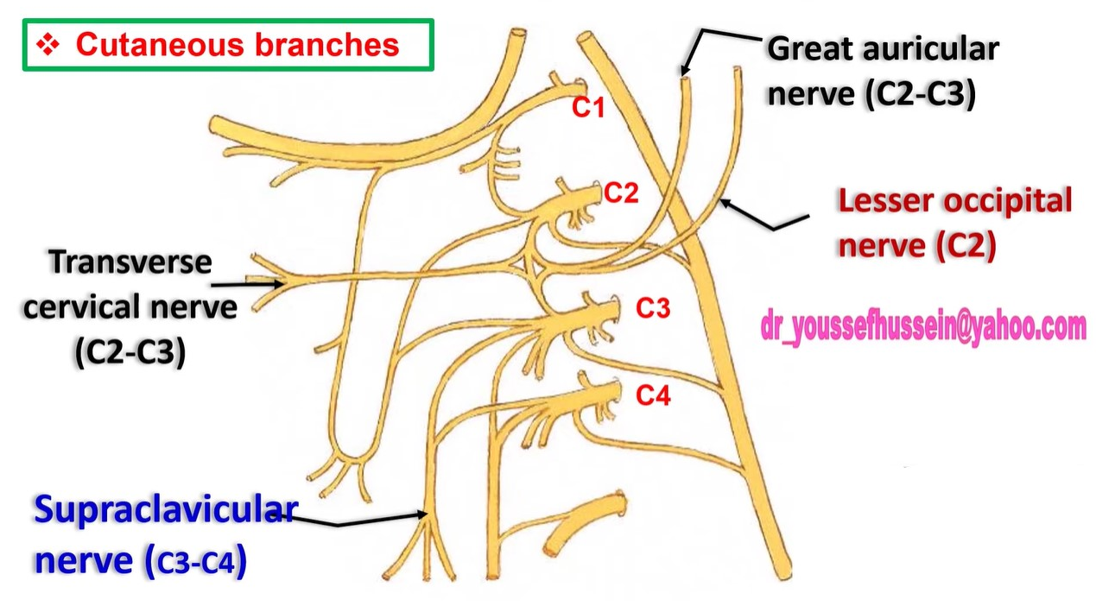

Slide 15
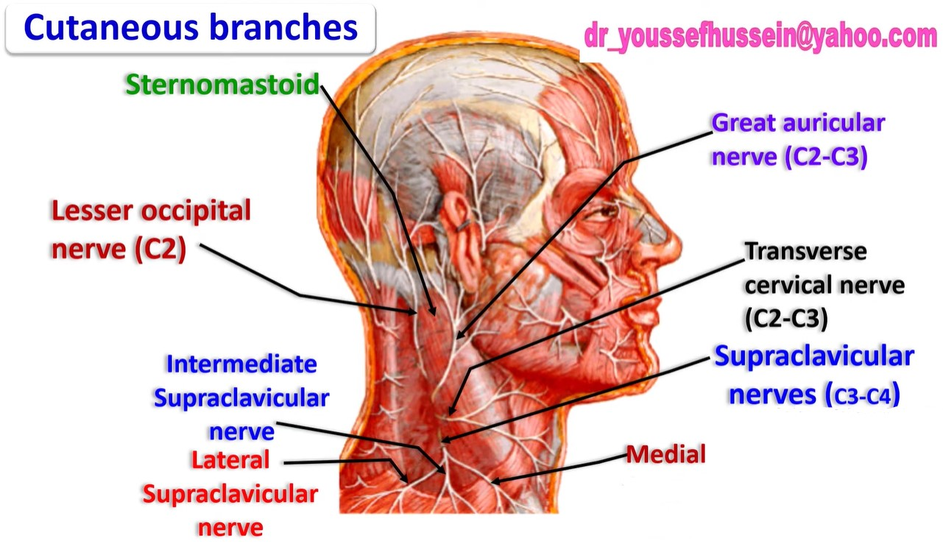
Supracalvicular
nerve

Slide 16
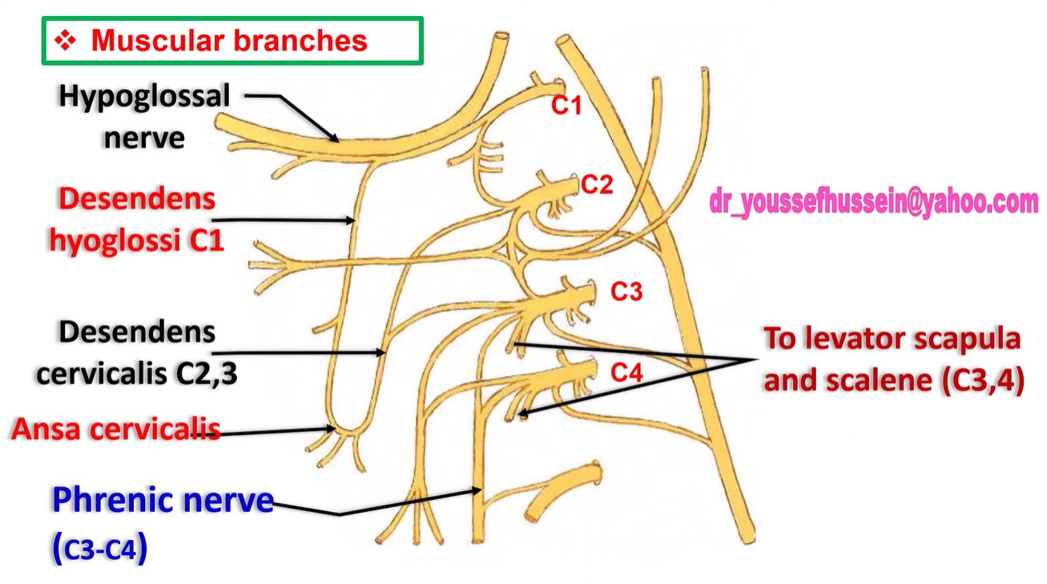

Slide 17
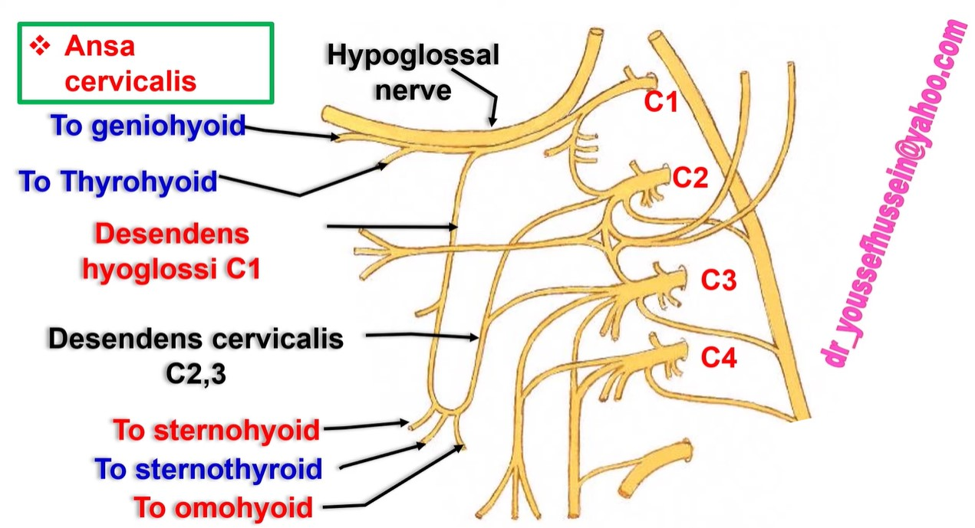

Slide 18
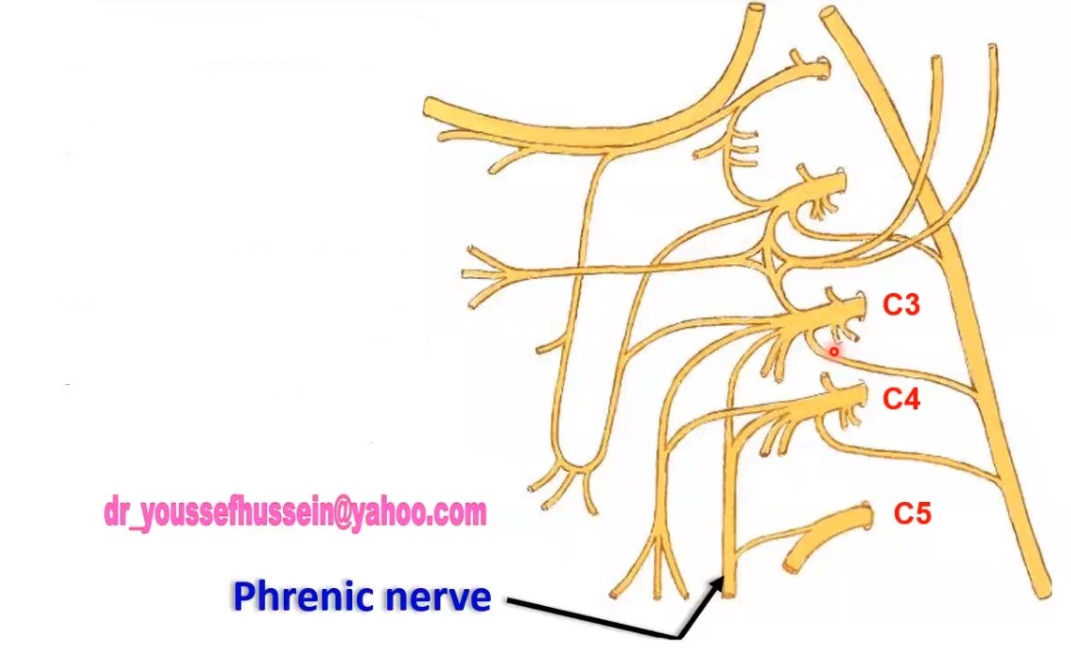
• Phrenic nerve is a mixed nerve.
• Roots, they arise from the ventral rami of C3, C4 and C5 (mainly from C 4).
• C3 and C4 from cervical plexus.
• C5 from brachial plexus.

Slide 19
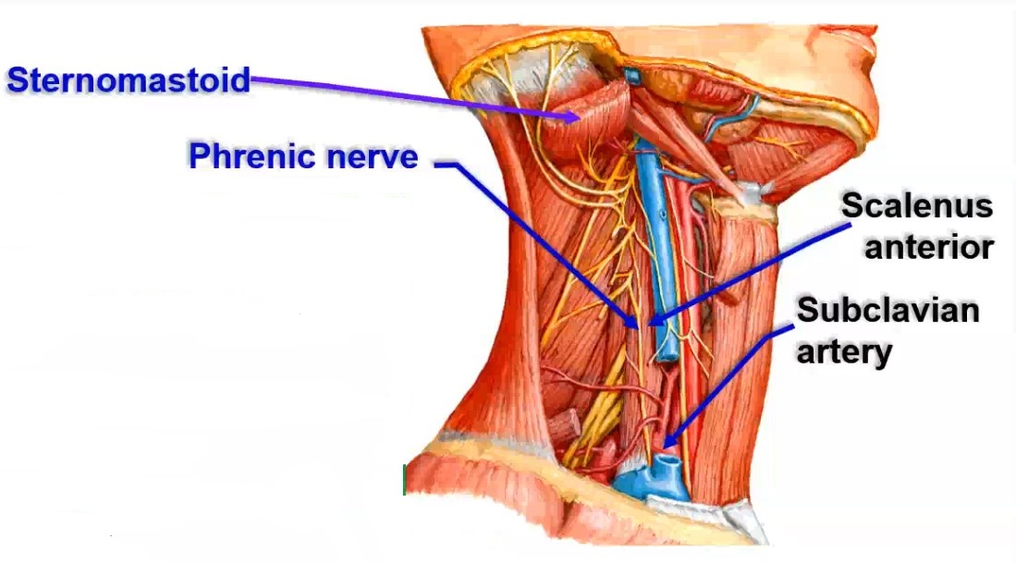

Slide 22
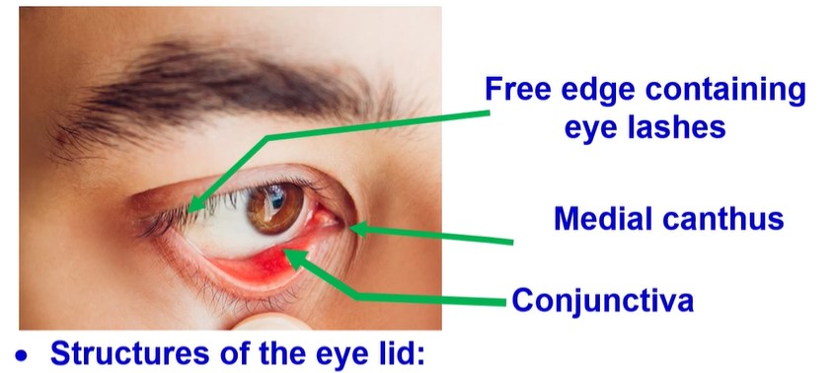

Slide 23
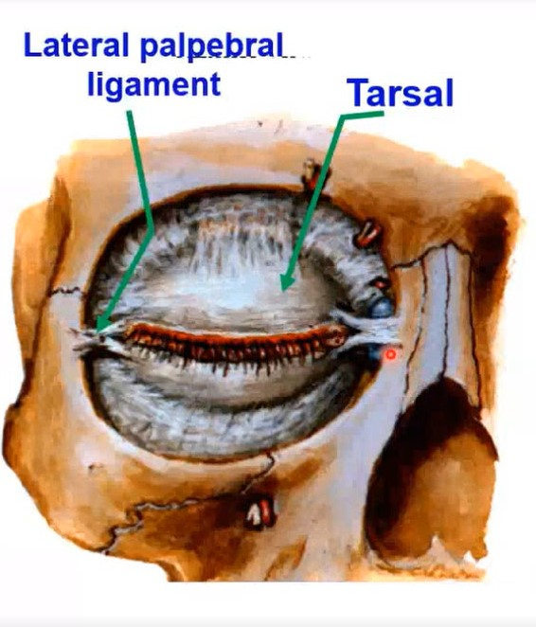

Slide 24
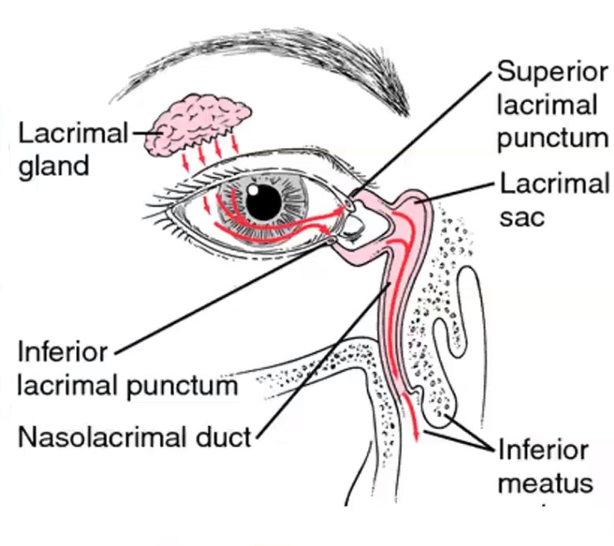

Slide 27
• Levator palpebrae superioris
• Origin: from the posterior part the roof of orbit just in front of the optic canal.
• Insertion: the muscle passes forwards below the roof and divides into 3 slips inserted into:
1) The skin of the upper eye lid.
2) The tarsus of the upper eye lid.
3) The upper fornix of conjunctiva

Slide 31
Occulomotor nerve
Point of crossing

Slide 32
Superior orbital fissure

Slide 34
Injury of the nerve
1- Paralysis of the levator palpebrae superioris leading to ptosis.
2- Squint by lateral rectus and superior oblique muscles

Slide 36
Trochlear nerve
Point of crossing
• It enters the orbit through superior orbital fissure outside tendinous ring to supply superior oblique muscle.

Slide 37
• Injury of the trochlear nerve
• Commonly presents as a squint or with the patient complaining diplopia of on looking downwards or at the end of the nose.

Slide 38
• ABDUCENT NERVE (6th)
• Nucleus, Motor nucleus in the pons.
• Exit: from the groove between the pons and the pyramid.
- It pierces dura at apex of the petrous part of the temporal bone.
- It enters cavernous sinus inferolateral to internal carotid artery.

Slide 39
• It enters the orbit through the superior orbital fissure inside the tendinous ring to supply the lateral rectus muscle.
• Injury of abducent nerve leading to medial squint.

Slide 40
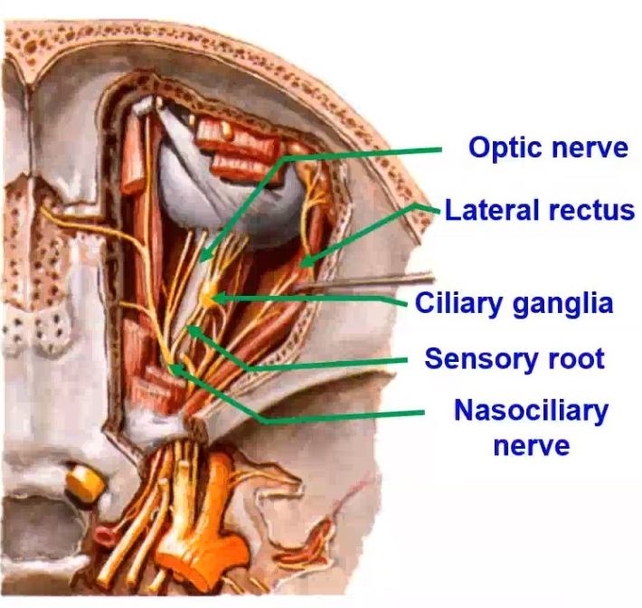

Slide 42
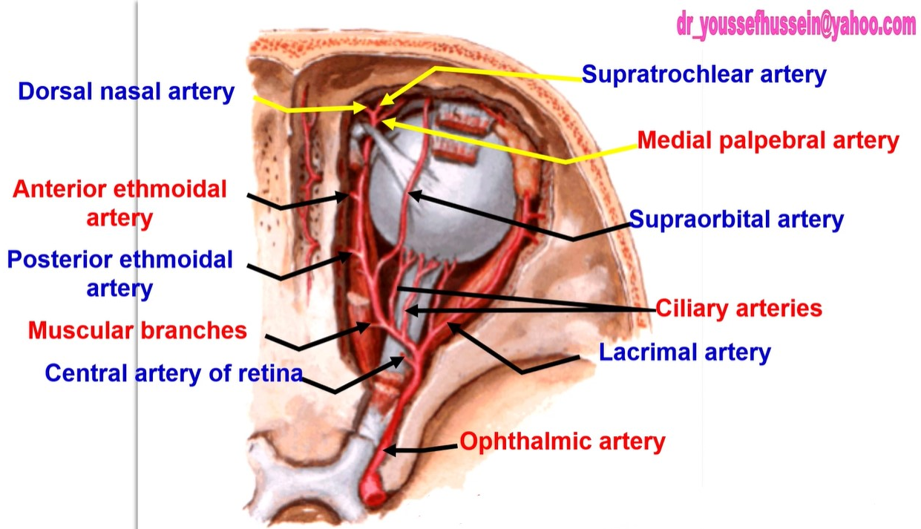

Slide 43
"وَالَّذِينَ [جَاهَدُوا] فِينَا
= لَنَهْدِيَنَّهُمْ سُبُلَنَا".

