Slide 1
Organized Archive
شامل لأسئلة سنوات حتى 09/March/2023

Slide 2
Intracranial pressure

Slide 3
Essay Questions
سنوات (3)
What is the CPP ?
Cerebral perfusion pressure = mean arterial blood pressure – intracranial pressure (avoid writing abbreviations)
What is the normal CBF with units ?
~50ml/100g/min
What is the normal amount of CSF produced daily ?
500-600
What the mechanism of early morning headache in intracranial hypertension ?
Co2 retention due to hypoventilation during sleep
Recumbent position during sleep decreases venous return
Cortisol level
سنوات (3)
سنوات (1)
سنوات (1)

Slide 4
Essay Questions
سنوات (3)
Mention 2 devices used in monitoring of ICP
Intraparenchymal catheter
Subdural catheter
Subdural bolt
Mention 2 Indications for ICP Monitor insertion
Head trauma
Closed head injury
Normal pressure hydrocephalus
Post brain tumor surgery or intracranial surgery
Mention 2 complications
Infection, Hemorrhage, CSF leak
سنوات (2)
سنوات (2)

Slide 5
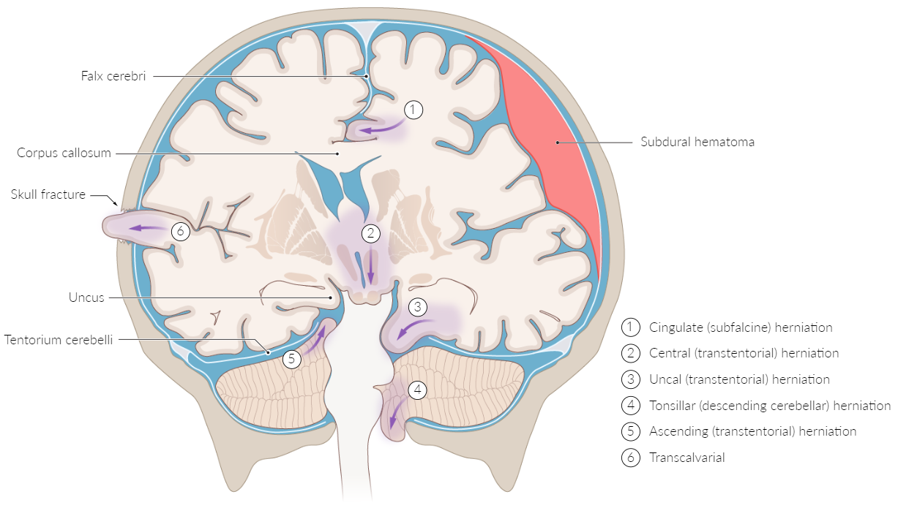
Essay Questions
سنوات (1)
Mention 2 types of brain herniation other than Chiari malformation
Subfalcine herniation
Descending transtentorial herniation
Foramen magnum herniation
What are the types of brain edema and the cause of each one ?
Vasogenic: due to tumors, it responds well to steroid
Cytotoxic: due to trauma

Slide 6
Lundberg Waves
سنوات (3)
What is the type of this wave ?
Lundberg Wave A ( if you don't write Lundberg the answer is WRONG)
What is the description of it?
Increase mean ICP > 50 mmHg
Lasting for 5-20 minutes
(these 2 points are enough)

Slide 7
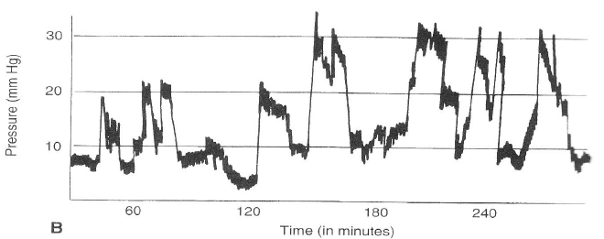
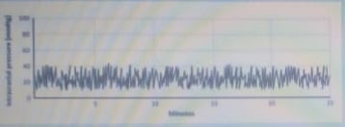
Lundberg Waves
سنوات (3)
What is the type of this wave ?
Lundberg Wave B ( if you don't write Lundberg the answer is WRONG)
What is the description of it?
Sharp, rhythmic increase ICP of (20-50) for 30s to 2 minutes
Mention 2 devices used for ICP monitoring
Intraventricular catheter, Extradural sensor, Subdural sensor

Slide 8
Hydrocephalus

Slide 9
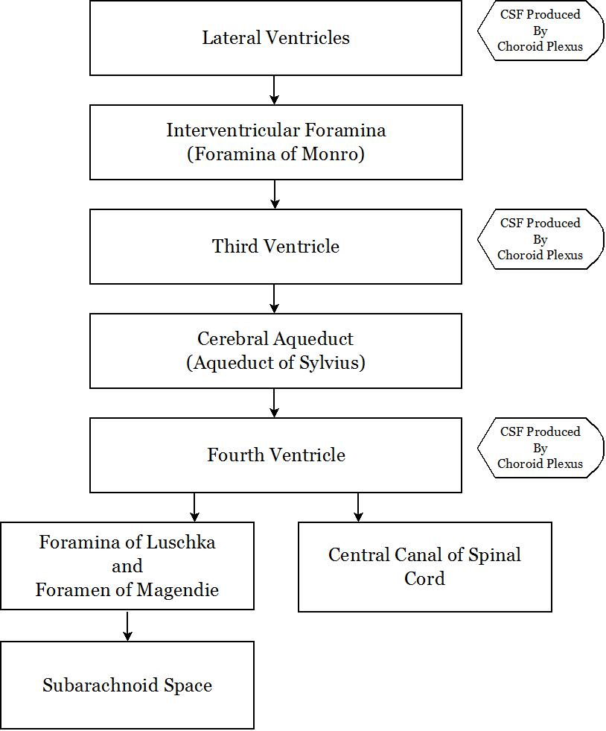
Write the pathway of CSF from secretion to absorption
سنوات (3)
Formed by choroid plexus (mainly) > Lateral ventricles > Foramen of Monroe > 3rd ventricle > Aqueduct of Sylvius > 4th ventricle > Foramen of Magendie and Luschka > Subarachnoid space over the brain and spinal cord > CSF is reabsorbed by arachnoids villi into the superior saggital sinus

Slide 10
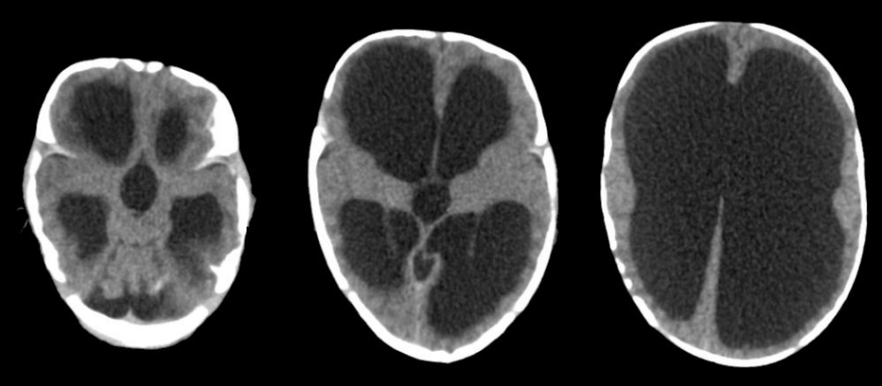
Hydrocephalus 1
سنوات (5)
What is your diagnosis ?
Hydrocephalus
What are the types ?
Communicating and obstructive
Mention 3 surgical procedures
Ventriculoperitoneal shunt
Endoscopic third ventriculostomy

Slide 11
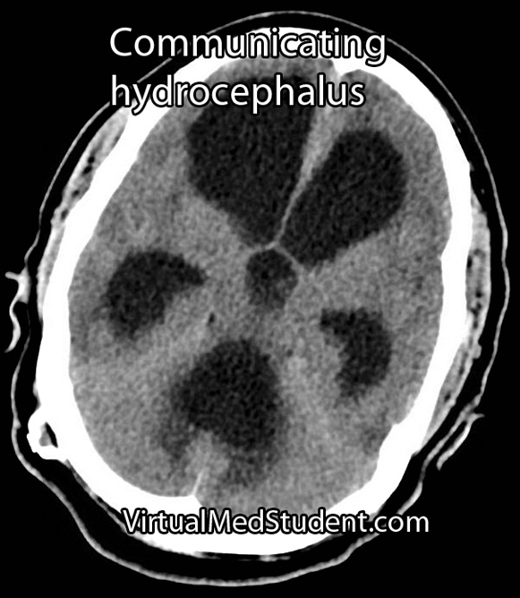
Hydrocephalus 2
سنوات (5)
What is the type of hydrocephalus ?
Communicating
Mention 2 possible causes
Infection
Subarachnoid hemorrhage
Mention 2 signs of acute hydrocephalus on CT scan
A. dilated ventricles
B. transepindymal edema
What is the appropriate management for this type ?
AP shunt

Slide 12
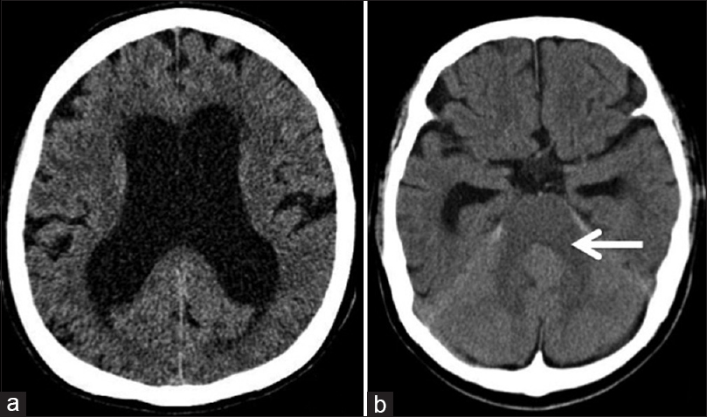
Hydrocephalus 4
سنوات (3)
What is the type of hydrocephalus seen in this image?
Obstructive

Slide 13
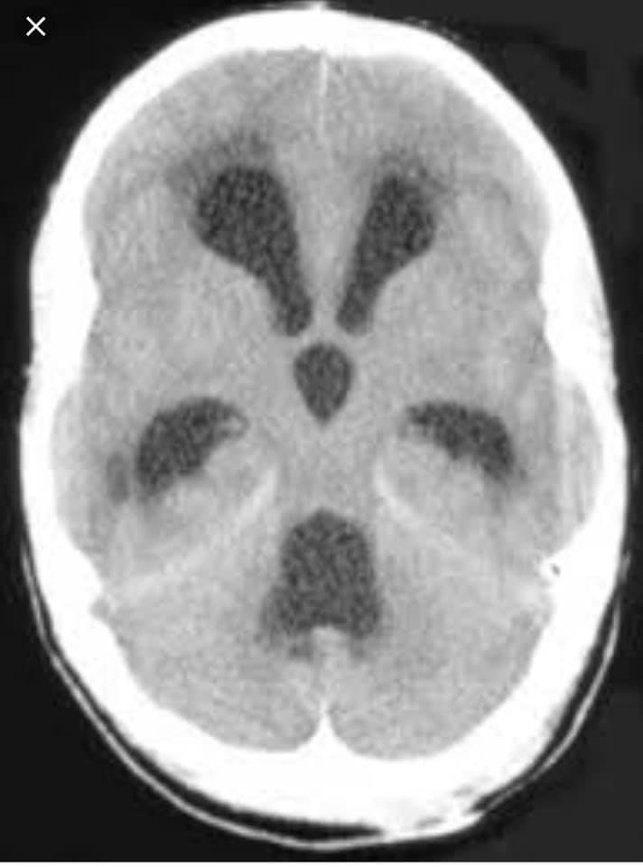
Hydrocephalus 5
سنوات (1)
What is the type of hydrocephalus seen in this image?
Communicating

Slide 14
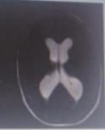
Hydrocephalus 6
سنوات (5)
Mention the entity classification of this picture and example on each one and treatment ?
Obstructive (tumor, aqudecut stenosis) treated by VP shunt and ETV
Communicating (infection and hemorrhage) treated by VP shunt

Slide 15
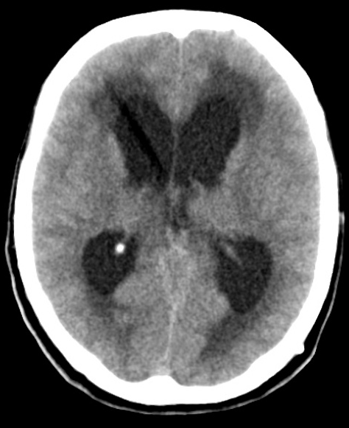
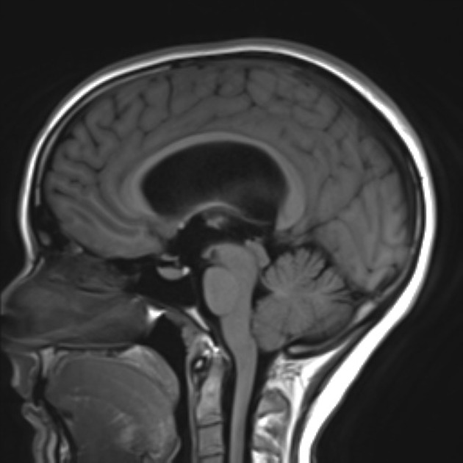
Hydrocephalus 7
سنوات (3)
What is the type of hydrocephalus seen in this image?
Obstructive (Aqueduct stenosis )
Management ?
ETV + shunt
Mention 2 signs of acute hydrocephalus in adult on CT scan
Dilated ventricles
Effacement of the sulci
Transepindymal edema

Slide 16
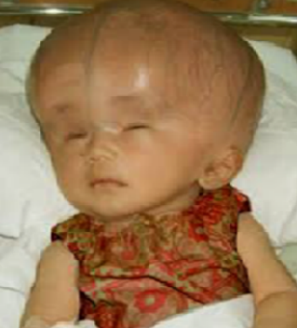
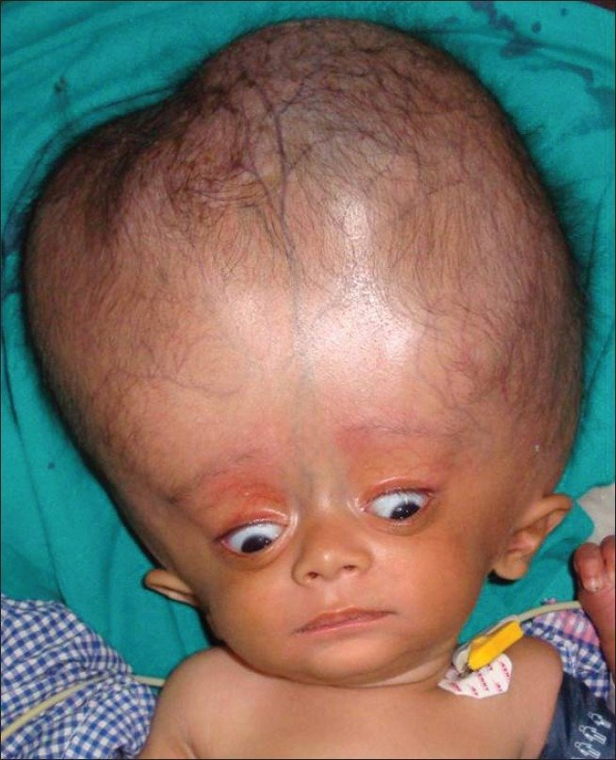
Infant’s Hydrocephalus
تجميعة سنوات
سنوات (10)
What is your diagnosis ?
Hydrocephalus
Mention 4 radiological signs
Dilated ventricles, Effacement of sulci, Periventricular edema, Evans ratio > 30%
Mention 2 solid clinical signs
Sun setting eye sign, Dilated superficial veins & macrocephaly
Mention 2 symptoms
Headache, nausea, and vomiting
Mention 2 signs seen in adults
Papilledema, Abnormal gait
سنوات (10)
سنوات (7)
سنوات (1)
سنوات (2)

Slide 17
Infant’s Hydrocephalus cont.
تجميعة سنوات
سنوات (6)
Mention 3 surgical procedures
Ventriculoperitoneal shunt
Endoscopic third ventriculostomy
Mention one single definite clinical manifestation for hydrocephalus in adults
No idea ☺
Mention a possible associated anomaly
Chiari malformation
Myelomeningocele
Mention 2 possible causes
Non-Communicating (Aqueductal stenosis)
Communicating (Infection)
سنوات (2)
سنوات (2)
سنوات (3)

Slide 18
Infant’s Hydrocephalus cont.
تجميعة سنوات
سنوات (2)
What is the mechanism of the sunset eyes
Results from compression of the tectum, including the superior colliculus, adjacent oculomotor and Edinger-Westphal nuclei, causing dysfunction to the motor function of the eye

Slide 19
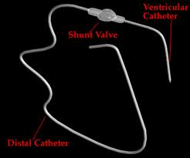
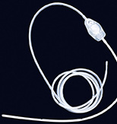
Infant’s Hydrocephalus 2
Mention 2 sign in the pic 1
increase skull circumference
setting sun eyes
less craniofacial proportion
What do you see in pic 2 ?
VP shunt
What are the complications of pic 2 ?
Infection
Hemorrhage
Blockage
سنوات (3)

Slide 20
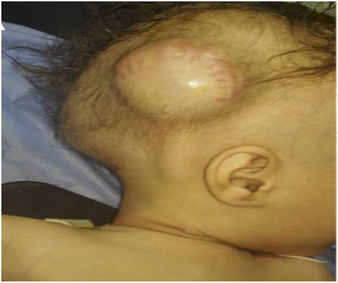
Ventriculoperitoneal shunt
سنوات (1)
A 3 months old child with VP, came with irritability, decreased oral intake. Vitals are stable, head circumference 45 cm
What is your diagnosis ?
VP shunt blockage
What is the most common cause of hydrocephalus for this patient ?
Aqueductal stenosis
Mention 4 signs of hydrocephalus can be present in this patient
Macrocephaly, Tense fontanelle, Setting sun sign, Irritability, Developmental delays
What investigations to be done ?
Ultrasound through the anterior fontanelle

Slide 21
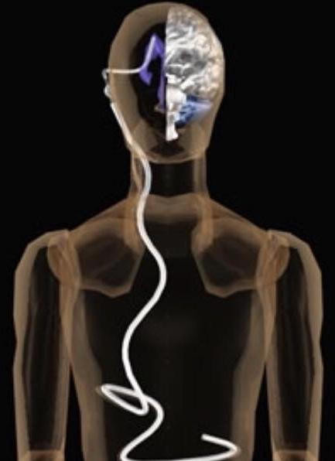
Ventriculoperitoneal shunt
سنوات (1)
What is this ?
Ventriculoperitoneal shunt
Mention 3 complications of it
Infection
Hemorrhage
Blockage

Slide 22
Endoscopic third ventriculostomy (ETV)
سنوات (5)
What is the site of fenestration in this procedure ?
The floor of 3rd ventricle
What is the affected artery ?
Basilar artery

Slide 23
Normal pressure hydrocephalus
سنوات (2)
Write the triad of normal pressure hydrocephalus ?
Incontinence
Dementia
Ataxia
What is the definitive treatment ?
ventriculoperitoneal shunt
Which the first symptom improves after treatment ?
Ataxia

Slide 24
Case Scenario
سنوات (1)
57-year-old male, complaining of incontinence, family says he has dementia, and physical exam shows ataxic gait
What is the diagnosis?
normal pressure hydrocephalus
What is the definitive treatment?
ventriculoperitoneal shunt

Slide 25
Case Scenario
سنوات (1)
A 43-year-old male pt come to ER with ataxia,dementia, urine incontinence, tachycardia, with B.PR:90/50 and he doesn’t take medication, what is your diagnosis?
What is the diagnosis?
normal pressure hydrocephalus
What is the definitive treatment?
ventriculoperitoneal shunt

Slide 26
Essay Question
سنوات (1)
Types of hydrocephalus
Cause of each type
Management of hydrocephalus
Give 2 signs on head CT in acute hydrocephalus
سنوات (1)
سنوات (2)
سنوات (3)

Slide 27
Congenital anomalies

Slide 28
Essay Questions
Mention 4 congenital anomalies (related to CNS abnormality)
Aqueductal stenosis
Spina bifida
Chiari malformation
Dandy-walker malformation
Anencephaly
Arachnoid cysts

Slide 29
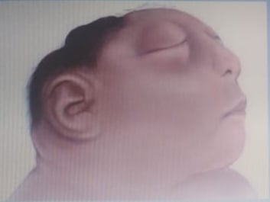
Anencephaly
سنوات (1)
What is your spot diagnosis ?
Anencephaly
How can you prevent it ?
4 mg of folic acid daily, started 3 months before conception

Slide 30
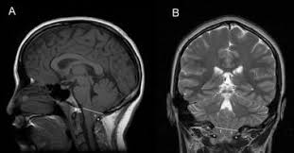
Chiari malformation 1
سنوات (1)
What is your DX ?
Chiari type 1 malformation
T stands for cerebellar tonsils

Slide 31
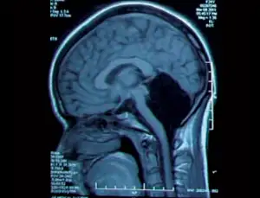
Chiari malformation 2
سنوات (1)
What is malformation shown in this MRI and what its type ?
Chiari malformation type 4
Give 2 differential diagnosis
Dandy walker malformation
Arachnoid cyst
Megacysterna magna

Slide 32
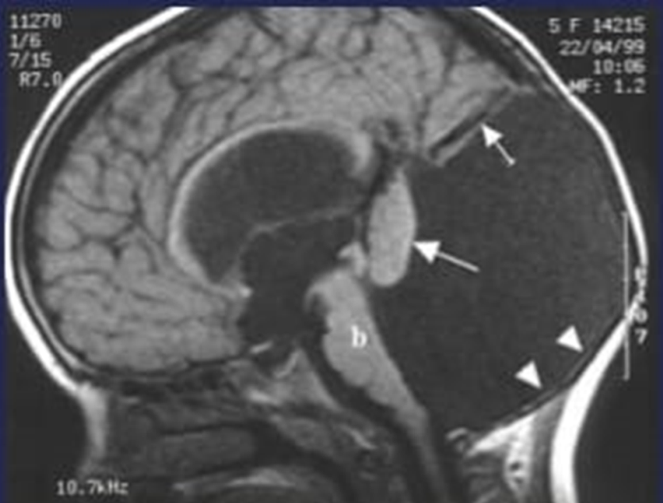
Dandy walker malformation
سنوات (2)
What is malformation shown in this MRI and what its type ?
Dandy walker malformation
Give 2 differential diagnosis
Arachnoid cyst
Chiari malformation type 4

Slide 33
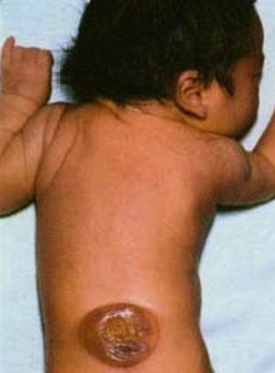
Myelomeningocele
سنوات (4)
What is your spot diagnosis ?
Myelomeningocele
How do you classify this pathology ?
Occulta, Aperta, cystica, open
What is your next step of management ?
Surgical excision
Mention 2 pathologies this disease is usually associated with
Chiara 2 malformation
Hydrocephalus

Slide 34
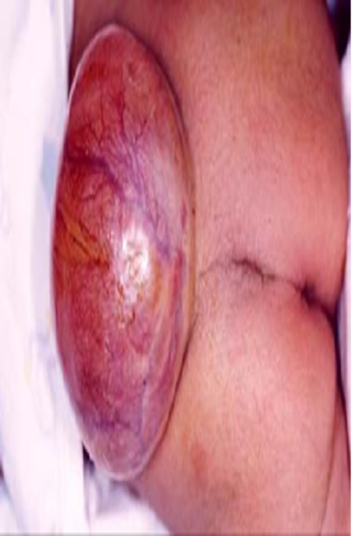
Myelomeningocele
سنوات (9)
What is your spot diagnosis ?
Myelomeningocele
What is your next step of management ?
Surgical excision
Mention 3 advantages of treatment
Prevent infection
For cosmetic causes
Prevent neurological deterioration (But do not improve or correct it)
Which type of Chiari malformation is it associated with ?
Chiara 2 malformation

Slide 35
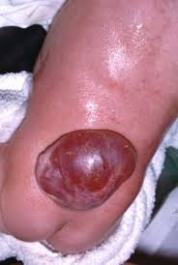
Myelomeningocele
سنوات (5)
Pregnant women deliver the child in the picture, he suffer from urinary incontinence and lower limb weakness, transillumination was positive on Examination
What is your spot diagnosis ?
Myelomeningocele
What is the dose of folic acid in the next pregnancy and when she should start it ?
4 mg daily, started 3 months before conception
What is the aim of treatment ?
Prevent infection
For cosmetic causes
Prevent neurological deterioration (But do not improve or correct it)

Slide 36
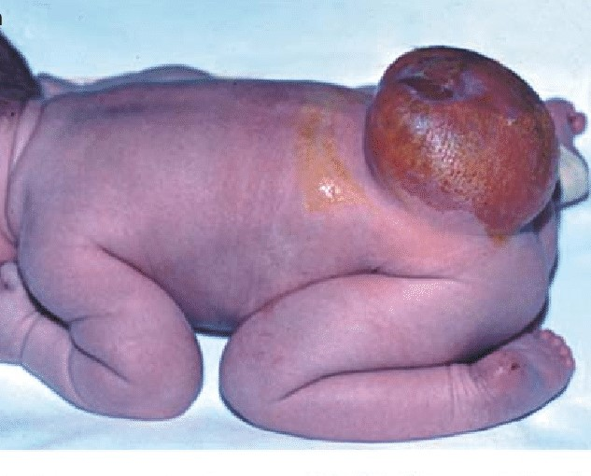
Myelomeningocele
سنوات (5)
What is your spot diagnosis ?
Myelomeningocele
What is your next step ?
Physical examination (transillumination text, neurological exam)
What is the site of the lesion?
Limbo-sacral
When does the posterior neuropore closes ?
By 28 days
Neural tube defects arise due to failure of the neuropores to fuse by the 4th week of pregnancy

Slide 37
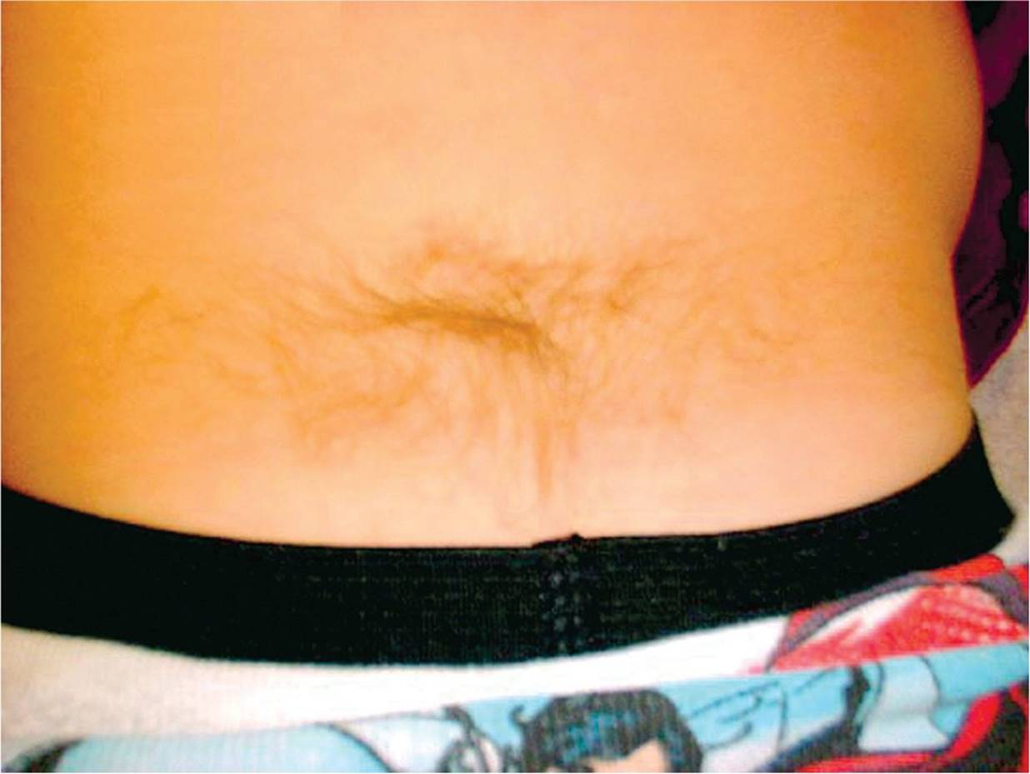
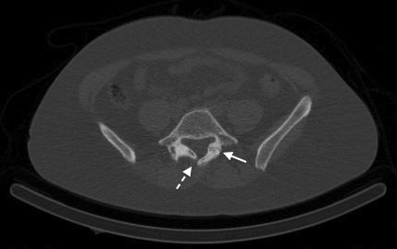
Spina bifida occulta
سنوات (2)
سنوات (1)
What is this sign ?
Hair tuft
What it’s clinical importance ?
It indicate spina bifida occulta
سنوات (1)
What is your spot diagnosis ?
Spina bifida occulta

Slide 38
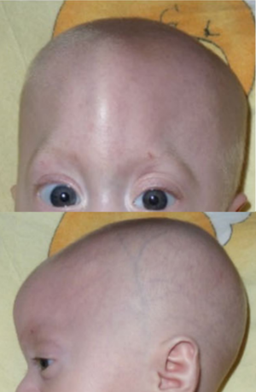
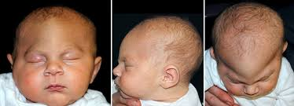
Trigonocephaly
سنوات (4)
What is your spot diagnosis ?
Trigonocephaly
Which suture is affected ?
Metopic suture

Slide 39
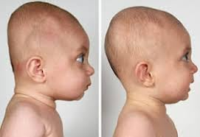
Brachycephaly
سنوات (1)
What is your spot diagnosis ?
Brachycephaly
Which suture is affected ?
lambdoid sutures

Slide 40
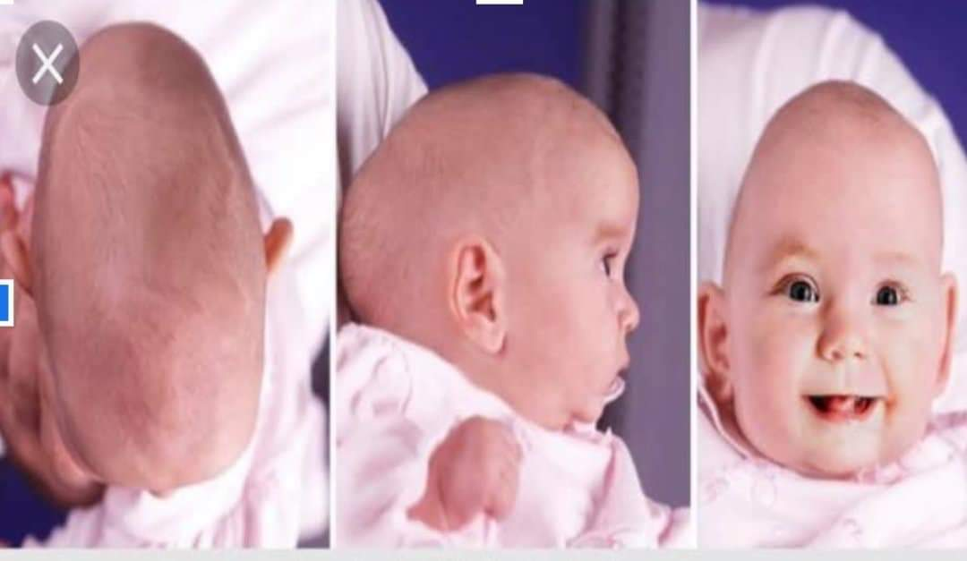
Scaphocephaly
سنوات (4)
What is your spot diagnosis ?
Scaphocephaly
Which suture is affected ?
Sagittal suture

Slide 41
Craniosynostosis
These answers apply to all craniosynostosis
سنوات (1)
What is the name of this anomaly ?
Trigonocephaly
What is the preferred imaging and why ?
Cranial CT (with 3D reconstruction)
To assess extent of CS
To identify hydrocephalus
Helps plan surgical reconstruction
What is the treatment and at what age ?
Strip craniectomy or cranial vault remodeling
Timing: controversial; mostly recommended at 3–9 months of age
Mention one goal for the treatment
To minimize cerebral constriction
For cosmetic reasons

Slide 42
Head injury

Slide 43
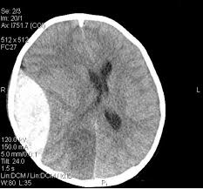
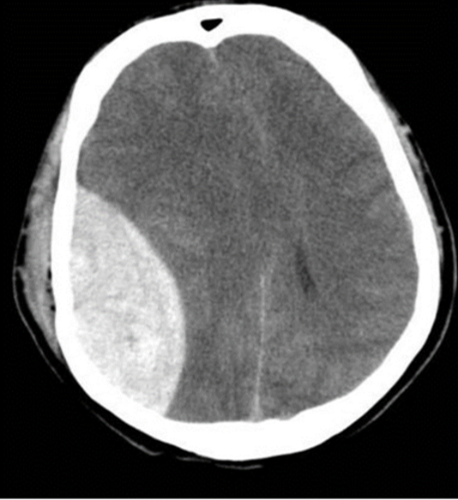
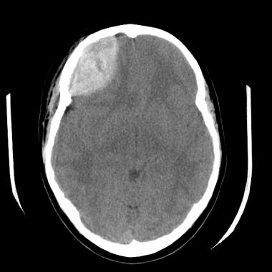
Epidural hematoma
سنوات (17)
What is your diagnosis ?
Acute epidural hematoma
What is the definitive management ?
Craniotomy and evacuation
Which vessel is affected ?
Middle meningeal artery
What are the findings
Non-contrast enhanced brain CT, axial view, that shows a lenticular shaped hyperdensity over the right frontal with mass effects in the form of effaced brain sulci and compressed frontal horn of the right lateral ventricle with minimal midline shift to the left

Slide 44
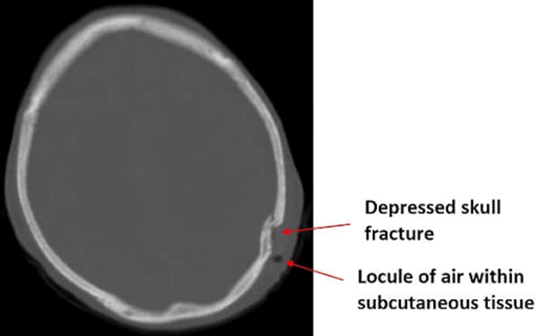
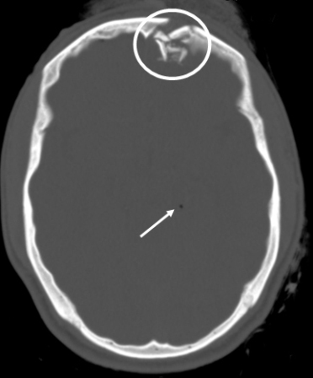
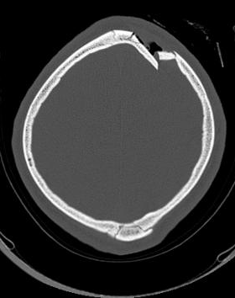
Depressed skull fracture
سنوات (11)
What is your spot diagnosis ?
Depressed skull fracture
What is the management ?
Surgical elevation
Mention 2 indications for surgery
Cosmetic disfigurement
Depressed more than 1 cm
Presence of neurological deficits
CSF leakage
Seizures
سنوات (6)
سنوات (2)
سنوات (3)

Slide 45
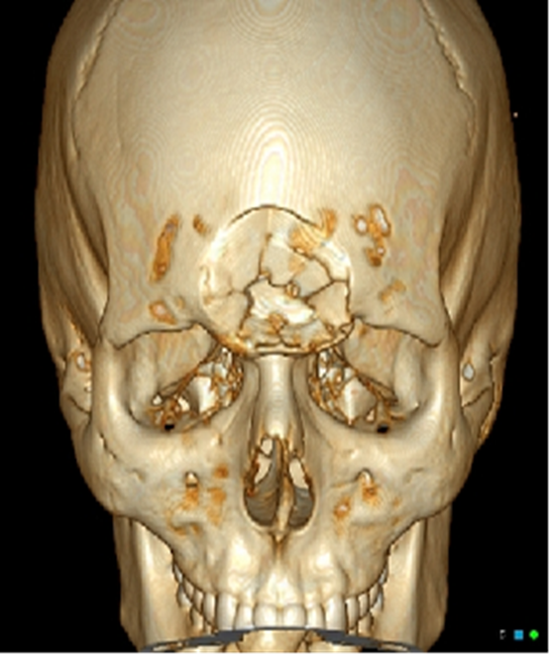
Depressed skull fracture
سنوات (5)
What is your spot diagnosis ?
Depressed skull fracture
What is the management ?
Surgical elevation
Mention 3 absolute indications for surgery
Focal Neurological signs
CSF leak
Overlying an eloquent area of the brain

Slide 46
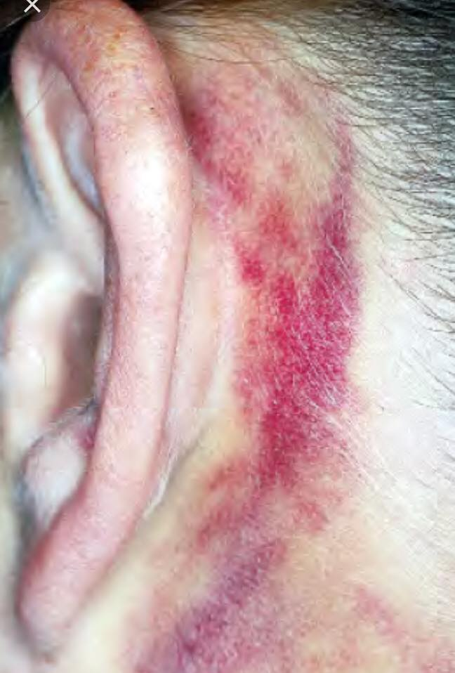
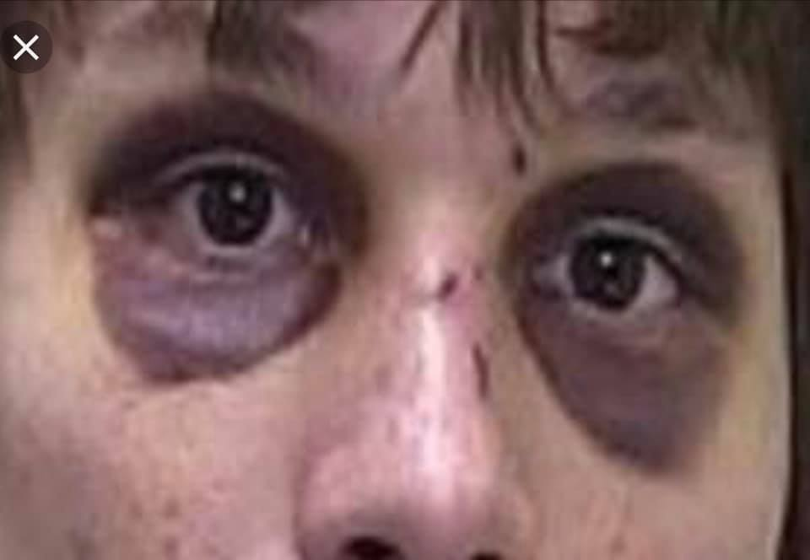
Basal skull fracture
سنوات (4)
What is the name of this sign ?
Battle’s sign
Raccoon eyes
What does this sign indicate ?
Basal skull fracture
a
b

Slide 47
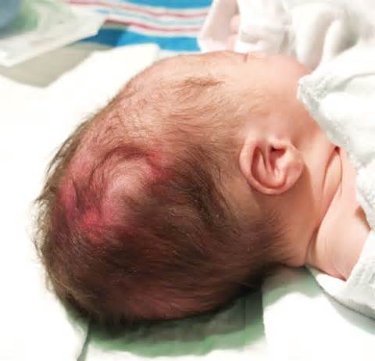
Case scenario
A case of scalp swelling after delivery (hint: by palpation the lumb was soft not firm)
What is your diagnosis ?
Subgaleal hematoma

Slide 48
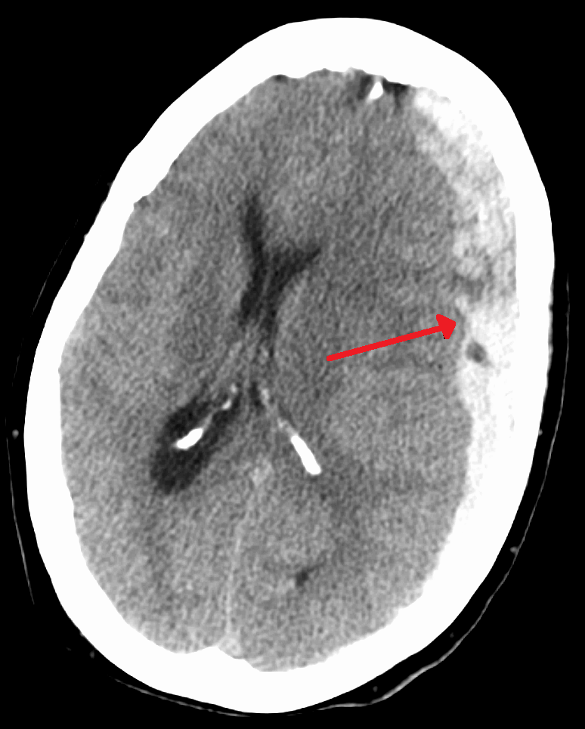
Acute subdural hemorrhage
سنوات (9)
What is your diagnosis ?
Left frontoparietal acute subdural hemorrhage
Mention 2 differential diagnosis for this finding
Brain hemorrhagic contusion
What is your management ?
Craniotomy and evacuation
If this patient came to the ER, opens eyes to painful stimulus, incomprehensive sounds, flexion to painful stimuli
What is your initial management in the ER ?
What is the GCS for this patient ?
What is the severity of the injury according to GCS ?

Slide 49
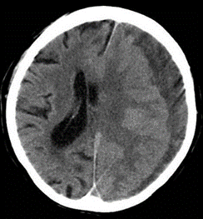
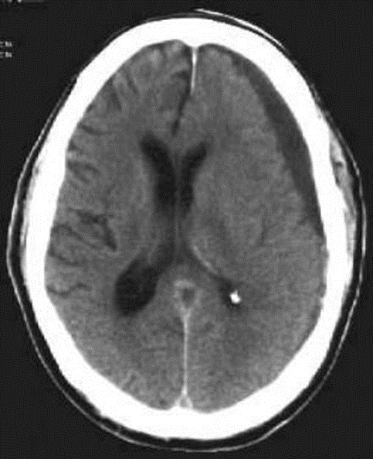
Chronic subdural hemorrhage
سنوات (9)
What is the diagnosis ?
Left side chronic subdural hemorrhage
What is the treatment ?
Burr holes
Acute: Craniotomy and evacuation
Chronic: Burr holes
Is there a midline shift ?
Yes
What is the timing ?
>14 days

Slide 50
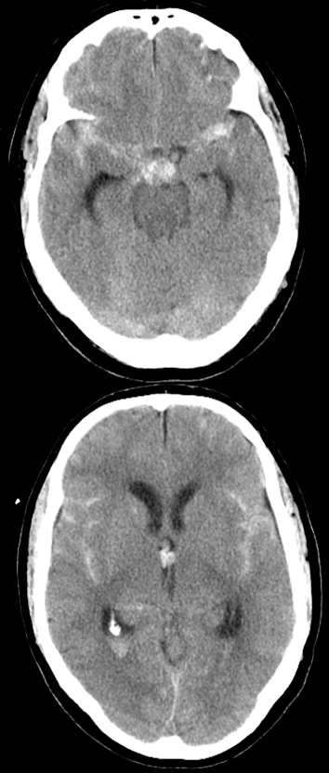
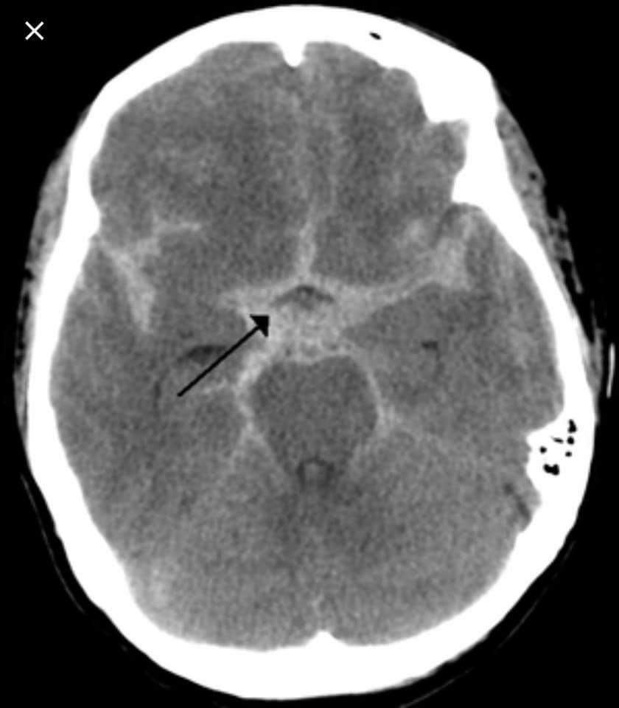
Subarachnoid hemorrhage
سنوات (3)
What is your diagnosis ?
Acute spontaneous SAH
If the CT scan was negative, what is the next step to confirm the diagnosis
Lumbar puncture
What is the gold standard investigation ?
Digital subtraction angiography
What are the possible causes ?
Ruptured arterial aneurysm
AV malformation
Mention 2 severity scale used
Hunt and his Fisher scale

Slide 51
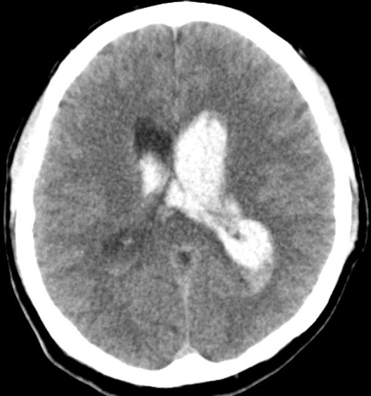
Intraventricular haemorrhage
سنوات (1)
What is your diagnosis ?
Intraventricular haemorrhage
Mention one complication for it ?
Hydrocephalus
How to treat ?
Drainage by extraventricular device

Slide 52
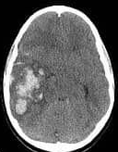
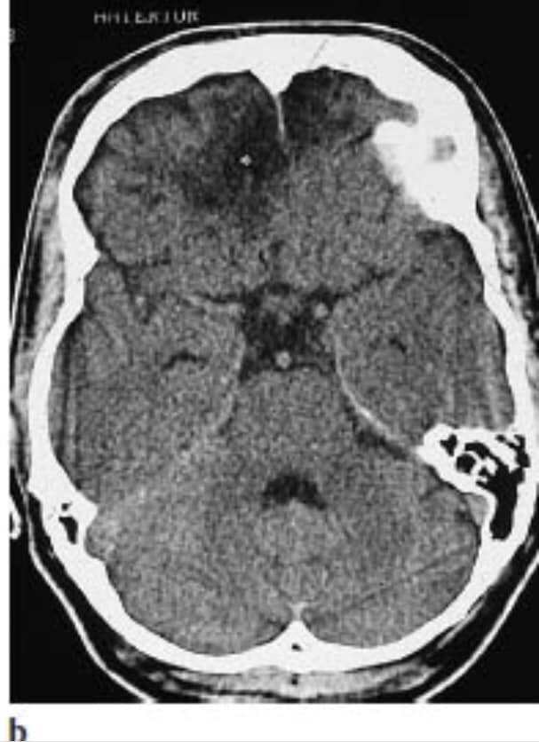
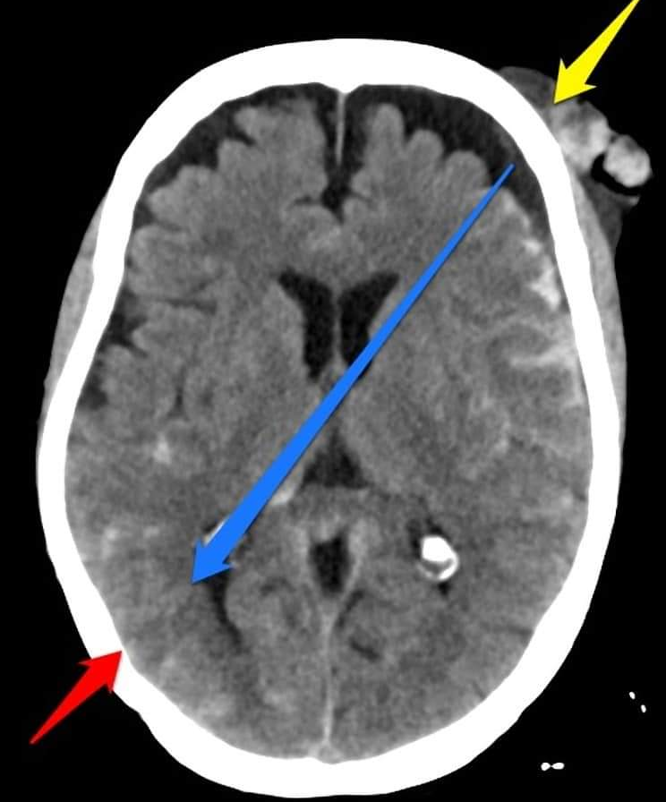
Acute hemorrhagic contusion
سنوات (3)
What is your interpretation
hyperdense area in the Rt parietal lobe
hyperdense area in the Lt temporal lobe
What is your diagnosis ?
Acute hemorrhagic contusion
A
B
What is th diagnosis according to these CT scan ?
Coup counter-coup hemorrhagic contusion

Slide 53
Glasgow coma scale
14-15>> mild
9-13>> moderate; next step: urgent CT head
3-8>> severe; next step: intubate
In case of tracheostomy, we add +T
Note: If you don't write /15 the answer is WRONG ☺

Slide 54
Calculate the GCS and determine the severity
Patient open eye to painful stimuli, inappropriate words, and decerebrate on both side
7/15, severe, management: intubation
Patient open only his left eye to painful stimuli, incomprehensible sounds, and localizes pain
9/15, moderate
Patient right eye is fixed dilated and don’t respond to light and the other eye response to pain, inappropriate words, and decerebrate on both side
7/15, severe, management: intubation
Patient open eyes to pain, incomprehensive sound, decerebrate right side, decorticate left side
7/15, severe, management: intubation

Slide 55
Calculate the GCS and determine the severity
Patient open eyes to speech, localize to pain, confused verbal response
12/15, moderate
Patient open his eyes to pain, localized to pain, confused and disoriented
11/15, moderate
Patient is permanent intubated, eyes open to pain, decerebrate, no verbal response
5/15+T, severe
Patient opens his eye to pain, inappropriate words, decorticate
8/15, severe, management: intubation
Patient opens his eye to pain, inappropriate words, decerebrate
7/15, severe, management: intubation

Slide 56
Calculate the GCS and determine the severity
Patient opens eyes to speech, confused, decerebrate right side and decorticate left side
10/15, moderate
Patient open his eyes to painful stimulus, produce words, moves to localized pain
10/15, moderate, management: urgent CT
Patient open only one of his yes to pain, one side withdraws from pain, the other side decorticate position, confused
10/15, moderate
Patient opens left eye spontaneously, incomprehensive sound, localize to pain right side, decorticate left side
11/15, moderate

Slide 57
Calculate the GCS and determine the severity
Patient with HTN and DM came to ER after RTA with direct trauma to head and orbital area with chest injury and hypotension, O2 sat 60%. Patient opens his eyes when the doctor calls him, obeys command, disoriented to time place and person
13/15, moderate
What is your next step ? Managing his airway
30 years old male patient came after falling down, His eyes do not respond to verbal or pain stimulations, produces sounds, extension of arms in response to pain and there is NO movement or sensation in lower limbs, on examination, doctor noticed bruises in his lower back, absent cremasteric reflex, anal examination reveals weak anal tone
5/15, severe, management: intubation

Slide 58
Calculate the GCS and determine the severity
A 55-year-old patient with a history of laryngeal tumor and permanent tracheostomy presented to the ER after falling down from the 3rd floor. Physical examination revealed a fixed dilated right pupil, eye opening after painful stimulation and decerebrate posture to painful stimulus
5/15+T, severe, next step: intubation
A 30-year-old male with a history of laryngeal cancer and permanent tracheostomy presented to the ER after falling down. Physical examination revealed no sensory or motor response in his right leg, opens his eyes to verbal command, localizes the pain
9/15+T, moderate, next step: emergent non-contrast brain CT
What is the type of spinal injury ? Incomplete

Slide 59
Brain Tumors

Slide 60
Essay Questions
سنوات (2)
What is the mechanism of early morning headache in brain tumor patients ?
While sleeping hypoventilation occurs leading to increase in PaCO2 which will result in dilatation of the cerebral vessels and hypotension then the ICP will increase.
Mention 2 ways of spread of brain tumor to the spinal cord
Hematogenous spread
Direct invasion
Drop metastasis
Which tumor is mostly associated with ossification and what are other ddx ?
Meningioma
Other ddx: Oligodendroglioma, ganglioma
سنوات (4)
سنوات (2)

Slide 61
Essay Questions
Mention one example on the following
Homogeneous enhancement lesion
Meningioma/lymphoma
Hourglass appearance lesion
Schwannoma
Brain tumor containing psammoma bodies
Meningioma
Tumor has dural tail
Meningioma
Example of nerve root tension sign

Slide 62
True or false, and if false correct it
Meningioma originate from dermal cells
False, originates from arachnoid cap cells
Meningioma is the most common primary tumor in adults
False, Glioblastoma Multiforme is the most common primary tumor in adults
Psammoma bodies seen in GBM tumor
False, it’s seen in meningioma
GBM considered grade 3 tumor
False, it’s grade 4
GBM tends to calcify
False, it doesn’t calcify
GBM is most common primary brain tumor in children
False, in adults

Slide 63
True or false, and if false correct it
Craniopharyngioma is a kind of tumor that can cause drop mets
False, Medulloblastoma is a kind of tumor that can cause drop mets
Functioning pituitary adenoma is mostly a macroadenoma
False, Functioning pituitary adenoma is mostly a microadenoma
Prolactinoma always considered macroadenoma
False, 99% of functioning adenoma are microadenoma because patient seek care early due to the signs and symptoms of hormonal imbalance
CSF is reabsorbed into transverse sinus
False, reabsorbed into superior sagittal sinus by arachnoid villi
Meningioma is most common extra axial brain tumor
True

Slide 64
Meningioma
سنوات (6)
What is your diagnosis ?
Meningioma
Where is it located ?
Intradural extramedullary!
Is it more common in females or males ?
In females

Slide 65
Meningioma
سنوات (1)
What is your diagnosis ?
Meningioma
From what type of cells this tumor originate ?
Arachnoid cap cells

Slide 66
Meningioma
سنوات (1)
What is your diagnosis ?
Meningioma
What imaging modality is used in each picture ?
T1 weighted without contrast, cross section view
T1 weighted with contrast, cross section view
T1 weighted with contrast, coronal view
What is the finding in image C ?
Epidural tail
Treatment options
Surgical excision
Stage according to WHO classification ?
Stage 1

Slide 67
Cerebellopontine angle Masses
سنوات (12)
What is the anatomic location of the tumor ?
Right side cerebellopontine angle
What are the differential diagnosis ?
Vestibular schawanoma
Meningioma
Epidermoid cyst
Dermoid cyst
Mention 2 clinical symptoms
Ataxia, headache, vertigo, hearing loss
If this paient present with dizziness, vertigo and hearing loss in his right ear, what is the most probable diagnosis ?
Vestibular schawanoma

Slide 68
Suprasellar Masses
سنوات (6)
What is the anatomic location of the tumor ?
Suprasellar
What is the most likely diagnosis ?
Pituitary adenoma (homogenous mass)
What is the visual abnormality you expect to see in this patient ?
Bitemporal hemianopia
Mention 2 surgical procedure?
Trans sphenoidal hypophysectomy
Craniotomy

Slide 69
Suprasellar Masses
سنوات (7)
What is the anatomic location of the tumor ?
Suprasellar
Mention 3 DDX
Pituitary adenoma
Dermoid cyst
Ranthky’s cyst
Craniopharyngioma
Mention 3 clinical manifestations
Visual impairment
Endocrine dysfunction
Hydrocephalus, Vomiting, Headache

Slide 70
Transsphenoidal approach
سنوات (1)
What is this name of this approach ?
Transsphenoidal approach
What is it used for?
Pituitary resection/pituitary adenoma

Slide 71
Infratentorial Masses
سنوات (6)
What is the anatomic location of the tumor ?
Infratentorial (cerebellar tumor)
What type of hydrocephalus is seen in this patient
Obstructive
Give 2 differential diagnosis
Astrocytoma, medulloblastoma
What are the signs and symptoms expected to be seen in this patient ?
Headache, Papilledema, Nausea/vomiting

Slide 72
Ring enhancement
سنوات (20)
What is the type of enhancement ?
Ring enhancement
Mention 2 other enhancements
Homogenous enhancement
Heterogeneous enhancement
Mention 2 DDx
Abscess
brain mets
GBM
Resolving hematoma
What is the type of edema surrounding this lesion & what is the treatment ?
Vasogenic edema, steroids (Dexamethasone)

Slide 73
Spinal cord Tumors

Slide 74
Spinal cord Tumors
سنوات (13)
How are spinal tumors classified according to the picture ? give one example on each one
Extradural: osteochondroma, osteoid osteoma
Intradural Extramedullary: meningioma, schwannoma
Intradural Intramedullary: astrocytoma, ependymoma, hemangioblastoma

Slide 75
Spinal cord Tumors
سنوات (9)
What is your diagnosis ?
Intradural extra medullary tumor
Mention 2 differential diagnosis
Meningioma, schwannoma and neurofibroma
Mention 2 indications of surgery in spinal tumors ?
Myelopathy
Progressive neurological deficit
Intractable pain

Slide 76
Spinal cord Tumors
سنوات (6)
What is your diagnosis ?
Intradural extra medullary tumor
Mention 2 differential diagnosis
Meningioma, schwannoma and neurofibroma

Slide 77
Spinal cord Tumors
سنوات (4)
What is your diagnosis ?
Intradural Intramedullary
Mention 2 differential diagnosis
Astrocytoma, ependymoma, hemangioblastoma
Mention 2 clinical features
PAIN
Neurological deficit
Deformities

Slide 78
Spinal cord Tumors
سنوات (1)
What is your diagnosis ?
Intradural Intramedullary
Mention 2 differential diagnosis
Astrocytoma, ependymoma, hemangioblastoma
What is the most likely diagnosis?
Astrocytoma
Mention 4 Upper motor neuron lesion symptoms?
Muscle weakness, Increase in muscle tone, Flaccid paralysis, Muscle spasms, Babinski sign, Fasciculation

Slide 79
Spinal Injuries

Slide 80
Odontoid fractures
سنوات (1)
What’s this ?
Anderson's dens fracture classification
What is the treatment of the third type ?
Spondylodesis
What is the prognosis of the third type ?
Unstable fracture might damage the spinal cord

Slide 81
Cervical spine burst fracture
سنوات (4)
What is the type of this fracture ?
Cervical spine burst fracture
At what level is it ?
C5
Mention 3 complications
Nerve root compression
Vascular injury
Upper limb weakness

Slide 82
Lumber spine burst fracture
سنوات (5)
What is the type of this fracture ?
Lumber spine burst fracture
At what level is it ?
L1
What is your initial management to this patient ?
Spinal lift-log roll. + fixation and immobilization

Slide 83
Lumber spine burst fracture
سنوات (1)
What is the type of this fracture ?
Lumber spine burst fracture
Will this fracture cause hyperreflexia ? and why ?
No, it will cause hyporeflexia
Because it will cause compression on the nerve root and not the spinal cord, because the spinal cord ends at the level of L1

Slide 84
Lumber spine burst fracture
سنوات (5)
What is your diagnosis ?
burst fracture at L5
Mention 2 indications for surgery ?
Progressive neurological deficit
Intractable pain
Unstable fracture
Cauda Eqina syndrome
What is the type of spinal injury in this patient ?
Complete

Slide 85
Essay Question
22-year-old patient come to ER with RTA
What is your management ?
ABC / vital signs / IV fluids / GCS / >>>
On examination RR :45 and BP:80/40 what is the type of shock ?
Spinal shock
Patient with spinal injury no motor or sensory response, no anal sphincter tone, what’s the type of injury ?
Complete
سنوات (2)

Slide 86
Essay question
Mention 3 types of incomplete spinal injuries
Central cord syndrome
Anterior cord syndrome
Posterior cord syndrome
Brown-Séquard syndrome (hemisection syndrome)
Which spinal cord injury has the best prognosis ?
Anterior Cord Syndrome has the best prognosis due to retention of sacral sensation at the S4 - S5 dermatome, especially pinprick, with 75% regaining the ability to walk at 72 hours to 1-week post-injury.
سنوات (1)
سنوات (1)

Slide 87
Adult male came after RTA
سنوات (2)
What Is The Name Of This Pathology ?
Central cord prolapse

Slide 88
Brown Sequard Syndrome
سنوات (1)
What Is The Name Of This Pathology ?
Brown Sequard Syndrome
Mention 3 Spinal Tracts That Are Affected In This Pathology
Spinothalamic Tract
Corticospinal Tract (Anterior & Lateral)
Dorsal Column
Mention 3 clinical presentations with this syndrome
Ipsilateral motor loss (paralysis)
Ipsilateral sensory loss (vibration, proprioception, light touch).
Contralateral sensory loss (pain ,temperature)

Slide 89
Cauda equina syndrome
سنوات (1)
What is the name of this syndrome ?
Cauda equina syndrome
Mention 3 symptoms the patient could have
Severe low Back pain
Bladder disturbances
Saddle numbness

Slide 90
Conus medullaris syndrome
سنوات (1)
What is the name of the lesion / syndrome at this level ?
Conus medullaris syndrome

Slide 91
Degenerative diseases

Slide 93
Cervical disc prolapse
سنوات (2)
What is your diagnosis ?
Cervical disc prolapse
Which dermatome is affected ?
C6 radiculopathy
Which nerve (not dermatome) is affected ?
Thoracodorsal nerve
Mention 3 indications for surgery
Myelopathy
Intractable pain
Focal neurological signs
History of malignancy

Slide 94
Cervical disc prolapse
سنوات (2)
What is your diagnosis and at which Level ?
Cervical herniated disc at C5-6
Mention 2 indications for surgery
Myelopathy
Intractable pain
Focal neurological signs
History of malignancy

Slide 95
Cervical disc prolapse
سنوات (3)
A female patient complaining of neck pain radiating to left arm, forearm, middle and index finger, the pain associated with numbness and paresthesia, sensory examination normal, motor examination is normal.
What is the dermatomal distribution of pain ?
C7
What is the level, site & diagnosis of the lesion ?
C6-C7 left disc herniation
Is the pain due to radiculopathy or myelopathy ?
Radiculopathy
Which reflex is affected ? Triceps reflex

Slide 96
Cervical disc prolapse
سنوات (1)
What is your diagnosis ?
Cervical Disc prolapse
What is the level and site ?
Right side C6-C7
What is the dermatome affected ?
Right C7
Mention 3 Indications For surgery
Myelopathy
Intractable pain
Focal neurological signs
History of malignancy

Slide 97
Case Scenario
سنوات (1)
A female patient presented with neck pain radiated to the right shoulder reaching the right middle finger, associated with decreased sensation. Physical examination revealed upper limb reflexes +++, positive hoffman sign, spasticity in upper and lower limbs
This patient has which o0f the following ?(MCQ)
Radiculopathy
Myelopathy
Myeloradiculopathy
Post op evaluation for this patient by physical examination revealed bilateral upper limb weakness (triceps and interossei muscles) and loss of sensation but lower limbs were preserved . What’s your DX ?
Central cord syndrome

Slide 98
Lumber disc herniation
سنوات (4)
What is your diagnosis ?
L4-L5 disk prolapse
Which dermatome is affected ?
L4
Which reflex is affected ?
Knee jerk reflex
Mention 2 complications of lumber Spine surgery
Infection
CSF leakage
Mention one Sign used for the diagnosis of lumbar PID
Bowstring sign

Slide 99
Case Scenario
سنوات (5)
45 years old female patient presented back pain, and right leg pain, numbness and paresthesia on the posterior aspect of the thigh and big toe, along with urinary incontinence. These symptoms developed following heavy lifting 5 days ago
What is the dermatomal distribution ?
Right L5
What is the Diagnosis and the level of the lesion?
Right L4-L5 disk prolapse
What is your management ?
Immediate surgery

Slide 100
Lumber disc herniation
سنوات (1)
What is your diagnosis ?
L4-L5 disk prolapse
The clinical picture of this patient is (MCQ)
Radiculopathy
Myelopathy
Radiculopathy and myelopathy
What is the affected dermatome ?
Right L5
What is the key muscle for this dermatome ?
Extensor hallucis longus
What is your next step ?
Immediate surgery

Slide 101
Lumber disc herniation
سنوات (5)
What is the diagnosis ?
Lumber disc herniation
What is your management ?
excision of the disc prolapse
If the patient had a paresthesia, urinary retention, stool incontinence what we call this syndrome?
Cauda equina syndrome

Slide 102
Lumber disc herniation
سنوات (4)
What is the diagnosis ?
Lumber disc herniation
What is the site ?
L5-S1
Mention 2 indications for surgery
Progressive neurological deficit
Intractable pain
Unstable fracture
Cauda eqina syndrome
What are the expected presentation in this patient?
Numbness, weakness, urinary incontinence
Is the knee reflex affected ? No

Slide 103
Lumber disc herniation
سنوات (8)
What is the site of prolapse ?
L5-S1
Mention 2 indication for surgery
Cauda equina syndrome
Intractable pain
History of malignancy
Progressive neurological deficit
Can it cause hyperreflexia in the knee join ? Why ?
No, the compression is on the nerve root and not the spinal cord (the spinal cord end at L1)

Slide 104
Spondylolisthesis
سنوات (5)
What is your diagnosis?
Spondylolisthesis
What is the name of this staging system ?
Myerding classification system (according the degree of displacement of the vertebral body)
Mention 2 types
Pathologic
Postsurgical
Post-traumatic
Degenerative
Dysplastic
Isthmic

Slide 105
Spondylolisthesis

Slide 106
Patient with history of sciatica
سنوات (3)
What is your diagnosis ?
L5-S1 Spondylolisthesis
What is the affected dermatome ?
S1
What is the clinical picture ?
Radiculopathy

Slide 107
Other Questions

Slide 108
Deep peroneal nerve injury
سنوات (1)
A 23 years old male complaining of numbness in his left big toe
What is the clinical name for this neurological sign?
Foot drop
Mention 4 questions in the history for this patient
Previous fibular fracture
Knee or hip replacement surgery
Pain
Decreased sensation tingling
Numbness and tingling of the skin between the big toe and second toe
Mention the expected physical exam findings
Slapping” gait (walking pattern in which each step makes a slapping noise
Inability to point the toes upward or lift the ankle up (dorsiflexion)
Muscle loss (atrophy) in the outer edge of the leg
Loss of ability to move the foot
What is your diagnosis ?
Deep peroneal nerve injury

Slide 109
Stereotactic frame
سنوات (5)
What is this ?
Stereotactic frame
Mention its uses
Biopsy
Deep brain stimulation in case of movement disorder

Slide 110
Mention 2 differences between neurogenic and vascular claudication
سنوات (2)

Slide 111
Drugs
سنوات (2)
What is phenytoin ? Anticonvulsant
Mention 3 side effects of phenytoin
Gingival hyperplasia
Vitamin b12 deficiency which lead to disc prolapse
Neural tube defect
What is Acetazolamide ? Carbonic Anhydrase inhibitor
Mention one indication for it in neurosurgery
Increased ICP to decrease CSF production
What is dexamethasone ? Steroid
Mention one indication for it in neurosurgery
Vasogenic edema
سنوات (2)
سنوات (6)
سنوات (6)
سنوات (1)
سنوات (1)

Slide 112
Anatomy
سنوات (1)
Mention 2 nerves exit from superior orbital fissure
Oculomotor, trochlear, abducent
Mention structure exit from foramen spinosum
Middle meningeal artery
Mention structure exit from foramen rotundum
Maxillary division of trigeminal nerve
Mention an example of pure sensory cranial nerve
Olfactory nerve
The medial rectus muscle of the eye is innervated by which nerve ?
Oculomotor nerve

Slide 113
Miscellaneous
سنوات (1)
سنوات (1)
Define motor aphasia ☺☺☺
A form of aphasia caused by lesions in the inferior frontal gyrus of the dominant hemisphere. Language production is greatly limited, resulting in non-fluent, telegraphic, and grammatically incorrect speech. The patient is unable repeat after the examiner. Language comprehension, however, is intact.

