Slide 1
Postpartum disorders
Rahaf Al-Tawarh
Mohammad mashaqbeh

Slide 2
Postpartum disorder
Postpartum disorder is a psychiatric disorder that occur in the first couple weeks of childbirth
Postpartum blues, PP depression, and PP psychosis are 3 of the
most common psychiatric disorders experienced in the PP period

Slide 3
Types :
1- postpartum blues: very common, up to 80% of pregnancies
2- Postpartum depression: 10%–25% of pregnancies
3- postpartum psychosis: rare, < 1–2 per 1000 births ( rare but more serious )

Slide 4
Pathophysiology
The exact mechanisms are unclear and often multifactorial.
Estrogen can affect the monoaminergic system (serotonin and dopamine) →
Drastic changes in hormone levels are thought to be major contributing factors in PP psychiatric disorders , early PP period is characterized by a marked ↓ in both estrogen and progesterone
Genetic factors may contribute.

Slide 5
Risk factors
Young age (< 25 years)
Poor social support
Difficulties with breastfeeding
Complicated birth
Women with infants having health problems and/or with infants admitted to the NICU
History of psychotic illnesses (especially anxiety and depression)
Family history of psychiatric illnesses
Previous episode of PP psychiatric disorder
Stressful life events (during pregnancy and near delivery)
Childcare stress (e.g., inconsolable crying infant)
History of sexual abuse and/or domestic violence
Financial difficulties

Slide 6
DMS-V
Does not classify PP psychiatric disorders as distinct entities
Allows providers to use the “with peripartum onset” with the diagnosis
According to the DSM-V, to use the “with peripartum onset” modifier, the onset of symptoms must occur during pregnancy or within 4 weeks PP

Slide 7
Postpartum Blues
Postpartum (PP) blues: mild depressive symptoms that are transient and self-limiting in the perinatal period
Symptoms may include:
1- Feeling guilty and/or overwhelmed (especially about being a mother)
2- Crying, sadness
3- Rapid changes in mood and irritability
4- Anxiety
5- Poor concentration
6- Eating too much or too little
7- Insomnia or frequent awakenings at night

Slide 8
Symptoms are mild and do not interfere with activities of daily living.
Onset of symptoms: within a couple of days after birth
Duration of symptoms: lasting up to and no more than 2 weeks
Does not meet the criteria for major depressive disorder
Management :
Resolves spontaneously

Slide 9
Postpartum depression
PP depression: depressive symptoms beginning within the 1st 12 months following childbirth and lasting for at least 2 weeks.
PPD ETIOLOGY
There is no single cause of postpartum depression, but genetics, physical changes and emotional issues may play a role. Genetics. Studies show that having a family history of postpartum depression — especially if it was major — increases the risk of experiencing postpartum depression

Slide 10
PPD Symptoms
Disinterest in self, in child, and in normal activities
Feeling isolated, unwanted, or worthless
Feeling a sense of shame or guilt about parenting skills
Anger outbursts
Suicidal ideation or frequent thoughts of deathSymptoms are more severe and patients have an inability to cope.

Slide 11
Onset of symptoms
Up to 1 year after delivery

Slide 12
PPD Diagnosis
Postpartum depression is a clinical diagnosis, which may be assisted by using screening questionnaires and the DSM-5 criteria, as well as excluding any contributory medical conditions: ( hypothyroidism)

Slide 13
Screening questionnaires (e.g., EPS, PDSS, or Patient Health Questionnaire-g)
DSM-5 criteria for major depressive disorder with peripartum onset, {]• Patients must meet at least 5 out of 9 symptoms for ≥ 2 weeks.• Depressed mood or anhedonia (reduced pleasure from previously enjoyaBle habits) must be among the patient's symptoms.

Slide 14
Depressed mood, almost everyday
Anhedonia
Appetite/weight changes
Sleep disturbances ( unrelated to caring for the newborn )
Psychomotor agitation or retardation (patient is anxious and moves alot, or barely moves)-
Loss of energy/fatigue
Feeling worthless or excessively guilty
Trouble concentrating
Suicidal ideation and/or attempts

Slide 15
• Symptoms cause a significant decline in function in social and occupational/school settings.The patient does not have a history of Other psychiatric disorders (especially bipolar disorder)
Substance use
Medical conditions such as hypothyroidism, nutritional deficiency, and cerebrovascular disease, which cause depressive mood

Slide 16
Management
1st-line treatments:
Mild depression: psychotherapy alone
•Moderate-to-severe depression: psychotherapy plus an antidepressant

Slide 17
Psychotherapy
Psychotherapy Cognitive behavioral therapy
Family-centered therapy
Nondirective counseling

Slide 18
Medication
Selective serotonin reuptake inhibitors (SSRIs):1st-line treatment; best studiedBest options: paroxetine 10-50 mg/day, sertraline 50-200 mg/day(unlikely to have 1 drug levels in breastfed infants)Associated with potentially high risks: fluoxetine 20-60 mg/day (higher risk of 1 levels in infants exposed to fluoxetine)- Target doses are similar to those used in the general adult population.
Electroconvulsive therapy (ECT) can also be considered (no risk to infant).
Most women recover within 6-12 months.

Slide 19
Complications of postpartum depression
† Risk of developing major depressive disorder later in life
suicide (preventable with adequate treatment)Infanticide

Slide 20
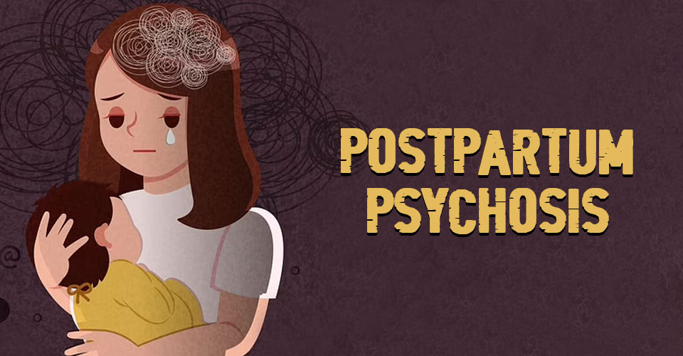
Postpartum Psychosis (PPP)

Slide 21
Postpartum Psychosis (PPP)
PP psychosis: a psychiatric manifestation with abrupt onset after delivery that is characterized by psychotic symptoms
There is no clear evidence on what causes postpartum psychosis. But there are some factors which mean you may be more likely to develop it. For example, if you have:
a family history of mental health problems, particularly a family history of postpartum psychosis
a diagnosis of bipolar disorder or schizophrenia
a traumatic birth or pregnancy
experienced postpartum psychosis before.
But you can develop postpartum psychosis even if you have no history of mental health problems.

Slide 22
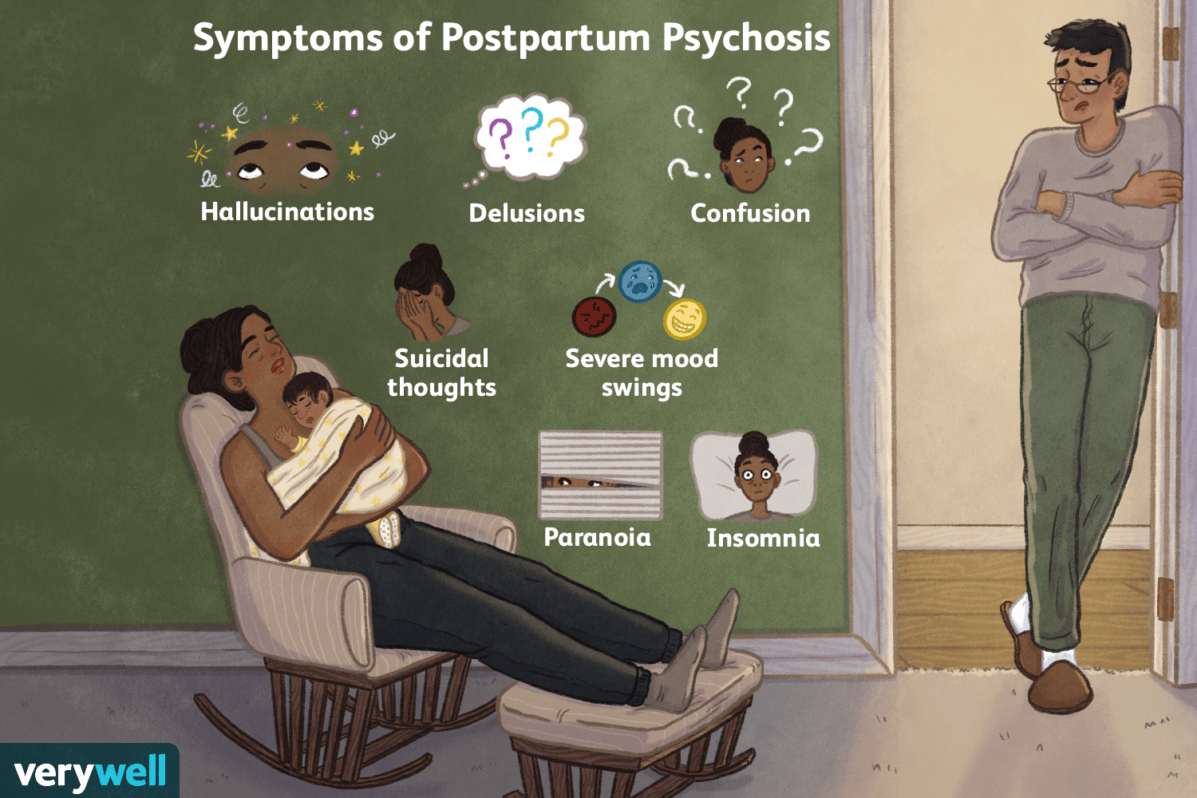
Symptoms
1-Hallucinations
2-Delusions
3-Thought disorganization
4-Disorganized behaviors
5- Mood symptoms (e.g., mania, depression, or both)
6- Obsession with caring for the infant
7- Severe insomnia or frequent awakenings at night
8- Irritability, anxiety, hyperactivity, and psychomotor agitation
9-homicidal or violent thoughts related to the infant
10- Suicidal ideation or attempts

Slide 23
Diagnosis
A mental health provider can diagnose postpartum psychosis based on your symptoms (either by observation or what patient describe) and a physical and neurological exam. Other tests are possible, but these are to rule out other conditions or underlying causes of psychosis. These tests can’t diagnose PPP itself.
Tests on blood, urine or other body fluids. These look for signs of a medical problem, especially with your body’s internal chemistry processes. These can identify infections, electrolyte imbalances, vitamin and mineral deficiencies or excesses, kidney or liver function problems and more.
Imaging scans. These tests look for changes in your brain structure that might explain your symptoms. The most common imaging scans for this are computerized tomography (CT) scans and magnetic resonance imaging (MRI) scans.

Slide 24
Management
Postpartum psychosis is considered a psychiatric emergency.
Hospitalization Especially if there is homicidal or suicidal ideation The patient should be under the care of a psychiatrist (not an obstetrician).
• Ensure safety of the patient and infant.
• Mother should remain hospitalized until stable.
• Mother should not be left alone with the infant.
• Supervised visits with the infant may be possible.

Slide 25
Medical therapy
Antipsychotics Typically considered 1st-line therapy
Consider risks of medication for breastfeeding infants:- Medications do enter the breast milk, though levels tend to be low
During lactation, choose options with more safety data.•
Best options (expert opinion): older 2nd-generation antipsychotics (start with the following initial doses, with a higher dose given for severe symptoms)
Quetiapine 50 mg once daily, up to 50 mg twice daily
Risperidone 0.5-1 mg/day
Olanzapine 2.5-5 mg/day

Slide 26
2nd-Line treatment:- 1st-generation antipsychotics (more side effects; e.g., extrapyramidal effects): haloperidol, perphenazine, trifluoperazine Newer 2nd-generation antipsychotics (minimal safety data):aripiprazole, ziprasidone

Slide 27
Mood stabilizers (used in bipolar disorder): Lithium (if not breastfeeding) 300 mg twice a day (requires serum monitoring)
Valproate (if breastfeeding) 500 mg once or twice daily.
Antidepressants are added to antipsychotics in women with: Major depression with psychotic features, Schizoaffective disorder with affective symptoms.
• Consider benzodiazepines for insomnia

Slide 28
BREASTFEEDING is contraindicated in case of puerperal psychosis as most of antipsychotics are excreted in breastmilk.
Mothers on lithium treatment should be encouraged not to breast feed due to potential toxicity in infants. Baby should be monitored for side effects in case of prescribed breastfeeding women.

Slide 29
• Psychotherapy:• Generally only useful after the initial crisis
• May help prevent recurrence (no clinical trials).
• Family-centered therapy can provide support for recovery.
ECT can be used to reduce depressive symptoms.
• Complications:
risk of behavioral problems and/or developmental delay in the infant.
Suicide and/or homicide (usually preventable with adequate treatment).

Slide 30
COMPLICATIONS
Suicide
Infanticide
Homicidal thoughts
• Lack of normal mother-infant bond
• Marital or family problems

