Slide 1
Thyroid Examination
Dr. Osama Shattarah Introductory Course 2022

Slide 2
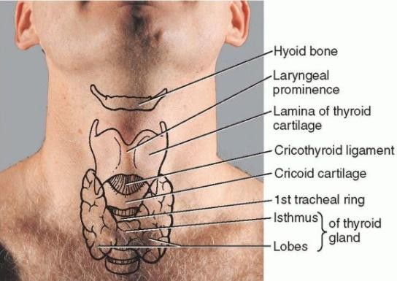
Surface Anatomy of Thyroid Gland

Slide 3
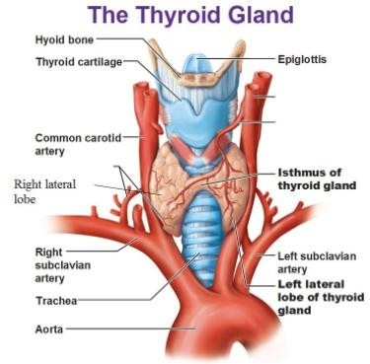

Slide 4
If someone is hypothyroid (underactive) what happens to their TSH,T3 and T4 levels?
TSH
T3 and T4

Slide 5
So if someone is hyperthyroid (overactive) what happens to their TSH and T3,T4 levels?
TSH
T3 and T4

Slide 6
Symptoms of Hypothyroidism
(Commonest cause Autoimmune Hashimoto’s Thyroiditis)
Tiredness, fatigue and lethargy
Psychological – poor memory, concentration and low mood
Weight gain
Neck swelling
Hoarse voice
Puffy face and hands (peri-orbital swelling)
Dry skin
Hair loss
Cold intolerance
Constipation
Menorrhagia / infertility
n.b. hypothyroidism may present as hypercholesterolaeamia – always check TFT if first time of finding someone with hypercholesterolaemia

Slide 7
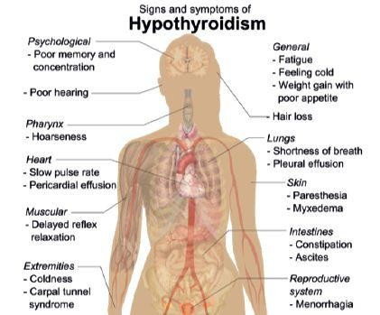

Slide 8
Symptoms of Hyperthyroidism
(Grave’s Disease commonest cause)
Agitated, `on edge’, nervous
Excessive tiredness (poor sleep)
Neck swelling (goitre)
Eye symptoms
protruding eye (exophthalmos, proptosis)
red painful eye (conjunctivitis)
double vision (diplopia)
Tremor
Palpitations (tachycardia, atrial fibrillation)
Weight loss and increased appetite
Heat Intolerance and excessive sweating
Muscle weakness
Diarrhoea
Irregular or no periods (oligomenorrhoea)

Slide 9
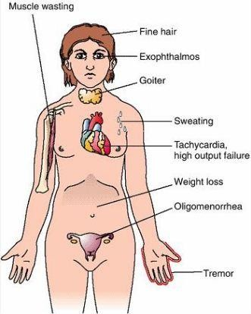
Signs of Hyperthyroidism

Slide 10
Summary
Hypothyroidism Everything slows down! Slower pulse
Slower metabolism – gain weight Slower bowels – constipation Slower reflexes - hyporeflexia
Hyperthyroidism Everything speeds up! Faster pulse
Faster metabolism – loss weight Faster bowels – diarrhoea Faster reflexes - hyperreflexia

Slide 11
Thyroid Examination Process
Introduction, consent and explanation with request for neck exposure
General Examination
general appearance - agitated or lethargic, tired?
check weight (weight gain or loss?)
finger swelling + clubbing (acropachy), wrist swelling (carpal tunnel
syndrome)
fine tremor (hands outstretched)
dry or sweating skin and palmar erythema
hair loss (loss in outer 1/3 eyebrows)
Pulse (rate and rhythm) – tachycardia, bradycardia or atrial fibrillation?
BP – raised in hyperthyroidism

Slide 12
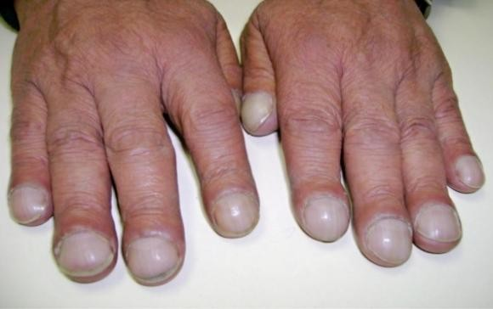
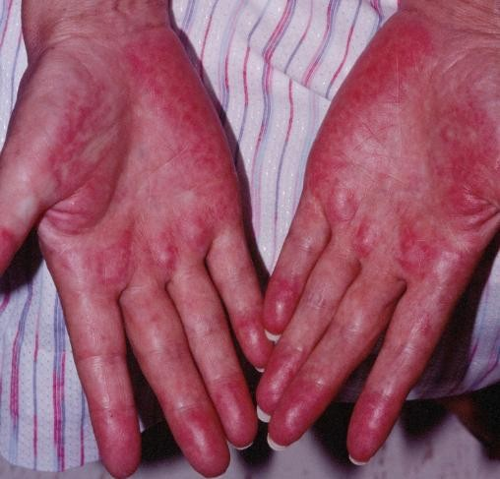
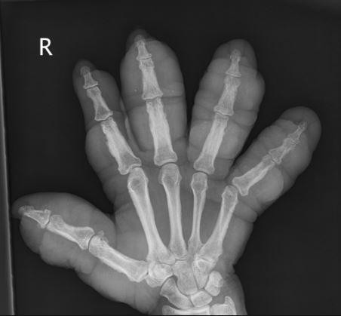

Slide 13
Thyroid Examination Process
Eye Examination
exophthalmos and proptosis – (look over top of head and lateral view for eyeball protrusion)
Chemosis (red eye)
periorbital swelling
lid retraction and lid lag (asks patient to follow finger downwards)
diplopia on lateral or vertical gaze (use H pattern)

Slide 14
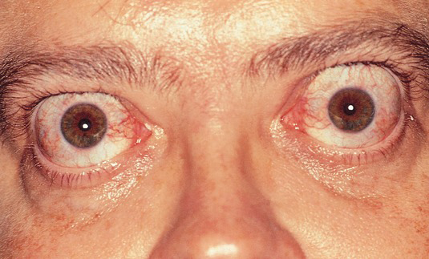
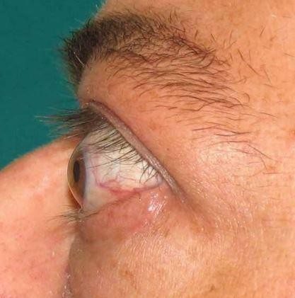
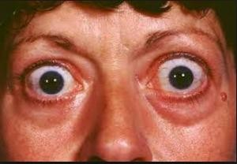
exophthalmos and proptosis

Slide 15
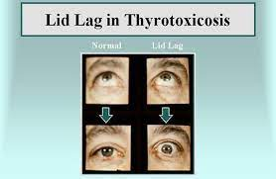

Slide 16
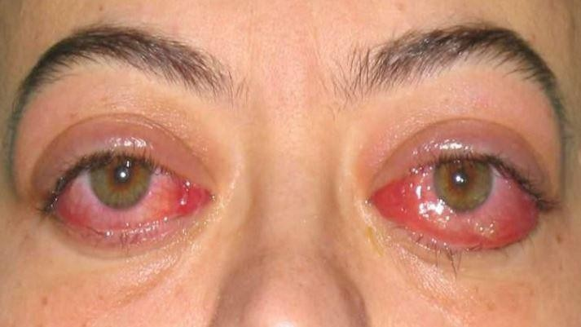
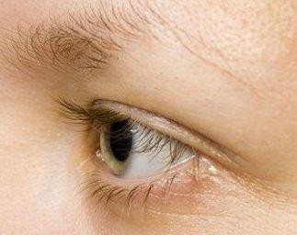
Chemosis (red eye)
Loss of the lateral eye brow

Slide 19
Thyroid Inspection:
Inspect thyroid gland from front and side (scars, thyroid lumps and lymph nodes)
ask patient to swallow glass of water and stick out tongue (looking for swelling)
Thyroid Palpation:
Ask if any pain before palpation
Stand behind patient and correctly locate thyroid gland
Use middle and index fingers of both hands to assess symmetry of thyroid gland lobes
🞄 If thyroid swelling ?global or unilateral
🞄 If thyroid lump(s) ?unilateral or multi-nodular
Ask patient to drink glass of water and stick out tongue
Check for palpable thrills
Check for cervical lymphadenopathy

Slide 20
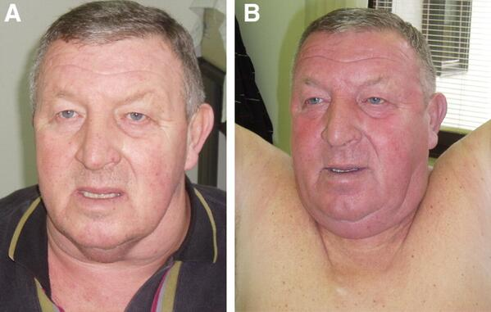
Pemberton's sign
- Tests the presence of latent pressure in the thoracic inlet
- positive Pemberton's sign :facial congestion and cyanosis, as well as respiratory distress after 1 min.
-Indicative of superior vena cava syndrome (SVC), commonly the result of a mediastinumal mass. Although the sign is most commonly described in patients with substernal goiters

Slide 23
Thyroid Percussion:
check for any thyroid gland enlargement
🞄 sternoclavicular edge to retrosternal area
Thyroid Auscultation:
listen for carotid bruits bilaterally
Extra considerations
check reflexes
Proximal muscle weakness
consider checking for cardiomegaly
consider checking for pleural effusion and ascites
check for pretibial swelling

Slide 24
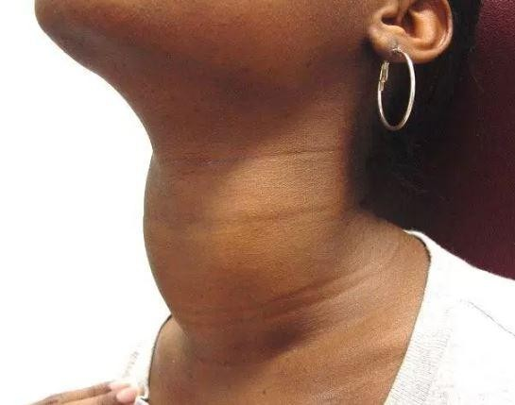
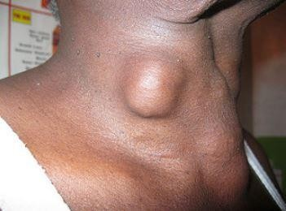
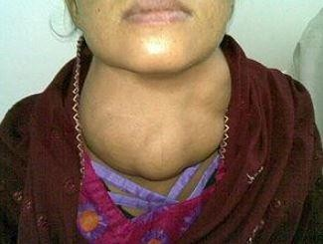
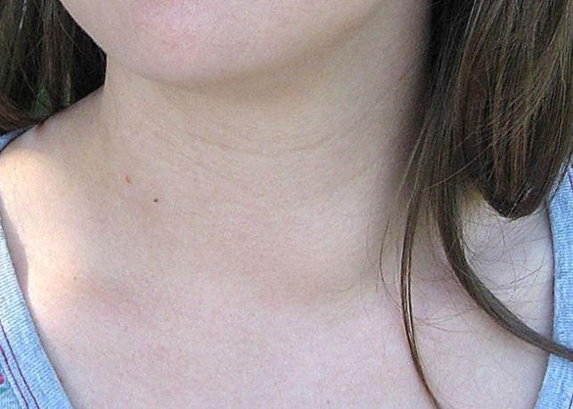

Slide 25
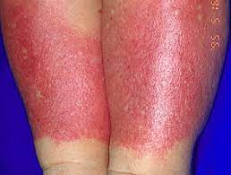
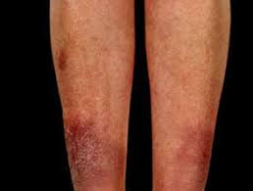
peritibeal mixedema in Graves disease

Slide 26
Thyroid Cancer presentation
Higher risk thyroid malignancy if thyroid nodule under age of 20 and over age of 70 (normally only 5% of all thyroid lumps)
Red flag features:
Child with thyroid nodule
Unexplained hoarseness or voice change with goitre
Painless mass enlarging rapidly over a few weeks
Palpable cervical lymphadenopathy
FHx of thyroid or endocrine tumour
Previous irradiation
Persistent neck pain lasting several weeks

Slide 27
Thyroid disease approach
Triple assessment :
History.
Physical examination.
Investigation:
Thyroid function test
Ultrasound → FNA

Slide 28
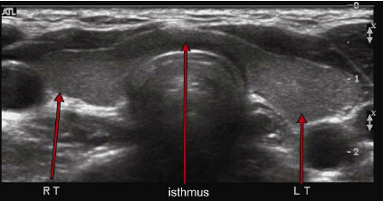
Ultrasound
Normal

Slide 29
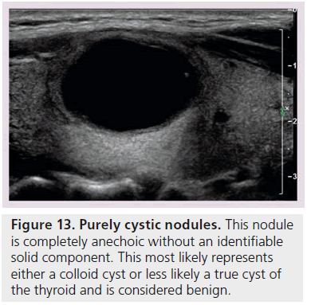
Cyst

Slide 30
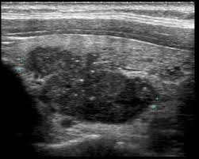
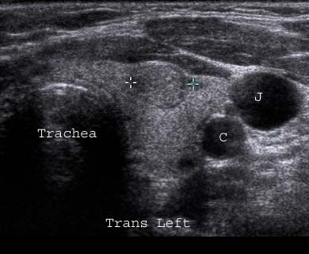
Solid Nodule
Malignant Nodule
Benign nodule

Slide 31
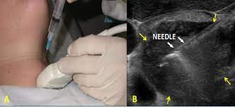
FNA

