Slide 1
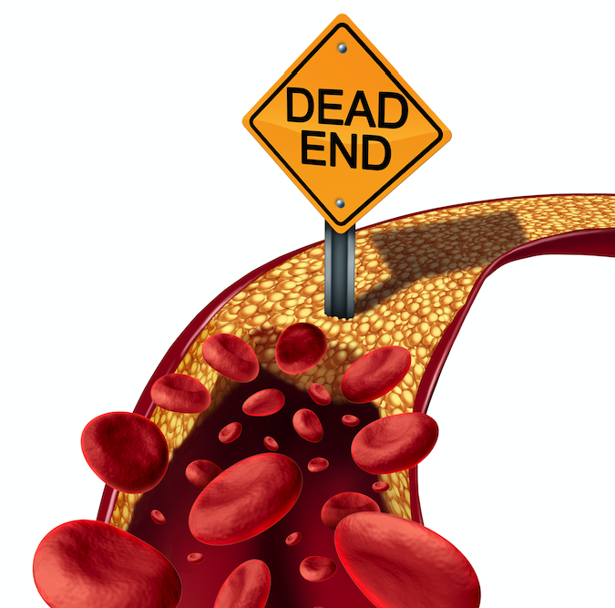
Thromboembolism
Done by :
Mutaz Al-hamayda
Sultan Al-dabobi

Slide 2
Thromboembolism is a medical term used to describe a blood clot (thrombus) that forms in a blood vessel, breaks loose, and is carried by the bloodstream to block another blood vessel
Stasis
Thrombosis
Vessel wall injury
Hypercoagulability
Notes:
*Hypercoagulability:
-Major surgery / Trauma
-Malignancy
-Pregnancy ”post -partum”
-Inherited thrombophilia
-Infection and sepsis
-Inflammatory bowel disease
-Autoimmune condition
-Estrogen therapy
-Inflammation
-Dehydration
*Vessel wall injury:
-Thrombophlebitis
-Cellulitis
-Atherosclerosis
-Indwelling catheter / heart valve
-Venepuncture
-Physical trauma / strain or injury
-Micro trauma to vessel wall
*Stasis:
-Immobility
-Venous obstruction ( pregnancy , obesity , tumour )
-Varicose veins
-Atrial fibrillation or LV dysfunction
-Congenital abnormalities affecting venous anatomy (may –thurner and paget schroetter syndrome)
-Low heart rate ‘ bradycardia ‘ and low blood pressure

Slide 3
Thromboembolism
Venous thromboembolism
VTE
Arterial / Systemic thromboembolism
DVT
PE

Slide 4
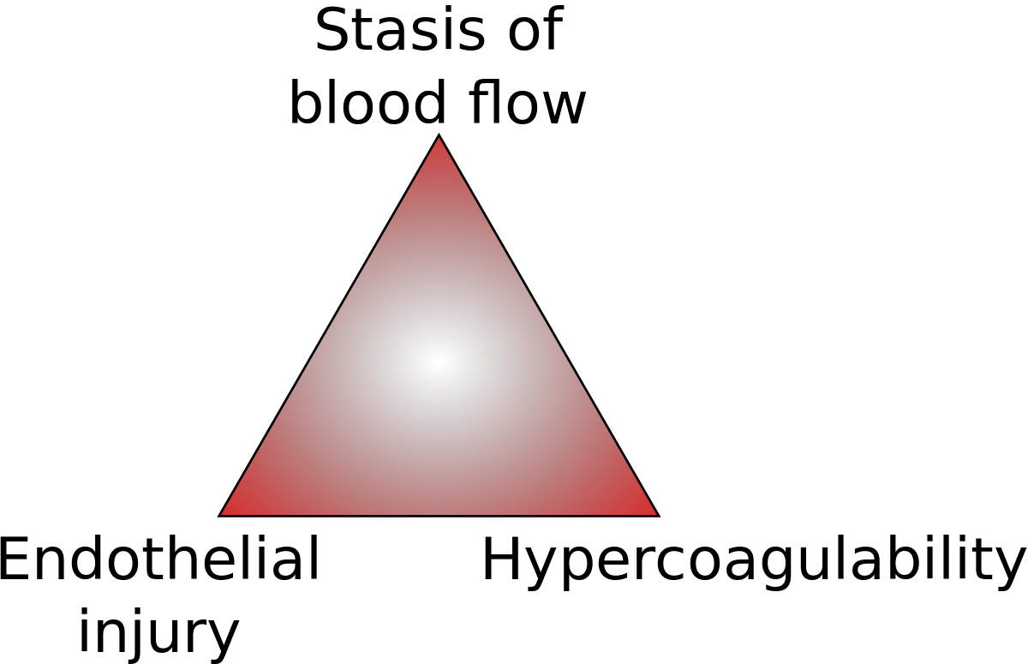
Deep Vein Thrombosis (DVT)
- Its development of blood clot within the vein , mostly affect the legs but also can affect the arms and other site in the body .
The causes that gives rise to venous thrombosis
mostly include in Virchow's Triad
Notes:
-stasis of blood as tumor obstruction , pregnancy .immobility
-injury to ensithelium : as inflammation .chemichal irritation ,truma, surgey
-hypercoagulable state as : hemophelia

Slide 5
Risk factors :
Clinical feature :
Age
Malignancies
Major surgery (preceding 3 months)
Hospitalization
Hereditary hypercoagulable state (pr c&s deficiency , antithrombin 3 deficiency )
Obesity
Pregnancy ,OCP
Trauma
Prior history of DVT ,PE, superficial thrombophlebitis
The presentation may be subtle
Lower limb swelling and pain
Homans signs
They may have variable discoloration in lower extremity
Notes:
-protein c and s produce in liver that control the clot which inhibit factor 5 and 8 deficient maybe seen in liver disease ,sever inflammation ,cancer or inherited
-OCP: the oestrogen will increase plasma fibrinogen and activity of coagulation profile
- Lower limb pain occur in 50 % of Pt

Slide 6
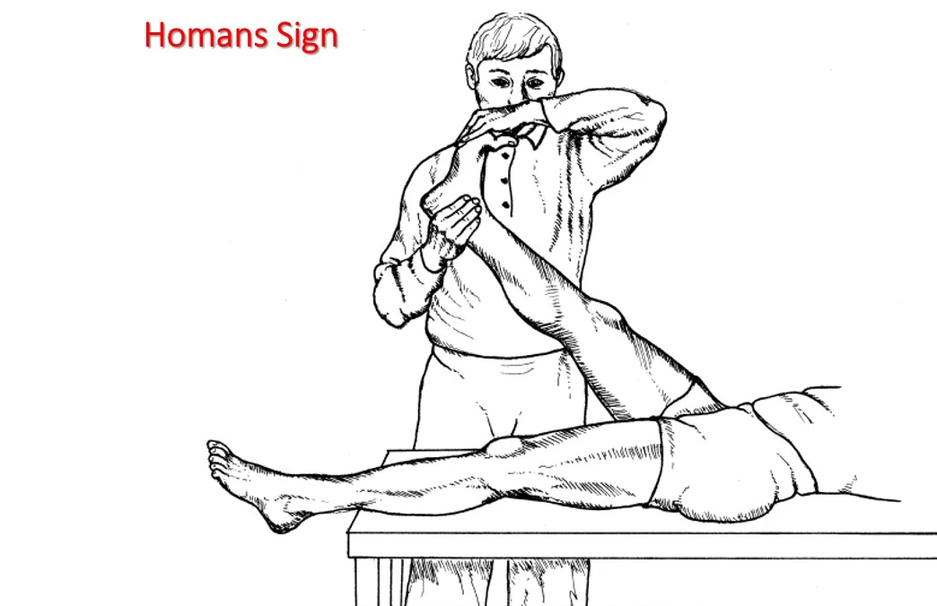
The patient lie in supine position with flexion of knee , then dorsiflexion of foot and squeeze the calf
Positive result when elicit pain in the calf
Notes:
Neither sensitive nor specific it present with less than one third of patient conformed DVT

Slide 7
Complication :
Pulmonary embolism : occur in 10% of patient with confirmed DVT
Post thrombotic syndrome : chronic complication of DVT ,occur in approximately half of patient ,the symptom range from mild erythema to severe swelling and ulceration
Phlegmasia cerulea dolens : painful ,blue ,swollen legs that occur in extreme case of DVT that indicate major venous obstruction and petechiae are often present
Notes:
Phlegmasia cerulean dolens : indicate major venous obstruction that often ass with malegnancies causing hypercoagulable state
And sever limb edema that compromise arterial su[pply to the limb resulting in sensory and motor function imparued
Venous thromoctomy indicated

Slide 8
Diagnosis:
A- Imaging :
-Doppler analysis and Duplex ultrasound Initial test for DVT; noninvasive, but highly operator dependent -Venography Most accurate test for diagnosis of DVT Invasive and infrequently used
B-Labs : - D-dimer testing Has a very high sensitivity (95%), but low specificity (50%); can be used to rule out DVT when combined with Doppler and clinical suspicion
- LFT
Notes:
High sensitivity and specificity for detecting proximal thrombi (popliteal and femoral), not so for distal (calf vein) thrombi A
B- for calf
c. impedance plethysmography A noninvasive alternative to Doppler ultrasound High sensitivity for proximal DVT, but not for distal DVT (calf veins) Poor specificity because there is a high rate of false positives As accurate as Doppler, but less operator dependent

Slide 9
Treatment:
- Dvt treatment mainly to prevents further propagation of thrombus and to prevent occurrence of PE
A- Medication :
Injectable LMWH (e.g., enoxaparin, dalteparin) (best choice for DVT/PE associated with malignancy),
DOACs (e.g., apixaban, rivaroxaban, edoxaban, dabigatran), and
warfarin (requires IV heparin bridge as below).
Thrombolytic therapy (streptokinase, urokinase, tissue plasminogen activator [tPA])Speeds up the resolution of clots b. Indicated mainly for patients with massive PE who are hemodynamically unstable (hypotension with SBP <90 mm Hg), and with no contraindications for thrombolytics

Slide 10
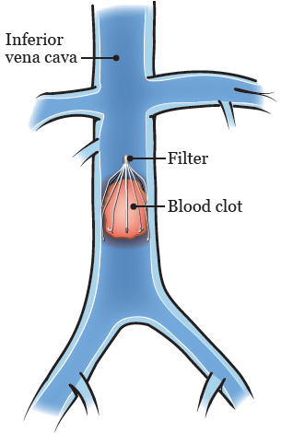
B- surgey :
Only indicate for large blood clots
C- prophylaxis:
iferior vena cava filter placement (Greenfield filter) : -Indications for treatment of VTE -If absolute contraindication to anticoagulation (bleeding) -If failure of appropriate anticoagulation
- Effective only in preventing PE, not DVT

Slide 11
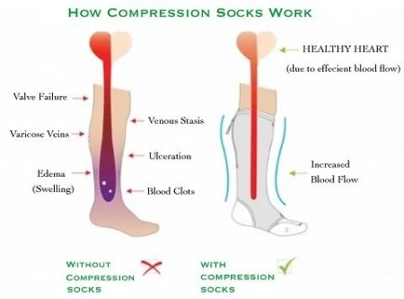
Low dose aspirin.
Calf exersice.
Compression stockings (to prevent stasis)

Slide 12
Pulmonary Embolism ‘PE’
A PE occurs when a thrombus in another region of the body embolizes to the pulmonary vascular tree via the RV and pulmonary artery.

Slide 13
Sources of emboli :
1-Lower extremity DVT—PE is the major complication of DVT
2- Upper extremity DVT is a rare source of emboli .
(it may be seen in IV drug abusers)
*- Most pulmonary emboli arise from thromboses in the deep veins of lower extremities above the knee (iliofemoral DVT).
*- Pulmonary emboli can also arise from the deep veins of the pelvis.
* - Although calf vein thrombi have a low incidence of embolizing to the lungs, in many patients these thrombi progress into the proximal veins, increasing the incidence of PE.
3- uncommon embolic materials (fat , air , or amniotic fluid ) .

Slide 14
Pathophysiology of PE
Emboli block a portion of pulmonary vasculature
increased pulmonary vascular resistance
increased right ventricular pressure
increased pulmonary artery pressure
If it is severe (large blockage),
acute corpulmonale may result.

Slide 15
Continuation of pathophysiology of PE
Regional decrease in lung perfusion
Dead space
( ventilation , but no perfusion)
drive respiratory effort, which leads to Tachypnea
Hypoxemia & Hypercapnia
If the size of the dead space is large (large PE), clinical signs are more overt

Slide 16
Clinical Features of PE
Symptoms:
-SOB
-Pleuritic chest pain
-Cough
-Hemoptysis
-”only one third of PE patients have the signs and symptoms of DVT”
-Syncope “in large PE”
Signs:
-Tachypnea. -Rales
-Tachycardia
-S4
-Increased P2
-Shock + rapid circulatory collapse ”in massive PE”
-Other signs : low grade fever/ decreased breath sounds/ dullness on percussion

Slide 17
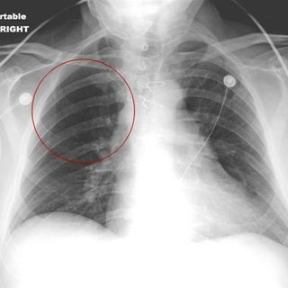
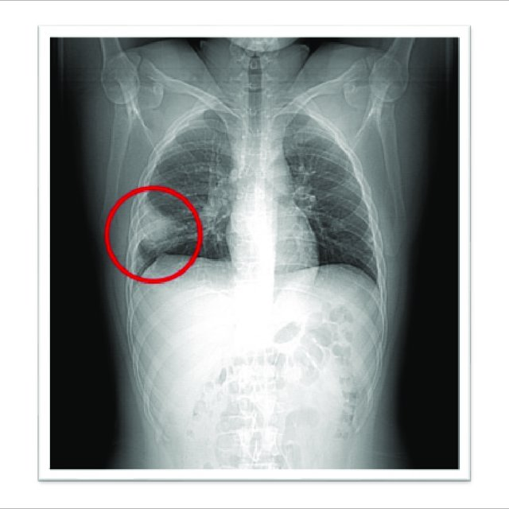
Diagnosis of PE
Westermark sign
1 ABG levels “not diagnostic for PE”
- PaO2 and PaCO2 are low
- pH is high;
there is typically a respiratory alkalosis.
Hampton’s hump
2 CXR “usually normal”
(main usefulness is in excluding alternative diagnoses)
Atelectasis or pleural effusion may be present.
Classic radiographic signs, such as Hampton hump or Westermark sign, are rarely present.
Notes:
*Westermark sign
is a chest x-ray finding of oligaemia (clarified area) distal to a large vessel that is occluded by a pulmonary embolus. The focal area of increased translucency due to oligaemia is caused by impaired vascularisation of the lung due to primary mechanical obstruction or reflex vasoconstriction.
*Hampton's hump
is a radiological sign consisting of a peripheral, wedge-shaped opacification adjacent to the pleural surface, which represents pulmonary infarction distal to a pulmonary embolus

Slide 18
Con. Diagnosis of PE
3 Venous duplex ultrasound of the lower extremities
4 V/Q (ventilation–perfusion lung) scan
5 D-dimer assay
6 CTA
7 The Wells criteria
8 Pulmonary angiography is the gold standard.
Notes:
D-dimer is a specific fibrin degradation product; levels can be elevated in
patients with PE and DVT.

Slide 19
Criteria
Points
Clinical signs/symptoms of DVT
3
PE is most likely diagnosis
3
Tachycardia ( > 100 bpm )
1.5
W e l l s S c o r e
Immobilization / surgery in prev. 4 weeks
1.5
Prior DVT/PE
1.5
Hemoptysis
1
Active malignancy (trt w/in 6 month)
1
Notes:
-Low risk <2 points
-Intermediate risk 2-6 points
-High risk >6 points
*PE unlikely : 0-4 points
*PE likely : >4 points

Slide 20
Pulmonary Angiogram
*Pulmonary angiogram definitively diagnoses or excludes PE , but is invasive.
*Contrast injected into the pulmonary artery branch after percutaneous catheterization of the femoral vein.
*Rarely performed because it carries a 0.5% mortality
Notes:
Picture :
Pulmonary angiogram (digital subtraction angiography) revealing large pulmonary embolus (indicated by arrow) in right lower lobe main pulmonary artery.

Slide 21
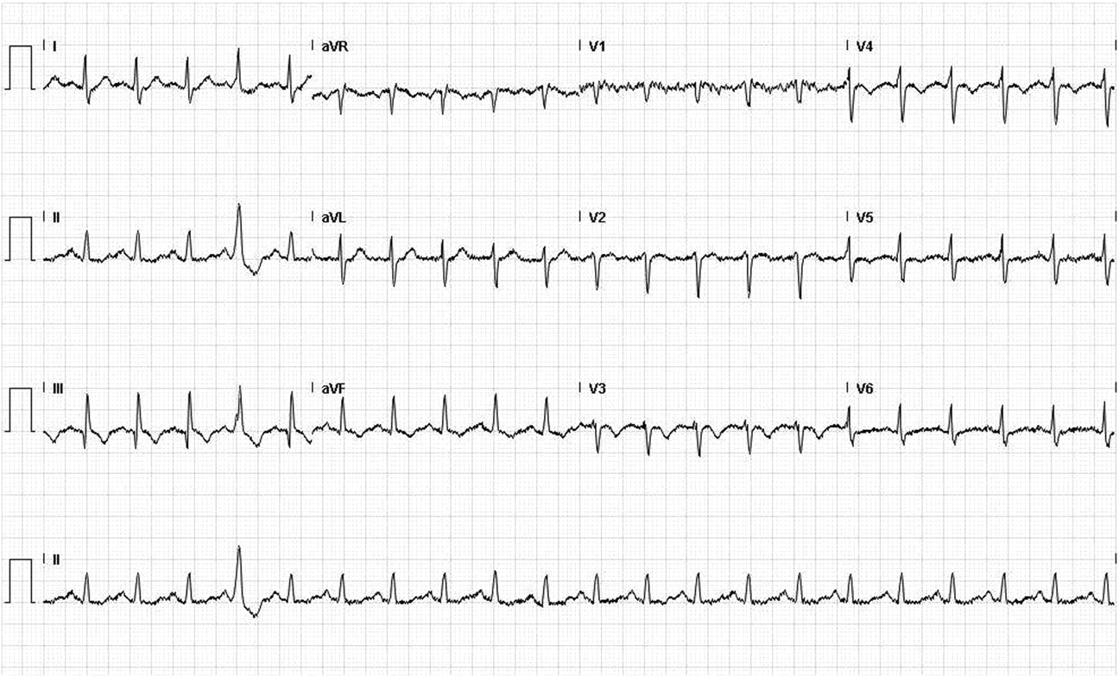
ECG showing sinus tachycardia and an S wave in lead I, Q wave and an inverted T wave in lead III.
Lokesh Shahani BMJ Case Reports 2012;2012:bcr-2012-006569
©2012 by BMJ Publishing Group Ltd
Notes:
ECG showing an S wave in lead I, Q wave and an inverted T wave in lead III.

Slide 22
Management of PE
Supplemental oxygen to correct hypoxemia
Oral anticoagulation
Severe hypoxemia or respiratory failure requires intubation and mechanical ventilation.
with warfarin or one of the novel oral anticoagulants (e.g.,rivaroxaban) for long-term treatment.
Acute anticoagulation therapy
Thrombolytic therapy (e.g., streptokinase , tPA )
with either unfractionated or low–molecular-weight heparin to prevent another PE

Slide 23
Cont. Management of PE
Inferior vena cava interruption (IVC filter placement).
Surgical thrombectomy

Slide 24
Systemic Thromboembolism
causes:
-80% is an intracardiac mural thrombi :
Thrombi occurring in heart champer or aortic lumen
AFib is the most common cause of embolus from the heart
Left atrium dilatation
Paradoxical emboli
Aortic aneurysm
-20% due to atherosclerotic plaque

Slide 25
Major sites of arterial emboli :
1) Lower extremities (75%) The common femoral artery is the most common site of occlusion.
2) Brain (10%)
3) Kidney , intestine , spleen

Slide 26
Systemic thromboembolism outcome Depend on
Vulnerability of the affected tissue
Calibre of the occluded vessels
Collateral circulation

Slide 27
Complication :
The effect of arterial emboli depend on their size , site of emboli.
- Arterial thrombosis can occur in the arteries that supply blood to the heart muscle (coronary arteries). This can lead to a heart attack.
When arterial thrombosis occurs in a blood vessel in the brain, it can lead to a stroke.
Infarction
Gangrene
Arteritis and mycotic aneuorysm
Sudden death

Slide 28
Clinical Features (Six Ps):
1. Pain—acute onset, the patient can tell you precisely when and where it happened.
2. Pallor
3. Polar (cold)
4. Paralysis
5. Paresthesia
6. Pulselessness (use Doppler to assess pulses)

Slide 29
Diagnosis :
1. Angiogram to define site of occlusion
2. ECG to look for MI, AFib
3. Echocardiogram for evaluation of cardiac source of emboli
4. Doppler ultrasound

Slide 30
Treatment :
Embolism treatment can involve medication , surgery or both
Medication:
1.Thrombolytics : lysis existing emboli and enhance perfusion
2.Anticoagulant drugs to prevent further embolization or clot propagation in partially reperfused areas
Surgery:
Angioplasty : using a balloon to open up blocked or stretch narrowed blood vessels
Embolectomy

