Slide 1
Monitoring of fetal well being in pregnancy and labor
Marah Althunibat
Noor Alzghoul
Lejoon Alkharabsheh

Slide 2
Introduction
The primary goal of antenatal testing is to :
Identify fetuses at risk of intrauterine neurologic injury or death .
prevent these adverse outcomes, and improve neonatal outcome (mostly to deliver or to apply intrauterine fetal therapy).
Notes:
The first prenatal visit initiates a process of monitoring.
A plan for fetal assessment begins to emerge based on identification of family, historical, and maternal risk factors.
Specific fetal information, including data from first- and second-trimester screening, biochemical testing, and growth evaluation, further refine the plan.

Slide 3
Indications for antenatal surveillance
Pregnancy-related conditions
Maternal Conditions
Gestational hypertension
Preeclampsia
Decreased fetal movement
Gestational diabetes mellitus (poorly controlled or medically treated)
Oligohydramnios
Fetal growth restriction
Late term or postterm pregnancy
Isoimmunization
Monochorionic multiple gestation (with significant growth discrepancy)
Pregestational diabetes mellitus
Hypertension
Systemic lupus erythematosus
Chronic renal disease
Antiphospholipid syndrome
Hyperthyroidism (poorly controlled
Hemoglobinopathies (sickle cell, sickle cell– hemoglobin C, or sickle cell–thalassemia disease)
Cyanotic heart disease

Slide 4
The American College of Obstetricians and Gynecologists (ACOG) , suggest starting monitoring at 32 to 34 weeks.
If the threshold of viability at a tertiary institution is 24 weeks and the presentation is severe like fetal growth restriction, monitoring is likely to be started early.
Tests should be repeated at least weekly or more frequently according to the test and the severity of the condition.

Slide 5
During the past 20 years, electronic monitoring advances have made the fetus more accessible. They have allowed visualization of the fetus and recording of intrauterine fetal activity. A combination of maternal self-assessment, nonstress testing (NST), and realtime ultrasonic assessment is used to evaluate fetal well-being.

Slide 6
Antepartum fetal surveillance methods
Fetal movement counting
Non Stress Test (NST )
Contraction Stress Test (CST )
Modified Biophysical Profile
Biophysical Profile (BPP)
Doppler Velocimetry

Slide 7
Objective maternal assessment of fetal movements ("fetal kick counts") is based on evidence that fetal movement decreases in response to fetal hypoxemia . Although there is universal consensus opinion that patients with decreased fetal movement should undergo further fetal assessment .
MATERNAL SELF-ASSESSMENT OF FETAL WELL-BEING
A simple technique (kick counting) may be used to assess fetal well-being. The mother assesses fetal movement (kick counts) each evening while lying on her left side. She should recognize 10 movements in 1 hour and if she does not, she should retest in 1 hour. If she still does not have 10 fetal movements in 1 hour, she should contact her doctor or present herself (usually to the hospital) for an NST and an ultrasonic assessment

Slide 8
Antepartum fetal surveillance methods
Fetal movement counting
Non Stress Test ( NST )
Contraction stress test ( CST)
Modified Biophysical Profile
Biophysical Profile (BPP)
Doppler Velocimetry

Slide 9
Non Stress Test (NST)
Assess the fetal heart rate (FHR) in response to fetal movement.
The first step in the assessment of fetal well-being With the mother resting in the left lateral supine position, a continuous fetal heart rate tracing is obtained using external Doppler equipment. The mother reports each fetal movement, and the effects of the fetal movements on heart rate are determined.
Done while pt isn’t in labor (no contractions, no stress), while CST and CTG done if pt in labor.

Slide 10
Baseline FHR (110-160 within 10 minute )
FHR variability *fluctuation of fetal heart rate , beat to beat variation (5-25) within 1 minute *.
Acceleration
Deceleration (absent)

Slide 11
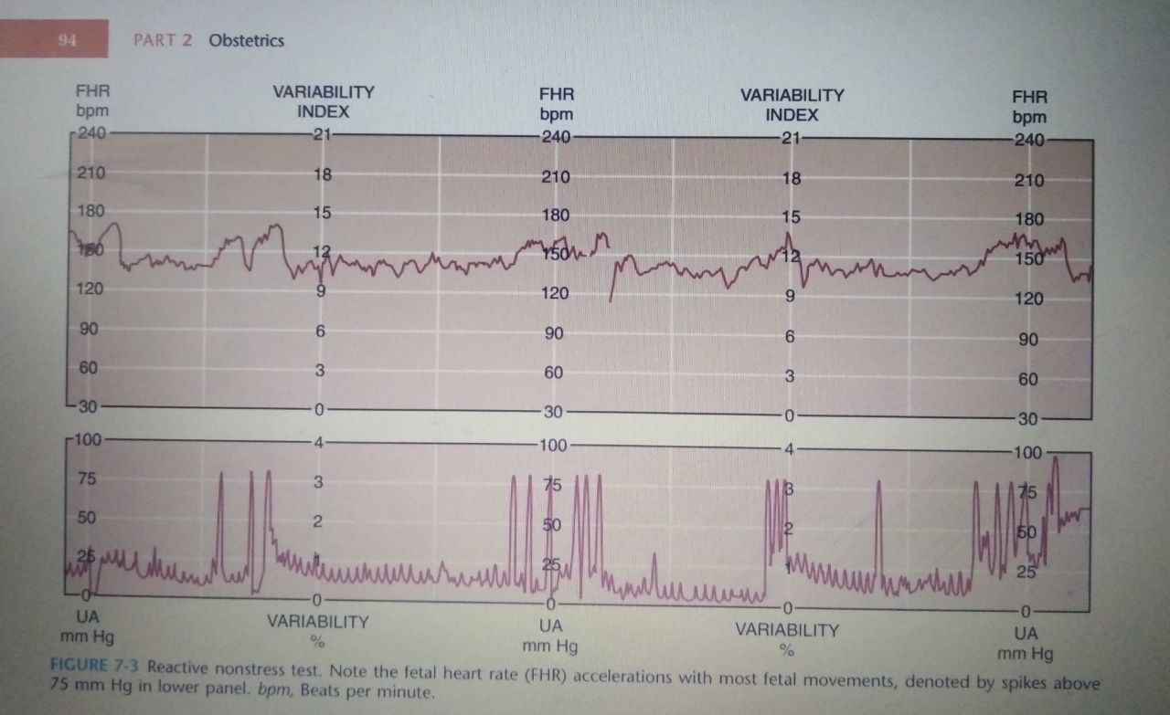
Reactive non stress test .
A normal fetus responds to fetal movement with accelleration in fetal heart rate of 15 beats or more per minute above the baseline for at least 15 seconds . If at least two such accelerations occur in a 20-minute interval, the fetus is regarded as being healthy, and the test is said to be reactive .

Slide 12
Non reactive non stress test
Absence of 2 acceleration within 40 minutes
A
B

Slide 13
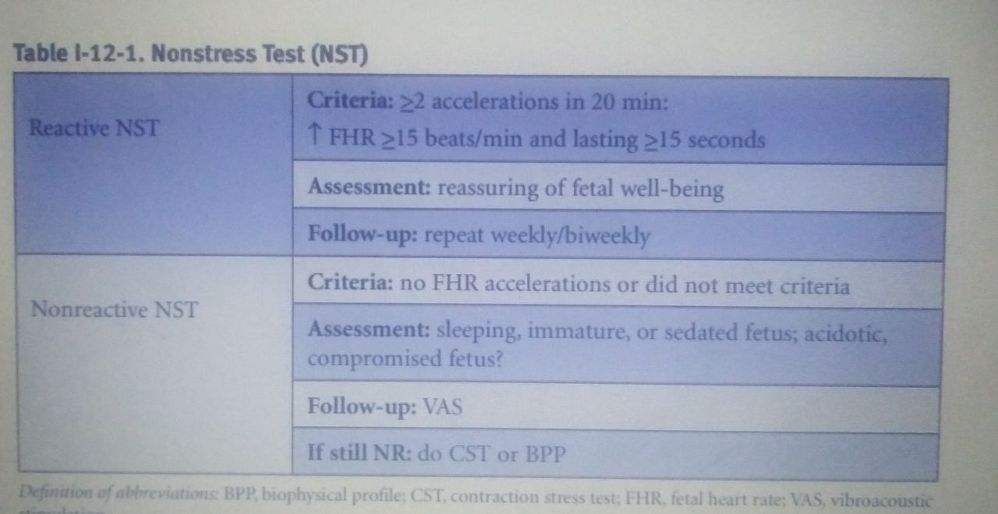
Nonreactive NST can be due to fetal immaturity, quiet fetal sleep ( normal Sleep cycle of fetus is 40-60 min.) , or maternal smoking .

Slide 14
Antepartum fetal surveillance methods
Fetal movement counting
Non Stress Test ( NST )
Contraction stress test ( CST) (but know we stop It because increased risk of preterm labor).
Modified Biophysical Profile
Biophysical Profile (BPP)
Doppler Velocimetry

Slide 15
Contraction stress test
This test assesses the ability of the fetus to tolerate transitory decreases in intervillous blood flow that occur with uterine contractions. It uses both external FHR and contraction monitoring devices and is based on the presence or absence of late decelerations.
Uterine contractions may be induced with either IV oxytocin infusion or nipple stimulation.
This test is rarely performed because of the cost and personnel time required and risk for preterm labour . The most common indication is a BPP of 4 or 6.

Slide 16
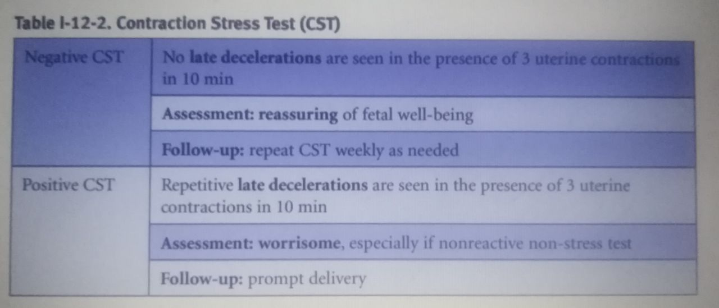
Negative CST requires absence of any late decelerations with contractions. This is reassuring and highly reassuring for fetal well-being. Management is to repeat the CST weekly. Fetal death rate is only 1 per 1,000 in the next week.
Positive CST is worrisome. This requires the presence of late decelerations associated with at least 50% of contractions. Fifty percent of positive CSTs are false positive (meaning the fetus is not hypoxemic). They are associated with good FHR variability. The 50% of true positives are associated with poor or absent variability. Management is prompt delivery

Slide 17
Containdication :
CST should not be performed whenever contraction whould be hazardous to the mother or fetus (previous classical uterine incision , previous myomectomy ,placenta previa ,incompetent cervix ,preterm rupture membrane ).

Slide 18
AMNIOTIC FLUID ASSESSMENT
In the third trimester, the volume of amniotic fluid is considered to largely reflect a balance between fetal urine production and fetal swallowing.
If fluid is low (oligohydramnios) consideration must be given to problems with urinary tract anomalies or renal perfusion.
If fluid is excessive (polyhydramnios) consideration must be given to problems with the decreased fetal swallowing or GI tract anomalies.

Slide 19
Third trimester assessment of amniotic fluid uses ultrasound measurement:
Single deepest pocket (SDP) or maximum vertical pocket (MVP): This is the vertical dimension (in cm) of the largest pocket of AF not persistently containing umbilical cord or fetal extremities. The horizontal measurement of the pocket must be at least 1 cm. º
Oligohydramnios: depth <2 cm
Normal :depth 2-8 cm
Polyhydramnios : depth >8 cm
Amniotic fluid index (AFI):The deepest vertical AF pocket in each of the 4 quadrant of the uterus .The sum of the AF pocket dimension .
Oligohydramnios: <5 cm
Normal :5-25 cm
Polyhydramnios : >25 cm

Slide 20
Antepartum fetal surveillance methods
Fetal movement counting
Non Stress Test ( NST )
Contraction stress test ( CST)
Biophysical Profile (BPP)
Modified Biophysical Profile
Doppler Velocimetry

Slide 21
Biophysical Profile (BPP)
The BPP relies on hypothesis that multiple parameters of fetal well-being are better predictors of outcome than any single parameter.
It is noninvasive.
Easily learned and performed.
Assesses indicators of both acute hypoxia (NST, breathing, body movement) and chronic hypoxia (AFV).
The risk of fetal death within one week of a normal biophysical assessment is estimated to be 1 in 1300.

Slide 22
The five components of the biophysical profile are as follows:
Non stress test
fetal breathing movements (one or more episodes of rhythmic fetal breathing movements of 30 seconds or more within 30 minutes)
fetal movement (three or more discrete body or limb movements within 30 minutes)
fetal tone (one or more episodes of extension of a fetal extremity with return to flexion, or opening or closing of a hand
determination of the amniotic fluid volume (a single vertical pocket of amniotic fluid exceeding 2 cm is considered evidence of adequate amniotic fluid).
Each of the components is given a score of 2 (normal or present as defined previously) or 0 (abnormal, absent or insufficient) , with a total possible score of 10.
Notes:
Includes 5 variables , with a total possible score of 10.
The BPP combines :
- NST (acute hypoxia)
- Ultrasonographic estimation of amniotic fluid volume (chronic hypoxia)
- Assessments of fetal breathing (acute hypoxia)
- Fetal body movements (acute hypoxia)
- Fetal tone

Slide 23
Systematic Application of Biophysical Profile Scoring
BPP | Interpretation | Predicted PNM/1000(within 1wk) | Recommended manegment
10/10 8/10 (normal AFV) 8/8 (NST not performed) | Nonasphyxiated | Less than 1/1000 | Conservative (No acute intervention on fetal basis; serial testing indicated by disorder)
8/10 (oligo) | Chronic fetal compromise | 89/1000 | If mature (≥37 wk), deliver If immature, antenatal steroids , serial testing (twice weekly)

Slide 24
Systematic Application of Biophysical Profile Scoring
6/10 (normal AFV) | Equivocal test; fetal asphyxia is not excluded | Depends on progression (61/1000 on average) | If term deliver If immature, repeat test in 24 h and if ≤6/10, deliver
6/10 (decreased AFV) | Chronic asphyxia with possible acute | 90/1000 | Factor in gestational age If ≥32 wk, deliver If <32 wk, test daily
4/10 (normal AFV) | Acute asphyxia likely | 90/1000 | Factor in gestational age If ≥32 weeks, deliver If ≤32 wk, test daily

Slide 25
Systematic Application of Biophysical Profile Scoring
4/10 (decreased AFV) | acute on chronic asphyxia very likely | 90/1000 | If ≥26 wk, deliver
2/10 (normal AFV) | Acute fetal asphyxia likely with chronic decompensation | 125/1000 | If ≥26 wk, deliver (frequently requires cesarean section)
0/10 | Severe, acute asphyxia virtually certain | 600/1000 | If fetal status is viable, deliver immediately by cesarean section

Slide 26
Score of 8 or 10—highly reassuring of fetal well-being. Management is to repeat the test weekly or as indicated. Fetal death rate is only 1 per 1,000 in the next week.
Score of 4 or 6—worrisome. Management is delivery if the fetus is >36 weeks or repeat the biophysical profile in 12–24 h if <36 week .
Score 0 or 2- highly predictive of fetal hypoxia with low probability of false positive .management is prompt delivery regardless of gestational age .

Slide 27
Biophysical Profile (BPP)
A reassuring BPS ( BPS of 8 to 10) should be repeated periodically (weekly or twice weekly) until delivery when the high-risk condition persists.
Frequency of testing increases in direct proportion to the severity of the maternal or fetal condition.
A total score ≥8 implies absence of significant central nervous system hypoxemia/acidemia at the time of testing. A score ≤4 can be a sign of fetal compromise

Slide 28
Antepartum fetal surveillance methods
Fetal movement counting
Non Stress Test ( NST )
Contraction stress test ( CST)
Modified Biophysical Profile
Biophysical Profile (BPP)
Doppler Velocimetry

Slide 29
Modified Biophysical Profile
During the late second or third trimester, amniotic fluid reflects fetal urine production. Placental dysfunction may cause diminished fetal renal perfusion, which can lead to oligohydramnios. Therefore, assessment of amniotic fluid volume can be used to evaluate long-term uteroplacental function. This led to the development of the modified biophysical profile.
The modified biophysical profile is considered normal if the nonstress test is reactive and the amniotic fluid index is greater than 5 cm and abnormal if the nonstress test is nonreactive or the amniotic fluid index is 5 cm or less. If either the NST or the AFI is abnormal, a complete BPP or CST is performed.
The rate of stillbirth within one week of normal test is the same as with full BPP, 0.8/1000 .
Notes:
The modified biophysical profile was developed to simplify the examination and reduce the time necessary to complete testing.

Slide 30
Doppler Velocimetry
Measurement of blood flow velocities in the maternal and fetal vessels gives information about utero-placental blood flow and fetal responses to physiologic challenges.
Non-invasive technique .
Vessels that can be studied :
- Uterine artery
- umbilical artery
- Middle cerebral artery
- Ductus venosus
- Umbilical vein

Slide 31
Uterine Artery

Slide 32
Doppler studies of the uterine artery during the first and early second trimester may be used to predict pregnancies at risk of adverse outcome, particularly pre-eclampsia.
The proposed pathogenic model of preclampsia is one of incomplete physiological invasion of the spiral arteries by the trophoblast, with a resultant increase in uteroplacental vascular resistance . This is reflected in the Doppler wave- forms obtained from the maternal uterine artery circulation.

Slide 35
High resistance wave form patterns are associated with adverse outcomes, including pre-eclampsia, FGR and placental abruption.
Sixty to seventy per cent of women at 20–24 weeks’ gestation with bilateral notched uterine arteries will subsequently develop one or more of these complications.
Consequently, such pregnancies will require close monitoring of fetal growth rate and increased surveillance for the possible development of maternal hypertension and proteinuria.

Slide 36
UMBILICAL ARTERY DOPPLER ASSESSMENT

Slide 38
Doppler indices such as the pulsatility index or the resistance index are useful as they calculate the variability of blood velocity in a vessel, comparing the amount of diastolic flow relative to systolic flow.
When these indices are high, there is high resistance to blood flow; when the indices are low, resistance to blood flow is low.

Slide 39
The most important prognostic feature of the umbilical artery waveform is the end-diastolic flow.
As umbilical artery resistance rises ,diastolic velocities fall and ultimately become absent ( absent end diastolic velocity AEDV).
As resistance rises even further, an elastic component is added, which induces reversed end-diastolic velocity (REDV) as the insufficient, rigid placental circulation recoils after being distended by pulse pressure.

Slide 40
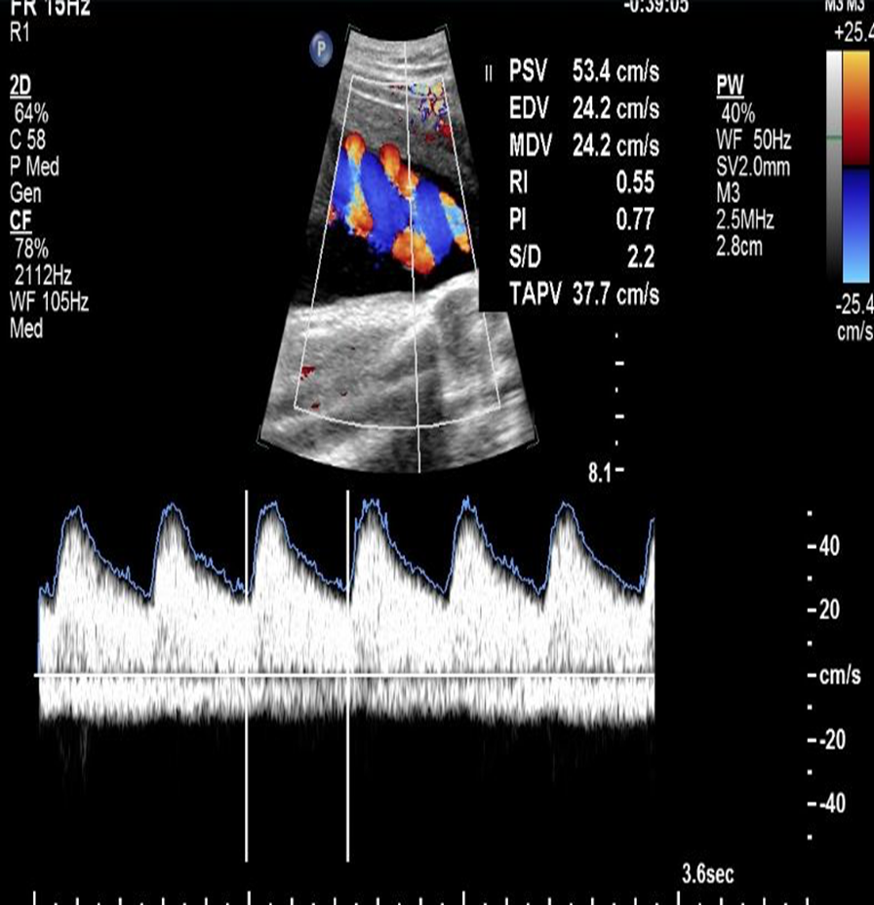
Normal diastolic flow is infrequently associated with significant perinatal morbidity or mortality and is strong evidence of fetal well-being, thus this finding provides support for delaying delivery when it is important to achieve further fetal maturity.

Slide 41
When 30 % of the villous vasculature ceases to function, an increase in umbilical artery resistance leading to reduced end diastolic flow is consistently seen.

Slide 42
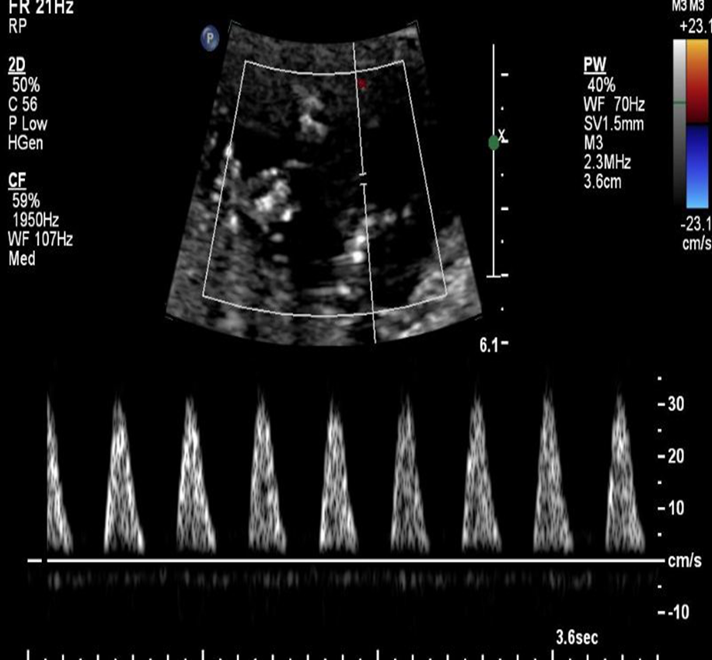
When 60 to 70 % of the villous vasculature is obliterated, umbilical artery diastolic flow is absent or reversed and fetal prognosis is poor.

Slide 43
Reversed end-diastolic flow effectively means that during diastole, there is flow of fetal blood away from the placenta and back to the fetus.
And it associated with poorer neonatal outcomes than absent diastolic flow.
Absent or reversed end diastolic flow in the umbilical artery can be a sign of impending fetal cardiovascular and metabolic deterioration. If either of these abnormal patterns is identified, delivery should be considered.

Slide 44
Deliver any fetus past 32 weeks with reversed umbilical artery flow, and any past 34 weeks with absent umbilical artery flow. One course of antenatal corticosteroids is given between 24 and 34 weeks of gestation in the week before delivery is expected.

Slide 45
Middle cerebral artery

Slide 46
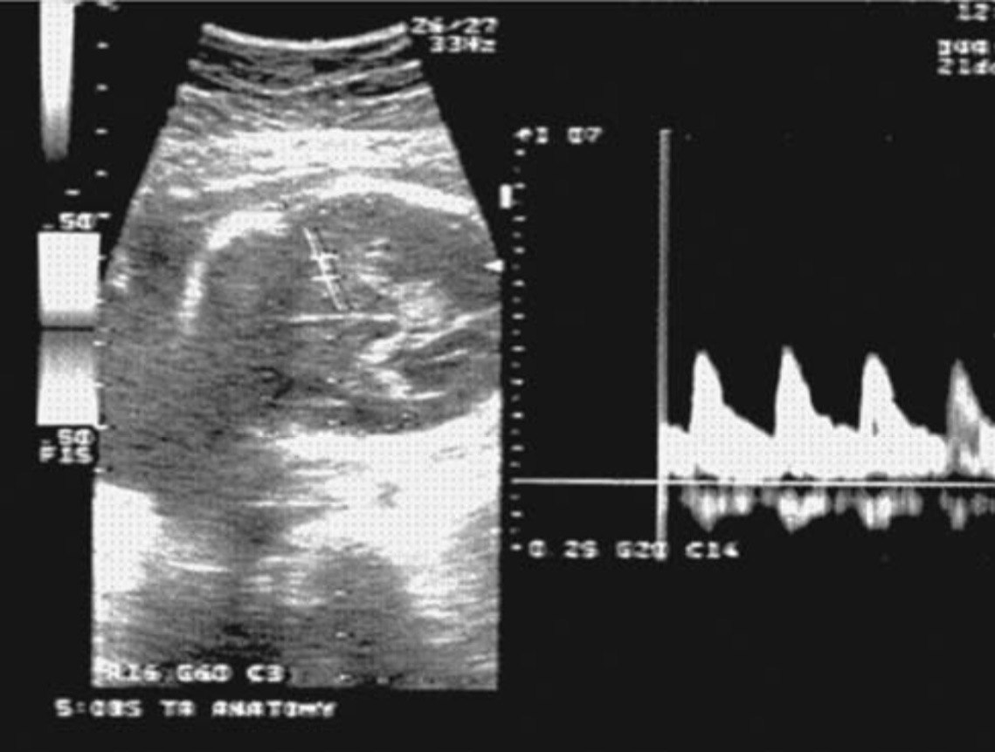
In the compromised fetus, systemic blood flow is redistributed from the periphery to the brain, "brain-sparing effect” .
As hypoxia increases the pulsatility index in the middle cerebral artery falls, indicating increasing diastolic flow as the cerebral circulation opens up. At the same time there is increased resistance in the fetal aorta reflecting compensatory vasoconstriction in the fetal body. Absent diastolic flow in the fetal aorta implies fetal acidaemia.

Slide 47
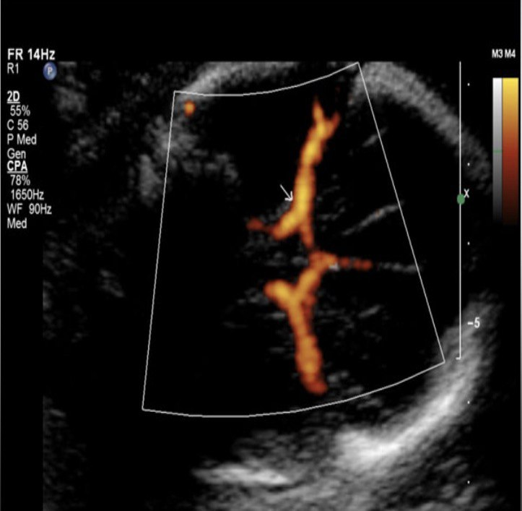
Measurement of velocity of blood flow in the middle cerebral artery also gives an indicator of the presence of fetal anemia. When the fetus is anemic, the peak systolic velocity increases. This technique is particularly useful to assess the severity of Rhesus
isoimmunization disease, and in twin-to-twin transfusion syndrome that results in anaemia in the donor twin.

Slide 49
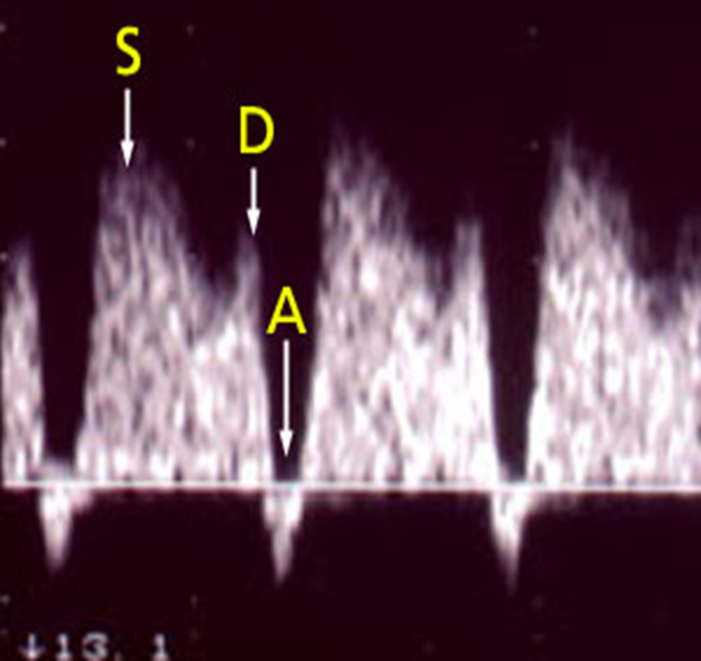
Ductus Venosus
The ductus venosus regulates oxygenated blood in the fetus , and is resistant to alterations in flow except in the most severely growth restricted fetuses.
Ductus venosus deterioration frequently precedes and strongly predicts changes in BPP that require delivery.

Slide 52
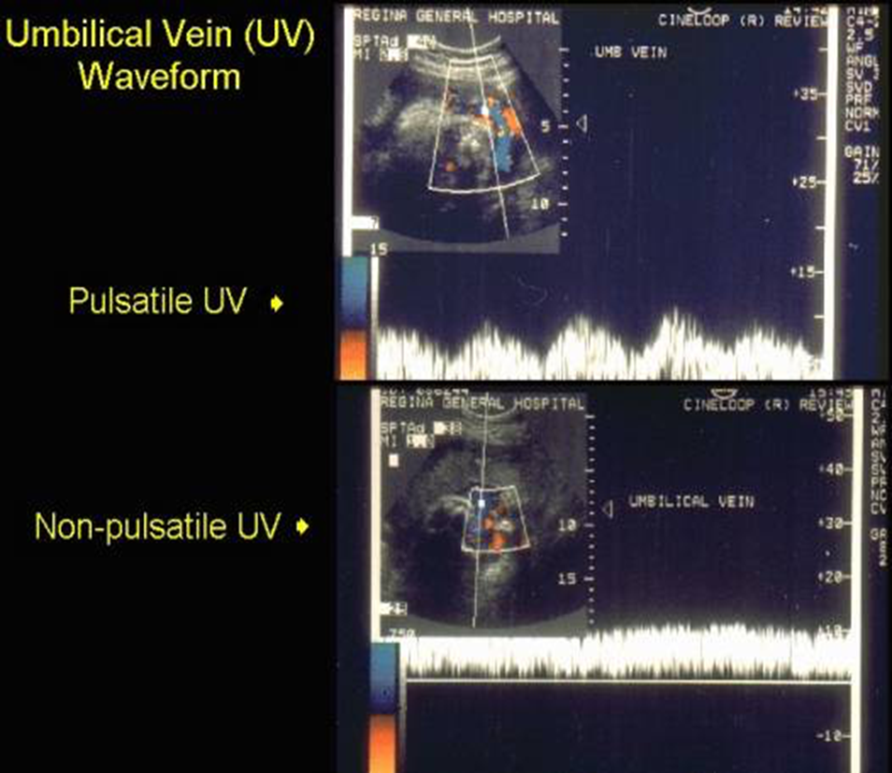
Umbilical Vein
Blood flow in the umbilical vein is continuous in normal pregnancies after 15 weeks of gestation.
In pathological states, such as fetal growth restriction, flow in the umbilical vein may be pulsatile, which reflects cardiac dysfunction related to increased afterload.

Slide 53
Emerging methods
Fetal magnetoencephalography :
Allows direct assessment of fetal cortical and brainstem function.
Noninvasive
Uses an array of ultrasensitive magnetic field detectors, that allows direct continuous recording of fetal electrocortical signals
can record fetal brain activity in response to auditory and visual stimuli applied to the maternal abdomen.

Slide 54
Intrapartum fetal surveillance

Slide 55
Intrapartum fetal surveillance
The aim is to detect potential fetal decompensation and to allow timely and effective intervention to prevent perinatal/neonatal morbidity or mortality.
Changes in fetal heart rate precede brain injury , so timely response to abnormal fetal heart patterns might be effective in preventing brain injury.
During uterine contractions there is a decrease in uteroplacental blood flow and a subsequent increase in fetal pCO2 and a decrease in pO2 and PH.(tolerated)
Avoiding adverse fetal outcome related to hypoxia/acidosis is the main objective of intrapartum fetal monitoring.

Slide 57
Antenatal factors that increase the risk of fetal compromise
1 - oligohydramnios or polyhydramnios
2 - multiple pregnancy
3 - antepartum haemorrhage
4 - previous caesarean section (scar)
5 - hypertension or pre-eclampsia and diabetes
6 - prolonged pregnancy
7 - intrauterine growth restriction
8 - induction of labour with prostaglandin/oxytocin
9 - regional anaesthesia (epidural)
10 - maternal pyrexia: ≥ 38°C
11 - meconium or blood stained liquor (stress)
12 - pre-term labour
13 - uterine hyperstimulation (oxytocin overdose)

Slide 58
Intrapartum fetal surveillance
Fetal Heart Rate Monitoring (FHR)
- Intermittent auscultation (low risk)
Continuous electronic fetal heart monitoring (EFM)
Fetal Scalp blood pH estimation (acidosis)
Intrapartum fetal stimulation tests
- Fetal scalp stimulation tests
Fetal acoustic stimulation test (FAST)
Newer approaches
- Fetal ECG
- Scalp blood lactate estimation
- Continuous biochemical monitoring
(Pulse oximetry)

Slide 59
Intermittent Auscultation
It is the recommended fetal surveillance method during labor for healthy women without risk factors for adverse perinatal outcome.
A baseline heart rate is assessed by listening and counting FHR between uterine contractions.
FHR is counted for 60 seconds. (110-160 bpm)
The FHR should be assessed at least every 30 minutes in the first stage of labor and every 15 minutes in the second stage . (active 5 minutes)
It ensures frequent contact between healthcare professionals and the laboring woman.
If abnormal, Electronic Fetal Monitoring is recommended .

Slide 60
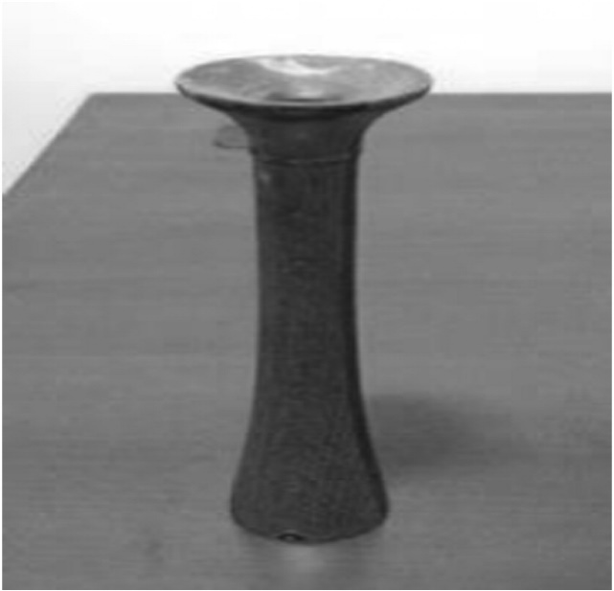
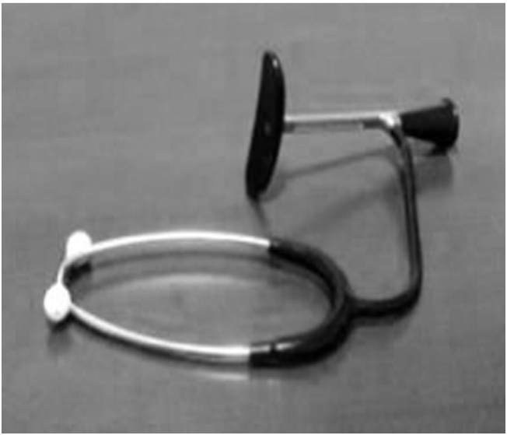
Pinard stethoscope. (old)
Handheld Doppler device (recent)
DeLee stethoscope(old)

Slide 61
Electronic fetal heart monitoring

Slide 62
Electronic fetal heart monitoring
It should be considered in all situations where there is a high risk of fetal hypoxia/acidosis.
The electronic FHR monitor is a device with two components. One establishes the FHR, and the other measures uterine contractions.
Continuous cardiotocography (CTG )is also recommended when abnormalities are detected during intermittent fetal auscultation.
CTG has been shown to decrease the occurrence of neonatal seizures.

Slide 63
Electronic fetal heart monitoring disadvantages
Limit woman’s mobility
Decease direct contact between woman & staff.
Continuous EFM is associated with an increase in the rates of Caesarean sections and instrumental vaginal births.

Slide 64
External fetal monitor
An ultrasound transducer transmits the FHR in beats per minute.
Non-invasive.
Does not require cervical dilatation or rupture of membranes.
Needs readjustment with maternal or fetal movements.
Difficult to obtain a clear tracing in obese women or those with polyhydramnios.

Slide 65
Internal fetal monitor
performed with a spiral electrode inserted through vagina and cervix and attached to the fetal scalp.
Indicated when the external tracing is inadequate for accurate interpretation.
Contraindications include placenta previa, face presentation, unknown presentation, HIV seropositivity, or active genital herpes.
Internal uterine activity monitoring is done via an Intra Uterine Pressure Catheter .

Slide 66
EFM may be performed with an external(abdomen) or internal(vaginal) monitor

Slide 67
External vs internal monitoring

Slide 68
Electronic fetal heart monitoring
Baseline FHR
FHR variability (beat to beat variation)
Acceleration
Deceleration

Slide 69
Interpretation of electronic fetal monitoring
Assess the quality of the signal acquisition.
Determine the paper speed and graph range.(1cm per minute)
Determine whether the mode of recording is external or internal.
Assess the uterine activity pattern, including frequency, duration, and intensity of contraction, and uterine resting tone.
Assess the FHR.

Slide 70
Assessment of uterine contractions
The lowest intrauterine pressure between contractions is called resting tone.
Normal resting tone is 5-10 mmHg, but during labor it may rise to 10-15 mmHg.
Pressure during contractions rises to ~25-100 mmHg (varies with stage).
A resting pressure above 20 mmHg causes decreased uterine perfusion.

Slide 71
Assessment of fetal heart rate
The baseline FHR :
Baseline FHR is the approximate mean FHR rounded to 5bpm during a 10-minute segment .
Normal baseline rate is between 110 and 160 bpm .( not acceleration or deceleration)

Slide 72
Tachycardia
A baseline value above 160 bpm lasting more than 10 minutes.
Maternal pyrexia (infection, epidural analgesia) is the most frequent cause of fetal tachycardia.
Other causes
Fetal hypoxia. prematurity
Medications (beta-agonist drugs) .
Fetal arrhythmias (SVT ).
Fetal anemia.
Maternal hyperthyroidism
chorioamnionitis

Slide 73
Tachycardia
Vital signs (temperature.pulse)
Left lateral position
IV hydration
Oxygen
Stop oxytocin
Up to 180 is acceptable especially in preterm baby

Slide 74
Bradycardia
A baseline value below 110 bpm lasting more than 10 minutes.
Values between 100 and 110 bpm may occur in normal fetuses, especially in postdate pregnancies.
Sudden drop in oxygenation, such as occurs with placental abruption.
Decrease or cessation in umbilical blood flow, such as occurs with a prolapsed cord or uterine rupture.
Maternal hypothermia, maternal hypotension, administration of beta-blockers , and fetal arrhythmias such as atrioventricular block are other possible causes.

Slide 75
Bradycardia
Left lateral position.
Increase IV hydration.
Oxygen
Vaginal exam (abruption . Cord prolapse)

Slide 76
Assessment of the FHR
baseline variability:
It refers to the fluctuations in the baseline FHR. (sym and para )
Evaluated as the average bandwidth amplitude of the signal in 1-minute segments.
Normal variability of 5−25 bpm.
Hypoxia and acidosis, fetal sleep, medications, (e.g., narcotics, sedatives, b-blockers, betamethasone), prematurity, fetal tachycardia, and congenital anomalies decrease FHR variability.

Slide 77
Assessment of the FHR
Absent
Less than 5 bpm minimal
5 to 25 bpm moderate (normal )
> 25 bpm marked

Slide 78
Early decelerations (begnin ;mirror )
gradual decrease in the FHR and return to baseline associated with uterine contraction. (15bpm ;15 sec)
The onset, nadir(tip), and recovery of the decelerations coincide with the beginning, peak, and ending of the contraction.
Caused by fetal head compression and do not indicate fetal hypoxia/acidosis.

Slide 79
Variable decelerations
Most common type
Caused by chemoreceptor stimulation secondary to cord compression
Not associated with contactions
Abrupt onset
shouldering

Slide 80
Late decelerations
Late decelerations are found in association with uteroplacental insufficiency.
Management :
Maternal left lateral position
Correct maternal hypotension with IV fluids
Stop oxytocin infusion
Administer O2 by mask
Vaginal examination (dilatation)
If persistent perform fetal scalp PH

Slide 81
Late decelerations

Slide 82
Prolonged decelerations
Usually lasting more than 3 minutes.
They indicate hypoxia
If associated with reduced variability, they indicate acute fetal hypoxia/acidosis and require emergent intervention.
Abruption ;cord prolapse

Slide 83
Sinusoidal pattern (rare)
A regular, smooth, undulating signal, resembling a sine wave. (20 minute)
It occurs in association with severe fetal anemia (anti-D alloimmunization, fetal-maternal hemorrhage, and ruptured vasa previa )

Slide 84
Interpretation of FHR
Interpretation | Baseline (bpm) | Variability (bpm) | Decelerations | Accelerations
Reassuring | 110-160 | 5-25 | None | present
Non-reassuring | 161-180 | less than 5 30–90 minutes | Variable decelerations with over 50% ,over 90min. Late decelerations, up to 30 minutes over 50% of contractions. Early decelration
Abnormal | Above 180 Below 100 | Less than 5 for over 90 minutes More than 25 always abnormal | Variable decelerations for more than 30 min despite conservative measure. Late decelerations over 30 minutes, occurring with over 50% of contractions . Single prolonged deceleration more than 3 min.

Slide 85
Interpretation of FHR
Category | Definition | Management
CTG is normal/ reassuring | All 3 features are normal/ reassuring | Continue CTG and normal care.
CTG is non- reassuring | 1 non-reassuring feature, and 2 normal/ reassuring features | check temperature left-lateral position oral or intravenous fluids stopping oxytocin Inform coordinating midwife and obstetrician
CTG is abnormal and indicates further testing | 1 abnormal feature OR 2 non-reassuring features | Same as non reassuring Take Fetal Blood Sample FBS C.s

Slide 86
Secondary tests of Fetal wellbeing
Fetal Scalp Sampling
Scalp stimulation
Acoustic stimulation
Fetal pulse oximetry
Fetal Electrocardiogram Analysis

Slide 87
Fetal blood sampling for pH and lactate
FBS may be used in cases of abnormal CTG.
A vaginal examination needs to be performed prior to the procedure to assess the nature and position of the presenting part.
Contraindications : maternal infection, women seropositive to hepatitis B, C, or to HIV, suspected fetal blood disorders, uncertainty about the presenting part, preterm fetus.
CTG + FBS results in a reduction in cesarean deliveries when compared with CTG alone

Slide 88
Fetal blood sampling for pH and lactate
Lactate (mmol/L) | pH | Interpretation
< 4.2 | > 7.25 | Normal
4.2 – 4.8 | 7.21 – 7.24 | Repeat in 30 mins
> 4.8 | < 7.20 | Birth expedited
> 5.0 | < 7.15 | Urgent delivery

Slide 89
Fetal stimulation tests
Recommendation | Test
Digital stimulation of the fetal scalp during vaginal exam may be considered as an adjunct to FHM (acceleration) | Digital stimulation
Of value in non-reactive NST, but no prove in assessment during labour (tuning fork) | Viboacoustic stimulation
No evidence to improve fetal wellbeing | Maternal glucose ingestion
This procedure is not recommended | Manual fetal manipulation

Slide 90
Fetal pulse oximetry
Monitor intrapartum fetal O2 saturation
Fetal pulse oximetry is a relatively new technique in the assessment of a fetus prior to delivery
It measures both the pulse rate and oxyhemoglobin saturation
Sensor is placed transvaginally through the cervix to rest against the fetal cheek or temple, requiring cervical dilatation (~ 2 cm or more) and ruptured amniotic membranes with a cephalic presentation.
Insufficient evidence to substantiate a recommendation for the use of Fetal Pulse oximeter as an adjunct or independent of electronic fetal surveillance.

Slide 91
Fetal Electrocardiogram Analysis
Used in combination with standard EFM.
Specialized monitor with software collects both the familiar fetal heart rate and uterine activity signals, and the fetal ECG
Interpretation is based on the observation that the fetal QRS and T wave change in relation to the metabolic state of the fetal heart
The impact of this type of monitoring compared with standard EFM was studied and showed no difference in the number of Caesarean sections, perinatal deaths, or NICU admissions.

Slide 92
THANK YOU

