Slide 1
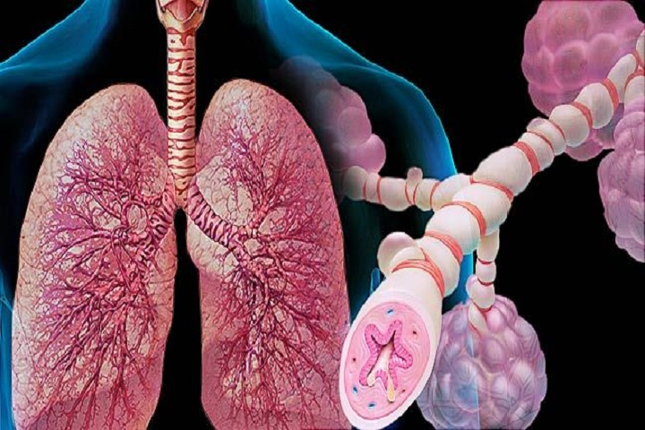
Drug Therapy For Bronchial Asthma
Dr/ Heba Ahmed Hassan
associate professor of clinical pharmacology faculty of medicine mutah university

Slide 2
Bronchial Asthma
Inflammatory disease characterized by reversible airway obstruction due to bronchoconstriction, mucosal edema, cellular infiltration, and viscid secretions
Manifested clinically by paroxysms of dyspnea, cough and wheezes

Slide 3
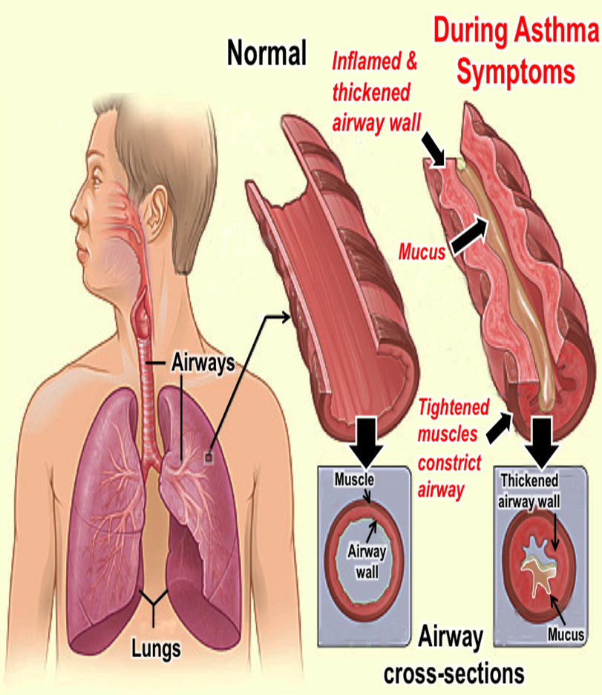

Slide 5
Drug therapy for bronchial asthma
1- Bronchodilators
B2 agonist  Methylxanthines
2- Anti-inflammatory drugs
Corticosteroids  Mast cell stabilizers
3- Supportive treatment
Mucolytics & expectorants
Anticholinergics
Omalizumab  Leukotriene antagonists
Antimicrobials  Oxygen inhalation

Slide 6
Bronchodilators
1- β₂ agonists
Non-selective β-agonists (βı, β₂): Adrenaline ( used only in bronchial asthma due to anaphylactic shock) Selective β₂ agonists:
Short-acting: salbutomal, terbutaline (4-6 H)
Long acting: salmeterol and formeterol (12 H)

Slide 8
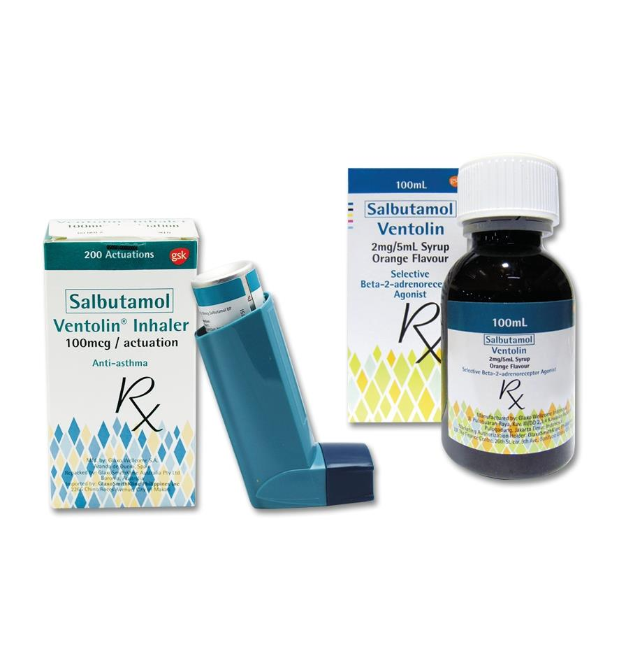
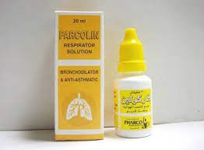
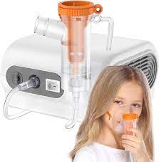
Selective β₂ agonists replaced non-selective β agonists as they lack their side effects e.g. palpitation, tachycardia and arrhythmias
Salbutamol: Short acting beta2 agonist (SABA)
Selective stimulant of β₂ adrenergic receptors
Selective action on the bronchi
Given orally & by inhalation
Terbutaline: Short acting beta2 agonist (SABA)
Like salbutamol but has a delayed onset of action

Slide 9
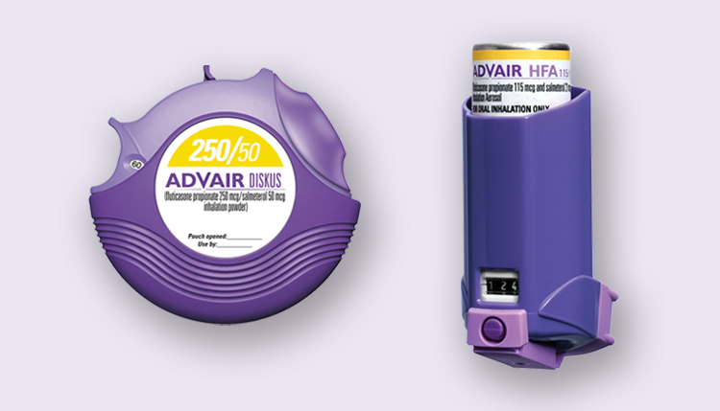
Salmeterol & Formoterol: long acting beta2 agonist (LABA)
Selective long-acting β₂ agonists
Given by inhalation for long-term prevention of bronchial asthma
Should be combined with inhaled corticosteroids to avoid tolerance

Slide 10
Adverse effects:
Tremors
Tachycardia: Arrhythmia may occur in patients with underlying cardiac diseases eg, ischemic heart disease
Tolerance
Hypokalemia
Note: Adverse effects occur more frequently with oral preparations than with inhalation
Note: Nebulizers provide more quantity of the drug than MDIs, so nebulized β₂ agonists can cause more adverse effects

Slide 11
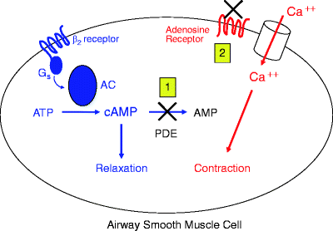
2- Methylxanthines (Aminophylline & Theophylline)
Mechanism of action:
PDE inhibitors ➔ ⬆ cAMP which causes redistribution of intracellular Ca⁺²➔ bronchodilatation
Block adenosine receptors ➔ bronchodilatation
Improve diaphragmatic contraction & ventilatory response to hypoxia
⬇ mediators release from mast cell.

Slide 12
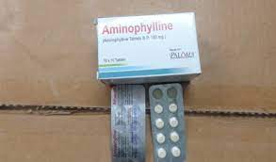
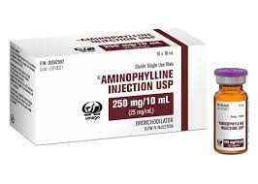
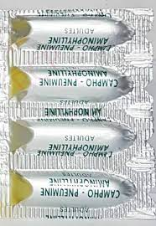
Pharmacokinetics:
Theophylline is absorbed by all routes
Distributed all over the body & passes BBB and placental barrier
Metabolized in liver (by xanthine oxidase) into soluble methyluric acid (not precipitated in the joints ➔ not contraindicated in gout)
Narrow therapeutic window with low safety

Slide 13
Pharmacological actions:
Relaxation of the smooth muscle (bronchial, intestinal, biliary, ureteric and vascular smooth muscles “except cerebral blood vessels” → vasodilatation and hypotension)
CVS: Direct: positive inotropic & chronotropic effects - VD (hypotension)
Central: stimulation of CIC (bradycardia) & VMC (hypertension)
Large & rapid IV injection → hypotension & arrhythmia.
Precautions:
Monitoring of plasma level (to avoid toxicity)
Slow IV administration to avoid hypotension & arrhythmia.

Slide 14
Note: Roflumilast:
Selective PDE-4 inhibitor ➔ selective action on airways & inflammatory cells ➔ fewer adverse effects than methylxanthines
Approved for treatment of COPD ( chronic obstructive disease)

Slide 15
3- Muscurinic (M) Antagonists
Atropine ( tertiary amine) blocks bronchial M receptors, but it is not effective in bronchial asthma because:
Cholinergic pathways play a minor role in pathogenesis of bronchial asthma
Non-selective effects:
Dryness of bronchial secretions
⬇ Muco-ciliary function

Slide 16
Ipratropium bromide:
Quaternary ammonium derivative of atropine
Minimal amounts are absorbed ➔ no systemic adverse effects
More selective (causes bronchodilation without effects on sputum viscosity or ciliary function)
No central effects
Given by inhalation & can be combined with β₂ agonists
Short-acting ➔ used 3-4 times daily

Slide 17
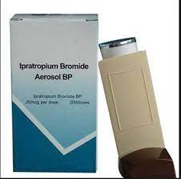
Tiotropium: differs from ipratropium in the following:
Long-acting (given once/day)
Given by inhalation
Approved for treatment of COPD with no cardiac adverse effects.

Slide 18
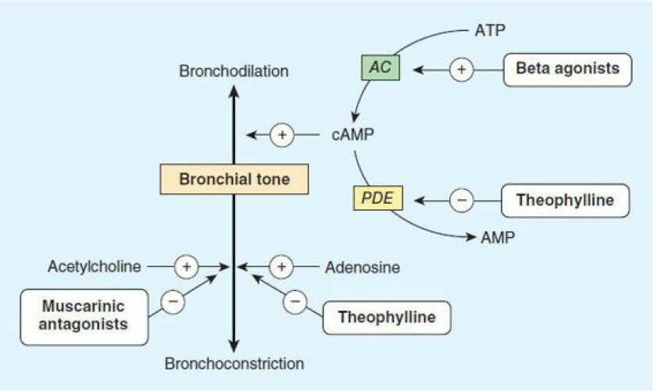
Bronchodilators

Slide 19
Anti-Inflammatory Drugs
1- Corticosteroids
Mechanism of action:
⬆ Synthesis of lipocortin ➔ ⬇ PLA₂ activity ➔ ⬇ arachidonic acid, PGs and LTs synthesis
Immunosuppressive action (⬇ antibody synthesis) & inhibition of Ag/Ab reaction & mast cell stabilization
⬇ Capillary permeability & reduce mucosal edema
⬆ Catecholamines effect through:
Block neuronal reuptake
⬆ Methylation of noradrenaline to adrenaline

Slide 20
Uses in bronchial asthma:
Prophylaxis (in between attacks)
Repeated nocturnal asthma
Acute severe asthma
Preparations:
Inhalation: beclomethasone, budesonide, fluticasone (long-acting)
Parentral: methyl prednisolone, hydrocortisone, dexamethsone, ACTH
Oral: prednisolone

Slide 21
Adverse effects:
Inhalation:
Oral moniliasis (treated by nystatin)
Dysphonia due to weakness (myopathy) of adductor muscle of the cord
Suppressive effects: adrenocortical suppression
Cushing's syndrome (with the use of large doses of corticosteroids)
Metabolic: hypokalemia, hyperglycemia, salt & water retention, weight gain and hypertension
Cataract

Slide 22
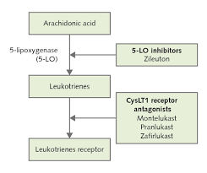
2- Leukotriene Antagonists
They include:
LT receptor antagonists (Montelukast & zafirlukast)
5-LOX inhibitors (zileuton): ⬇ LTs synthesis
Pharmacokinetics:
All members are given orally
Zafirlukast absorption is affected by food
They are metabolized by liver

Slide 23
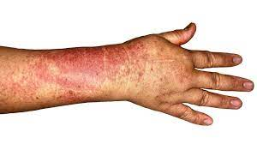
Uses:
prophylaxis of bronchial asthma especially aspirin-induced asthma
Adverse effects:
Liver toxicity:
Regular monitoring of liver transaminases is required if their levels exceeded 3-5 times the normal level, these drugs should be discontinued
More reported with zileuton
Systemic vasculitis (Churg-Strauss syndrome): rare

Slide 24
3- Mast cell stabilizers
Members:
Disodium cromoglycate (Cromolyn sodium)
Ketotifen
They are not bronchodilators
So, they cannot relieve acute attacks of asthma
They can be effective only if given before the exposure the antigen
Mechanism: stabilization of mast cell membrane (possibly by blocking calcium influx) ➔ ⬇ release of allergic mediators eg, histamine & LTs.

Slide 25
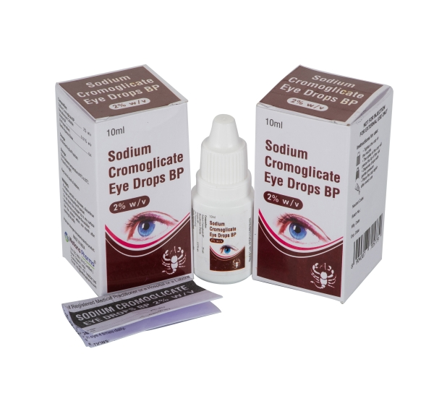
They are useful chiefly for asthma prophylaxis, particularly children & young adults
Ketotifen has additional antihistamine effect
Route:
Disodium cromoglycate: inhalation
It is also available as nasal spray for allergic rhinitis & as eye drops for allergic conjunctivitis
Ketotifen: oral administration
Adverse effects:
Disodium cromoglycate:
Local irritation: bronchospasm & cough
Ketotifen:
Drowsiness

Slide 26
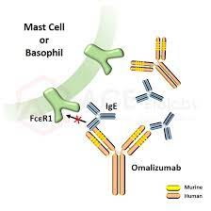
4-Omalizumab
Selectively binds to human IGE ➔ inhibits IGE binding to its receptor on mast cells & basophils surface ➔ ⬇ release of inflammatory mediators
It decreases severity and frequency of asthma exacerbations
Used in patients resistant to conventional therapy (β2 agonists & inhaled corticosteroids)
Its use is limited by its high cost

Slide 28
Bronchial Asthma Prophylaxis
Control of predisposing factors
Desensitization
Drugs that prevent or diminish the frequency of the attacks:
Bronchodilators ( long duration)
Corticosteroids (oral or inhalation)
LT antagonists
Mast cell stabilizers
Omalizumab

Slide 29
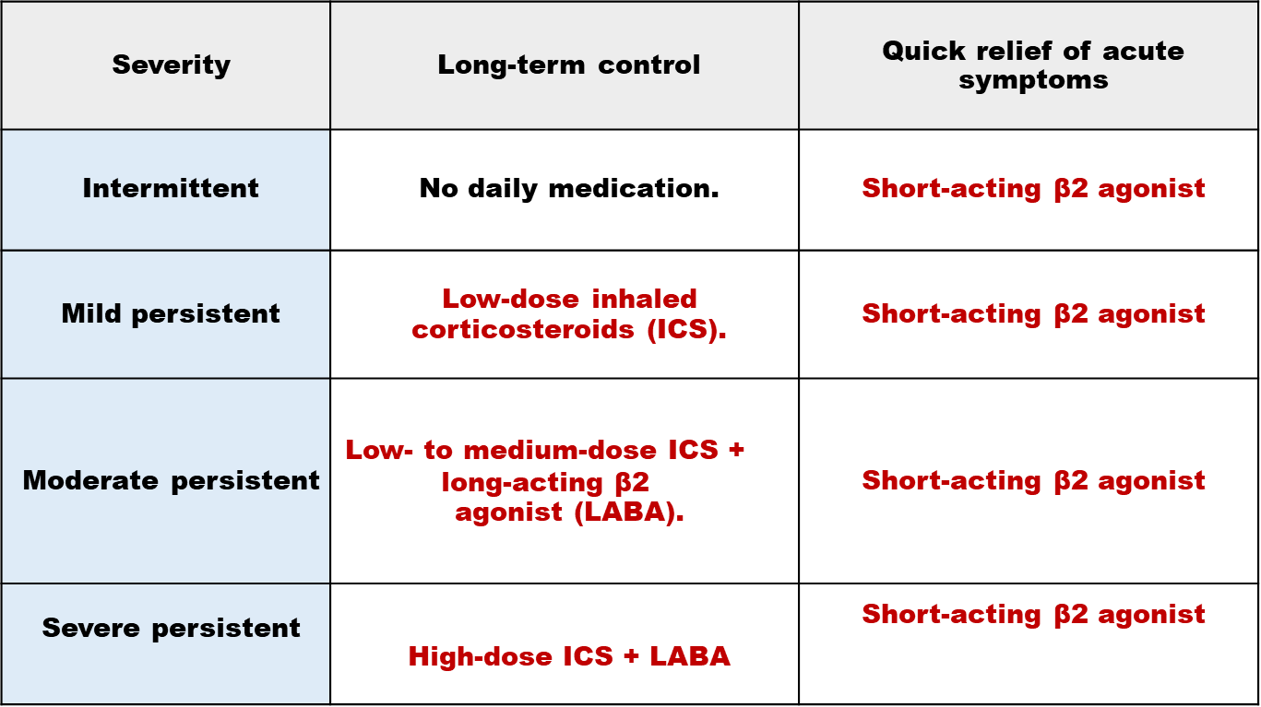
Acute attack
Inhaled short-acting β2 agonist e.g. salbutamol or terbutaline
Long-term prophylaxis (Between attacks):
Less than 2/ week
more than 2/ week
daily
continual

Slide 30
Acute severe asthma (Status asthmaticus)
Treatment:
Hospitalization & O₂ therapy
Inhaled short-acting β₂ agonist (frequent or continuous administration) is the 1st line of choice. Ipratropium bromide should be added.
Systemic corticosteroids:
Oral prednisolone (or)
IV hydrocortisone or methylprednisolone (if the patient has vomiting or unable to swallow)
IV fluids (some patients are dehydrated). K+ supplements are considered (repeated administration of β₂ agonists ➔ hypokalemia)
If failed to improve, aminophylline slow IV infusion can be administered
Mechanical ventilation is considered if the patient still deteriorating
On discharge, oral prednisolone should be continued for short courses

Slide 31
References
Wilkins R,Cross S, Megson L and Meredith D (2011):Oxford Handbook of Medical Sciences Second Edition
Tao Le, Vikas Bhushan Matthew Sochat, Yash Chavda, Kimberly Kallianos, Jordan Abrams, Mehboob Kalani and Vaishnavi Vaidyanathan (2019): FIRST AID for the USMLE Step 1.
Sandra K. Leeper-Woodford and Linda R. Adkison, (2016): Lippincott Illustrated Reviews: Integrated Systems. Page 173.
Duncan Richards, Jeffrey Aronson, D. John Reynolds, and Jamie Coleman (2012): Oxford Handbook of Practical Drug Therapy. Cardiovascular system. page 173.

Slide 32
THANK YOU

