Slide 2
Types of urine sample
Sample type | Sampling | Purpose
Random specimen | No specific time most common, taken anytime of day | Routine screening
Morning sample | First urine in the morning, most concentrated | Pregnancy test, microscopic test
Clean catch midstream | Discard first few ml, collect the rest | Culture
24 hours | All the urine passed during the day and night and next day Ist sample is collected. | used for quantitative and qualitative analysis of substances
Postprandial | 2 hours after meal | Determine glucose in diabetic monitoring
Supra-pubic aspired | Needle aspiration | Obtaining sterile urine

Slide 3
Urine analysis I. Physical properties of urine
Volume, Colour, Odour, Reaction, Aspect, Deposits, Specific Gravity.
Volume
Normal urine volume is 600 - 2 000 ml/day.
Normally, more urine is secreted during the day than at night.
Increased volume:
Physiological increase: - After excessive fluid intake.
Abnormal increase(polyuria): More than 3 L/day
- Diabetes mellitus (may reach 5 L/day)
- Diabetes insipidus (10-15 L/day)

Slide 4
Urine analysis I. Physical properties of urine:Volume
Decreased volume:
Physiological decrease: in summer due to increased sweating
Abnormal decrease (Oliguria): Less than 200 ml/day
acute nephritis.
heart failure.
hemorrhage.
Anuria: No urine at all. In late stages of renal failure and heart failure.

Slide 5
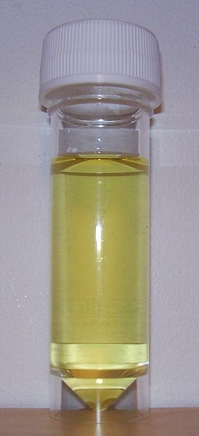
Urine analysis I. Physical properties of urine: Color
Normal color is amber yellow due to pigments called urochromes.
Abnormal urine colors:
Obstructive jaundice: Greenish brown due to presence of cholebilirubin (conjugated or direct bilirubin).
Haemorrhage in urinary tract: reddish brown colour.
Alkaptonuria: Black (homogentisic acid is oxidized to give black color when exposed to air).
Alkaptonuria: Rare inherited genetic disorder of phenylalanine and tyrosine metabolism .It is an autosomal recessive condition. It is due to a defect in the enzyme homogentisate 1,2-dioxygenase.

Slide 6
Urine analysis
Odor: Fresh urine is normally aromatic (urineferous). Abnormalities:
Fruity odor: uncontrolled DM & severe starvation
Ammoniacal odour: Urinary tract infection & Long standing exposed sample.
Reaction:
The urine pH depends on the ratio of NaH2PO4 / Na2HPO4.
Acidic urine: - Ketoacidosis.
Alkaline urine: - Bacterial infection.
Aspect: Normal urine is clear (transparent).
It becomes turbid and opaque due to presence of albumin.
Exposed urine is a good medium for bacterial growth as its pH becomes alkaline, resulting in precipitation of phosphates.

Slide 7
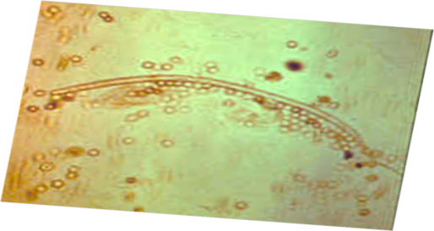
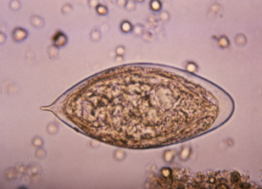
Urine analysis: Deposits microscopic examination
Normal urine is devoid from deposits.
In order to examine the deposit, we make centrifugation to urine then microscopic examination.
The examination includes:
Organized elements
-cells:RBCs, WBCs and pus cells,
epithelial cells and neoplastic cells
- pasasites and ova:B , filariasis. -casts.
b) Non organized elements (crystalluria)
1-acidic urine: uric acid crystals, calcium oxalate.
2-alkaline urine: amorphous phosphate, triple phophate.

Slide 8
Specific gravity
urinary specific gravity (SG) is a measure of the concentration of solutes in the urine. It measures the ratio of urine density compared with water density and provides information on the kidney's ability to concentrate urine.
Measured by:
urinometer
refractometer
dipsticks

Slide 9
Specific gravity
Normal :- 1.010- 1.030.
Increase in Specific Gravity - Low water intake, Diabetes mellitus, Albuminuruia, Acute nephritis.
Decrease in Specific Gravity - Absence of ADH, Renal Tubular damage.
Fixed specific gravity (isosthenuria)=1.010
In chronic renal failure

Slide 10
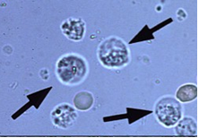
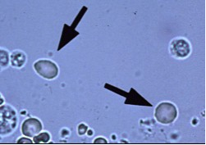
Urine analysis microscopic examination: Cells
Pus cells:
Nucleus: disintegrated.
Normal urine contain from 2-4 pus cells.
Their presence in excess would point to infection.
Red Cells:
Nucleus: non-nucleated.
Normal urine contain from 0-2 red cells.
Their presence in excess is pathological and is due to the different causes of hematuria e.g. bilharziasis, urinary tumors, urinary stones.

Slide 11
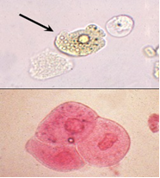
Urine analysis microscopic examination: Cells
Epithelial cells:
Shape: large irregular cells
Nucleus: large, intact and central.
Normal urine may contain few epithelial cells, but excess of these cells in urine point to the presence of an inflammatory condition.

Slide 12
Urine analysis microscopic examination: Casts
The casts are the molds of renal tubules.
Normal urine does not contain casts and so their appearance in urine is important and diagnostic for certain diseases.
There are various types of casts which may appear in urine.
The material or cells that form a cast may have:
come through a damaged glomerulus.
been part of an interstitial inflammatory infiltrate.
have been dead tubular cells.
The cast is expelled into the urine, and maintains the shape of the tubule in which it formed.
Casts reflect conditions of the kidney proper and not the lower urinary tract.

Slide 13
Urine analysis: microscopic examination: Casts
Hyaline casts: They are colorless, homogenous and empty. In nephritis and also in heart failure.
Blood casts: in acute nephritis.
Pus casts: in pyelonephritis.
Epithelial casts: in acute nephritis.
Granular casts: in chronic nephritis.

Slide 14
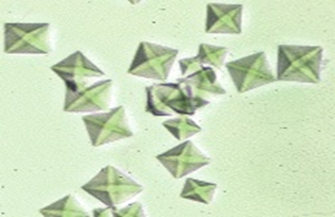
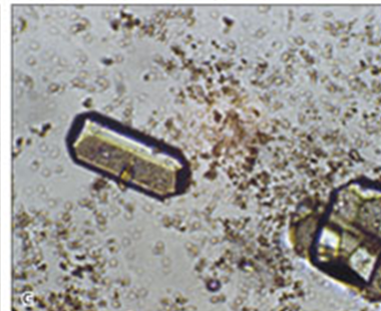
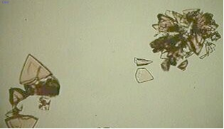
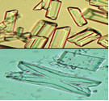
Urine analysis microscopic examination: Crystals
Crystals in acidic urine:
Calcium oxalate:
Shape: envelope shaped or in the form of dumb-bells.
Color: colorless.
Uric acid:
Shape: various forms e.g. rosettes or barrels.
Color: brownish or colorless.
Crystals in alkaline urine
Triple phosphate:
Shape: prismatic
Color: colorless

Slide 15
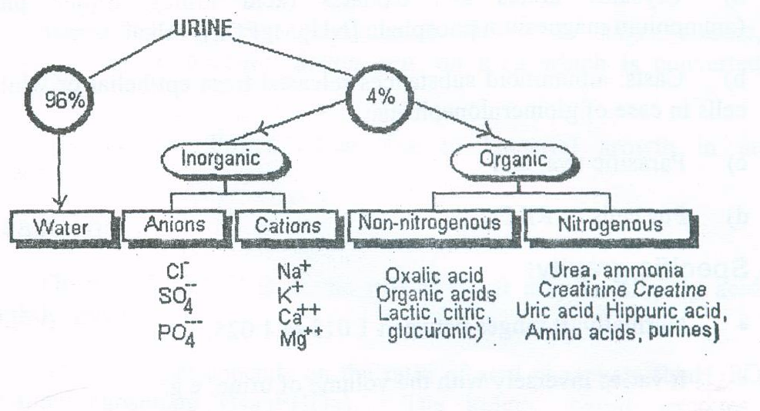
Normal constituents of urine

Slide 16
Constituents of urine: Organic constituent
Nitrogenous:
1. urea: 2. uric acid 3. creatinine 4. ammonia
5. proteinuria :<150mg/24h
6. albuminuria :<30mg/24h
7. urinary pigment (urobilinogen).
8. Amino acids:
Large amounts of amino acids are excreted in case of:
- extensive destruction of the liver: chloroform and tetrachlorocarbon poisoning.
- inborn error known as (cystinuria) which is a tubular defect in reabsorption of cystine, arginine, lysine and ornithine.

Slide 17
ABNORMAL CONSTITUENTS OF URINE
Proteins
Sugars
Ketone bodies
Bile
Blood
Porphyrins

Slide 18
Abnormal constituents of urine
1. Proteins (proteinuria)
Albuminuria:
Increased amount of albumin in urine is called albuminuria ,which can be:
A. Physiological (less than 500 mg/day): after severe muscle exercise.
B. Pathological:
Prerenal: e.g. heart failure.
Renal: intrinsic in the kidney, e.g. nephritis and nephrosis.
Postrenal: in the lower urinary tract, e.g. cystitis.
Bence-Jones Proteins.
It is Abnormal globulins which is detected in multiple myeloma a bone marrow cancer, leukemia and lymphoma.

Slide 19
Proteinuria
Normally excretion in most healthy adults is between 20-150 mg of protein in urine over 24 hrs.
Proteinuria more than 3.5 gm/day is taken to be diagnostic of nephrotic syndrome.
Panels of protein measurement including albumin, macroglobulin, IgG and β 2- microglobulin have been employed in differential diagnosis of prerenal and postrenal disease.

Slide 20
Abnormal constituents of urine
2. Sugars
Glucose (glucosuria): Normally glucose <0.5 g/day. Glucosuria. In most cases glucosuria is a symptom of diabetes mellitus, when level of glucose in blood more than kidney threshold (180 mg/dl).
Galaclose (galactosuria): in congenital galactosemia (deficiency of galactose-1-phosphate uridyl transferase enzyme).
Lactose (lactosuria): During pregnancy and lactation, may appear in mothers and infants.

Slide 21
Abnormal constituents of urine Familial renal glycosuria
Glucose is present in urine even its level in blood is normal.
It is characterized by decreased renal reabsorption of glucose.
In most cases this abnormality is due to mutations in the SLC5A2 gene, which encodes for the sodium glucose co-transporter 2, SGLT2 (SGLT2 is the major glucose co-transporter in the proximal tubule responsible for 90% of the renal glucose reabsorption).

Slide 22
Abnormal constituents of urine
3. Ketone bodies (ketonuria)
Normally 3-15 mg are excreted in urine per day.
Ketonuria is the presence of excessive amounts of ketone bodies in urine (acetone, aceto-acetate, 3-hydroxybutyrate).
This may occur in:
uncontrolled diabetes mellitus
prolonged starvation.
.

Slide 23
Abnormal constituents of urine
4. Bile
Bile pigments : appear in urine in hepatic, obstructive and haemolytic jaundice.
Bile salts: Bile salts appear only in obstructive jaundice.
5. Blood
Hematuria in: - blood diseases. - renal stones. - renal tumors.
Hemoglobinuria: which is less common, is due to excessive hemorrhage in the urinary tract.
6. Porphyrin
Porphyrias: the occurrence of uroporphyrins as well as increased amount of coproporphyrins in urine .

