Slide 1
Hypertension in Pregnancy
Malek Al Qasem , MD
Maternal and Fetal Medicine

Slide 2
Introduction
Hypertensive disorders of pregnancy are one of the leading causes of maternal mortality
Worldwide: 50,000 women die each year

Slide 3
Hemodynamic Changes in Normal Pregnancy
Systemic vascular resistance decreases
Plasma volume and cardiac output increase
There is a physiological drop in BP detectable before the end of the first trimester due to vasodilation

Slide 4
Hypertension one the most common medical complication in pregnancy
Major cause of maternal/fetal and neonatal morbidity and mortality
Hypertension is systolic blood pressure of ≥140 mm Hg and/or diastolic blood pressure of ≥90 mmHg on ≥2 occasions 4 hours apart
Proteinuria is the presence of ≥300 mg of protein in a 24-hour collection of urine
OR urinary protein to creatinine ratio of ≥30 mg/mmol 0.3 mg /dl
OR two readings of at least ++ on dipstick analysis of a midstream or catheter urine specimen

Slide 5
Classification of HTN in Pregnancy (HDP)
Chronic/ essential HTN
Gestational HTN
Preeclampsia
HTN known before pregnancy OR present in the first 20 weeks of gestation
HTN arising de novo at or after 20 weeks
Preeclampsia de novo
OR superimposed on chronic hypertension
Eclampsia
white coat hypertension

Slide 6
Chronic hypertension
Diagnosed prior to pregnancy or before 20 weeks gestation (and persisting 12 weeks after pregnancy)
Has doubled in prevalence over the last decade and now complicates at least 100,000 pregnancies (2.36%) in the United States each year
The diagnostic criteria for hypertension in pregnancy were similar to those for non-pregnant individuals and included a systolic blood pressure (SBP) of ≥ 140mm Hg or a diastolic blood pressure (DBP) of ≥ 90mm Hg on at least 2 separate occasions more than 4 hours apart for mild hypertension
SBP ≥ 160 mm Hg or a DBP ≥ 110 mm Hg for severe hypertension

Slide 7
Classification of chronic hypertension
Primary (idiopathic) or essential
Secondary due to
Renal :glomerulonephritis, renal artery stenosis ,Polycystic kidneys .. etc
Endocrine: crushing's syndrome ,Conn's syndrome ,Phaeochromocytoma , Thyrotoxicosis..etc
Vascular: coarctation of the aorta

Slide 8
What are the effects of HTN on Pregnancy
Maternal :
Preeclampsia up to 50 % of those with severe chronic HTN
Placental abruption up to 10%
Cesarean delivery
Cerebrovascular accidents
Acute renal failure
Congestive heart disease
Liver failure
DIC
Death

Slide 9
Fetal complications : Fetal growth restriction Preterm birth Perinatal mortality

Slide 10
Gestational hypertension
Hypertension after 20 weeks of gestation with no proteinuria
High BP>=140/90 in 2 reading 4 hours apart

Slide 11
Preeclampsia
Multisystem syndrome developing during the second half of pregnancy
characterized by hypertension and proteinuria OR in the absence of proteinuria the finding of maternal organ dysfunction

Slide 12
Preeclampsia superimposed on chronic hypertension
PET superimposed on chronic hypertension :
History of hypertension before conception
the presence of hypertension before 20 weeks
Gestation and proteinuria OR maternal organ dysfunction should develop after 20 weeks gestation

Slide 13
Maternal organ dysfunction
Renal insufficiency – serum creatinine ≥ 90 μmol/L or 1,04 mg/dl
Hepatic dysfunction – high serum hepatic transaminase levels (≥2 times the upper limit of normal) and / or severe persistent upper abdominal pain unresponsive to medication
Neurological complications - eclampsia, stroke, confusion, hyperreflexia accompanied by clonus, severe headache accompanied by hyperreflexia, blindness or persistent visual scotomata
Hematological complications - platelet count <100,000/dL
Disseminated intravascular coagulation (DIC) or hemolysis
Pulmonary edema

Slide 14
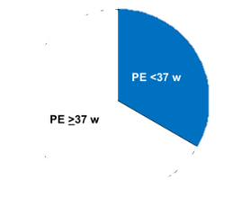
Prevalence
In 2-5% of pregnancies
The rate depends on the demographic characteristics of the population in Black women the rate is 2-3 times higher than in White women
In one third of the cases the condition leads to delivery at <37 weeks’ gestation (preterm PE) and in two thirds delivery occurs at ≥37 weeks (term PE)

Slide 15
Maternal complications of Preeclampsia
Eclampsia (convulsions or coma in a woman with PET
Brain hemorrhage or stroke
Disseminated intravascular coagulation (DIC)
HELLP syndrome (Hemolysis, Elevated Liver enzymes and Low Platelets)
Other severe complications include:
Brain edema
Blindness
Renal failure
Hepatic failure
Pulmonary edema
Death

Slide 16
Long term complications
Doubling in lifetime risk of cardiovascular disease (CVD)
Including: Hypertension
Ischemic heart disease
Stroke
Death from CVD

Slide 17
Fetal complications
Reduced blood supply to the placenta
Impairment in fetal growth oxygenation and increased risk of stillbirth
Premature delivery for maternal and / or fetal indications
Babies are subjected to the additional risks arising from prematurity: - neonatal death
-brain hemorrhage
-seizures
-respiratory and feeding difficulties, jaundice, retinopathy, and prolonged hospitalization

Slide 18
PEt and eclampsia are implicated in about 25% of stillbirths and neonatal deaths and 15% of growth restricted neonates

Slide 19
Childhood compications
Children exposed to PE before birth compared to those born after normal pregnancy have
a doubling in risk of cerebral palsy
( this risk is mediated through premature birth
growth restriction or both)
Higher blood pressure
Body mass index
Increased risk for CVD
Diabetes in adult life

Slide 20
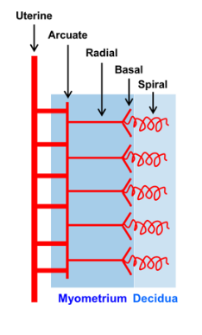
Pathogenesis
In pregnancy the blastocyst implants into the maternal endometrium
The outer layer of the blastocyst develops into the trophoblast
This differentiates into villous trophoblasts and extravillous trophoblasts

Slide 21
Villous trophoblasts give rise to chorionic villi that transport nutrients and oxygen between the fetus and the mother
Extravillous trophoblasts which invade and transform the spiral arteries

Slide 22
The trophoblasts replace the endothelial lining and destroy the musculoelastic tissue in the walls of the spiral arteries
so that they are converted from tortuous narrow muscular vessels into large non-muscular channels thereby increasing maternal blood flow to the placenta
This physiological process occurs in two stages:
The first wave of trophoblastic invasion involves the spiral arteries in the decidua (endometrium of pregnancy) and starts at 8 weeks of gestation
The second involves the spiral arteries in the inner third of the myometrium and occurs at 14-18 weeks

Slide 23
In PEt the physiologic process of placentation is impaired There is trophoblastic invasion in 50-70% of spiral arteries does not extend into the myometrial segments and is confined to the decidual part of the vessels
The spiral arteries are less dilated than the normally transformed arteries and the blood supply the placenta is reduced
The reason why in some pregnancies there is failed placentation is unknown but genetic and immunological reasons may be implicated

Slide 24
Reduced perfusion of the placenta causes oxidative stress release of trophoblast-derived factors enter the maternal circulation and cause endothelial cell damage in:
The kidney
liver
brain and placenta
** exaggerated inflammatory response which underlines many of the changes observed in PE

Slide 25
Placental-derived factors released in response to stress include :
the anti-angiogenic protein sFLT1( which is increased in PEt) whereas the circulating concentration of the angiogenic placental growth factot (PlGF) is reduced in PE This angiogenic imbalance results in increased maternal vascular inflammation and generalized endothelial dysfunction

Slide 26
In preterm PEt which is characterized by impaired placentation
In term PEt placentation is usually normal
In women with medical disorders, such as chronic hypertension, there is endothelial dysfunction even before pregnancy in such cases PE can develop in the absence or lower degree of impaired placentation

Slide 27
Impaired trophoblastic invasion of the maternal spiral arteries
Placental hypoxia
Release of trophoblast factors into the maternal circulation
Platelet and endothelial cell activation and damage
Clinical symptoms of preeclampsia

Slide 28
Prevention of preeclampsia
In 1543 BC the Egyptians used extracts from the willow tree for pain relief
In 400 BC Hippocrates used powder made from the bark and leaves of the willow tree for headaches, pains and fevers
In 1828 Johann Buchner at the University of Munich, extracted the active ingredient of the willow plant and called it salicin (Latin term for willow)
In 1915 Bayer developed aspirin tablets
In 1979 Crandon and Isherwood reported that women who had taken aspirin regularly during pregnancy were less likely to have PE than women who had not

Slide 29
Prevention of preeclampsia
The rate of PE is not reduced by
bed rest
restriction of physical activity or dietary manipulations, including restriction of salt intake or supplementation with magnesium, zinc, folate vitamins C, D and E or fish oil
Dietary calcium supplementation in women with low calcium diets may halve the rate of PE
Preliminary data suggest that prophylactic use of pravastatins may also benefit women at high-risk of PEt

Slide 30
Low dose aspirin
The prophylactic use of low-dose aspirin in the prevention of PE has been studied extensively
A meta-analysis of trials showed that the administration of low-dose aspirin in high-risk pregnancies resulted in a 10% lower incidence of PE However in most studies aspirin was started after 16 weeks’ gestation and at a dose of <100 mg/day
Other meta-analyses showed that aspirin started before 16 weeks resulted in halving the rate of PE, whereas aspirin started after 16 weeks did not have a significant benefit
In addition, the beneficial effect of aspirin was dose dependent, with a greater reduction in the incidence of PE being associated with a dose of >100 mg/day

Slide 31
ASPRE trial
International multicenter study
Routine screening for preterm PE was carried out at 11-13 weeks
gestation by the FMF algorithm that combines maternal
factors and biomarkers in about 27,000 singleton pregnancies
Use of aspirin was associated with a 62% reduction in the incidence of preterm PE and 82% reduction in the incidence of PE at <34 weeks’ gestation

Slide 32
Maternal risk factors
Advancing maternal age
Increasing weight
Afro-Caribbean and South Asian racial origin
Medical history of chronic hypertension
Diabetes mellitus
Systemic lupus erythematosus or antiphospholipid syndrome
Conception by in vitro fertilization
family history or personal history of PE
The risk of PE in women in their first pregnancy is three times higher than in women with previous pregnancies that were not complicated by PE
Women who had PE in a first pregnancy are up to 10 times more likely to develop PE in a second pregnancy
The risk for PE is lower in tall than in short women
Decreased in parous women with no previous PE
The protective effect against PE of a previous pregnancy without PE, decreases with the time interval between the previous and the current pregnancy so that after 15 years the risk of PE is about the same as that in nulliparous women

Slide 33
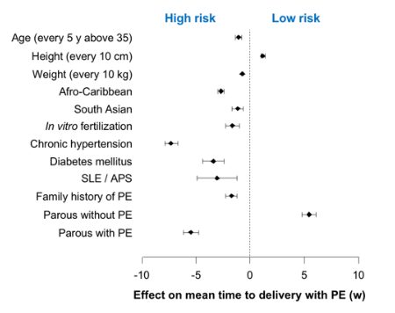

Slide 34
Screening at 11-13 weeks
Combined screening by maternal risk factors, mean arterial pressure MAP, uterine arteries UTPI and PLGF predicts about 90% of early PE (<34 weeks), 75% of preterm PE (<37 weeks) and 45% of term PE (≥37 weeks)

Slide 35
Mean arterial pressure (MAP)
In the prediction of PE measurement of MAP is more useful than measurement of systolic and diastolic blood pressure
The MAP is defined as the average arterial pressure during a single cardiac cycle and is calculated from the following formula: MAP = 2/3 diastolic blood pressure + 1/3 systolic blood pressure

Slide 36
Measurement of uterine artery PI (UTPI)
The UTPI can be measured by either transabdominal or transvaginal sonographey

Slide 37
Waveform has good end-diastolic flow
shows high resistance of flow with early diastolic notch and low end-diastolic flow

Slide 38
Placental growth factor PIGF
Measure the amount of PIGF in blood plasma or serum
PIGF is a protein involved in placental angiogenesis ( the development of new blood vessels)
In normal pregnancy PGIF levels rise and peak at 26-30 weeks
PIGF levels do not rise during pregnancy may be placental dysfunction
In Preeclampsia level of PIGF can be abnormally low

Slide 39
Soluble FMS-like tyrosine kinase-1 (sFlt-1)
an anti-angiogenic factor that is thought to play a central role in the pathogenesis of PE
Exogenous sFLT-1 administered to pregnant rats induces hypertension, proteinuria, and glomerular endotheliosis

Slide 40
Pregnancy associated plasma protein-A (PAPP-A)
PAPP-A is produced by the placenta and is thought to play an important role in placental growth and development
Maternal serum levels of PAPP-A in the first-trimester of pregnancy are decreased in pregnancies with fetal trisomies 21, 18 and 13
In pregnancies that develop PE, compared to unaffected pregnancies, maternal serum PAPP-A is decreased during the first-trimester, not significantly different in the second-trimester and increased in the early third-trimester

Slide 41
Screening at 20-24 weeks
Screening at 30-34 weeks

Slide 42
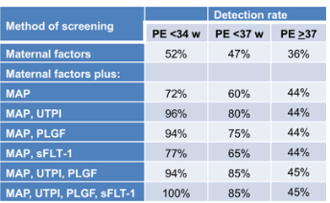

Slide 43
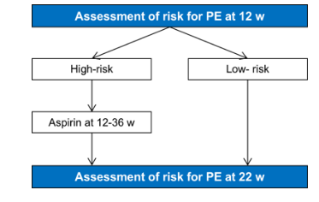

Slide 44
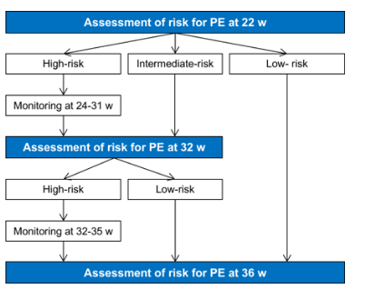

Slide 45
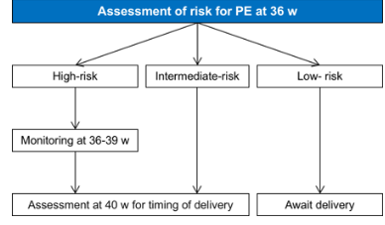

Slide 46
Managements
Chronic hypertension:
STOP :
ACE inhibitors or ARBs ( within 2 days of notification of pregnancy
Diuretics
ACE case fetal renal damage
ARB cases fetal renal failure lung dysplasia cranial hypoplasia
Limb contractures and fetal death
All these outcomes may de due to fetal hypotension and reduced renal blood flow perfusion
kidney ischemia – anuria --- oligohydramnios

Slide 47
Antenatal appointments
Weekly if HTN poorly controlled or admission
Every 2 to 4 weeks if well controlled

Slide 48
Laboratory findings
Urine analysis ---proteinuria
Microangiopathic hemolytic anemia---elevated serum lactate dehydrogenase LDH or decreased serum Hepatoglobin
Elevated hematocrit ---due to third spacing fluid
Elevated serum creatinine
Elevated serum uric acid
Elevated serum transaminases
Thrombocytopenia
Prolonged prothrombin and partial thromboplastin
Decreased fibrinogen
Increased fibrin degradation products

Slide 49
Treatment of chronic hypertension in pregnancy
Start antihypertensive SBP>= 140 mmHg , DBP>=90 mmHg
Consider labetalol
Consider Nifedipne for women in whom labetalol is not suitable
Consider methyldopa if both labetalol and Nifedipne are not suitable
Offer pregnant women with chronic hypertension aspirin 75 mg-150 mg once at night from 12 week

Slide 50
Antihypertensive therapy: Treating the hypertension is mainly to reduce the maternal complications It will not improve fetal condition Acute treatment of severe hypertension: Hydralazine: 5mg IV repeated every 20-30 min. Nifedipine: 10mg orally repeated at 30 min. IV infusion can be used in severe cases. Labetalol:10-20mg IV . The dose can be doubled every 10 minutes if proper response is not achieved. Magnesium Sulphate should be given in the management of all cases of severe preeclampsia to prevent eclampsia

Slide 51
Time of delivery
In chronic hypertension no induce delivery before 37 weeks if
BP lower 160/110
After 37 weeks depends on senior obstetrician decision
If early birth is necessary offer :
Antenatal corticosteroids
Magnesium sulfate

Slide 52
HELLP syndrome
Hemolysis : identified by burr cells and schistocytes
Thrombocytopenia
Elevated liver function tests

Slide 53
Eclampsia
The occurrence of tonic-clonic convulsions (without any neurological disease) in a woman with pre-eclampsia
Incidence: 5 in 10 000 deliveries and 1-2% of severe PE cases
High maternal and fetal mortality
It can occur antenatally, intra-partum and post-partum
The pathophysiology is cerebral vasospasm leading to ischemia and cerebral edema

Slide 54
Management of eclampsia
During seizure: Maintain airway, Administer oxygen and avoid supine hypotension
Anticonvulsant therapy:
Magnesium sulfate 4-6 g IV followed by a maintenance infusion of 1-2 g / h
Diazepam 20mg IV followed by a maintenance infusion as required
Phynenton
Anticonvulsant should be continued for at least 24 h after the last convulsion
CS is indicated unless the mother is in active labour

Slide 55
Magnesium Sulfate (MgSO4)
It can be given IV or IM or SC
The therapeutic level is 4-7mEq/L
The total dose of MgSO4 should not exceed 24 gms in 24 hours
The dose of MgSO4 is monitored by:
Preserved patellar reflex. (7-10 mEq/L)
Respiratory rate >16/min. (10-13 mEq/L)
Urine output >100ml/4hours. (15-25 mEq/L)
Serum Mg++ level.
Is stopped 24 hours after delivery
Antidote is ca gluconate

Slide 56
Thank you

