Slide 1
Intrapartum fetal surveillance
|PRICE: 0.20|
Dr. Seham Abu fraijeh

Slide 2
Intrapartum fetal surveillance
The aim is to detect potential fetal decompensation and to allow timely and effective intervention to prevent perinatal/neonatal morbidity or mortality.
Changes in fetal heart rate precede brain injury , so timely response to abnormal fetal heart patterns might be effective in preventing brain injury.
During uterine contractions there is a decrease in uteroplacental blood flow and a subsequent increase in fetal pCO2 and a decrease in pO2 and PH.
Avoiding adverse fetal outcome related to hypoxia/acidosis is the main objective of intrapartum fetal monitoring.

Slide 4
Antenatal factors that increase the risk of fetal compromise
- oligohydramnios or polyhydramnios
- multiple pregnancy
- antepartum haemorrhage
- previous caesarean section
- hypertension or pre-eclampsia and diabetes
- prolonged pregnancy
- intrauterine growth restriction
Antenatal factors that increase the risk of fetal compromise
- induction of labour with prostaglandin/oxytocin
- regional anaesthesia
- maternal pyrexia: ≥ 38°C
- meconium or blood stained liquor
- pre-term labour
- uterine hyperstimulation

Slide 5
Intrapartum fetal surveillance
Fetal Heart Rate Monitoring (FHR)
- Intermittent auscultation
- Continuous electronic fetal heart monitoring (EFM)
Fetal Scalp blood pH estimation
Intrapartum fetal stimulation tests
- Fetal scalp stimulation tests
- Fetal acoustic stimulation test (FAST)
Newer approaches
- Fetal ECG
- Scalp blood lactate estimation
- Continuous biochemical monitoring
(Pulse oximetry)

Slide 6
Intermittent Auscultation
It is the recommended fetal surveillance method during labor for healthy women without risk factors for adverse perinatal outcome.
A baseline heart rate is assessed by listening and counting FHR between uterine contractions.
FHR is counted for 60 seconds.
Intermittent Auscultation
The FHR should be assessed at least every 30 minutes in the first stage of labor and every 15 minutes in the second stage .
It ensures frequent contact between healthcare professionals and the laboring woman.
If abnormal, EFM is recommended .

Slide 7
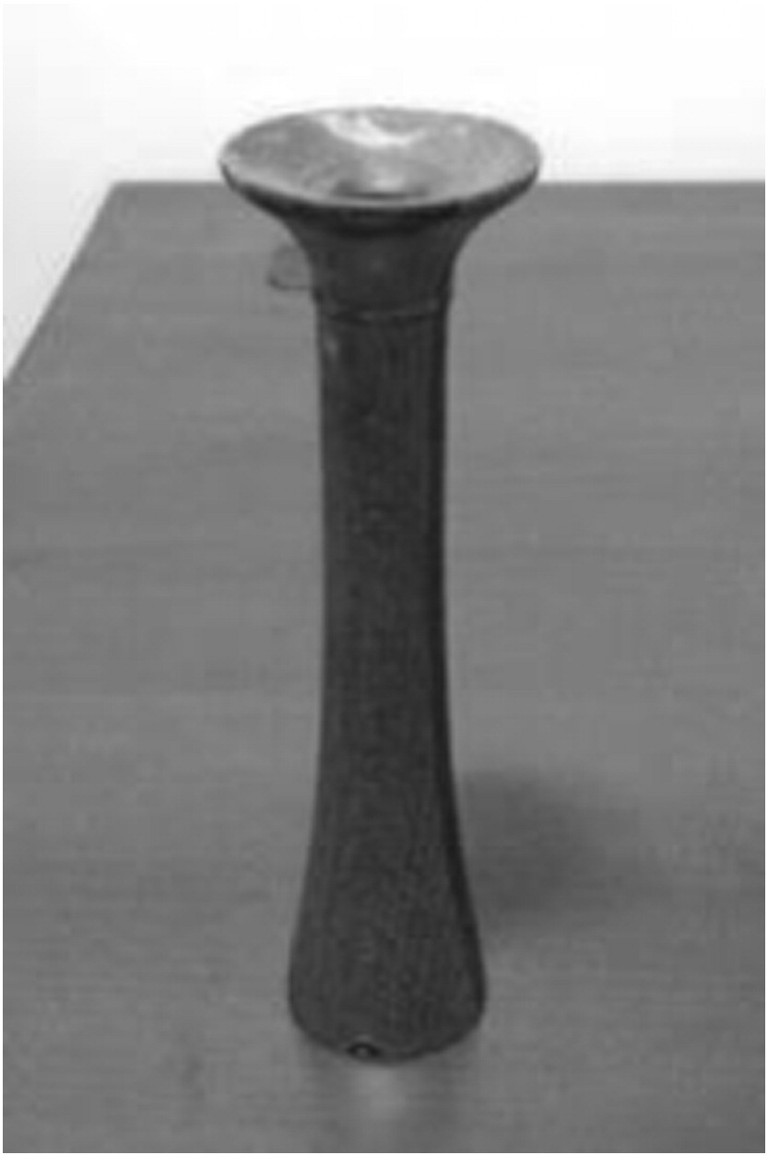
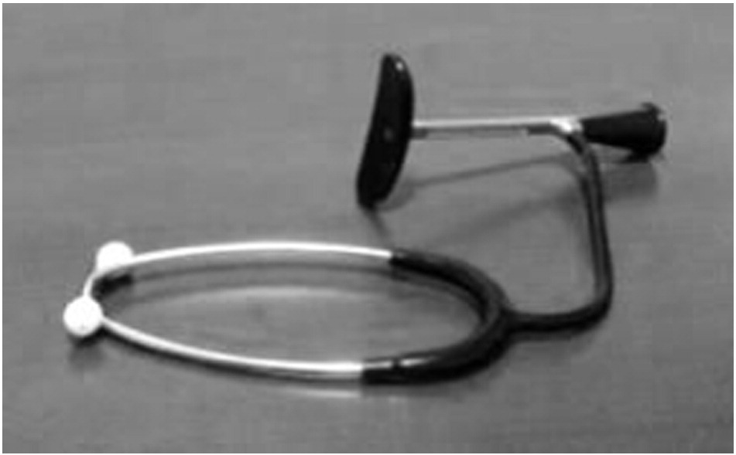
Pinard stethoscope.
Handheld Doppler device
DeLee stethoscope

Slide 8
Electronic fetal heart monitoring

Slide 9
Electronic fetal heart monitoring
It should be considered in all situations where there is a high risk of fetal hypoxia/acidosis.
The electronic FHR monitor is a device with two components. One establishes the FHR, and the other measures uterine contractions.
Continuous cardiotocography (CTG )is also recommended when abnormalities are detected during intermittent fetal auscultation.
CTG has been shown to decrease the occurrence of neonatal seizures.

Slide 10
Electronic fetal heart monitoring
Limit woman’s mobility
Decease direct contact between woman & staff.
Continuous EFM is associated with an increase in the rates of Caesarean sections and instrumental vaginal births.

Slide 11
EFM may be performed with an external or internal monitor

Slide 12
External fetal monitor
An ultrasound transducer transmits the FHR in beats per minute.
Non-invasive.
Does not require cervical dilatation or rupture of membranes.
Needs readjustment with maternal or fetal movements.
Difficult to obtain a clear tracing in obese women or those with polyhydramnios.

Slide 13
Internal fetal monitor
performed with a spiral electrode inserted through vagina and cervix and attached to the fetal scalp.
Indicated when the external tracing is inadequate for accurate interpretation.
Contraindications include placenta previa, face presentation, unknown presentation, HIV seropositivity, or active genital herpes.
Internal uterine activity monitoring is done via an IUPC.

Slide 14
External vs internal monitoring

Slide 15
Electronic fetal heart monitoring
Baseline FHR
FHR variability (beat to beat variation)
Acceleration
Deceleration

Slide 16
Interpretation of electronic fetal monitoring
Assess the quality of the signal acquisition.
Determine the paper speed and graph range.
Determine whether the mode of recording is external or internal.
Assess the uterine activity pattern, including frequency, duration, and intensity of contraction, and uterine resting tone.
Assess the FHR.

Slide 17
Assessment of uterine contractions
The lowest intrauterine pressure between contractions is called resting tone.
Normal resting tone is 5-10 mmHg, but during labor it may rise to 10-15 mmHg.
Pressure during contractions rises to ~25-100 mmHg (varies with stage).
A resting pressure above 20 mmHg causes decreased uterine perfusion.

Slide 18
Assessment of fetal heart rate
The baseline FHR :
Baseline FHR is the approximate mean FHR rounded to 5bpm during a 10-minute segment .
Normal baseline rate is between 110 and 160 bpm .

Slide 19
Tachycardia
A baseline value above 160 bpm lasting more than 10 minutes.
Maternal pyrexia (infection, epidural analgesia) is the most frequent cause of fetal tachycardia.
Other causes
Fetal hypoxia.
Medications (beta-agonist drugs) .
Fetal arrhythmias (SVT ).
Fetal anemia.

Slide 20
Tachycardia
Left lateral position
IV hydration
Oxygen
Stop oxytocin

Slide 21
Bradycardia
A baseline value below 110 bpm lasting more than 10 minutes.
Values between 100 and 110 bpm may occur in normal fetuses, especially in postdate pregnancies.
Sudden drop in oxygenation, such as occurs with placental abruption.
Decrease or cessation in umbilical blood flow, such as occurs with a prolapsed cord or uterine rupture.
Maternal hypothermia, maternal hypotension, administration of beta-blockers , and fetal arrhythmias such as atrioventricular block are other possible causes.

Slide 22
Bradycardia
Left lateral position.
Increase IV hydration.
Oxygen
Vaginal exam

Slide 23
Assessment of the FHR
baseline variability:
It refers to the fluctuations in the baseline FHR.
Evaluated as the average bandwidth amplitude of the signal in 1-minute segments.
Normal variability of 5−25 bpm.
Hypoxia and acidosis, fetal sleep, medications, (e.g., narcotics, sedatives, b-blockers, betamethasone), prematurity, fetal tachycardia, and congenital anomalies decrease FHR variability.

Slide 24
Assessment of the FHR
Less than 5 bpm minimal
5 to 25 bpm moderate
> 25 bpm marked

Slide 25
Early decelerations
gradual decrease in the FHR and return to baseline associated with uterine contraction.
The onset, nadir, and recovery of the decelerations coincide with the beginning, peak, and ending of the contraction.
Caused by fetal head compression and do not indicate fetal hypoxia/acidosis.

Slide 26
Variable decelerations
Most common type
Caused by chemoreceptor stimulation secondary to cord compression

Slide 27
Late decelerations

Slide 28
Late decelerations
Late decelerations are found in association with uteroplacental insufficiency.
Management :
Maternal left lateral position
Correct maternal hypotension with IV fluids
Stop oxytocin infusion
Administer O2 by mask
Vaginal examination
If persistent perform fetal scalp PH

Slide 29
Prolonged decelerations
Usually lasting more than 3 minutes.
They indicate hypoxia
If associated with reduced variability, they indicate acute fetal hypoxia/acidosis and require emergent intervention.

Slide 30
Sinusoidal pattern
A regular, smooth, undulating signal, resembling a sine wave.
It occurs in association with severe fetal anemia (anti-D alloimmunization, fetal-maternal hemorrhage, and ruptured vasa previa )

Slide 31
Interpretation of FHR
Interpretation | Baseline (bpm) | Variability (bpm) | Decelerations | Accelerations
Reassuring | 110-160 | 5-25 | None | present
Non-reassuring | 161-180 | less than 5 30–90 minutes | Variable decelerations with over 50% ,over 90min. Late decelerations, up to 30 minutes over 50% of contractions.
Abnormal | Above 180 Below 100 | Less than 5 for over 90 minutes | Variable decelerations for more than 30 min despite conservative measure. Late decelerations over 30 minutes, occurring with over 50% of contractions . Single prolonged deceleration more than 3 min.

Slide 32
Interpretation of FHR
Category | Definition | Management
CTG is normal/ reassuring | All 3 features are normal/ reassuring | Continue CTG and normal care.
CTG is non- reassuring | 1 non-reassuring feature, and 2 normal/ reassuring features | check temperature left-lateral position oral or intravenous fluids stopping oxytocin Inform coordinating midwife and obstetrician
CTG is abnormal and indicates further testing | 1 abnormal feature OR 2 non-reassuring features | Same as non reassuring Take Fetal Blood Sample FBS

Slide 33
Secondary tests of Fetal wellbeing
Fetal Scalp Sampling
Scalp stimulation
Acoustic stimulation
Fetal pulse oximetry
Fetal Electrocardiogram Analysis

Slide 34
Fetal blood sampling for pH and lactate
FBS may be used in cases of abnormal CTG.
A vaginal examination needs to be performed prior to the procedure to assess the nature and position of the presenting part.
Contraindications : maternal infection, women seropositive to hepatitis B, C, or to HIV, suspected fetal blood disorders, uncertainty about the presenting part, preterm fetus.
CTG + FBS results in a reduction in cesarean deliveries when compared with CTG alone

Slide 35
Fetal blood sampling for pH and lactate
Lactate (mmol/L) | pH | Interpretation
< 4.2 | > 7.25 | Normal
4.2 – 4.8 | 7.21 – 7.24 | Repeat in 30 mins
> 4.8 | < 7.20 | Birth expedited
> 5.0 | < 7.15 | Urgent delivery

Slide 36
Fetal stimulation tests
Recommendation | Test
Digital stimulation of the fetal scalp during vaginal exam may be considered as an adjunct to FHM | Digital stimulation
Of value in non-reactive NST, but no prove in assessment during labour | Viboacoustic stimulation
No evidence to improve fetal wellbeing | Maternal glucose ingestion
This procedure is not recommended | Manual fetal manipulation

Slide 37
Fetal pulse oximetry
Monitor intrapartum fetal O2 saturation
Fetal pulse oximetry is a relatively new technique in the assessment of a fetus prior to delivery
It measures both the pulse rate and oxyhemoglobin saturation
Sensor is placed transvaginally through the cervix to rest against the fetal cheek or temple, requiring cervical dilatation (~ 2 cm or more) and ruptured amniotic membranes with a cephalic presentation.
Insufficient evidence to substantiate a recommendation for the use of Fetal Pulse oximeter as an adjunct or independent of electronic fetal surveillance.

Slide 38
Fetal Electrocardiogram Analysis
Used in combination with standard EFM.
Specialized monitor with software collects both the familiar fetal heart rate and uterine activity signals, and the fetal ECG
Interpretation is based on the observation that the fetal QRS and T wave change in relation to the metabolic state of the fetal heart
The impact of this type of monitoring compared with standard EFM was studied and showed no difference in the number of Caesarean sections, perinatal deaths, or NICU admissions.

