Slide 1
Introduction to pathology
Dr. Bushra Al-Tarawneh, MD
Anatomical pathology Mutah University School of Medicine-
Department of Microbiology & Pathology lectures 2022

Slide 2
So what is pathology ?
Pathology comes from an Ancient Greek roots; literally to the study of suffering; pathos: "suffering“ (disease) & logia "study of“
So it is.. The scientific study of disease!

Slide 3
The study of the structural & functional changes in cells, tissues, & organs that underlies diseases

Slide 4
+ Cellular pathology → to emphasize that all diseases originate at the cellular level. “ R.Virchow” who is "the father of modern pathology“
+ NOW, cellular disturbances arise from alterations in molecules (genes, proteins, and others) that influence the survival and behavior of cells.
+ SO the foundation of modern pathology is understanding the cellular & molecular abnormalities that give rise to diseases.

Slide 5
+ General pathology:
basic concepts that are shared among various disease in multiple organs/systems (Ex: Inflammation, cell injury and neoplasia) + Systematic Pathology: discuss pathology of diseases of a specific organs/systems
Anatomical pathology
+Cytopathology
+Dermatopathology
+Forensic pathology
+Histopathology
+Neuropathology
+Pulmonary pathology
+Renal pathology
+Surgical pathology
Clinical pathology
+Hematopathology
+Immunopathology
+Radiation pathology
Molecular pathology

Slide 6
the study of disease Includes:
The four aspects of a disease process that form the core of pathology are:
1-Causation (etiology).
2-Biochemical and molecular mechanisms (pathogenesis)
3- The associated structural (Morphologic changes) and functional alterations in cells and organs.
4- The resulting clinical consequences (clinical manifestations).

Slide 7
1-Etiology ..The “why’’
+underlying causes and modifying factors that are responsible for the initiation and progression of disease.
+ genetic and environmental factors

Slide 8
2-Pathogenesis ..The “HOW’’
+the mechanism through which Etiology causes the development & progression of disease,
+the cellular & molecular changes that give rise to the specific functional & structural abnormalities that characterize the disease.

Slide 9
Etiology and pathogenesis of disease are essential for understanding disease ++ also is the basis for developing rational treatments and effective preventive measures.
Thus, pathology provides the scientific foundation for the practice of medicine.

Slide 10
3-Morphology is structural alteration of cell and tissue as a result of the pathogenesis:
+ gross : naked eye
+ microscopic
+Pathologists also use a variety of molecular, and other techniques to define the biochemical, structural, and functional changes that occur in cells, tissues, and organs in response to injury.

Slide 11
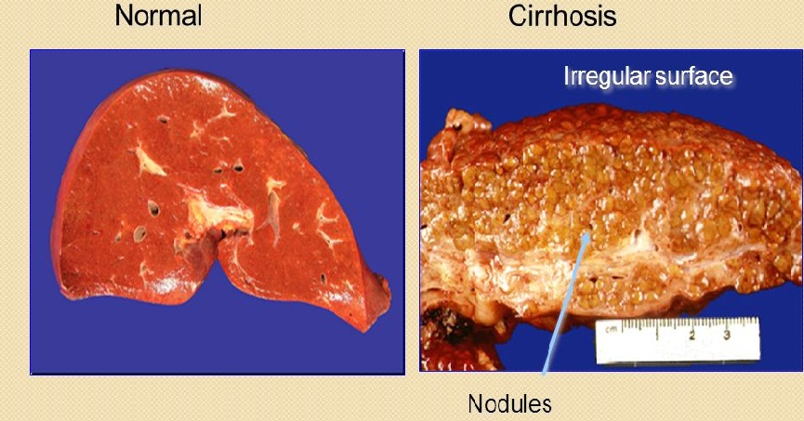
Morphology, Gross (Naked eye)

Slide 12
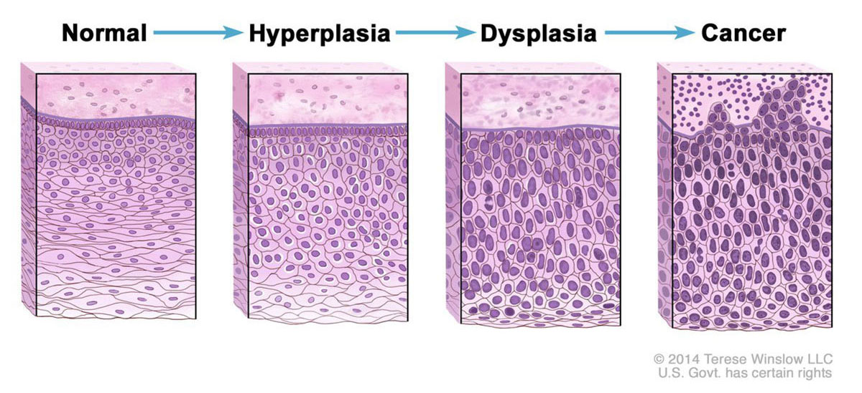
Morphology, microscopic

Slide 13
4-Clinical manifestations.
• The end results of genetic, biochemical, and structural changes in cells and tissues are functional abnormalities that lead to the clinical manifestations (symptoms and signs) of disease, as well as its progression (clinical course and outcome).
Hence, clinicopathologic correlations are very important in the study of disease.

Slide 14
Etiology
Pathogenesis
Morphology
Clinical manifestations

Slide 15
anatomy, physiology, biochemistry, pharmacology, microbiology, community, ..etc
medicine , surgery, orthopedic, gyne-obs, pediatrics,
ENT, Psychiatry, Radiology
Pathology

Slide 16
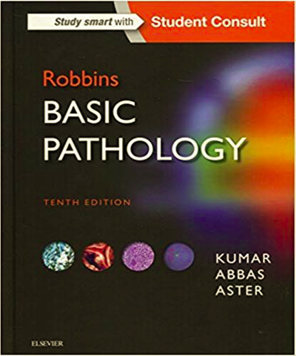
The book .. ☺

Slide 17
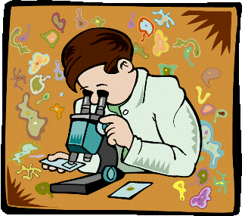
So what do pathologist do?

Slide 18
1st: The Sample .. What do we get?
Biopsy, like :
Bone marrow aspiration and biopsy
Cardiac biopsy
Core biopsy
Endometrial biopsy, D&C
Endoscopic biopsy
Bronchoscopic biopsy
Excisional and incisional biopsy
Fine-needle aspiration biopsy
Lymph node biopsy
CT guided Needle biopsy
Punch biopsy
Shave biopsy
Resections

Slide 19
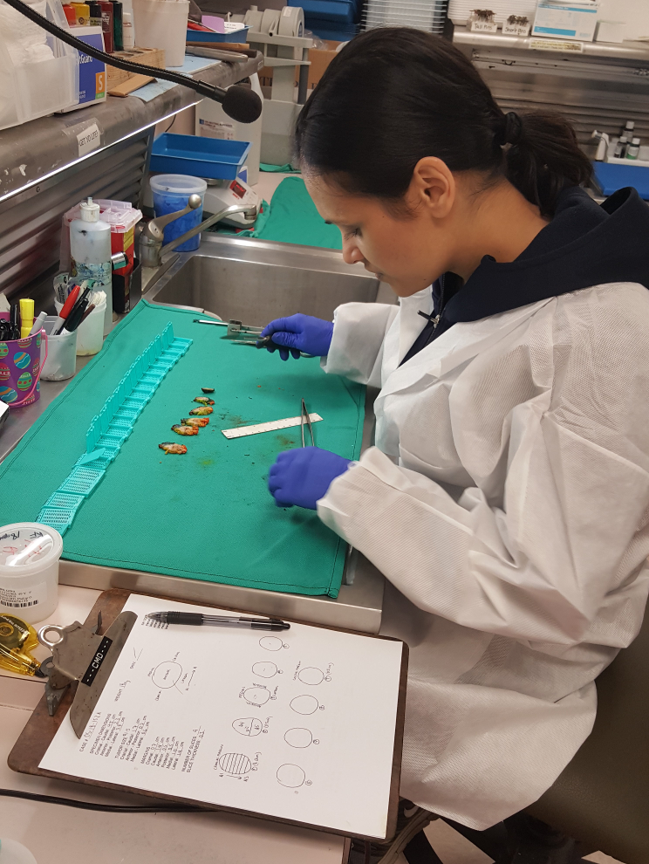
Grossing

Slide 20
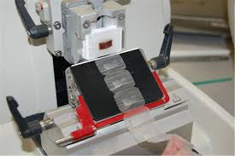
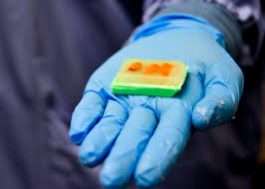
Processing into a paraffin block
Microtome

Slide 21
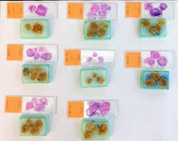
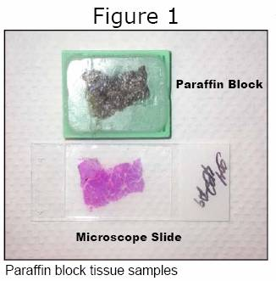
Staining H&E ☺

Slide 22
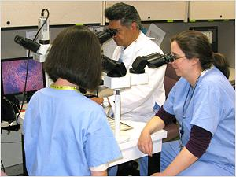
Diagnosis

Slide 23
Thank you

