Slide 1
Fat soluble vitamins (K, E, A & D) Lecture 1 (39 slides)
Dr. Eman Shaat
Professor of Biochemistry & Molecular biology

Slide 2
Vitamins
Organic compounds
Cannot be synthesized in ample amounts in the body. Required in small amounts
Deficiencies can result in potentially serious consequences.
Provitamin (precursor) vs Preformed vitamin (vitamins found in foods in their active form)
vitamins can be destroyed by: Heat, Light (ultraviolet), Oxygen.
Fat-soluble vitamins tend to be more stable.
Whole foods: Fruits, vegetables, and whole grains.
Vitamins from animal foods are generally more bioavailable than those in plant foods.
Vitamins grouped into two major categories:
Fat-soluble (4 fat soluble) Vitamin A, D, E, K.
Water-soluble (9 water soluble)

Slide 3
Vitamins
Water-soluble vitamins
Found in watery parts of foods (hydrophilic)
After absorbed move directly into blood
Transported freely in blood
Not stored
Needed more regularly – every 1-3 days; because not stored
Deficiencies fast to develop; because not stored
Toxicities less likely
Usually no precursors
Urine excretion
Fat-soluble vitamins
Found in fats and oils of foods (hydrophobic).
After absorbed enter lymph, then blood
Protein carriers for transport
Stored (fatty tissue/liver)
Doesn’t need as regularly - weekly, monthly; because stored
Deficiencies slow to develop; because stored
Toxicities more likely; because stored
Precursors
Fecal excretion

Slide 4
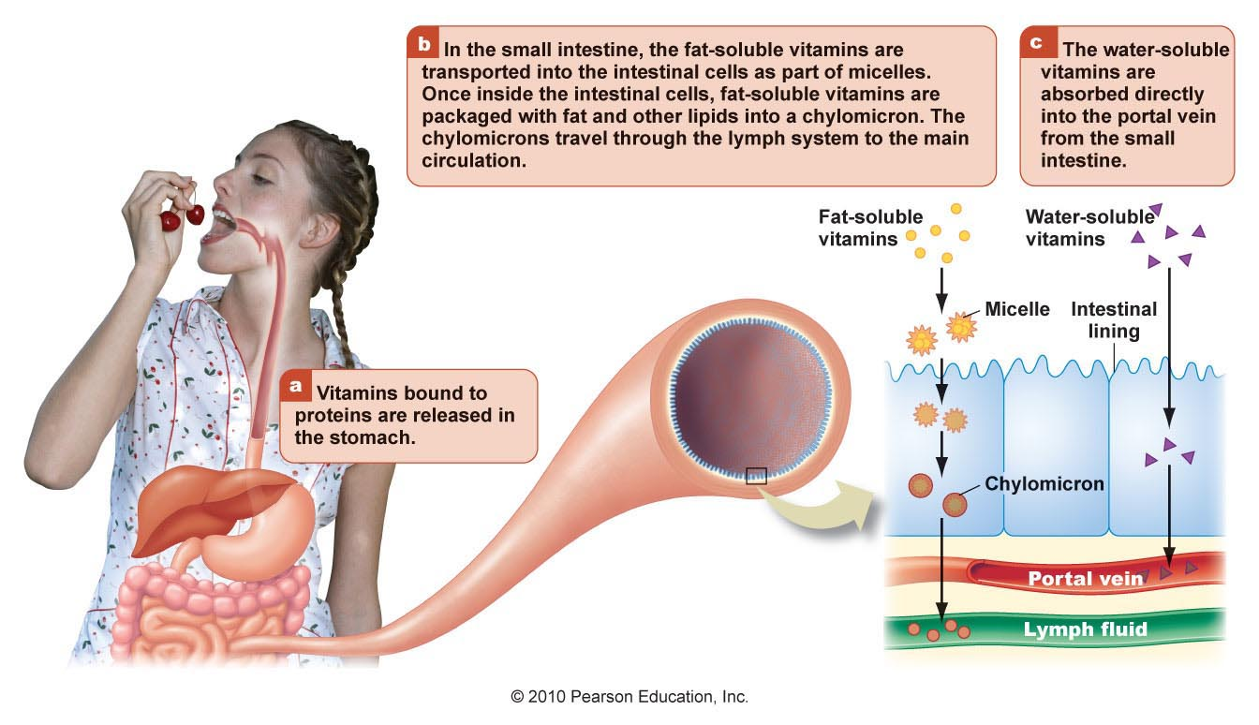
Digesting and absorbing vitamins

Slide 6
FAT SOLUBLE VITAMINS
They are non polar.
All of them are isoprene derivatives.
require normal fat absorption to be absorbed.
are transported to the liver in chylomicrons.
They are stored either in the liver (A, D and K) or in adipose tissue (E) for varying periods of time.
In blood they are transported by lipoproteins or specific binding proteins.
They are not excreted in urine, but in feces.
Toxicity occurs from over dosage.
No specific coenzyme function has yet been found for the fat soluble vitamins EXCEPT vitamin K.

Slide 7
Fat soluble vitamins Vitamin K

Slide 8
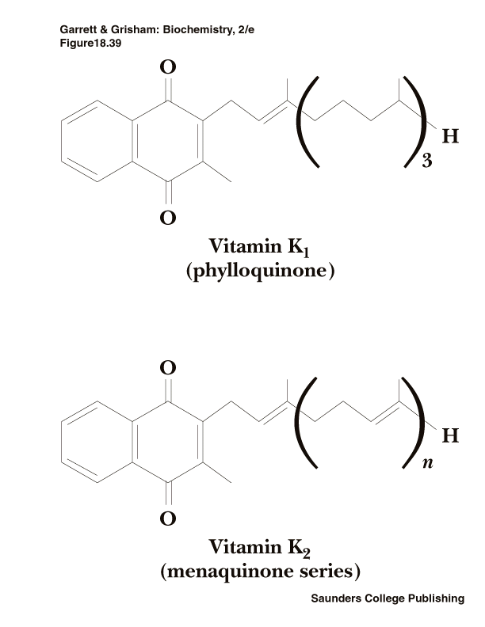
Vitamin K: chemical structure, Sources & function
Vitamin K₁ is abundant in vegetable oils and green leafy vegetables e.g. Spinach, also in cabbage, cauliflower and peas.
Vitamin K₂ is synthesized by intestinal flora and is found in animal tissues. Putrefied fish meal is a rich source.
Good sources of vitamin K include tomatoes, cheese, egg yolk, and liver. Breast milk is NOT a good source of vitamin K.
Vitamin K is required for post translational modifications of several proteins required in the coagulation cascade. It converts blood clotting factors (II, VII, IX and X) to the active state.
All these factors are proteins synthesized in the liver in an inactive precursor form.

Slide 9
Vitamin K: Mechanism of vitamin K-dependent activation for prothrombin
Prothrombin is synthesized in the liver in an inactive precursor form called Pre-prothrombin.
Pre-prothrombin (prothrombin precursor) to active prothrombin Requiring vitamin K-dependent carboxylation (of specific glutamic acid residues to γ-carboxyglutamic)
Pre-prothrombin Prothrombin
(Glutamate) (γ caboxyglutamate)
γ
β
α
Vit. K-dependent
carboxylase

Slide 10
Vitamin K: Mechanism of vitamin K-dependent activation for prothrombin
Ca++
3. The γ-carboxygulatmic acid residues are good chelators which allow prothrombin (active) to bind (chelate) calcium.
4. Prothrombin-Ca++-complex binds to Phospholipid membrane where proteolytic conversion to thrombin can occur.
Summary of function:
Vitamin K is an essential cofactor for the carboxylase enzyme in specific protein molecules such as:
Blood clotting factors (II,VII, IX, X).
Bone calcium-binding proteins as Osteocalcin.
The product of Growth arrest specific gene Gas6 which is involved in differentiation & development of nervous system.

Slide 11
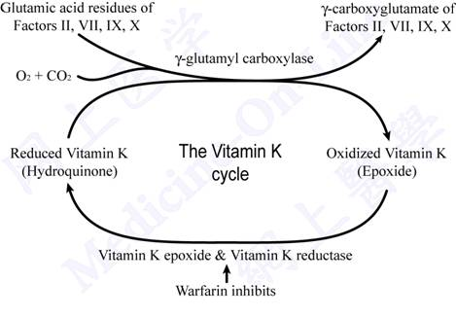
Vitamin K cycle

Slide 12
Vitamin K: Anti-coagulants
Dicumarol & warfarin are antagonists of vitamin K (anti-coagulants).
Are used to reduce blood coagulation in patients at risk of thrombosis.
Thus, vitamin K is the antidote to an overdose of warfarin.
Deficiency
Causes:
Primary deficiency: rare
Secondary deficiency:
In newborn who lack bacterial colonization.
Anticoagulant Therapy.
Fat malabsorption.
in patients suffering from Liver diseases (obstructive jaundice).
long-term or high-dose administration of antibiotics (they kill the bacteria in large intestine).

Slide 13
Vitamin K: Deficiency
Manifested by:
bleeding tendency (GIT, ecchymoses) from minor wounds. . Nose& gum bleeding. Heavy menstrual bleeding.
Increased risk for osteoporosis.
Diagnosed by:
prolonged blood coagulation time: prolonged prothrombin time (↑↑ PT). [ blood takes 10-13.5 sec to clot].
Prevention: single shot of vit. K at birth in newborn.
End of vitamin K

Slide 14
Fat soluble vitamins Vitamin E

Slide 15
Vitamin E: Chemical structure & sources
Vitamin E is a family of α−, β−, γ−, δ− tocopherols which are derivatives of an alcohol.
The highest biological activity has α-tocoferol.
Plant sources:
Vegetable oils
Nuts
Whole grains
Leafy green vegetables as green lettuce leaves .
Animal sources:
Egg yolk, liver, meat, fish.
[Freezing may destroy Vitamin E]

Slide 16
Metabolism of vitamin E
Absorption of vitamin E from the intestine depends on micelle formation.
Vitamin E is transported in the blood by the plasma lipoproteins. Chylomicrons carry tocopherol from the enterocyte to the liver.
Upon reaching the liver, RRR-alpha-tocopherol is preferentially taken up by alpha-tocopherol transfer protein (α-TTP). then either sulfated or glycuronidated. This renders the molecules water-soluble and leads to excretion via urine.
Unabsorbed vitamin E is excreted via feces.

Slide 17
Vitamin E: Functions
Tocopherols have antioxidant activity i.e. they react very readily with molecular oxygen and free radicals, thus prevent autoxidation of tissues.
Vit E acts as lipid-soluble antioxidant in cell membranes.
Vitamin E prevents oxidation of :
PUFAs in all membranes. This prevents hemolysis of RBCs by H2O2 .
LDL (low density lipoprotein). Oxidized LDL may be more atherogenic (Vit.E may protect against coronary heart disease).
DNA. (may help prevent DNA damage & cancer).

Slide 18
Free Radicals
Free Radicals are By-products of the body’s metabolic reactions.
Cells contain many potentially oxidizable substrates such as polyunsaturated fatty acids (PUFAs), proteins, and DNA.
Anti-oxidants: Group of compounds that neutralizes free radicals, helping to counteract the oxidation that takes place in cells. E.g.
Vitamins E: it is an example of a phenolic antioxidant. They donate the hydrogen from the hydroxyl (-OH) group on the ring structure to free radicals, which then become un-reactive. On donating the hydrogen, the phenolic compound itself becomes a relatively free radical.
Vitamins C.
Selenium.
Carotenoids as beta carotene
If exposure to free radicals exceed the protective capacity of the antioxidant defense system, a phenomenon often referred to as oxidative stress.

Slide 19
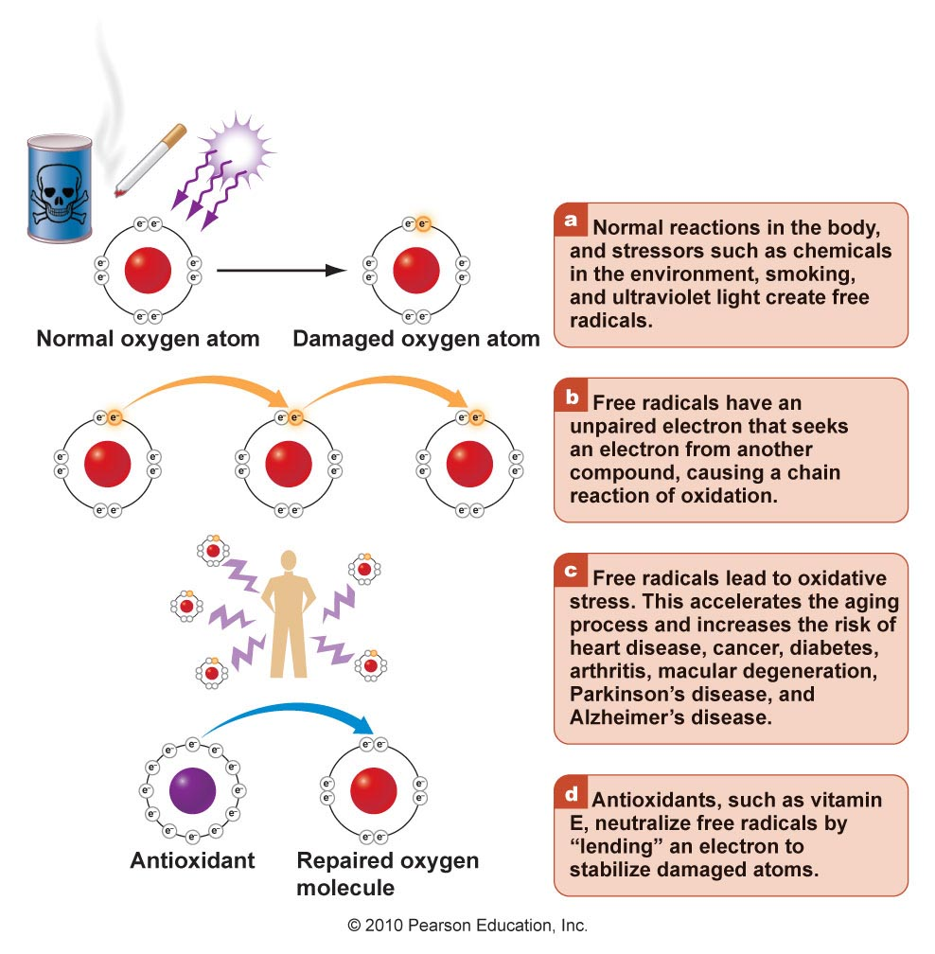

Slide 20
Vitamin E: deficiency
Causes:
Severe malabsorption.
Chronic liver disease. [They suffer deficiency because they are unable to absorb the vitamin or transport it.]
Premature infants are born with inadequate reserve of the vitamin.
Manifestations:
Muscle weakness & neurological problems. Due to nerve and muscle membrane damage.
Hemolytic anemia. The RBC membranes are abnormally fragile as a result of lipid peroxidation. It can be corrected by vitamin E supplementation.
End of vitamin E

Slide 21
Fat soluble vitamins Vitamin A

Slide 22
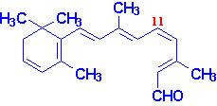
Vitamin A: Chemical structure
• 3 forms of vitamin A:
Retinol.
Retinal.
Retinoic acid
• β-carotene.
All-trans-retinal
11-cis-retinal

Slide 23
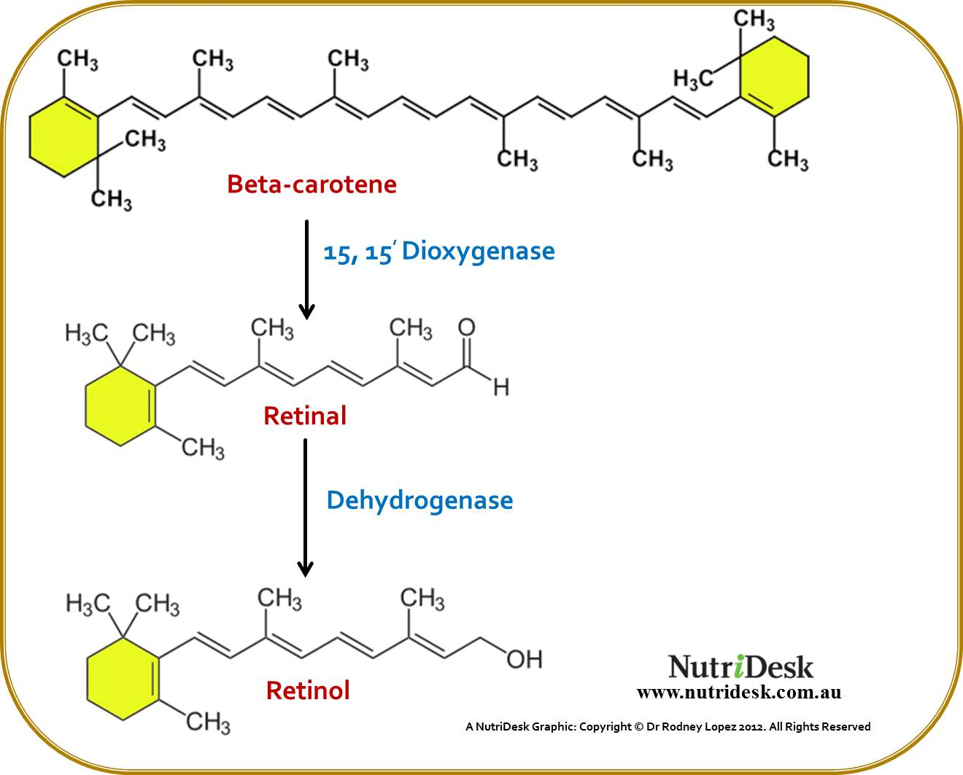
Vitamin A:
Sources
1. Vitamin A is supplied by foods of animal origin e.g. liver, egg yolk, butter, whole milk and fish liver oil.
2. Carotenes (provitamin A): plant origin: dark green and yellow vegetables and fruits are good sources e.g. carrots, sweet potatoes, spinach, apricots and green leafy vegetables.
Synthesis & storage: Synthesis of vitamin A from α , β , and γ carotenes by carotenase (dioxygenase) enzyme occurs in the intestinal mucosa and the liver.

Slide 24
Absorption and Storage
Retinyl esters and carotenoids are incorporated into micelle. Phospholipids, and bile salts are essential for the efficient solubilization of retinol.
Retinyl esters together with other lipids are incorporated into chylomicrons, excreted into intestinal lymphatic channels, and delivered to the blood.
most retinyl esters are taken by liver cells.
Following hydrolysis of stored retinyl esters, retinol combines with a plasma-specific transport protein, retinol-binding protein (RBP).
The RBP-retinol complex associates with transthyretin. The transthyretin-RBP-retinol complex circulates in the blood, delivering the retinol to tissues.

Slide 25
Vitamin A: Metabolism
Reduction
Oxidation
Light
11-cis-retinal
Dark

Slide 26
Vitamin A: Function and Physiological Role
I. Antioxidant: Vitamin A (retinol and retinoic acid) reduce the risk of:
cancers e.g. lung cancer in heavy smokers. (Anticancer agent)
Protecting from heart disease.
II. Role in cell growth and differentiation:
The mechanism of vitamin A action is mediated through specific nuclear receptors. These receptors are activated by binding with retinoic acid. Activated receptors bind to DNA response elements located upstream of specific genes to regulate the level of expression of those genes. Those proteins will be involved in regulation of cell growth and differentiation.
III. Role in Epithelial Tissue:
• Vitamin A is essential for health and integrity of the epithelial tissues.
• Retinal also inhibits the synthesis and deposition of keratin by epithelial cells.

Slide 27
Vitamin A: IV. Role in Vision:
The retinal rod cells are adapted for vision in low light intensities (night vision).
Rhodopsin; conjugated protein, is formed in the retinal-rods by binding of opsin to 11-cis-retinal during dark.
When rhodopsin is exposed to light, the bound 11-cis-retinal is transformed into all trans retinal (change in configuration; non enzymatic).
Dissociation of the bleached rhodopsin to yield free opsin and all trans retinal initiates the nerve impulse which will be perceived by the brain.
Rhodopsin must be reconstituted for continued vision in dim light.

Slide 28
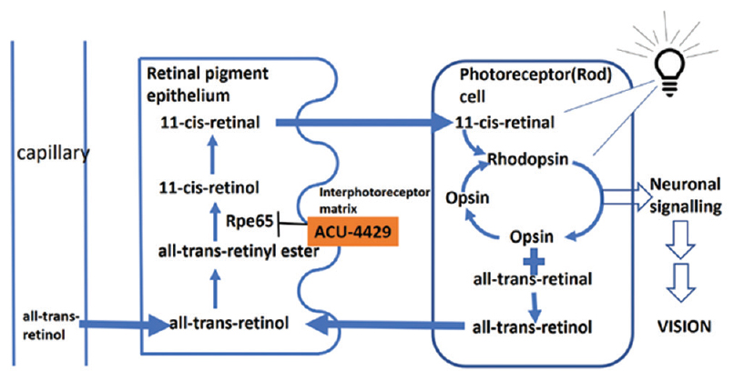
Vitamin A: IV. Role in Vision:

Slide 29
Vitamin A: Summary of function
Antioxidant: Vitamin A (retinol and retinoic acid) & β-carotene (Anticancer agent).
Role in cell growth and differentiation (retinoic acid).
Role in Epithelial Tissue.
Role in Vision (retinal).
Support reproduction and growth. (retinol and retinoic acid)
Support immunity (retinoic acid and carotenoids). Vitamin A plays a role in T cell differentiation, and can increase IgA secretion.

Slide 30
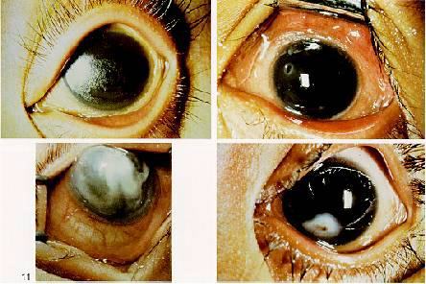
Vitamin A: Deficiency
Deficiency: is characterized by:
Night blindness: The earliest sign of vit A deficiency is a loss of sensitivity to green light, followed by impairment to adapt to dim light.
Follicular hyperkeratosis (rough and dry skin with keratinization of hair follicles).
Xerophthalmia (dry eye due to keratinization
of the epithelium of lacrimal glands and loss of
tears). Collection of keratin in conjuctiva are
known as Bitot’s spots).
Keratomalacia (keratinization of the cornea).
Abnormal skeletal development.
Immune dysfunction.
Reproductive disorders: as Increased abortions , Neonates born dead.

Slide 31
Toxicity (Hypervitaminosis A)
• Large doses over a period of months or years as in treatment of acne can be toxic.
Toxic symptoms include:
Symptoms affects CNS (headache, nausea, ataxia, anorexia).
Enlargement of liver (hepatomegaly).
Calcium homeostasis (calcification of soft tissues), bone pain.
Skin (dryness, desquamation, alopecia).
It is virtually impossible to develop vit.A toxicity by ingesting natural foods.
End of vitamin A

Slide 32
Fat soluble vitamins Vitamin D

Slide 33
Vitamin D: Introduction
Vitamin D is not strictly a vitamin since it can be synthesized in the skin.
Only when sunlight exposure is inadequate, is a dietary source required.
Chemical structure:
D vitamins are a group of sterol compounds:
Vitamin D₂ (ergocalciferol) is generated from ergosterol (pro-vitamin D₂) by ultraviolet irradiation.
Vitamin D3 (cholecalciferol) is derived from 7-dehyro cholesterol (pro-vitamin D₃) by ultraviolet irradiation.
Vitamins D₂ and D₃ are of equal biologic potency and are metabolized identically.

Slide 34
Vitamin D: Sources
Cholecalciferol is produced in the skin by U.V. (the cheapest source of vitamin D₃).
Preformed vitamin D₃ from fish-liver oils, flesh of oily fish, egg yolk and liver.
Activation:
Activation of vitamin D starts in liver cells, where it is hydorxylated on the 25 position by specific microsomal enzyme.
25-hydroxy D can be further hydroxylated in kidney by a mitochondrial enzyme to produce 1,25 dihyroxy D₃ (calcitriol) which is the metabolically active form of the vitamin.
24,25-dihydroxy-D is another active form isolated. However, it is less active than 1,25 dihydroxy D3.
25-OH D₃ = storage form
1,25-(OH)₂ D₃ (calcitriol) = active form

Slide 35
Vitamin D: Activation
Diet
25-hydroxylase
1-hydroxylase
Calcitriol
Steroid hormone

Slide 36
Vitamin D: Function
I. Calcium homeostasis: The mechanism of action of 1,25 dihyroxy D:
In the intestine: it increases the absorption of calcium and phosphorus from the intestine (it induces the synthesis of specific mRNA responsible for synthesis of intestinal calcium binding protein).
In the bone: It promote bone resorption (mobilization of calcium from bone) at low Ca level. In moderate amount 1,25 dihydroxy D enhance deposition of calcium in bone.
It promotes synthesis of osteocalcin which is needed for bone mineralization. It also promotes bone collagen synthesis.
In the kidney: It enhances reabsorption of filtered tubular calcium & phosphate.
II. Reduce risk of:

Slide 37
Function
II. Reduce risk of:
insulin resistance, obesity , metabolic syndrome: it is lower in obese individuals who are more likely to develop diabetes mellitus.
Cancer: 1,25(OH)₂D can prevent cancer development or retard its progress/metastasis once developed by inhibition of the cell cycle, inducing apoptosis, prevention of tumor angiogenesis, and inhibition of metastasis.
Vitamin D also affects immunity. vitamin D derivatives are now used successfully in the treatment of psoriasis.
Cardiovascular system: Severe vitamin D deficiency in humans is associated with cardiomyopathy

Slide 38
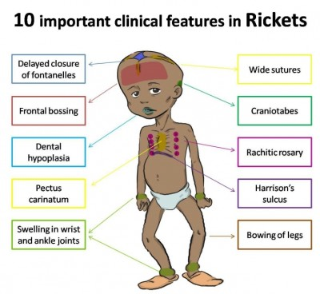
Vitamin D: Deficiency
Causes:
insufficient exposure to sunlight.
inadequate dietary intake.
GIT disorder (malabsorption) &
obstructive jaundice.
Manifestations:
In children:
Rickets is due to defective mineralization secondary to calcium deficiency: -delayed closure of fontanelles.
- soft bones. - “bowed” legs. - knobs on ribs.
Rickets is due to defective mineralization secondary to:
Type I vit D dependent rickets: caused by an inherited defect in the conversion of 25(OH)- D3 to calcitriol (1-hydroxylase).
Type II: Is a vitamin D-resistant rickets caused by absence of calcitriol receptor.

Slide 39
Vitamin D: Deficiency
Manifestations:
In adults: Osteomalacia due to decreased absorption of calcium and phosphorous → low plasma calcium level → resulting in demineralization of preexisting bone → causing the bone to become softer and more susceptible to fracture.
Toxicity (Hypervitaminosis D)
Hypercalcemia.
Hypercalcuria which predisposes to formation of renal stones.
Although Excess vit.D intake is toxic, excessive exposure to sunlight does not lead to toxicity because a limited capacity to form a precursor (7-dehydrocholesterol) and prolonged exposure leads to formation of inactive compounds.
Thank you & Best wishes
Dr. Eman Shaat

