Slide 1
Osteoporosis

Slide 3
SO Osteoporosis is
-Disease characterized by low bone mass density
-micro- architectural deterioration of bone tissue, leading to enhanced bone fragility
-increase in fracture risk, , particularly of the spine, wrist, hip, pelvis and upper arm.
Notes:
The disease is in the bone structure ( quantity)

Slide 4
According to WHO …
osteoporosis is defined as bone density less than 2.5 standard deviation below the average for the young healthy adults for the same race and gender ( T – score)

Slide 5
Who are at risk ??
Old age
female
Family hx
Menopause (Either Naturally or early???) due to estrogen
White race
Sedentary life style , no exercise
Alcoholics or malabsorption and slim
Cigarette smoking
Dietary lack of calcium or vitamin D eating disorders
Medications & Diseases – Cortisone, Thyroid Hormone. Or anti-epilepsy medication (secondary causes )
Notes:
All medications affect the bone

Slide 6
Classification:
1-Primary osteoporosis : two types that are impractical clinically)
-type 1 :postmenopausal
(most often in postmenopausal women 51-75 years of age)
-type 2 : senile
(both in males and females 70years of age and above )
2-Secondary : systemic disorder or medications

Slide 7
Pathophysiology of Primary
1- Postmenopausal osteoporosis
Estrogen slows dawn bone resorption by inhibiting Osteoclast
Post menopause → estrogen deficiency → increased recruitment and responsiveness of osteoclasts → increased bone resorption .
It’s possible that the sex hormone deficiency causes the bone to be more sensitive for the effects of parathyroid hormone leading to increased bone resorption
males eventually suffer same bone changes as postmenopausal women,(postclimacteric ). this occurs about 15 years later than females. If it happens early in male R/O secondary causes

Slide 8
2- senile osteoporosis
-over the age of 70
-It occurs due to decreased bone formation and decreased production of 1,25 DHCC by the kidney
-Male and female are equally affected

Slide 9
Causes of Secondary osteoporosis:
Hyperparathyroidism
Thyrotoxicosis ( hyperthyroidism)
Cushing’s disease
Medications : most common steroids
Anorexia nervosa
Malabsorption
Cancer
Inflammatory disorders
Physical inactivity
Cigarette smoking
Alcoholism
Notes:
Female athelest triad : amenorrhea , anorexia nervosa, weight loss

Slide 10
Clinical features
Osteoporosis is often called the “silent disease” because bone loss occurs without symptoms. No pain
People may not know that they have osteoporosis unless they get:
1- fractures (fragility related fractures)
Typical fractures :spine, wrist, Hip, pelvis and proximal Humerus
2-height loss
3-curved spine
4- lower back pain
Notes:
Diagnosis mainly by screening

Slide 11
Compression fractures
Notes:
When you go down the height of the vertebrae increases

Slide 12
Intertrochanteric fracture

Slide 13
Metaphyseal fracture in the distal radius

Slide 14
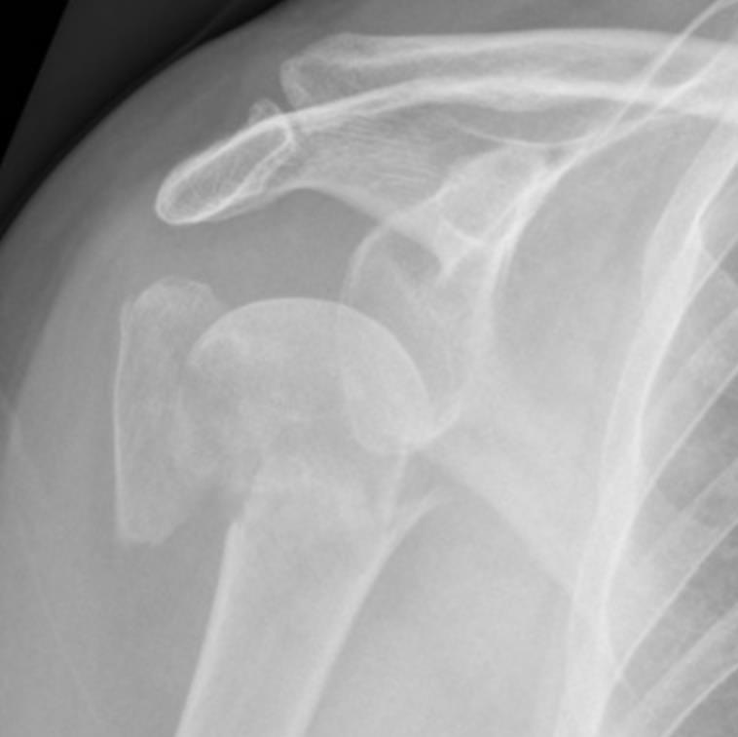
Proximal humeral fracture
Notes:
Greater tuberosity

Slide 15
Height loss due to compression on vertebrae

Slide 16
Diagnosis
The aim is to have early dx so that the fractures associated with the disease can be prevented.
History taking.
Physical examination.
Investigations:
1-Labs
2-Xray
3-DEXA scan

Slide 17
History taking
Risk factors: smoking ,alcohol, race and age
Family history of disease, including osteoporosis.
Medication history. steroids
General intake of calcium and vitamin D.
Exercise pattern .
For women, menstrual history and gynecological surgeries

Slide 18
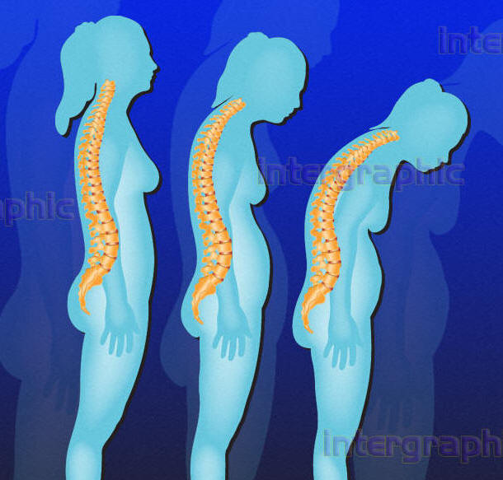
Examination
Height changes.
posture to note any curvature of the spine from vertebral fractures (Kyphosis).
Notes:
Wrist exam

Slide 19
Investigations
1- Laboratory Tests: to rule out secondary causes:
✔ Calcium levels.
✔ vitamin D levels.
✔ TFT.
✔ PTH level.
✔ Estradiol levels and estrogen (in women).
✔ (FSH) test to establish menopause status.
✔ Testosterone levels (in men).
✔ Osteocalcin levels to measure bone formation.
✔ Alkaline phosphatase level (Marker of bone activity : High level indicates high activity while low level indicates that the bone is inert).
✔ 24-hour calcium urine collection to measure calcium metabolism

Slide 20
2- X rays:
at least 30% of the bone mass must be lost before the loss is recognized on XR
More prominent in the axial skeleton(Skull + Spine + Pelvis).

Slide 21
normal
Bone looks less white (darker) and trabecular lines are more prominent

Slide 22
FRAX SCORE
app For diagnosis of osteoprosis only in risk factors

Slide 23
3-DEXA scan: dual energy x-ray absorptiometry
GOLD STANDERED
measures bone density (the amount of bone mass contained in a certain volume of bone) by passing x-rays with two different energy levels through the bone.
The preferred measurement sites are the lumbar spine and the hip
DEXA scan gives results such as:
T- score : measures by how many standard deviations the patient’s BMD deviates from that of a young healthy control of same gender.
Z-score: measures by how many standard deviations the BMD deviates from that of an aged-matched control of same gender ( used in children )
Notes:
Young healthy adult : 25-30 years old

Slide 24
T score | Meaning
1 to -1 | normal
-1 to -2.5 | osteopenia
<-2.5 | osteoporosis
< -2.5 with fragility fractures | Severe osteoporosis

Slide 25
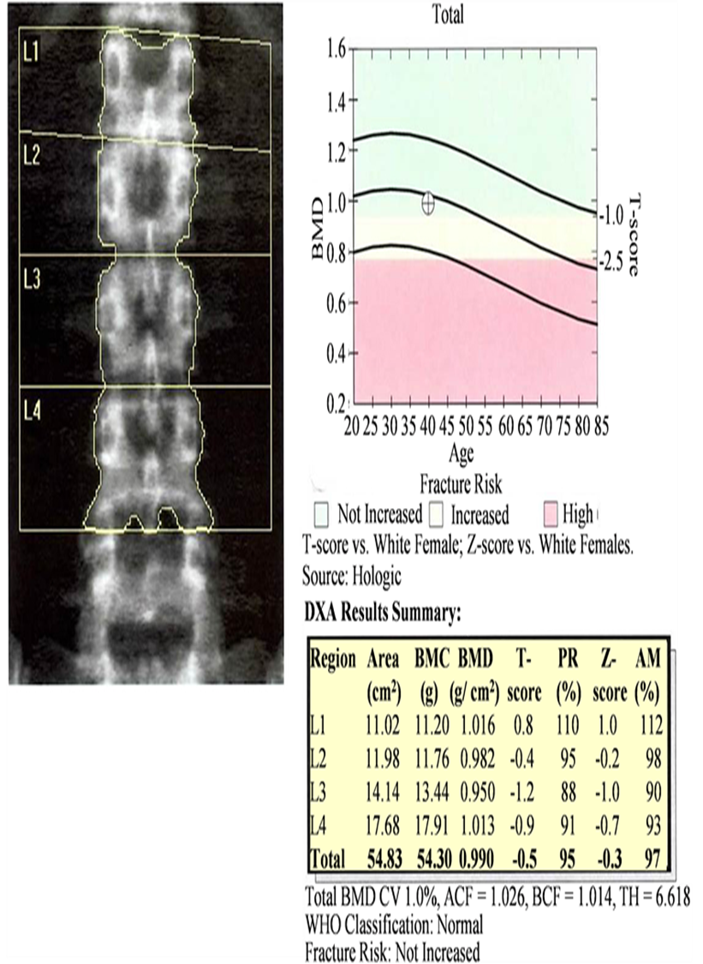

Slide 26
BMD should be measured in the following people :
Postmenopausal women older than 65 years
Postmenopausal women younger than 65 years who have 1 or more risk factor
Postmenopausal women who present with fragility fractures
Men who experience fractures after minimal trauma
People with a disease or medication known to place them at risk of osteoporosis
Notes:
It differs according to the women menopause age but in general we start after 5 years of menopause

Slide 27
4-Biopsy:
-Rarely indicated ,in unexpected or explained cases
-Patient under 45 with osteoporosis needs full investigation, including biopsy.
-in the 5-6th decade, R/O multiple myeloma with biopsy
Notes:
Most common bone tumor is secondary

Slide 28
Treatment
- Prevention :
1. Exercise.
2. Good diet.
3. Avoid smoking and alcohol
✔Exercise improves the bone strength , it also increases the muscle strength, coordination and balance.
4. Adequate amounts of vitamin D and calcium should be taken Doses include 500mg of calcium 2-3 times /day , and 800 IU of vit D per day (For maintenance).
-Fixation of fractures and rehabilitation.
-Medications for osteoporosis.
Notes:
Minerals are usually normal in osteoporosis

Slide 29
Bisphosphonates
first-line treatment in women.
Alendronate , Risedronate , Ibandronate .
poorly absorbed, and must therefore be taken on an empty stomach, with no food or drink to follow for the next 30 minutes and to stay upright to 30 min .
G.I symptoms ( esophagitis) : most common side effect
Can increase risk of fractures if used for very long term (Stops the activity of Osteoclast and thus inhibiting bone remodeling) , so if the presentation of the patient is fracture from start , they shouldn’t be given.
Notes:
Osteoclast inhibition
Not given for more than 3 years

Slide 30
Hormone replacement therapy
estrogen (or a combination of estrogen and progesterone)
reduce the risk of osteoporotic fractures
rebound effect : after stopping the medication the BMD gradually falls to the usual low level.
high risk of breast cancer and uterine cancer

Slide 31
Teriparatide
Recently, teriparatide (recombinant parathyroid hormone ) has been shown to be effective in osteoporosis.
It is used mostly for patients with (severe cases) :
1 - established osteoporosis (who have already fractured)
2 - have particularly very low BMD
3 - several risk factors
4 - cannot tolerate the oral bisphosphonates.
It is given as a daily injection
Notes:
Increase bone mass by enhancing the proliferation of osteoblast bone formation

Slide 32
Strontium ranelate
Ranelic acid
Enhance proliferation of osteoblasts, as well as inhibiting the proliferation of osteoclasts.
causes less upper GI side effect,
increase in the risk of venous thromboembolism

Slide 33
Denosumab
human monoclonal antibody which inhibits the receptor activator needed to activate osteoclast differentiation.(inhibits osteoclast)
Denosumab is administered by subcutaneous injection every 6 months. & its expensive.
must be supplemented with calcium and vitamin D.
Notes:
Immunological therapy

Slide 34
The End

