Slide 1
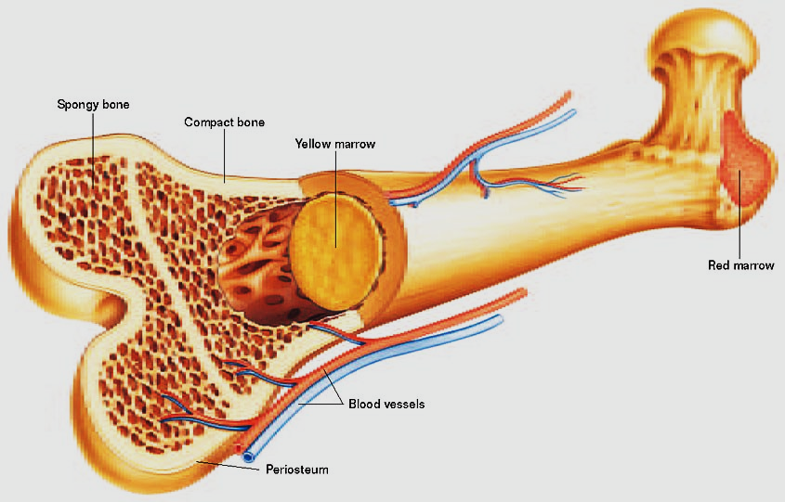
Bone Marrow
BY
Dr. Nour A. Mohammed
MUTAH SCHOOL OF MEDICINE

Slide 2
Bone marrow
Bone marrow is a spongy organ that fills the center of various bones of your body. It is where stem cells produce red and white blood cells and platelets. Without bone marrow, you couldn't move oxygen through your body or fight infections, and blood wouldn't clot.
It is composed of :
Stem cells (hematopoietic )
Marrow adipose tissue.
Supportive stromal cells.
In adult humans, bone marrow is primarily located in the axial bones ribs, vertebrae, sternum, and bones of the pelvis. Bone marrow comprises approximately 5% of total body mass in healthy adult humans.

Slide 3
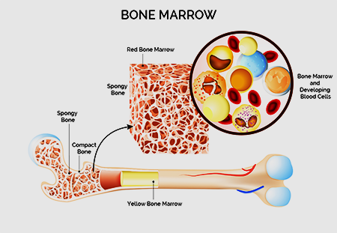
Structure
In humans, marrow is characterized as "red" or "yellow" marrow, respectively depending on the prevalence of hematopoietic (stem cells) vs fat cells.
A newborn baby's bones exclusively contain haematopoietically active "red" marrow, and there is a progressive conversion towards "yellow" marrow with age.
Yellow bone marrow stores fat and nutrients for red bone marrow to use and to maintain body functions.
In conditions of chronic hypoxia, the body can convert yellow marrow back to red marrow to increase blood cell production.

Slide 4
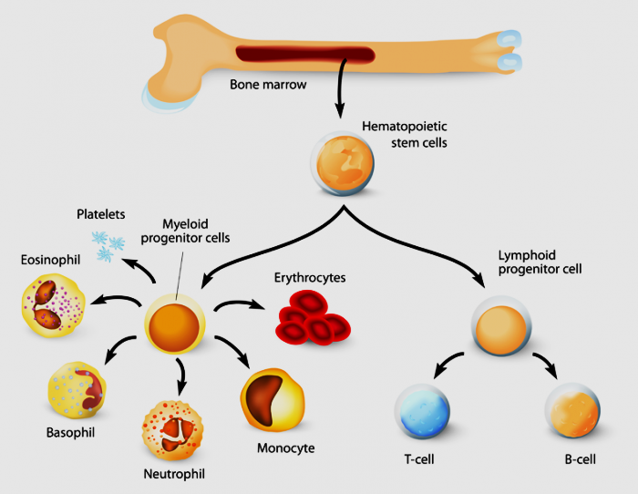
Hematopoietic components
At the cellular level, the main functional component of bone marrow includes the progenitor cells which are destined to mature into blood and lymphoid cells.
Marrow contains hematopoietic stem cells which give rise to the three classes of blood cells that are found in circulation: white blood cells (leukocytes), red blood cells (erythrocytes), and platelets (thrombocytes).

Slide 6
Stroma
Stromal cells may be indirectly involved in hematopoiesis, providing suitable-environment that influences the function and differentiation of hematopoietic cells.
For example : they generate colony stimulating factors, which have a significant effect on hematopoiesis.
Cell types that constitute the bone marrow stroma include:
Fibroblasts (reticular connective tissue), Adipocytes (fat cells) , Osteoblasts (synthesize bone), Osteoclasts (resorb bone), Endothelial cells, which form the sinusoids.
Function
Mesenchymal stem cells
The bone marrow stroma contains mesenchymal stem cells (MSCs), also known as marrow stromal cells. These are multi-potent stem cells that can differentiate into a variety of cell types. MSCs have been shown to differentiate, in vitro or in vivo, into osteoblasts, chondrocytes, myocytes, marrow adipocytes and beta-pancreatic islets cells.

Slide 7
Bone marrow barrier
The blood vessels of the bone marrow constitute a barrier, inhibiting immature blood cells from leaving the marrow. Only mature blood cells contain the membrane proteins, such as aquaporin and glycophorin, that are required to attach to and pass the blood vessel endothelium.
Lymphatic role
The red bone marrow is a key element of the lymphatic system, being one of the primary lymphoid organs that generate lymphocytes from immature hematopoietic progenitor cells. The bone marrow and thymus constitute the primary lymphoid tissues involved in the production and maturation of lymphocytes.

Slide 8
Clinical significance
Disease
The normal bone marrow architecture can be damaged or displaced by aplastic anemia, malignancies such as multiple myeloma, or infections which leading to a decrease in the production of blood cells and blood platelets.
The bone marrow can also be affected by various forms of leukemia, which attacks its hematopoietic progenitor cells. Furthermore, exposure to radiation or chemotherapy will kill many of the rapidly dividing cells of the bone marrow and will therefore result in a depressed immune system.
Application of stem cells in therapeutics
Bone marrow derived stem cells have a wide array of application in regenerative medicine.

Slide 9
Thank You

