Slide 1
Irritable bowel syndrome
Toqa Al Omari
Danah jihad
Ala’a khader

Slide 2
Irritable bowel syndrome (IBS)
(IBS) is a common condition that affects the digestive system.
It causes symptoms like stomach cramps, bloating, diarrhea and constipation. These tend to come and go over time, and can last for days, weeks or months at a time.
It's usually a lifelong problem. It can be very frustrating to live with and can have a big impact on your everyday life.

Slide 3
Epidemiology
Prevalence: 10–20% in North America and Europe .
Sex: In North America it’s most common in middle aged women but in other parts of the world it affect both sexes equally.
Age: highest prevalence in individuals aged 20–39 ^{[1]}
Associated conditions ^{[2]}
Somatic pain syndromes: fibromyalgia, chronic fatigue syndrome, functional chest pain
Psychiatric disorders: major depressive disorder, anxiety disorder, somatization disorder
Gastrointestinal disorders: GERD, functional dyspepsia

Slide 4
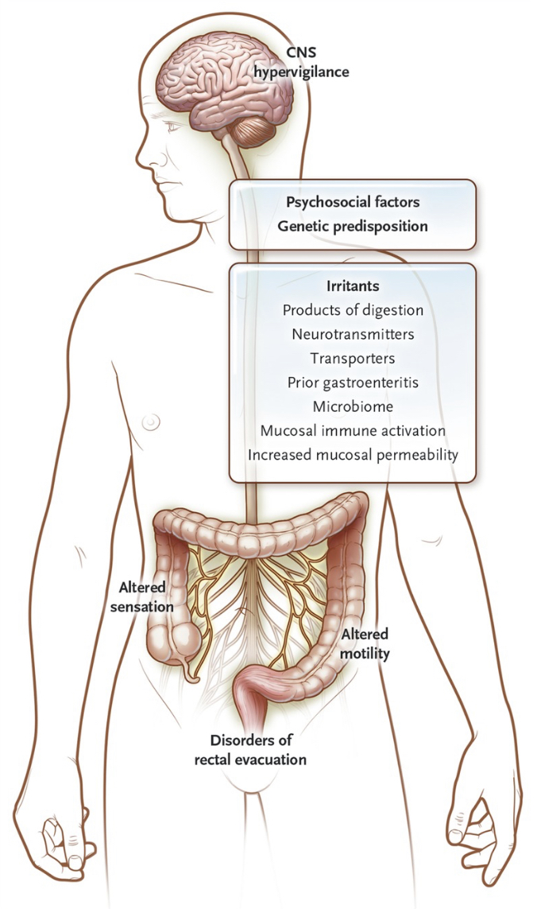
Pathophysiology
IBS is a functional gastrointestinal disorder without a specific organic cause. The pathophysiological processes leading to IBS are multifaceted and not yet fully understood. The most common findings associated with IBS are:
Gastrointestinal motility disturbances.
Visceral hypersensitivity/hyperalgesia
Psychiatric symptoms may precede onset of GI symptoms.
Other Factors :
Intestinal inflammation (increased lymphocytes and mast cell)
Bacterial overgrowth.
Food sensitivity
Post-infectious ( E.coli , campylobacter )

Slide 5
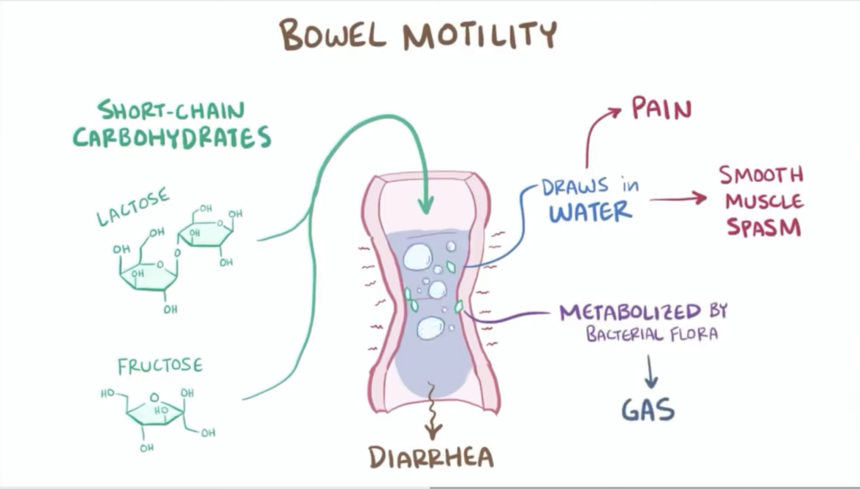
Gastrointestinal motility disturbances.

Slide 6
Visceral hypersensitivity/hyperalgesia

Slide 7
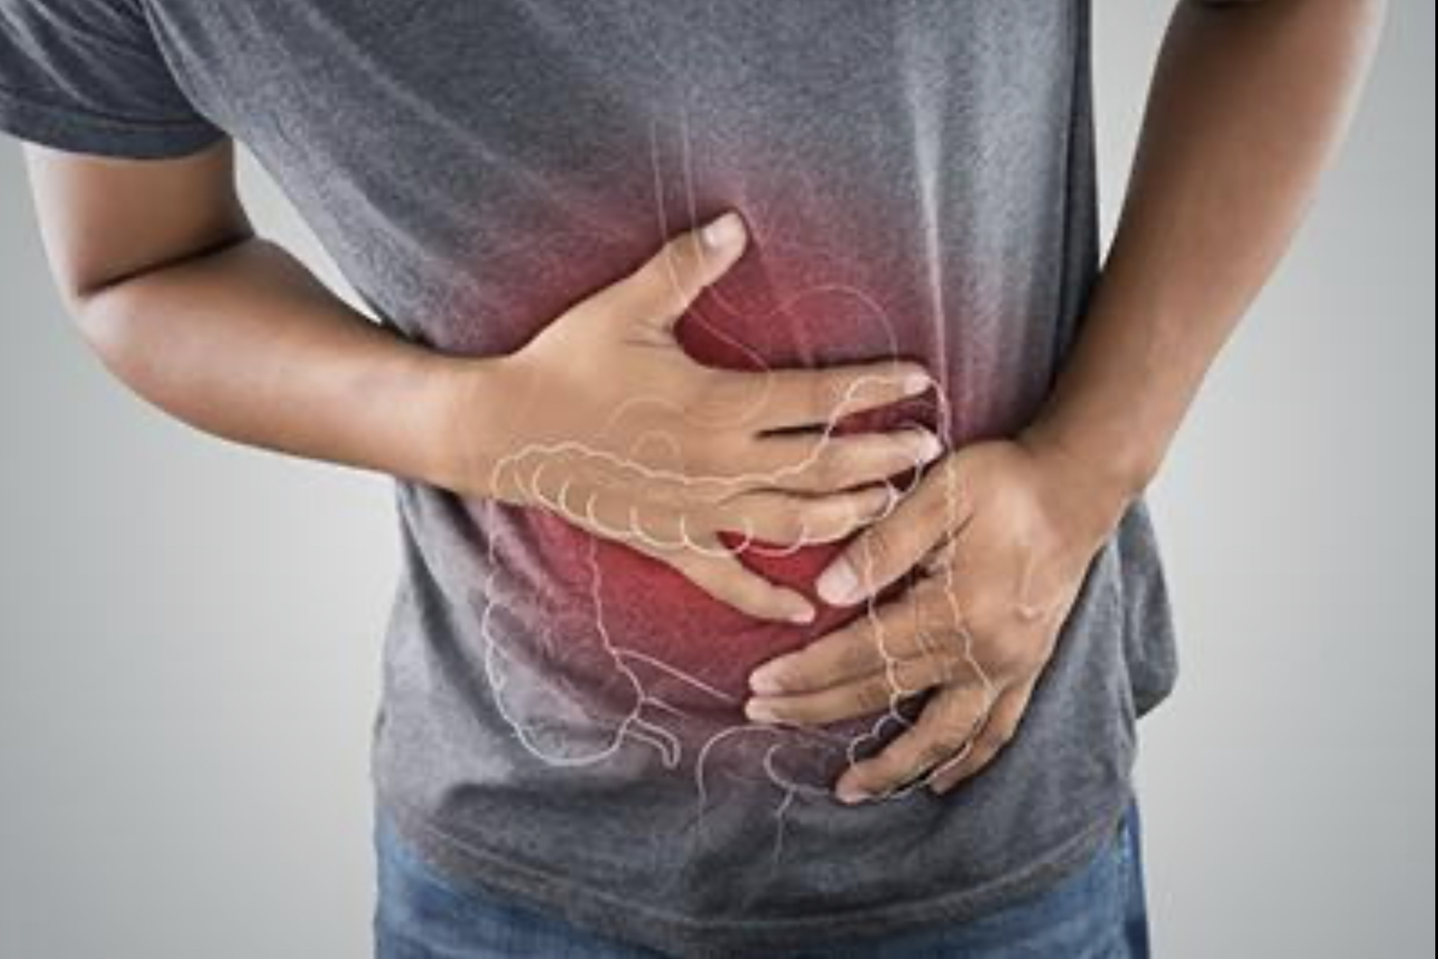
Clinical features
IBS is characterized by chronic abdominal pain and changes in bowel habits.
Abdominal pain
Frequency, intensity, and localization generally vary widely from patient to patient
Typically Relieved by defecation
Altered bowel habits: diarrhea and/or constipation
Diarrhea : Most often occur in the morning or after eating﮼ preceded by lower abdominal pain and sense of urgency.
Constipation : pellet shaped , can also have sensation of tenesmus .
Other symptoms :
Passing of mucus and abdominal bloating
excessive wind (flatulence)
Urgency
Physical examination: normal

Slide 8
Complications:
Physical:
Intolerance to certain food
Hemorrhoids
Abdominal bloating
Increased flatulence
Weight loss
Psychological:
Depression
Anxiety

Slide 12
INVESTIGATIONS:
- Barium Enema.
- Flexible Sigmoidoscopy.
- CT scan .
- Colonoscopy.
Other laboratory tests:
-Blood test
-Stool test
-Breath test
-Lactose intolerance test

Slide 15
management
Asymptomatic: No treatment.
Constipation: Fiber diet +/- bulking laxative
Treatment of Diverticulitis:
Surgery for severe hemorrhage or perforation

Slide 17
Thank you

