Slide 2
Synthesis Of Unsaturated Fatty Acids: A. Nonessential unsaturated fatty acids: 1. These are fatty acids which contain one double bond e.g. palmitoleic acid (16: 1) and oleic acid (18:1). 2. Synthesis of oleic acid (oleyl CoA) : It is synthesized - in the microsomes - from stearyl CoA (active stearic acid)
B. Essential fatty acid:
These are unsaturated fatty acids which contain more than one double bond.
1. They are essential because they cannot be formed in the body and should be taken in the diet
2. Examples: linoleic acid (18:2) linolenic (18:3) and arachidonic acid (20:4).
3. Sources: Vegetable oils as corn oil and cotton seed oil.
4. Functions:
a- They are Important for normal growth.
b- Synthesis of phospholipids:
c- Prevention of atherosclerosis: Essential fatty acids combine with cholesterol forming esters which are rapidly metabolized by the liver. This prevents precipitation of free cholesterol along the endothelium of blood vessels ~ prevents atherosclerosis.
d· Synthesis of eicosanoid.

Slide 3
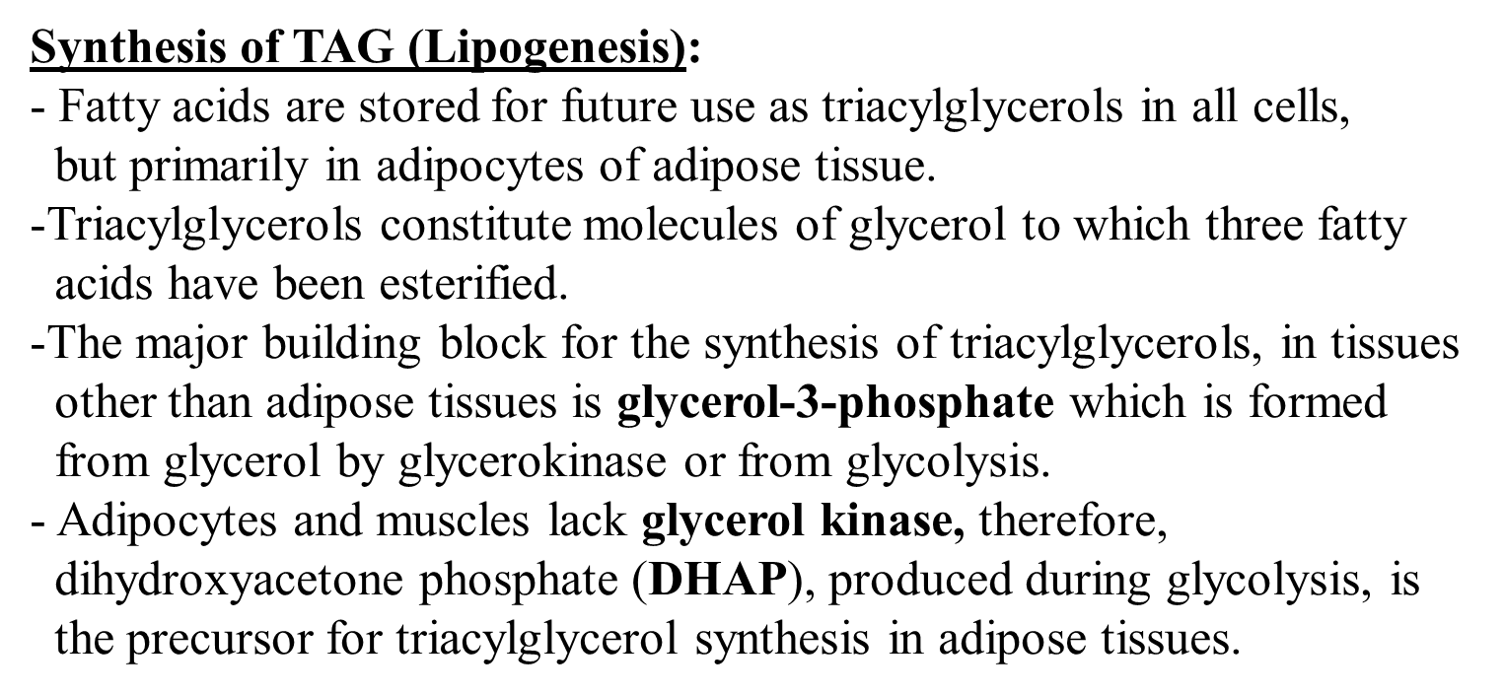

Slide 4
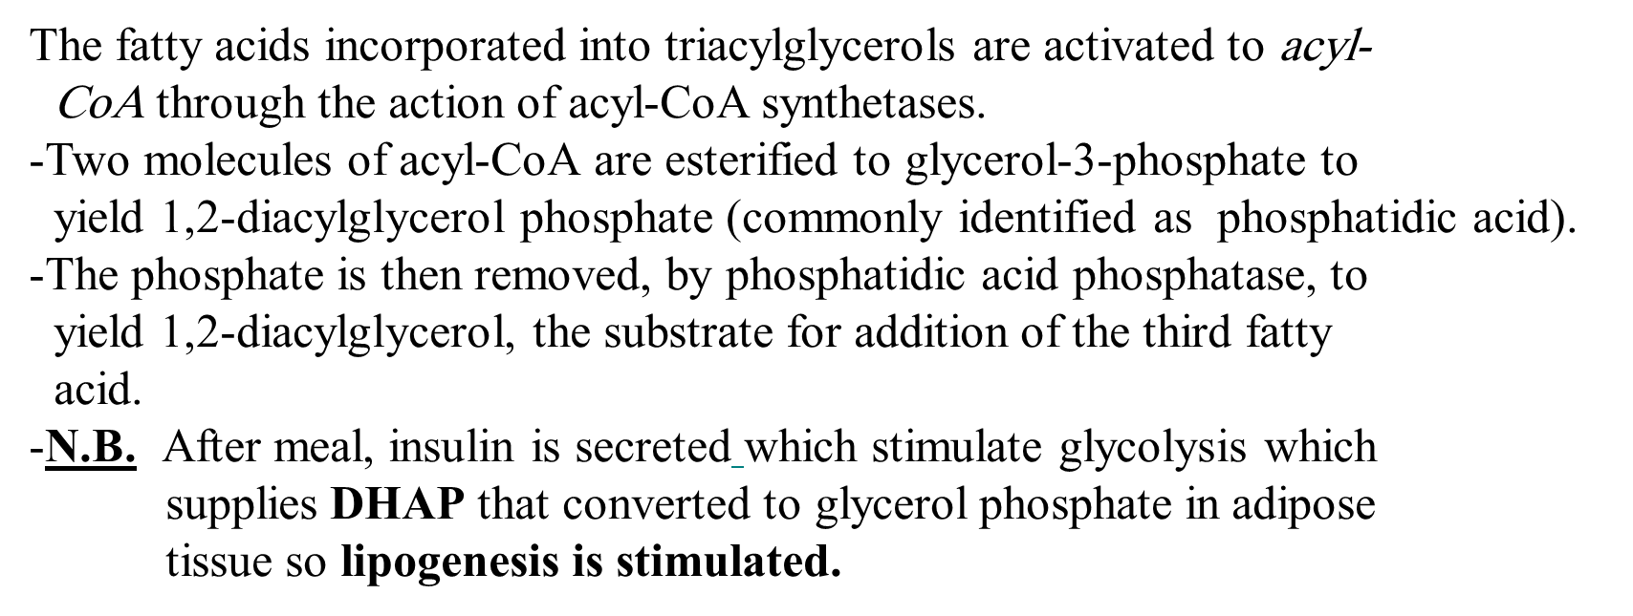
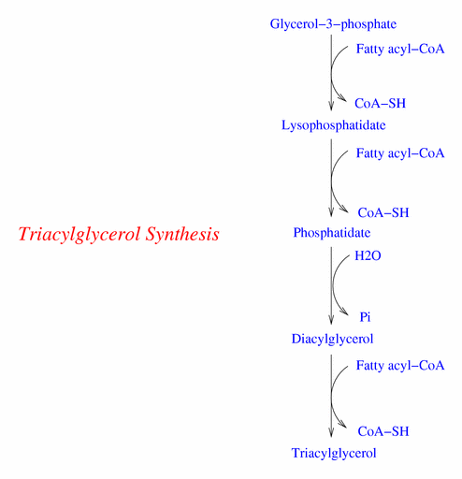

Slide 5
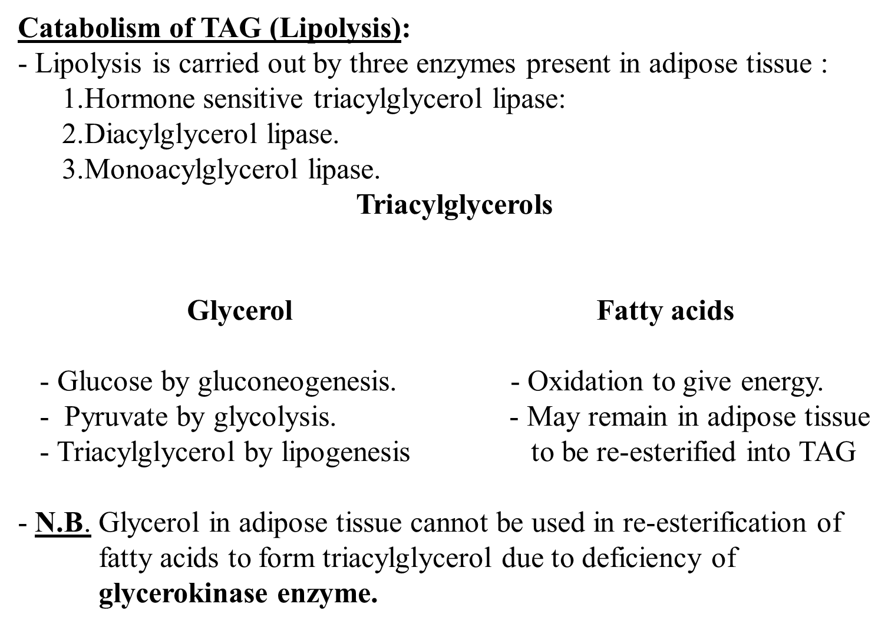

Slide 6
Regulation of lipolysis
The key enzyme controlling lipolysis is Hormone sensitive triacylglycerol lipase (HSL):
This enzyme is activated when phosphorylated by 3′ 5′-cyclic AMP- dependent protein kinase.
3′ 5′-cyclic AMP is produced in adipocyte when one of several hormones (mainly epinephrine) binds to receptors on cell membrane and activates adenylate cyclase. In the presence of high plasma level on insulin and glucose, HSL is dephosphorylated, and become inactive. So during fasting → stimulation of lipolysis.
Coffee contains caffeine and tea contains theophylline. Both inhibit phosphodiesterase enzyme → stimulation of lipolysis.
Causes of excessive lipolysis: where there is a need for energy;
starvation, diabetes mellitus, low carbohydrate diet, and in certain infectious disease as in tuberculosis ( due to high catabolic state).

Slide 7
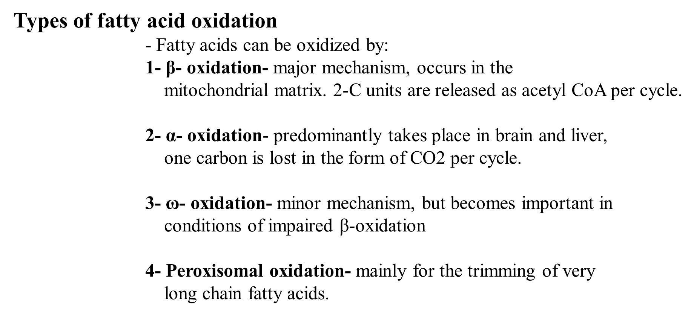

Slide 8
Oxidation of fatty acids occurs in the mitochondria.
-The CoA derivatives of long chain F.A. can not penetrate the inner mitochondrial membrane (short chain F.A.s & their acyl CoA can penetrate).
- The transport of fatty acyl-CoA into the mitochondria is accomplished via an acyl – carnitine intermediate
thiokinase
- Fatty acids results from TAG hydrolysis in adipose tissue are taken up by most tissues and must be activated in the cytoplasm before being oxidized in the mitochondria.
- Activation is catalyzed by fatty acyl-CoA synthetase or (thiokinase).

Slide 9
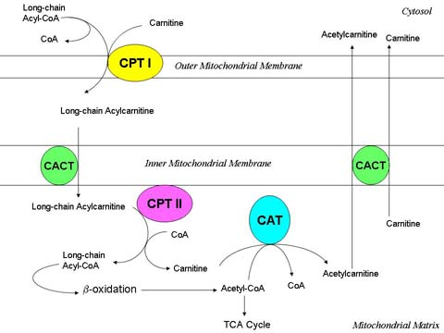
Long chain F.A.s transport
Carnitine Shuttle
It can cross the inner mitochondrial membrane in exchange with carnitine.
Acyl carnitine transported to
the inner mitochondrial membrane
is accomplished by carnitine acyl-carnitine translocase.
In mitochondria carnitine is
regenerated by carnitine palmitoyl
transferase II enzyme, and the
active acyl CoA is now ready for
oxidation and energy production.

Slide 10
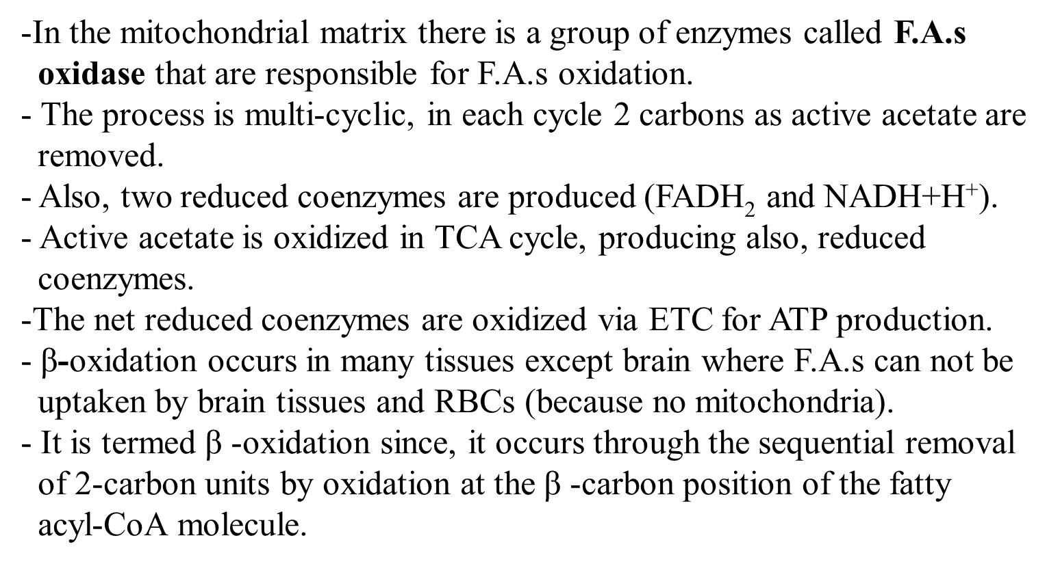
β –Oxidation

Slide 11
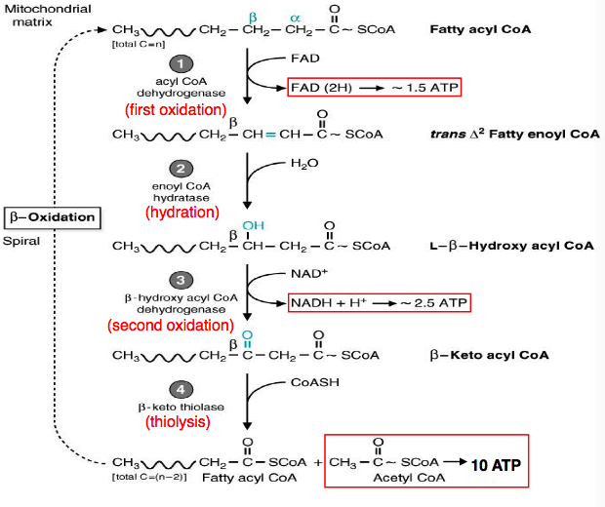

Slide 12
Through energy production: ↑ATP → inhibit ETC → inhibit β-oxidation.
Importance of β-oxidation:
1- Energy production.
2- Production of acetyl CoA which enters in many pathways
3- Ketone body formation : Acetoacetyl CoA is the last 4 carbon atoms in the course of β-oxidation, it may be converted into acetoacetate; one of ketone bodies.
1- Carnitine deficiency: It leads to accumulation of toxic amounts of
free fatty acids and branched-chain acyl groups
- It occurs in patients with:
1- liver disease.
2- malnutrition.
3- In those with increased requirement of carnitine as sever infection and
burns.
4- During hemodialysis which removes carnitine from blood.

Slide 13
Symptoms include muscle cramps during exercise, severe weakness
Muscle weakness related to importance of fatty acids as long term
energy source
- Hypoglycemia and hypoketosis are common findings
Diet containing medium chain fatty acids is recommended since they
do not require carnitine shuttle to enter mitochondria.

Slide 14
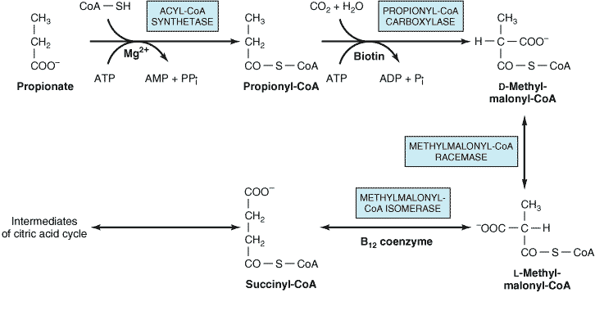
Fatty acids with an odd number of carbon atoms are oxidized by the
pathway of β-oxidation, producing acetyl-CoA, until a three-carbon
(propionyl - CoA) residue remains.
This compound is converted to Succinyl-CoA, a constituent of the citric acid cycle
The propionyl residue from an odd-chain fatty acid is the only part of a
fatty acid that is glucogenic.

Slide 15
α -Oxidation
Takes place in the microsomes of brain and liver
Involves decarboxylation process for the removal of single carbon atom at one time with the resultant production of an odd chain fatty acid that can be subsequently oxidized by beta oxidation for energy production.
- It is strictly an aerobic process.
No prior activation of the fatty acid is required.
The process involves hydroxylation of the α-carbon with a specific α-hydroxylase that requires Fe⁺⁺ and vitamin C/FH4 as cofactors.
α- Oxidation is most suited for the oxidation of phytanic acid, produced
from dietary phytol, a constituent of chlorophyll of plants.
- Phytanic acid is a significant constituent of milk lipids and animal fats.
Normally it is metabolized by an initial α- hydroxylation followed by
dehydrogenation and decarboxylation.

Slide 16
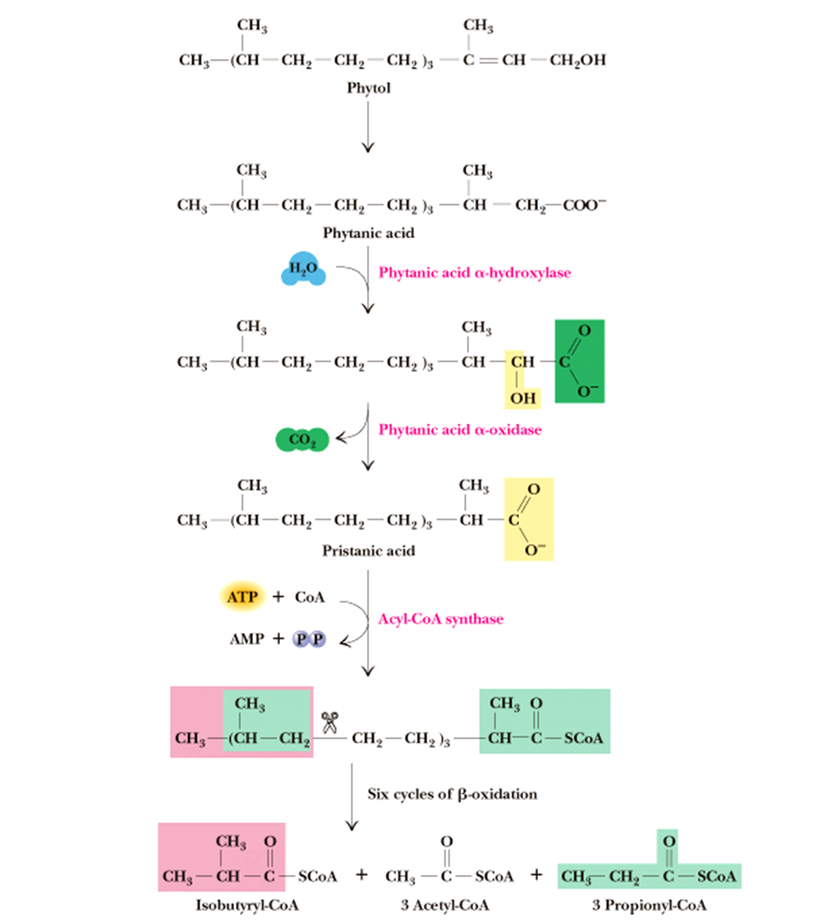

Slide 17
α-oxidation can not occur initially because of the presence of 3- methyl
groups, but it can proceed after decarboxylation.
The whole reaction produces three molecules of propionyl CoA, three
molecules of Acetyl co A, and one molecule of iso butyryl Co A .
Phytanic acid is oxidized by phytanic acid α oxidase (α- hydroxylase enzyme) to yield CO2 and odd chain fatty acid
Refsum's disease (RD)-is a neurocutaneous syndrome that is
characterized biochemically by the accumulation of phytanic acid in
plasma and tissues.
Patients with Refsum's disease are unable to degrade phytanic acid
because of a deficient activity of phytanic acid oxidase enzyme
catalyzing the first step of phytanic acid α-oxidation.
Peripheral polyneuropathy, cerebellar ataxia, retinitis pigmentosa, and Ichthyosis (rough, dry and scaly skin) are the major clinical components.

Slide 18
Zellweger's (cerebrohepatorenal) syndrome: Due to rare inherited
absence of peroxisomes in all tissues.
They accumulate C26-C38 polynoic acids in brain tissue owing to
inability to oxidize long-chain fatty acids in peroxisomes.
ω -Oxidation
Involves hydroxylation and occurs in the endoplasmic reticulum of
many tissues.
Hydroxylation takes place on the methyl carbon at the other end of
the molecule from the carboxyl group or on the carbon next to the
methyl end.
It uses the “mixed function oxidase” type of reaction requiring
Cytochrome P450, O2 and NADPH, as well as the necessary
enzymes.
Hydroxy fatty acids can be further oxidized to a dicarboxylic acid via
sequential reactions of Alcohol dehydrogenase and aldehyde
dehydrogenases.
- The process occurs primarily with medium chain fatty acids.

Slide 19
Dicarboxylic acids so formed can undergo β- oxidation to produce
shorter chain dicarboxylic acids such as adipic acids (C6) and succinic
acid (C4).
The microsomal (endoplasmic reticulum, ER) pathway of fatty acid ω-
oxidation represents a minor pathway of overall fatty acid oxidation.
However, in certain pathophysiological states, such as diabetes,
chronic alcohol consumption, and starvation, the ω-oxidation
pathway may provide an effective means for the elimination of toxic
levels of free fatty acids.

Slide 20
