Slide 1
PERIPHERAL NERVOUS SYSTEM
CN IX , X , XI ,XII
Dr. Aiman Qais Afar
Surgical Anatomist
College of Medicine / University of Mutah
2022-2023
Monday 13 March 2023

Slide 2
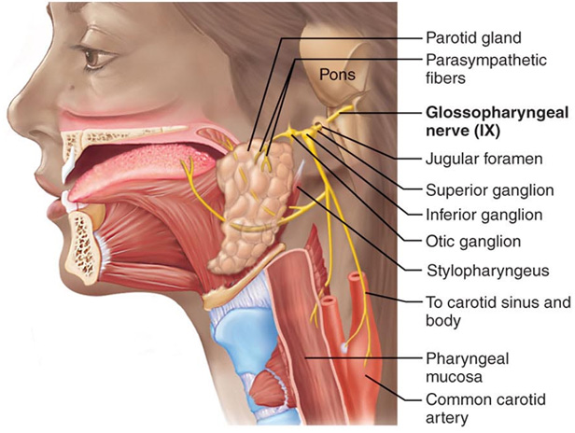
Glossopharyngeal Nerve CN IX
The glossopharyngeal nerve is a motor and sensory nerve
It emerges from the anterior surface of the medulla oblongata between the olive and the inferior cerebellar peduncle.
It passes laterally in the posterior cranial fossa and leaves the skull by passing through the jugular foramen.

Slide 3
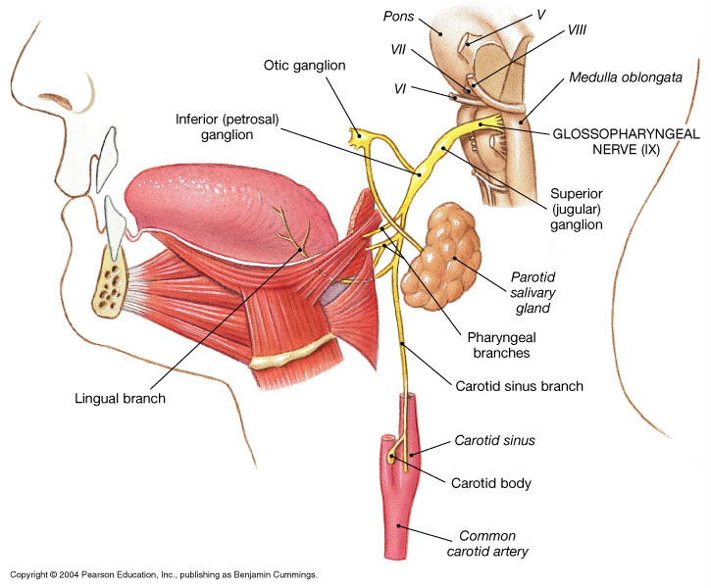
Glossopharyngeal Nerve CN IX
The superior and inferior sensory ganglia are located on the nerve as it passes through the foramen.
The glossopharyngeal nerve then descends through the upper part of the neck to the back of the tongue

Slide 4
Functions:
Somatic (Branchial) Motor
Visceral (Parasympathetic) Motor
Somatic (General) Sensory
Special Sensory (Taste)
Visceral Sensory

Slide 5
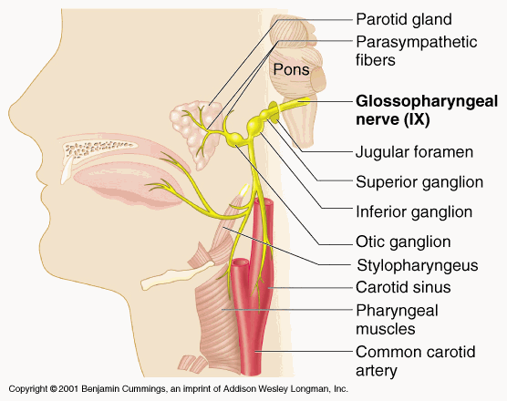
Glossopharyngeal Nerve CN IX
Somatic (Branchial) Motor
Motor fibers pass to one muscle, the stylopharyngeus, derived from the 3rd pharyngeal arch.

Slide 6
Glossopharyngeal Nerve CN IX
Visceral (Parasympathetic) Motor
Following a circuitous route initially involving the tympanic nerve, presynaptic parasympathetic fibers are provided to the otic ganglion for innervation of the parotid gland.

Slide 7
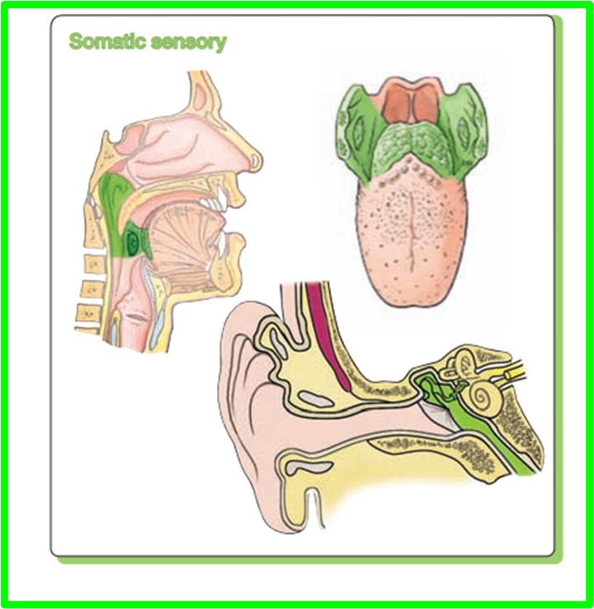
Glossopharyngeal Nerve CN IX
Somatic (General) Sensory
The tympanic nerve.
Via the tympanic plexus, CN IX supplies the mucosa of the tympanic cavity, pharyngotympanic tube, and the internal surface of the tympanic membrane.

Slide 8
Glossopharyngeal Nerve CN IX
The pharyngeal, tonsillar, and lingual nerves to the mucosa of the oropharynx and isthmus of the fauces (L., throat), including palatine tonsil, soft palate, and posterior third of the tongue.

Slide 9
Glossopharyngeal Nerve CN IX
In addition to general sensation (touch, pain, temperature),
tactile (actual or threatened) stimuli determined to be unusual or unpleasant here may evoke the gag reflex or even vomiting.

Slide 10
Glossopharyngeal Nerve CN IX
Visceral Sensory
The carotid sinus nerve to the carotid sinus, a baro-(presso-) receptor sensitive to changes in blood pressure,
and the carotid body, a chemoreceptor sensitive to blood gas (oxygen and carbon dioxide levels).

Slide 11
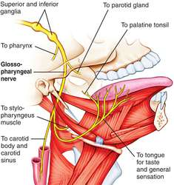
Glossopharyngeal Nerve CN IX
Special Sensory (Taste)
Taste fibers are conveyed from the posterior third of the tongue to the sensory ganglia, the superior and inferior ganglia of CN IX

Slide 12
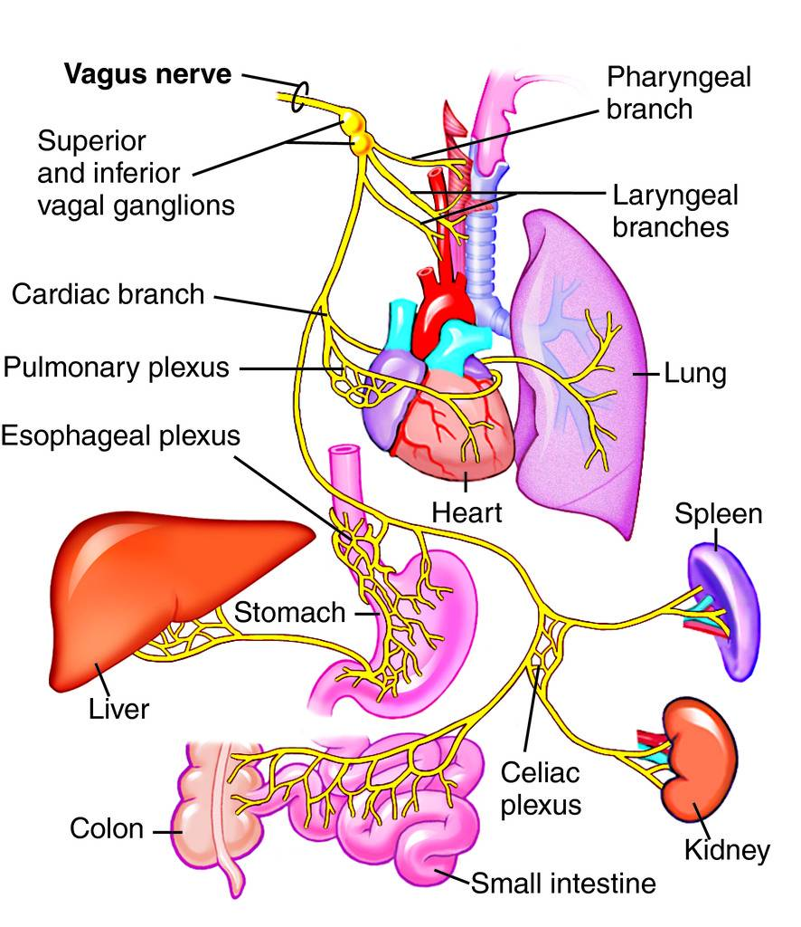
Vagus Nerve CN X
The vagus nerve is composed of motor and sensory fibers
It emerges from the anterior surface of the medulla oblongata between the olive and the inferior cerebellar peduncle.
The nerve passes laterally through the posterior cranial fossa and leaves the skull through the jugular foramen.

Slide 13
Vagus Nerve CN X
The vagus nerve has both superior and inferior sensory ganglia.
Below the inferior ganglion, the cranial root of the accessory nerve joins the vagus nerve and is distributed mainly in its pharyngeal and recurrent laryngeal branches.

Slide 14
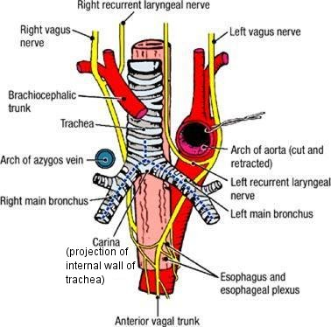
Vagus Nerve CN X
The vagus nerve descends through the neck alongside the carotid arteries and internal jugular vein within the carotid sheath
It passes through the mediastinum of the thorax passing behind the root of the lung, and enters the abdomen through the esophageal opening in the diaphragm

Slide 15
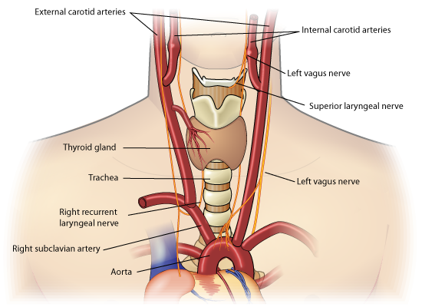
Important Branches of the Vagus Nerve in the Neck
■■ Meningeal and auricular branches
■■ Pharyngeal branch contains nerve fibers from the cranial part of the accessory nerve.
■■ Superior laryngeal nerve divides into the internal and the external laryngeal nerves.
The internal laryngeal nerve is sensory to the piriform fossa and the larynx down as far as the vocal cords.
The external laryngeal nerve is motor and it supplies the cricothyroid muscle.

Slide 16
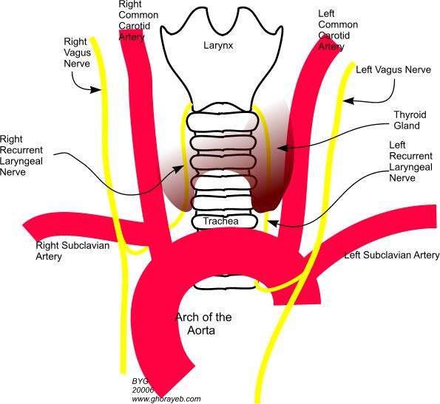
Important Branches of the Vagus Nerve in the Neck
■ Recurrent laryngeal nerve
On the right side, the nerve hooks around the first part of the subclavian artery
On the left side, the nerve hooks around the arch of the aorta
The nerve is closely related to the inferior thyroid artery, and it supplies all the muscles of the larynx, except the cricothyroid muscle, the mucous membrane of the larynx below the vocal cords, and the mucous membrane of the upper part of the trachea.
■■ Cardiac branches (two or three) arise in the neck, descend into the thorax, and end in the cardiac plexus

Slide 17
Vagus Nerve CN X
The vagus nerve thus innervates:
The heart and great vessels within the thorax
The larynx, trachea, bronchi, and lungs
Much of the alimentary tract from the pharynx to the splenic flexure of the colon.
It also supplies glands associated with the alimentary tract, such as the liver and pancreas.
The vagus nerve has the most extensive distribution of all the cranial nerves and supplies the forementioned structures with afferent and efferent fibers.

Slide 18
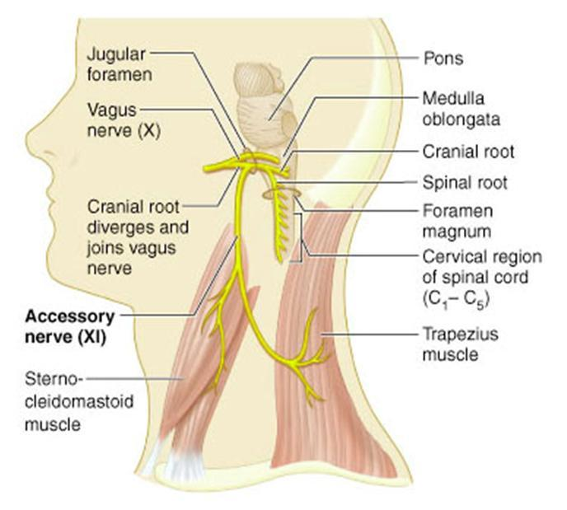
Accessory Nerve CN XI
The accessory nerve is a motor nerve.
It consists of a cranial root (part) and a spinal root (part)
Cranial Root
Emerges from the anterior surface of the medulla oblongata between the olive and the inferior cerebellar peduncle
The nerve runs laterally in the posterior cranial fossa and joins the spinal root

Slide 19
Accessory Nerve CN XI
Spinal Root
Arises from nerve cells in the anterior gray column (horn) of the upper five segments of the cervical part of the spinal cord
The nerve ascends alongside the spinal cord and enters the skull through the foramen magnum. It then turns laterally to join the cranial root

Slide 20
Accessory Nerve CN XI
The two roots unite and leave the skull through the jugular foramen.
The roots then separate:
The cranial root joins the vagus nerves and is distributed in its branches to the muscles of the soft palate and pharynx (via the pharyngeal plexus) and to the muscles of the larynx (except the cricothyroid muscle).

Slide 21
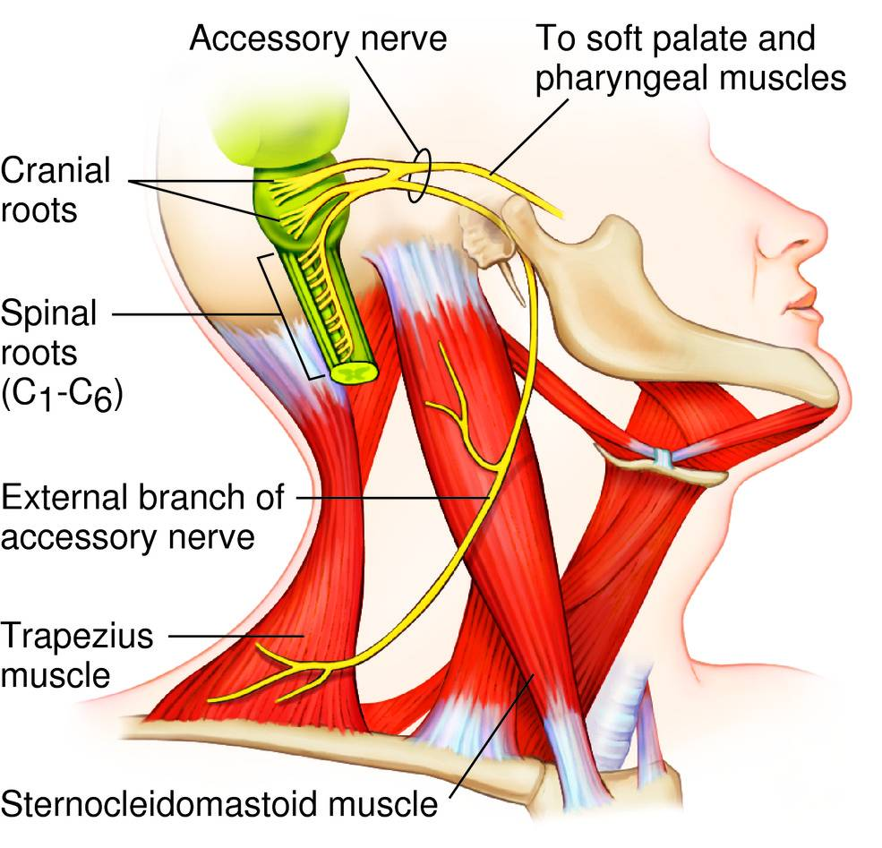
Accessory Nerve CN XI
The spinal root runs downward and laterally and enters the deep surface of the sternocleidomastoid muscle, which it supplies, and then crosses the posterior triangle of the neck to supply the trapezius muscle
The accessory nerve thus brings about:
Movements of the soft palate, pharynx, and larynx
Controls the movements of the sternocleidomastoid and trapezius muscles, two large muscles in the neck

Slide 22
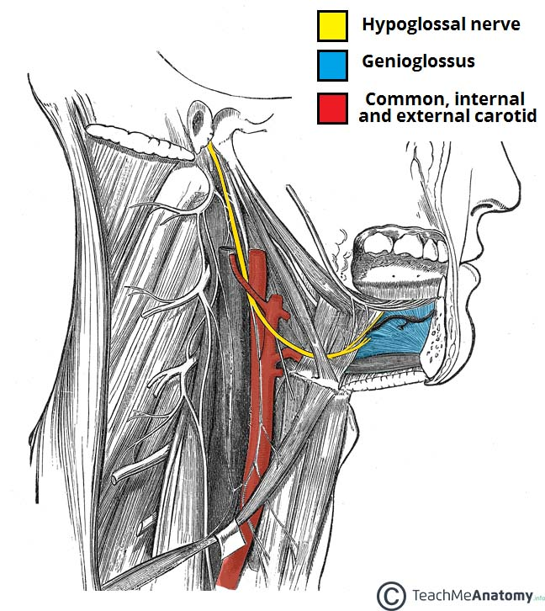
Hypoglossal Nerve CN XII
The hypoglossal nerve is a motor nerve.
It emerges on the anterior surface of the medulla oblongata between the pyramid and the olive, crosses the posterior cranial fossa, and leaves the skull through the hypoglossal canal.
The nerve then passes downward and forward in the neck and crosses the internal and external carotid arteries to reach the tongue
In the upper part of its course, it is joined by C1 fibers from the cervical plexus

Slide 23
Important Branches of the Hypoglossal Nerve
■■Meningeal branch
■■ Descending branch (C1 fibers) passes downward and joins the descending cervical nerve (C2 and 3) to form the ansa cervicalis.
Branches from this loop supply the omohyoid, the sternohyoid, and the sternothyroid muscles.
■■ Nerve to the thyrohyoid muscle (C1)

Slide 24
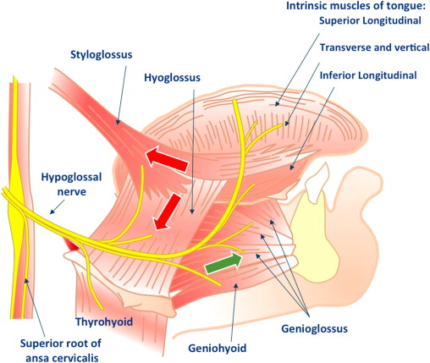
Important Branches of the Hypoglossal Nerve
■■ Muscular branches to all the muscles of the tongue except the palatoglossus (pharyngeal plexus)
■■ Nerve to the geniohyoid muscle (C1).
The hypoglossal nerve thus innervates the muscles of the tongue (except the palatoglossus) and therefore controls the shape and movements of the tongue.

Slide 25
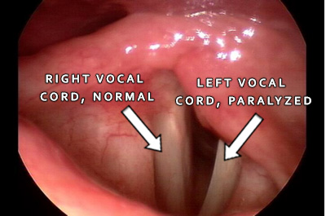
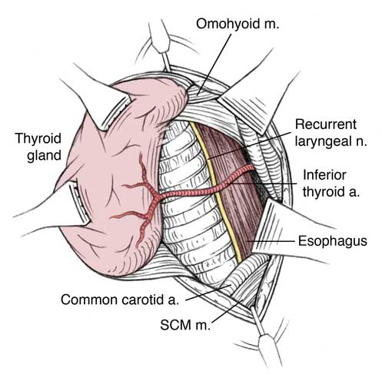
VAGUS NERVE INJURY Injury to pharyngeal branches of CN X results in dysphagia (difficulty in swallowing).
Injury of the recurrent laryngeal nerve causes hoarseness and dysphonia (difficulty in speaking) because of paralysis of the vocal folds (cords).
Paralysis of both recurrent laryngeal nerves causes aphonia (loss of voice) and inspiratory stridor (a harsh, high pitched respiratory sound). All these may results from cancer of the larynx and thyroid gland and/or from injury during surgery on the thyroid gland, neck.

Slide 26
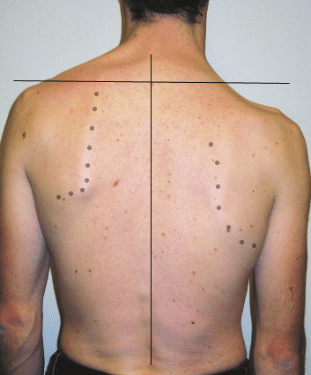
SPINAL ACCESSORY NERVE INJURY
Because of its nearly subcutaneous passage through the posterior cervical region, CN XI is susceptible to injury during surgical procedures such as lymph node biopsy, cannulation of the internal jugular vein, and carotid endarterectomy result in marked ipsilateral weakness of shoulder (Drooping of the shoulder)

Slide 27
Injury to Hypoglossal Nerve
Injury to CN XII paralyzes the ipsilateral half of the tongue. After some time, the tongue atrophies, making it appear shrunken and wrinkled. When the tongue is protruded, its apex deviates toward the paralyzed side because of the unopposed action of the genioglossus muscle on the normal side of the tongue

Slide 28
Dr. Aiman Qais Afar
Monday 13 March 2023

