Slide 1
Pancreas
Dr. Omar Hamdan MD
Anatomical pathology Mutah University School of Medicine- Department of Laboratory medicine & Pathology GIT lectures 2020

Slide 2
Acute pancreatitis
Inflammation of the pancreas associated with acinar cell injury

Slide 3
Clinical features:
1-abdominal pain cardinal sign mild-severe
epigastric with radiation to the back

Slide 4
2-shock
It is due to:
-pancreatic hemorrhage
-Release of vasodilating agents as bradykinin & PGs
It results in electrolyte imbalance , loss of blood volume & toxemia

Slide 5
3- increased serum amylase level
-It inceases within the first 12 hrs & back to normal within 48-72 hrs

Slide 6
Other conditions associated with increase in amylase serum level are:
1-perforated gastric ulcer 2-pancreatic carcinoma
intestinal obstruction
perotinitis
secondary pancreatic disease

Slide 7
4-increase serum lipase level
-it increases within 72-96 hrs &lasts for 7-10 days
- It is highly sensitive & specific for acute pancreatitis

Slide 8
5-hypocalcemia
Calcium binds fatty acids released from lipolysis of fat in the abdomen

Slide 9
6-Jaundice ,hyperglycemia & glycosuria occur in less than 50% of cases
7-ARDS & acute renal failure

Slide 10
Causes of acute pancreatitis
1-pancreatic duct obstruction (35-60 %) a.gall bladder stones (25X increase risk) b.cystic fibrosis
c.tumors d.edema
e.parasites e.g Ascaris

Slide 11
2-direct injury of acinar cells of pancreas a.ethanol
b.viruses
c.drugs as diuretics d.trauma
e.acute ischemia , shock,vasculitis ----- f.hypercalcemia
g.hyperlipidemia h.obesity

Slide 12
3- idiopathic
10-20% of the cases
4-hereditary pancreatitis Aut. Dominant trait Mutation in PRSS1 gene

Slide 13
pathogenesis
autodigestion of pancreatic tissue by activated pancreatic enzymes (chemotrypsinogen,proelastase,
prophospholipase& trypsinogen)
cellular injury response mediated by proinflammatory cytokines
defective transport of proenzymes within acinar cells

Slide 14
-normally pancreatic enzymes are present in acinar cells as proenzyme forms (zymogen granules) & confind to membrane-bound compartment before secrtion

Slide 15
-zymogen granules release their enzymes into the apical lumen for delivery via the pancreatic duct to the duodenal lumen
-trypsin is a major activator of other proenzymes which is synthesized by acinar as proenzyme trypsinogen

Slide 16
-in acute pancreatitis proenzymes are activated & released from zymogen granules within the acinar cells 
damage of acinar cells & fatty tissue in & around the pancreas 
damage of elastic tissue of blood vessels  hemorrhage

Slide 17
-premature activation of proenzymes esp.trypsinogen is the key step & it is favoured by:
low pH
increased I.C calcium
cathepsin B within lysosomes

Slide 18
Activated trypsin 
Prekallikrin  active form
stimulate kinin system,hagman factor(factor IX) & clotting &complement factors  small vessels thrombosis  rupture
hemorrhage

Slide 19
-damaged acinar cells release potent cytokines attraction of neutrophils & macrophages
release of more cytokines as
IL-1,NO,PAF inflammation & pancreatic damage

Slide 20
Mrphology of acute pancretitis
-It is related to duration & severity
-features:
proteolytic destruction of pancreatic substance
necrosis of blood vessels & interstitial hemorrhage
necrosis of fat by lipase
acute inflammatory reaction

Slide 21
-Fat necrosis is most characteristic Fat hydrolysis)FFA(----combine with Ca++
(saponification)----insoluble
salts(calcification)

Slide 22
-Pancreatic pseudocyst are formed in 50% of the cases
-suppurative appendicitis
-obstruction of duodenum
-abscess formation
-hemorrhages

Slide 23
prognosis:
-mortality is high 20-40%
-death is usually due to:- 1-shock
2-abdominal sepsis 3-ARDS

Slide 25
Chronic pancreatitis
Repeated bouts of mild-moderate pancreatic inflammation with progressive loss of pancreatic parenchyma & fibrosis

Slide 26
Predisposing factors
alcoholism
hypercalcemia
hyperlipoproteinemia
long standing obstruction of pancreatic duct 5-biliary tract disease
hereditary
hemochromatosis 8-cystic fibrosis
9-idiopathic 40% of cases

Slide 27
morphology
-Atrophy of exocrine gland
-fibrosis
-chronic inflammation
-destruction of pancreatic ducts
-ductal protein plugs
-calcifications
-pseudocysts

Slide 28
Clinical features
-asymptomatic
-attacks of abdominal pain
-recurrent attacks of jaundice
-indigestion
-diabetes mellitus
-weight loss
-malabsorption

Slide 29
diagnosis
-increased amylase & lipase in the serum
-calcifications in the pancreas on x-ray or CT scan
-presence of pseudocysts

Slide 30
Pancreatic carcinoma
-Peak incidence 60-80 yr
-predisposing factors:
smoking
hereditary pancreatitis (increase risk 40X 3-genetic mutations
K-ras gene mutation(most common) CDKN2A P16) mutation -Both present in 90% of the cases- T53gene mutation (>50% of cases) HER2/NEU amplification (>50% of the cases) BRCA2 & MLH genes mutation

Slide 31
epidemiology
-M : F = 3 : 1 in youngs
1 : 1 in olds (>60yrs)
-blacks > whites

Slide 32
Risk factors
1-smoking increase the risk by 2-3X 2-chemical carcinogens
3-meat & fat-rich diet 4-D.M
5-chronic pancreatitis

Slide 33
-location:
60-70% | head of the pancreas
10-15% | body
5% | tail
20% | diffuse infiltration

Slide 34
General features:
-adenocarcinoma
-desmoplastic reaction
-ulceration of duodenal mucosa
-dilatation of biliary tree
-involvement of adjacent organs as spleen, adrenal, vertebra, colon, stomach---
-perineural invasion

Slide 35
METS
-liver & regional lymph nodes
-lung ,bones , adrenals , peritoneum

Slide 36
Clinical presentation
-silent
-pain
-weight loss
-obstructive jaundice
-migratory thrombophlebitis (Trousseau sign ) in 10% of the cases
-acute painless dilatation of GB & jaundice (Courvoisie sign)
-increased CEA & CA 19.9 Ag in the serum

Slide 37
Prognosis
-50% of cases die within 6 months
-5-yr survival is < 1%

Slide 39
BILLARY ATRESIA
Complete obstruction of the lumen of the extrahepatic biliary tree within the first 3 months of life

Slide 40
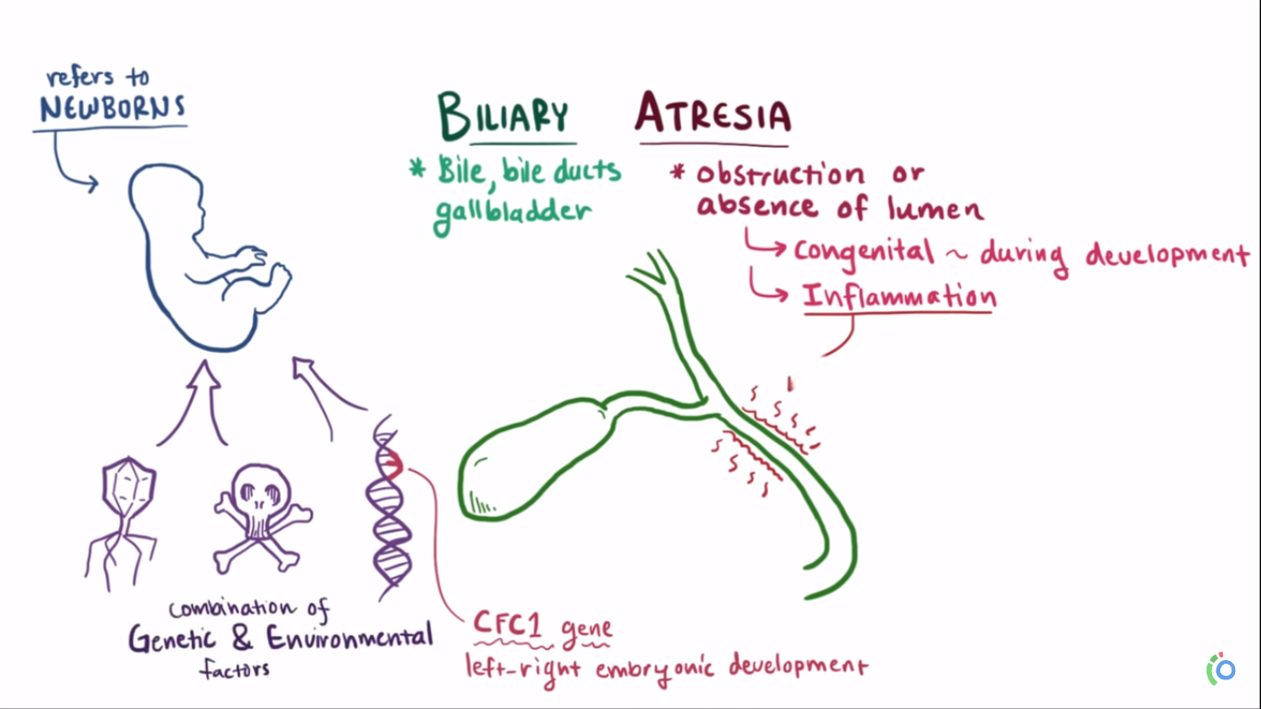

Slide 41
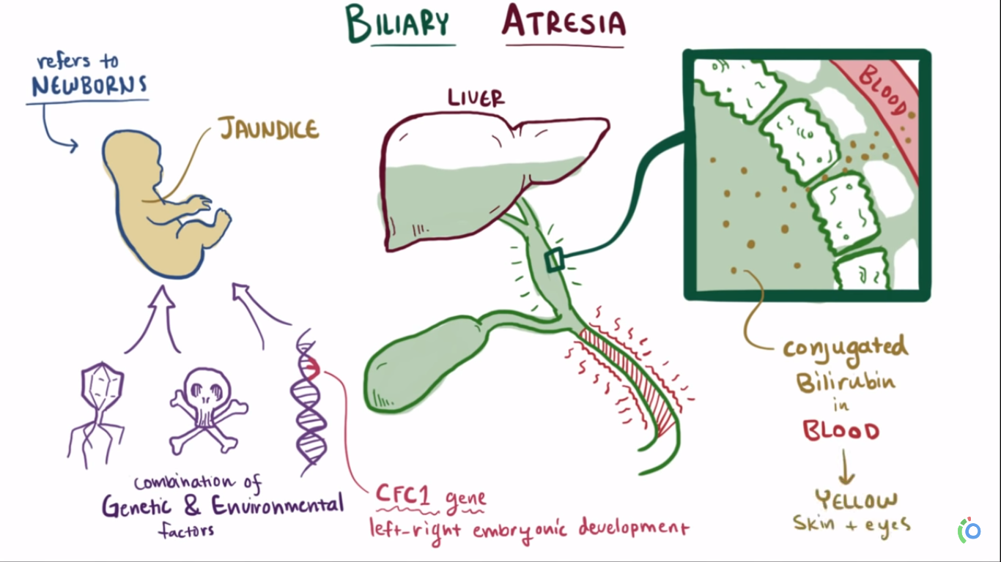

Slide 42
It occurs in about 1:10000 live births
It is the cause of neonatal cholestasis in One third of the cases.
It is the most common cause of death from liver disease in early childhood
Rapid progress to cirrhosis.

Slide 43
Pathogenesis:
Two types:
1. Fetal form
20% of the cases
Associated with other anomalies as malrotation of abd viscera, interrupted inf. Vena cava, polysplenia, CHD

Slide 44
2. Perinatal Form
-Normally developed biliary tree is destroyed after birth
-? Viral infection as rotavirus
- ? Genetic inheritance.

Slide 45
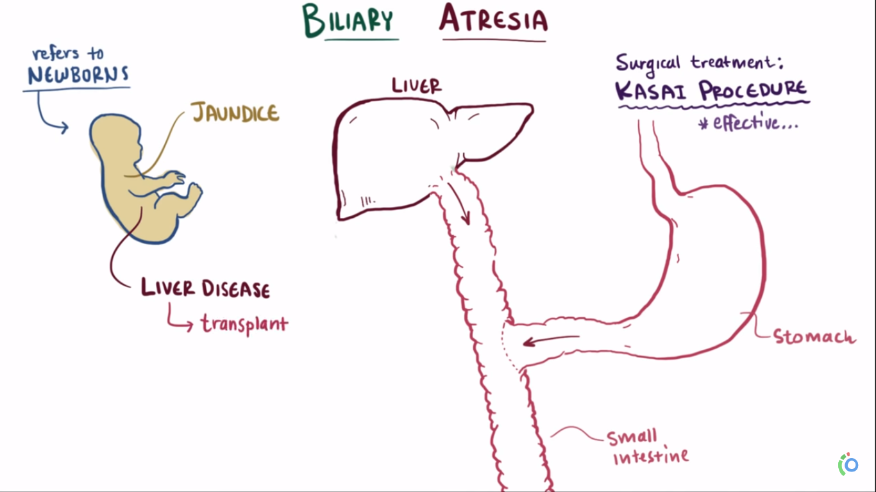

Slide 46
Morphology of biliary atersia
Inflammation & stricture of the hepatic or common bile ducts.
Periductular inflammation of intrahepatic bile ducts.
Progressive destruction of the intrahepatic biliary tree.
Bile duct proliferation
Portal tract edema & fibrosis
Cholestasis

Slide 47
Clinical Features:
-Neonatal cholestasis
-Normal wt. & postnatal wt. gain
-F > M
-Hyperbilirubinemia
-A cholic stool

Slide 48
CHOLECYSTITIS
Acute
Chronic
Acute on top of chronic Almost always occurs in
association with stones

Slide 49
Morphology Acute cholesytitis
enlarged tense GB
Bright red – GreeSubserosal hemorrhages
Fibrin & suppurative exudate on serosa.
Stones in 90% of cases in neck of GB or cystic duct.
nblack discoloration

Slide 50
Cloudy turbid bile + fibrin, hemorhage, pus
Empyema = GB filled with pus. GB wall in thick, edematous, hyperemic
Gangrenous GB = necrosis of wall
Histologically GB wall shows features of acute inflammation, edema, leukocytes infiltration congestion ….etc.

Slide 51
Chronic cholecytitis
Recurrent attacks of steady or colicky epigastric or RUQ pain.
Nausea & vomiting,
Fat intolerance
Almost always associated with GB stones.

Slide 52
Morphology of chronic cholecystitis
Changes are variable & might be minimal.
Presence of stones is sufficient for Dx.
Gall bladder may be normal in size, contracted, or enlarged
Mucosal ulceration are infrequent
Submucosal & subserosal fibrosis
Lymphocytic infiltration of GB wall.

Slide 53
Cholangitis = Bacterial infection of the bile ducts mainly due to obstruction (commonly by stone)
Other cause
Stent or catheters
Tumors
Acute pancreatitis
Benign stricture
Bacteria enter biliary tract throught the sphincter of oddi.

Slide 54
CARCINOMA OF THE GALLBLADDER
Women 7th decades 5yr. Survival about 1%
Gallstones in 60-90% of cases

Slide 55
Morphology:
Infiltrating or exphytic
Fundus &neck are the most common sites (lateral walls.(
Adenocarcinoma 95%
Adenosquamous, squamous ca. 5%
Carcinoid
Local exension to liver, cystic duct, lymph nodes
Distant spread: peritoneum, GI, lungs

Slide 56
Clinical Features
Pre-operative Dx in <20% Nausea, vomiting, pain, jaundice
, wt loss, anorexia
Obstruction which leads to acute cholecytitis.

Slide 57
CHOLANGIOCARCINOMA
-Arise from bile ducts within & outside the liver
-Incidence 0.6/100000
-M=F

Slide 58
Predisposing factors:
Sclerosing cholangitis
Congenital fibropolycystic disease of biliary system
Thorostat
Chronic infection by liver fluke

Slide 59
Morphology Adenocarcinoma Marked demoplasia
Metastasis
Hematogenous: Lung, bones (vertebra), Adrenals, brain (50% of cases)
Lymphatic: regional LN. (50%)

Slide 60
Ampullary tumors
Morphology
small tumors at time of diagnosis.
Adenocarcinoma
+ mucin
+ Squmous
Klastskin tumor
Tumors arise from Rt. And Lt. hepatic duct at the liver hilus.

Slide 61
Presentation
Jaundice, decoloration of stool Nausea, vomiting and wt loss
liver in 50%
GB in 25%
serum alkaline phophatase and transaminases
prothrombin time Dark urine
Prognosis very bad mean survival 6-18 months.

