Slide 1
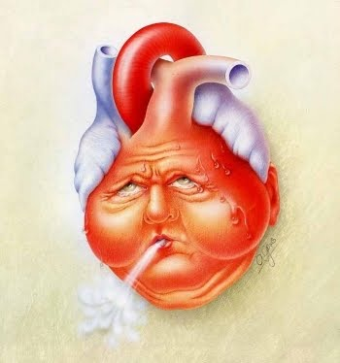
Heart failure
Made by : Abdelrahman omar nour

Slide 2
Management of labour and delivery
In most cases the aim of management is to await the onset of spontaneous labour
Induction of labour should be considered for the usual obstetric indications and in very high-risk women
minimize the risk of intervention
maximize the chances of a normal delivery

Slide 3
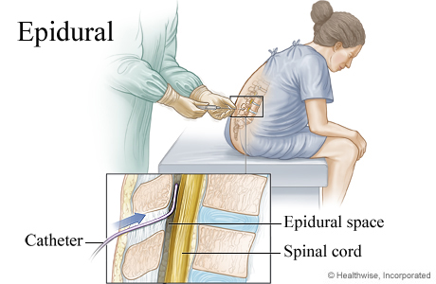
Anesthesia
Epidural anaesthesia is often recommended
However, regional anaesthesia has the risk of maternal hypotension ,
That’s why the senior anaesthetist has to formulate and document an anaesthetic management plan and minimize the procedure-related risks
Because it reduces the pain-related stress and, thereby, some of the demand on cardiac function ( )

Slide 4
Other needs …
Prophylactic antibiotics should be given to any woman with a structural heart defect to reduce the risk of bacterial endocarditis
Depending on the severity , other forms of monitoring may be appropriate during labour :
High-level maternal surveillance is required until the main haemodynamic changes following delivery have passed
(amoxycillin 2 g i.v. plus gentamicin 1.5 mg/kg i.v.)
(if penicillin allergic give vancomycin 1 g i.v.)
oxygen saturation monitoring
continuous arterial blood pressure monitoring

Slide 5
Labour stages
Second stage of labour :
Should be kept short , with an elective forceps or ventouse delivery
(if normal delivery does not occur readily)
This reduces maternal effort and the requirement for increased cardiac output
Third stage of labour :
active management of the third stage is usually with Syntocinon™ only
( which is a vasodilator and therefore should be given slowly , with low-dose infusions preferable )
Ergometrine may be associated with intense vasoconstriction, hypertension and heart failure

Slide 6
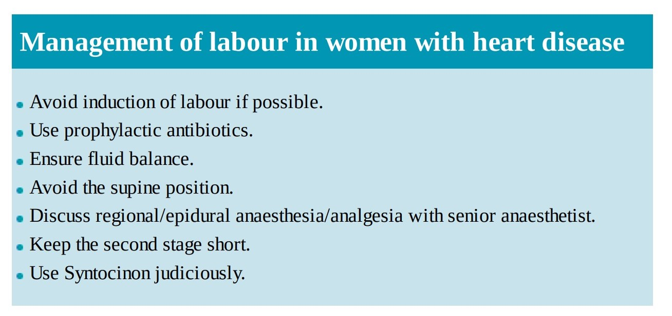

Slide 7
Caesarean delivery ??
Should only be performed if the maternal condition is considered too unstable to tolerate the physiological demands of labour
Cesarean delivery is associated with an increased risk of :
And these conditions are less well tolerated in women with cardiac disease
Why ?
Haemorrhage
Thrombosis
Infection

Slide 8
Treatment of heart failure in pregnancy
the principles of treatment are the same as in the non-pregnant individual
The patient should be admitted and the diagnosis confirmed by clinical examination and by echocardiography confirming ventricular dysfunction

Slide 9
Drug therapy
Drug therapy may include :
Oxygen and morphine may also be required
Arrhythmias also require urgent correction and drug therapy; for example, adenosine
Diuretics
Vasodilators
digoxin

Slide 10
The fetus
In all cases, assessment of fetal wellbeing is essential , and should include:
fetal ultrasound to assess fetal growth
regular cardiotocography (CTG)
If there is evidence of fetal compromise, premature delivery may be considered
the risks to the mother of continuing the pregnancy and the risks to the fetus of premature delivery must be carefully balanced

Slide 11
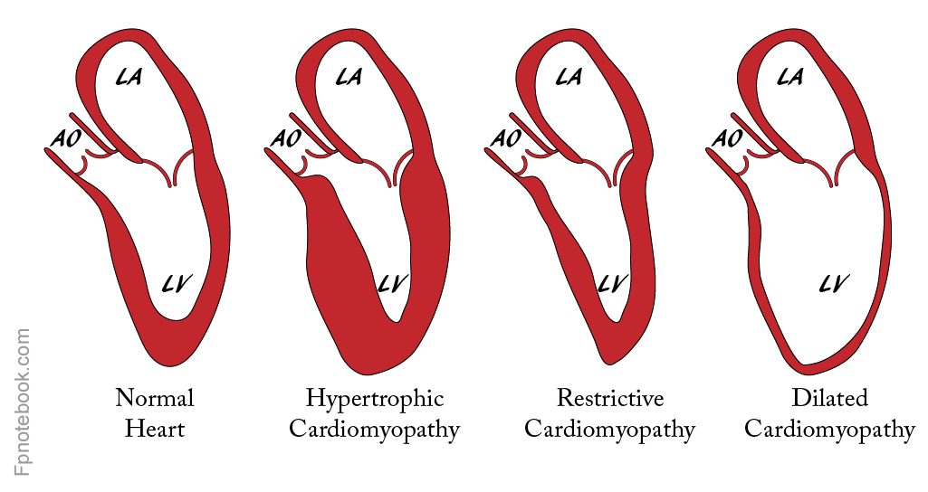
cardiomyopathies

Slide 12
Hypertrophic cardiomyopathy (HCM)
About 70% of cases are familial with autosomal dominant inheritance.
It is a rare disease associated with a high risk of sudden death
Clinical features : Risk factors
1. may be asymptomatic
2. Chest pain or syncope
3. Pansystolic murmur
4. Arrhythmias
5. Heart failure
1. family history of sudden death
2. ventricular tachycardia
3. failure of blood pressure to increase during exercise
4. left ventricular wall thickness >30 mm

Slide 13
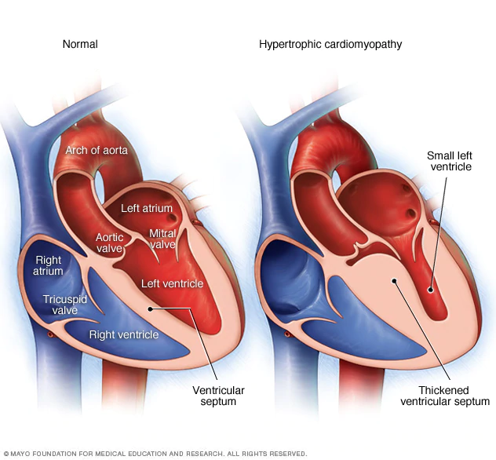
Effect of pregnancy on HCM :
Mostly well tolerated in pregnancy because of an increase in left ventricular cavity size and the stroke volume is usually able to increase
β-blockers should be continued or started in pregnancy
Care is required with regional anaesthesia/analgesia to avoid hypotension
Any hypovolemia will have the same effect as hypotension and should be rapidly and adequately corrected

Slide 14
Peripartum cardiomyopathy
rare condition defined as The development of heart failure at the end of pregnancy or in the months following delivery
Risk factors :
1. Multiple pregnancy
2. Multiparity
3. Advanced maternal age
4. Pregnancy complicated by hypertension
5. Afro-Caribbean race

Slide 15
Symptoms :
1. Dyspnea
2. Palpitations
3. Reduced exercise tolerance
4. Pulmonary and/or peripheral oedema
Signs :
1. Tachycardia, tachypnoea
2. Pulmonary oedema
3. Congestive cardiac failure
4. Dysrhythmias
5. Signs of pulmonary, cerebral and systemic embolization

Slide 16
Etiology :
1. myocarditis on endomyocardial biopsy
2. autoimmune response
3. increased myocyte apoptosis
4. vasotoxic 16 kDa subform of prolactin
Diagnosis :
Diagnosis often requires echocardiography , which shows the heart is enlarged with global dilation of all four chambers and markedly reduced left ventricular function.

Slide 17
Management :
Elective delivery if antenatal.
Thromboprophylaxis. Anticoagulants are mandatory in severe cases .
treatment for heart failure (diuretics , vasodilators , digoxin , …..)
Immunosuppressive therapy → if the cause is myocarditis
Bromocriptine → if the cause is prolactin
intra-aortic balloon pumps and left ventricular assist devices
Cardiac transplantation is the last option available .
Prognosis :
Prognosis depends on normalization of left ventricular size and function within 6 months after delivery
95% of patients documented a 5-year survival
50% of patients make a spontaneous and full recovery
Women should be advised against further pregnancy if left ventricular size or function does not return to normal , risk of recurrence, worsening heart failure (50%) and death (25%)

