Slide 1
بِسْمِ اللّهِ الرَّحْمَنِ الرَّحِيمِ
Infectious process
I
Prof DR. Waqar Al – Kubaisy

Slide 2
Contents
Definitions related to infectious disease epidemiology
Requisites for Perpetuation of Communicable Diseases

Slide 3
Diseases
Infectious
Non-infectious
Infection, followed by manifestations
(signs and symptoms)
Disease not caused by microbiological agent (nutritional, allergic, endocrinal, psychogenic…etc)

Slide 4
Infectious disease epidemiology is a fundamental part
of the whole of epidemiology.
Studying of communicable diseases??
(a) by the discovery of "new" infections, and
(b) changes in the pattern of communicable diseases,
( c) some chronic diseases may have an infective origin.??
The development of vaccines and /or antibiotics was
not followed, by the virtual (practical, functional), disappearance of infectious disease.
Therefore it’s prevention and control needs
epidemiological knowledge and experience .

Slide 5
Definitions related to infectious disease epidemiology
Health
Infection
Pathogenesis:
Contamination
Infestation
Communicable Disease: (CD)
Non- Communicable Disease (NCD)
Contagious Disease
Host
Epidemic
"Outbreak Sporadic
Endemic
Pandemic
Nosocomial Infection
Opportunistic Infection
Iatrogenic (Physician-induced) Disease
Eradication

Slide 6
Health (WHO definition)
It is the state of complete physical, mental and social well being, and not merely the absence of disease or infirmity.
Any deviation from normal health is called Disease
Infection
The entry and development and/or multiplication of an infectious agent in the body of man or animals.
Also It is the body responds to
defend itself against the invader, either in the form of an
immune response or
disease.
An infection does not always cause illness.
Health
Infection
Pathogenesis:
Contamination
Infestation
CD
NCD
Contagious Disease
Host

Slide 7
The outcome of infection depends on:
1. Host resistance (immunity)
2. Microbiological agent characters (invasiveness, toxicity & Virulence)
There are several levels of infection :
Colonization (e.g., S. aureus in skin and normal nasopharynx)
Subclinical or clinically inapparent infection (e.g., polio);
Latent infection (e.g. TB)
Clinical infection or manifest
Health
Infection
Pathogenesis:
Contamination
Infestation
CD
NCD
Contagious Disease
Host
Pathogenesis:
End result of agent host interaction:
Agent fails to lodge(inhabit ) resulting in No Infection
Agent lodges without causing illness resulting in subclinical infection (silent or latent)
Agent lodges with frank illness resulting in Disease

Slide 8
Health
Infection
Pathogenesis:
Contamination
Infestation
CD
NCD
Contagious Disease
Host
Contamination
The presence, multiplication and development
of an infectious agent on a body surface; or an
inanimate article. clothes, beddings, toys, surgical instruments or water, milk and food.
Infestation
Lodgement, development and reproduction of arthropods on the surface of the body of persons or animals or in the clothing, e.g., lice, itch mite.
Also to describe invasion of the gut by parasitic worms, e.g., ascariasis.

Slide 9
Host
A person or animal, including birds and arthropods,
that affords living or lodgement to an infectious
agent under natural conditions.
Obligate host ,means the only host, e.g., man in measles and typhoid fever.
Definitive (primary) hosts; Hosts in which the parasite attains (achieves, accomplishes) maturity or passes its sexual stage For example, human tapeworm makes use of human as its definitive host.
Intermediate (secondary) hosts: those in which the parasite is in a larval or asexual state s a host in which a parasite passes one or more of its asexual stages; usually designated first and second, if there is more than one.
Transport host is one that is used until the appropriate one definitive host reached, but is not necessary to completion of.
the life cycle of the parasite, not undergo development.
.
Health
Infection
Pathogenesis:
Contamination
Infestation
CD
NCD
Contagious Disease
Host

Slide 10
Forms of diseases According to Communicability
Health
Infection
Pathogenesis:
Contamination
Infestation
CD
NCD
Contagious Disease
Host
Communicable disease:
it is an infectious disease due to a specific
infectious agent, or its toxic products.
capable of being directly or indirectly transmitted
from man to man, animal to animal, or from the
environment (through air, dust, soil, water, food, etc.) to man or animal that can be transmitted. e.g..: influenza
Non-Communicable disease: it is an infectious disease that can not be transmitted. e.g.: appendicitis, peritonitis
Contagious disease: part of communicable disease, transmitted by direct contact between reservoir and host. e.g. scabies, trachoma, STD and leprosy.

Slide 11
Epidemic
"Outbreak Sporadic
Endemic
Pandemic
Nosocomial Infection
Opportunistic Infection
Iatrogenic (Physician-induced) Disease
Eradication
Forms of Disease Occurrence
Epidemic (Epi upon; demos = people).
The "unusual“ occurrence in a community or region, of a disease, specific health-related behaviour (e.g., smoking)
or other health related events (e.g., traffic accidents) clearly
in excess of "expected occurrence
Covers the communicable and non-communicable diseases (e.g., CHD, lung cancer
The key words in the definition of an epidemic are :
in excess of "expected occurrence".
There is no agreement on what constitutes a significant excess USA , cholera is not normally present in the population. Therefore, even one case of cholera would constitute a "potential" epidemic in US.
But in. India For cholera to be considered as an epidemic, hundreds of cases

Slide 12
"outbreak" for a small, usually localized epidemic
affecting certain large numbers or a group in the community,
e.g. outbreak of food poisoning in an institution.
Sporadic
The word sporadic means scattered about.
The cases occur irregularly, haphazardly from time to
time, and generally infrequently
The cases are so few and separated widely
in space and time that they show
little or no connection with each other,
nor a recognizable common source of infection, e.g.,
polio, tetanus, herpes-zoster and meningococcal meningitis.
A sporadic disease may be the starting point of an epidemic when conditions are favourable for its spread.
Many zoonotic diseases are characterised by sporadic transmission to man
Epidemic
"Outbreak Sporadic
Endemic
Pandemic
Nosocomial Infection
Opportunistic Infection
Iatrogenic (Physician-induced) Disease
Eradication

Slide 13
Epidemic
"Outbreak Sporadic
Endemic
Pandemic
Nosocomial Infection
Opportunistic Infection
Iatrogenic (Physician-induced) Disease
Eradication
Endemic
(En=in; demos=people).
It refers to the constant or permanently
presence of a disease or infectious agent within a given geographic area or population group or community
all the time,
e.g. bilharziasis in Egypt
Pandemic
An epidemic usually affecting a large proportion of the
population, affecting countries sequentially (at the same time) occurring over a wide geographic area such as a section of a nation, the entire nation, a continent or the world e.g., COVID 19 , H1N1

Slide 14
Nosocomial Infection
Nosocomial (hospital acquired) infection is an
infection originating in a patient while in a hospital or other health care facility.
It denotes a new disorder (unrelated to the patient's primary condition) associated with being in a hospital.
it was not present or incubating at the time of
admission or the residual of an infection acquired during a previous admission.
It includes infections acquired in the hospital but appearing after discharge, and also such
infections among the staff of the facility.
Examples include infection of surgical wounds, hepatitis B, C and urinary tract infections.

Slide 15
Epidemic
"Outbreak Sporadic
Endemic
Pandemic
Nosocomial Infection
Opportunistic Infection
Iatrogenic (Physician-induced) Disease
Eradication
Opportunistic Infection
Infection by an organism(s) that takes the
opportunity provided by a defect in host
defence to infect the host and hence cause disease.
Eg. Herpes simplex, Cytomegalovirus, Toxoplasma, AIDS). M. tuberculosis,
Iatrogenic (Physician-induced) Disease
It is any adverse consequence resulting from a physician's professional or other health professionals activity whether preventive, ???,
diagnostic or ???,
therapeutic procedure ???, that causes impairment, handicap, disability or death
Reactions to contrast media injected intravenously or intra-arterially may be mild, moderate or severe, and some are potentially fatal. Intravascular contrast media may have a nephrotoxic reaction. Radioisotopes are safe except in pregnant mothers or in new-born

Slide 16
Epidemic
"Outbreak Sporadic
Endemic
Pandemic
Nosocomial Infection
Opportunistic Infection
Iatrogenic (Physician-induced) Disease
Eradication
Eradication
Termination of all transmission of infection by
extermination of the infectious agent.
It implies that disease will no longer occur in a population.
Termination of infection from the whole world
To-date, only one disease has been eradicated, that is smallpox.
to our present knowledge, diseases which are amenable to eradication are measles, diphtheria, polio
Period of communicability:
the time during which the infectious agent could be transmitted directly or indirectly from the reservoir to a susceptible host

Slide 17
Definitions related to infectious disease epidemiology
Requisites for Perpetuation of Communicable Diseases
Requisites For Perpetuation of Communicable Diseases (The Cycle Of Infection)
Chain of infection
Chain of event

Slide 18
Requisites for Perpetuation of Communicable Diseases (The Cycle Of Infection
Presence of the microbiologic agent.
Presence of a reservoir and source.
An outlet (portal of exit) from reservoir.
A suitable mode of transmission.
An inlet (portal of entry).
A susceptible host.

Slide 20
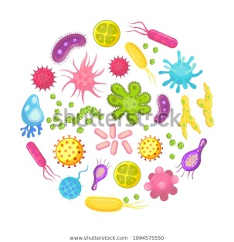
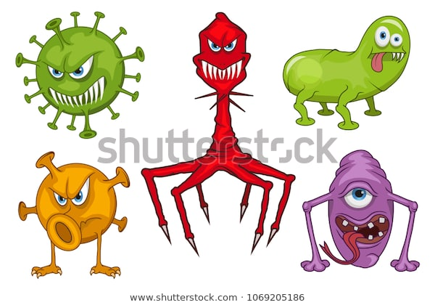
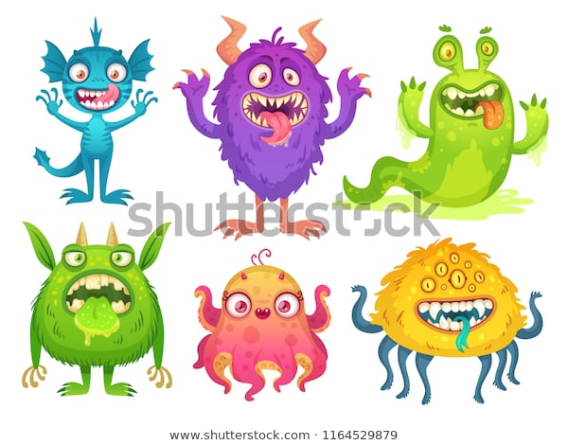
Disease Agent

Slide 21
Disease Agent
It is the first link in the chain of disease transmission
Defined as a substance, living or non-living, or a force, tangible or intangible, the excessive presence or relative lack of which may initiate or perpetuate a disease process.
A disease may have a single agent, a number of independent alternative agents or a complex of two or more factors whose combined presence is essential for the development of the disease
Disease agents may be classified broadly into groups :
1. Biological agents, >>>>>>>>>>>

Slide 22
Biological Agents
These are living agents of disease,
Viruses, hepatitis viruses, influenza, mumps, measles,…etc)
Rickettsia, (typhus)
Fungi, : (Candida)
Bacteria, Cocci (staphylococci, streptococci, ….etc)
Bacilli (diphtheria, salmonella, shigella….etc)
Spirochetes (syphilis, borrelia….etc)
Protozoa Entamoeba

Slide 23
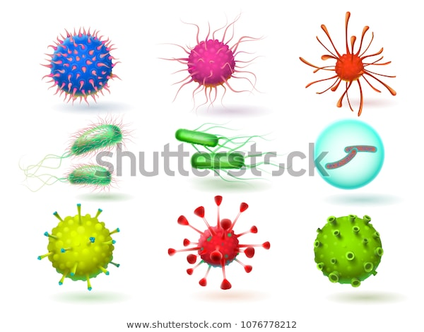
These agents exhibit certain
"host-related" biological properties such as:
(i) infectivity: this is the ability of an infectious agent to invade and multiply (produce infection) in a host;
(ii) pathogenicity: this is the ability to induce clinically apparent illness, and
(iii) virulence: this is defined as the proportion of clinical cases resulting in severe clinical manifestations The case fatality rate is one way of measuring virulence

Slide 24
Mechanisms of disease production (pathogenesis)
Invasiveness
Toxicity:
Endo-toxin
Exo-toxin
Hypersensitivity
Invasiveness:
The ability of the organisms to invade the tissues and multiply.
Each organism has the ability of invasiveness and toxicity (e.g. Treponema palidum, typhoid organisms
have a high power of invasiveness but
they have low toxicity)

Slide 25
Toxicity: Exo-toxin:
released by living organisms.
Destroyed rapidly by heat (above 60 °C)
Highly immunogenic and
converted to antigenic non toxic toxoid by formalin, heat and acid.
Diffusible, do not produce fever
e.g. (Neurotoxins of tetanus and botulism, erythro-genic toxins of scarlet fever)
Mechanisms of disease production
Invasiveness
Toxicity:
Hypersensitivity
Endo-toxin:
Released after disintegration of micro-organisms
Highly stable (withstand heat above 60 °C)
Weakly immunogenic
Not converted to toxoid
Usually produce patho-physiologic effects as fever, leucopenia, hypotension, hypoglycemia and shock.

Slide 26
Mechanisms of disease production
Invasiveness
Toxicity:
Hypersensitivity
Hypersensitivity:
It is an allergic state of the host following
exposure to certain antigens of micro-organisms
E.g. mycobacterium tuberculosis), whereby subsequent exposure results in a disease state.

Slide 27
Outcome of infection depends on:
Pathogenicity and virulence of micro-organism.
Antigenic power of micro-organism
Period of and ease of communicability
Dose of infection (inoculums)
Tissue selectivity (tropism)
Host specificity
Spore formation
Viability of the organism
Susceptibility of the pathogen to chemotherapy.

Slide 28
Pathogenicity and virulence of
micro-organism.
Outcome of infection depends on:
Pathogenicity and virulence of micro-organism.
Antigenic power of micro-organism
Period of and ease of communicability
Dose of infection (inoculums)
Tissue selectivity (tropism)
Host specificity
Spore formation
Viability of the organism
Susceptibility of the pathogen to chemotherapy.
Pathogenicity
ability of the organism to produce specific
clinical reaction after infection, (does not refer to the
severity of the reaction).
Virulence
ability of the organism to produce severe pathological
reaction, it refers to severity of the reaction.
Pathogenicity and virulence of micro-organism can be measured by:
Ratio of clinical to sub-clinical cases
Case fatality rate= No. of deaths from a certain disease X 100
No. Of cases from that disease

Slide 29
Pathogenicity and virulence of micro-organism.
Antigenic power of micro-organism
Period of and ease of communicability
Dose of infection (inoculums)
Tissue selectivity (tropism)
Host specificity
Spore formation
Viability of the organism
Susceptibility of the pathogen to chemotherapy.
Antigenic power of micro-organism:
The ability to initiate the development of
antibodies or antitoxin and associated immunity.
It can measured be:
Second attack frequency
Age specific attack rate
In certain diseases second attacks are rarely recorded (measles, mumps, chickenpox)
In other diseases re-infection occurs (common cold, upper respiratory diseases, syphilis and gonorrhea)
In diseases caused by micro-organisms of high antigenic power (measles), there is a drop of the attack rate after young age.

Slide 30
Pathogenicity and virulence of micro-organism.
Antigenic power of micro-organism
Period of and ease of communicability
Dose of infection (inoculums)
Tissue selectivity (tropism)
Host specificity
Spore formation
Viability of the organism
Susceptibility of the pathogen to chemotherapy.
Period and ease of communicability
Can be measured by the Secondary attack rate =
No. of secondary cases occurring within the accepted incubation period following exposure to a primary caseX 100
No. of exposed susceptible
Dose of infection (inoculums)
The higher the dose of infection the more liability of having an apparent illness and the severe will be the disease.

Slide 31
Pathogenicity and virulence of micro-organism.
Antigenic power of micro-organism
Period of and ease of communicability
Dose of infection (inoculums)
Tissue selectivity (tropism)
Host specificity
Spore formation
Viability of the organism
Susceptibility of the pathogen to chemotherapy.
Tissue selectivity (tropism)
It is the inherent capacity of the
micro-organisms to invade particular
type of tissue.
It is the factor that gives each disease its particular signs and symptoms.
Host specificity
Some pathogens infect man only as in relapsing fever.
Others infect only animals.
Some others infect both man and animal as in zoonotic diseases.
vii. Susceptibility of the pathogens to chemotherapy:
The degree of sensitivity to antibiotics differs from one pathogen to the other and even from one strain of a pathogen to another

Slide 32
Pathogenicity and virulence of micro-organism.
Antigenic power of micro-organism
Period of and ease of communicability
Dose of infection (inoculums)
Tissue selectivity (tropism)
Host specificity
Spore formation
Viability of the organism
Susceptibility of the pathogen to chemotherapy.
viii. Spore formation
The ability of some bacteria to change to a
resistant form under unsuitable conditions
and these spores remains viable for long periods.
When spores get the chance of coming into contact with a susceptible host under favorable conditions, they change
to vegetative forms and cause the disease
(e.g. tetanus and anthrax)
ix. Viability of the organism (resistance of the organism)
The ability to live outside the body
the longer the duration the more the chance to come into contact to new hosts transmitting the disease to them.

Slide 33
Sources and reservoir
(2) RESERVOIR OF INFECTION

Slide 34
Sources and reservoir
Existence of a reservoir or source of infection is the starting point for the occurrence of a communicable disease
source of infection is defined as “
the person, animal, object or substance from which an infectious agent passes or is disseminated to the host"
A reservoir is defined as
“ any person, animal, arthropod, plant, soil or substance
{or combination of these) in which an infectious agent
lives and multiplies,
on which it depends primarily for survival, and
where it reproduces itself in such manner that it can be transmitted to a susceptible host"
In short, the reservoir is the natural habitat in which the organism metabolizes and replicates.

Slide 35
The reservoir may be of three types :
1. Human reservoir
2. Animal reservoir, and
3. Reservoir in non-living things
Reservoirs
Inanimate ( non-living things.)
Animal
Human

Slide 36
1. Human reservoir
Is the most important source or reservoir of infection for humans is man himself.
He may be a case or carrier.
Man is often described as his own enemy
Reservoirs
Inanimate
Animal
Human
Carriers
Cases

Slide 37
Human reservoirs of infection:
Cases:
defined as "a person in the population or study group identified as having the particular disease, health disorder or condition under investigation"
A variety of criteria (e.g., clinical, biochemical, laboratory) may be used to identify cases.
Broadly, the presence of infection in a host may be
Clinical,
Subclinical or
Latent.
are potential sources
of infection,
Whatever may be the "gradient of infection", all infected persons, whether clinical or subclinical, are potential sources of infection, because the disease agent is leaving the body through frequent stools, vomiting, coughing, sneezing or other means and is potentially available for transfer to a new host.

Slide 38
The clinical illness
may be mild or moderate,
typical or atypical,
severe or fatal.
Epidemiologically, mild cases may be more important sources of infection than severe cases because they are
ambulant and spread the infection wherever they go,
whereas severe cases are usually confined to bed

Slide 39
The subclinical cases
unapparent, covert, missed or abortive cases.
The disease agent may multiply in the host but
does not manifest itself by signs and symptoms.
The disease agent is, contaminates the environment in the same way as clinical cases.
contribute more than symptomatic patients to the transmission of infection to others
The persons unbeknown to themselves & others
Subclinical cases play a dominant role in maintaining the chain of infection in the community (endemicity).
detected only by laboratory tests, e.g., organism, antibody response, biochemical

Slide 40
latent infection
must be distinguished from subclinical infection.
In latent infection, the host does not shed the infectious agent which lies dormant within the host
without symptoms (and often without demonstrable presence in blood, tissues or bodily secretions of the host). For example, latent infection occurs in herpes simplex,
latent infection play great role in the perpetuation of certain infectious

Slide 41
In epidemiological terminology,
Primary case
is the first case of a communicable disease introduced into the population unit being studied.
index case
Is the first case to come to the attention of the investigator; it is not always the primary case.
Secondary cases
are those developing from contact with primary case.
A suspect case
is an individual (or a group of individuals) who has all of
the signs and symptoms of a disease ,yet has
not been diagnosed as having the disease or had the cause of the symptoms connected to the suspected pathogen

Slide 42
He may be a
case or
carrier
b. Carriers
"an infected person or animal that harbours a specific infectious agent in the absence of discernible clinical disease and serves as a potential source of infection for others"
As a rule carriers are less infectious than cases, but
epidemiologically, they are more dangerous than cases
because they escape recognition, and
continuing as they do to live a normal life among the population or community, and infect the susceptible individuals over a wider area and longer period of time, under favourable conditions.

Slide 43
The elements in a carrier state are :
(a} the presence in the body of the disease agent
{b) the absence of recognizable symptoms and signs of disease, and
(c) the shedding of the disease agent in the discharges or excretions, thus acting as a source of infection for other
In some diseases, either due to
inadequate treatment or
immune response,
the disease agent is not completely eliminated, leading to a carrier state

Slide 45
Carriers may be classified as below
C. Portal of exit
(a) Urinary
(b) Intestinal
(c) Respiratory
(d) Others
A. Type Chronologically
(a) incubatory
(b) Convalescent
(c) Healthy
B. Duration
(a) Temporary
(b) Chronic

