Slide 1
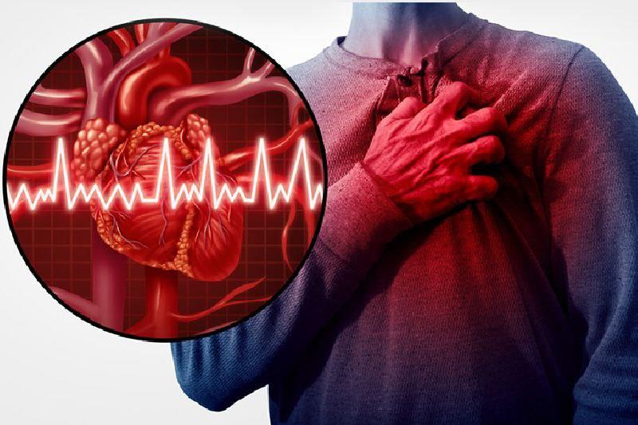
Complications of myocardial infarction
Presented by:
Mouniah Nawaiseh
Mai Al-Blawnah
Shams Arman

Slide 2
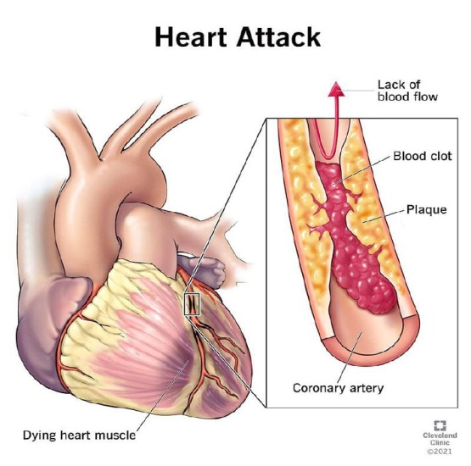
Myocardial infarction (definition)
A myocardial infarction (MI), also known as a heart attack ,happens when one or more areas of the heart muscle don't get enough oxygen. This happens when blood flow to the heart muscle is blocked

Slide 3
Myocardial Infarction (definition)
The frequency rises progressively with aging & with increasing risk factors for atherosclerosis.
But approximately 10% of MIs occur before 40 years of age.
Men are at greater risk than women, but the gap narrows with age; women are protected against MI during reproductive years.

Slide 4
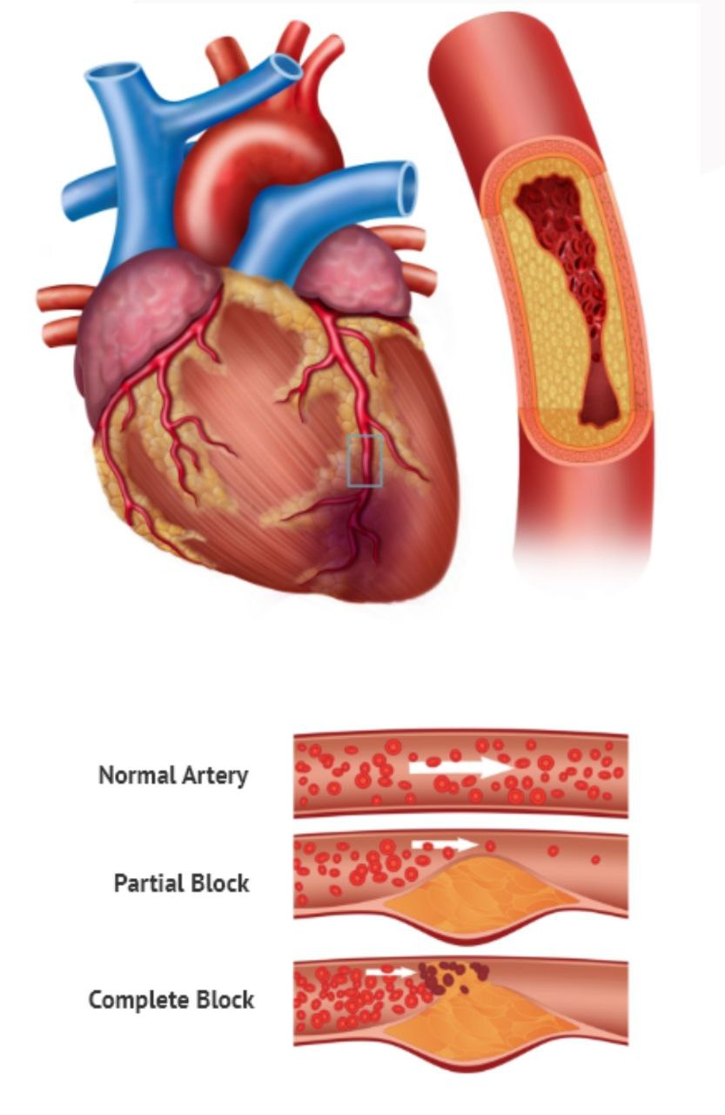
Myocardial infarction
Mechanism
The most common cause of a myocardial infarction is the rupture of an atherosclerotic plaque on an artery supplying heart muscle (coronary artery).
Plaques can become unstable, rupture, and additionally promote the formation of a blood clot that blocks the artery; this can occur in minutes.
Blockage of an artery can lead to tissue death in tissue being supplied by that artery. Atherosclerotic plaques are often present for decades before they result in symptoms.

Slide 5
Myocardial infarction (risk factors)
The risk factors for MI and atherosclerosis are basically the same:
Family history of coronary artery disease at an early age.
Cigarette Smoking.
Obesity.
Physical inactivity
Stress
An abnormally high level of blood cholesterol (hypercholesterolemia).
An abnormally low level of HDL, commonly called "good cholesterol“.
High blood pressure(hypertension).
Diabetes.

Slide 6
Myocardial infarction (Clinical features)
chest pain, usually described as Intense substernal pressure sensation; often described as “crushing” and “an elephant standing on your chest.” squeezing , and it can radiates to neck, jaw, arms, or back, commonly to the left side .
Similar to angina pectoris in character and distribution but much more severe and lasts longer. Unlike in angina, pain may not respond to nitroglycerin. Some patients may have epigastric discomfort
Can be asymptomatic in up to one-third of patients; painless infarcts or atypical presentations more likely in postoperative patients, the elderly, diabetic patients, and women.

Slide 7
Myocardial infarction (Clinical features)
Other symptoms:
a. Dyspnea
b. Diaphoresis
c. Weakness, fatigue
d. Nausea and vomiting
e. Sense of impending doom
f. Syncope
N.B :The combination of substernal chest pain persisting for longer than 30 minutes and diaphoresis strongly suggests
acute MI.

Slide 8
Myocardial infarction (complications)
1- THE FIRST 24 HOURS:
Sudden cardiac death
Cardiogenic Shock
Flash Pulmonary Edema
3- 3 DAYS TO 14 DAYS:
pericarditis
2- 24 HOURS - 3DAYS:
Rupture syndrome
Left Ventricular Pseudo Aneurysm
3- 14 DAYS TO 1 MONTH:
left Ventricular Aneurysm
Dressler’s Syndrome

Slide 9
Myocardial infarction (complications)
~Sudden cardiac death
If there is an MI, the cell permeability ↑ in the area of
infarction.
high permeability: ↑ cations (calcium, sodium) load
into the cells, this depolarizes the cells abnormally, and generates electric potentials causing the ventricles to contract abnormally
This can lead to PVC and progress into VT then VF
ventricular fibrillation can result in sudden cardiac death

Slide 10
Myocardial infarction (complications)
~Cardiogenic Shock
If there is a significant infarct in a major vessel (e.g LAD
occlusion) especially in the left ventricle
The heart would not be able to push blood into systemic circulation resulting in hypotension
Hypotension causes cold extremities due to
hypoperfusion
This can progress to cardiogenic shock

Slide 11
Myocardial infarction (complications)
~Flash Pulmonary Edema
Blood backs up into the pulmonary circulation leading to
flash pulmonary edema
Shortness of breath, hypoxia
reflex tachycardia to maintain a decent cardiac output

Slide 12
Myocardial infarction (complications)
~Rupture syndrome (Mechanical):
1. IN SEPTUM:
When there is an infarction in the septum, the tissue can becomes weak and susceptible to rupture
Since the left ventricle pumps blood at a higher pressure, with a weak septum it would be able to push blood into the right ventricle
This is called a Ventricular Septal Defect due to an inter-ventricular septal rupture
May cause:
Murmur ( hollow systolic murmur )
Mixed venous oxygenation

Slide 13
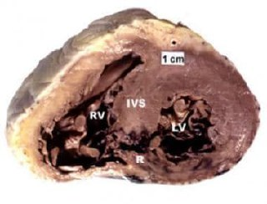
Interventricular septal rupture

Slide 14
Myocardial infarction (complications)
2. IN LEFT VENTRICLE:
Infarct in the left ventricle can render it weak and if it ruptures, blood can get into the pericardial cavity, this is
called a free wall rupture.
Blood in the pericardial cavity can lead to hemopericardium resulting in Cardiac Tamponade.
Recall: Beck’s Triad occurs with cardiac tamponade, this consists of hypotension, JVD, and muffled heart sounds.

Slide 15
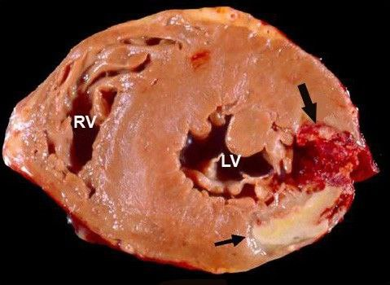
Left ventricular free wall rupture.

Slide 16
Myocardial infarction (complications)
3.IN PAPILLARY MUSCLES:
Papillary muscles are found in the inner walls of the heart, and they attach to the valves via the chordate tendineae to anchor the valves.
If an infarct develops in the papillary muscles, the
tissue can get weak and rupture.
Valves would no longer be anchored and become flail causing regurgitation
If this occurs in the left heart, it causes Mitral Valve Regurgitation.
Presentation: mitral valve murmur, hypotension, pulmonary edema, etc.

Slide 17
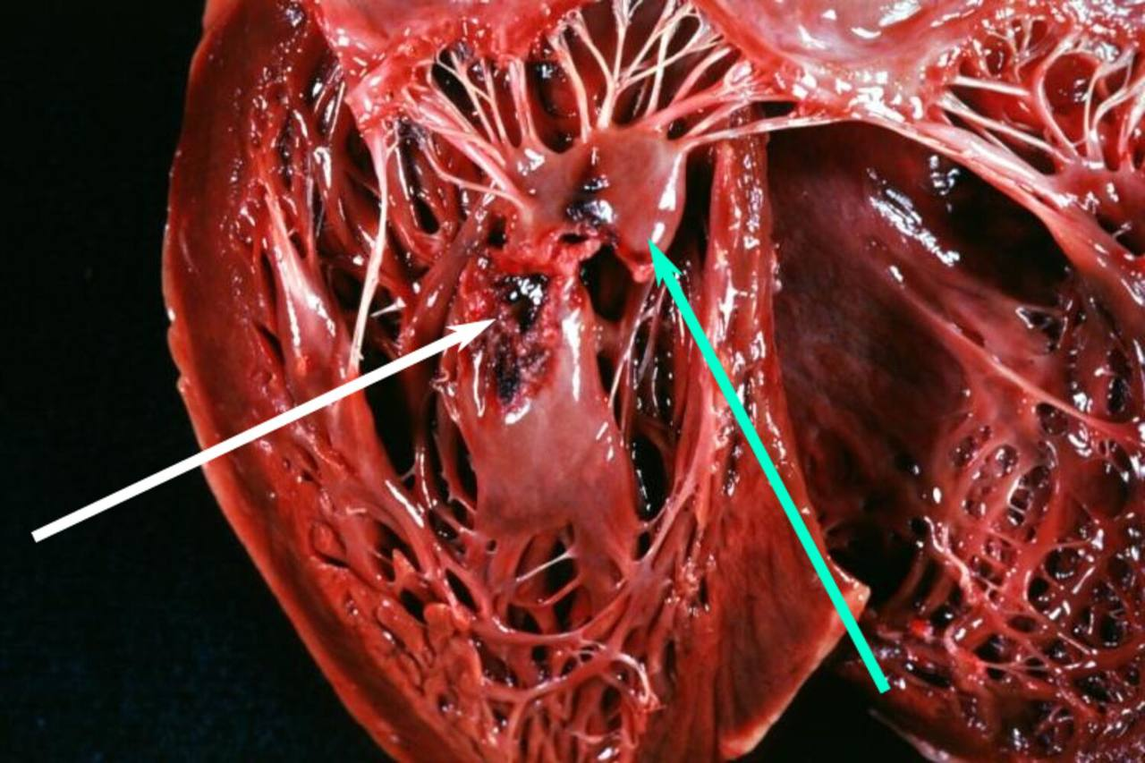
Papillary muscles rupture.

Slide 18
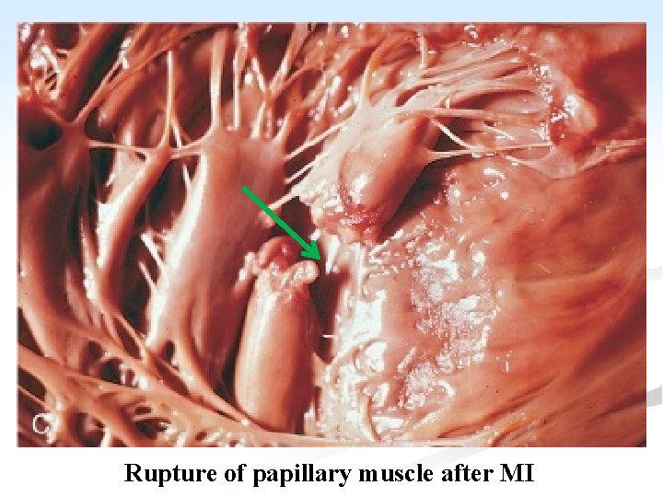

Slide 19
Myocardial infarction (complications)
~Left Ventricular Pseudo Aneurysm (Mechanical):
In free wall ruptures, blood can accumulate in the
pericardium and this can form a pseudoaneurysm
Due to blood stasis, clots can form in these areas and
increase the risk of thrombi (mural thrombus)

Slide 20
Myocardial infarction (complications)
~Pericarditis (inflammatory):
If there is an infarct in the left ventricle, an inflammatory
reaction can occur to clean up the debris
This local inflammatory reaction is called pericarditis :
Presentation: sharp and positional chest pain, friction rub (via lung sounds)
The inflammation can increase the formation of fluid,
leading to pericardial effusion

Slide 21
Myocardial infarction (complications)
~Left Ventricular Aneurysm (Mechanical):
In an infarction, first there is a soft granulation tissue → fibrous tissue.
Fibrous tissue can “bulge out” creating a left ventricular aneurysm
▪ There is a low risk of rupture since the fibrous tissue is stronger
Since the affected area of the ventricle is not contracting, this creates blood stasis which increases the risk of clot formation and mural thrombi.
Recall: Virchow’s triad; if there is stasis, hypercoagulability or endothelial injury then there is a higher risk of clot formation
Thrombi also increases the risk of emboli formation which can occlude different organs (e.g. brain, spleen, kidney, etc.)

Slide 22
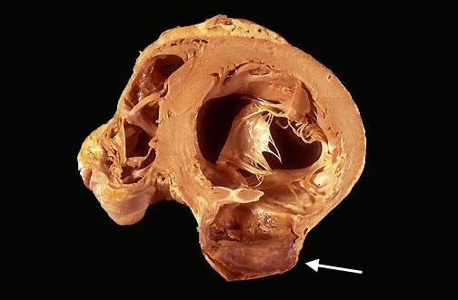
Left Ventricular Aneurysm

Slide 23
Myocardial infarction (complications)
~Dressler’s Syndrome (inflammatory)
Infarct in the ventricle can create an underlying immune
reaction, however the etiology is unknown
o The immune system develops antibodies against the
pericardium
▪ This leads to the inflammation of the pericardium
(This occurs later, unlike the pericarditis that occurs in the
3-14 days time period)

Slide 24
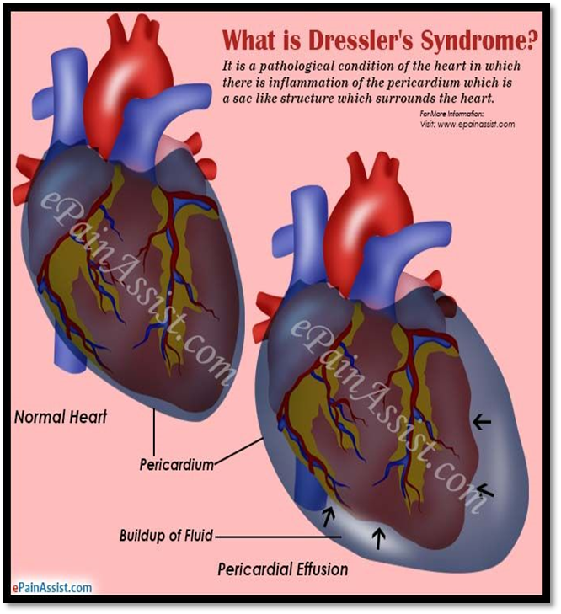
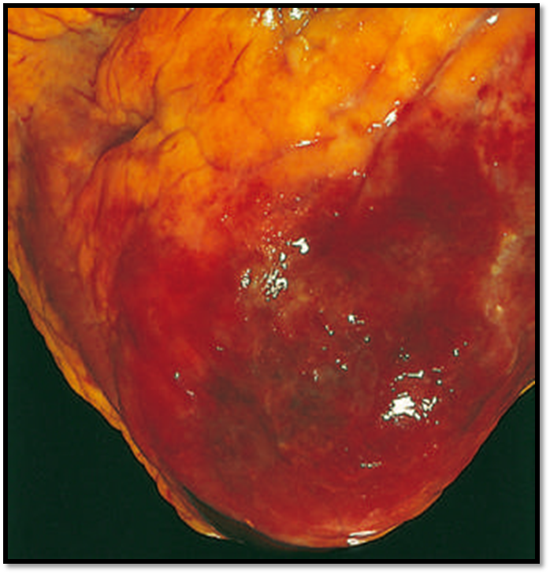
Dressler’s Syndrome

Slide 25
Myocardial infarction (complications)
~Recurrent infarction (extension of existing infarction or reinfarction of a new area
~Acute heart failure due to extensive myocardial necrosis and ischemia, arrhythmias/conduction disturbances, or mechanical complications of MI.
Most common cause of in-hospital mortality

Slide 26
Myocardial infarction (complications)
~Arrhythmia (Electrical) :
Arrhythmia is a problem with the rate or rhythm of heart beats
Arrhythmia is the most common complication of acute MI and the risk of arrhythmia can be minimised by adequate pain relief ,rest and correction of hypokalemia
Arrhythmia occur when cardiac cell lack of oxygen they become depolarize which lead to altered impulse formation and altered impulse conduction .

Slide 27
Myocardial infarction (complications)
Most serious types of arrhythmia:
Ventricular arrhythmia:( premature ventricular contraction /ventricular tachycardia / ventricular fibrillation).
Supraventricular arrhythmias:( sinus tachycardia /sinus bradycardia /paroxysmal SVT /AF/premature atrial beat ).
AV block.
Intraventricular block: ( hemi blocks {left anterior, left posterior} /Bundle Branch block /third degree AV block ).

Slide 29
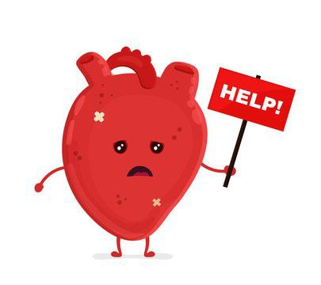
THE END

